Slide 1
0 1 2 3 4 5 6 7 8
<PAD> | The | Camera | Quality | Is | Very | Good | Battery | Life

Slide 2
Indexes into vocabulary
input_x = (np.array([1, 2, 3, 4 , 5, 6]), np.array([1, 7, 8, 4, 6, 0]))
Sentence 1
Sentence 2

Slide 3
(For each word in sentence 0)
(For each sentence)
Out
Len(Out[0][0][0]) = 128
0
0
1
0
1
2
3
4
5
0 | 1
126 | 127
Len(Out) = 1
Len(Out[0]) = 2
Word vector for 0th word of sentence 0. Here each element is a real value. In the expanded case, each element is a list/vector of length 1, thus increasing tensor dimension by 1.
Dim = [ batch _size * 6 * 128 *1]
= [ 2 * 6 * 128 * 1]
Len(Out[0][0]) = 6

Slide 4
Filter of size 3
0 1 … … 127
0 1 ……… 127
3 * 128
6 * 128
Sentence of length 6 in word vector (of size 128) representation

Slide 5
0 1 … … 127
1 | 2 | 1 | … | 3 | 3
2 | 1 | 0 | …. | 1 | 2
3 | 1 | 2 | …. | 0 | 1
0 1 ……… 127
0.58 | 0.79 | 0 | …… | 0 | 0
0 | 0 | 0.9 | ….. | 0.6 | 0
0.7 | 0 | 0 | …. | 0 | 0.9
3 * 128
6 * 128
(0.58 * 1) + (0.79 * 2) + (0 * 1) + …+(0 * 3) + (0 * 1) + [First row ]
(0 * 2) + (0 * 1) + (0.9 * 0) + …+ (0.6 * 1) + (0 * 2) + [Second row]
(0.7 * 3) + (0 * 1) + (0 * 2) + …. + (0 * 0) + (0.9 * 1) [Third row]
= 0.58 + 1.58 + 0 + …. + 0 + 0 +
0 + 0 + 0 + …….0.6 + 0 +
2.1 + 0 + 0 + …….+ 0 + 0.9
=5.76

Slide 6
Max pooling with :
Ksize = [ 1 * 4 * 1 * 128],
Stride =[ 1 * 1 * 1 * 1 ]
Filter 0
Filter 1
Filter 127
Input
128 Filter outputs
4 * 1
4 * 1
4 * 1
MAX()
MAX()
MAX()
Output
1 * 1
1 * 1
1 * 1
[1 * 1 * 128]

Slide 7
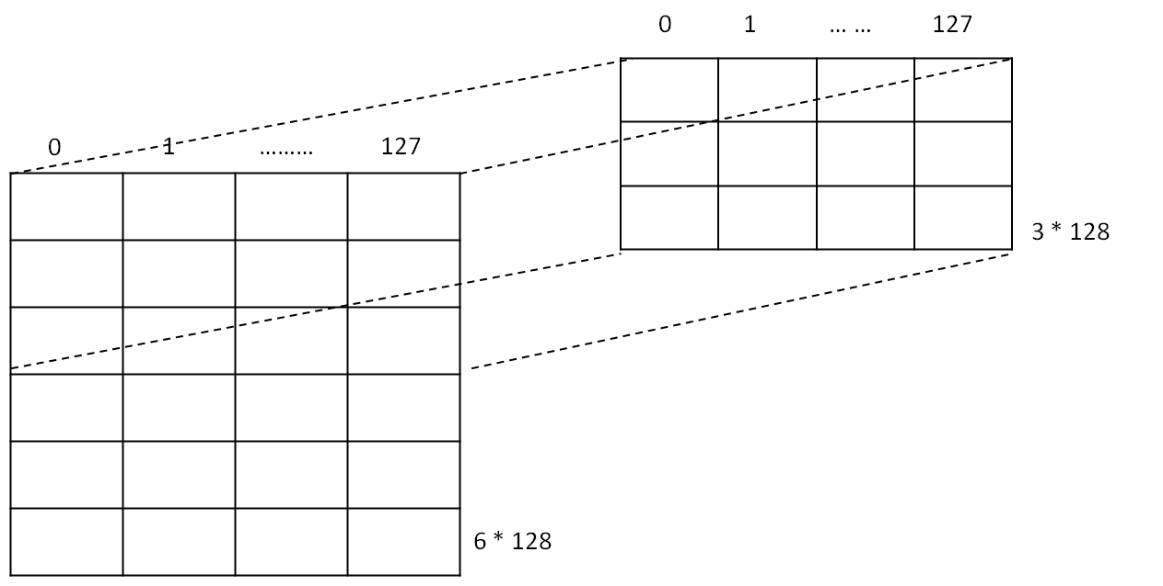
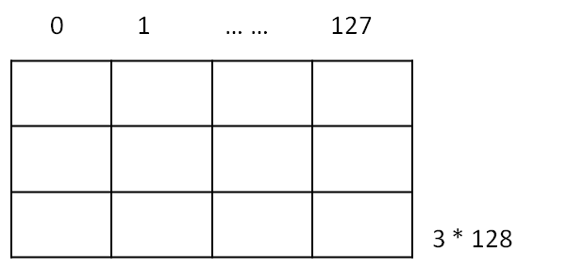
+b0
+b127
Output volume
4 * 1 * 128
4 * 1
4 * 1
+b0
+b127
Add bias for each filter, b = [0.1, 0.1……0.1]
128 * 1
ReLu(x)
ReLu(x)
4 * 1
4 * 1
Apply Non Linearity using ReLu
ReLu(x)
ReLu(x)
4 * 1
4 * 1
Shape of output
[4 *1*128]
Final shape of output [batch_size * 4 *1*128] = [2 * 4 * 1 * 128]

Slide 8
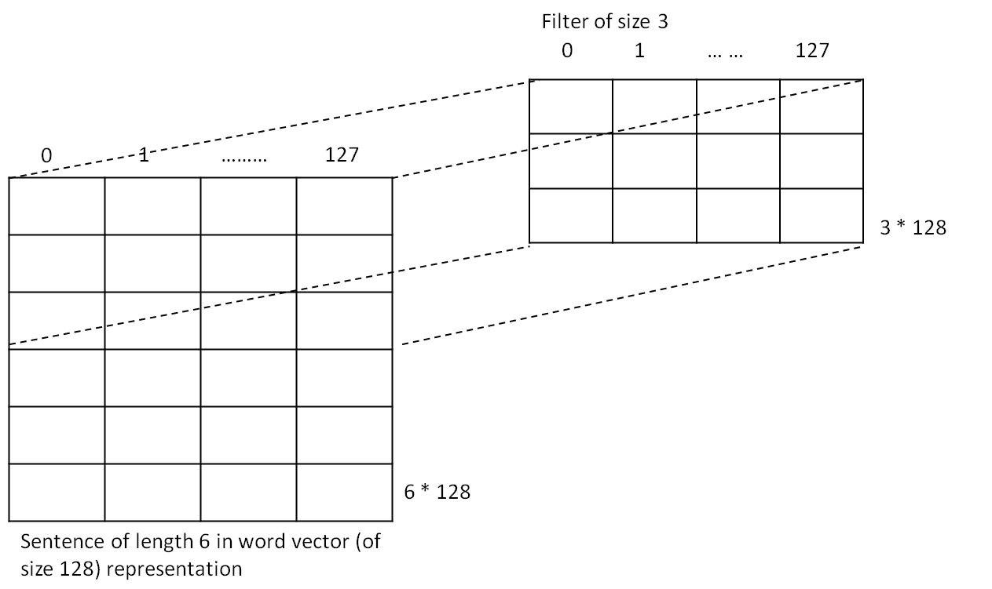
Filter 0 [3 * 128 * 1], 1 here denotes num_input_channels
Filter 127 [3 * 128 * 1]
+b0
+b127
Output volume
4 * 1 * 128
4 * 1
4 * 1
+b0
+b127
Add bias for each filter, b = [0.1, 0.1……0.1]
128 * 1
ReLu(x)
ReLu(x)
4 * 1
4 * 1
Apply Non Linearity using ReLu
ReLu(x)
ReLu(x)
4 * 1
4 * 1
Shape of output
[4 *1*128]
Final shape of output [batch_size * 4 *1*128] = [2 * 4 * 1 * 128]

Slide 9
Max pooling with :
Ksize = [ 1 * 2 * 1 * 128],
Stride =[ 1 * 1 * 1 * 1 ]
Filter 0
Filter 1
Filter 127
Input
128 Filter outputs
4 * 1
4 * 1
4 * 1
MAX()
MAX()
MAX()
Output
MAX()
MAX()
MAX()
[3 * 1 * 128]
3 * 1
3 * 1
3 * 1

Slide 10
Output from max pooling for
filter size = 3
Output from max pooling for
filter size = 4
Output from max pooling for
filter size = 5
1 * 1
1 * 1
1 * 1
1 * 1
1 * 1
1 * 1
1 * 1
1 * 1
1 * 1
[1 * 1 * 128]
[1 * 1 * 128]
[1 * 1 * 128]
Concatenate
1 * 1
1 * 1
1 * 1
1 * 1
1 * 1
1 * 1
1 * 1
1 * 1
1 * 1
3 * 1 * 1 * 128
For the complete batch shape : Batch_size * 3 * 1 * 1 * 128 = 2 * 3 * 1 * 1 * 128
After reshape for a single sentence shape : (1, 384)
1 * 1
1 * 1
1 * 1
1 * 1
1 * 1
1 * 1
1 * 1
1 * 1
1 * 1
For complete batch after reshape : (batch_size, 384) or (2, 384)

Slide 11
0
1
P1 | P2
P1 = Probability of being in class 1
P2 = Probability of being in class 2
For sentence 0
For sentence 1
P1 | P2

