Slide 1
TBVPX-203 Transcriptomics: Update
Andrew Fiore-Gartland, Ph.D.
Senior Staff Scientist
Vaccine and Infectious Disease Division
Aaron Seese, M.A.
Research Technician
September 2019

Slide 2
Summary of Objectives and Study Design
Aim 1: Evaluate the impact of ID93 + GLA-SE immunization on the TB correlate of risk gene expression signature
Measure 16-gene COR biomarker with each sample
Identify genes that systematically change throughout treatment as potential markers of treatment success
Aim 2: Identify innate immune predictors of humoral and cellular adaptive responses to immunization with ID93 + GLA-SE
Characterize innate vaccine response signature in whole-blood
Assess correlation of response signature with adaptive responses
Evaluate baseline gene expression as predictor of vaccine response
Availability of samples | Study Day
Treatment Group | 0* | 3 | 56* | 59 | 63 | 112 | 168
10 µg ID93 + 2 µg GLA-SE | 5 | 5 | 0 | 5 | 5 | 2 | 2
2 µg ID93 + 2 µg GLA-SE | 15 | 14 | 0 | 13 | 13 | 2 | 2
2 µg ID93 + 5 µg GLA-SE (2 Vaccine Injections) | 15 | 14 | 12 | 11 | 11 | 10 | 9
2 µg ID93 + 5 µg GLA-SE (3 Vaccine Injections) | 14 | 12 | 9 | 9 | 10 | 8 | 7
Placebo | 12 | 12 | 4 | 12 | 12 | 4 | 4
TOTAL | 61 | 57 | 25 | 50 | 51 | 26 | 24
*vaccine administration

Slide 3
Aim 1 Update
Munyaradzi Musvosvi and Tom Scriba (SATVI) measured the 16-gene TB risk signature (COR) in all samples
Preliminary analysis suggests COR positivity decreases during treatment, consistent with previous findings
Awaiting RNA sequencing data to complete integrated analysis

Slide 4
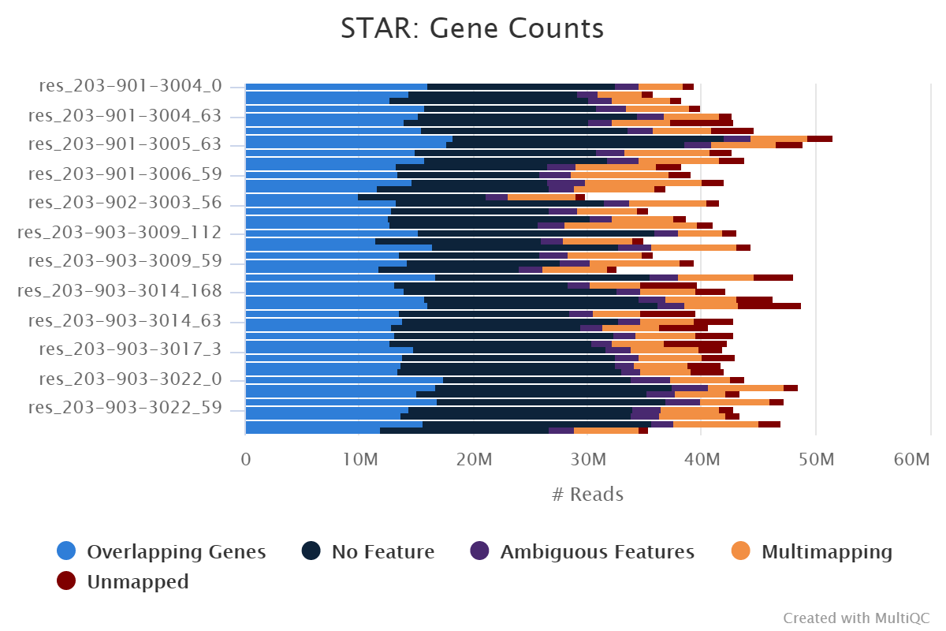
Aim 2: PAXGENE protocol optimization
RNA extractions were completed on all 298 PAXGENE samples and 2 healthy control samples; aliquots sent to SATVI for COR testing (June 2018)
Pilot tested of Ilumina Globin-Zero Gold rRNA and globin depletion kit (48 samples); high yield and high quality product
Library prep (no poly-A selection) then sequenced on Illumina HiSeq (PE50, Dec 2018)
Results: 95% of reads mapped to human genome, but only around 35% mapped to protein coding gene
Too many ribosomal and long non-coding transcripts remained

Slide 5
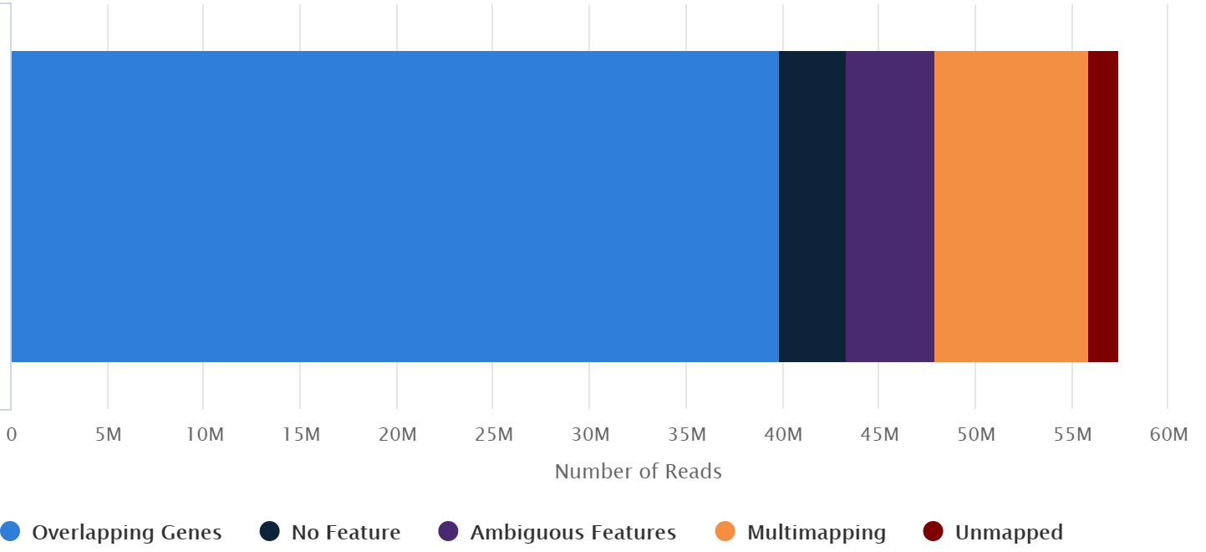
Aim 2: Sequencing and analysis
Evaluated kit for globin mRNA removal only (20 samples, Thermofisher GLOBINclear, Feb 2019)
Library preparation, including selection of poly-adenylated transcripts (TruSeq Stranded mRNA)
Sequenced on Illumina NovaSeq 6000 (50 PE, SP flow cell, May 2019)
Generated high-quality sequencing data: 70 – 85% mapped to known protein coding regions
Performed globin depletion and made libraries for remaining samples (n = 278, Aug 2019)
Samples queued for sequencing in Oct 2019 (NovaSeq, 100PE, S4, 40M reads per sample)
Analysis will begin when RNA sequencing data is ready. Cellular and humoral immunogenicity have been transferred and analyzed in preparation
Primary results expected Q1 2020

