Slide 1








TB Hackday
February 11, 2025
Andrew Fiore-Gartland, Ph.D.
Fred Hutchinson Cancer Center
Shuyi Ma, Ph.D.
Seattle Children’s Research Institute
Brian Aldana, Ph.D.
Mark Warden, Ph.D.
Patrick Phillips, Ph.D.
UCSF Center for Tuberculosis
Thanks to Jordan McCrary for help organizing!

Slide 2
Land acknowledgement
SEATRAC acknowledges the Coast Salish peoples of this land, the land which touches the shared waters of all tribes and bands within the Duwamish, Puyallup, Suquamish, Tulalip and Muckleshoot nations.

Slide 3
TB Hack Day Objectives
Specifically learn and teach:
TB pathogenesis and treatment
Clinical trials
Data processing
Survival and regression analysis
R visualization tools
Learn
Hypothesize
Visualize
Build
community
Teach

Slide 4
Guest speakers
Mark Warden, Ph.D.
Brian Aldana, Ph.D.
Notes:
Alex Shalek, Professor MIT
Professor in the Institute for Medical Engineering and Science and the Department of Chemistry
Director of Health Innovation Hub
Director, Institute for Medical Engineering and Science, MIT
Immunologist, engineer and terrific translational collaborator, will talk about his work with Tricia Darrah, Bob Seder and colleagues looking at immunity induce by intravenous BCG in NHP, and work with JoAnn Flynn and Sarah Fortune looking at immunity from a primary Mtb infection.
Josh Bromley is a graduate student in the Microbiology program at MIT, lead author on their recent study of Mtb immunity in NHP

Slide 5
Agenda for today
Emory (EST) | Seattle (PST) | Activity
9:00 AM |  | Opening remarks (Shuyi Ma)
9:10 |  | Drs. Mark Warden and Brian Aldana present analysis examples from TB-PACTS dataset
9:40 |  | Hack day plan with Q&A (Andrew Fiore-Gartland)
10:00 |  | Break into groups for open hack time
 | 8:30 AM | Gather with coffee and light breakfast
 | 9:00 | Repeat opening talks for Seattle/UCSF
 | 10:00 | Break into groups for open hack time in Seattle
3:00 PM | 12:00 PM | JOINT Small group readouts from EDT group: Each group shares processing and analysis findings
 | 3:00 | Small group readouts from Seattle/UCSF
Feel free to come and go, change seats, move rooms, go for a walk, etc.
Small groups are meant to facilitate conversation and collaboration; use them as much or as little as you want
Be open, curious, inclusive, respectful!
Let’s make this the best that science can be:
Free food + free flow of thoughts and ideas
Code of conduct: We’re committed to hosting TB Hackday as an inclusive and harassment-free learning experience for everyone.
Real-time feedback welcome!

Slide 6
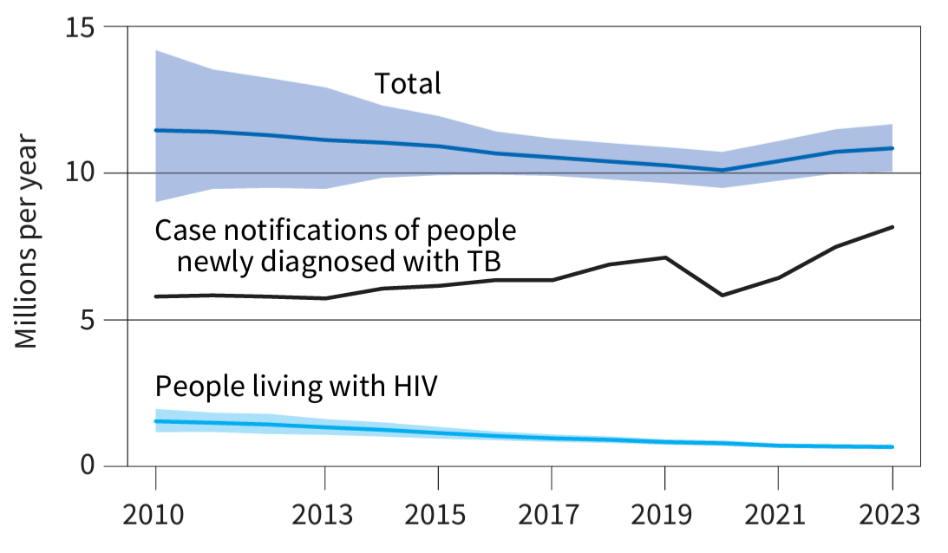
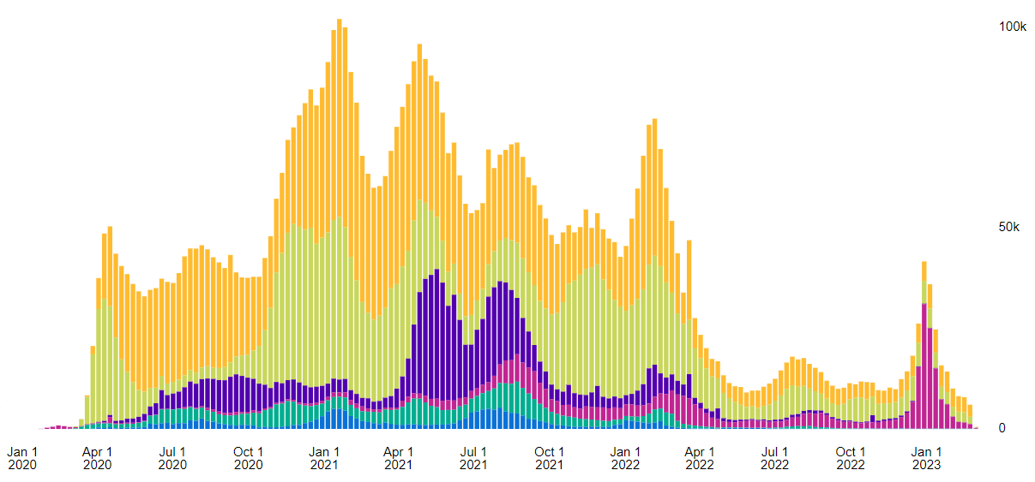
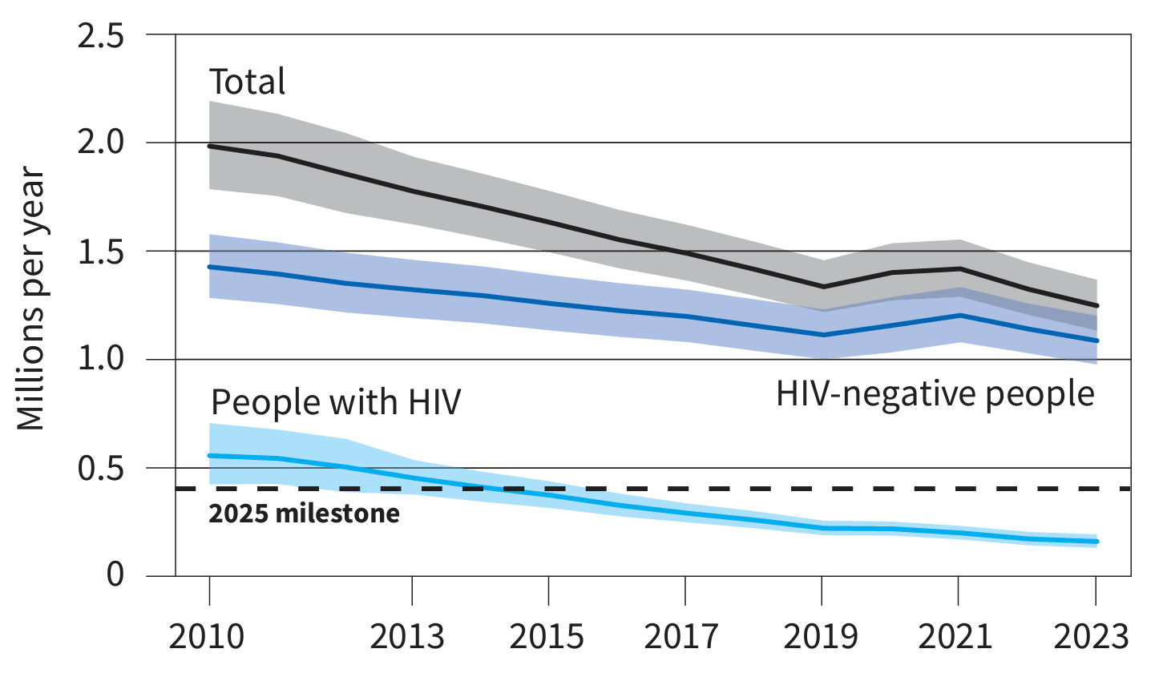

Global trends in the estimated number of incident TB cases (in millions)
WHO Global Tuberculosis Report 2023
TB notifications are rising since the COVID pandemic interrupted health services
Under-diagnosed and under-treated TB led to an increase in TB deaths during pandemic
Comparatively COVID-19 deaths were 3.5 M and 1.2 M in 2021 and 2022
Global trends in the estimated number of deaths caused by TB and HIV (in millions)
Global COVID-19 deaths (weekly, WHO)
1.25 M TB deaths in 2023
Avg. 29K weekly TB deaths
WHO Global Tuberculosis Report 2024
Notes:
Deaths have begun to decline again, but not below pre-pandemic levels

Slide 7
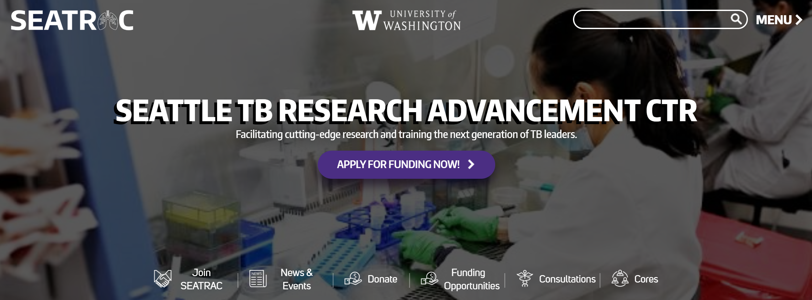

Opportunities to get involved in TB research
Join SEATRAC or your local NIH TB Research Accelerator (TRAC)
Join for access to Clinical, Immunology and Data Science Core services (e.g., BSL3 trainings, sample repository, data science consultations, seminar announcements)
SEATRAC seed funding ($50K/yr for 2 yrs):
“New to TB” and “New Investigator” awards
Regular seminar series (monthly at UW SLU)
https://seatrac.uw.edu/

Slide 8
Thank you for participating!
Your feedback is welcome for next time

