Slide 1








TB Hackday February 11, 2025
Andrew Fiore-Gartland, Ph.D.
Fred Hutchinson Cancer Center
Shuyi Ma, Ph.D.
Seattle Children’s Research Institute
Brian Aldana, Ph.D.
Mark Warden, Ph.D.
Patrick Phillips, Ph.D.
UCSF Center for Tuberculosis
Thanks to Jordan McCrary for help organizing!

Slide 2
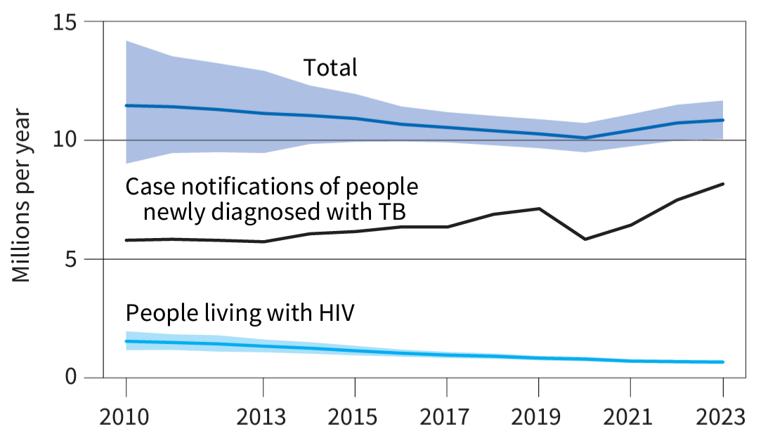
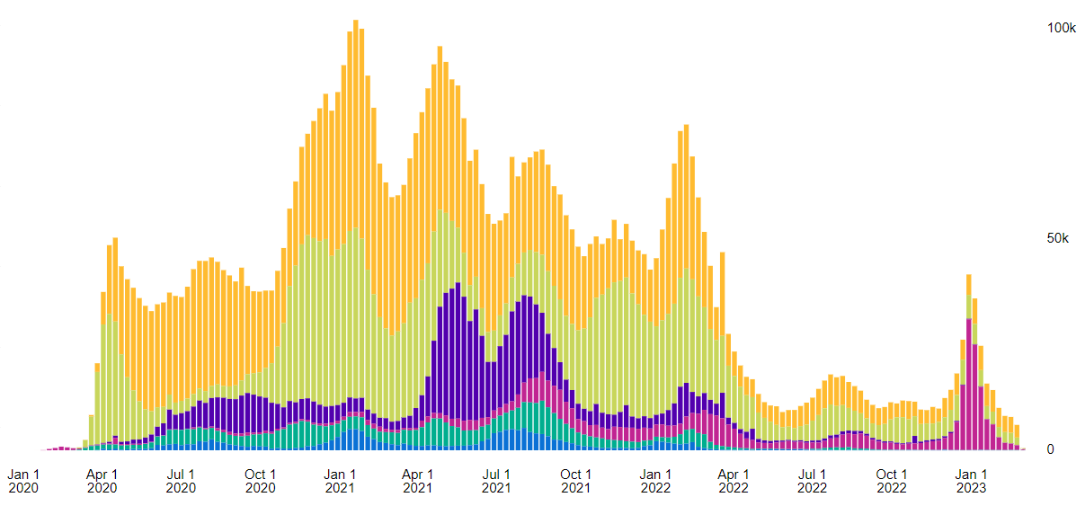
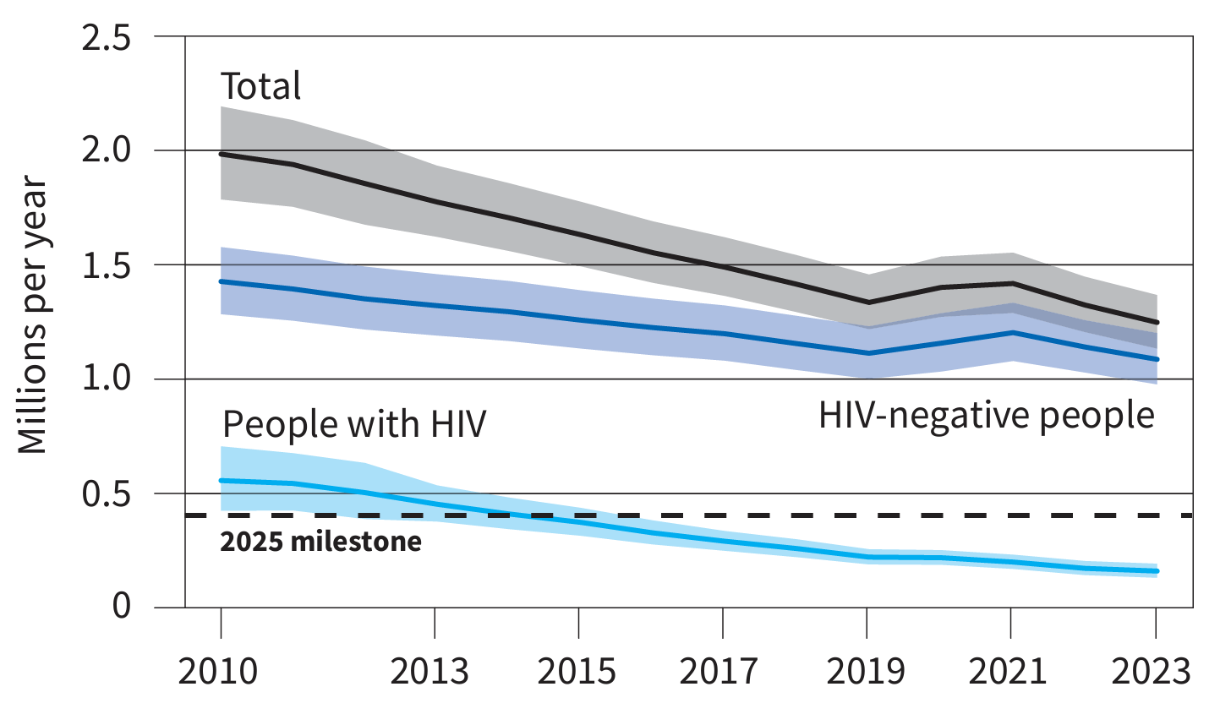

Global trends in the estimated number of incident TB cases (in millions)
WHO Global Tuberculosis Report 2023
TB notifications are rising since the COVID pandemic interrupted health services
Under-diagnosed and under-treated TB led to an increase in TB deaths during pandemic
Comparatively COVID-19 deaths were 3.5 M and 1.2 M in 2021 and 2022
Global trends in the estimated number of deaths caused by TB and HIV (in millions)
Global COVID-19 deaths (weekly, WHO)
1.25 M TB deaths in 2023
Avg. 29K weekly TB deaths
WHO Global Tuberculosis Report 2024
Notes:
Deaths have begun to decline again, but not below pre-pandemic levels

Slide 3
TB Hack Day Objectives
Learn
Hypothesize
Visualize
Build community
Teach
Specifically learn and teach:
TB pathogenesis and treatment
Clinical trials
Data processing
Survival and regression analysis
R visualization tools

Slide 4
East (EST) | West (PST) | Activity
9:00 AM |  | Opening remarks (Shuyi Ma)
9:10 |  | Drs. Mark Warden and Brian Aldana present analysis examples from TB-PACTS dataset
9:40 |  | Hack day plan with Q&A (Andrew Fiore-Gartland)
10:00 |  | Break into groups for open hack time
 | 8:30 AM | Gather with coffee and light breakfast
 | 9:00 | Repeat opening talks for Seattle/UCSF
 | 10:00 | Break into groups for open hack time in Seattle
3:00 PM | 12:00 PM | JOINT Small group readouts from EDT group: Each group shares processing and analysis findings
 | 3:00 | Small group readouts from Seattle/UCSF
Agenda for today
Feel free to come and go, change seats, move rooms, go for a walk, etc.
Small groups are meant to facilitate conversation and collaboration; use them as much or as little as you want
Be open, curious, inclusive, respectful!
Let’s make this the best that science can be: Free food + free flow of thoughts and ideas
Code of conduct: We’re committed to hosting TB Hackday as an inclusive and harassment-free learning experience for everyone.
TB Hackday participants have full access to the TB-PACTS repository for the day. The data is anonymized, but should not be posted publicly or downloaded to your computer.
Registration (free) is required for access beyond the hack day (https://c-path.org/tools-platforms/tb-pacts/)

Slide 5
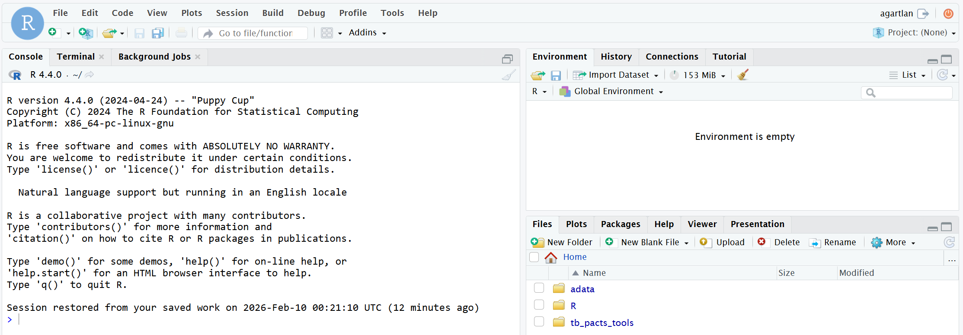
Rstudio server info
Server address is posted in slack: login with the username/prefix half of your email (left of @)
Your home folder: /home/[USERNAME] (read+write access)
Tool repo is cloned in your home folder: ~/tb_pacts_tools
Data folder: /home/TB-PACTS (read-only access)
Shared adata folder: /home/shared (read+write access)
Install any packages you need: they will install into your home folder by default
Don’t forget you have terminal access
Use “…” to change the folder

Slide 6
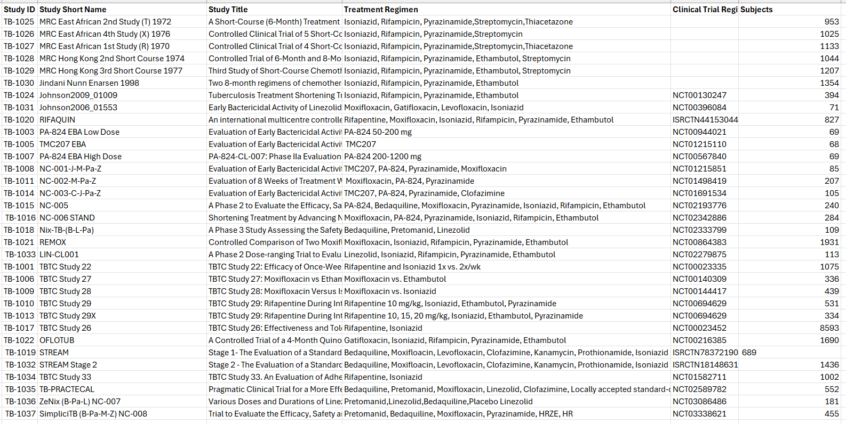
Study Guide
/home/TB-PACTS/metadata/2025-04-03 Critical Path Trials Overview.xlsx
/home/TB-PACTS/metadata/2025-04-03 Critical Path Trials Overview.xlsx
Note the “Study ID” for locating the data for each study

Slide 7
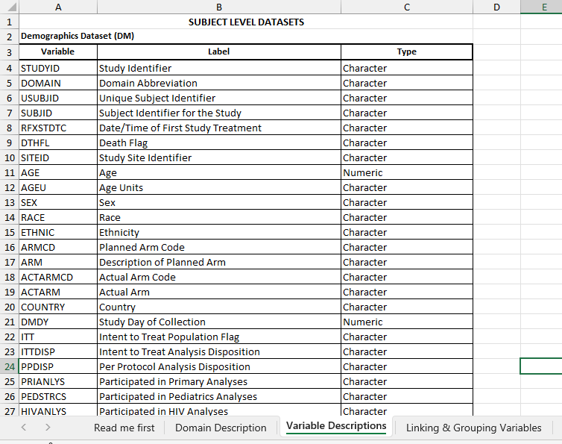
CDISC: Clinical Trial Data Standards
Clinical Data Interchange Standards Consortium: Industry standards for organizing clinical trial data to enable regulatory submissions and data sharing
Key feature is controlled terminology with standardized variable names, domains, and values across all studies
CDISC is REQUIRED by FDA/EMA for new drug applications
SDTM: Study data tabulation model: raw datasets (like TB-PACTS)
ADAM: analysis ready datasets
Resources for Learning More
CDISC Official Site: https://www.cdisc.org/standards
CDISC Library (searchable standards): https://www.cdisc.org/cdisc-library
Beware: standardized variable names does NOT mean that every trial uses the same variables to represent the same kinds of data
Look out for missing variables or missing values in each trial
/home/TB-PACTS/metadata/2022-04-14-TB-PACTS_Data_Dictionary.xlsx

Slide 8
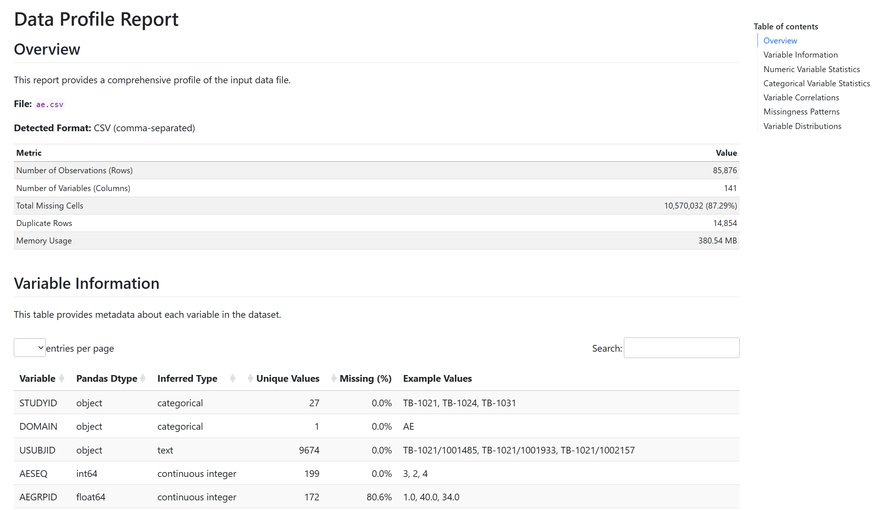
Repository Guide: info
/home/TB-PACTS/info
Subfolder | File name
info | cdisc_domains.html | Description of all the CDISC domain data file names
 | [DOMAIN]_info.html | Summary of the variables and their values within a specific CDISC domain
 | [DOMAIN].csv.info.csv | Listing of the variables in the domain in a CSV format
 | [DOMAIN]_csv_info_with_descriptions.csv | Listing of the variables with AI-generated annotations
/home/TB-PACTS/info/ ae_info.html

Slide 9
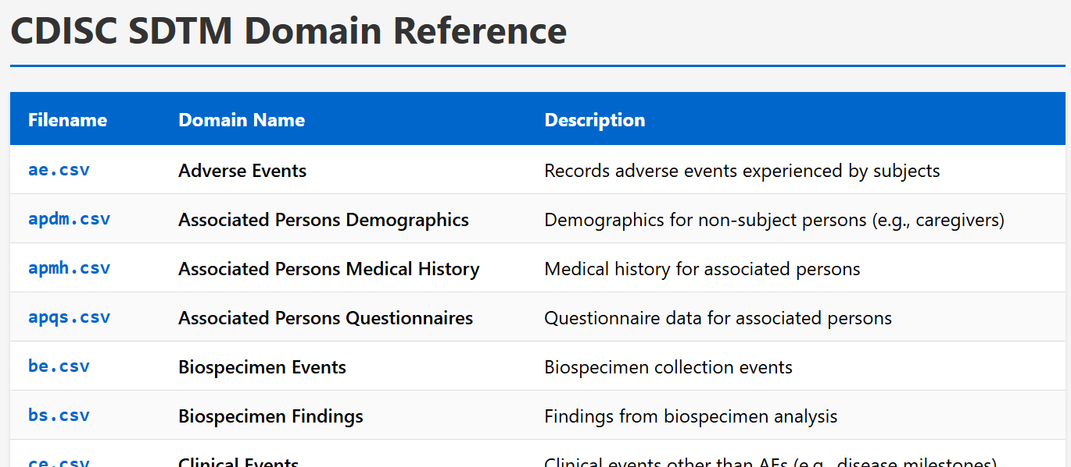
Repository Guide: metadata
/home/TB-PACTS/metadata
Subfolder | File name
metadata | 2022-04-14 TB-PACTS_Data_Dictionary.xlsx | Brief descriptions of all the CDISC variables in TB-PACTS
 | 2025-04-03 Critical Path Trials Overview.xlsx | Listing of the studies in TB-PACTS (with Study ID)
 | 2025-04-03 ISRCTN metadata download.xlsx | Info from ISRCTN registry
 | 2025-04-03 NCT metadata download.csv | Info from clinicaltrials.gov
 | CTCAE_Word_Conversions.xlsx | CDISC info for AE terms
 | MEDRA_Word_Conversion.xlsx | CDISC info for AE terms
/home/TB-PACTS/info/ cdisc_domains.html

Slide 10
Hackday framework
Choose a trial from the TB-PACTS repository (put a note in slack about what you are working on)
Find the protocol and manuscript for the study: /home/TB-PACTS/metadata
Find the tools repository in your home folder, and the README.md: ~/tb_pacts_tools/README.md
Modify the AE processing script for your study and be sure to document modifications: ~/tb_pacts_tools/process_ae_data_template.R
Try to create the AE analysis data set (“adata”); iterate until it looks good and matches data from the manuscript
Test out the AE adata by rendering the quarto markdown (QMD) file: quarto render ae_analysis_report_template.qmd –output ~/adata/TB-[DIGITS]/ae_analysis_report_TB-[DIGITS].html
If the report doesn’t render correctly or there is an issue with the data, modify the processing script until its working (try not to modify the QMD)
When you have good adata, copy to the shared folder: cp -r ~/adata/TB-[DIGITS] /home/shared/TB-[DIGITS]_[USERNAME]

Slide 11
Shared folder naming conventions
When you have adata and a rendered QMD for a trial (ae or eff adata) create a folder for your study in the shared space: /home/shared/TB-[DIGITS]_[USERNAME]
Add these files for “ae” and/or “eff” adata: ae_adata_TB-[DIGITS]_[TXT/DATE/VERSION].csv ae_analysis_report_[TXT].qmd
Add a markdown file for notes including sections “# Status”, “# TODO” and “# Issues”: notes_[USERNAME/VERSION].md
Invite others on slack to review your code, adata and QMD report: they can also add notes files (with naming convention)
Progress script will periodically scan /home/shared for these files and notes

Slide 12
Other ideas to consider
Create a new analysis dataset template with new variables
Review code and analysis datasets in /home/shared, checking against the protocol and manuscript
Build out new efficacy or AE analysis report figures and tables; make it a template for others to apply to additional trials
Plan analysis to address new hypotheses with demographic variables and treatment efficacy or AE
Combine analysis datasets and build out a meta-analysis template
Combine AE and efficacy analysis datasets to ask how adverse events relate to efficacy

Slide 13
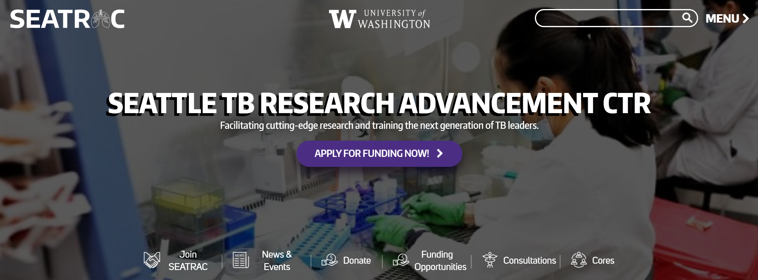

Opportunities to get involved in TB research
Join SEATRAC or your local NIH TB Research Accelerator (TRAC)
Join for access to Clinical, Immunology and Data Science Core services (e.g., BSL3 trainings, sample repository, data science consultations, seminar announcements)
SEATRAC seed funding ($50K/yr for 2 yrs): “New to TB” and “New Investigator” awards
Regular seminar series (monthly at UW SLU)
https://seatrac.uw.edu/

Slide 14
Thank you for participating!
Your feedback is welcome for next time

