Slide 1

SAS Optimization Challenge
Pavan Kumar Ghantasala
Srinikhil Bolneyti
Anil Cavale
Rajib Mahato
Shubham Agarwal

Slide 2

Forecasting and Optimization Solution for water allocation at building T for XYZ corporation

Slide 3
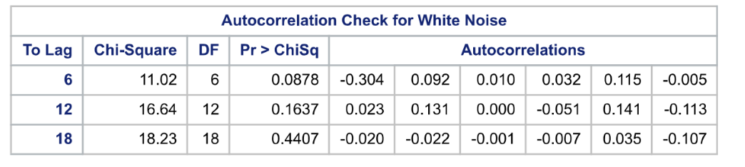
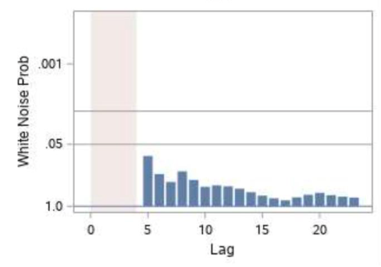
Forecasting(Model Selection)
We tried different models for forecasting and checked for the significance level to compare and choose the best model for the forecasting scenario
We found that the ARIMA model was the best model for prediction because after running the model, the p – values for auto correlation of white noise were greater than the significance level of 0.05, which was further confirmed by the White Noise vs. Lag plot
Models Preferred: -
ARIMA Model
Auto-Regressive Model
Integrated Forecasting Model
Seasonal ARIMA Model
Model Selected: -
ARIMA MODEL

Slide 4
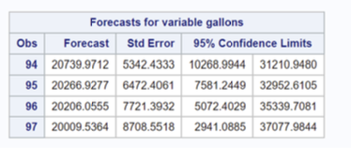
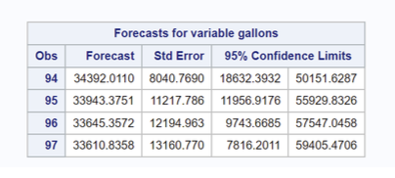
Forecasting
After choosing the ARIMA model and variants of it like SARIMA, we made parameter adjustments to sort out the predicted values with p-values greater than the significance level. Below are the parameters that provide the desired result.
ARIMA MODEL(PARAMETERS TUNNING)
Autoregressive order (p) | 1 | 1 | 2
Differencing order (d) | 1 | 1 | 1
Moving average order (q) | 1 | 3 | 1
After collecting the forecast values for different parameters, we ensembled it and took the average of all the values for our water demand
Forecasts for the cooling water
Forecasts for the Main water from Water Corp
Week | Forecasts
1 | 54172.24
2 | 54223.42
3 | 53514.76
4 | 53675.54
Total water demand forecast(Cooling and Main Water)

Slide 5
Optimization
Objective: -
To choose a contract with the lowest total water cost with below constraints: -
Amount of water ordered from i-th{Water Corp., Storage Tank} source in j-th{1,2,3,4} week (Wij)>= 0 for all i,j (non-negativity constraint)
Sj >= 30000 gallons for all j (Storage tank constraint)
Wprecip,j > = 0.25 * (Wprecip,j + WWater Corp, j )
Wprecip,j + WWater Corp, j >= Forecasts
Choosing the optimum contract which is cost effective to XYZ Corporation
We created two more binary variables one for each contract (xa, xb), with their values suggesting whether that particular contract is selected or not. Only one of the variables will have a value of 1. Thus, we added below constraints as well.
Xa + Xb = 1 Xa isbinary Xb isbinary
WWater Corp, j >= (25000* Xa + 30000* Xb ) (Water Corp base Constraint)
Contract Options: -
1. 15 cents ($0.15) per gallon with a minimum of 25,000 gallons purchased per week
2. 12 cents ($0.12) per gallon with a minimum of 35,000 gallons purchased per week

Slide 6
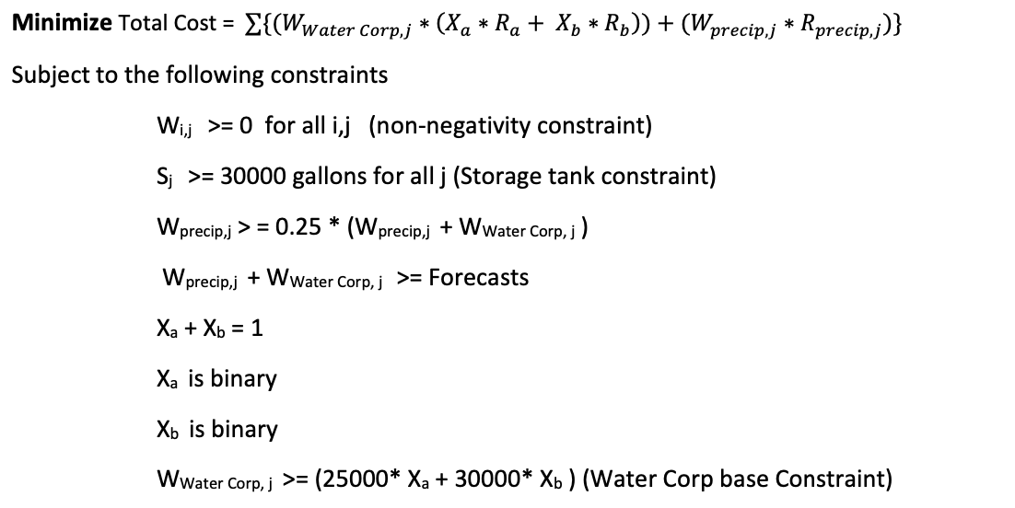
Optimization
Using SAS Optimization techniques, we would find out minimum total cost subject to constraints which XYZ should opt for.
Total number of gallons that Building T requires for the next 4 weeks are: -
Week | Forecasts
1 | 54172.24
2 | 54223.42
3 | 53514.76
4 | 53675.54

Slide 7
Optimization
Results
After Solving the problem on SAS, for the first contract, the total cost is around $30,291 whereas for the second contract, the total cost is around $26,752. (Constraint : Xb = 1)
We found out that the second contract ($0.12 with minimum purchase of 35000 gallons per week) is more beneficial as the total cost is minimized.
Week | Water Ordered
1 | 40629
2 | 40668
3 | 35000
4 | 35000
Week | Water Ordered
1 | 13543
2 | 13556
3 | 18515
4 | 18676
Water ordered from the Water company each week
Water ordered from the storage tank each week

Slide 8
Optimization
Results
XYZ’s projected total cost at the end of four weeks would be $ 26,752 and it would save ($30,291- $26,752) $3539 if opted for the second contract.
If we had chosen the first contract, at the end of 4 weeks the storage tank inventory is 50210 gallons which is 20000 gallons less than choosing the second alternative (70210 gallons).
Week | Water in Tank
1 | 60956.93916
2 | 65401.08443
3 | 66886.36231
4 | 70210.86117

Slide 9


Thank You

