Slide 1
Design Lab Project (ME-306)
Hybrid Earthquake Vibration Control for Buildings
Group Members - Tuesday Group D
Bewele Suyog Asaram (2023MEB1337)
Daggolu Sai Mohith Reddy (2023MEB1338)
Deepanshi Dhir (2023MEB1339)
Dev Agarwal (2023MEB1340)
Diya Seal (2023MEB1341)

Slide 2
Problem Statement
Introduction
Earthquakes generate dynamic lateral forces in structures
These forces cause vibrations, instability, and possible failure
Traditional buildings rely only on structural strength
Modern approach: Control vibrations instead of resisting them
Problem Statement
Excessive vibrations during earthquakes lead to:
Structural damage
Resonance effects
Reduced safety
Passive systems alone are not adaptive
Active systems alone depend on power
Therefore, need for a hybrid vibration control system

Slide 3
Project Objectives
1. Structural Modeling: Design and fabricate a 3-storey acrylic and WPC building scale model (~3 ft, 1.2 kg) representative of low-rise structures.
2. Numerical Simulation: Perform Modal and Harmonic Response analyses in ANSYS 2025 R2 to extract natural frequencies and mode shapes.
3. Passive Damping: Implement spring-based passive isolation at the base to reduce incoming ground excitation energy.
4. Active Control: Design a PID-based active damping controller using a high-torque servo motor driven by Arduino Mega with MPU6050 feedback.
5. System Validation: Experimentally verify hybrid system performance under simulated seismic excitation and compare with baseline.

Slide 4
Working Principle
Active Damping and Passive Damping
Passive damping in our system is achieved using a spring mechanism. This works on the principle of a tuned damper.
When the structure vibrates, the attached spring begins to shear. This oscillation absorbs a portion of the vibrational energy from the structure. As a result, the vibration amplitude decreases over time. The main advantage of this system is that it does not require any external power.
Active damping in our system is implemented using a servo motor. The servo motor is controlled by an Arduino, enabling precise, controlled movement. When vibrations occur, the motor generates motion in the opposite direction.
This opposing motion helps counteract vibrations and stabilise the structure more quickly. Unlike passive damping, active damping can adapt to changing conditions. However, it requires a continuous power supply and control mechanisms.

Slide 5
System Architecture
Hybrid Vibration Control — Signal Flow
Seismic
Excitation
Passive Damping
(Spring Isolators)
3-Storey
Building Model
MPU6050
Accelerometer
Arduino Mega
(PID Controller)
← Feedback loop
Active Damping — High-Torque Servo
generates counter-torque to suppress vibration
Outcomes: Passive damping attenuates primary seismic energy · Active PID controller suppresses residual vibrations · Real-time feedback via MPU6050

Slide 6
Governing Equations
Equation of Motion (Single Degree of Freedom):
PID Control Law:
mẍ + cẋ + kx = F(t)
u(t) = Kp·e(t) + Ki·∫e(t)dt + Kd·de/dt
m — Mass of the structure
c — Damping coefficient
k — Stiffness of the structure
x, ẋ, ẍ — Displacement, velocity, and acceleration
F(t) — External seismic force (time-varying)

Slide 7
Modal Analysis Natural Frequencies
ANSYS 2025 R2 3-Storey Acrylic Model
Mode
Frequency (Hz)
Mode Shape
Significance
1
4.846
1st lateral bending
Primary seismic risk — design target
2
13.506
2nd lateral bending
Secondary target
3
18.417
Torsional
4
18.88
Higher lateral
5
22.253
Combined
6
51.393
High-freq. axial
Critical design frequencies: Mode 1 (4.846 Hz) and Mode 2 (13.506 Hz). Passive and active systems tuned to suppress these modes.

Slide 9
Natural Frequencies : Modal Analysis

Slide 10
Harmonic Response Analysis

Slide 11
Passive Damping System
Spring-Based Base Isolation
What is Passive Damping?
Passive damping uses mechanical elements, such as springs, rubber pads, or friction dampers, placed between the building foundation and the ground. They absorb and dissipate seismic energy without requiring any external power or control signal.
Our Implementation
Springs are installed at the four base corners of the acrylic building model. When the shake table excites the structure, the springs decouple ground motion from the building frame, significantly reducing the energy transmitted to the floors.
Limitation
Passive systems are designed for a fixed frequency range. At excitation frequencies near natural modes (4.846 Hz, 13.5 Hz), residual vibration persists, which is why active control is also employed.

Slide 12
Active Damping System
Arduino Mega + MPU6050 + High-Torque Servo
Arduino Mega 2560: Main microcontroller (16 MHz, 54 I/O pins). Reads accelerometer data via I²C and outputs PWM signal to servo. Runs real-time PID loop at ~100 Hz.
MPU6050 Accelerometer / Gyro: 6-DOF sensor, 16-bit resolution, ±16g range. Measures storey acceleration in real time via I²C. Provides error feedback for the PID controller.
High-Torque Servo Motor: Active actuator physically attached to the building frame column. Generates controlled counter-torque proportional to the PID output to suppress residual vibrations.
Control Loop: MPU6050 senses vibration → Arduino reads acceleration → PID computes error & output → Servo generates counter-torque → Vibration suppressed

Slide 13
PID Controller — Design & Tuning
Control Law:
u(t) = Kp · e(t) + Ki · ∫e(t) dt + Kd · de(t)/dt
Kp — Proportional Gain: Directly proportional response to current acceleration error. Controls how aggressively the servo reacts to present vibration.
Ki — Integral Gain: Accumulates past error over time. Eliminates steady-state offset and drift in the accelerometer reading.
Kd — Derivative Gain: Reacts to rate of change of error. Provides predictive damping, preventing overshoot and improving settling time.
e(t) — Error Signal: Difference between desired acceleration (setpoint = 0 m/s²) and measured acceleration from MPU6050.

Slide 14
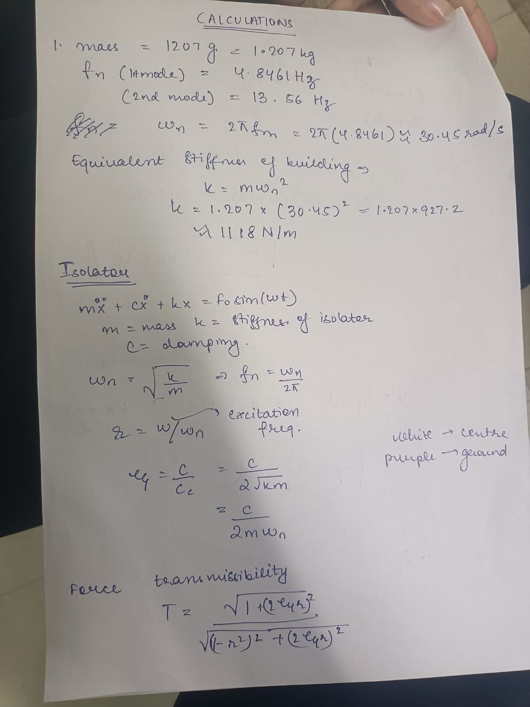
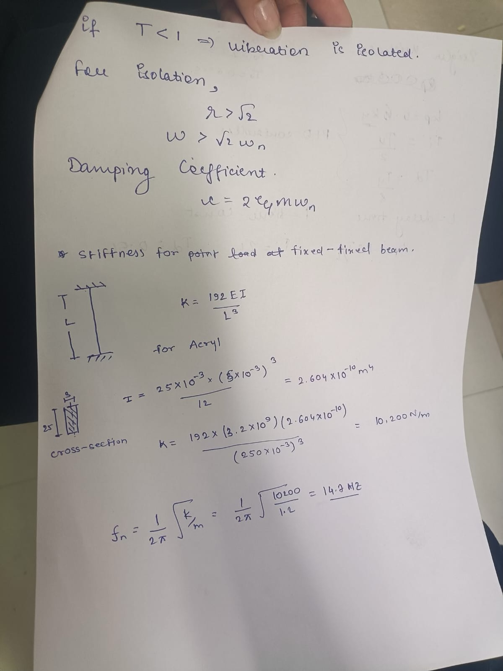

Slide 16
Experimental Setup & Hardware
1. Acrylic Columns (×16)
Vertical load-bearing members, transparent, lightweight
5. Arduino Mega
Main controller; runs PID loop and servo PWM output
2. MDF Floor Slabs (×6)
Simulates floor mass; 3 storeys at equal spacing
6. MPU6050 Accelerometer
Mounted on 2nd floor; I²C interface, 6-axis sensing
3. Base Plate (MDF)
Houses Arduino Mega and provides mounting for springs
7. High-Torque Servo
Active actuator; attached to frame column; counter-torque
4. Coil Springs (×4)
Passive isolation at base corners; tuned for stiffness
8. Power Supply
USB 5V for Arduino; separate 5V/2A rail for servo

Slide 17
Conclusion & Future Work
Key Conclusions
• 3-storey acrylic scale model designed, fabricated, and simulated in ANSYS 2025 R2. Natural frequencies validated: 4.846 Hz (Mode 1), 13.506 Hz (Mode 2).
• Harmonic response confirmed maximum deformation near resonance; results informed passive spring selection.
• Spring-based passive isolation.
• Full hybrid system (Arduino + MPU6050 + Servo, PID-controlled).
• PID gains (Kp, Ki, Kd) tuned iteratively to minimise overshoot and achieve acceptable settling time.
Future Work
• Multi-directional Control — extend to 2-axis servo actuation for simultaneous X and Y lateral excitations.
• Adaptive / ML-based Control — replace fixed-gain PID with a reinforcement-learning controller that self-tunes in real time.
• Shake Table Validation — test with recorded seismic waveforms (El Centro, Bhuj) on a calibrated shake table.
• Full-Scale Feasibility — investigate hydraulic or electromagnetic actuators for real-structure implementation.

