Slide 1
Text Classification
Implemented on PyTorch
Two Approaches tried:
Glove Embedding + CNN and Most Common 20K works vocab
Complete code at https://github.com/agarwalanant/TextClassifier

Slide 2
Data Preprocessing
Text Field was tokenized in ‘spacy’ format, as it is the fastest and has String to hash mappings
Text Vocab was built using Glove embedding (6 billion words and 100 dim)
From my past experience, I think there was no need to remove punctuation marks as they also tells a lot about the formation of the sentence and hence the type of sentence written.

Slide 3
Glove + CNN
Glove Vector Embedding was used with 6B words and 100 dimension.
CNN input is the pre trained glove embedding.
Max pooling is used after convolutions followed by dropout. Of probability 0.5.
The model has 2,592,005 trainable parameters.
Adam optimizers is used with default parameters of a = 0.9 and b =0.99.
Loss Function Cross Entropy Loss.

Slide 4
Why Glove Approach ?
The key concept in these word embeddings is that words that appear in similar contexts appear nearby in the vector space, i.e. the Euclidean distance between these two words vectors is small.
Thus Glove vector very efficiently convert word into numbers for processing.
Now as the words in the paragraphs are related and we have to exploit that inter dependence among words, CNN is the best architecture which exploit inter dependence of features and also shares features with each other making training faster than FCNN.

Slide 5
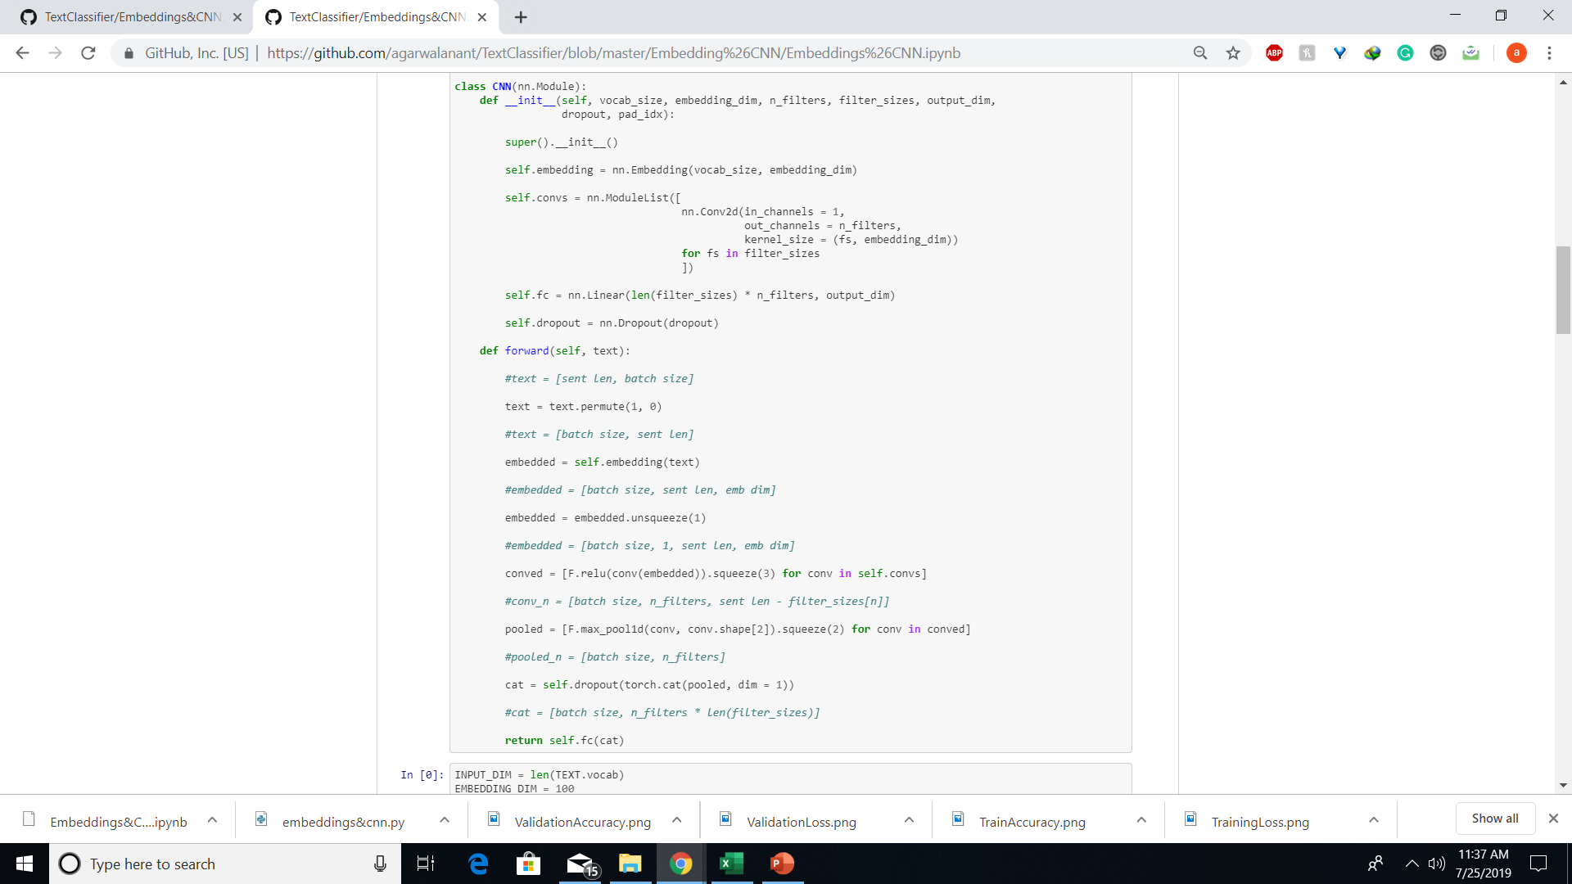
Glove + CNN Code Snippet
Complete code at https://github.com/agarwalanant/TextClassifier

Slide 6
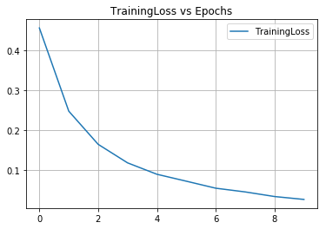
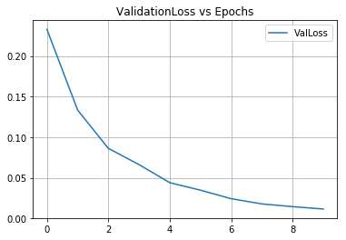
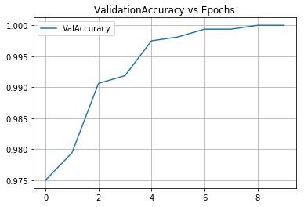
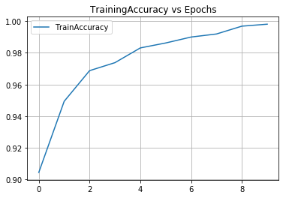
Glove + CNN Output

Slide 7
RNN
Vocabulary size 25K
The coarse embedding was also trained by the RNN model.
Optimizer used : Stochastic Gradient Decent with Learning rate 1*e(-3).
Criterion Cross Entropy Loss.
Complete code at https://github.com/agarwalanant/TextClassifier

Slide 8
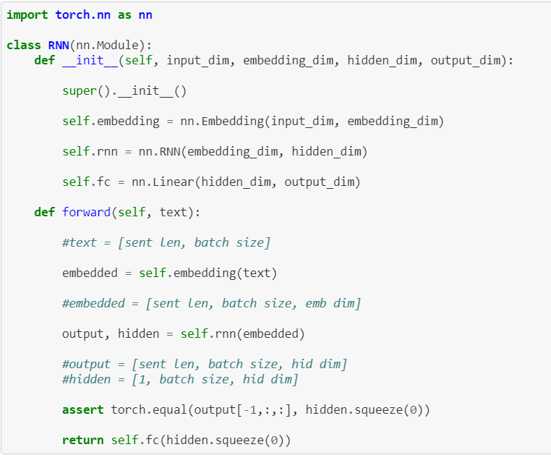
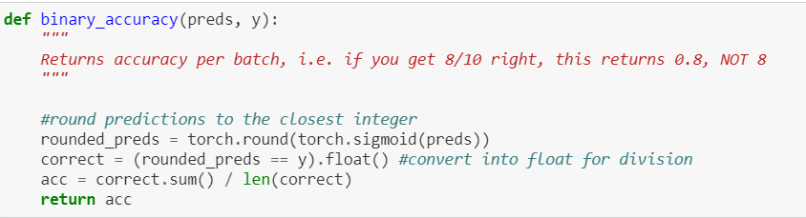
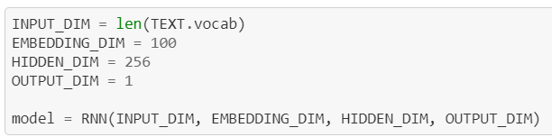
RNN Code Snippet

Slide 9
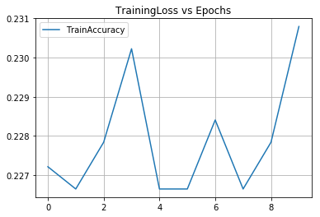
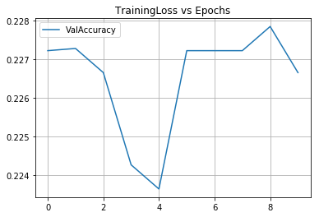
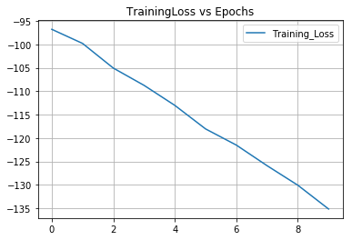
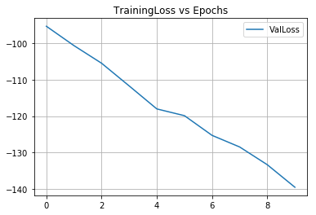
RNN Outputs

Slide 10
Final Verdict
The results from pretrained Embeddings and CNN perform far better than Vanilla RNN.
Glove embedding also reduced the total training time that allowed us to us CNN to further improve accuracy of the model.

