Slide 1

Team Name: The Dundies Team Members: Harshita V, Krish A, Joan J, Reiyonna S Registration Numbers: 21112041, 21112016, 21112037, 21112020

Slide 2




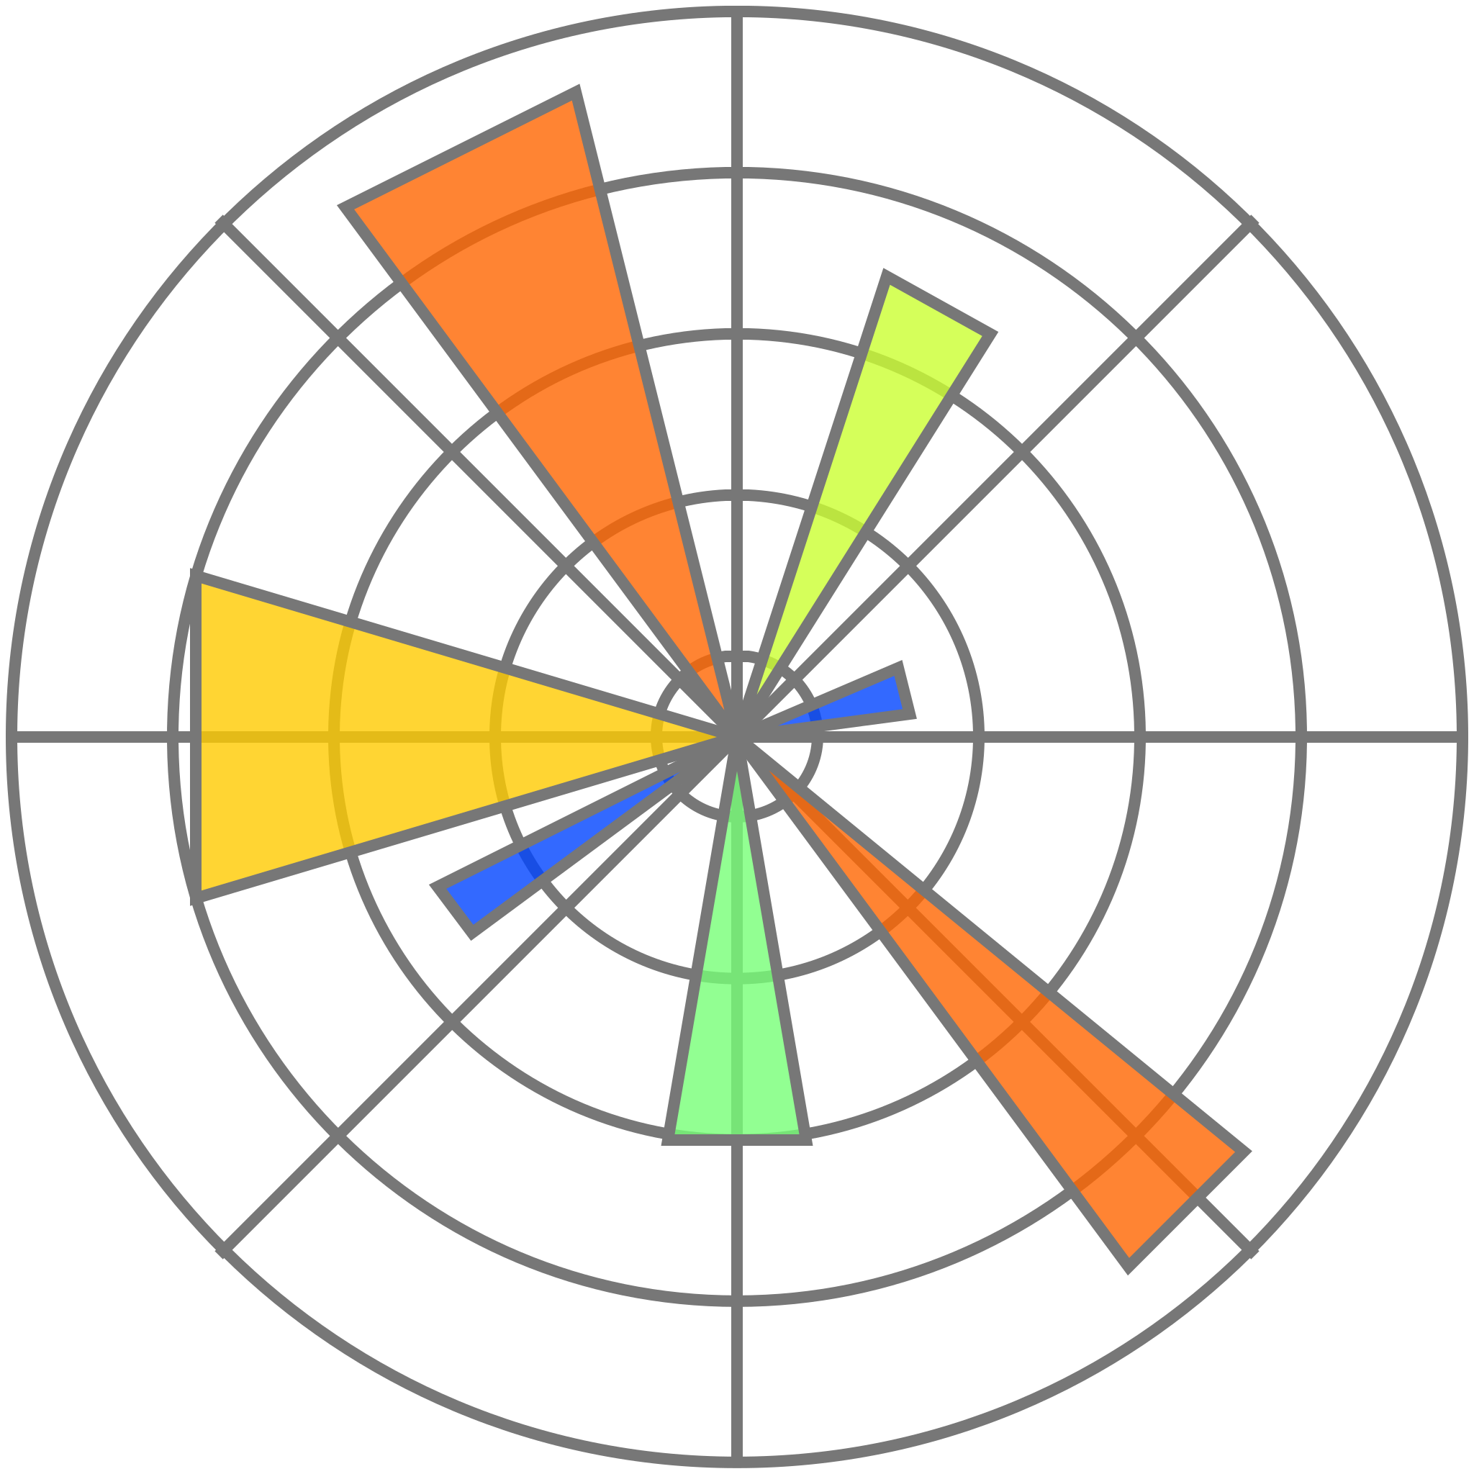



Tools and Framework Used

Slide 3
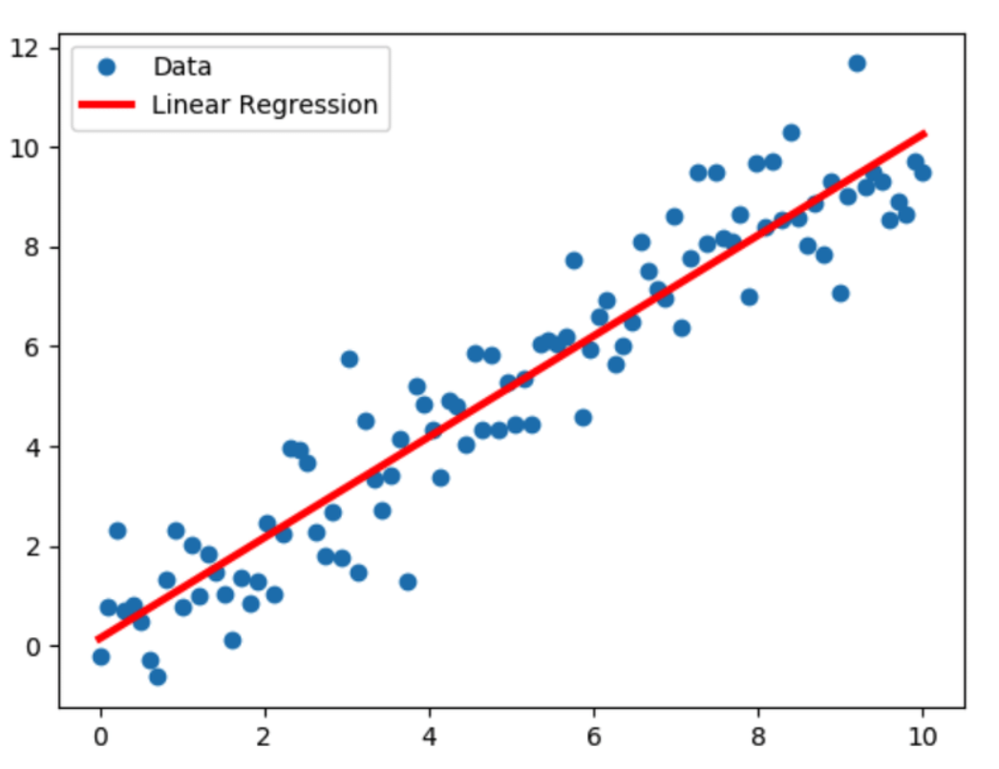
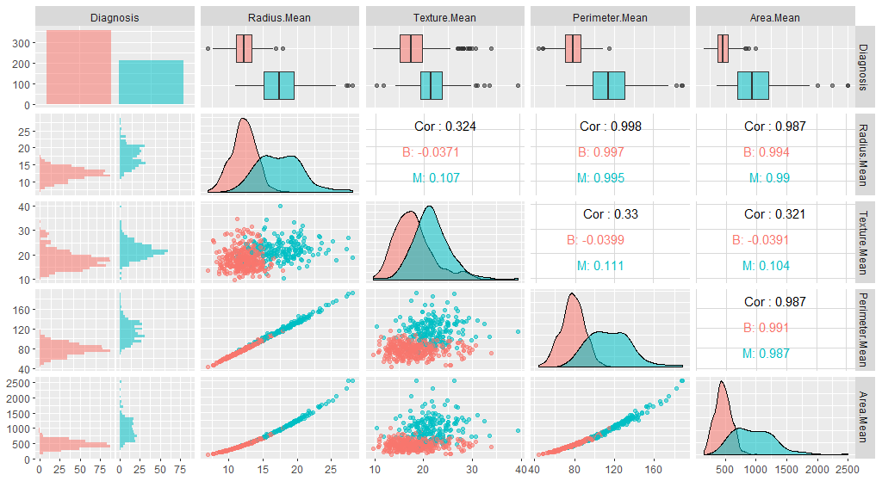
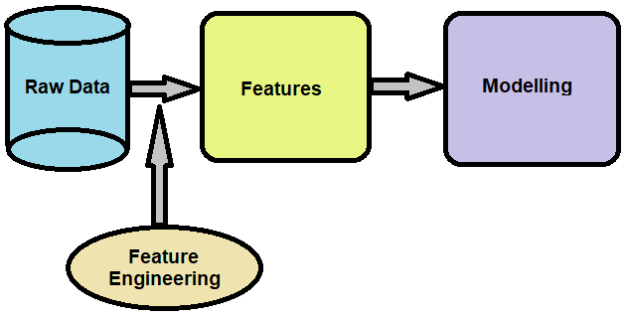

Process we followed:
1. Understanding the dataset
2. Pre-Processing the data
3. Feature Engineering
4. EDA
5. Deploying ML models
6. Implementation of UI

Slide 4
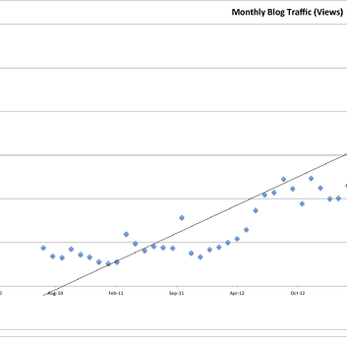
Algorithms Used
1. Linear Regression
2. Ridge Regression
3. Decision Tree
4. Random Forest
5. SGD Regressor
6. Model Optimization

Slide 5
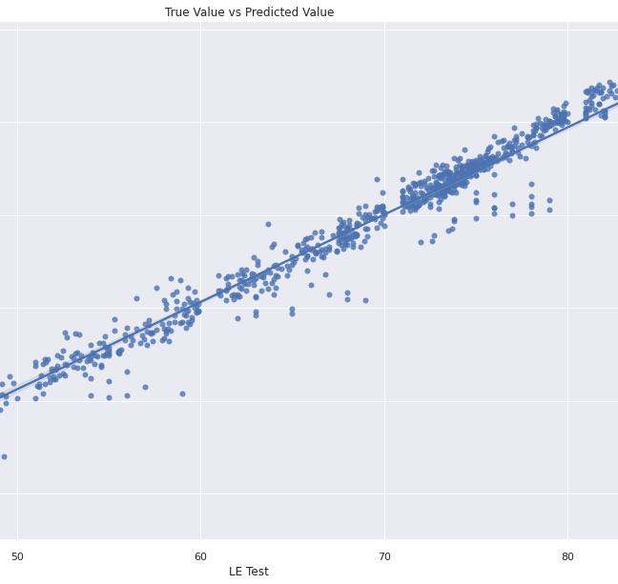
Linear Regression
Accuracy: 90.7382
Mean Squared Error: 8.3131
RMSE: 2.8832

Slide 6
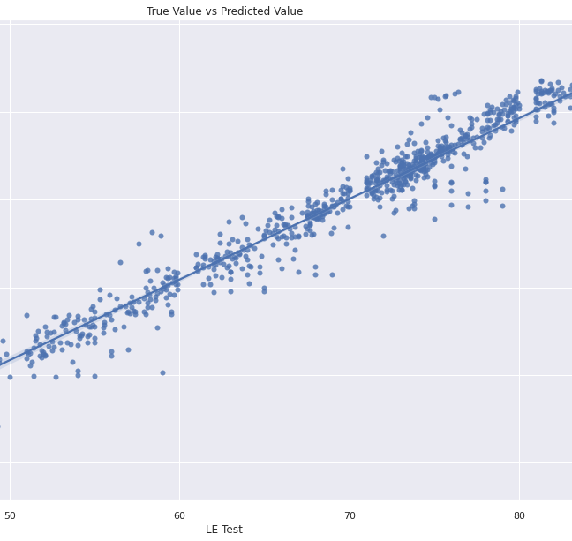
Ridge Regression
Accuracy: 81.3997
Mean Squared Error: 16.6951
RMSE: 4.0859

Slide 7
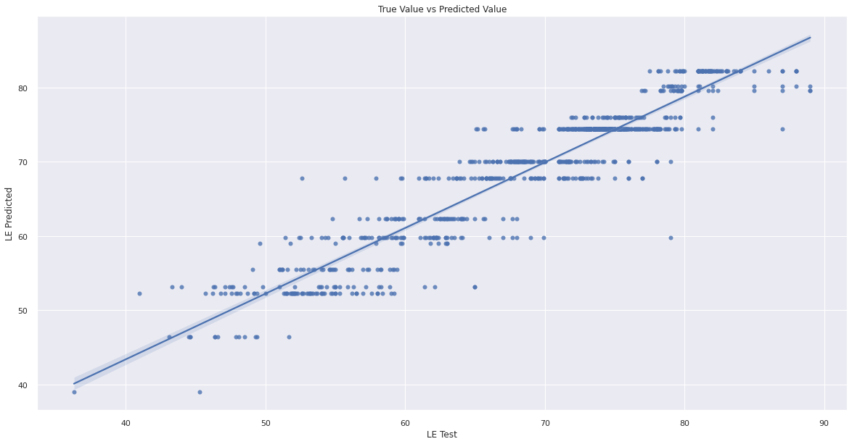
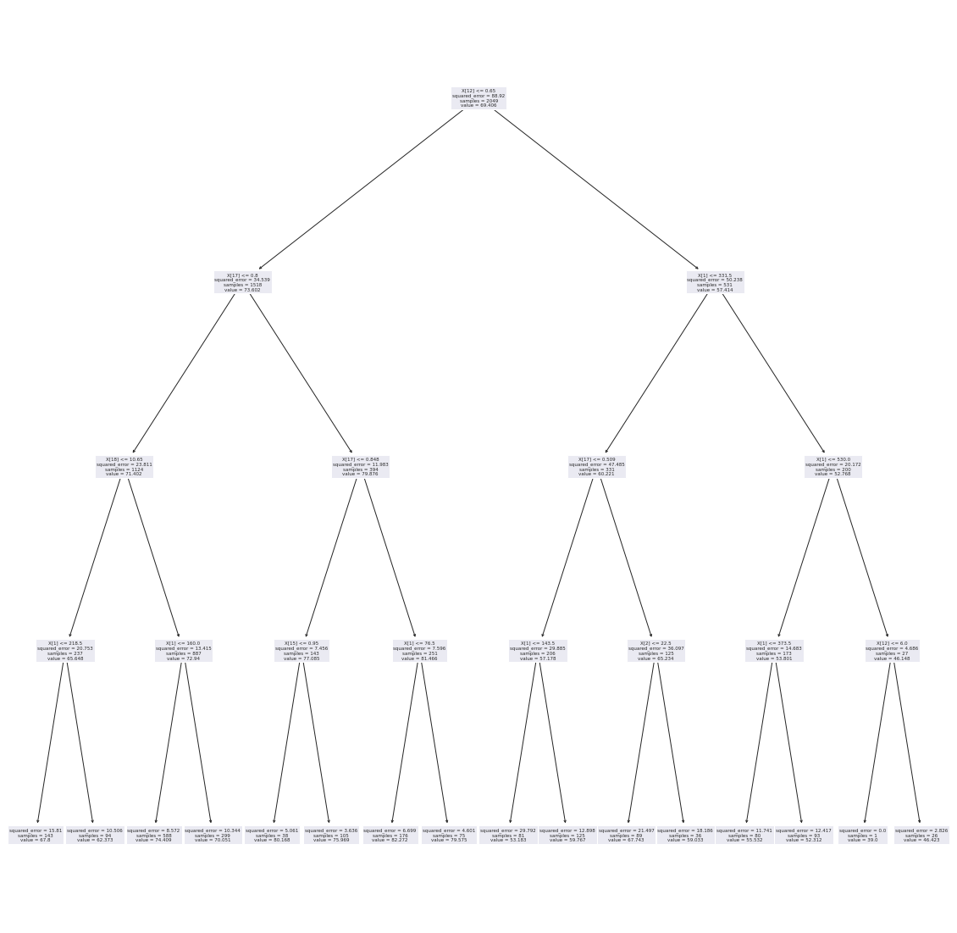
Decision Tree
Accuracy: 85.6989
Mean Squared Error: 12.8363
RMSE: 3.5827

Slide 8
Random Forest
Accuracy: 95.5892
Mean Squared Error: 3.9589
RMSE: 1.9897

Slide 9
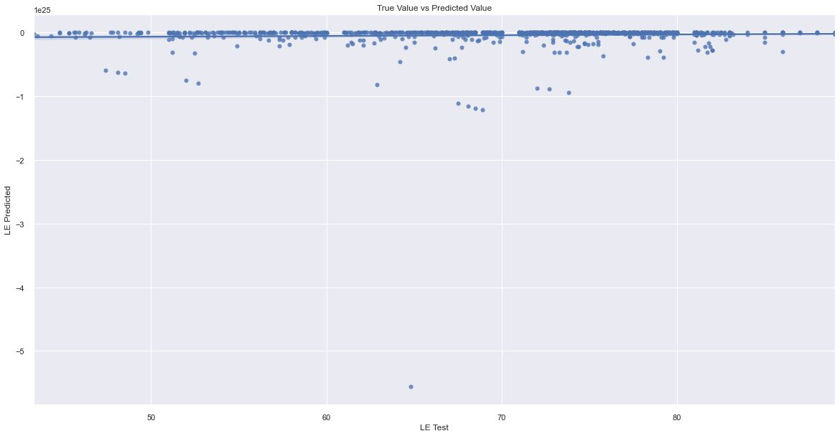
SGD Regression

Slide 10
Model Optimization
Model | Score | MAE | RMSE
Gradient Boosting Regressor | 0.930 | 1.83 | 2.50
LGBM Regressor | 0.955 | 1.37 | 2.00
XGBRF Regressor | 0.924 | 1.86 | 2.61

