Slide 1
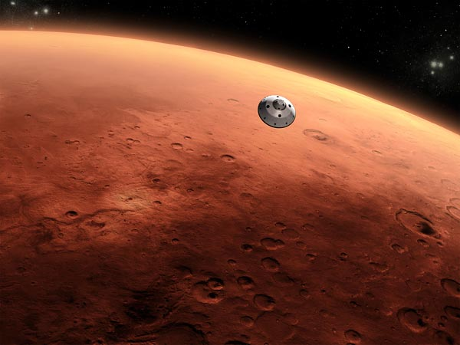
Solar System (Sistema Solare)
By Mrigya Agarwal and Christine Graff

Slide 2
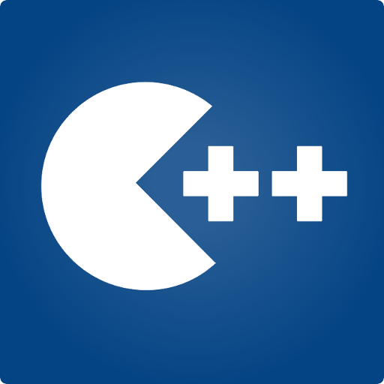


Tools
C++
OpenGL
QT Creator

Slide 3
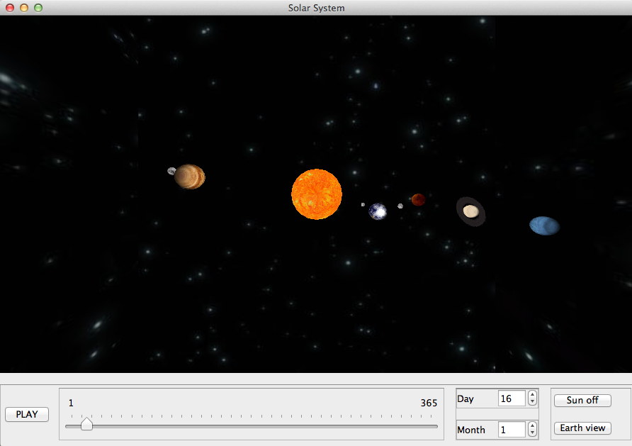
Features
Keyboard:
Zoom+/-
Turn left/right
Change view
light source
Planets orbit the sun
Jupiter
Mars
Sun
Earth
Saturn
Uranus
Moons orbit planets
Play/Pause
Activate alternative light source
Display or change position according
To Earth’s calendar
View earth only

Slide 4
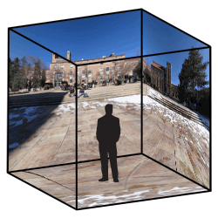
Skybox

Slide 5
Demo!

Slide 6

Special thanks to…
Professor Kai Hormann
Tas:
Teseo Schneider
Randolf Schaerfig

