Slide 1
RAKSHAK
Team No. 6
Mentors Members:
Dr.Arpan Gupta Rohit Agarwal
Dr.Amit Prasad Atyant Yadav
Rishabh
Yash Paliwal
Manas deep
Dheeraj Ram

Slide 2
BRIEF INTRODUCTION
RAKSHAK is a surveillance rover designed for patrolling of International Borders and various sneak operations.
The main Motivation behind this project is to reduce the risk of life loss / injuries of soldiers risking their everything at borders.

Slide 3
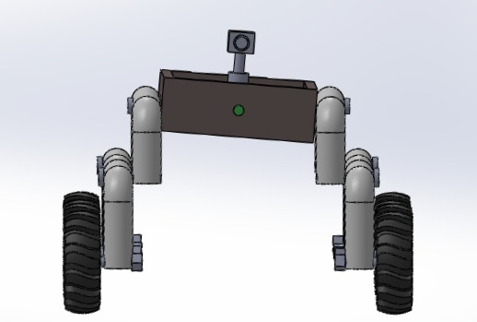
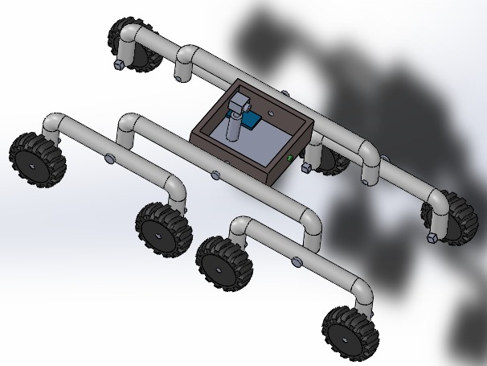
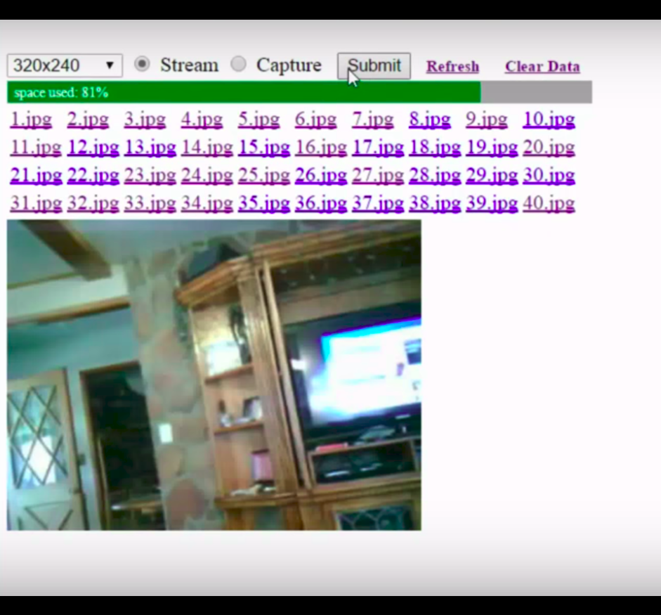
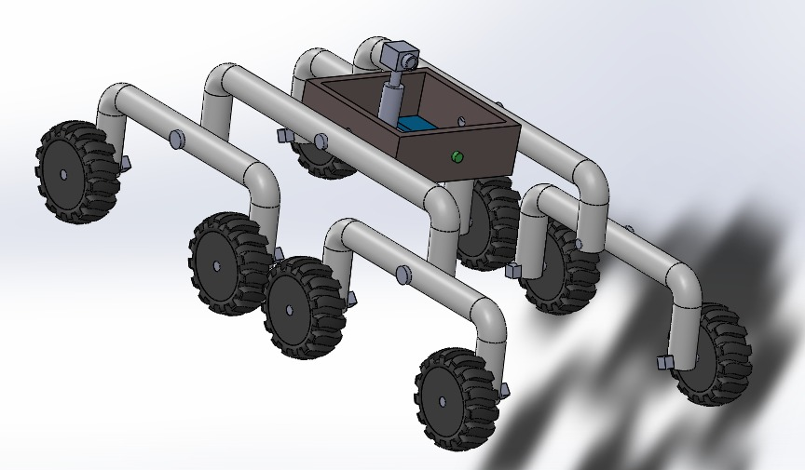
PROJECT DESIGN
fvf
FRONT
TOP
Web page on I.P.
SIDE

Slide 4
PROGRESS PROPORTION
Progress Made | To be achieved
Literature analysis | Constructing mechanical structure
Finalisation of design | Programming on r-pi with sensors
Distribution of work | Floating of data on IP
Purchase of components | Making final prototype

Slide 5
STRATEGY
Mechanical work
Electrical &
Programming
Implementing rocker bogie mechanism
Camera and sensor mounting
Programming with sensors
Uploading the data on IP

Slide 6
TIMELINE
30th April - Rover will be completed.
5th May - Camera and sensor mounted on rover .
10th May - Sensors will be programmed using raspberry-pi and data will be Floated on IP.
15th May - Making of Final product
After 15th May - Testing of product.

