Slide 1

An Autonomous Institution
Affiliated to VTU, Belagavi
Approved by AICTE, New Delhi
Recognised by UGC with 2(f) & 12(B)
Accredited by NBA & NAAC
Subject Code– MVJ21IS182
Date: 22.05.2025

Slide 2
A Presentation on Internship Work
“College2Campus”
PRESENTED BY | EXTERNAL GUIDE | INTERNAL GUIDE
NAME: Shrish Agarwal USN: 1MJ21IS101 | NAME: Manaswee Tripathi DESIGNATION: Director ORGANIZATION: Srijan Services & Consultancy | NAME: RamaKalyani K DESIGNATION: Assistant Professor DEPT: Information Science ORGANIZATION: MVJ College of Engineering

Slide 3
Agenda
About the Organization
About the Department
Task Performed
Reflection Notes
Conclusion
Reference

Slide 4
About the Organisation
Srijan Services is a forward-thinking IT company committed to empowering businesses and individuals through innovative IT development and comprehensive HR solutions. With a focus on delivering customized, high-quality services, the company blends technical expertise with people-centric strategies to enhance operational efficiency and build lasting partnerships. From software development to strategic HR support, Srijan Services adapts to the evolving tech landscape to meet diverse client needs.
The company places strong emphasis on continuous learning and development, offering extensive training programs to upskill employees and keep them aligned with the latest industry trends. This dedication to professional growth ensures Srijan Services remains at the forefront of both HR and IT innovation, simplifying administrative tasks while creating impactful, future-ready solutions.

Slide 5
About the Department
Srijan Services, founded in 2015 and headquartered in Raipur, Chhattisgarh, is a leading IT services and consulting firm offering innovative software solutions and end-to-end HR outsourcing. The HR department plays a strategic role in aligning talent acquisition with the company’s tech-driven and client-focused goals. Their structured hiring process includes educational background checks, stream categorization (IT or non-IT), and role alignment in areas like Cloud, Database, or Development, followed by a multi-stage screening process.
Beyond recruitment, the HR team is deeply invested in employee development through tailored training programs and continuous support. This approach fosters a collaborative and innovative work culture, significantly contributing to both organizational growth and individual career advancement.

Slide 6
Task Performed and Reflection Notes
During my internship, I worked on a real-time project titled College2Campus, a web-based campus placement management system developed using Java, JSP, and MySQL. The project aimed to streamline the traditional placement process by automating key tasks such as student registration, resume submission, shortlisting, and interview scheduling. It featured dedicated interfaces for students, recruiters, and placement administrators, enhancing coordination and transparency across all stakeholders.
Technical Skills Gained
Gained hands-on experience in full-stack development using Java, JSP, and MySQL.
Learned to design secure, role-based access systems and build intuitive user interfaces.
Developed skills in automating workflows and managing structured data efficiently.

Slide 7
Task Performed and Reflection Notes
Professional Development
Improved problem-solving and project planning abilities through real-world application development.
Strengthened communication and collaboration skills by working closely with mentors and team members.
Gained insights into the challenges of digital transformation in educational institutions.

Slide 8
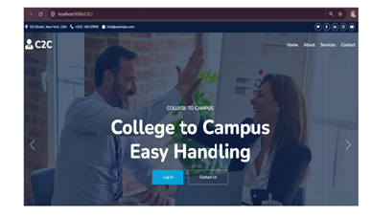
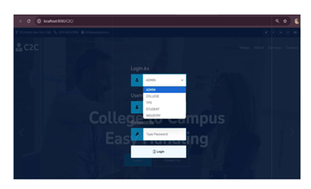
Outcomes

Slide 9
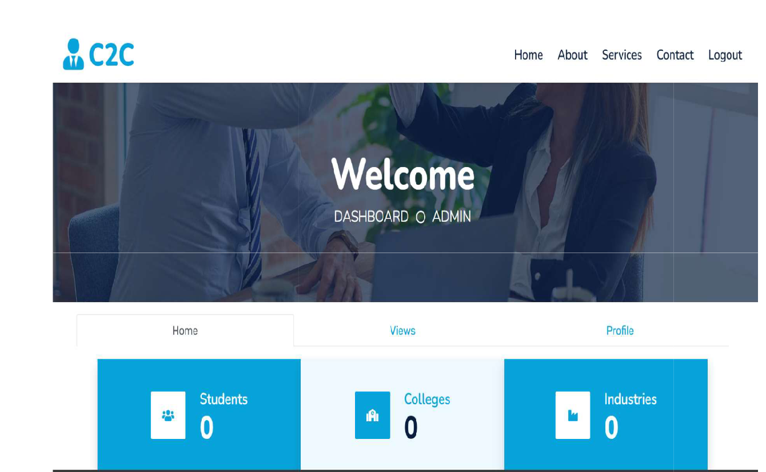
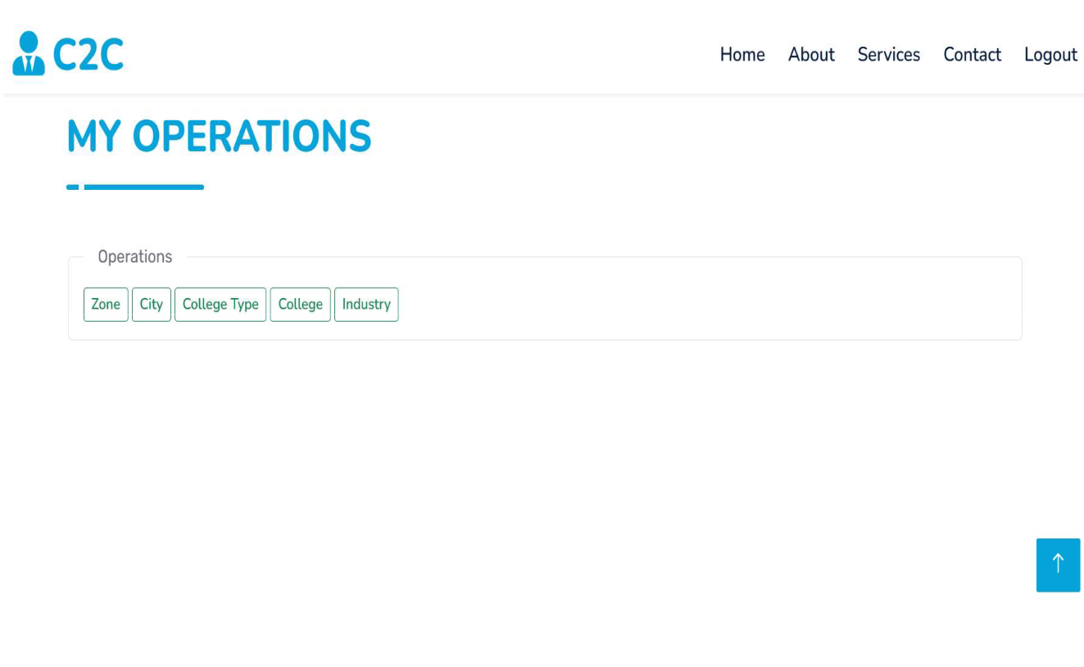
Outcomes

Slide 10
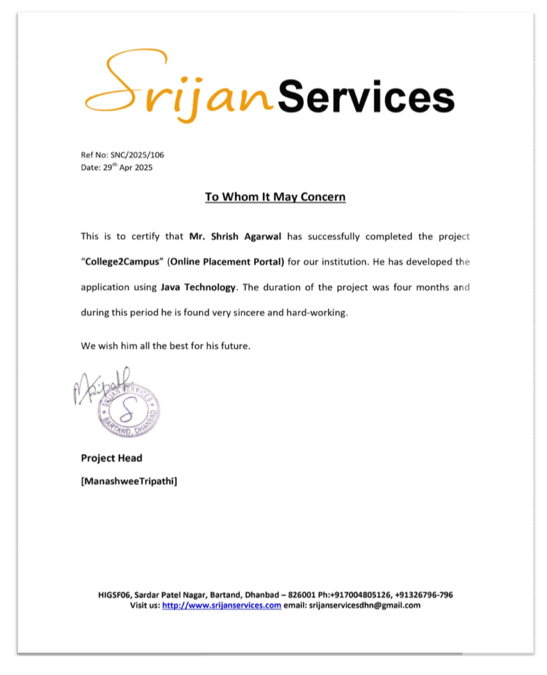
Certificate

Slide 11
Conclusion
The College2Campus project offers a robust and efficient solution to the limitations of traditional campus placement systems. Developed using Java, JSP, and MySQL, it streamlines the entire placement workflow by automating tasks such as student registration, job applications, resume tracking, and interview scheduling. With secure, role-based access and centralized data management, the system enhances accuracy, reduces manual effort, and improves coordination among students, recruiters, and placement officers.
Looking ahead, the project is designed with scalability in mind. Future enhancements like mobile app integration, AI-driven candidate filtering, automated notifications, and analytics dashboards can further elevate its functionality. These advancements will help transform College2Campus into a comprehensive digital placement management platform aligned with the evolving needs of educational institutions.

Slide 12
Reference
Oracle Corporation, “JSP Technology,” https://docs.oracle.com/javaee/7/tutorial/servelts.htm
MySQL Documentation, Oracle Corporation https://dev.mysql.com/doc/
Apache Software Foundation, “Apache Tomcat,” https://tomcat.apache.org/
W3Schools, “HTML, CSS, JavaScript and Web Development Tutorials,” https://www.w2schools.com/
GeeksforGeeks, “Java and Web Technology Tutorials,” https://www.geeksforgeeks.org/

Slide 13
MVJ College of Engineering
Near ITPB, Whitefield
Bangalore- 560067
Thank You

