Slide 1

Final Project Case Study in Web Analytics
Vaibhav Agarwal
CSCI E-63 Big Data Analytics
Harvard University
Prof. Zoran B. Djordjević

Slide 2

Problem Statement
Problem:
To analyze online traffic of a website – in near real-time, which would help the e-commerce division of that organization to understand the website traffic numbers, understand customer demographics. To analyze traffic I will be using Apache Kafka – Spark.
Background:
Online retail sales in United States has reached 10% of total sales and is expected to grow till 25% by year 2025*
Therefore organizations are utilizing web analytics to understand their online customers and to optimize their websites
Analyzing traffic in-real time can lead to personalization experience for each user coming to website

Slide 3





Software and Technology
Python 2.7
Packages:
Pandas Dataframe
Kafka-python
Pyspark
Matplotlib
Apache Spark
Apache Kafka
Apache Superset
Power BI

Slide 4


My Hardware Environment
Operating System: CentOS 7 , Windows 10

Slide 5
Data Set
The data was created through Adobe Debugger tool (Data generation methodology described in appendix)
This dataset contains summary information of clickstream data, which is present around world wide web. There are usually 161 columns in this data source.
(For more info see: data_dictonary.txt file attached with submission)
For demo purposes, I have reduced the dimension of this data and masked all the information (PII – if present to hide user identity)
File Name: orders_data.csv
File Size: 151 MB , reduced file size: (10MB)
File Format: Comma Separated Values
File Name: clicks_data.csv
File Size: 10 MB
File Format: Comma Separated Values

Slide 6
Data Set Overview
orders_data.csv description
visitorid: Unique visitorid assigned to everyone on web
sessionid: Unique session assigned to each visitor
page_name: Name of Page on which visitor is currently
device: Platform through which customer is accessing website
event: Button interacted by the visitor during session
date_time: Timestamp of that interaction
clicks_data.csv description
visitorid: Unique visitorid assigned to everyone on web
sessionid: Unique session assigned to each visitor
page_name: Name of Page on which visitor is currently
device: Platform through which customer is accessing website
event: Button interacted by the visitor during session
date_time: Timestamp of that interaction

Slide 7
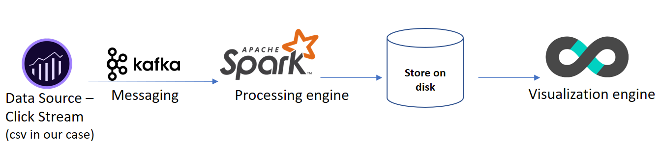
Project Overview
Installing required software(s)/servers
Data: Scraping off clickstream data (1 GB) of web and sub-sample it for demo purposes
Save data as a csv file – and write a simulation as real-time clickstream
Using Microsoft Power BI tool, to perform some Exploratory data analysis/visualizations
Pass the same simulated data on a Kafka-Topic
Read the data on two different consumers – simultaneously
Transform Kafka Stream to Spark RDDs/Dataframe – For real time ETL/Analytics
Write processed data back to disk in form of csv
Combine data from different files – by using python scripting and using cron jobs
Loading compiled csv to Apache Superset and creating dashboards showing real-time data

Slide 8
Proposed Solution
Why Spark streaming:
Apache Spark is one of the most popular distributed computing libraries
Spark Streaming is built-in library in Apache Spark has built-in library called as Spark Streaming which provides real time stream processing in form of micro batches
Spark Streaming reads streams from source. Being more specific Spark community calls them “receiver” and that received data processes in micro batch jobs for each iteration. The iteration interval must be assigned at some point of development cycle
Why Kafka then:
Kafka enables parallel streaming with a support named “partition” which is highly compatible to use with Spark’s partitioning
When data traffic is high, Kafka can use its queuing mechanism to handle large volumes of data, where Spark streaming may lose data

Slide 9
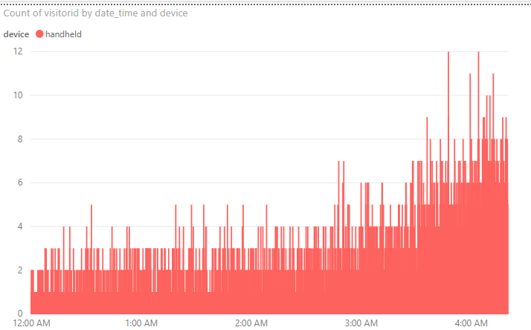
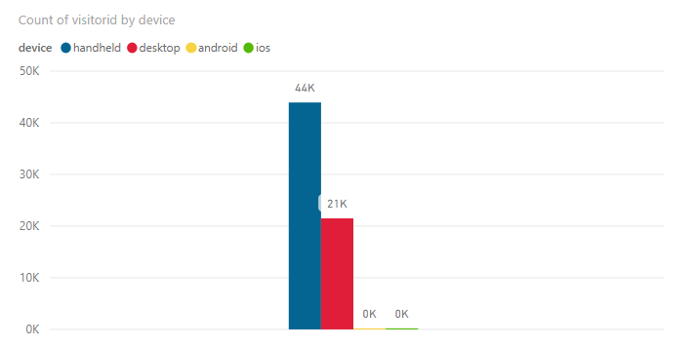
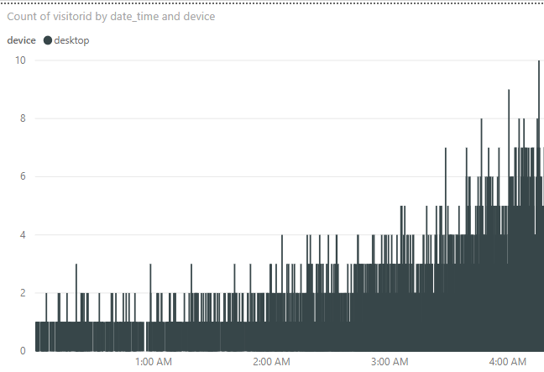
Data Analysis & Visualization
Using Power BI tool to use clicks_data.csv to understand at what time customers come to website and which platform is more popular

Slide 10
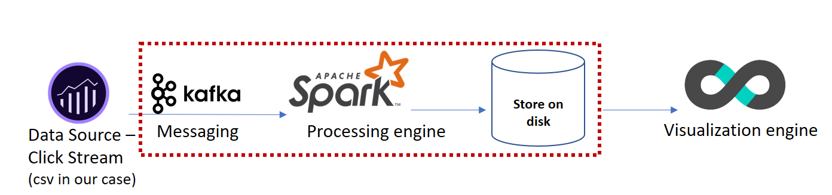
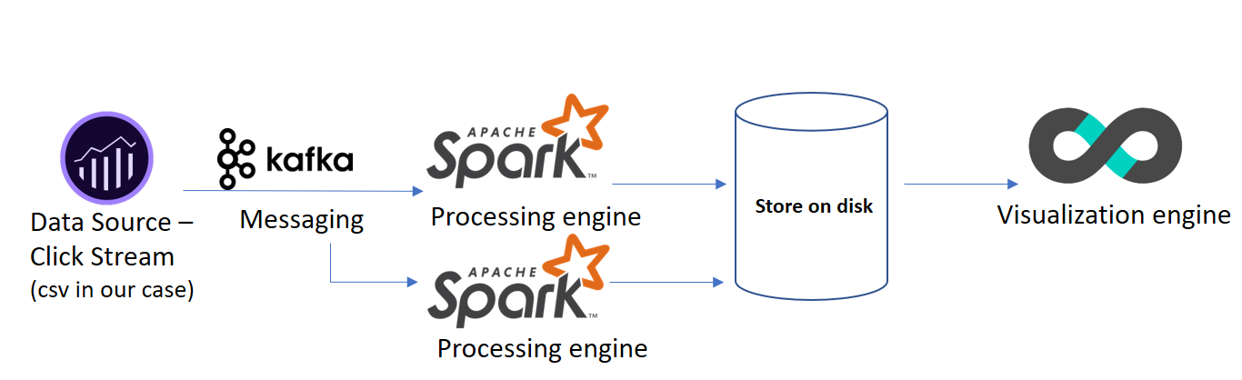
Code Overview
Producer side files | Consumer side files
orders_producer.py | orders_update_state_by_key.py
Producer side files | Consumer side files
clicks_producer.py | orders_update_state_by_key.py
 | clicks_update_state_by_key.py

Slide 11
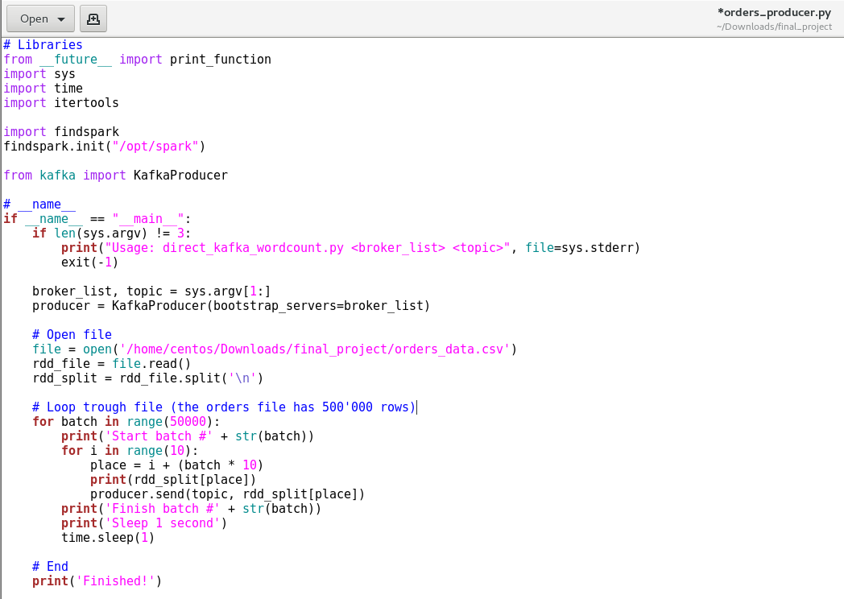
Producer Code

Slide 12
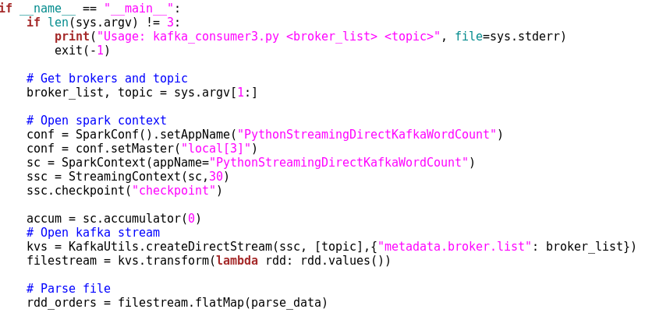
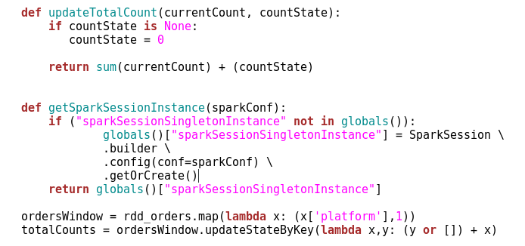
Consumer Code (update_state_by_key.py)

Slide 13
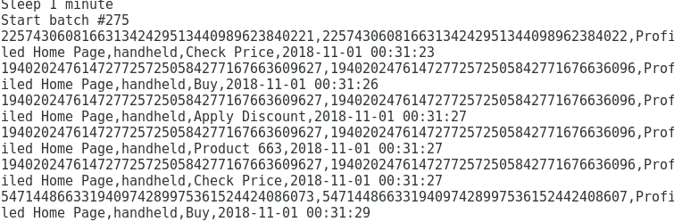
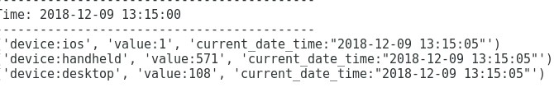
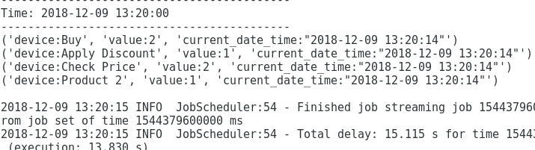
Preliminary Results (Streaming results)
Producer-side results
Consumer-side results

Slide 14

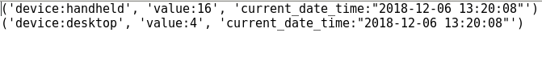
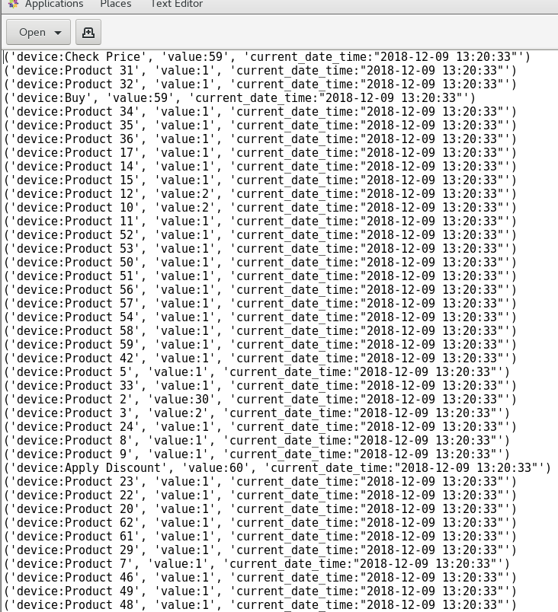
Preliminary Results (Writing to disk)
Part-files inside output_dir
Folders generated
Part-files inside output_dir_clicks

Slide 15
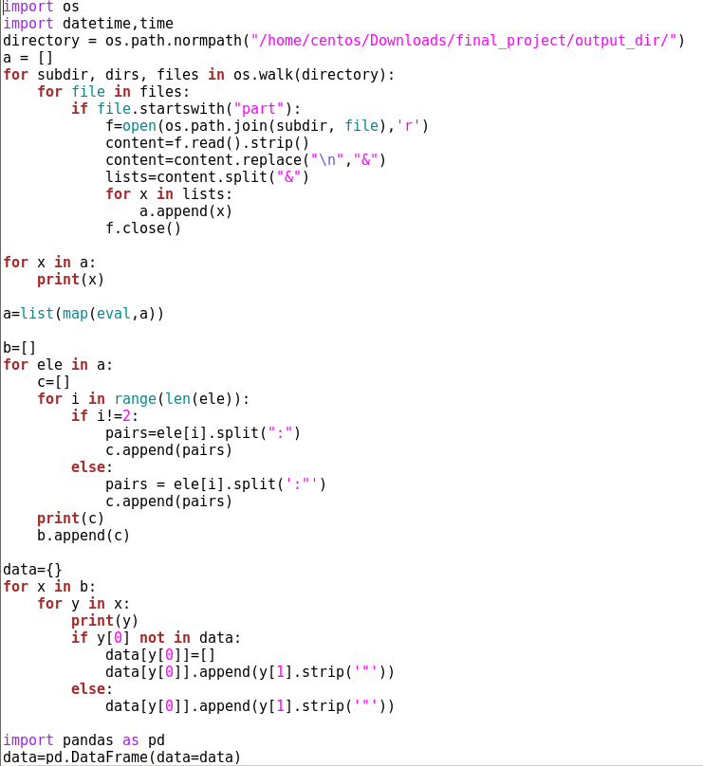
Data Cleaning (Combining part files)

Slide 16
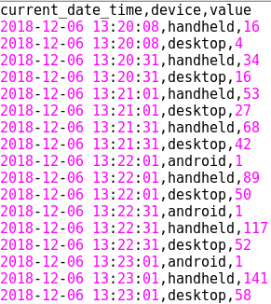
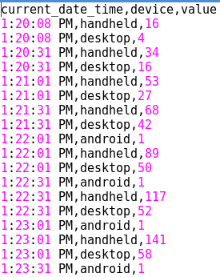
Preliminary Results (File ready for visualization)
Files after running combining_output_files.py

Slide 17
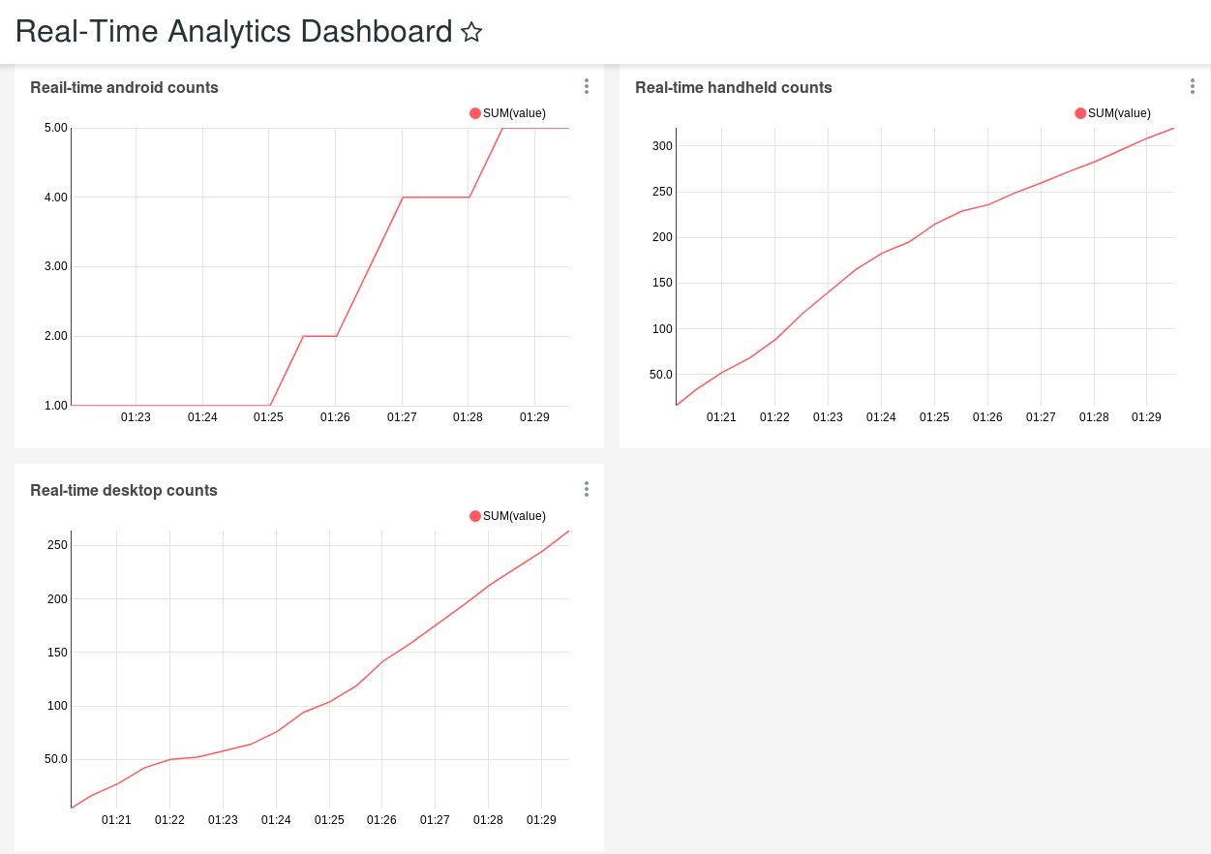
Final Results
Creating dashboard using Apache Superset and visualizing the near-time generated data

Slide 18
Lessons Learned
Apache Kafka combined with Apache Spark processing gives us the computational power to do analysis in real-time
Using Kafka Streams an application can produce data streams at one end and can consume those data streams at multiple end clients.
Kafka processing makes stream processing a bit easier specially for an event-at-a-time processing. It is also useful for stateful processing including distributed joins and aggregations (what we used in our project).
The downside of Kafka Spark infrastructure is -- setting up of the infrastructure itself (specially in making frameworks to communicate with each other).
Another challenge can be working with streaming data (Dstreams) where one must be cognizant of the state of the stream. One other challenge be conversion of (Dstreams to RDD to Spark DF)
Nonetheless, once the infrastructure has been correctly setup: Kafka- Spark infrastructure can be useful for real-time applications. As a result, it has been widely adopted by the industry and companies like New York Times, Airbnb, Trivago, Netflix, etc. use Kafka and Spark for their analytics engines.

Slide 19

Future Work
Instead of writing data back to disk in form of csv files, I would intend to connect to Apache Druid to Spark processed data
The reason of choosing druid as a database is because druid is meant for real-time analytics and it also takes lesser space as compared to any other traditional OLAP database
Another reason is : Druid is considered as one of the best databases for storing time-series data
More information about Druid can be found here

Slide 20
YouTube URLs
Two minute (short): https://youtu.be/EkGusepOISw
15 minutes (long):https://www.youtube.com/watch?v=WPPFJ1Dh2DI&t=29s
7 minute Demo video: https://youtu.be/3HWcTSNimK0

Slide 21
References
https://www.statista.com/statistics/379112/e-commerce-share-of-retail-sales-in-us/
https://towardsdatascience.com/introduction-to-druid-4bf285b92b5a
Code-blocks from CSCI E-63 Big Data Analytics Fall 2018 Class
Databricks Spark Definitive Guide (GitHub Link)
https://medium.com/@trK54Ylmz/real-time-dashboard-with-kafka-and-spark-streaming-53fd1f016249

