Slide 1
Predicting the optimal location for opening a new restaurant in the city of Pune India
Pooja Agarwal
6th March 2020

Slide 2
Predicting best location for a new business is valuable
The success of a restaurant is affected by its location, area population and other attractions in the area
The city of Pune has seen a major growth in population as it is moving ahead in its path of being a hub for IT and Education services
The property costs in Pune are not as high as other major cities of India. But with good average income, this city is a good candidate for business

Slide 3
Data Acquisition and Cleaning
We have taken below data for the city of Pune, India:
Neighborhoods of the city
Map coordinates of the neighborhoods
Various types of venues in 500m of the neighborhoods
Current attraction - a new/undergoing project
Sources of data:
Neighborhoods data is taken from Wikipedia
Coordinates are taken using Google Maps API geocoders
Venues data is taken from Foursquare API

Slide 4
Additional data points
Number of venues in restaurants/food category in the neighborhoods
Neighborhoods with nearby venues like IT Center, Malls, Multiplexes or Cineplex, Education centers, Airport will be given preference in selection
Neighborhoods with high rate of property sales will be further given preference
Distance of neighborhood from city’s center is also important factor

Slide 5
Methodology
Highlight areas with fewer numbers of restaurants
Location coordinates can be fetched using Foursquare API
Get data of top 10 trending most famous venues in each neighborhood
Use this data to create K-mean clusters and plot using folium
Consider additional factors like property tax and distance from city’s center

Slide 6
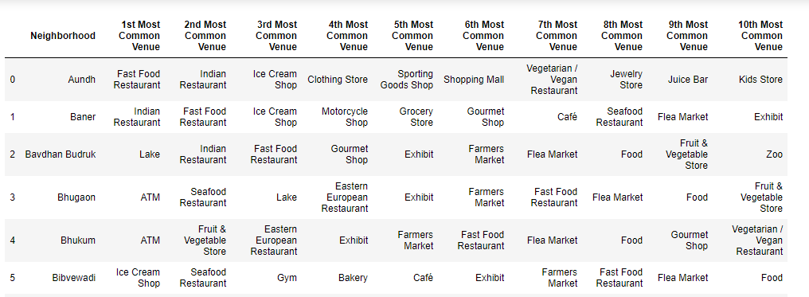
Exploratory Data Analysis Data with 10 most famous venues data for each neighborhood

Slide 7
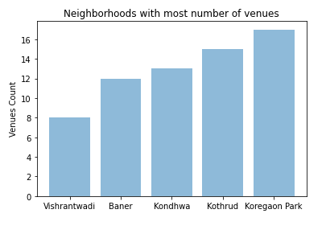
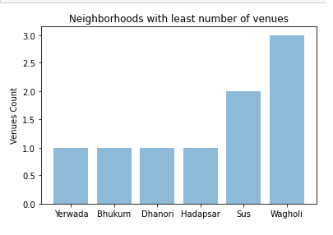
Neighborhoods with 5 most and least venue count

Slide 8
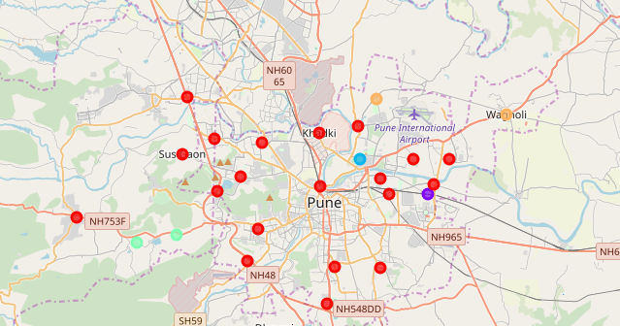
Neighborhood Clusters based on top 10 most famous venues

Slide 9
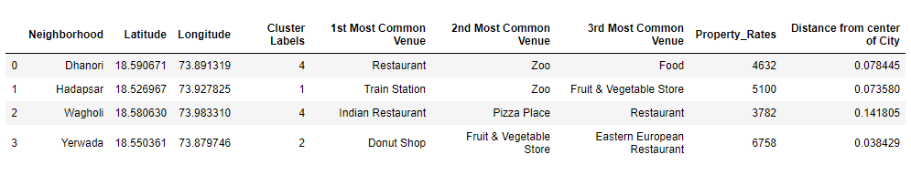
Optimal Options Final data output

Slide 10
Results and Discussion
Our analysis shows that the areas identified in the dataframe are with low density of venues as compared to other areas of the city. Interesting to note that three of these areas are not very far from the city center.
On further analyzing these areas on factors like population density, and other major attractions in the area, we see that the area 'Yerwada' contains a lot of Business Parks, big Hotels, golf course ground and more. Even though property rates are a nit high but this area also has least distance from city center.
Another location that looks promising is 'Hadapsar' where on further analysis we found that a lot of new construction is going on in this area. And it is nearby to international airport.

Slide 11
Conclusion
The purpose of this project was to identify an optimal location to open a new restaurant in the city of Pune India.
Using our analysis, we have come up with a couple of suitable neighborhoods
The results can help an interested audience to take an informed decision. As there is no limitation to data, more factors can be taken into account along with above information to finalize a location. Details like new/ongoing projects, Business Parks or Cineplex in the area, connectivity of metro lines to the area, population of the area etc. are few factors that can add value to take a decision.

Slide 12
References
Google geocoder API
Foursquare API
https://www.99acres.com/property-rates-and-price-trends-in-pune
https://en.wikipedia.org/wiki/List_of_neighbourhoods_in_Pune

