Slide 1
Digital Portfolio
STUDENT NAME:AGASH.K
REGISTER NO AND NMID: 24132251802521002
DEPARTMENT:B.Sc computer science
COLLEGE: COLLEGE/ UNIVERSITY: government arts and science College vanur/annamalai University

Slide 2
PROJECT TITLE
Student Digital Portfolio Structure
1. Project Title
A clear, concise, and meaningful name for your project.
Example: *"Smart Waste Management System using

Slide 3


AGENDA
Problem Statement
Project Overview
End Users
Tools and Technologies
Portfolio design and Layout
Features and Functionality
Results and Screenshots
Conclusion
Github Link
3/21/2024 Annual Review

Slide 4

PROBLEM STATEMENT
Define the real-world problem you are solving. Explain why it matters and what challenges exist. (e.g., "Farmers struggle with water wastage due to uncontrolled irrigation, leading to reduced crop yield.")

Slide 5

PROJECT OVERVIEW
Short summary of your project idea. Describe the core concept in simple words. Mention what makes it unique.

Slide 6

WHO ARE THE END USERS?
Who will benefit from your project? Identify primary and secondary users. (e.g., Farmers, Students, Teachers, Businesses, General Public, etc.)

Slide 7

TOOLS AND TECHNIQUES
List the software, programming languages, frameworks, and methodologies used. (e.g., Python, TensorFlow, Arduino, Figma, Agile, SQL, HTML/CSS, etc.)

Slide 8
POTFOLIO DESIGN AND LAYOUT
How you've designed your portfolio section for this project. Mention color scheme, typography, navigation, and layout. (Tip: Keep it minimal, consistent, and user-friendly.)
8

Slide 9
FEATURES AND FUNCTIONALITY
List the key features of your project. Explain how it works step by step. (e.g., "IoT sensors collect soil moisture data ← data sent to cloud → mobile app notifies farmer → automatic irrigation triggered.")

Slide 10
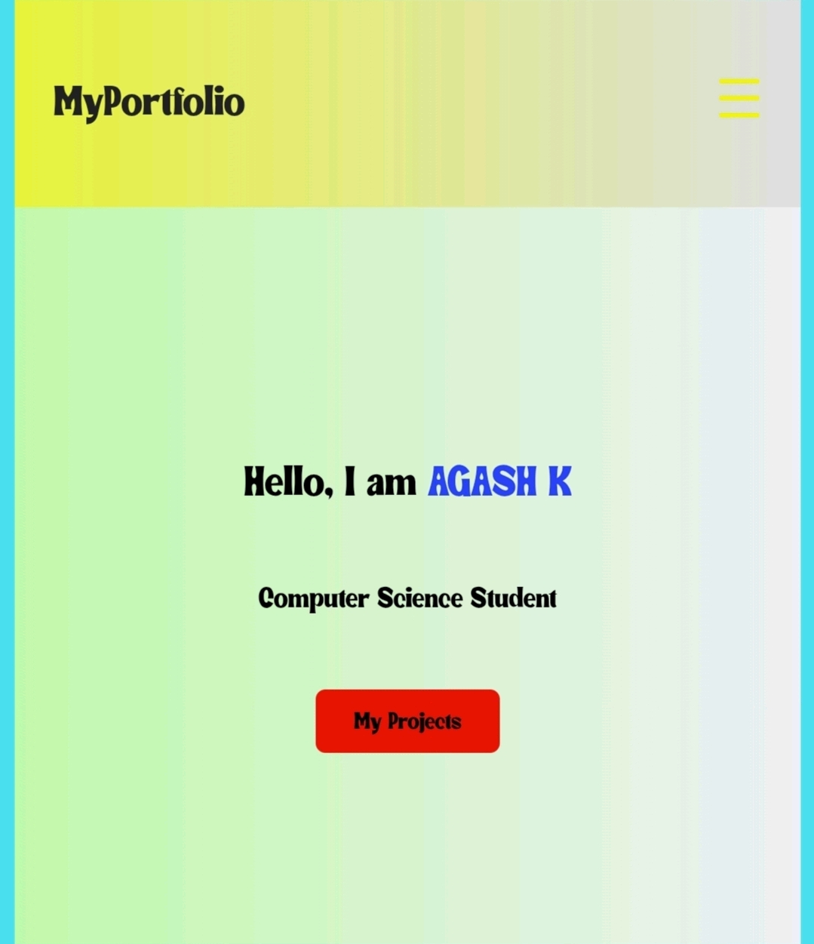
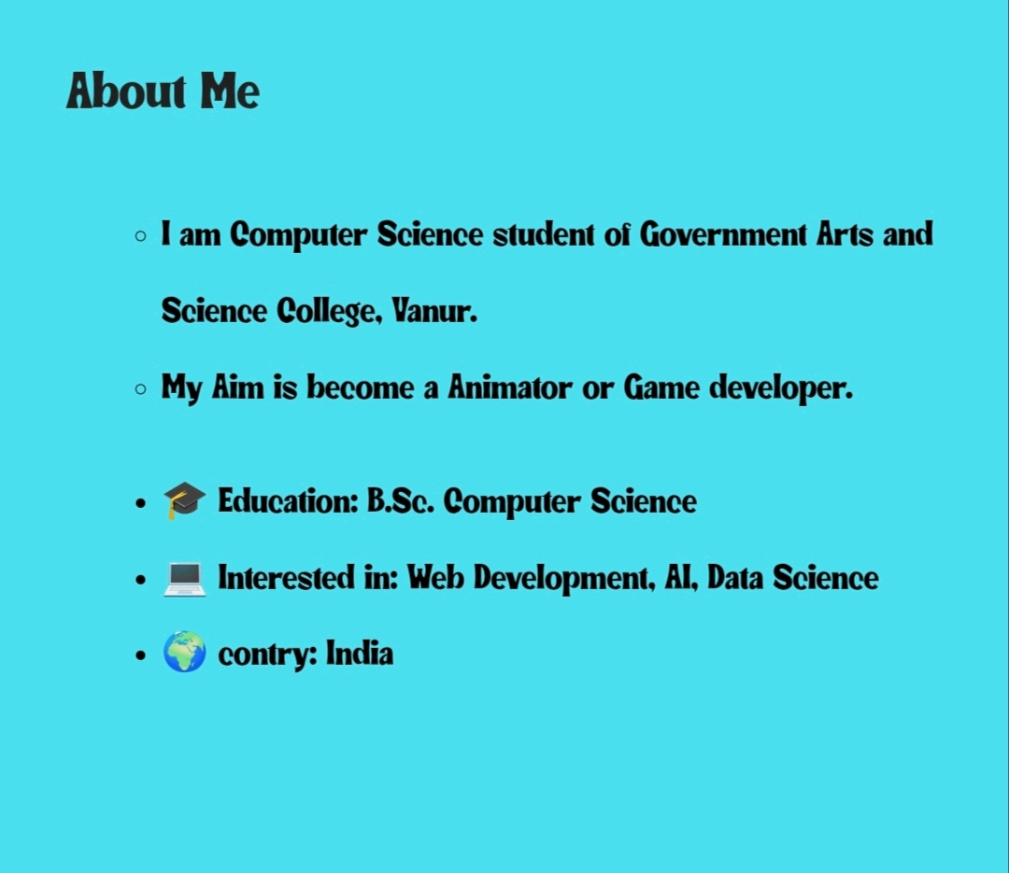

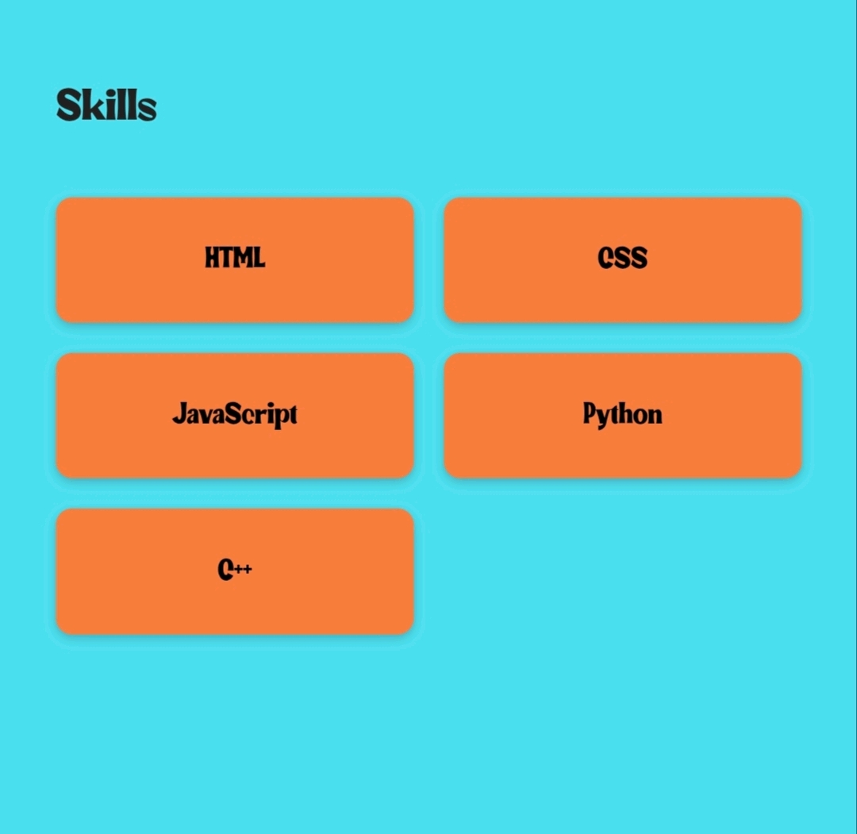
RESULTS AND SCREENSHOTS
3/21/2024 Annual Review
10

Slide 11
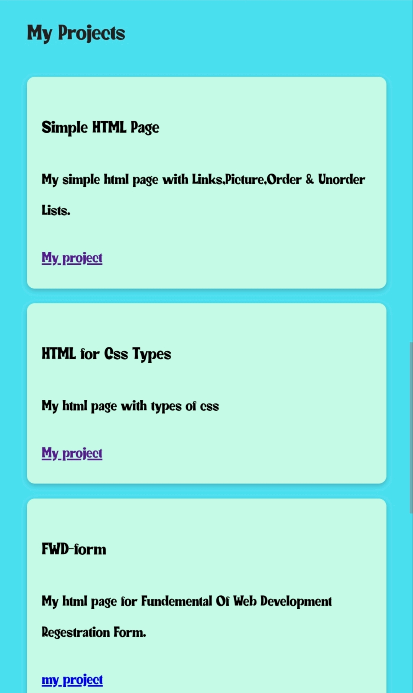
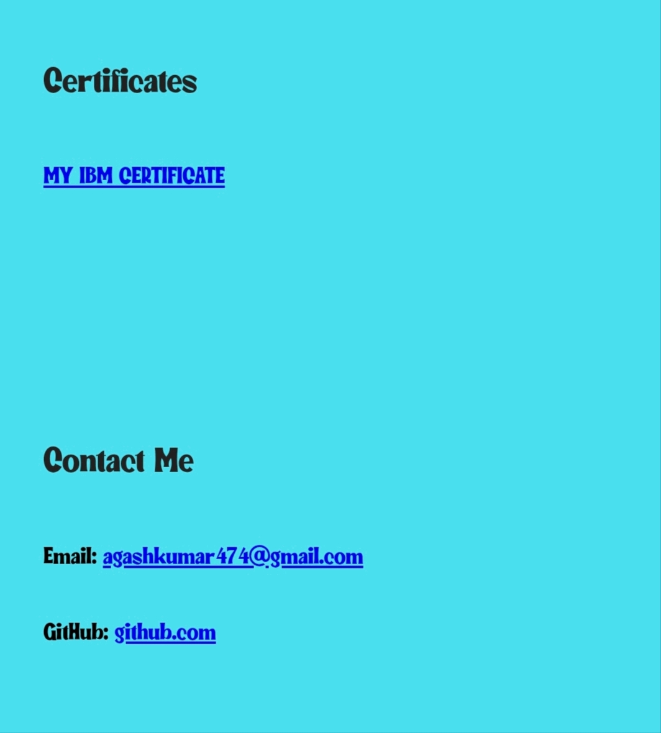

Slide 12
CONCLUSION
Summarize what you achieved. Mention lessons learned. Suggest future improvements or scalability options.
11

Slide 13
GITHUB LINK
FOR MORE CONTEXT ME ON GITHUB
https://github.com/agashkumar474-cyber/AGASH-K

