Slide 2
DO NOT REPRINT
© FORTINET
FortiManager Study
Guide
for FortiManager 6.2

Slide 3



DO NOT REPRINT
© FORTINET
Fortinet Training
http://www.fortinet.com/training Fortinet Document Library http://docs.fortinet.com
Fortinet Knowledge Base
http://kb.fortinet.com
Fortinet Forums
https://forum.fortinet.com
Fortinet Support
https://support.fortinet.com
FortiGuard Labs
http://www.fortiguard.com
Fortinet Network Security Expert Program (NSE)
https://www.fortinet.com/support-and-training/training/network-security-expert-program.html
Feedback
Email: courseware@fortinet.com
6/27/2019

Slide 4

DO NOT REPRINT
© FORTINET
TABLE OF CONTENTS
01 Introduction and Initial Configuration 4 02 Administration and Management 42 03 Device Registration 98 04 Device Level Configuration and Installation 142 05 Policy and Objects 193 06 SD-WAN and Security Fabric 247 07 Diagnostics and Troubleshooting 280 08 Additional Configuration 331

Slide 5
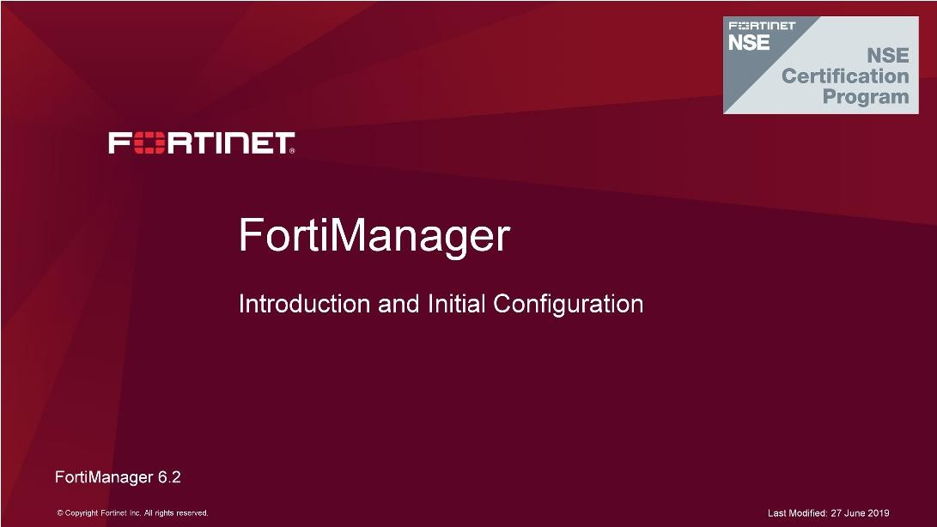
DO NOT REPRINT
© FORTINET
Introduction and Initial Configuration
In this lesson, you will learn the basics of FortiManager. This includes how FortiManager fits into your existing network architecture.
FortiManager provides centralized policy provisioning, configuration, and update management for various Fortinet security devices.
FortiManager 6.2 Study Guide
‹#›

Slide 6
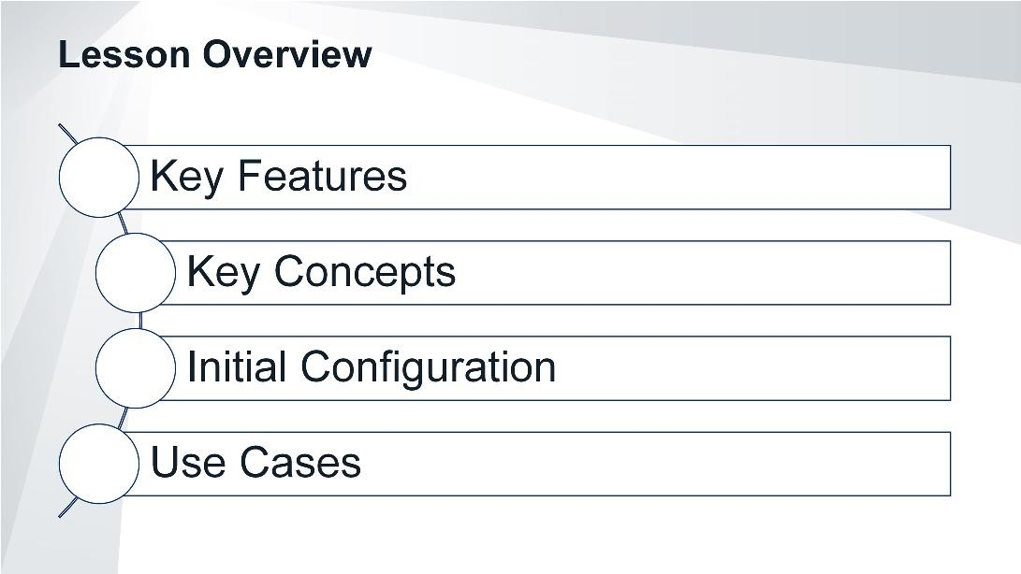
DO NOT REPRINT
© FORTINET
Introduction and Initial Configuration
In this lesson, you will explore the topics shown on this slide.
FortiManager 6.2 Study Guide
‹#›

Slide 7
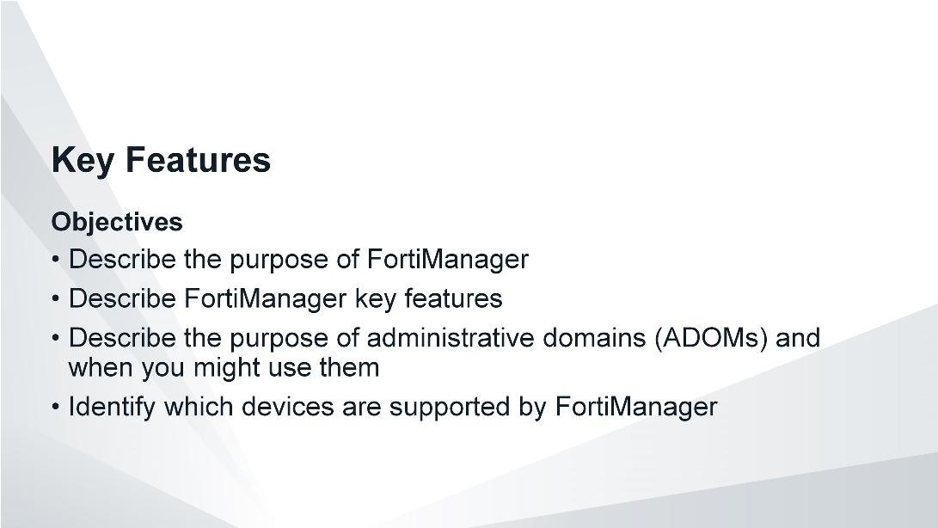
DO NOT REPRINT
© FORTINET
Introduction and Initial Configuration
After completing this section, you should be able to achieve the objectives shown on this slide.
By demonstrating competence in using FortiManager’s key features, you will be able to use the device effectively in your own network.
FortiManager 6.2 Study Guide
‹#›

Slide 8
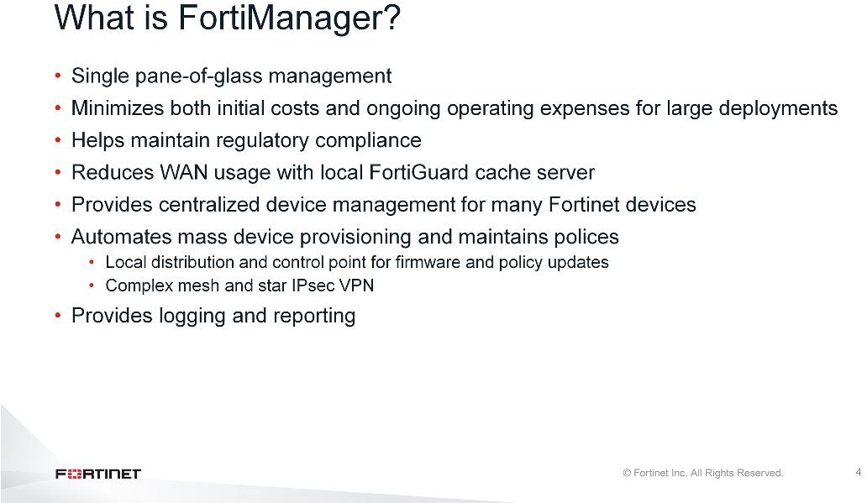
DO NOT REPRINT
© FORTINET
Introduction and Initial Configuration
When should you use FortiManager in your network?
In large enterprises and managed security service providers (MSSPs), the size of the network introduces challenges that smaller networks don’t have: mass provisioning; scheduling rollout of configuration changes; and maintaining, tracking, and auditing many changes.
Centralized management through FortiManager can help you to more easily manage many deployment types with many devices, and to reduce cost of operation.
What can FortiManager do?
Provision firewall policies across your network
Act as a central repository for configuration revision control and security audits
Deploy and manage complex mesh and star IPsec VPNs
Act as a private FortiGuard distribution server (FDS) for your managed devices
Script and automate device provisioning, policy changes, and more with JSON APIs
FortiManager 6.2 Study Guide
‹#›

Slide 9
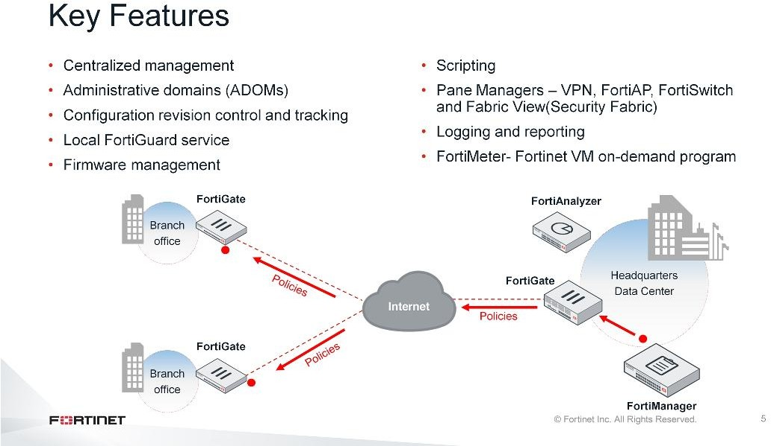
DO NOT REPRINT
© FORTINET
Introduction and Initial Configuration
FortiManager can help you to better organize and manage your network. Key features of FortiManager include:
Centralized management: Instead of logging in to hundreds of FortiGates individually, you can use FortiManager to manage them all from a single console.
Administrative domains (ADOMs): FortiManager can group devices into geographic or functional ADOMs, ideal if you have a large team of network security administrators.
Configuration revision control: Your FortiManager keeps a history of all configuration changes. You can schedule FortiManager to deploy a new configuration or revert managed devices to a previous configuration.
Local FortiGuard service provisioning: To reduce network delays and minimize Internet bandwidth usage, your managed devices can use FortiManager as a private FortiGuard Distribution Network (FDN) server.
Firmware management: FortiManager can schedule firmware upgrades for managed devices.
Scripting: FortiManager supports CLI-based and TCL-based scripts for configuration deployments.
Pane Managers (VPN, FortiAP, FortiSwitch, Fabric View): FortiManager management panes simplify the deployment and administration of VPN, FortiAP, FortiSwitch, and Fabric View.
Logging and reporting: Managed devices can store logs on FortiManager. From that log data, you can generate SQL-based reports, because FortiManager has many of the same logging and reporting features as FortiAnalyzer.
FortiMeter: Provides large MSSPs with a cost-effective way of managing their client’s security needs. The FortiManager metering module reports the traffic volume handled by the special FortiOS-VM to FortiGuard or FortiCare, which manages the point calculations.
FortiManager 6.2 Study Guide
‹#›

Slide 10
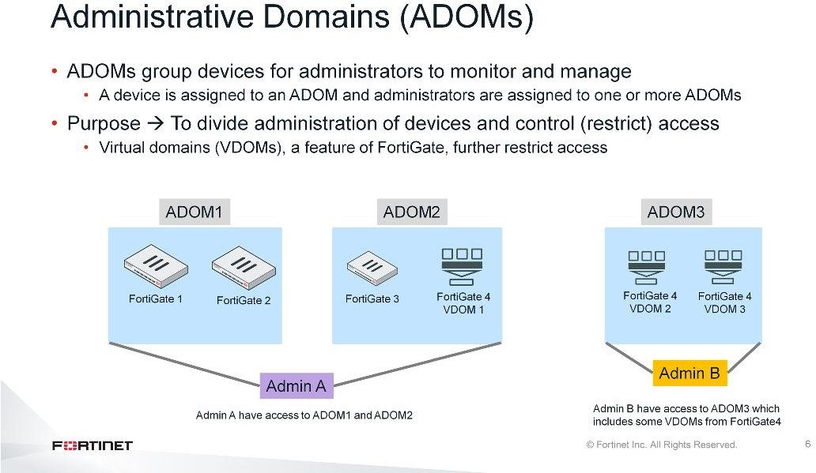
DO NOT REPRINT
© FORTINET
Introduction and Initial Configuration
Administrative domains (ADOMs) enable the admin administrator to create groupings of devices for administrators to monitor and manage. For example, administrators can manage devices specific to their geographic location or business division.
The purpose of ADOMs is to divide administration of devices by ADOM and to control (restrict) administrator access. If virtual domains (VDOMs) are used, ADOMs can further restrict access to only data from a specific device’s VDOM.
FortiManager 6.2 Study Guide
‹#›

Slide 11
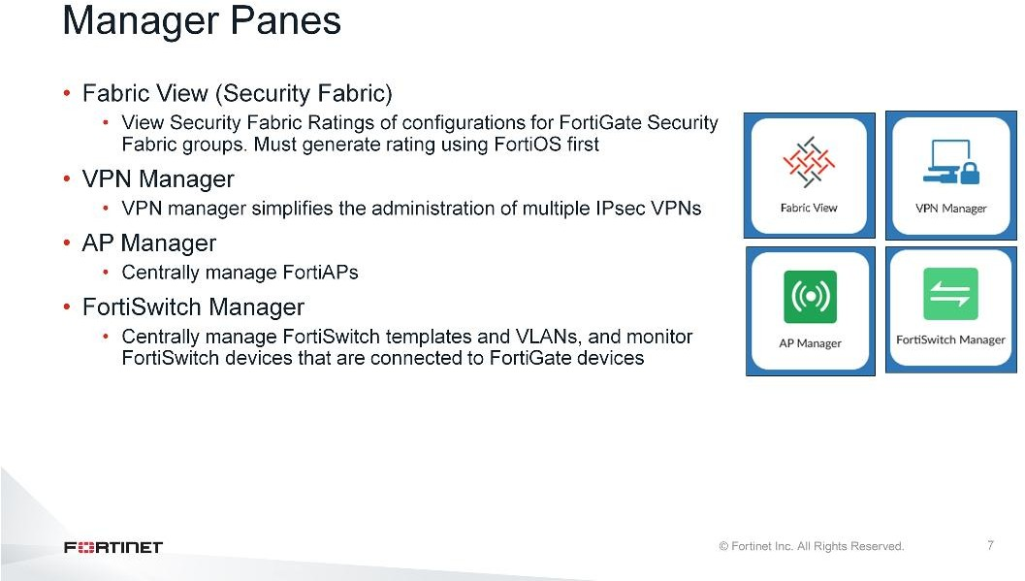
DO NOT REPRINT
© FORTINET
Introduction and Initial Configuration
FortiManager enables you to manage your Fortinet devices centrally using manager panes.
Fabric View (Security Fabric): The Fabric View pane is displayed when FortiManager is managing FortiGate units that have Security Fabric enabled and are part of a Security Fabric group. You can view Security Fabric Ratings of configurations for FortiGate Security Fabric groups. You must generate the Security Fabric Ratings by using FortiOS before you can view the information in FortiManager.
VPN Manager: On the VPN manager pane, you can configure IPsec VPN settings that you can install on multiple devices. The settings are stored as objects in the objects database. You push the IPsec VPN settings to one or more devices by installing a policy package. Enabling VPN Manager for an ADOM overrides existing VPN configurations for managed devices in that ADOM. Mixed-mode VPN allows VPNs to be concurrently configured through VPN Manager and on the FortiGate device in Device Manager.
AP Manager: The AP Manager pane allows you to manage FortiAP devices that are controlled by FortiGate devices that are managed by the FortiManager. Administrator can use Wi-Fi templates to easily manage and distribute AP profiles, SSIDs, and Wireless Intrusion Detection System (WIDS) profiles. Administrator also can monitor all wireless cients and check AP`s health.
FortiSwtich Manager: The FortiSwitch Manager pane enables you to centrally manage FortiSwitch templates and VLANs, and monitor FortiSwitch devices that are connected to FortiGate devices. You can configure multiple templates for specific FortiSwitch platforms that can be assigned to multiple devices.
FortiManager 6.2 Study Guide
‹#›

Slide 12
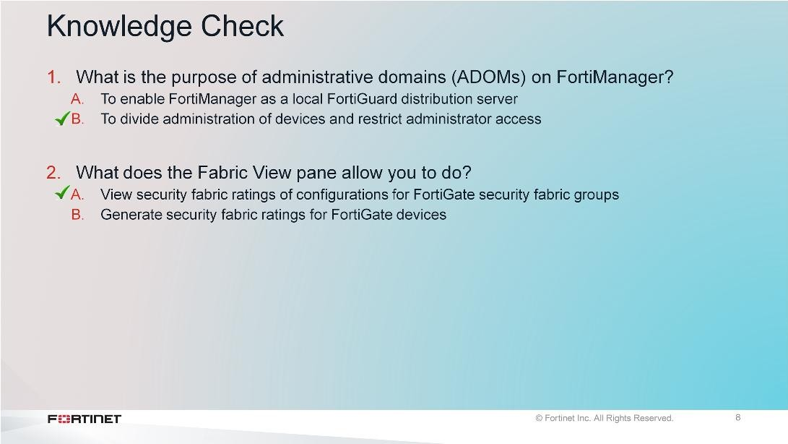
DO NOT REPRINT
© FORTINET
Introduction and Initial Configuration
FortiManager 6.2 Study Guide
‹#›

Slide 13
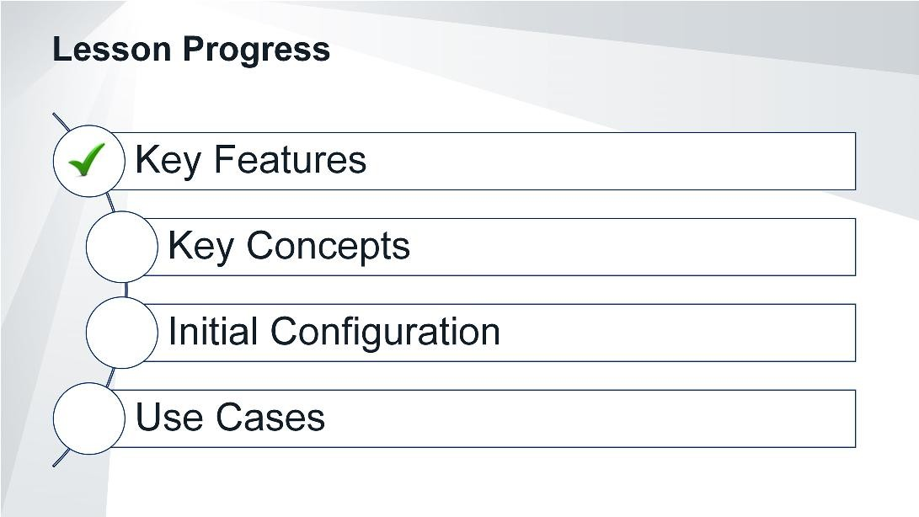
DO NOT REPRINT
© FORTINET
Introduction and Initial Configuration
Good job! You now understand FortiManager’s key features.
Now, let’s explore FortiManager’s key concepts.
FortiManager 6.2 Study Guide
‹#›

Slide 14
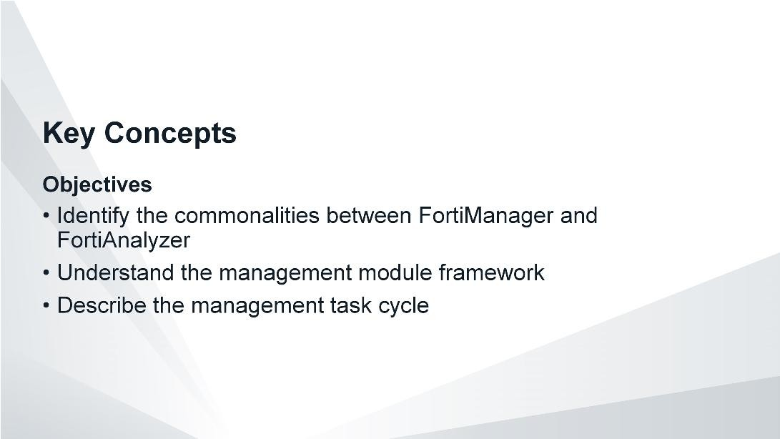
DO NOT REPRINT
© FORTINET
Introduction and Initial Configuration
After completing this section, you should be able to achieve the objectives shown on this slide.
By demonstrating competence in understanding FortiManager’s key concepts, you will be able to more effectively use FortiManager in your network.
FortiManager 6.2 Study Guide
‹#›

Slide 15
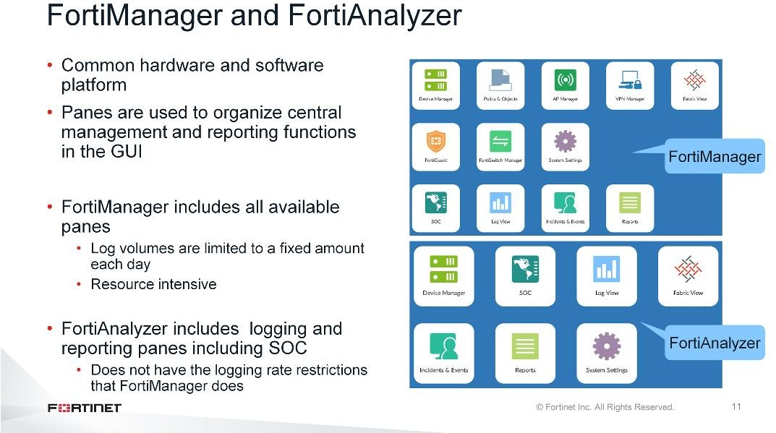
DO NOT REPRINT
© FORTINET
Introduction and Initial Configuration
FortiManager and FortiAnalyzer run on the same hardware and software platform. Like FortiAnalyzer, FortiManager can also act as a logging and reporting device, but there are logging rate restrictions. Also, FortiManager will require additional resources (CPU, memory, disk) to process logs and reports.
FortiManager can be used as a fully functional logging and reporting device for low volumes of logs, but it needs to use some of its system resources for other features, such as configuration management.
If you have high log volumes, you should use a dedicated FortiAnalyzer.
FortiManager 6.2 Study Guide
‹#›

Slide 16
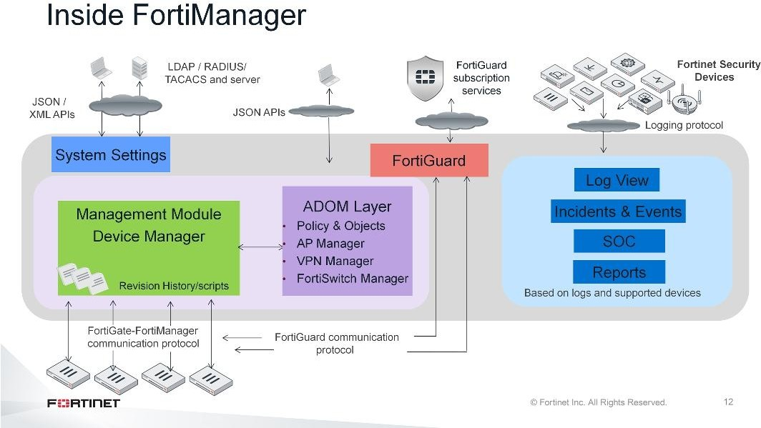
DO NOT REPRINT
© FORTINET
Introduction and Initial Configuration
Inside FortiManager there are management layers that are represented as panes in the GUI. For example, the device management module is represented by the Device Manager pane, which you use to perform revision history and scripting.
Let’s look at the management layers in more detail.
FortiManager 6.2 Study Guide
‹#›

Slide 17
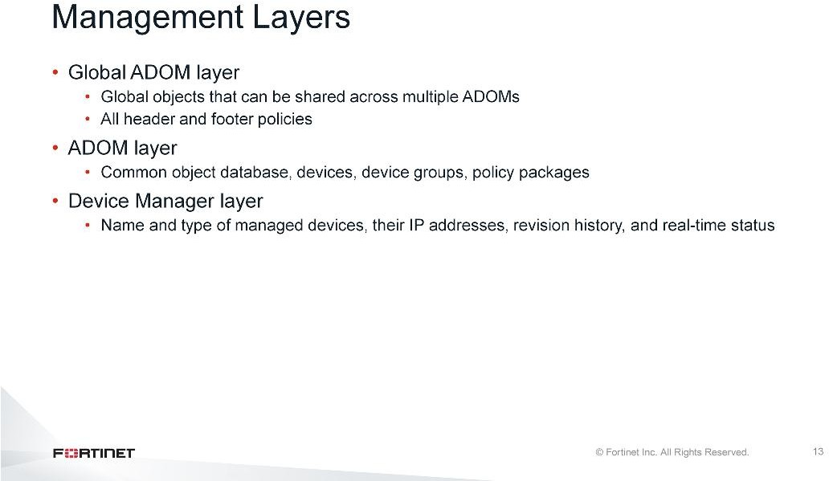
DO NOT REPRINT
© FORTINET
Introduction and Initial Configuration
To organize and efficiently manage a large scale network, FortiManager has multiple layers:
The Global ADOM layer has two key pieces: the global object database, and all header and footer policy packages. Header and footer policy packages envelop each ADOM’s policies. An example of where this would be used is in a carrier environment, where the carrier allows customer traffic to pass through their network, but would not allow the customer to have access to the carrier’s network infrastructure.
The ADOM layer is where policy packages are created, managed, and installed on managed devices or device groups. Multiple policy packages can be created here. The ADOM layer has one common object database for each ADOM. The databases contains information such as addresses, services, and security profiles.
The Device Manager layer records information on devices that are centrally managed by the FortiManager device, such as the name and type of device, the model, IP address, current firmware installed, revision history, and real-time status.
Let’s look at how these layers are related.
FortiManager 6.2 Study Guide
‹#›

Slide 18
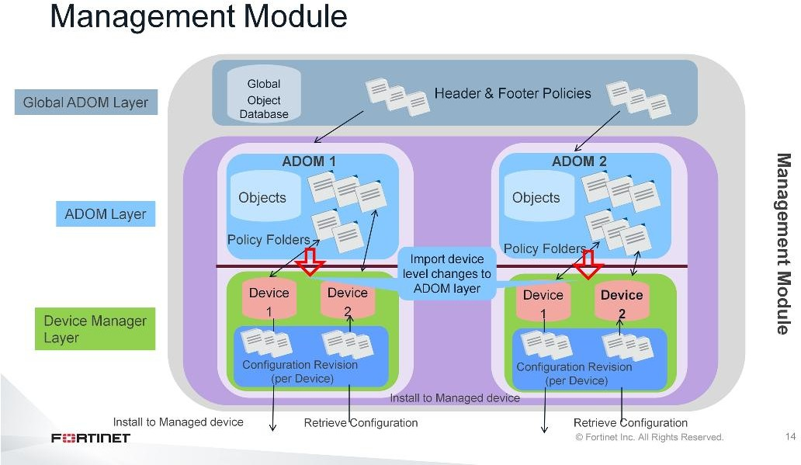
DO NOT REPRINT
© FORTINET
Introduction and Initial Configuration
Understanding the layers of FortiManager’s device management model is important.
In the Global ADOM layer, you create header and footer policy rules. These policy rules can be assigned to multiple ADOMs. If multiple ADOM policy packages require the same policies and objects, you can create them in this layer, so that you don’t have to maintain copies in each ADOM.
In the ADOM layer, objects and policy packages in each ADOM share a common object database. Policy packages can be created, or they can be imported from and installed on many managed devices at once.
In the Device Manager layer, device settings can be configured and installed per device. If a configuration
change is detected—whether the change is made locally or on the FortiManager—then, FortiManager compares the current configuration revision to the changed configuration, and creates a new configuration revision on FortiManager. Whether the configuration change is big or small, FortiManager records it and saves the new configuration. This can help administrators to audit configuration changes, and to revert to a previous revision, if required.
FortiManager 6.2 Study Guide
‹#›

Slide 19
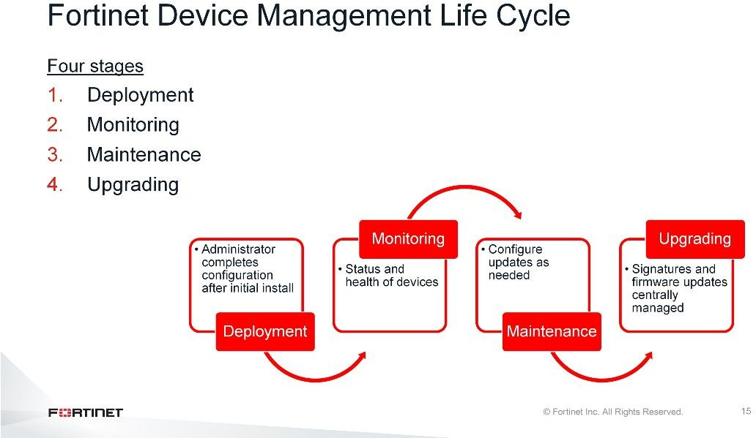
DO NOT REPRINT
© FORTINET
Introduction and Initial Configuration
When you use FortiManager to centrally manage your Fortinet devices, the workflow usually follows this pattern:
Deployment: An administrator configures the Fortinet devices after initial network installation.
Monitoring: The administrator monitors the status and health of devices in the security infrastructure, including resource monitoring and network usage. External threats to your network infrastructure can be monitored and alerts generated to advise.
Maintenance: The administrator performs configuration updates as needed to keep devices up-to-date.
Upgrading: Virus definitions, attack and data leak prevention signatures, web and email filtering services, and device firmware images are all kept current to provide continuous protection.
FortiManager can help reduce workload in each of these phases.
FortiManager 6.2 Study Guide
‹#›

Slide 20
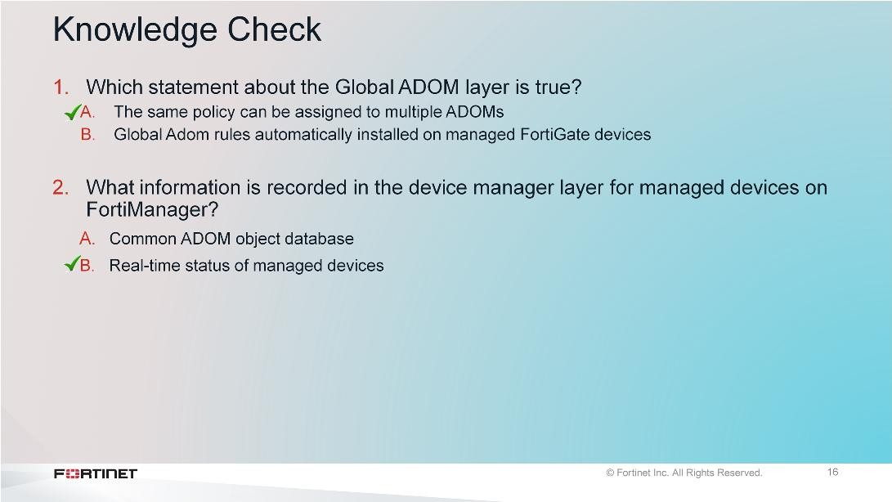
DO NOT REPRINT
© FORTINET
Introduction and Initial Configuration
FortiManager 6.2 Study Guide
‹#›

Slide 21
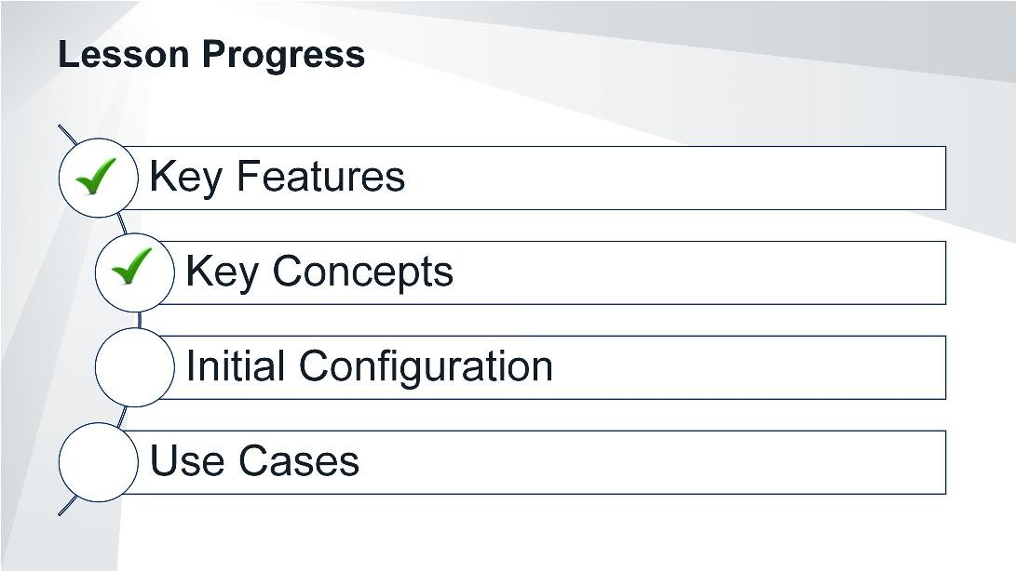
DO NOT REPRINT
© FORTINET
Introduction and Initial Configuration
Good job! You now understand FortiManager’s key concepts.
Now, let’s examine how to initially configure FortiManager.
FortiManager 6.2 Study Guide
‹#›

Slide 22
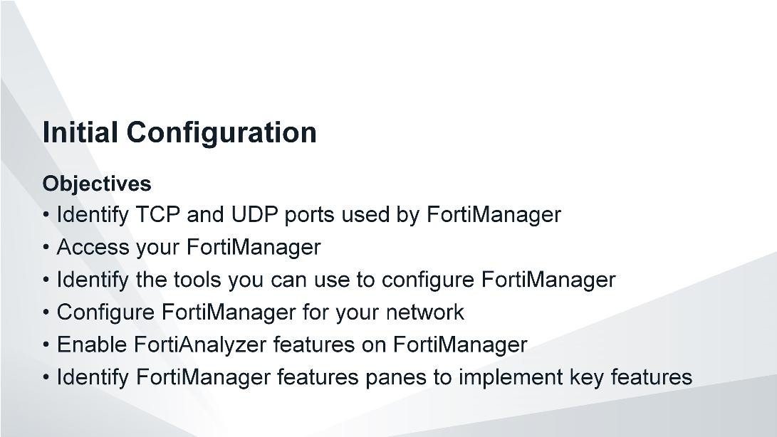
DO NOT REPRINT
© FORTINET
Introduction and Initial Configuration
After completing this section, you should be able to achieve the objectives shown on this slide.
By demonstrating competence of FortiManager’s initial configuration, you will be able to add FortiManager to your network and perform basic administrative tasks.
FortiManager 6.2 Study Guide
‹#›

Slide 23
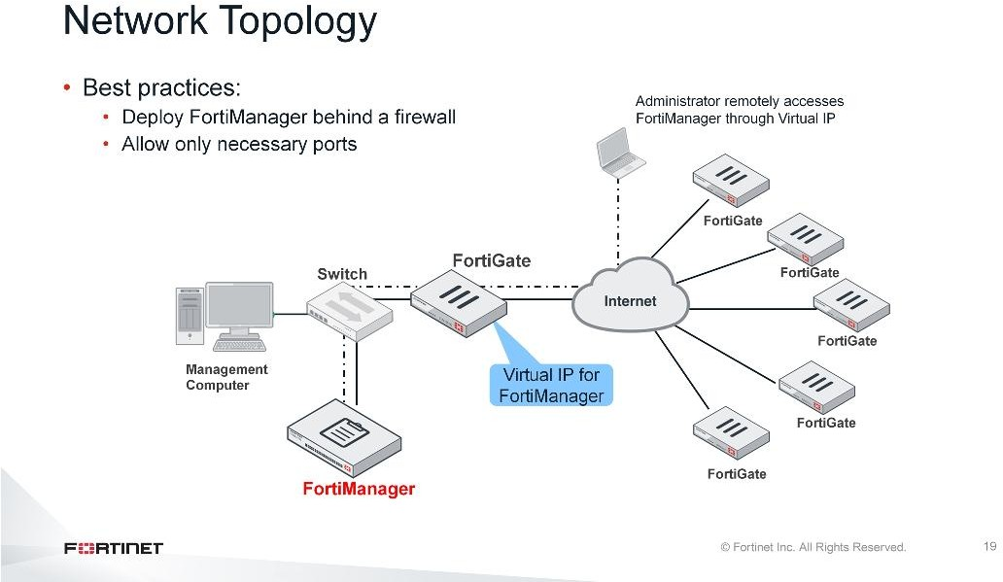
DO NOT REPRINT
© FORTINET
Introduction and Initial Configuration
Often, your first consideration is, “Where should I put FortiManager in my network?”
Typically, you should deploy FortiManager behind a firewall, such as FortiGate. On the perimeter firewall, allow only relevant ports in the firewall policy for FortiManager as a security consideration. If administrators or remote FortiGates will make inbound connections to FortiManager from outside your administrative subnet, such as from the Internet, create a virtual IP.
To safeguard against losing access if your network is down, connect your management computer directly to FortiManager, or through a switch.
FortiManager 6.2 Study Guide
‹#›

Slide 24
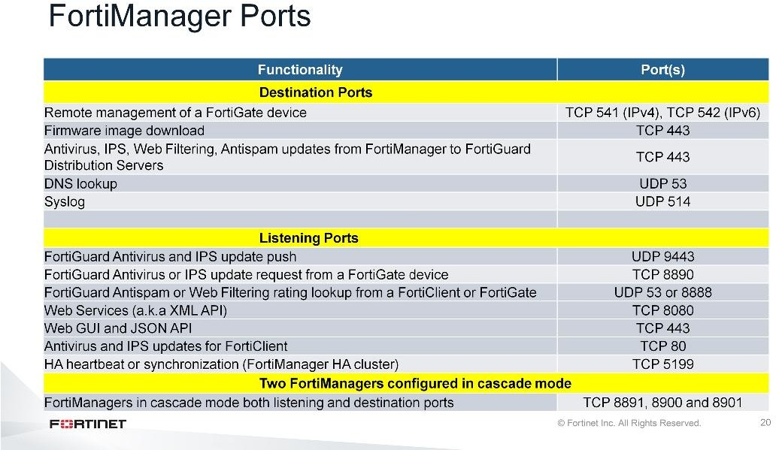
DO NOT REPRINT
© FORTINET
Introduction and Initial Configuration
FortiManager uses many TCP and UDP ports for its tasks. Only the most common default ports used by FortiManager are listed in this table. In addition, FortiManager uses standard management ports such as:
HTTP HTTPS SSH
Port 80 (TCP)
Port 443 (TCP)
Port 22 (TCP)
Especially if your FortiManager is deployed behind a firewall, it is always good to know what ports are being used. This can help you to analyze, diagnose, and resolve common network issues.
FortiManager cascade mode: Optional upstream(cascade-mode) server for FortiGuard services.
FortiManager 6.2 Study Guide
‹#›

Slide 25
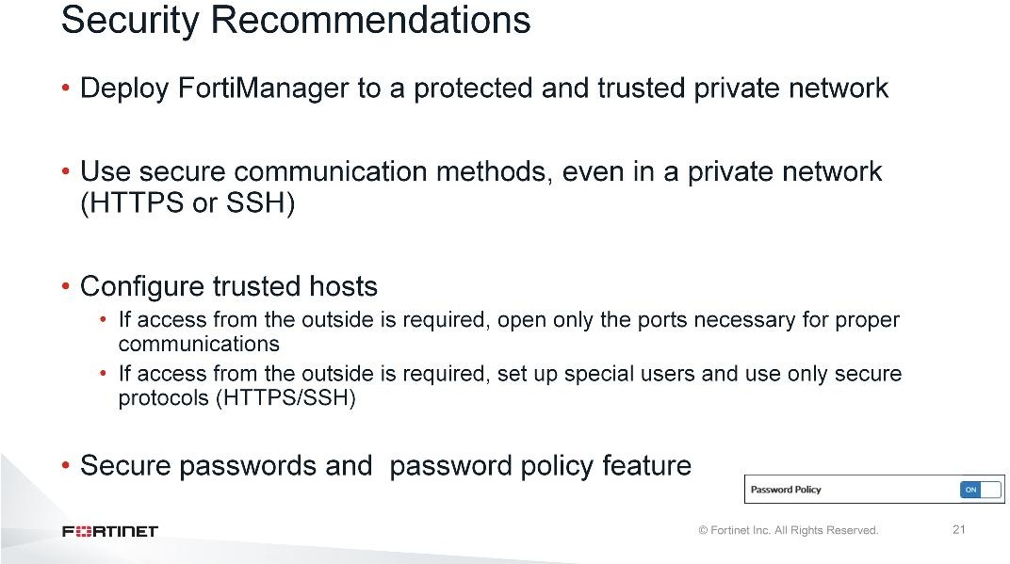
DO NOT REPRINT
© FORTINET
Introduction and Initial Configuration
Before reviewing the configuration settings, it is necessary to discuss the importance of security. Your FortiManager manages all your Fortinet network security devices, so it is vital that data is properly protected.
Here are some security recommendations:
Deploy your FortiManager in a protected and trusted private network. It should never be deployed directly on the Internet.
Always use secure connection methods to do administration: HTTPS for Web-based management or SSH for the CLI. Insecure methods(like HTTP) are plain text, so an attacker can use packet sniffing tools to obtain information that can be used to breach your network.
Use trusted hosts on your users and only allow logins from specific locations. If you do need to open outside access to the device so that remote FortiGates or other devices can connect, only open the ports necessary for this. Additional open ports increases your security risk. If you need to open direct login access from the outside, be sure to set up special user accounts for this and only open protocols that are secure. Secure passwords should also be used, and password policy is highly recommended.
You can enable and configure following password policies:
Minimum Length: Specify the minimum number of characters that a password must be, from 8 to 32.
Default: 8.
Must Contain: Specify the types of characters a password must contain: uppercase and lowercase letters, numbers, and/or special characters.
Admin Password Expires after: Specify the number of days a password is valid for. When the time expires, an administrator will be prompted to enter a new password
FortiManager 6.2 Study Guide
‹#›

Slide 26
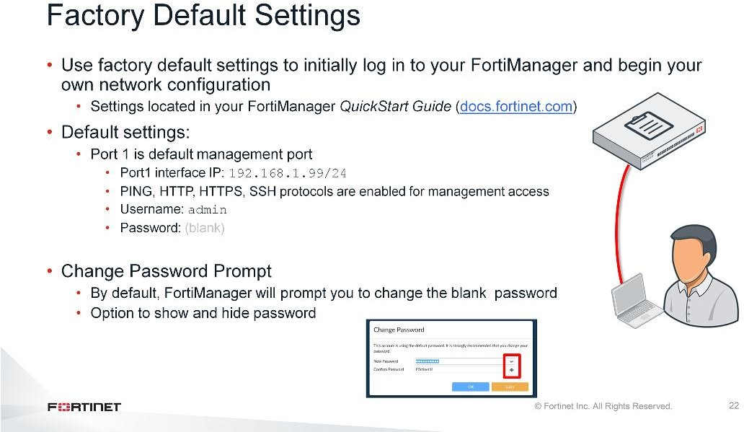
DO NOT REPRINT
© FORTINET
Introduction and Initial Configuration
It is important to know the factory default settings, such as the default user name and password, the port 1 IP address, netmask, and default supported management access protocols, so that you can initially connect to your management computer and configure FortiManager for your network.
You can find the default settings in your model-specific Quick Start Guide. Different FortiManager models have different numbers of ports, but port 1 is the management port and will always have this default IP.
To log in to the FortiManager GUI for the first time, open a browser and enter the URL https:// <the factory default IP address>. Once the login screen appears, use the factory default administrator credentials to log in. The default credentials are, user name admin and a blank password.
By default, when you log into FortiManager with the default blank password, the password change prompt will appear. administrator can change the password at this stage or decide later. Also admin can view or hide password using the show password and hide password toggle icons.
FortiManager 6.2 Study Guide
‹#›

Slide 27
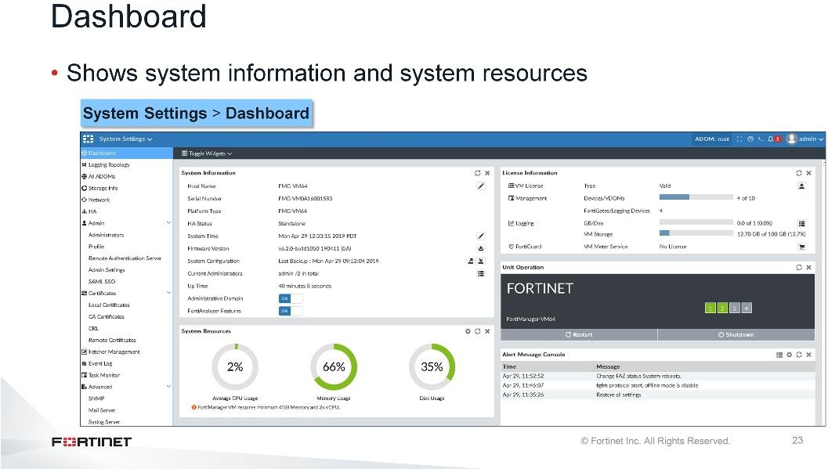
DO NOT REPRINT
© FORTINET
Introduction and Initial Configuration
Under the System Settings > Dashboard, you can see system resources and other widgets, which include:
System Information: Displays basic information about the FortiManager system, such as up time and firmware version. You can also enable or disable Administrative Domain and FortiAnalyzer Features.
System Resources: Displays the real-time and historical usage status of the CPU, memory, and hard disk.
License Information: Displays the number of devices being managed by the FortiManager and the maximum numbers of devices allowed. You can also manually upload a license for FortiManager VM
systems. Add-on licenses can be purchased for high end FortiManager devices to increase the number of device that can be managed.
Unit Operation: Displays status and connection information for the ports of the FortiManager device. It also enables you to shut down and restart the FortiManager, or reformat a hard disk.
Alert Message Console: Displays log-based alert messages for both the FortiManager and connected devices.
FortiManager 6.2 Study Guide
‹#›

Slide 28
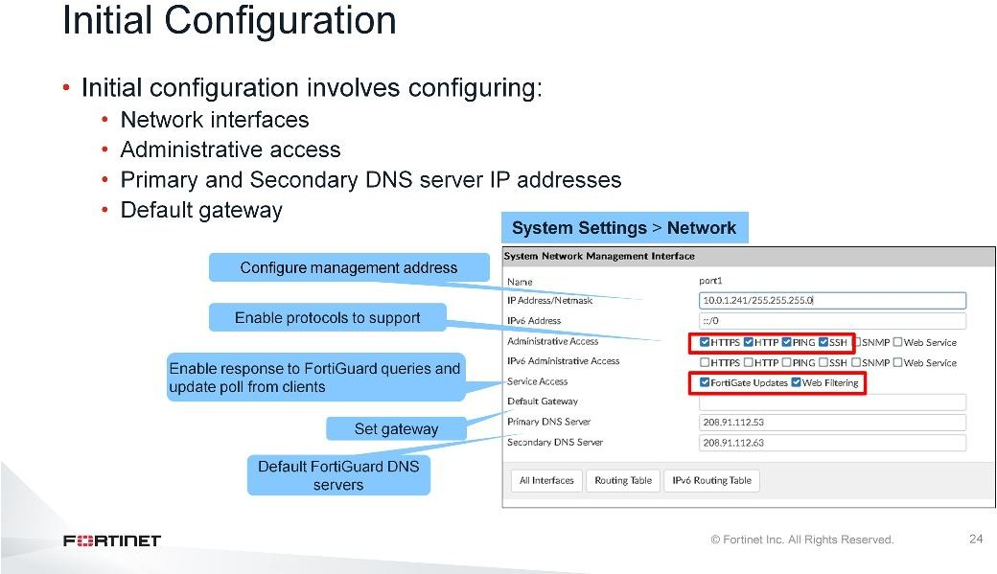
DO NOT REPRINT
© FORTINET
Introduction and Initial Configuration
The initial configuration of FortiManager is very similar to FortiGate. In order to configure FortiManager for your network, you must set the IP address and netmask, select supported administrative access protocols, and specify a default gateway for routing packets. You can do all this from the Network page.
Port1, the management interface, has a default IP address and netmask: 192.168.1.99/24. If your management subnet uses a different subnet, or uses IPv6, change these settings . The IP address must be a unique static IP address. Relatedly, enter the IP of the next hop router in Default Gateway, and specify your DNS servers. By default, FortiGuard DNS servers are configured in DNS server settings, to help guarantee connectivity for FortiGuard downloads and queries. But, you can specify a local DNS server instead.
Service access allows you to enable FortiManager’s response to the requests from managed devices for FortiGuard services on this interface. This includes FortiGate updates and web filtering. By default, all services to managed devices are enabled on port1, and disabled on other ports.
FortiManager 6.2 Study Guide
‹#›

Slide 29
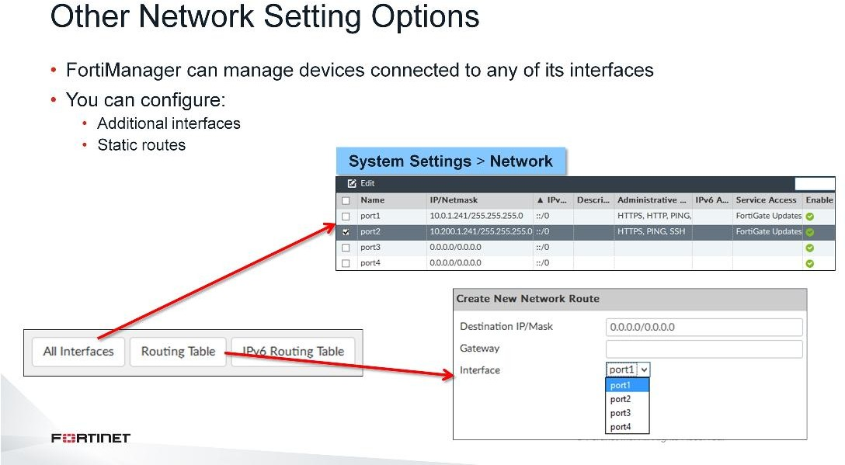
DO NOT REPRINT
© FORTINET
Introduction and Initial Configuration
Based on the your network, you can configure additional interfaces, and you can configure static routes (IPv4 or IPv6) to a different gateway, so that packets are delivered by a different route.
FortiManager 6.2 Study Guide
‹#›

Slide 30
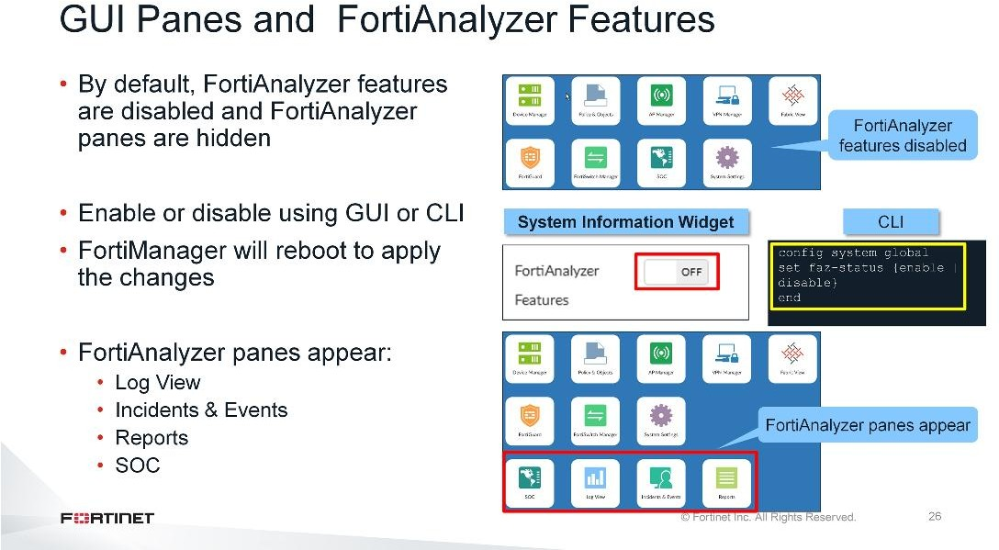
DO NOT REPRINT
© FORTINET
Introduction and Initial Configuration
The FortiManager features panes include:
The Fabric View, Device Manager, Policy & Objects, AP Manager, VPN Manager, FortiSwitch Manager, FortiGuard, SOC, and System Settings panes.
If you want to enable FortiManager to act as a logging and reporting device, you can do that on the FortiManager dashboard or use the CLI. Remember that logging rate restrictions apply. Also, FortiManager will require additional resources (CPU, memory, disk) to process logs and reports.
Determine your network’s maximum logging rate before enabling this feature in order to verify that no logs will be dropped.
When the FortiAnalyzer feature set is enabled on FortiManager, FortiManager will reboot. You’ll also have the following panes:
The Log view pane, which offers log messages from managed devices. You can view the traffic log, event log, or security log information. The Event Monitor pane, where you can configure event handlers based on the log type and logging filters, and specify whether to notify an email address, SNMP server, or syslog server. The Reports pane, which provides reports based on logs from devices.
FortiManager 6.2 Study Guide
‹#›

Slide 31
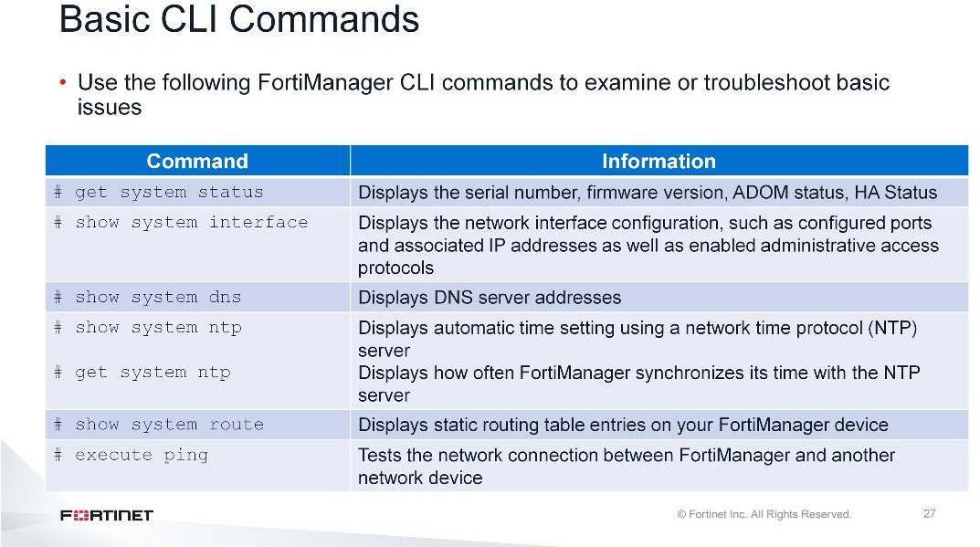
DO NOT REPRINT
© FORTINET
Introduction and Initial Configuration
Similar to FortiOS, you can use the CLI commands shown on this slide to examine or troubleshoot general issues on FortiManager. For example, you can view the general status, interface, and DNS settings of FortiManager.
FortiManager 6.2 Study Guide
‹#›

Slide 32
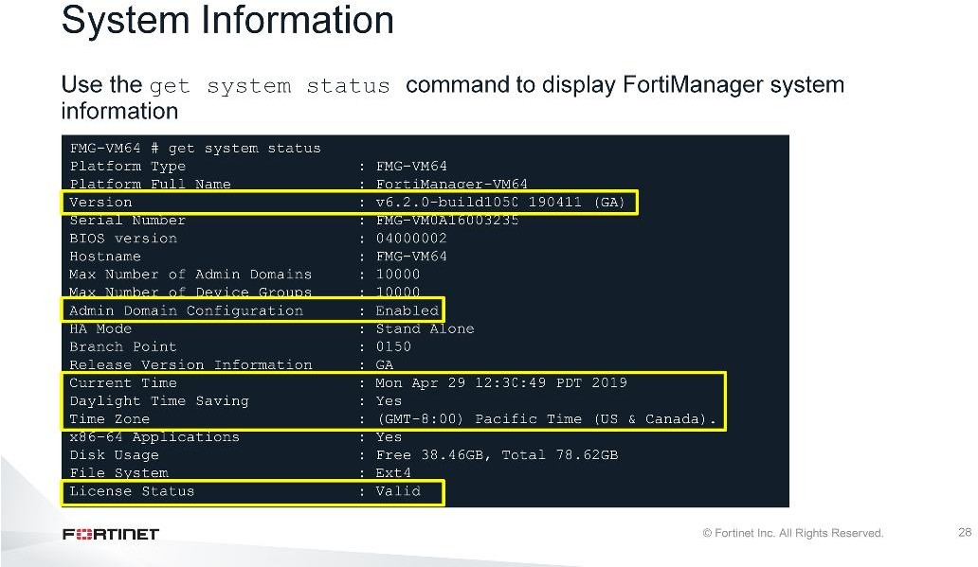
DO NOT REPRINT
© FORTINET
Introduction and Initial Configuration
You can use this command to get basic FortiManager system information, which can be useful for troubleshooting. You can use the command to get information, such as:
Version: Ensure the FortiManager firmware version is compatible with the device you are registering. (See the FortiManager Release Notes for supported firmware versions.)
Admin Domain Configuration: Ensure ADOMs are enabled if attempting to register a non-FortiGate device. Also, it shows you how many ADOMs are supported on the FortiManager model.
Current Time: Ensure your date and time is set according to your needs. For many features to work, including scheduling, FortiManager-FortiGate tunnel negotiations, and logging features, the FortiManager system time must be accurate. While you can manually set the date and time, you should synchronize with a Network Time Protocol (NTP) server.
License Status: Ensure you have a valid licence.
FortiManager 6.2 Study Guide
‹#›

Slide 33
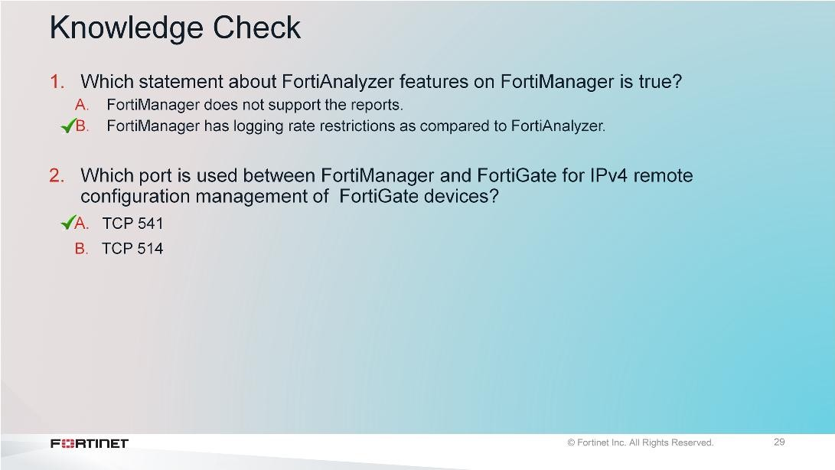
DO NOT REPRINT
© FORTINET
Introduction and Initial Configuration
FortiManager 6.2 Study Guide
‹#›

Slide 34
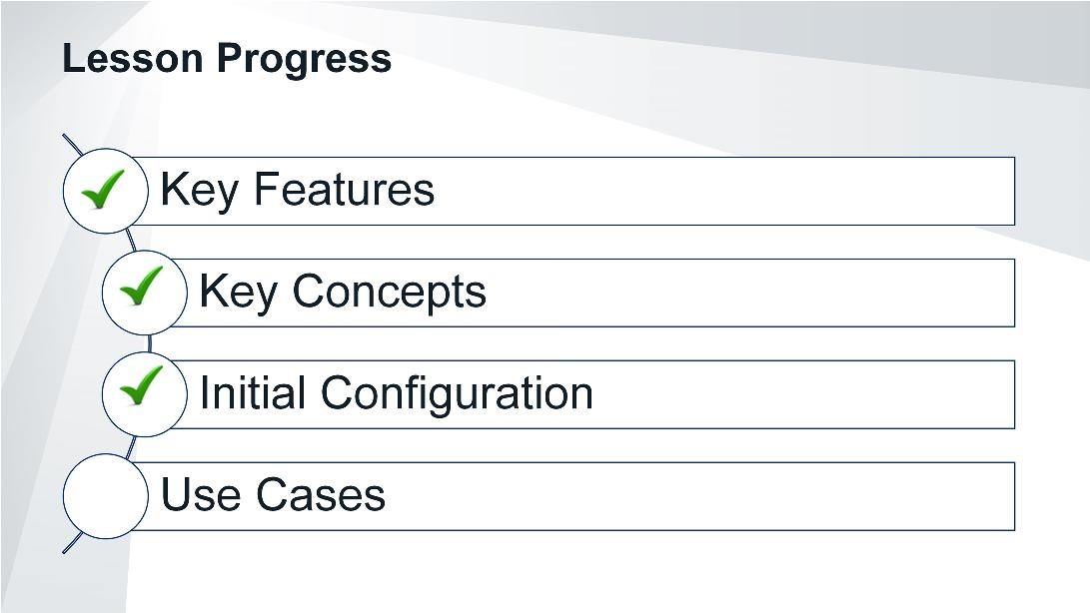
DO NOT REPRINT
© FORTINET
Introduction and Initial Configuration
Good job! You now understand how to initially configure FortiManager.
Now, let’s examine some of the use cases for FortiManager, based on different organizations.
FortiManager 6.2 Study Guide
‹#›

Slide 35
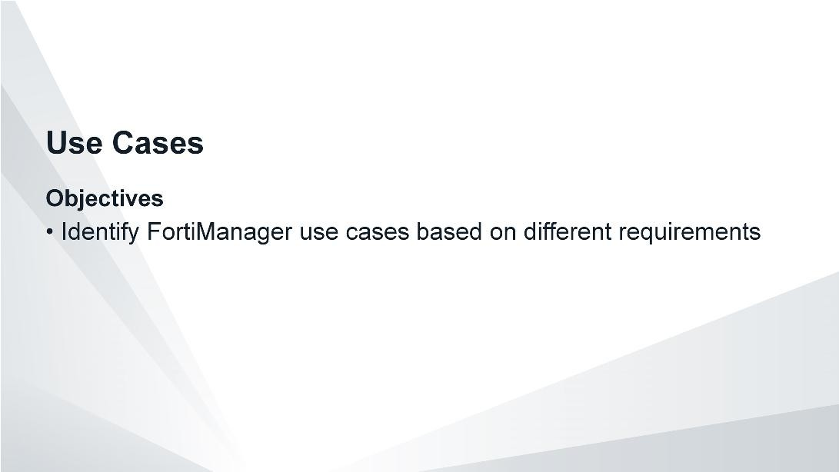
DO NOT REPRINT
© FORTINET
Introduction and Initial Configuration
After completing this section, you should be able to achieve the objectives shown on this slide.
By understanding FortiManager use cases, you will be able to see the different ways in which FortiManager is commonly used in other organizations and, if applicable, employ some of these strategies.
FortiManager 6.2 Study Guide
‹#›

Slide 36
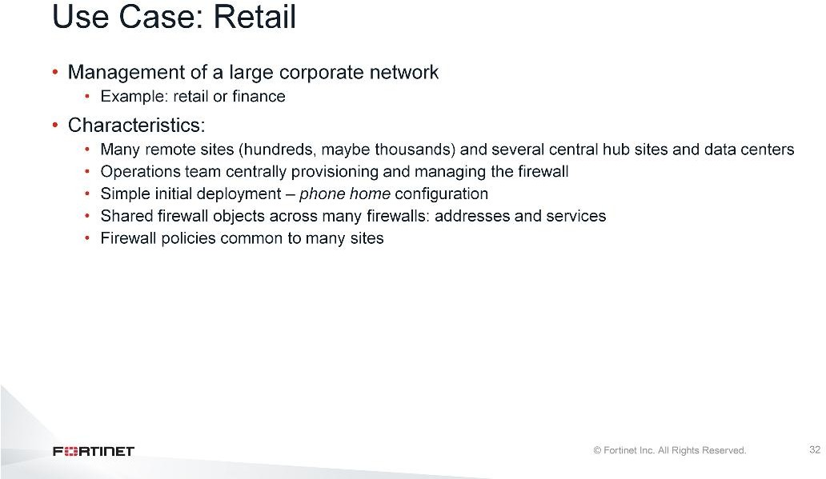
DO NOT REPRINT
© FORTINET
Introduction and Initial Configuration
One common FortiManager use case involves large retail customers or distributed enterprises, because they tend to have many smaller customer premises equipment (CPE) devices in their branches, plus remote sites, and several main sites. These customers benefit from centralized firewall provisioning and monitoring.
In large scale enterprise deployments, administrators usually prefer a basic initial configuration that the installation technician loads through a USB, or copies and pastes into the console. This basic configuration allows the FortiGate to contact a FortiManager, where the administrator can add it to the appropriate device group or ADOM, then send the full configuration to that FortiGate.
FortiManager 6.2 Study Guide
‹#›

Slide 37
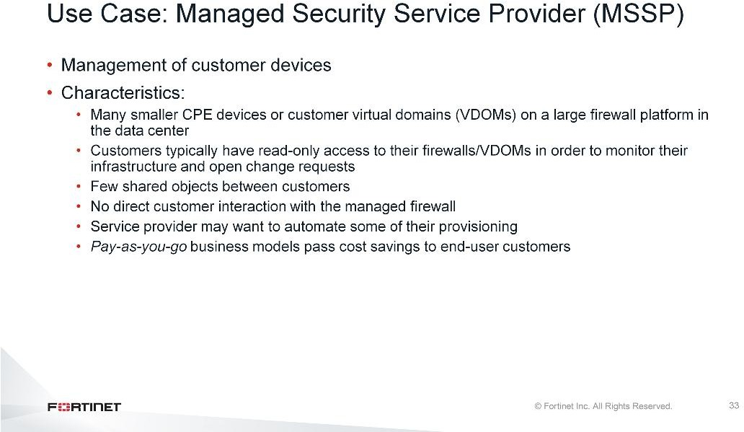
DO NOT REPRINT
© FORTINET
Introduction and Initial Configuration
Another common use case involves managed security service providers (MSSPs).
Carriers often may have many powerful firewalls and require strict configuration control, which is achievable by restricting configuration from the FortiManager. MSSPs may subdivide their firewalls into virtual firewalls that they provide to customers, or they may manage devices on customer premises. In both cases, they need to maintain configuration revisions for the customer, and, optionally, provide a portal where customers can view or edit some of their settings.
Another important use case for MSSPs is being able to determine (or report) which firewall or configuration objects are in use or not in use. Firewall policies change over time and associated objects are substituted for other new objects. However, administrators often want to keep the old objects temporarily, in case they need to revert changes. Eventually, unused objects clutter the FortiGate’s configuration, making it harder to understand and troubleshoot. So, performing periodic clean-ups of these orphan configuration objects is useful.
Now able to meet the demand for pay-as-you-go service models, FortiManager allows MSSPs to avoid the overhead of perpetual licenses through the use of the Fortinet VM On-Demand Program.
FortiManager 6.2 Study Guide
‹#›

Slide 38
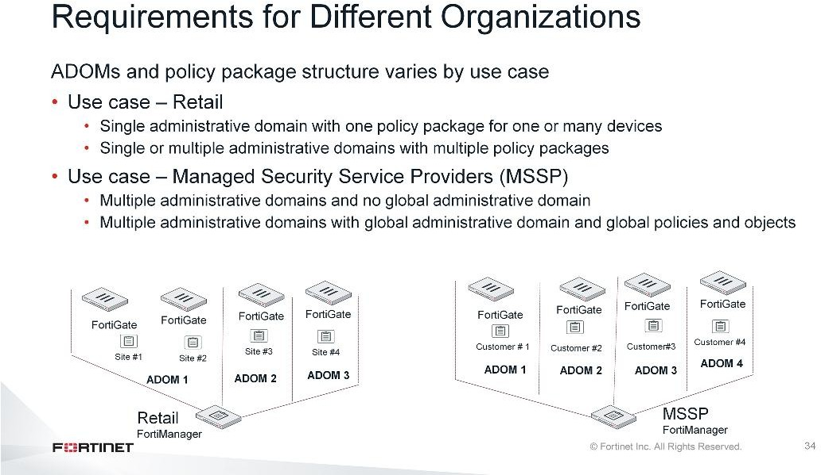
DO NOT REPRINT
© FORTINET
Introduction and Initial Configuration
As you can see, different organizations may use FortiManager’s ADOMs and policy packages differently. In a retail organization, you may have a single ADOM with many FortiGates, or multiple ADOMs with one FortiGate. In MSSPs, each customer’s FortiGate devices are placed in their ADOM.
We will cover these topics in detail so you can have the practical skills necessary to manage devices for diverse organizations.
FortiManager 6.2 Study Guide
‹#›

Slide 39
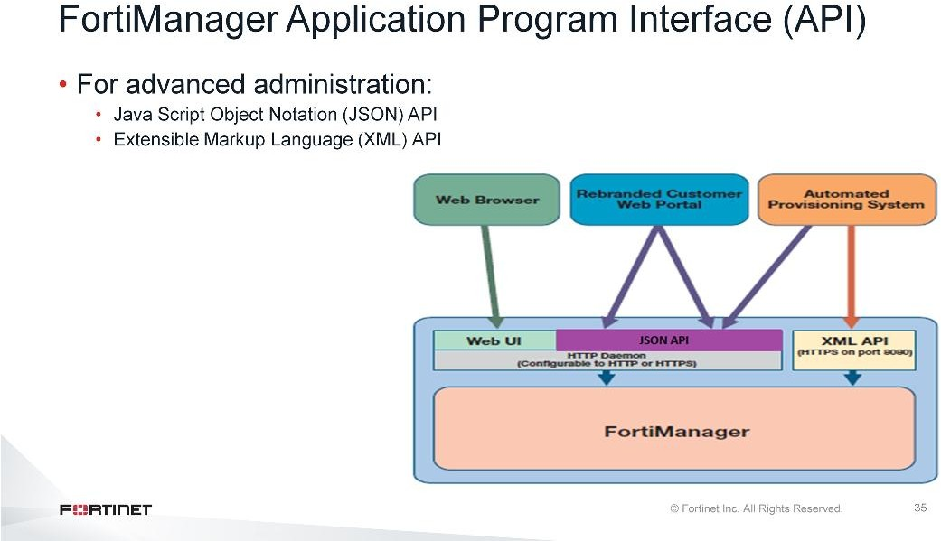
DO NOT REPRINT
© FORTINET
Introduction and Initial Configuration
MSSPs often use APIs, too. There are two APIs available on FortiManager.
JSON API: This API allows you to do many of the same tasks as the FortiManager GUI. It allows MSSP and large enterprises to create customized, branded Web portals for policy and object administration.
XML API: This API enables you to retrieve information about managed devices, execute scripts to modify device configurations, and install the modified configurations on the devices. It is designed to allow for
quick provisioning of ADOMs, devices, and scripts on a FortiManager.
The Fortinet Developer Network (FNDN) provides access tools, sample code, documentation, and the Fortinet developer community, when you subscribe.
FortiManager 6.2 Study Guide
‹#›

Slide 40
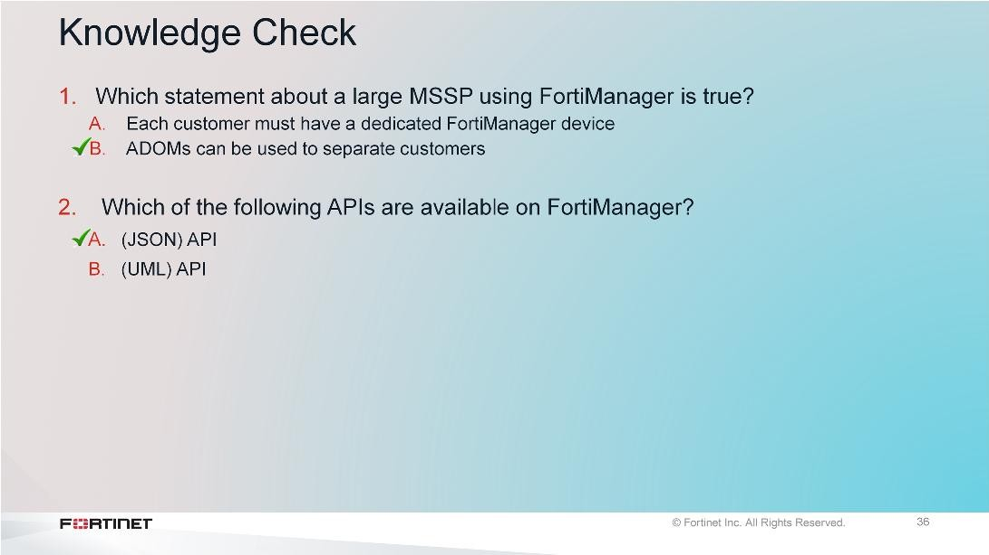
DO NOT REPRINT
© FORTINET
Introduction and Initial Configuration
FortiManager 6.2 Study Guide
‹#›

Slide 41
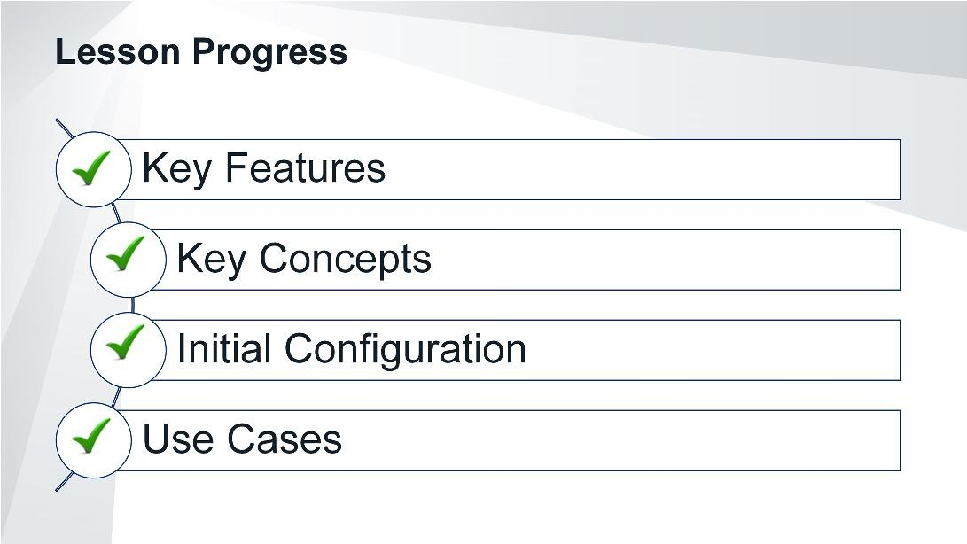
DO NOT REPRINT
© FORTINET
Introduction and Initial Configuration
Congratulations! You have completed this lesson.
FortiManager 6.2 Study Guide
‹#›

Slide 42
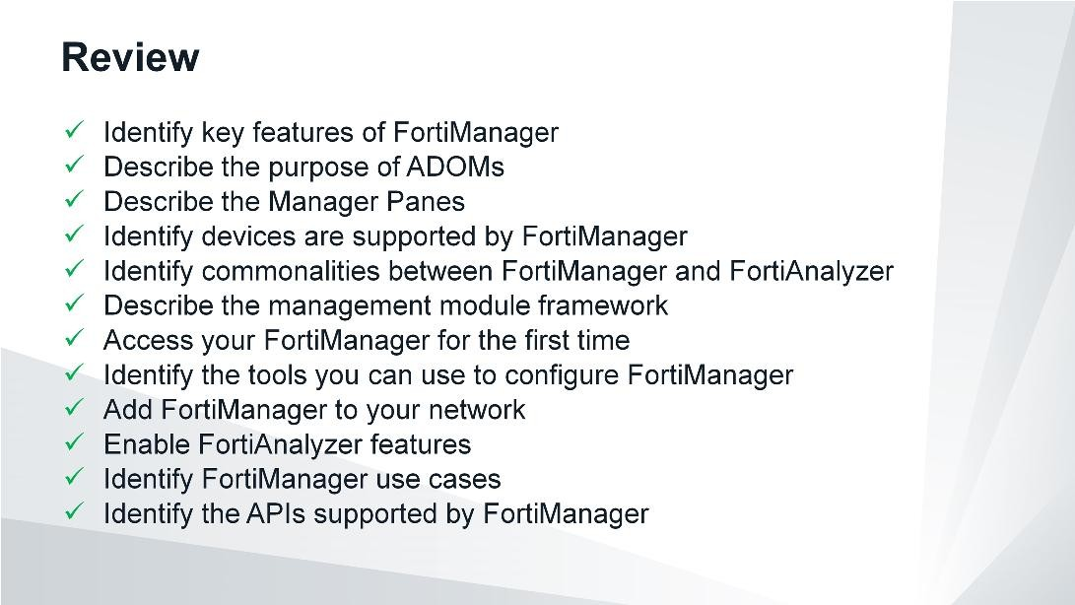
DO NOT REPRINT
© FORTINET
Introduction and Initial Configuration
This slide shows the objectives covered in this lesson. By mastering the objectives covered in this lesson, you learned the basics of FortiManager and how to use it in your network.
FortiManager 6.2 Study Guide
‹#›

Slide 43

DO NOT REPRINT
© FORTINET
Administration and Management
In this lesson, you will learn how to set up and administer FortiManager. You will also learn how to use features that are critical to day-to-day use, such as ADOMs, event monitoring, back up, and restore.
FortiManager 6.2 Study Guide
‹#›

Slide 44
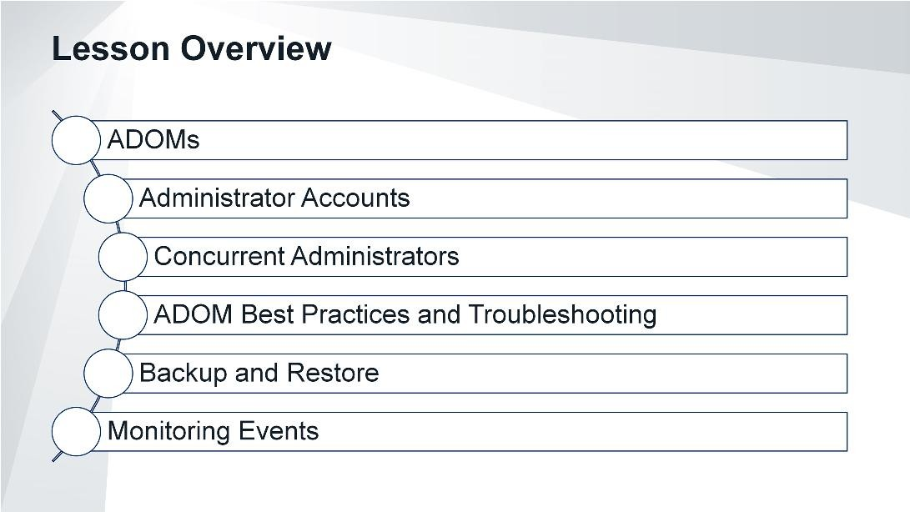
DO NOT REPRINT
© FORTINET
Administration and Management
In this lesson, you will explore the topics shown on this slide.
FortiManager 6.2 Study Guide
‹#›

Slide 45
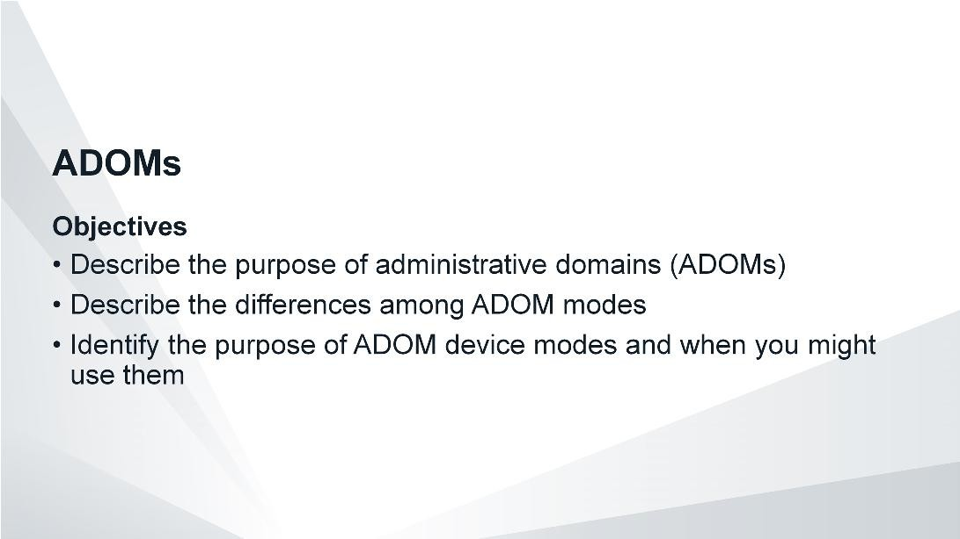
DO NOT REPRINT
© FORTINET
Administration and Management
After completing this section, you should be able to achieve the objectives shown on this slide.
By demonstrating competence in ADOMs, you will be able to organize FortiGate devices effectively within FortiManager.
FortiManager 6.2 Study Guide
‹#›

Slide 46
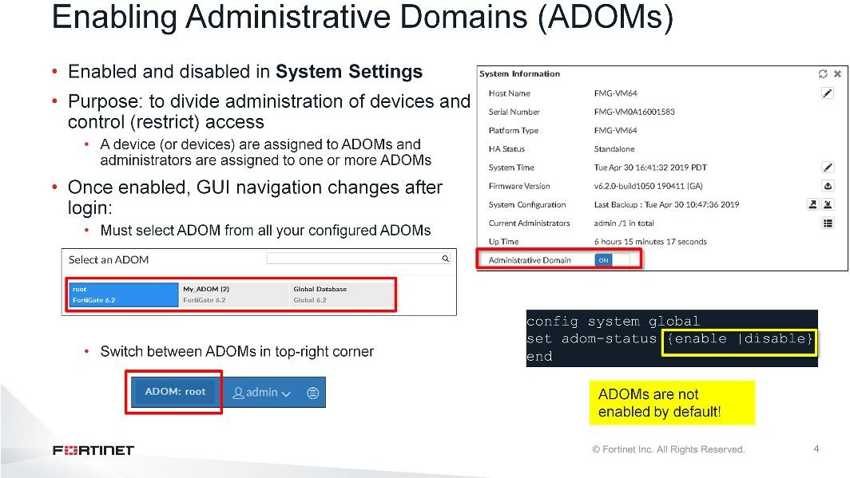
DO NOT REPRINT
© FORTINET
Administration and Management
ADOMs enable the admin administrator to create groupings of devices for administrators to monitor and manage. For example, administrators can manage devices specific to their geographic location or business division. The purpose of ADOMs is to divide the administration of devices by ADOM, and to control (restrict) administrator access.
ADOMs are not enabled by default and can be enabled (or disabled) only by the admin administrator or an administrator that has the Super_User profile. Once you change the ADOM mode, you are logged out so the system can reinitialize with the new settings. When you log in with ADOMs enabled, you must select the ADOM you want to view from your list of configured ADOMs. You can easily switch between ADOMs by clicking on the ADOM list in the upper-right corner of the GUI.
Remember, the maximum number of ADOMs varies by FortiManager physical model or VM license.
FortiManager 6.2 Study Guide
‹#›

Slide 47
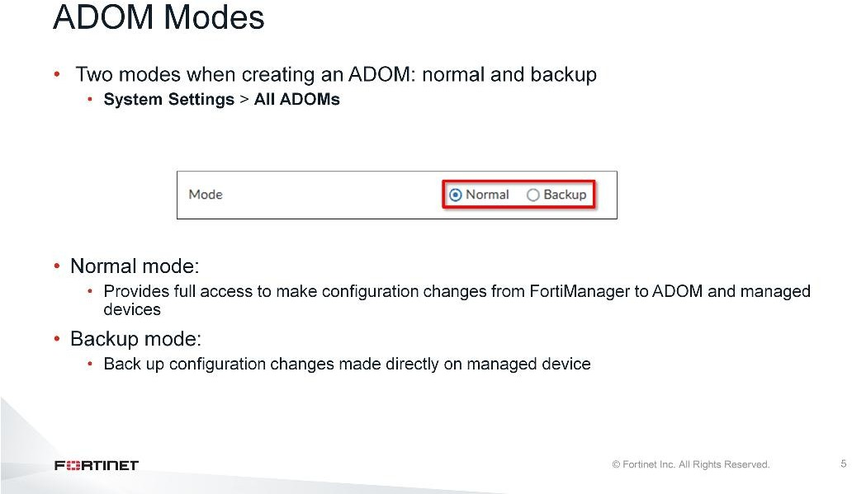
DO NOT REPRINT
© FORTINET
Administration and Management
When you configure ADOMs, you can choose between two modes: normal or backup.
In normal mode, you can make configuration changes to an ADOM and the managed devices.
The main purpose of backup mode is to back up the configuration changes made directly on the managed device.
FortiManager 6.2 Study Guide
‹#›

Slide 48
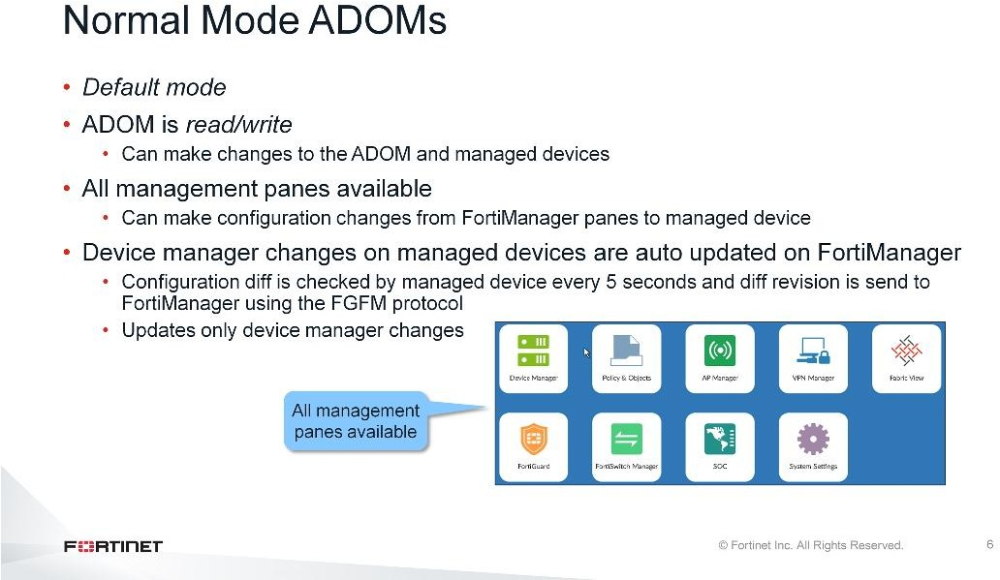
DO NOT REPRINT
© FORTINET
Administration and Management
By default, ADOMs run in normal mode and all panes are available. The ADOM is read-write, which allows you to make configuration changes to managed devices stored in the ADOM database and then install those changes on managed devices.
You can also make configuration changes directly to each managed device through FortiGate’s CLI or GUI. This will trigger the managed device to automatically update the FortiGate revision history on FortiManager. However, auto-update has a limitation in that it updates only device manager changes and not policy and object changes.
FortiManager 6.2 Study Guide
‹#›

Slide 49
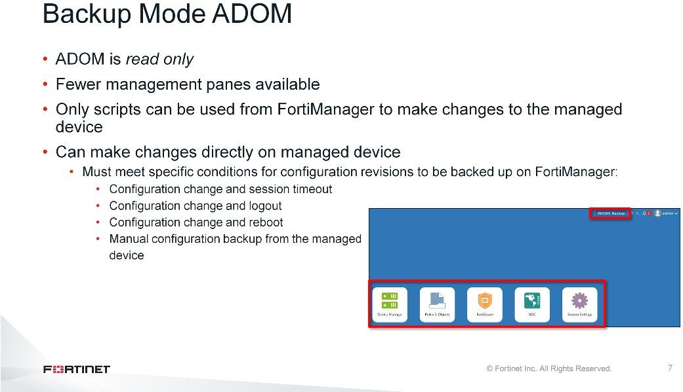
DO NOT REPRINT
© FORTINET
Administration and Management
What if managed device configuration changes always need to be made directly on the device and you want to use FortiManager only for revision control and tracking purposes?
In this case, you can configure the ADOM in backup mode.
When in backup mode, the ADOM is read-only, so the Device Manager pane is restricted. You can add and delete devices, but the device-level settings are not available for configuration and installation. For the same reason, other panes such as AP Manager, VPN Manager, FortiClient Manager, and FortiSwitch Manager are not available. In backup mode, you can import firewall address and service objects to FortiManager, and FortiManager stores the objects in the Device Manager database. You can view the objects on the Policy & Objects pane. Although you can view the objects on the Policy & Objects pane, the objects are not stored in the central database. This lets you maintain a repository of objects used by all devices in the backup ADOM that is separate from the central database.
You can use the script feature on FortiManager to make configuration changes to managed devices. If you make changes directly on the managed device, those changes need to meet specific conditions in order to trigger the device to back up its configuration to FortiManager.
FortiManager 6.2 Study Guide
‹#›

Slide 50
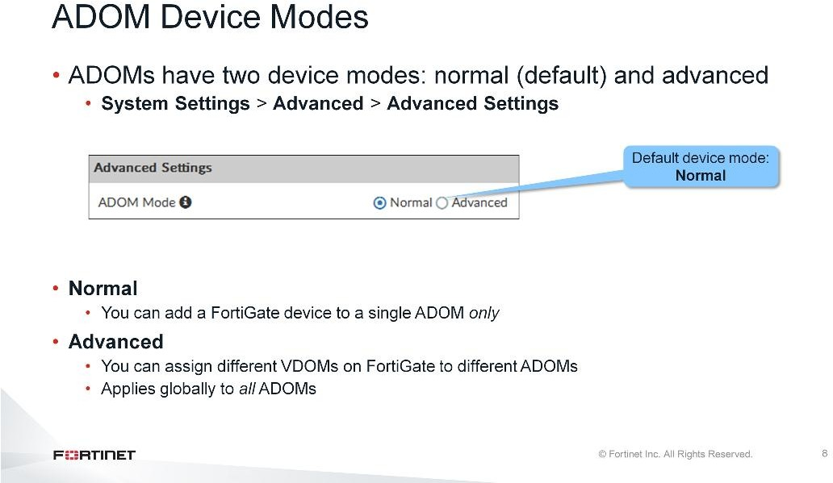
DO NOT REPRINT
© FORTINET
Administration and Management
An ADOM has two device modes: normal, which is the default mode, and advanced. In normal mode, you cannot assign different FortiGate virtual domains (VDOMs) to different FortiManager ADOMs.
What if you are a Managed Security Service Provider (MSSP), have FortiGate VDOMs for different customers, and want to separate those VDOMs in different ADOMs?
In advanced mode, you can assign different VDOMs from the same FortiGate device to different ADOMs. The system applies this setting globally to all ADOMs. This results in more complicated management scenarios. It is recommended for advanced users only.
FortiManager 6.2 Study Guide
‹#›

Slide 51
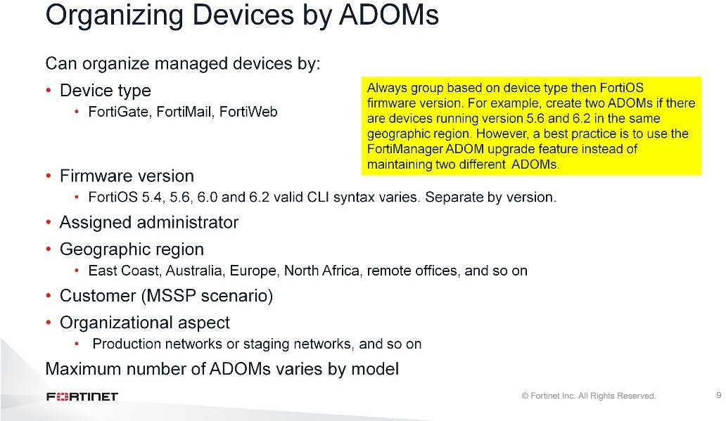
DO NOT REPRINT
© FORTINET
Administration and Management
Which devices should be in each ADOM?
Use a scheme that simplifies management. For example, you could organize your devices by:
Firmware version: You can group all devices with the same firmware version in the same ADOM. For example, if FortiGate devices are running firmware version 5.6, you can group these devices in a version
5.6 ADOM.
Geographic regions: You can group all devices for a specific geographic region into an ADOM, and devices for a different region into another ADOM.
Assigned administrators: You can group devices into separate ADOMs and assign them to specific administrators.
Customers: You can group all devices for one customer into an ADOM, and devices for another customer into another ADOM.
Device type: You can create a separate ADOM for each device type. Non-FortiGate devices are automatically located in specific ADOMs for their device type. They cannot be moved to other ADOMs.
Organizational needs: You can separate production and test network FortiGate devices into separate
ADOMs.
When organizing managed FortiGate devices, always group based on the device type first, then the FortiOS firmware version. Valid command syntax varies by firmware versions, which affects script compatibility and other features. For example, if you are grouping based on geographic region and have FortiGate devices running FortiOS 5.6 and 6.2 firmware in the same region, you should create two ADOMs based on the firmware version for that geographic region. Then, you would assign both ADOMs to the administrator for that region. However, a best practice is to use the FortiManager ADOM upgrade feature and upgrade all the devices to the same firmware version.
FortiManager 6.2 Study Guide
‹#›

Slide 52
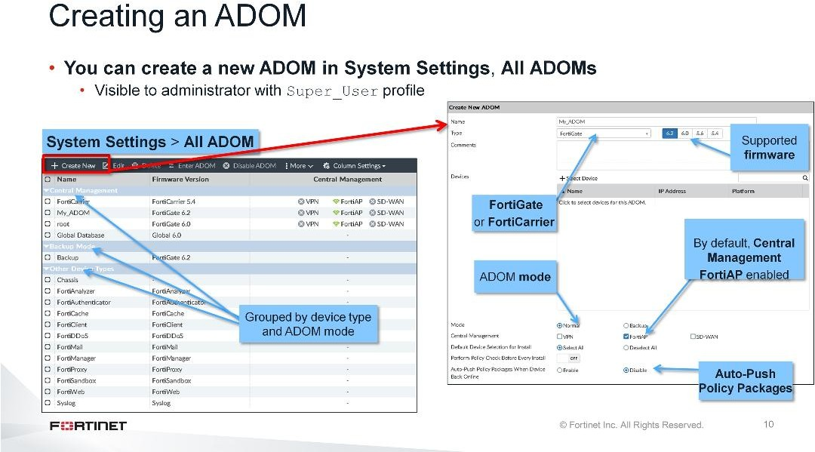
DO NOT REPRINT
© FORTINET
Administration and Management
With ADOMs enabled, administrators with the Super_User profile have access to the All ADOMs page, where all default ADOMs and custom ADOMs created by the administrator appear. You can restrict the access of other administrators to one or more specific ADOMs.
FortiGate ADOMs are grouped together. If the default ADOMs do not fit your requirements, you can create your own. While you can edit these default ADOMs, you cannot edit the device type or firmware version of the device. This is because, internally, how the database is structured depends on what types of data that FortiManager needs to store for that device type or firmware.
The ADOM type you create must match the device type you are adding. For example, if you want to create an ADOM for FortiGate, you must select FortiGate as the ADOM type. With FortiGate ADOMs specifically, you must also select the firmware version of the FortiGate device.
Different firmware versions have different features, and therefore different CLI syntax. Your ADOM setting
must match the device’s firmware.
The default ADOM mode is Normal. Under Central Management, you can enable VPN to centrally manage IPsec VPNs or you can enable SD-WAN, which allows you to manage SD-WAN for all managed devices in that ADOM. FortiAP central management is enabled by default.
Auto-Push-Policy: If auto-push is enabled, policy packages and device settings will be installed to offline devices when they come back online.
The maximum number of ADOMs you can create varies by FortiManager model.
FortiManager 6.2 Study Guide
‹#›

Slide 53
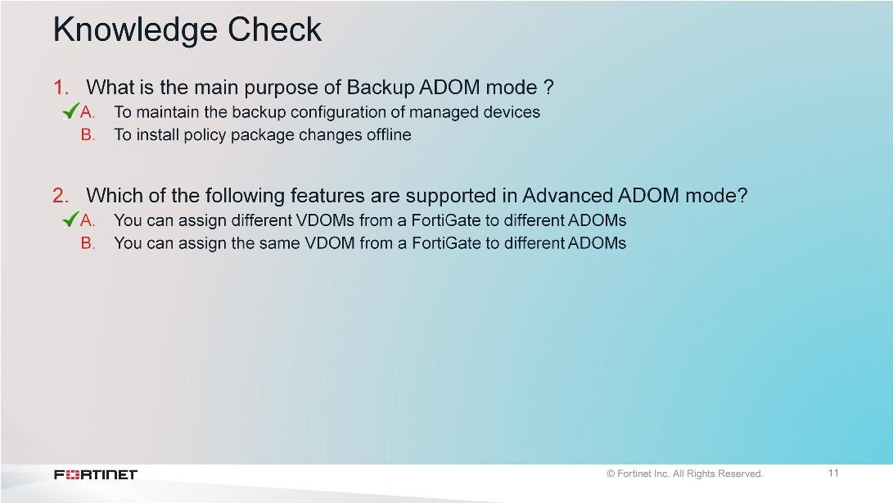
DO NOT REPRINT
© FORTINET
Administration and Management
FortiManager 6.2 Study Guide
‹#›

Slide 54
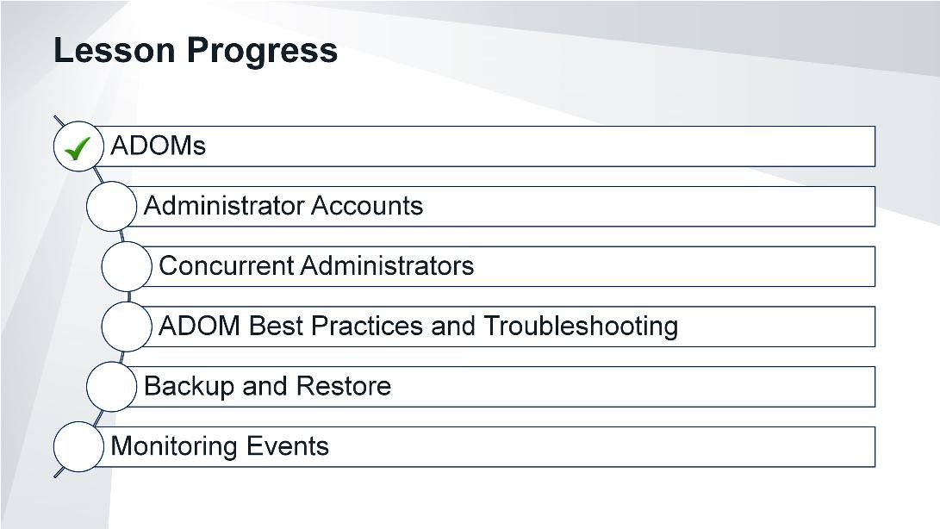
DO NOT REPRINT
© FORTINET
Administration and Management
Good job! You now understand ADOMs.
Now, you will examine administrator accounts on FortiManager.
FortiManager 6.2 Study Guide
‹#›

Slide 55
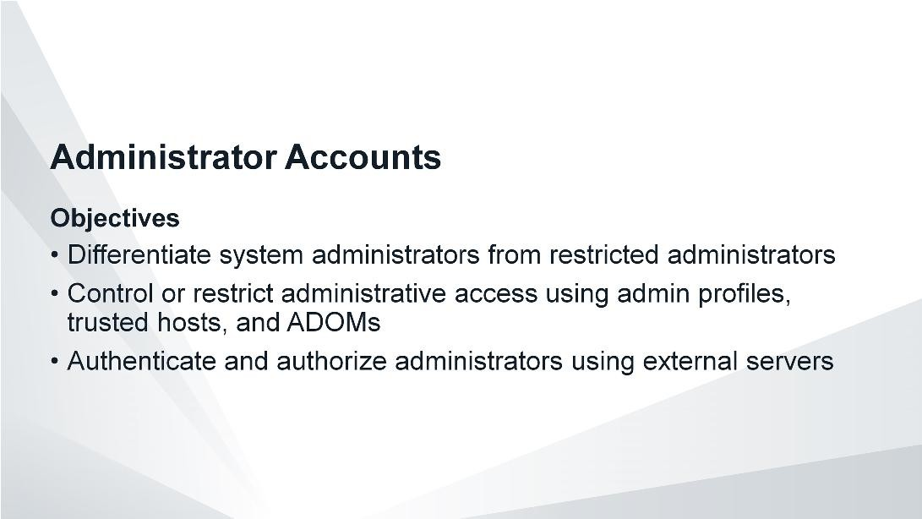
DO NOT REPRINT
© FORTINET
Administration and Management
After completing this section, you should be able to achieve the objectives shown on this slide.
By demonstrating competence in using administrative access controls, you will be able to better safeguard the administration and management of FortiManager and the managed devices.
FortiManager 6.2 Study Guide
‹#›

Slide 56

DO NOT REPRINT
© FORTINET
Administration and Management
In order to efficiently administer your system, FortiManager comes with four pre-installed default profiles that you can assign to other administrative users. Administrator profiles define administrator permissions and are required for each administrative account. The four default profiles are:
Package User: provides read/write access to policy package and objects permissions, but read-only access for system and other permissions
Restricted_User: provides read-only access to device permissions, but not system permissions
Standard_User: provides read and write access to device permissions, but no system permissions
Super_User: provides access to all device and system permissions, such as FortiGate
You can assign the default profiles to administrative accounts, or you can modify the individual permissions associated with each default profile. Alternatively, you can create your own custom profile.
FortiManager 6.2 Study Guide
‹#›

Slide 57

DO NOT REPRINT
© FORTINET
Administration and Management
You can customize both administrator profile types: system admin and restricted admin.
For the system admin type, you can modify one of the predefined profiles, or create a custom profile. Only administrators with full system permissions can modify administrator profiles. Depending on the nature of the administrator’s work, access level, or seniority, you can allow them to view and configure as much, or as little, as required.
For the restricted admin type, you can create a new restricted administrator profile to allow the delegated administrator to make changes to the web filtering profile, IPS sensor, and application sensor associated with their ADOM.
FortiManager 6.2 Study Guide
‹#›

Slide 58

DO NOT REPRINT
© FORTINET
Administration and Management
Depending on your deployment, you may want to divide FortiManager administrative tasks among multiple employees by creating additional administrator accounts.
In order to protect your network, you can control and restrict administrator access using the following methods:
Administrative profiles
ADOMs
Trusted hosts
FortiManager 6.2 Study Guide
‹#›

Slide 59

DO NOT REPRINT
© FORTINET
Administration and Management
In addition to controlling administrative access through administrator profiles, you can further control access by setting up trusted hosts for each administrative user. This restricts administrators to logins from specific IPs or subnets only. You can even restrict an administrator to a single IP address if you define only one trusted host IP address.
The trusted hosts you define apply to both the GUI and the CLI when accessed through SSH.
FortiManager 6.2 Study Guide
‹#›

Slide 60

DO NOT REPRINT
© FORTINET
Administration and Management
Another way you can control administrative access is through ADOMs. This makes device management more effective, because administrators need to monitor and manage devices only in their assigned ADOM. It also makes the network more secure, because administrators are restricted to only those devices to which they should have access.
Administrators who have the Super_User profile have full access to all ADOMs, whereas administrators with any other profile have access only to those ADOMs to which they are assigned—this can be one or more.
FortiManager 6.2 Study Guide
‹#›

Slide 61

DO NOT REPRINT
© FORTINET
Administration and Management
Instead of creating local administrators, where logins are validated by FortiManager, you can configure external servers to validate your administrator logins. You can use RADIUS, LDAP, TACACS+, and PKI as means of verifying the administrator credentials.
To configure two-factor authentication, you also require FortiAuthenticator and FortiToken. See the
FortiManager Administration Guide for more details.
FortiManager 6.2 Study Guide
‹#›

Slide 62

DO NOT REPRINT
© FORTINET
Administration and Management
To track administrator user sessions, including who is currently logged in and through what trusted host, click System Settings > Admin > Administrator. Only the default admin administrator or administrator with the Super_User profile can see the complete administrator’s list.
To track installation changes from FortiManager user, click Log & Report > System Events on the managed FortiGate device.
FortiManager 6.2 Study Guide
‹#›

Slide 63

DO NOT REPRINT
© FORTINET
Administration and Management
FortiManager 6.2 Study Guide
‹#›

Slide 64

DO NOT REPRINT
© FORTINET
Administration and Management
Good job! You now understand administrator accounts.
Now, you will examine concurrent administrators on FortiManager.
FortiManager 6.2 Study Guide
‹#›

Slide 65

DO NOT REPRINT
© FORTINET
Administration and Management
After completing this lesson, you should be able to achieve the objectives shown on this slide.
By demonstrating competence in using ADOMs, a device, or policy package locking, you will be able to better safeguard the administration and management of FortiManager and the managed devices.
FortiManager 6.2 Study Guide
‹#›

Slide 66

DO NOT REPRINT
© FORTINET
Administration and Management
By default, multiple administrators can access the same ADOM concurrently because workspace-mode is set to disabled.
Usually this is OK, especially if you’ve used administrator profiles with non-overlapping permissions. The probability of two people changing the same setting in a network with hundreds of complex devices is small, but it is still possible.
FortiManager 6.2 Study Guide
‹#›

Slide 67

DO NOT REPRINT
© FORTINET
Administration and Management
What if multiple administrators try to change the same devices, at the same time, but make different changes?
This can cause conflicts: one administrator’s changes will be overwritten by the other administrator’s changes. If conflicts are likely to occur for you, you can use the CLI to enable workspace mode and prevent concurrent ADOM access.
This allows administrators to lock their ADOM, a device, or a policy package. Furthermore, only a single administrator has read/write access to the ADOM, while all other administrators have read-only access. Locking an ADOM automatically removes locks on devices and policy packages that you have locked within that ADOM.
FortiManager 6.2 Study Guide
‹#›

Slide 68

DO NOT REPRINT
© FORTINET
Administration and Management
When workspace is enabled, how do you use it?
Prior to making changes, Admin A locks the ADOM. A green lock icon appears. Admin A now has read- write access and can make changes to the managed devices in that ADOM.
During this time, Admin B sees a red lock icon on the ADOM. Admin B has read-only access to that ADOM, and cannot make changes.
When Admin A finishes making changes, they saved the changes and then unlock the ADOM. The icon changes to a grey unlocked icon. Admin B sees that the ADOM is now available for use.
Now Admin B locks the ADOM, and again the lock icon changes to green. Admin B now has read-write access, and can safely make changes without risk of conflicts.
FortiManager 6.2 Study Guide
‹#›

Slide 69

DO NOT REPRINT
© FORTINET
Administration and Management
When workspace is enabled, the ADOM is initially read-only. To enable read-write permission, and make changes to the ADOM, you must lock the ADOM, device, or policy package.
You can lock the ADOM in the upper-right corner of the GUI. Once you lock the ADOM, you can safely make changes to the managed device’s settings, in that ADOM, without worrying about conflicts. If you make changes to the managed device configuration or policy packages, changes must be saved prior to attempting to install them. Other administrators can’t make changes to the ADOM because they have read-only permissions.
There are three lock status icons:
Grey Lock icon: The ADOM is currently unlocked. To make changes, you must first lock the ADOM.
Green Lock icon: The ADOM is locked by you. You can make changes in that ADOM.
Red Lock icon: The ADOM is locked by another administrator. You must wait for them to finish and unlock the ADOM.
FortiManager 6.2 Study Guide
‹#›

Slide 70

DO NOT REPRINT
© FORTINET
Administration and Management
In normal workspace mode, a device or a policy package must be locked before changes can be made to it. Other administrators will be unable to make changes to that device or policy package until you unlock it, log out of the FortiManager, or forcibly disconnect you when they are locking the ADOM that the device or package are in.
Locking an ADOM automatically removes locks on devices and policy packages that you have locked within that ADOM.
You cannot lock individual devices if ADOMs are in advanced mode.
FortiManager 6.2 Study Guide
‹#›

Slide 71

DO NOT REPRINT
© FORTINET
Administration and Management
FortiManager 6.2 Study Guide
‹#›

Slide 72

DO NOT REPRINT
© FORTINET
Administration and Management
Good job! You now understand concurrent administrators.
Now, you will examine ADOM best practices and troubleshooting.
FortiManager 6.2 Study Guide
‹#›

Slide 73

DO NOT REPRINT
© FORTINET
Administration and Management
After completing this section, you should be able to achieve the objectives shown on this slide.
By demonstrating competence of ADOM best practices and troubleshooting, you will be able to organize and manage your FortiGate device more effectively within FortiManager.
FortiManager 6.2 Study Guide
‹#›

Slide 74

DO NOT REPRINT
© FORTINET
Administration and Management
In FortiManager’s database, each ADOM is associated with a specific FortiGate firmware version, based on the firmware version of the devices that are in that ADOM. The firmware version determines the appropriate database schema.
What if you created an ADOM using version 5.4, added FortiGate devices running FortiOS 5.4, but then needed to upgrade the FortiGate devices to FortiOS 5.6? An ADOM can concurrently manage FortiGate devices running two FortiGate firmware versions; for example, FortiOS 5.4 and 5.6. Therefore, the devices running firmware versions 5.4 and 5.6 can share a common FortiManager database.
Although multiple FortiOS versions can exist in the same ADOM, some of the features of the newer firmware version may be restricted if you are using an older ADOM version. This is because the CLI command syntax for the newer firmware version might have changed because of new features and is, therefore, configured differently. It is very important to make sure you add FortiGate to an ADOM that is based on its FortiOS firmware version. You should not add a higher-version FortiGate to lower version of ADOM. Also, keep in mind that upgrading the FortiManager firmware version will not upgrade the ADOM version.
You should use this feature only to facilitate upgrading to new firmware. ADOMs are not usually run with mixed firmware. In that case, use separate ADOMs instead.
FortiManager 6.2 Study Guide
‹#›

Slide 75

DO NOT REPRINT
© FORTINET
Administration and Management
Multiple FortiOS versions can exist in the same ADOM, but you can upgrade the ADOM only after you have upgraded all the devices contained in it.
Note: If there are many ADOM revisions, FortiManager requires more system resources and the ADOM upgrade can take more time to complete.
FortiManager 6.2 Study Guide
‹#›

Slide 76

DO NOT REPRINT
© FORTINET
Administration and Management
If all the devices in an ADOM are not upgraded, you will get a warning message and won’t be allowed to upgrade the ADOM version. You must upgrade all devices in an ADOM prior to upgrading the ADOM version.
You can upgrade the ADOM in System Settings > All ADOMs. You can upgrade an ADOM to one version higher. For example, you can upgrade an ADOM running 5.4 to 5.6 first, then to 6.0.
If the ADOM has already been upgraded to the latest version, this option will not be available.
FortiManager 6.2 Study Guide
‹#›

Slide 77

DO NOT REPRINT
© FORTINET
Administration and Management
You can perform real-time ADOM upgrade debugging using the CLI commands shown on this slide. When you upgrade the ADOM, the system generates an event log stating that the ADOM upgrade was successful. The task monitor also generates an entry for the ADOM upgrade.
FortiManager 6.2 Study Guide
‹#›

Slide 78

DO NOT REPRINT
© FORTINET
Administration and Management
What if you need to upgrade a few FortiGate devices, but not all of them are contained in the same ADOM?
Another way to handle mixed FortiGate versions in the ADOMs is to first upgrade the devices in the original ADOM, then move them to the new ADOM using a matching firmware version.
If you move a device from one ADOM to another, policies and objects are not imported into the ADOM database. You must run the Import Policy wizard to import policies and objects into the ADOM database. Moving devices from one ADOM to another is not recommended practice. For example, if you have configured complex IPSec VPNs with VPN Manager, you will need to reconfigure the VPN settings after you move the IPSec VPNs from one ADOM to another.
FortiManager 6.2 Study Guide
‹#›

Slide 79

DO NOT REPRINT
© FORTINET
Administration and Management
You can move devices between ADOMs after registration on the All ADOMs page. You can move devices between ADOMs by editing the custom ADOM to which you want to add the device, and then selecting the device to add to it.
FortiManager 6.2 Study Guide
‹#›

Slide 80

DO NOT REPRINT
© FORTINET
Administration and Management
Before an ADOM upgrade, you should install any pending device settings or policy package changes to the managed devices and get all devices and policy packages synchronized.
Once you have upgraded the devices and the ADOM, you should perform the installation preview. The Install preview shows you any changes that occurred during the upgrade process. You will need to check that all the to-be-installed changes occurred during the upgrade process, and make corrections if required.
When you move devices from one ADOM to another ADOM, shared policy packages and objects do not move to the new ADOM. You will need to import policy packages from managed devices.
FortiManager 6.2 Study Guide
‹#›

Slide 81

DO NOT REPRINT
© FORTINET
Administration and Management
FortiManager 6.2 Study Guide
‹#›

Slide 82

DO NOT REPRINT
© FORTINET
Administration and Management
Good job! You now understand ADOM best practices and troubleshooting.
Now, you will examine backup and restore on FortiManager.
FortiManager 6.2 Study Guide
‹#›

Slide 83

DO NOT REPRINT
© FORTINET
Administration and Management
After completing this section, you should be able to achieve the objectives shown on this slide.
By demonstrating competence in backup and restore, you will be able to ensure that if there is a severe hardware failure, you can quickly restore FortiManager to its original state without affecting the network. This is, after all, your central network management system, and you will probably be investing considerable time and resources in building and maintaining your firewall policies. So, you will learn how to keep the data safe.
FortiManager 6.2 Study Guide
‹#›

Slide 84

DO NOT REPRINT
© FORTINET
Administration and Management
At any time, you can back up the FortiManager configuration in the System Information widget on the GUI. By default, encryption is enabled when you use the GUI for backups. If you use encryption, you must set a password that is used to encrypt the backup file. The backup file can’t be restored unless you provide the same password. Fortinet Technical Support usually request the FortiManager backup in unencrypted format.
The backup contains everything except the logs, FortiGuard cache, and firmware images saved on FortiManager.
You can also use the CLI to schedule backups at regular intervals.
If changes are made to FortiManager that end up negatively affecting your network, you can restore the configuration from any of the backups you performed.
FortiManager 6.2 Study Guide
‹#›

Slide 85

DO NOT REPRINT
© FORTINET
Administration and Management
You can restore the FortiManager configuration using the GUI or CLI. When you perform a restore, FortiManager reboots and the changes take effect. When you are restoring a backup file, make sure the FortiManager’s firmware version and model matches the backup file.
There are few other options in the Restore System pop-up that are worth discussing:
Overwrite current IP, routing, and HA settings: By default, this option is enabled. If FortiManager has an existing configuration, restoring a backup will overwrite everything, including the current IP, routing, and HA settings. If you disable this option, FortiManager will still restore the configurations related to device information and global database information, but will preserve the basic HA and network settings.
Restore in Offline Mode: By default, this is enabled and grayed out–you cannot disable it. While restoring, FortiManager temporarily disables the communication channel between FortiManager and all managed devices. This is a safety measure in case any devices are being managed by another FortiManager.
FortiManager 6.2 Study Guide
‹#›

Slide 86

DO NOT REPRINT
© FORTINET
Administration and Management
You can back up the configuration on one FortiManager model and restore this configuration on a different FortiManager model. This can be useful for:
Troubleshooting purposes, by restoring configuration into a different FortiManager model
Upgrading the FortiManager to a bigger model, as it will preserve your already configured devices and task manager database
System settings are not preserved
The steps required to migrate a configuration are simple. You need to back up the configuration on one FortiManager model, and then run the CLI migrate command on the second FortiManager.
FortiManager supports FTP, SCP, and SFTP protocols to migrate a configuration from one FortiManager model to another FortiManager model.
FortiManager 6.2 Study Guide
‹#›

Slide 87

DO NOT REPRINT
© FORTINET
Administration and Management
By default, offline mode is disabled, allowing FortiManager to manage the devices. When you perform a configuration restore, FortiManager disables the FGFM protocol. This protocol uses TCP port 541 for communication between FortiManager and FortiGate devices. You can manually enable or disable in System Settings > Advanced > Advanced Settings.
When should you enable offline mode?
You can enable offline mode to troubleshoot problems. Offline mode allows you to change FortiManager device settings without affecting managed devices, or to load a backup on a second FortiManager for testing. That way, the second FortiManager cannot automatically connect to your FortiGate devices and start managing them.
FortiManager 6.2 Study Guide
‹#›

Slide 88

DO NOT REPRINT
© FORTINET
Administration and Management
Connect to FortiManager using the console port, if you need to factory reset FortiManager.
The reset all settings command returns FortiManager to its factory default settings and reboots FortiManager.
The format disk command erases all device settings and images, FortiGuard databases, and log data on FortiManager’s hard drive.
To completely erase all configuration databases, reset all settings, then format the disk using the CLI.
Even if you format your disks, this only destroys the file system tables. Files remain, and attackers could use forensic tools to recover the data. Failure to overwrite your configuration databases jeopardizes the security of your entire network. So, if you will be replacing or selling your FortiManager, or replacing the hard disk, you should use a secure (deep-erase) disk reformat, to overwrite the hard disk with random data. Usually, the deep-erase feature takes longer to complete and is not necessary in most cases.
FortiManager 6.2 Study Guide
‹#›

Slide 89

DO NOT REPRINT
© FORTINET
Administration and Management
FortiManager 6.2 Study Guide
‹#›

Slide 90

DO NOT REPRINT
© FORTINET
Administration and Management
Good job! You now understand backup and restore.
Now, you will examine monitoring events.
FortiManager 6.2 Study Guide
‹#›

Slide 91

DO NOT REPRINT
© FORTINET
Administration and Management
After completing this section, you should be able to achieve the objectives shown on this slide.
By demonstrating competence in monitoring FortiManager events, you will be able to diagnose and troubleshoot issues related to FortiManager and managed devices.
FortiManager 6.2 Study Guide
‹#›

Slide 92

DO NOT REPRINT
© FORTINET
Administration and Management
To monitor the status of all tasks, such as imports and device upgrade status, click System Settings > Task Monitor. You can filter a task category in the View drop-down list, or leave the default All.
For example, you can filter by running, pending, cancelling, or aborting tasks, and can identify if the tasks have been in that stuck state for long time. You can cancel or delete the tasks that are stuck for a long time and have stopped progressing, because they might prevent other pending tasks from being processed.
The system stores tasks in a separate task database. Under special circumstances, it is possible to reset this database (thus clearing all task entries). The system includes these tasks in the configuration backup and are visible when you perform a configuration restore.
FortiManager 6.2 Study Guide
‹#›

Slide 93

DO NOT REPRINT
© FORTINET
Administration and Management
Logs provide important troubleshooting information about events that happen on FortiManager.
You can view logs, download, view logs in raw format, or view historical logs by clicking System Settings >
Event Log.
By default, event log severity is set to the information level. You can change the level (increase or decrease) using the CLI. Information-level log severity provides enough details about the log messages to investigate an issue. If you need to work with Fortinet Technical Support, you can increase the log severity to debug level to get more details on the event logs.
Depending upon the number and type of the FortiGate devices managed and amount of daily activity, you should monitor disk (i/o wait states) and CPU activity after increasing it to debug level to ensure that there are no significant increases in CPU or disk usage.
FortiManager 6.2 Study Guide
‹#›

Slide 94

DO NOT REPRINT
© FORTINET
Administration and Management
If you need to focus on specific types of log messages, use filters. For example, you can filter by level, administrator, subtype, and messages. To apply a filter, click Add Filter, then select which parameter you would like to refine.
Next, pick a level and, if required, select an event subtype. NOT and OR operators are also available in the dynamic list. You can use Add Filter to add and combine additional filters.
Event logging for FortiManager has several subtypes. For additional details, refer to the FortiManager Log Message Reference Guide.
FortiManager 6.2 Study Guide
‹#›

Slide 95

DO NOT REPRINT
© FORTINET
Administration and Management
If you want to use APIs to monitor your system, or to set or get data using third-party devices, you can use the JSON and XML APIs. The FortiManager APIs are a very powerful tool that offers administrative web portals to customers, automated deployment, and provisioning systems.
If you want to use web services to monitor your system, you can download the WSDL interface definition from FortiManager in Advanced Settings.
Web services is a standards-based, platform-independent access method. The file itself defines the format of commands the FortiManager will accept, as well as the response to expect.
FortiManager 6.2 Study Guide
‹#›

Slide 96

DO NOT REPRINT
© FORTINET
Administration and Management
FortiManager 6.2 Study Guide
‹#›

Slide 97

DO NOT REPRINT
© FORTINET
Administration and Management
Congratulations! You have completed this lesson.
Now you will review the objectives that you covered in this lesson.
FortiManager 6.2 Study Guide
‹#›

Slide 98

DO NOT REPRINT
© FORTINET
Administration and Management
This slide shows the objectives that you covered in this lesson.
FortiManager 6.2 Study Guide
‹#›

Slide 99

DO NOT REPRINT
© FORTINET
Device Registration
In this lesson, you will learn about the primary functions of the device manager pane, and how to manage FortiGate using FortiManager.
FortiManager 6.2 Study Guide
‹#›

Slide 100

DO NOT REPRINT
© FORTINET
Device Registration
In this lesson, you will explore the topics shown on this slide.
FortiManager 6.2 Study Guide
‹#›

Slide 101

DO NOT REPRINT
© FORTINET
Device Registration
After completing this section, you should be able to achieve the objectives shown on this slide.
By demonstrating competence in provisioning common settings, you will be able to use FortiManager to configure common settings for many FortiGates.
FortiManager 6.2 Study Guide
‹#›

Slide 102

DO NOT REPRINT
© FORTINET
Device Registration
Provisioning templates allow you to create profiles that contain device-level settings. These templates facilitate identical device-level settings across many devices. You can edit and reapply the templates .
There are three types of templates based on common device settings:
System templates: allow you to create and manage common system-level settings for the managed device
Threat weight templates: allow you to create threat weights, which can provide information by tracking client behavior and reporting on activities that you determine risky or otherwise worth tracking
Certificate templates: allow you to create certification authority (CA) certificate templates, add devices to them, and generate certificates for selected devices. Once you generate and sign the CA certificates, you can install them using the install wizard.
Note that the provisioning templates are based on specific ADOM versions, so some settings may not be available.
FortiManager 6.2 Study Guide
‹#›

Slide 103

DO NOT REPRINT
© FORTINET
Device Registration
The System Template page contains one generic profile named default, which is a subset of the model device configurations and contains the widgets such as DNS, Alert Email, Admin Settings, and others.
You can create a new device profile and configure the settings in the widgets in that profile. You can use the Import icon to import the settings from a specific managed device, which inherits the system-level settings and CLI settings of that managed device.
You can use the Assign to Device tab to associate devices with a profile, or to view the list of devices already assigned to a profile.
You can apply these configured profiles to multiple devices within the same ADOM, which facilitates identical device-level settings across many devices.
You will apply the default profile in System Templates when you add FortiGate to FortiManager in the next section of this presentation.
FortiManager 6.2 Study Guide
‹#›

Slide 104

DO NOT REPRINT
© FORTINET
Device Registration
What if you need to apply the same system-level settings to many FortiGate devices in different ADOMs?
Remember, each ADOM has a unique object database, which also includes the templates. You can, however, export and import system templates from one ADOM to another ADOM. The ADOMs must be running the same firmware version. First, you need to export the system template from the original ADOM to the FortiManager file system, then you can import that profile into the other ADOM.
FortiManager 6.2 Study Guide
‹#›

Slide 105

DO NOT REPRINT
© FORTINET
Device Registration
FortiManager 6.2 Study Guide
‹#›

Slide 106

DO NOT REPRINT
© FORTINET
Device Registration
Good job! You now understand provisioning common settings.
Now, you will examine registration methods.
FortiManager 6.2 Study Guide
‹#›

Slide 107

DO NOT REPRINT
© FORTINET
Device Registration
After completing this section, you should be able to achieve the objectives shown on this slide.
By demonstrating competence in device registration, you will be able to add devices into FortiManager for managing and administering these devices from FortiManager.
FortiManager 6.2 Study Guide
‹#›

Slide 108

DO NOT REPRINT
© FORTINET
Device Registration
The Device Manager provides device and installation wizards to help you perform administrative and maintenance tasks. Using these tools can help you shorten the amount of time it takes to do many common tasks.
There are four main wizards:
Add Device : add devices to central management and import their configurations.
Install Wizard: install configuration changes from Device Manager or Policies & Objects to the managed devices. It allows you to preview the changes and, if the administrator doesn’t agree with the changes, cancel and modify them.
Import Policy: import interface mapping, policy database, and objects associated with the managed devices into a policy package under the Policy & Object pane. You can run it with the Add Device wizard, and run it at any time from the managed device list.
Re-install Policy: install the policy package quickly. It also allows you to preview the changes that will be installed on the managed device.
You can access the Import policy and Re-install Policy wizards by right-clicking your managed device on the Device Manager tab.
FortiManager 6.2 Study Guide
‹#›

Slide 109

DO NOT REPRINT
© FORTINET
Device Registration
There are two ways you can register a device using FortiManager:
The first method involves the FortiManager device registration wizard. If the device is supported and all the details of the device are correct, FortiManager registers the device.
The second method involves a request for registration from a supported device. When the FortiManager administrator receives that request, the request is accepted (though it can be denied).
FortiManager 6.2 Study Guide
‹#›

Slide 110

DO NOT REPRINT
© FORTINET
Device Registration
Using the Add Device wizard, you can add a FortiGate device with an existing configuration (which includes its firewall policies) or add a new FortiGate device. FortiGate is usually provisioned with a call home configuration, which is the minimum configuration needed to reach FortiManager (the central management server). Such configurations are typically installed by a technician and the actual firewall configuration is done by the administrator in the security/network operations center where FortiManager resides.
When you import a device that has an existing configuration, FortiManager imports the device's firewall policies into a new policy package (which you can rename). Objects share the common object database per ADOM. FortiManager saves the objects in the ADOM database, which you can share or use among different managed FortiGate devices in the same ADOM. FortiManager also checks for duplicate or conflicting objects.
FortiManager 6.2 Study Guide
‹#›

Slide 111

DO NOT REPRINT
© FORTINET
Device Registration
The first registration method you will learn about is the device registration wizard on FortiManager. When this method is used, the FortiManager administrator proactively initiates and, ultimately, performs the registration. When this method is used, the administrator must have specific details about the device that they are registering.
You can launch the wizard from the Device Manager pane by clicking Add Device from the menu bar. If you have enabled ADOMs and want to add the device to a specific ADOM, select the ADOM from the ADOM list before clicking Add Device.
FortiManager 6.2 Study Guide
‹#›

Slide 112

DO NOT REPRINT
© FORTINET
Device Registration
The wizard includes two options for adding a device: Discover and Add Model Device.
You use the Discover option to add an existing device. Here, you must enter the login credentials for the FortiGate device–IP address, user name, and password.
In order to fully discover the device and add the full configuration, the login credentials that you enter when you use the Discover option, must have full read-write access on the FortiGate. This also allows FortiManager to install the configuration to the managed FortiGate.
You use the Add Model Device option to provision a new device that is not yet online. You'll learn more about this option in this lesson.
FortiManager 6.2 Study Guide
‹#›

Slide 113

DO NOT REPRINT
© FORTINET
Device Registration
In this step, FortiManager determines whether the FortiGate device is reachable and also discovers basic information about the device, including–IP address, administrative user name, device model, firmware version (build), serial number, and high-availability mode.
Administrators can configure the system template in advance and apply it to new devices as they are being added to the FortiManager. Templates save time by removing the need to repeat common configuration settings multiple times.
FortiManager 6.2 Study Guide
‹#›

Slide 114

DO NOT REPRINT
© FORTINET
Device Registration
You can run the diagnose debug application depmanager 255 and diagnose debug enable
CLI commands on FortiManager to obtain a real-time status of the FortiGate device being added.
Note that the output of this command is very verbose and shows the output from other managed devices too.
FortiManager 6.2 Study Guide
‹#›

Slide 115

DO NOT REPRINT
© FORTINET
Device Registration
In the next step, FortiManager checks the addition of the FortiGate device and creates the initial configuration file in the revision history. This is the full configuration that contains all used and orphaned objects along with the firewall policies on the FortiGate. It also checks the support contract, which is useful in the event FortiManager is used as the local FortiGuard server for the managed FortiGate.
There are two options for importing policies and objects:
Clicking Import Now will add the policies in the policy package and objects in the common shared ADOM database. These objects can be used by multiple FortiGate devices in the same ADOM.
Clicking Import Later will only add the device-level settings to the device database, but the firewall policy and objects are not imported into Policy & Objects. This can be imported later using the Import policy wizard.
In this example, the Import Now option is selected.
FortiManager 6.2 Study Guide
‹#›

Slide 116

DO NOT REPRINT
© FORTINET
Device Registration
The wizard searches for all policies to import into FortiManager’s database. In this step, policies are imported into a new policy package under the Policy & Objects pane.
At this point, you can choose whether to import all policies or selected policies, and whether to import only referenced objects or all objects. The Import All and Import only policy dependent objects options are selected by default when adding a device.
FortiManager 6.2 Study Guide
‹#›

Slide 117

DO NOT REPRINT
© FORTINET
Device Registration
If virtual domains (VDOMs) are configured, you are prompted to select the VDOMs you want to import. The majority of a firewall configuration is specific to the VDOM, therefore each VDOM counts as one managed device.
FortiManager probes FortiGate and creates an interface mapping in the ADOM database. You can also rename the ADOM interface mapping. The FortiGate device has interfaces port1 and port3 which are renamed to WAN and LAN respectively. This mapping is local to the FortiManager database and policies can be viewed on FortiManager as from LAN and WAN interfaces. These local ADOM interface mappings can be used for multiple FortiGate devices. Keep in mind that ADOM interface names are case sensitive. For example, if you have an existing device with an interface WAN and you rename the interface to wan, you will see two interfaces named WAN and wan in your interface lists.
Proper interface mappings are useful in large deployments, where administrators can use common names for ADOM interface(s). You can also use the same name for the FortiGate device interface(s) at the ADOM level. It also helps administrators view and track firewall policies easily on FortiManager.
By default, the Add mappings for all unused device interfaces setting is enabled. Enabling this setting creates an automatic mapping for the new interface. As such, the FortiManager administrator does not need to create a manual mapping.
FortiManager 6.2 Study Guide
‹#›

Slide 118

DO NOT REPRINT
© FORTINET
Device Registration
Next, the wizard searches the FortiGate device for objects to import and if any conflicts exist, they appear here. You can view additional details, as well as download the conflicts in HTML format.
If you select FortiGate from the Use Value From column, the FortiManager database gets updated with that value. If you select FortiManager, the next time you install the configuration from FortiManager to FortiGate it makes those changes to the FortiGate firewall. By default, FortiGate is selected.
FortiManager 6.2 Study Guide
‹#›

Slide 119

DO NOT REPRINT
© FORTINET
Device Registration
Once the object conflicts are noted and resolved, the wizard searches for the objects to import. FortiManager adds new objects and updates the existing FortiManager objects. The FortiManager does not import duplicate entries in the ADOM database, because those objects already exist in the database.
FortiManager 6.2 Study Guide
‹#›

Slide 120

DO NOT REPRINT
© FORTINET
Device Registration
The final page of the wizard is Import Summary. On this page of the wizard the firewall policies and objects are imported into FortiManager.
You can also download the import report, which is only available on this page. As a best practice, it is recommended that you download the report. The next slide shows the downloaded import report.
FortiManager 6.2 Study Guide
‹#›

Slide 121

DO NOT REPRINT
© FORTINET
Device Registration
The import report provides important information, such as which device is imported into which ADOM, as well as the name of the policy package created along with objects imported. These objects and policies are created in the Policy & Objects pane for that ADOM.
The FortiManager imports new objects. FortiManager does not import already existing, or duplicate, entries in to the ADOM database. If a conflict is detected, FortiManager updates the object associated with the selected device in the Objects Conflict step of the wizard. In the import report, the object is referred to as update previous object.
As shown on the example, when you import the configuration from the FortiGate device to FortiManager, a comment is associated with the address object named ALL in the device configuration. However, there is no comment associated with the address object ALL in the FortiManager database. When you choose the FortiGate device value and import the address object ALL, an entry named update previous object is added to the import report.
Dynamic objects can also be created, whereby a single object name has different values, depending on which device it is installed.
FortiManager 6.2 Study Guide
‹#›

Slide 122

DO NOT REPRINT
© FORTINET
Device Registration
Because you renamed port3 to LAN and port1 to WAN on the interface mapping step of the wizard, on FortiManager, the policy shows as being imported from LAN and WAN interfaces. However, on FortiGate the policy shows port1 and port3. This is called dynamic mapping: firewall policies created in policy packages refer to these mappings. When the policy packages are installed, the interface mapping is translated to the local interfaces on the managed device.
Dynamic mapping is useful when installing the same policy package to multiple managed FortiGate devices, where interface mapping is translated to the local interfaces on the managed device.
FortiManager 6.2 Study Guide
‹#›

Slide 123

DO NOT REPRINT
© FORTINET
Device Registration
The second option in the Add Device wizard is Add Model Device, which allows you to add a device that is not yet online. Using this option, you can create the configuration in advance.
You can link to the real device using either of the following two methods:
FortiGate serial number, which is mandatory when adding FortiGate as model device
Pre-shared key, a unique pre-shared key if adding multiple model devices
FortiManager 6.2 Study Guide
‹#›

Slide 124

DO NOT REPRINT
© FORTINET
Device Registration
On the FortiGate side, you need to configure FortiGate to point to FortiManager. This is important for minimal touch deployments, such as when using FortiDeploy.
If you are using a serial number to add a FortiGate as a model device, you need to configure the FortiManager IP address on FortiGate under central management configuration.
If you are using a preshared key to add a model device, you need to configure central management configuration, plus you need to run a register device command from the FortiGate CLI.
This command requires a FortiManager serial number, along with a preshared key to use when adding a model device.
The FortiGate device is automatically promoted as a registered device once the FortiGate is deployed with its basic IP and routing configuration to reach FortiManager. You can then install the preconfigured configuration from FortiManager to the FortiGate device.
FortiManager 6.2 Study Guide
‹#›

Slide 125

DO NOT REPRINT
© FORTINET
Device Registration
The FortiGate administrator must configure the FortiManager IP address and apply the settings. A pop-up window appears stating that the management request has been sent to FortiManager. Clicking OK logs you out of FortiGate.
FortiManager 6.2 Study Guide
‹#›

Slide 126

DO NOT REPRINT
© FORTINET
Device Registration
So how does FortiGate move from an unauthorized device to a managed device?
This happens on the FortiManager side. Once the request is made from the supported device, the request appears under Device Manager > Unauthorized Devices in the FortiManager GUI.
The FortiManager administrator should review the details of the unauthorized device and, if satisfied, authorize the device. If you authorize an unauthorized device, then you need to run the Import Policy wizard to import the device’s firewall policy into a new policy package.
If ADOMs are enabled, the device appears in the root ADOM, which is the management ADOM of FortiManager. The root ADOM is based on the FortiGate ADOM type, so you can authorize only FortiGate devices to the root ADOM. Alternatively, if you’ve created a custom ADOM based on the FortiGate ADOM type, you can authorize the FortiGate to the custom ADOM instead.
From the FortiManager CLI, you can enable automatic authorization of unauthorized devices. But, you still need to run the Import Policy wizard to import the device’s firewall policy into a new policy package.
FortiManager 6.2 Study Guide
‹#›

Slide 127

DO NOT REPRINT
© FORTINET
Device Registration
What if you need to add multiple FortiGate devices simultaneously?
You can enable Show Add Multiple Button under Admin Settings, which enables the option for adding multiple devices under Device Manager. You can click the plus sign (+) and enter the FortiGate’s IP address, user name, and password.
Similar to adding an unauthorized device, policy packages are not automatically created. You must run the
Import Policy wizard to import the device’s firewall policy to a new policy package.
FortiManager 6.2 Study Guide
‹#›

Slide 128

DO NOT REPRINT
© FORTINET
Device Registration
Once you register FortiGate devices, they appear on the Device Manager in the ADOM to which they were added.
FortiManager 6.2 Study Guide
‹#›

Slide 129

DO NOT REPRINT
© FORTINET
Device Registration
The Device Manager Map View enables you to view the location of FortiGate devices on Google Maps. You can enter the location of the device manually, under Device Location settings, or you can drag the device to the accurate position. This feature is very useful if you have many devices scattered over many countries or cities.
Map view shows device location on Google Maps and indicates the device status by color: green, orange, or red.
Green: indicates that the device is healthy. The policy package configuration and device configuration are in sync.
Orange: indicates a warning status. The device configuration status or policy package configuration status is Out of Sync. Or, there is no policy imported or no policy package installed.
Red: indicates an error status. The copy has failed, the installation has failed, or the device connection is down.
FortiManager 6.2 Study Guide
‹#›

Slide 130

DO NOT REPRINT
© FORTINET
Device Registration
Some FortiManager devices can work with the shelf manager to manage the FortiGate 5000 series chassis. First, you need to enable chassis management on the System Settings > Advanced > Advanced Settings pane. Once enabled, you can add the chassis in the default chassis ADOM.
The dashboard for chassis provides the information related to slot number, slot information, current state of blade, and various other parameters. From the dashboard, you can view or configure information related to blades, PEM, fan tray, shelf manager, and SAP.
FortiManager 6.2 Study Guide
‹#›

Slide 131

DO NOT REPRINT
© FORTINET
Device Registration
FortiManager physical devices or virtual machine (VM) licenses support a limited number of devices, depending on the device size or license type. A FortiGate high availability (HA) cluster counts as a single device as does a virtual domain (VDOM). This is because the bulk of the configuration relates to the firewall policies and objects, and a device that is in a cluster will not increase the size of that configuration, because devices in the cluster are running the same configuration. The use of VDOMs increases the size of the configuration.
For example, if there are two FortiGate devices in an HA cluster (active-active or active-passive), both FortiGate devices have the same configuration and are counted as one device. However, enabling a VDOM increases the size of the configuration, because each VDOM is logically a separate firewall.
FortiManager 6.2 Study Guide
‹#›

Slide 132

DO NOT REPRINT
© FORTINET
Device Registration
A FortiGate HA cluster is managed as a single device from FortiManager, and has a unique ID. You can use the diagnose dvm device list command on the CLI to view the device members. FortiManager is unaware of—and will not verify—FortiGate HA synchronization status. The optional, dedicated HA per device management interface is for SNMP monitoring only and must not be used for FGFM management.
FortiGate HA configuration on FortiManager is read-only using the GUI only. It is retrievable and visible, but cannot be modified. FortiGate HA configuration will also not be applied to FortiGate during installations. This is to avoid overwriting the HA configuration. However, if FortiGate HA roles have changed, you can force an HA failover using FortiManager. FortiGate configuration changes concerning HA parameters will not modify the checksum (get system mgmt-csum) and will not cause an out-of-sync situation.
FortiManager 6.2 Study Guide
‹#›

Slide 133

DO NOT REPRINT
© FORTINET
Device Registration
FortiManager 6.2 Study Guide
‹#›

Slide 134

DO NOT REPRINT
© FORTINET
Device Registration
Good job! You now understand registration methods.
Now, you will examine common device discovery issues and how to resolve them.
FortiManager 6.2 Study Guide
‹#›

Slide 135

DO NOT REPRINT
© FORTINET
Device Registration
After completing this section, you should be able to achieve the objectives shown on this slide.
By demonstrating competence in device discovery troubleshooting, you will be able to diagnose and resolve issues related to device discovery.
FortiManager 6.2 Study Guide
‹#›

Slide 136

DO NOT REPRINT
© FORTINET
Device Registration
The management protocol FGFM runs on both FortiGate (fgfmd) and FortiManager (fgfmsd). The FortiManager and FortiGate create a secure tunnel on port TCP 541. Being TCP-based, the connection works with port-based NAT, which allows both the FortiGate and the FortiManager to be behind a NAT device. On the FortiGate side, you can enable the FMG-Access setting for each interface and for the interface facing the FortiManager.
Once you have configured the management tunnel, it can be established in either direction—by FortiManager or the managed FortiGate device. FortiManager reserves link-level addressing using the 169.254.0.0/16 subnet. The 169.254.0.1 IP address is reserved for FortiManager and managed devices are allocated to other IP addresses in the 169.254.0.0/16 range.
A keep-alive message is sent from the FortiGate device. The keep-alive message includes the checksum of the FortiGate configuration, which calculates the synchronization status.
FortiGate login credentials are required when discovering the device the first time or reclaiming the tunnel. The login credentials are to set the serial number. Once the login credentials have been entered, the serial number becomes the basis of authentication.
FortiManager 6.2 Study Guide
‹#›

Slide 137

DO NOT REPRINT
© FORTINET
Device Registration
There are two steps involved when FortiGate is registering with the FortiManager:
Discovery: In this step, FortiManager sends a CLI command to obtain the minimum information for the FortiGate.
Adding: During this step, complete configuration details of FortiGate are obtained by FortiManager and FortiGate configuration is stored in the revision history.
There are two methods to register FortiGate to FortiManager. The secure FGFM tunnel can be initiated by either device: FortiGate or FortiManager.
If the tunnel is initiated by FortiGate, the device is added to FortiManager’s unauthorized device list in the root ADOM. At this point, it has not been discovered. The complete discovery and add process starts once the device is promoted to being a authorized device.
FortiManager 6.2 Study Guide
‹#›

Slide 138

DO NOT REPRINT
© FORTINET
Device Registration
When FortiManager is discovering and adding a FortiGate, it sends commands to FortiGate to get complete information on FortiGate.
You can also run the following CLI command on FortiGate, while discovering and adding it:
diagnose debug cli 8 diagnose debug enable
FortiManager 6.2 Study Guide
‹#›

Slide 139

DO NOT REPRINT
© FORTINET
Device Registration
If you are experiencing communication issues between FortiGate and FortiManager, first ensure that the two devices can reach each other. Use the execute ping CLI command from either device to verify that the devices are capable of routing to each other. (Ping must be enabled and allowed by all intermediate firewalls.)
If you are having issues with discovering the FortiGate from FortiManager, check the following:
FortiManager has sufficient administrator privileges. Sufficient privileges are required to add a FortiGate.
Offline is disabled (disabled by default). Enabling offline mode disables the FGFM protocol (TCP port 541) used to communicate with managed devices.
Packets from FortiGate are reaching FortiManager and packets from FortiManager are reaching FortiGate. Run sniffers on both devices to confirm.
FortiGate credentials are correct in the Add Device wizard.
FGFM access is enabled on the FortiGate interface facing FortiManager.
FortiGate is in an unauthorized device list. You can check from the root ADOM on the GUI or from the CLI using the following command:
diagnose dvm device list.
The date and time are synchronized between FortiManager and FortiGate.
FortiManager 6.2 Study Guide
‹#›

Slide 140

DO NOT REPRINT
© FORTINET
Device Registration
FortiManager 6.2 Study Guide
‹#›

Slide 141

DO NOT REPRINT
© FORTINET
Device Registration
Congratulations! You have completed this lesson.
Now, you will review the objectives that you covered in this lesson.
FortiManager 6.2 Study Guide
‹#›

Slide 142

DO NOT REPRINT
© FORTINET
Device Registration
This slide shows the objectives that you covered in this lesson.
FortiManager 6.2 Study Guide
‹#›

