Slide 1
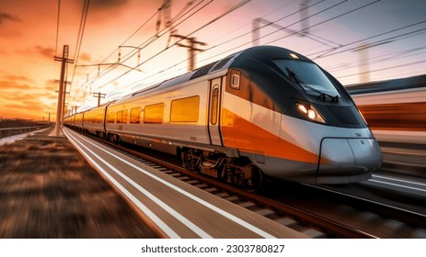
Track your train
Name : Agastya Kumar
Roll No : 22cs3003

Slide 2
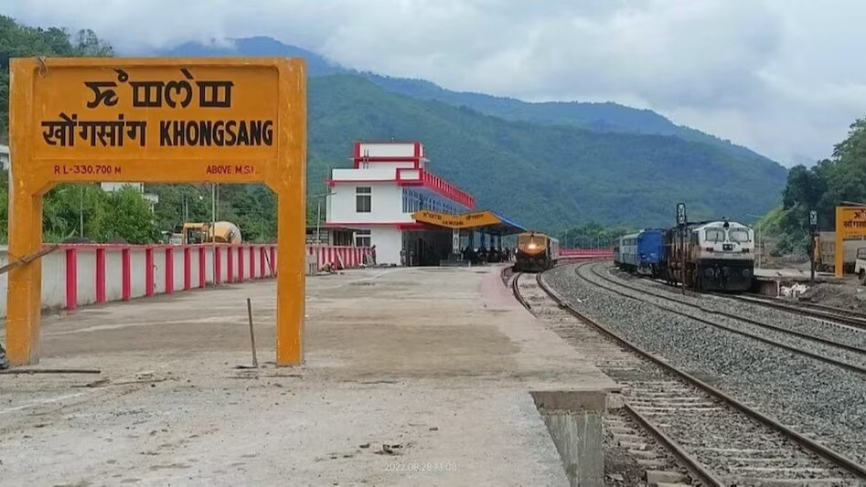
Introducing our user-friendly train tracking website – the perfect solution for conveniently monitoring trains using either the train number or station names. Our platform simplifies the process of accessing essential train information, including locations, arrivals, and departures. Whether you're planning a journey or checking in on loved ones' travels, our website offers an easy and efficient way to stay updated. Say goodbye to the hassle of deciphering complex train schedules – we're here to make train tracking simple and accessible for everyone. All aboard for a stress-free and convenient travel experience! 🚂✨

Slide 3
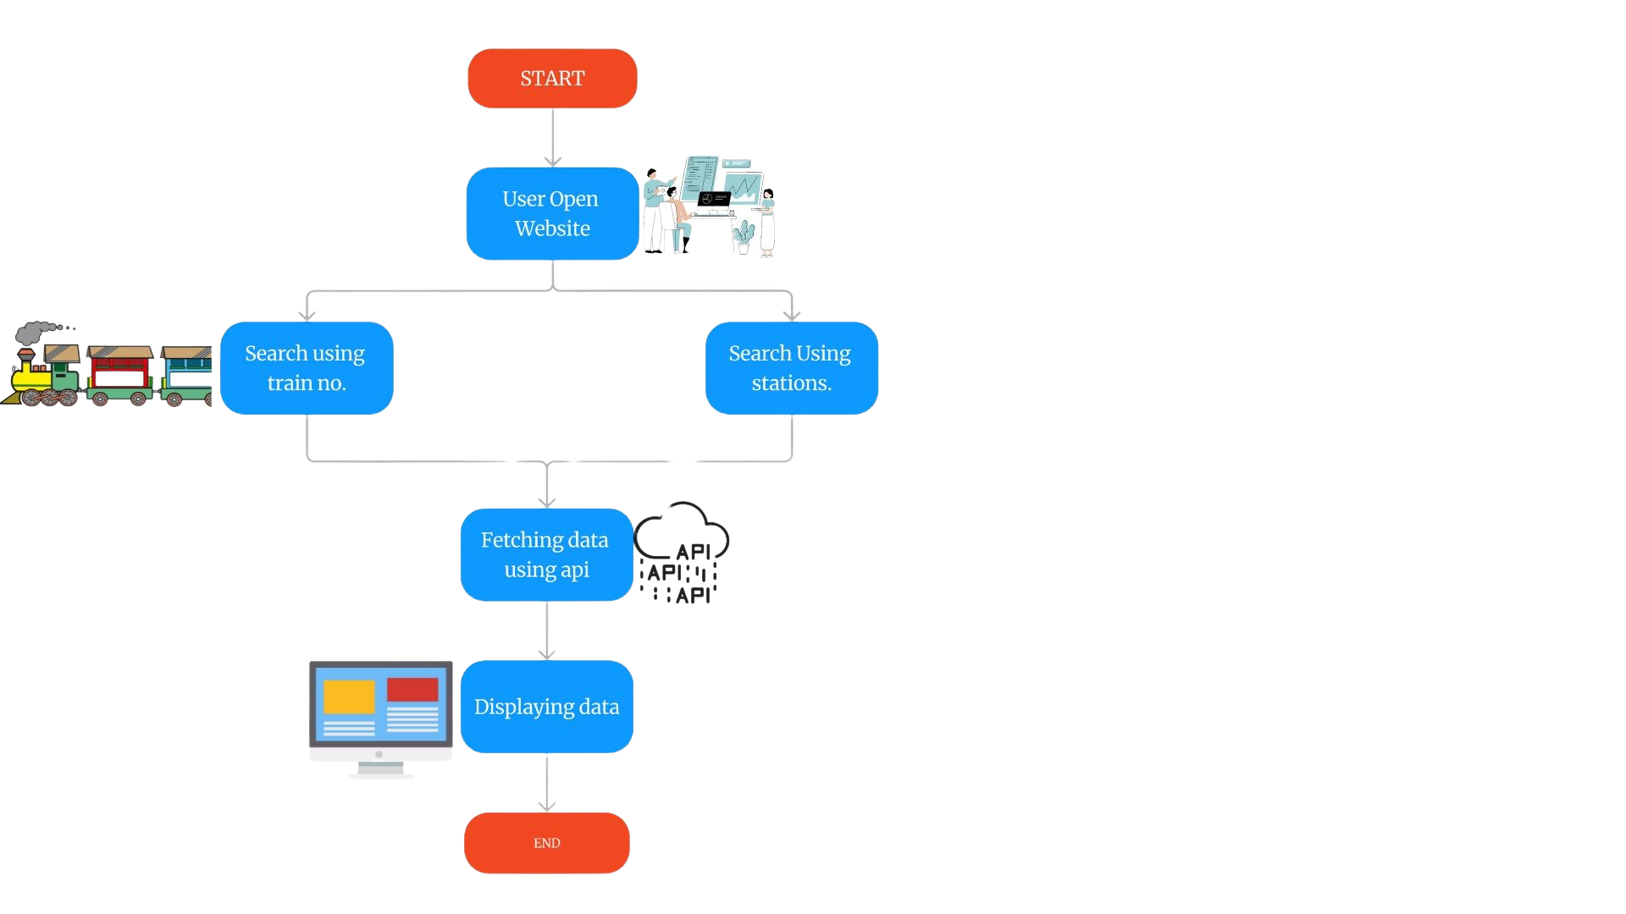
Flowchart

Slide 4
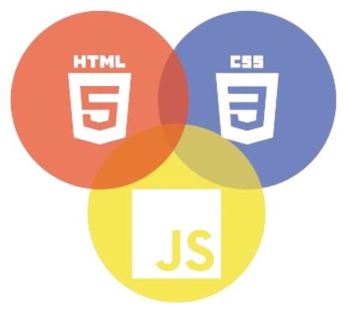

Technology used
Front-end:
HTML, CSS, JavaScript: These are the core technologies for building the user interface and handling client-side interactions.
Back-end :
JavaScript : This is what going to do the backened part of the website .
Node.js:These are server-side frameworks that can handle HTTP requests, process data .
Train-related APIs: To fetch train data. Some transportation authorities provide APIs for developers to access this information. So we can integrate this in our website to get the information.

