Slide 1
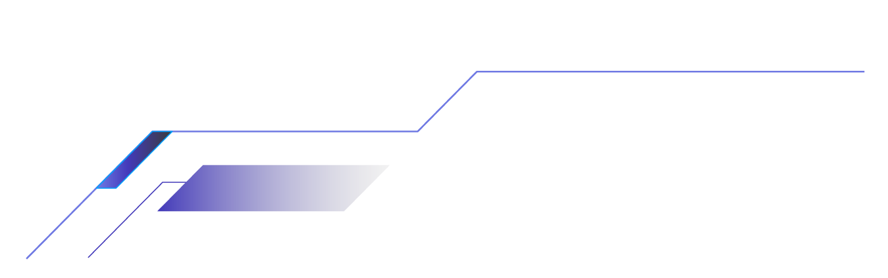
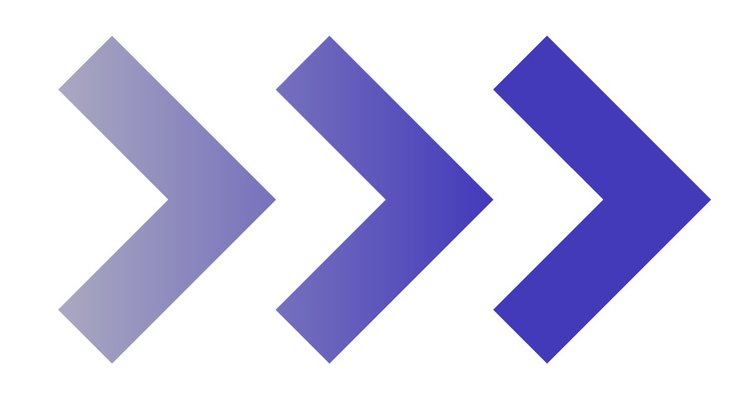
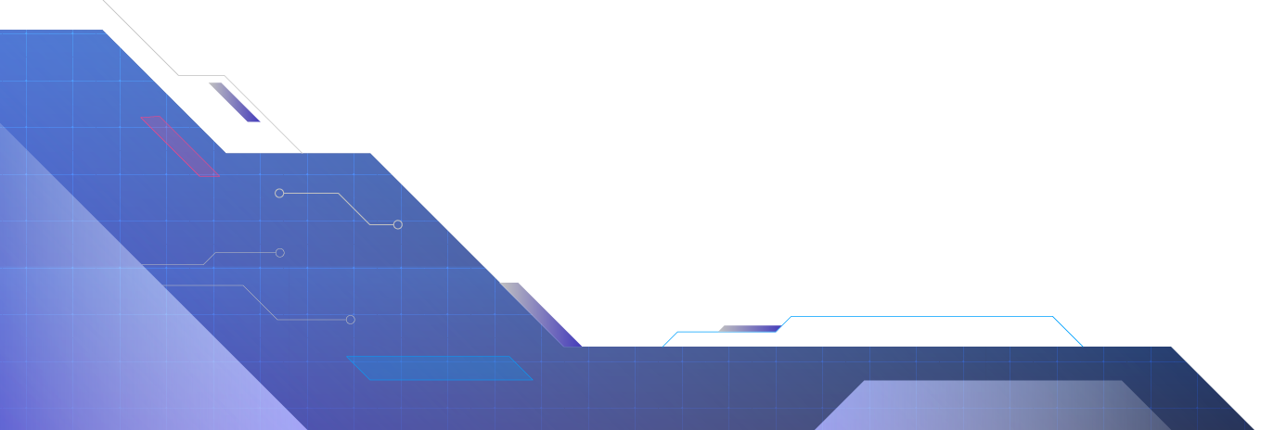
VeriCode AI - Secure Code Intelligence and DevOps Automation Platform

Slide 2
Introduction
Modern software projects contain a large amount of source code, external libraries, and deployment components. As projects become larger, it becomes difficult for developers to manually identify all code-quality and security problems.
Tools such as code analyzers and vulnerability scanners can detect these problems, but their results are often provided separately and may be difficult for developers to understand.
VeriCode AI is proposed as a unified platform that combines code analysis, security scanning, AI-based explanations, and DevOps automation to help developers build and deploy software more securely.

Slide 3
Abstract
VeriCode AI is an AI-integrated platform designed to improve the security and reliability of software development. The system analyzes source code and project dependencies to identify code-quality issues and security vulnerabilities.
SonarQube is used for code analysis, while Trivy is used for vulnerability scanning. The detected issues are processed by an AI component that provides simple explanations and possible remediation suggestions.
The platform integrates these results into a centralized dashboard and supports DevOps practices using GitHub and Docker. PostgreSQL is used for data storage, while Prometheus and Grafana are used for application monitoring. DVC is used for versioning AI-related datasets.

Slide 4
Literature Survey
Existing System: SonarQube
Existing Features
➔ Code quality analysis. ➔ Bug detection. ➔ Vulnerability detection. ➔ Code smell detection. ➔ Security issue reporting.
Scope for Improvement
➔ Primarily focuses on code analysis and issue detection. ➔ Technical reports may be difficult for beginners to understand. ➔ Does not provide AI-based explanations for every finding. ➔ Limited support for personalized remediation guidance. ➔ Developers may need additional tools for dependency and container scanning.

Slide 5
Literature Survey
Existing System: Trivy
Existing Features
➔ Dependency vulnerability scanning. ➔ Container image scanning. ➔ Secret detection. ➔ Misconfiguration detection. ➔ Severity-based vulnerability reporting.
Scope for Improvement
➔ Mainly focuses on detecting security risks. ➔ Provides technical vulnerability information that may be difficult to understand. ➔ Does not provide AI-powered explanations of detected issues. ➔ Limited support for integrated remediation guidance. ➔ Developers may need separate tools to analyze code quality and monitor applications.

Slide 6
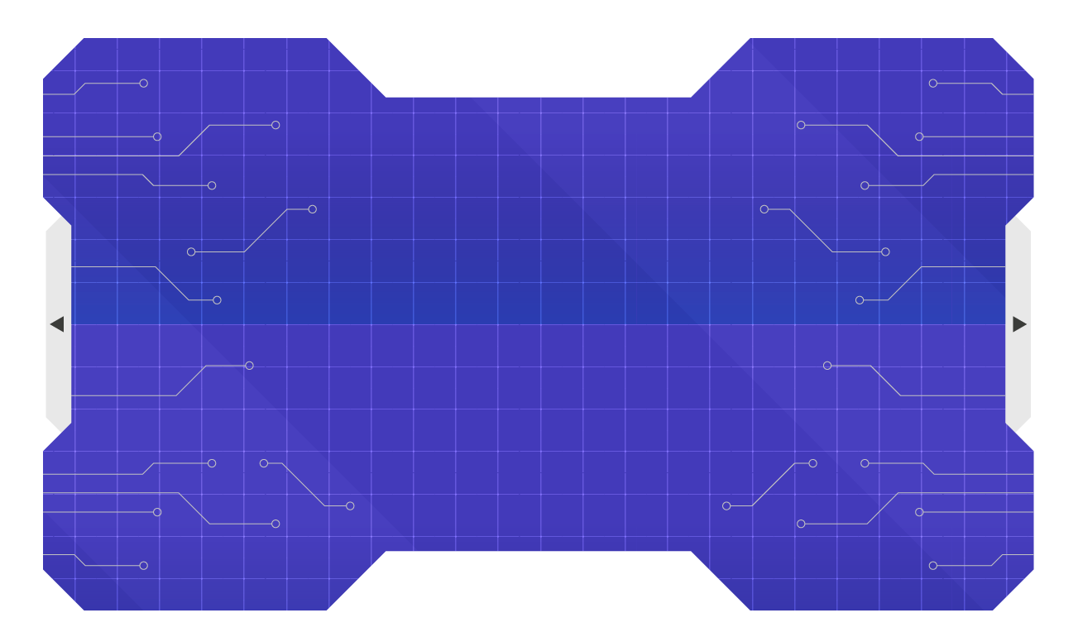
Research Gap Identification
Feature | Existing Tools | VeriCode AI
Code Quality Analysis | ✅ | ✅
Vulnerability Detection | ✅ | ✅
Dependency Scanning | ❌ (Separate Tool) | ✅
Centralized Security Dashboard | ❌ | ✅
AI-Based Issue Explanation | Limited | ✅
Fix Recommendations | Limited | ✅
Unified Security Analysis | ❌ | ✅
DevSecOps Integration | ❌ (Partial) | ✅
Application Monitoring | ❌ (Separate Tool) | ✅

Slide 7
Previous Methodology
Traditional software security follows a mostly separate and manual approach.
➔ Developers write and maintain the application code.
➔ Code quality is checked using separate analysis tools.
➔ Dependencies and container images are scanned using separate security tools.
➔ Developers manually review the generated technical reports.
➔ Security issues are investigated and fixed manually.
➔ Security checks may happen later in the development process, increasing the risk of finding issues before deployment.
Limitations
➔ Multiple tools require separate analysis and management.
➔ Technical reports can be difficult for developers to understand quickly.
➔ Limited AI assistance for explaining security issues.
➔ Fixing vulnerabilities depends heavily on manual effort.
➔ No single platform provides a combined view of code quality, security, and monitoring.

Slide 8
New Methodology
The proposed system follows an integrated AI-based DevSecOps approach for analyzing and securing software projects.
➔ GitHub Integration: The developer provides the project source code through GitHub.
➔ Code Analysis: SonarQube analyzes the source code for bugs, code smells, and security issues.
➔ Vulnerability Scanning: Trivy checks project dependencies and container images for known vulnerabilities.
➔ AI Analysis: The Python-based AI module analyzes the detected issues and provides simple explanations and possible remediation suggestions.
➔ Centralized Dashboard: React.js displays the scan results, security status, and AI recommendations in one place.
➔ Data Storage: PostgreSQL stores project details, scan results, vulnerabilities, and recommendations.
➔ DevOps & Deployment: Docker supports containerized deployment and GitHub supports the development workflow.
➔ Monitoring: Prometheus collects application metrics and Grafana provides visual monitoring of system health.
class Robot:
def __init__(self, x, y):
self.x = x
self.y = y
def move_up(self):
self.y += 1
def move_down(self):
self.y -= 1
def move_left(self):
self.x -= 1
…………

Slide 9
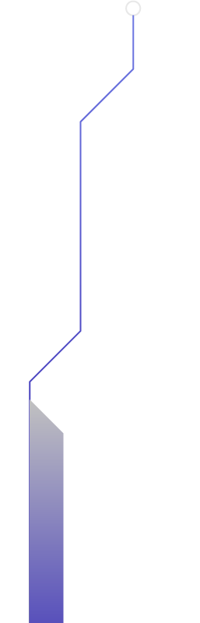
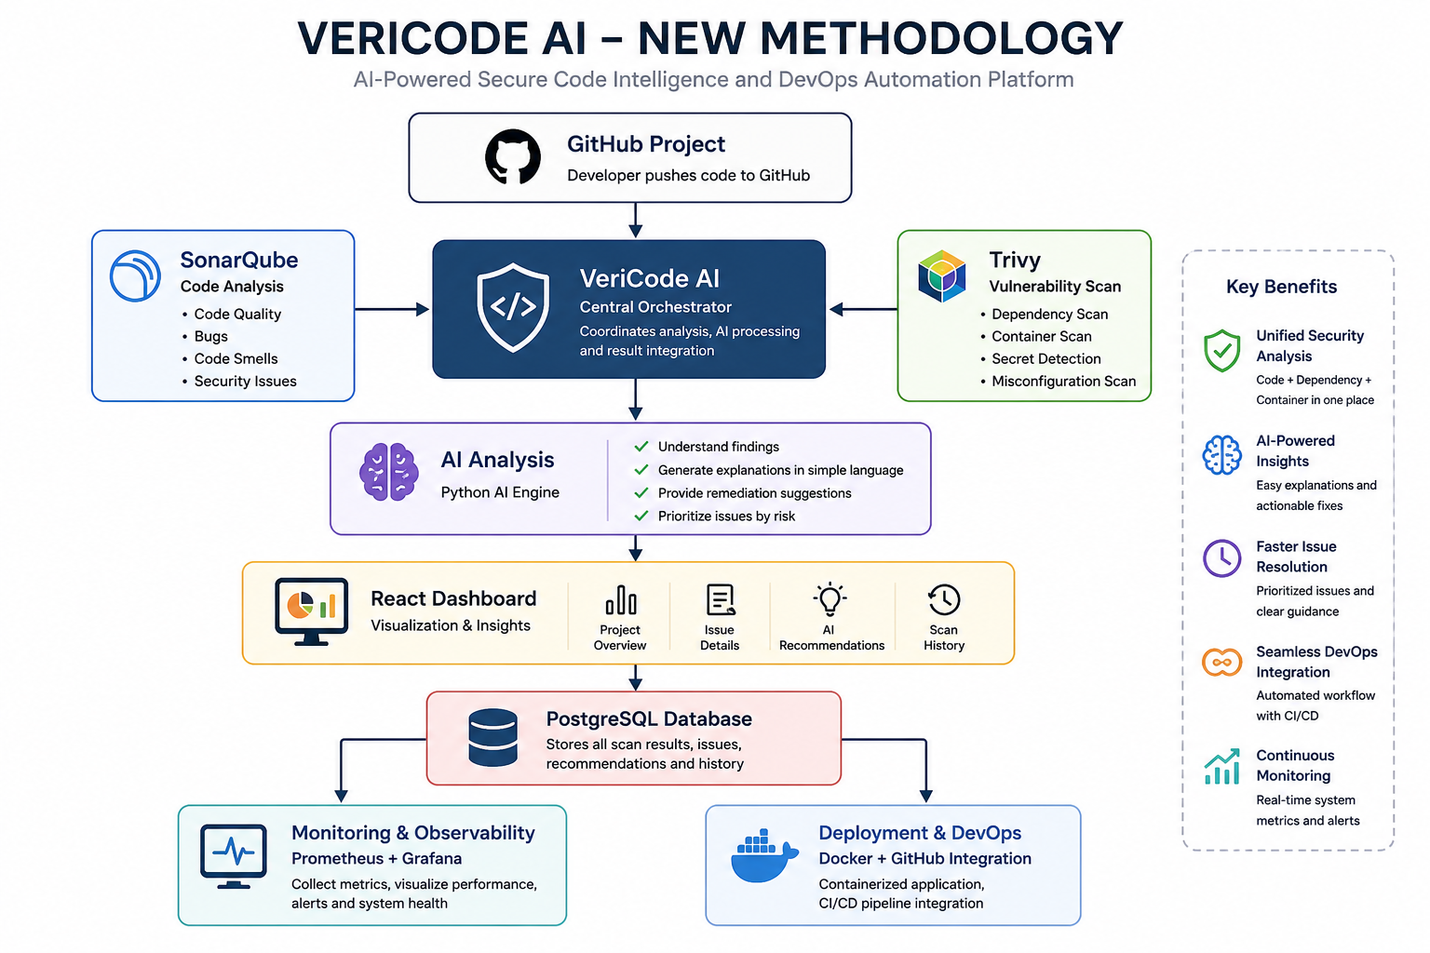
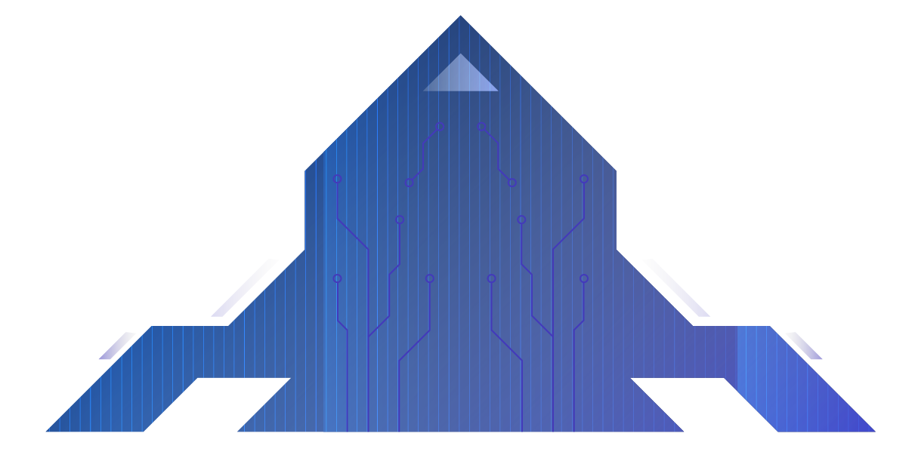

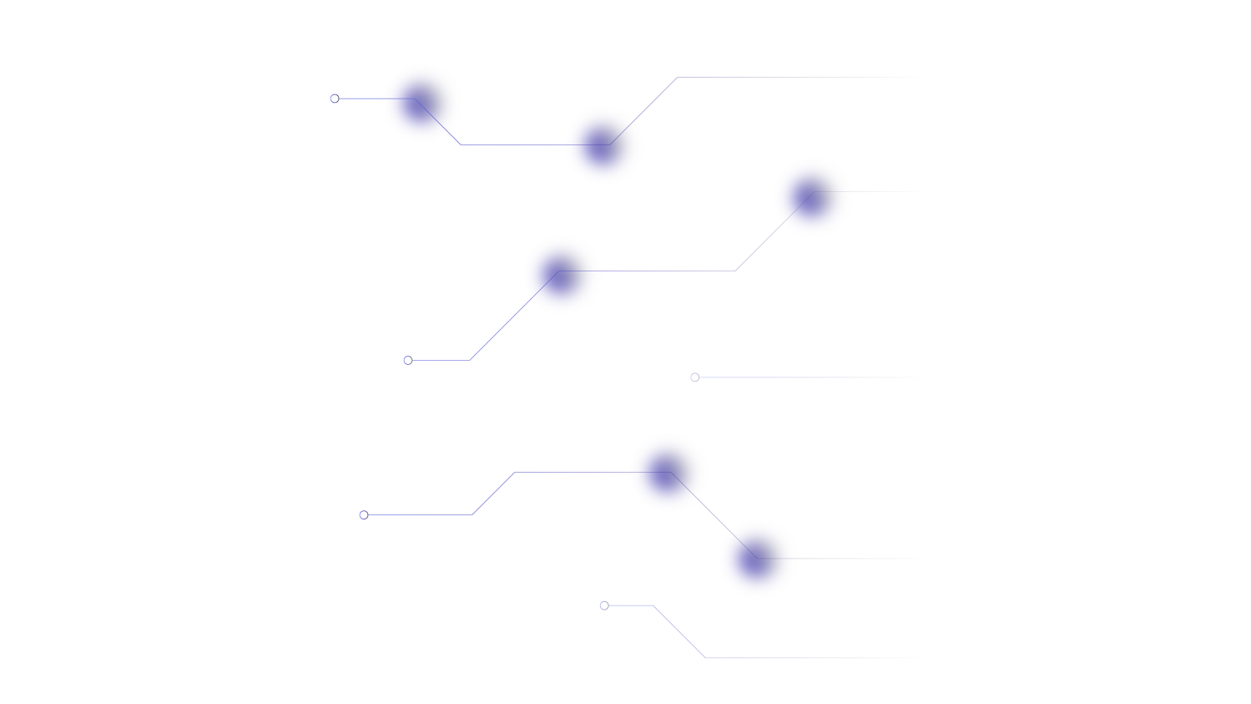
New Methodology

Slide 10
THANKYOU!
Presented By:
Agastya Singh
Challa Saketh Kumar
Shaga Yashwanth

