Slide 1
🏦
CIB Early Warning System
A 30–90 Day Silent-Deterioration Risk Model for a Current Account / CIB Portfolio
Agastya Sharma • Data Science Internship Portfolio Project • github.com/agastyasharma20/cib-ews
⚠ Built entirely on synthetic data — not affiliated with or endorsed by HDFC Bank
Notes:
Open by naming the real problem in one sentence before touching the deck: 'HDFC's CA customers don't close accounts when they're unhappy — they quietly move activity to a competitor while the account stays open.' Then say this is a from-scratch, end-to-end project built to demonstrate how you'd approach that as a data scientist, on synthetic data since real data isn't available outside the bank. Mention the navy/red theme is a deliberate nod to HDFC's brand, not their actual logo — shows you thought about professionalism and IP boundaries, which is itself a good signal to a bank's reviewers.

Slide 2
Agenda
• 1. Business problem — why silent deterioration, not closure
• 2. In plain English — the 60-second version
• 3. Approach — end-to-end pipeline, 9 phases
• 4. Synthetic data & the deterioration index
• 5. Feature engineering — 5 signal groups
• 6. Model results — baseline → tuned core model
• 7. Explainability — SHAP reason codes
• 8. Risk sizing & actions — PFaR + RM recommendations
• 9. Survival analysis — estimating WHEN, not just IF
• 10. Graph feature experiment — an honest negative result
• 11. The dashboard
• 12. Why this matters for HDFC, and what's next
CIB Early Warning System • Agastya Sharma • github.com/agastyasharma20/cib-ews
2

Slide 3
WHY THIS PROJECT EXISTS
The Business Problem
Not closure — large CA/CIB customers keep the account technically open while quietly shifting balances, transaction flow, payroll, and trade activity to a competing bank.
Reactive today — RMs typically act only once balance erosion is already visible in monthly reports — by then, most of the wallet share is usually already gone.
The ask — a system that flags this kind of silent deterioration 30–90 days in advance, explains WHY, estimates roughly WHEN, sizes the exposure, and recommends a specific action.
CIB Early Warning System • Agastya Sharma • github.com/agastyasharma20/cib-ews
3
Notes:
This is the slide to slow down on. Emphasize 'technically open' — that's the whole insight the project is built around. If asked 'why not just watch balances', that's your cue for the next slide's framing: balance is the LAST thing to move, and the whole value of an early-warning system is watching what moves BEFORE it.

Slide 4
SAME IDEA, NO JARGON — THE 60-SECOND VERSION
In Plain English
Imagine a company banks with HDFC. They don't close the account — they just quietly start routing payments, salaries, and trade deals through a rival bank instead. By the time the balance visibly drops, they're already mostly gone.
1. WATCH
Every month, compare each customer's recent behavior to their own history and to similar peers.
2. EXPLAIN
If something looks like quiet drifting-away, say exactly which behaviors are driving that — in plain English.
3. ACT
Estimate roughly when it'll get serious, size the ₹ at risk, and hand the RM one specific action.
The rest of this deck is how each of those three steps was actually built and validated.
CIB Early Warning System • Agastya Sharma • github.com/agastyasharma20/cib-ews
4
Notes:
Use this slide if the audience includes anyone non-technical (a hiring manager, an HR panelist). It's your elevator pitch — you should be able to say this paragraph from memory without looking at the slide. Everything after this slide is proving each of the three boxes actually works.

Slide 5
9 PHASES, ONE PIPELINE
End-to-End Approach
1. Synthetic Data
2. Labeling & Features
3. Baseline Model
4. Tuned Core Model
5. Explainability (SHAP)
6. PFaR + RM Actions
7. Survival Analysis
8. Graph Feature
9. Dashboard
Every stage reads/writes through src/config.py's file paths — a real data source swaps in at ONE seam, nothing downstream rebuilds.
CIB Early Warning System • Agastya Sharma • github.com/agastyasharma20/cib-ews
5

Slide 6
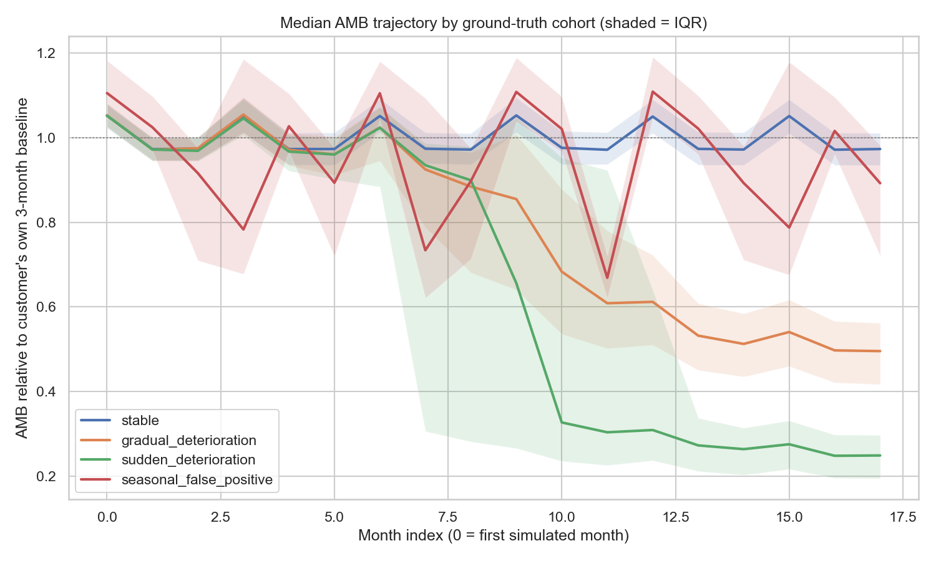
PHASE 1 — WITH HIDDEN GROUND TRUTH FOR VALIDATION
Synthetic Data: 4 Planted Cohorts
5,000 customers × 18 months. stable (55%) / gradual (20%) / sudden (10%) / seasonal_false_positive (15%, deliberately NOT deterioration).
CIB Early Warning System • Agastya Sharma • github.com/agastyasharma20/cib-ews
6

Slide 7
PHASE 2 — PERCENTILE-RANKED, NOT A FLAT THRESHOLD
The Deterioration Index
• Composite score: AMB decline (35%) + transaction decline (30%) + digital decline (15%) + payroll/trade decline (20%)
• Each component ranked against SAME-SEGMENT, SAME-MONTH peers — cancels out size differences and shared seasonality
• A breach reverting within 2 months AND uncorroborated by other signals is filtered out as a harmless dip
True cohort (hidden ground truth) | Flag rate
sudden_deterioration | 100.0%
gradual_deterioration | 97.5%
seasonal_false_positive | 1.7%
stable | 0.1%
• Precision 98.9% • Recall 98.3%
• Median detection lag vs. true onset: 2 months (sudden), 4 months (gradual)
CIB Early Warning System • Agastya Sharma • github.com/agastyasharma20/cib-ews
7
Notes:
If asked 'why not just threshold the balance': explain that an SME's balance naturally swings more than a Large Corporate's, and quarter-end window dressing moves everyone's balance at once — ranking against same-segment, same-month peers cancels both effects out. The seasonal_false_positive row (1.7% flagged) is the proof that a naive dip-detector would have failed here.

Slide 8
PHASE 2B — ALL LEAKAGE-SAFE (TRAILING DATA ONLY)
Feature Engineering — 5 Groups, 22 Features
Group | # Features | Example
1. Balance & Liquidity | 6 | amb_trend_slope_3m, seasonal-adjusted deviation
2. Transaction & Digital Activity | 5 | txn value trend, digital channel share
3. Product & Wallet-Share | 4 | payroll regularity score, trade utilization trend
4. Network & Counterparty | 3 | competitor-bank transaction share, HHI
5. Relationship & Engagement | 4 | tenure, complaint/service-ticket trend
Same grouping reused end-to-end: reason codes (Phase 5) and the RM-action mapping (Phase 6) key off these exact 5 groups.
CIB Early Warning System • Agastya Sharma • github.com/agastyasharma20/cib-ews
8

Slide 9
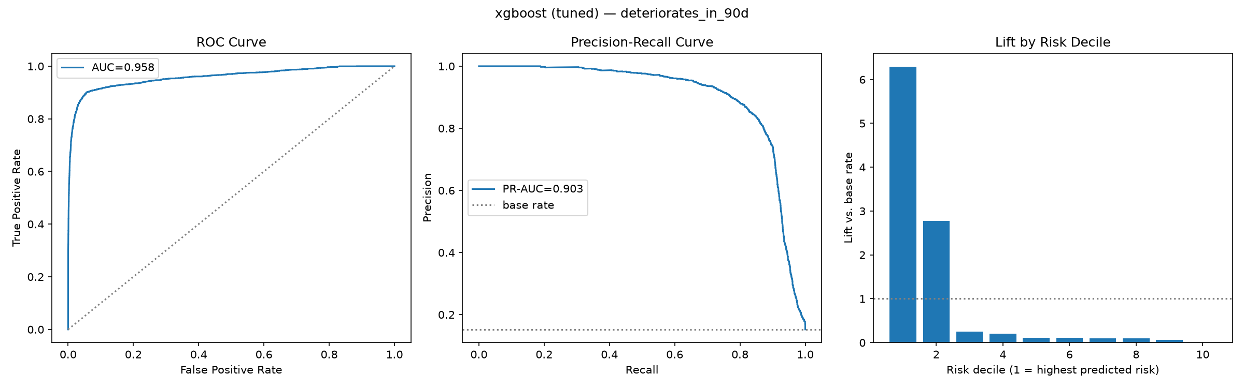
PHASES 3–5 — 90-DAY HORIZON SHOWN
Model Results — Baseline → Tuned Core Model
Model | ROC-AUC | PR-AUC | Top-decile lift
Logistic Regression (baseline) | 0.935 | 0.841 | 5.85x
LightGBM (tuned) | 0.951 | 0.854 | 6.16x
XGBoost (tuned) — CHOSEN | 0.958 | 0.903 | 6.29x
• Chosen on PR-AUC, not ROC-AUC — at a ~6-15% positive rate, ROC-AUC can look strong while precision in the actionable top slice is mediocre.
• LightGBM's PR-AUC looked competitive, but its precision/recall COLLAPSED TO 0 at the default 0.5 threshold — miscalibrated probabilities, caught by checking beyond the headline metric.
CIB Early Warning System • Agastya Sharma • github.com/agastyasharma20/cib-ews
9
Notes:
The LightGBM 0.000/0.000 precision/recall row is a great interview story: it shows you don't just read the headline metric and stop — you checked a second angle (a fixed threshold) and caught something the PR-AUC alone hid. Lead with that if asked 'tell me about a time you caught your own mistake / a subtle bug'.

Slide 10
PHASE 5 — FROM A SCORE TO A STORY
Explainability — SHAP Reason Codes
• SHAP TreeExplainer computes PER-CUSTOMER attributions — not just global feature importance
• Raw features grouped into plain-language driver labels BEFORE ranking (3 distinct stories, not 1 story 3 times)
• Ranked by signed SHAP sum, not magnitude — a protective factor never crowds out the actual risk drivers
Risk | 90d score | Top 3 reason codes
High | 1.00 | Falling balances → Lower digital activity → Reduced payroll activity
Medium | 0.50 | Declining credits → Concentrating counterparties → Declining transactions
Low | 0.00 | Narrowing product relationship → Rising complaints → Concentrating counterparties
CIB Early Warning System • Agastya Sharma • github.com/agastyasharma20/cib-ews
10

Slide 11
PHASE 6 — PFAR (PROBABILITY-WEIGHTED FUNDS AT RISK)
Risk Sizing & Recommended Actions
PFaR = 90-day risk score × (current balance × empirically-calibrated expected decline %)
• Decline % calibrated from OUR OWN historically-confirmed deterioration cases — never from the hidden ground truth (that would be leakage a real deployment could never replicate)
• Decomposed into a driver TYPE — liquidity / relationship / competitor — from the customer's top reason code
• RM action mapping: a swappable rules-based lookup (top reason code → action), interface shaped for a future contextual-bandit upgrade once real RM-outcome data exists
Reason code | Recommended action
Falling balances | Discuss liquidity requirements
Rising competitor-transfer share | Proactive wallet-share conversation / pricing review
Reduced payroll activity | Assess payroll migration risk
CIB Early Warning System • Agastya Sharma • github.com/agastyasharma20/cib-ews
11

Slide 12
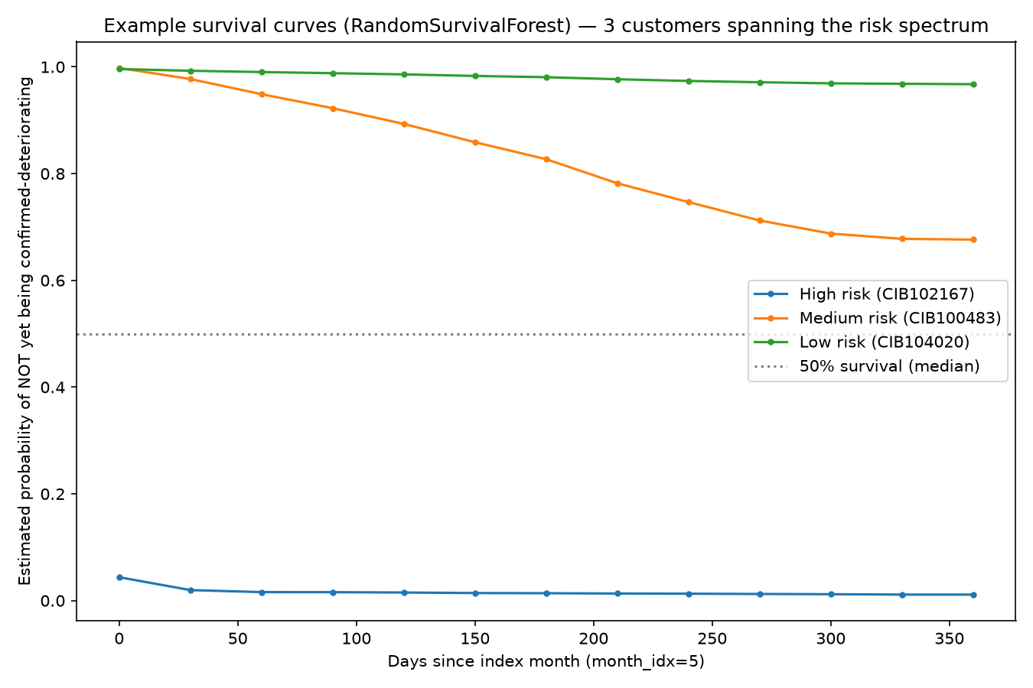
PHASE 7 — TIME-TO-DETERIORATION
Survival Analysis — Estimating WHEN
Tried first: CoxPHFitter — the standard approach.
Checked, not assumed: check_assumptions() flagged 11 of 24 covariates (46%) violating proportional hazards — pervasive, not borderline.
Switched to: Random Survival Forest — no such assumption. Concordance index 0.659 vs. Cox's 0.591.
0.659 is modest next to the classifiers' 0.90+ AUC — expected: this model gets ONE early snapshot per customer, not fresh features every month.
CIB Early Warning System • Agastya Sharma • github.com/agastyasharma20/cib-ews
12
Notes:
This is your best 'I check my assumptions instead of trusting a library's default' story. Cox is the textbook answer; running check_assumptions() and actually reading the output (11/24 covariates failing) before trusting the hazard ratios is the part worth narrating slowly if asked about statistical rigor.

Slide 13
PHASE 8 (STRETCH) — NETWORKX WALLET-LEAKAGE GRAPH
Graph Feature — An Honest Negative Result
Horizon | Variant | ROC-AUC | PR-AUC
90d | Before (no graph) | 0.9585 | 0.9027
90d | After (+ graph feature) | 0.9580 | 0.9019
No lift: flat to very slightly worse at every horizon; ranks 14th–25th of 27 features by SHAP.
Root cause, confirmed: the graph feature correlates 0.88–0.91 with an existing Phase 2 feature built from the same transactions — methodologically distinct, mostly redundant information.
Why keep it: shows the negative result was investigated and explained, not hidden — and the graph is the right extension point once real counterparty-entity data exists.
CIB Early Warning System • Agastya Sharma • github.com/agastyasharma20/cib-ews
13
Notes:
Don't skip or rush this slide — a negative result you investigated and explained is a STRONGER signal of maturity than another slide of things that worked. If a reviewer asks 'what didn't work', this is the answer, and you already have the root cause (0.88-0.91 correlation) ready, not just 'it didn't help'.

Slide 14
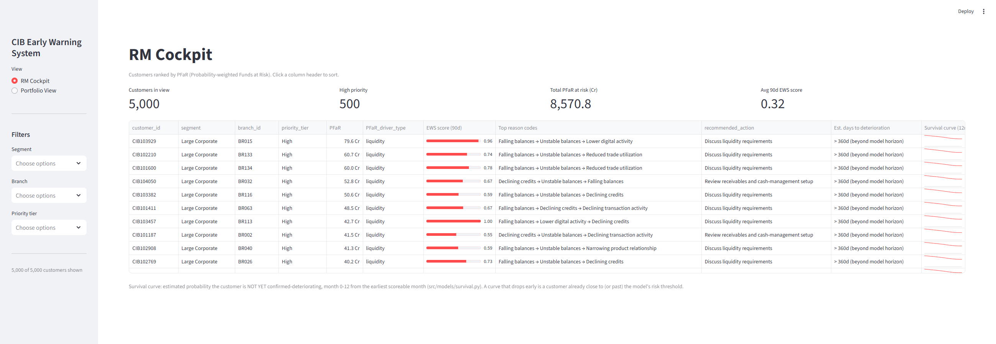
PHASE 9 — RM COCKPIT + PORTFOLIO VIEW
The Dashboard
RM Cockpit: PFaR-ranked, filterable, with plain-language reason codes and an inline survival-curve sparkline per customer.
CIB Early Warning System • Agastya Sharma • github.com/agastyasharma20/cib-ews
14

Slide 15
BUSINESS FRAMING, NOT A REAL REVENUE ESTIMATE
Why This Could Matter for HDFC
CIB relationships are high-value — large balances, deep cross-sell, and expensive to win back once fully gone. Even a modest improvement in EARLY detection compounds at portfolio scale.
Shifts RM effort from reactive to prioritized — instead of a monthly balance report an RM notices too late, a ranked worklist with a reason and a specific action.
The ₹8,570 Cr flagged exposure on this synthetic 5,000-customer book isn't a real estimate — it's a demonstration of the SHAPE of the calculation a real portfolio-scale PFaR number would take.
The real ask: a chance to do this analysis on real (anonymized/sampled) CIB data, where every threshold and calibration in this deck would be re-tuned, not reused blindly (see the Path to Production section of docs/methodology.md).
CIB Early Warning System • Agastya Sharma • github.com/agastyasharma20/cib-ews
15
Notes:
Be careful with this slide — do not let it sound like you're claiming to know HDFC's real numbers. The point is showing you think about business impact, not just model metrics, while being explicit that the rupee figure is illustrative. If pressed, say plainly: 'I don't have HDFC's real numbers — this shows the mechanism, and I'd want the chance to run it on real data.'

Slide 16
HOW THIS GROWS FROM A PORTFOLIO PROJECT INTO A STRONGER ONE
Innovation & What's Next
Close the one gap myself: an automated test suite (label thresholds, feature leakage-safety, PFaR logic) — the one thing this project doesn't have yet.
Contextual bandit RM-action recommender: the action-engine interface is already shaped for it — needs real RM-outcome data to learn from, not more code.
The REAL wallet-leakage graph: customer↔customer, via shared vendors/directors, once entity-level counterparty data exists — Phase 8 showed exactly why the bank-level version fell short.
Model monitoring: track PR-AUC and calibration drift over time as real data accumulates, not just a one-time evaluation.
NLP on RM call notes / service tickets: a 6th feature group, using text the current data doesn't include.
CIB Early Warning System • Agastya Sharma • github.com/agastyasharma20/cib-ews
16
Notes:
This slide is deliberately about what you'd do NEXT, not more of what's already done — use it to show self-awareness of the project's edges and genuine ideas for extending it, which is exactly what an internship interviewer wants to see: can this person keep improving something after the first version ships, not just finish an assignment.

Slide 17
BEING DIRECT ABOUT WHAT CHANGES WITH REAL DATA
Limitations & Path to Production
Known limitation: 0.90+ AUCs are unusually strong because engineered features are correlated with how the synthetic labels were built — real data will likely perform lower.
One seam to swap: src/config.py's file paths are the ONLY place a real core-banking source plugs in — nothing downstream (features, models, dashboard) needs to change.
Must be recalibrated: DI threshold, PFaR decline %, model hyperparameters, the Cox-vs-RSF decision — all tuned on synthetic data, not assumed to transfer.
CIB Early Warning System • Agastya Sharma • github.com/agastyasharma20/cib-ews
17

Slide 18
Thank You
Agastya Sharma
work.agastya20@gmail.com • github.com/agastyasharma20/cib-ews
Full methodology, every result, and the code: see docs/methodology.md in the repository.

