Slide 1



On Predicting the Outcomes of Chemotherapy Treatment in Breast Cancer
Agastya Silvina, Juliana Bowles, and Peter Hall

Slide 2

Outline
Introduction
Related Work
Data Analysis
Models Creation
Result
Conclusion

Slide 3
Introduction
Cancer
is a mutation caused by an abnormal reproduction of cells.
can occur in different organs (e.g., breast, lungs, bone, etc.)
Treatments vary from surgery with chemotherapy and/or radiotherapy (i.e. usually take a long time and in sequence)
However some treatments are toxic and expensive
We compared several different techniques (Markov Model, HMM, RF, RNN) applied to the same data set to predict the toxicity outcome of different treatment options

Slide 4



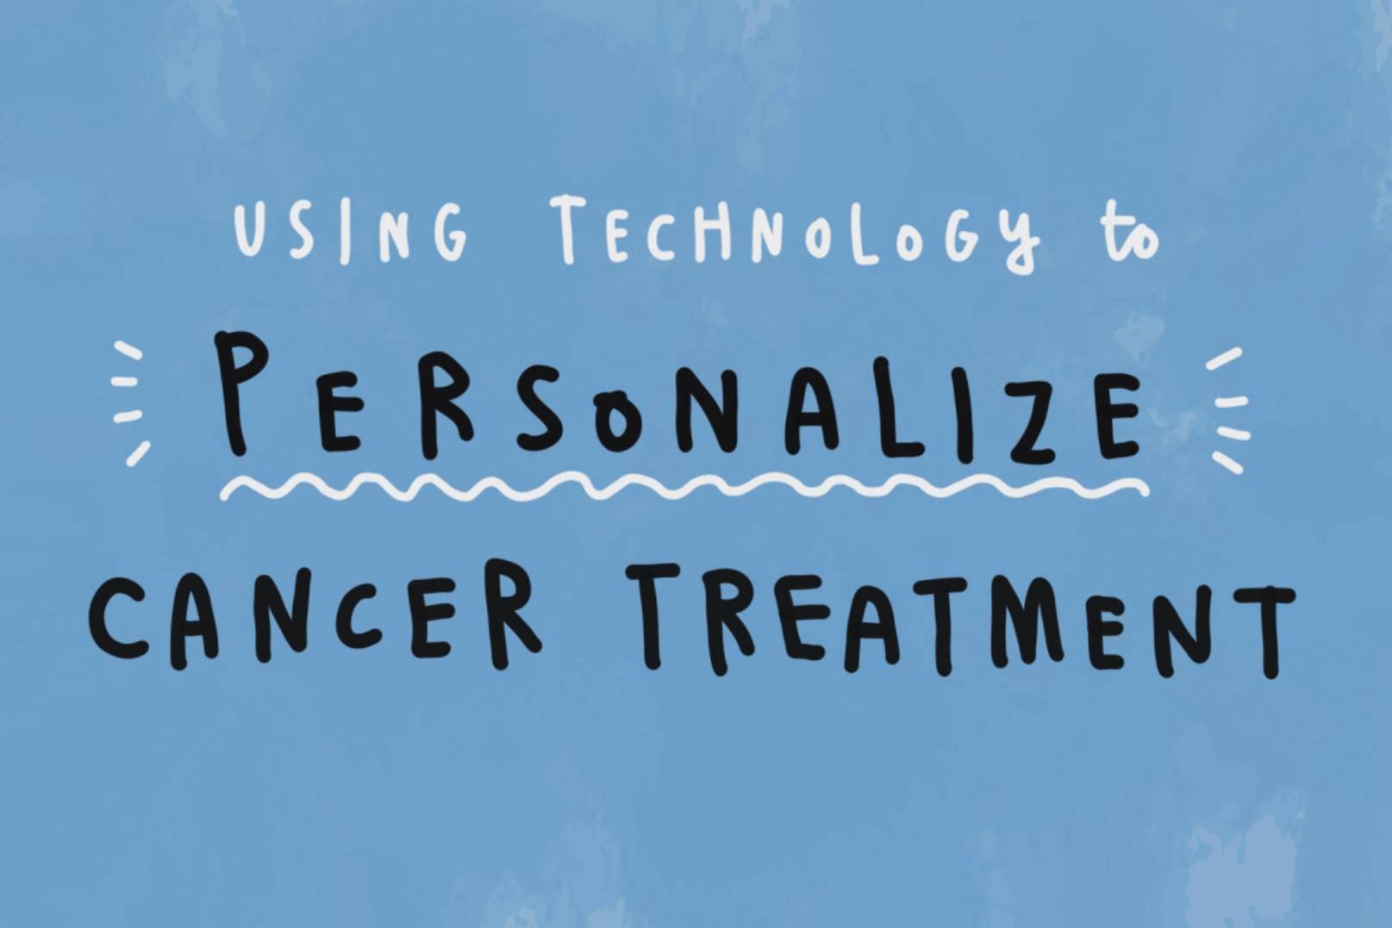

Related Work
Many ongoing research looks at prediction of cancer treatment outcomes
Bayesian Logistic Regression (Subramani et al.)
Random Forest (Hui-Ling Chen et al.)
SVM (Nguyen et al.)
We have added HMM and RNN (common in different fields like NLP) to explore what their benefits might be

Slide 5
Outline
Introduction
Related Work
Data Analysis
Models Creation
Result
Conclusion

Slide 6
Data Analysis
We use a data extraction from an oncology department in Scotland
3 years (2014 - 2016 )
Includes various observations concerning breast cancer treatments (e.g. intention, regime, cycles), recorded side effects (here, toxicity level), and patient characteristics (e.g. age, BMI, performance status).
Intention | Number of Treatments | Number of Patients
Adjuvant | 1209 | 205
Neo-adjuvant | 1855 | 382
Palliative | 2752 | 213

Slide 7
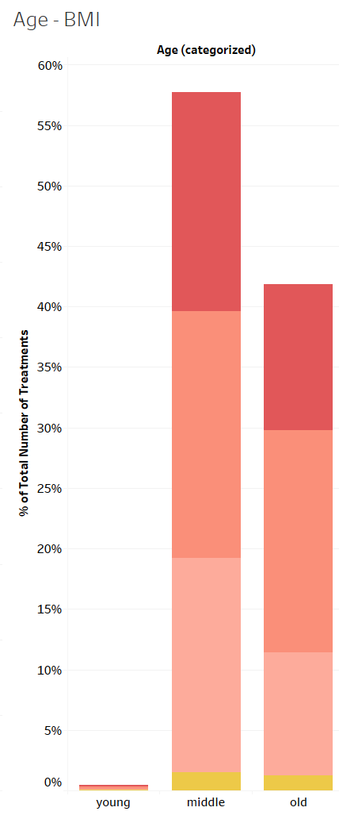
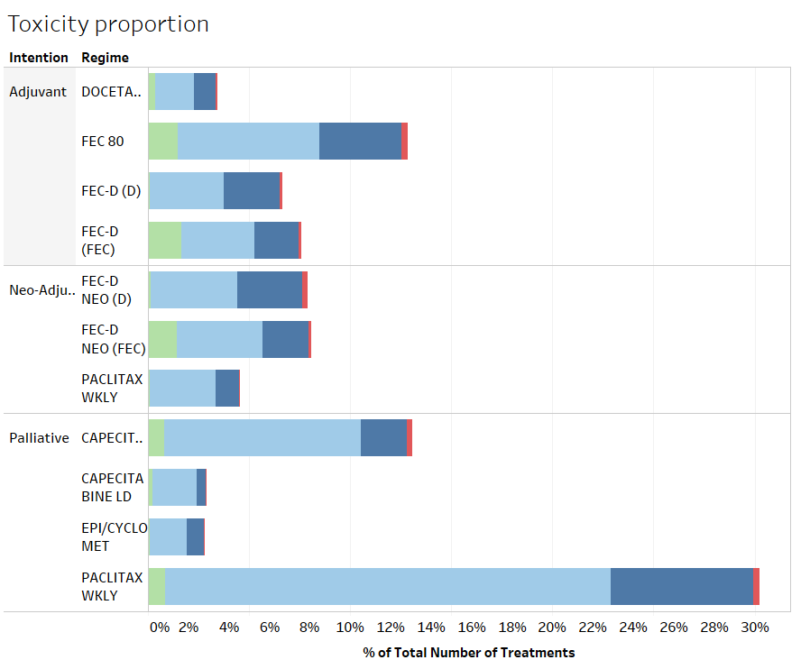
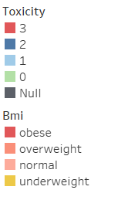

Slide 8
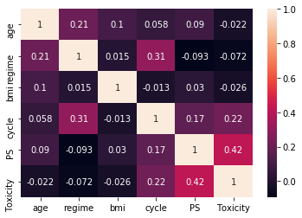
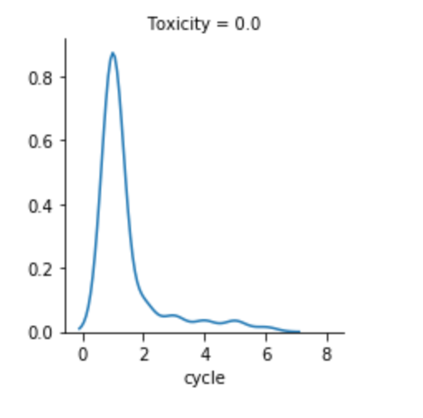
Features correlation
Low Toxicity distribution
Notes:
Data should distinguish the options on dosage
No information on stages

Slide 9
Outline
Introduction
Related Work
Data Analysis
Models Creation
Result
Conclusion

Slide 10
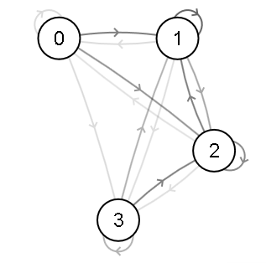
Markov Model (MM)
A stochastic model with the assumption that a future state only depends on the current state.
0, 1, 2, 3 denote the toxicity state(i.e. No toxicity, Low, Medium, High)
The Adjuvant therapy Markov Chain
Notes:
Add transition matrix

Slide 11
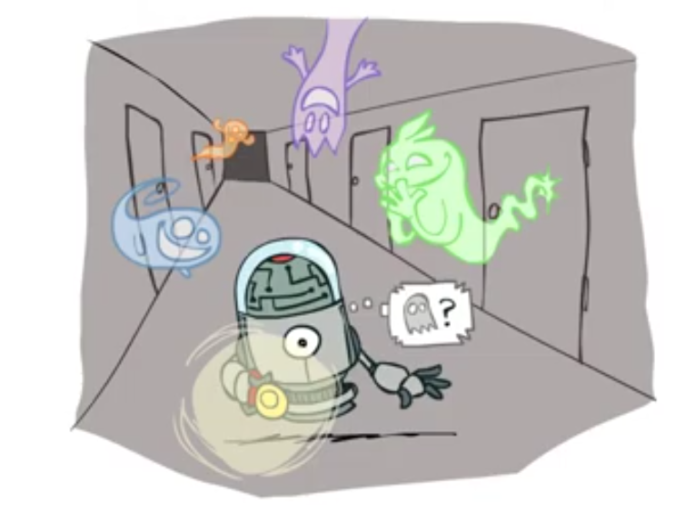
Hidden Markov Model (HMM)
Based on augmenting a Markov chain to observe the hidden states of events
Our HMM components:
States: T0, T1, T2, T3
Transitions: from T0 to T1, from T1 to T3, etc
Observations: cycle, age, BMI, regime (categorised and coded). For example, 1-2-3-1 denotes the observation for an overweight patient who gets the FEC-D (D) in their first cycle and is aged less than 50 years
Emissions: the probability of the observations generated from the toxicity state
Notes:
Add more visualisation of how from NLP you got the idea to use this model for the cancer prediction problem

Slide 12
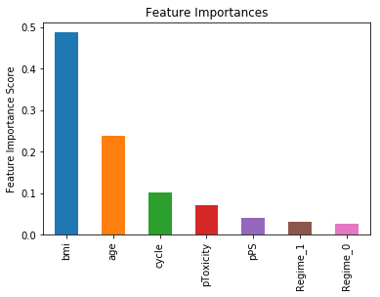
Random Forest
An ensemble of decision trees for solving classification problems.
We created three RF models for each treatment intention (i.e., adjuvant, neoadjuvant, palliative)
Predictors: age, BMI, Regime, cycle, previous toxicity, and previous performance status.
Outcome: Patients’ toxicity

Slide 13
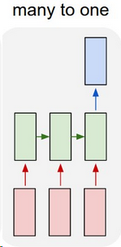
Recurrent Neural Network (RNN)
A class of NN where connections between nodes form a directed graph along a temporal sequence.
Implemented using tensorflow LSTM module.
Used similar features as for our RF model. However, we do not use the previous performance status and previous toxicity fields.

Slide 14
Model Comparison
Markov Model
A Stochastic model
Has no state memory
Random Forest
Ensemble learning
Has one state memory with previous toxicity field
Hidden Markov model (HMM)
Statistical Markov Model
Has one state memory
Based on POS Tagging
Recurrent Neural Network
Sequential ANN
Memorises all states

Slide 15
Outline
Introduction
Related Work
Data Analysis
Models Creation
Result
Conclusion

Slide 16
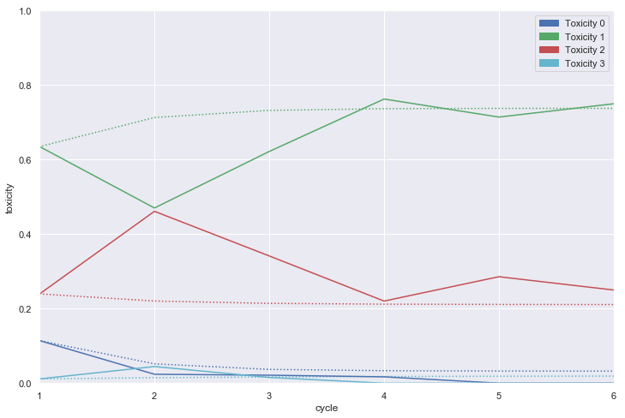
Markov Model
Palliative treatments distribution

Slide 17
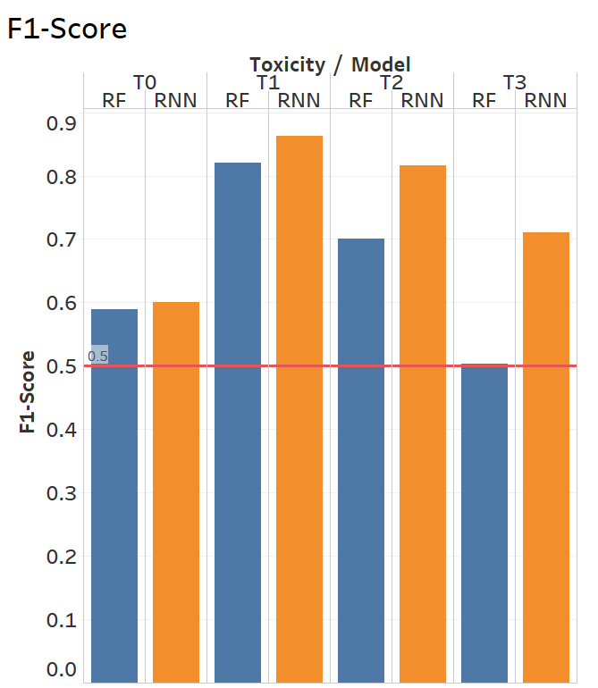
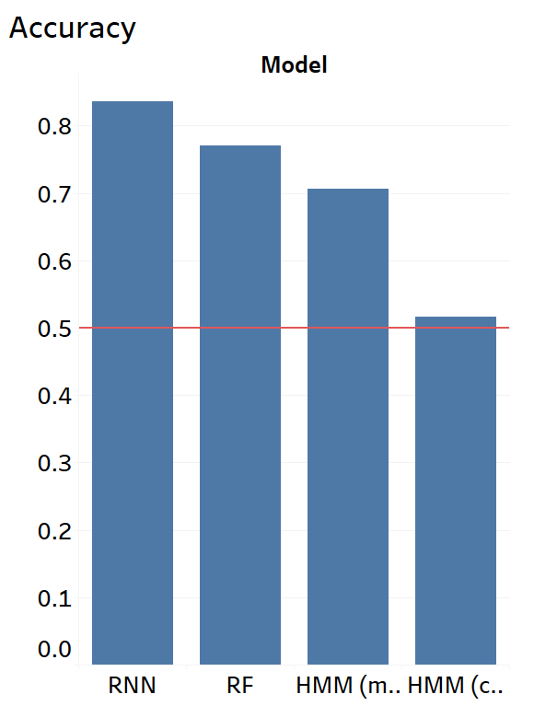
Classifier
RNN RF HMM-1* HMM-2**
RNN: Recurrent Neural Network
RF: Random Forest
*HMM-1: Hidden Markov Model-mid treatments
**HMM-2: Hidden Markov Model-init & end cycle (i.e., cycle = 0 or cycle = end of treatment)

Slide 18
Outline
Introduction
Related Work
Data Analysis
Models Creation
Result
Conclusion

Slide 19
Conclusion
Our classifiers can predict the toxicity outcome of the chemotherapy outcomes with around 0.8 - 0.85 accuracy.
The RNN model performed better than all other models because it considers all the history of patients' treatments
In contrast to the MM, the classifiers are more tailored for an individual patient.
Both the MM and the classifiers are a complement to each other.

Slide 20
Future Work
Improve the accuracy further by integrating more data regarding the cancer characteristics and patients' comorbidity – usually ignored.
Create a dashboard and/or reporting system which can be helpful to the clinical oncologist as a second opinion to decide which regimen is more suitable for an individual patient.

Slide 21
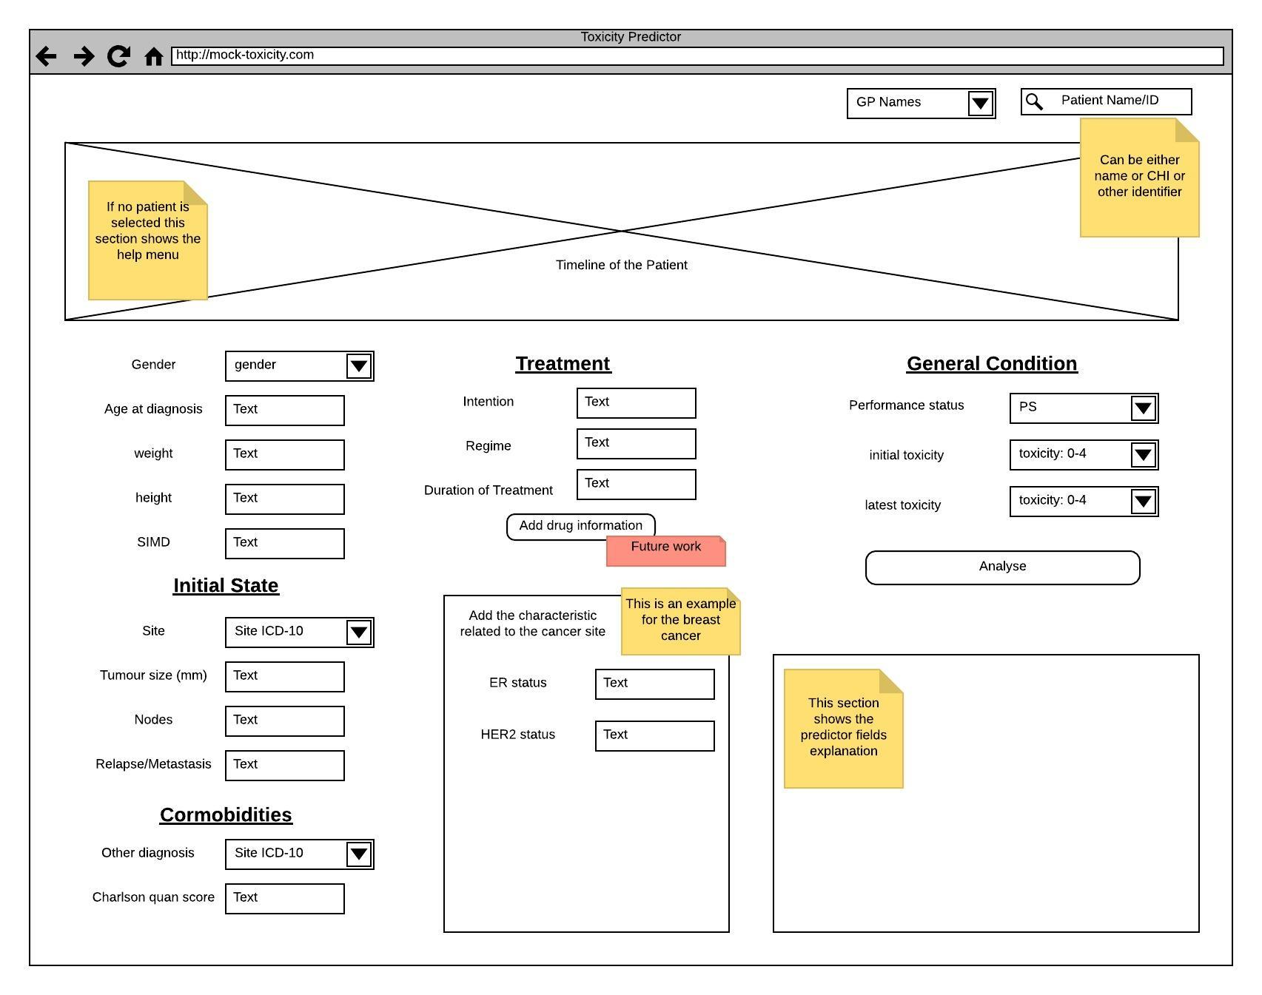
Future Work
Our aim is to use a synthetic data to further develop the application.
Dashboard
https://breast.predict.nhs.uk/tool

Slide 22
Open Issues and further work
Missing Values
Solution: regression, removing some instances
Class imbalance
Solution: duplication for some classes
Overfitting
Solution: Cross Validation, use synthetic data to mock-train and perform prospective validity on the model (as part of H2020 EU project SERUMS - provided by IBM Research)
Notes:
Add prostect

Slide 23
Thank you
Q/A

