Slide 1
Analyses and Management of Healthcare Data for Cancer Care
Agastya Silvina

Slide 2
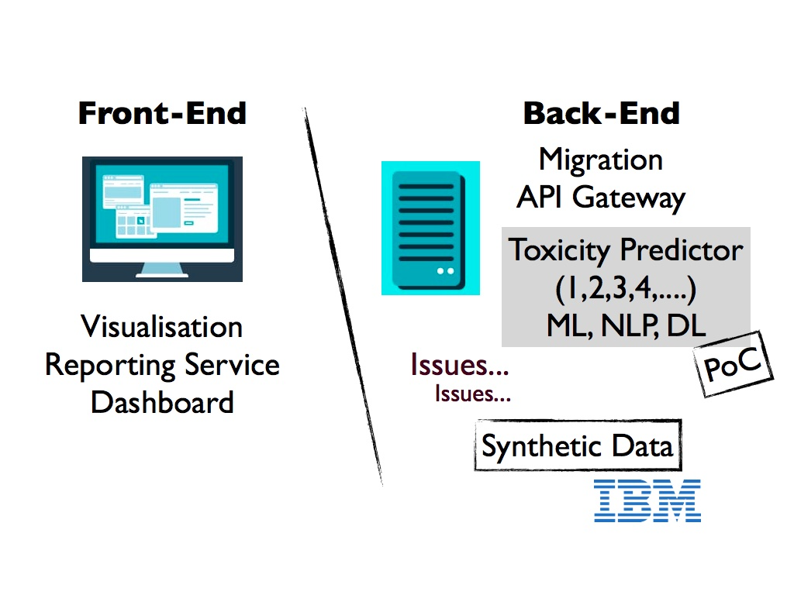
>> Treatment waiting time pathway analyses

Slide 3
Model Comparison
Markov Model
A Stochastic model
Has no state memory
Random Forest
Ensemble learning
Has one state memory with previous toxicity field
Hidden Markov model (HMM)
Statistical Markov Model
Has one state memory
Based on POS Tagging
Recurrent Neural Network
Sequential ANN
Memorised all state

Slide 4
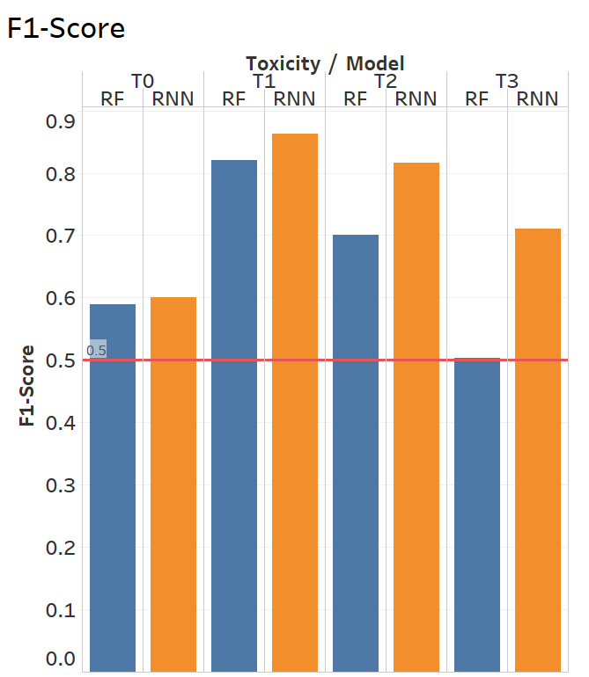
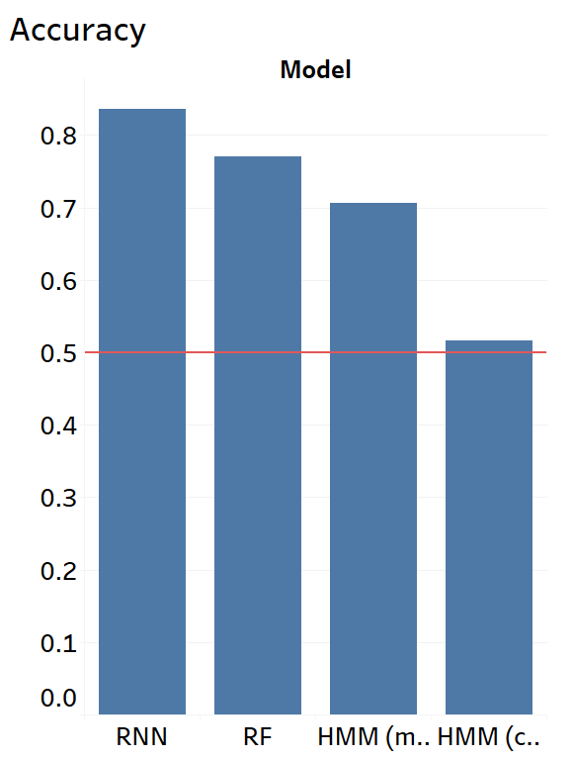
Classifier
RNN RF HMM-1* HMM-2**
RNN: Recurrent Neural Network
RF: Random Forest
*HMM-1: Hidden Markov Model-mid treatments
**HMM-2: Hidden Markov Model-init & end cycle (i.e., cycle = 0 or cycle = end of treatment)

Slide 5
Issues
●Missing Values
Solution: regression, removing some instances
●Class imbalance
Solution: duplication for some classes
●Overfitting
Solution: Cross Validation, use synthetic data to mock-train and perform prospective validity on the model (as part of H2020 EU project SERUMS - provided by IBM Research)

Slide 6
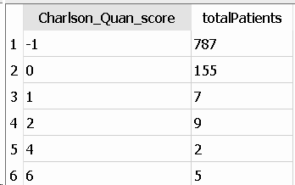
Used delta toxicity as the outcome (i.e., 0,-1,1) .
Accuracy was improved: 88%.
Need further model validation
Integrated Comorbidities (i.e., other medical conditions) to the model

Slide 7
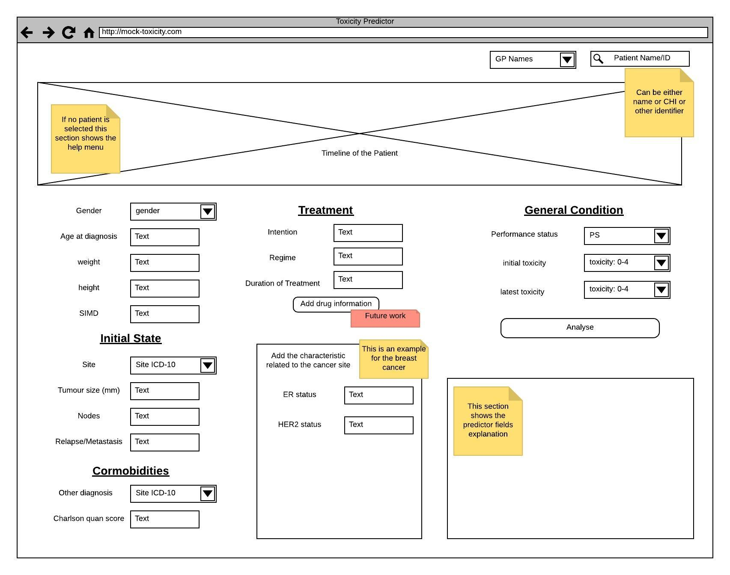
Future Work
Dashboard
https://breast.predict.nhs.uk/tool

Slide 8
Cancer Treatment Waiting Time Pathway
TODO:
Get the access to the TRAK backend for the last EngD project, developing cancer waiting times pathways project.
Analyse (e.g., tagging, filtering) the real patient data by comparing the pathway from the database with the guidance pathway.

Slide 9
THANK YOU

