Slide 1
Project Presentation
Expanding the proof rule base and tactics of AtelierB automated prover
by Agata Borkowska, u1690550

Slide 2
The B-Method
Formal specification method
Used in industry, especially transportation
  Siemens Transportation Systems
  Paris Metro (RAPT)
  more extensive list in the proposal

Slide 3
Atelier B
Tool for development in B
Includes interactive prover with a large rule base
First step in industrial projects
Used for quality assurance and guiding documentation

Slide 4
The abstract machine
First step towards a formal specification
System represented as a set of states and transitions
Set theory and logic notation
No loops
No temporal logic
Nondeterminism allowed

Slide 5
Progress

Slide 6
The versatile Bag Machine
Bag contains items from a specified set, ITEMS
Limit on the number of items it can hold
User can add, remove and query the content
Application:
List of cars which can park in a private car park
  ‘ITEMS’ is the set of all registration plates
  content is the list of cars allowed to park
  limited by the number of spaces

Slide 7
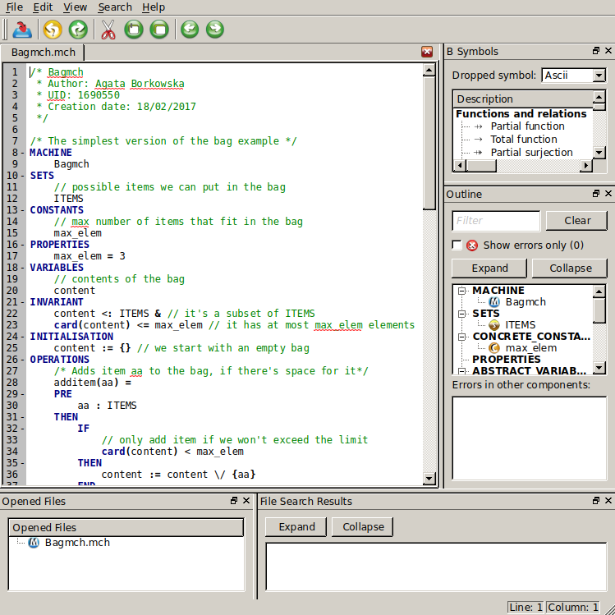
The Bag Machine
The static part:
  Sets
  Constants
  Properties
  Variables
  Invariant
The dynamic part:
  Initialisation
  Operations

Slide 8
Variations
Different way of expressing the set of ITEMS:
a set of numbers
an enumerated set
an ordered sequence
a partial function
...

Slide 9
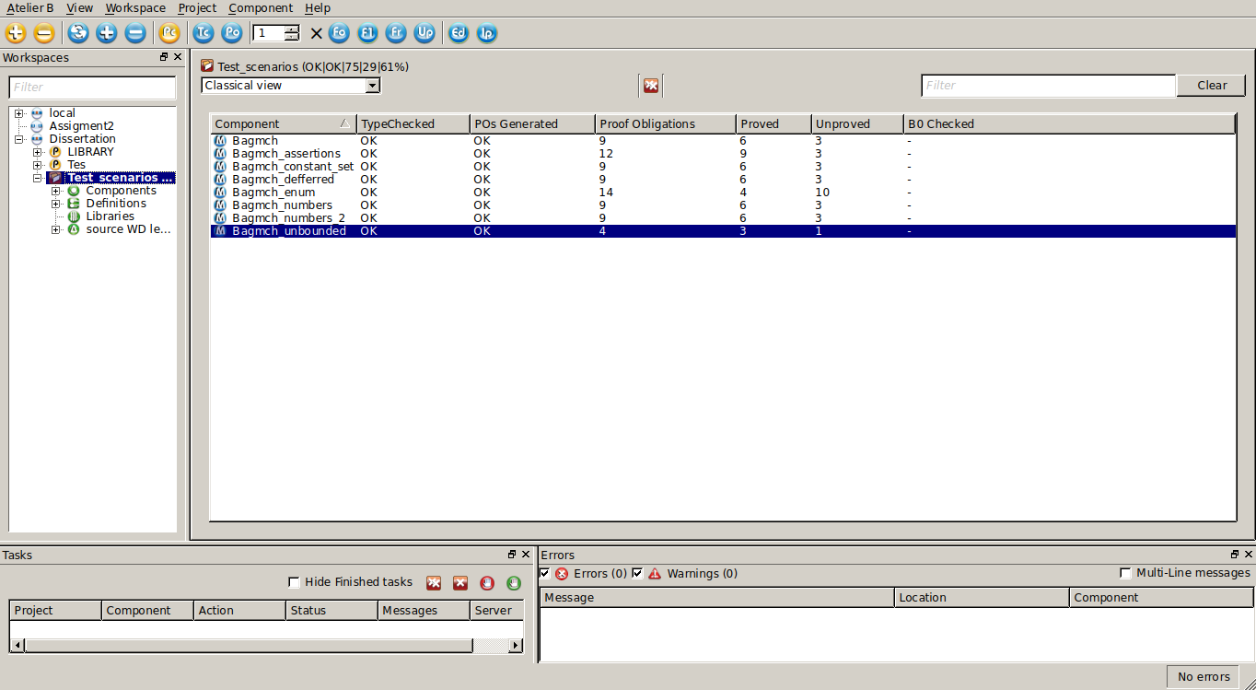

Slide 10
The Proof Process
Generate proof obligations
Discharge as many as possible automatically
Use Interactive Prover to demonstrate the rest
Write additional rules, theories and tactics only if necessary

Slide 11
Limitations of the Prover
The rule base is large, but not complete
It cannot disprove
  the problem is undecidable
Closed-source
No public list of bugs and tech support

Slide 12
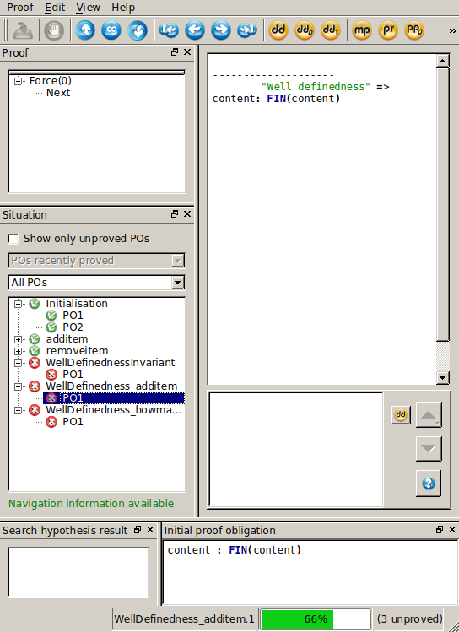
A closer look at the prover
The goal is to show that the content is a finite set
Ensured by invariant

Slide 13
Demonstrating finite set
Invariant contains ‘card(A)’
It’s well-defined, only if A is a finite set
The expression implies: card(A) ∈ ℕ
  card(A) ≤ 2³¹
  programming definition of INT
Adding ‘content ∈ FIN(content)’ solves the issue

Slide 14
Plan for the future

Slide 15
Overview
Focus on abstract machines, static part
  Most tricky to reason about
Identify repetitive problems
  E.g. finiteness of a set - solved
  enumerated set
Find a method of demonstrating it with the prover
If that fails, add rules and/or tactics

Slide 16
Writing rules
Don’t do it
Unless it’s really necessary
Each rule has to be verified
In industry, it is done with other software
  Theorem provers, e.g. Coq
  embedding B language

Slide 17
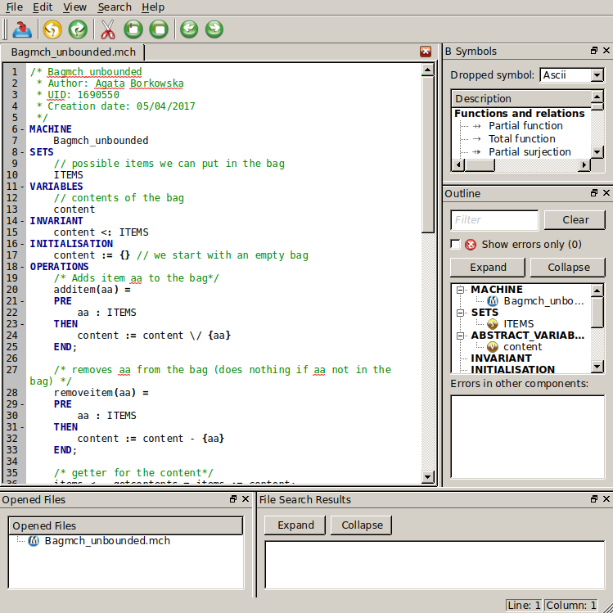
A cautionary tale
No limit on the number
of items

Slide 18
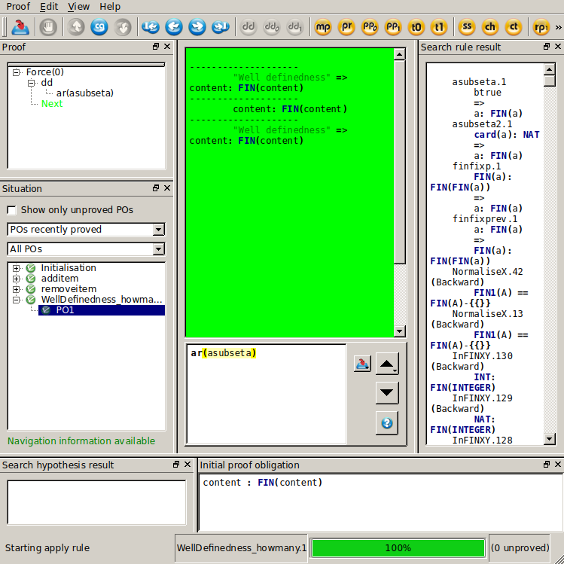
Using a user-written rule

Slide 19
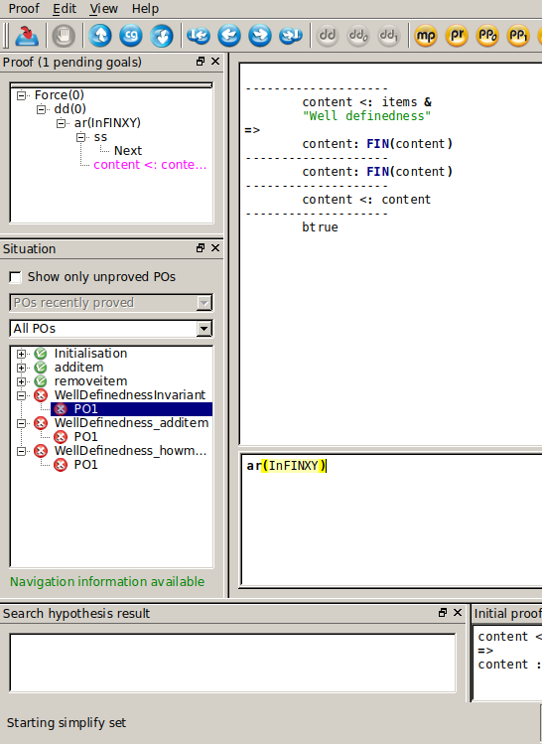
Strange behaviour
Uses only original rules
Goal is to show TRUE
It isn’t accepted

