Slide 1
DBusMenu
A way for applications to expose their menus over D-Bus transparently
Cross-desktop (Qt and GTK+ implementations)
Limitations :
  No support for widget in menu items
  No support for generated icons

Slide 2
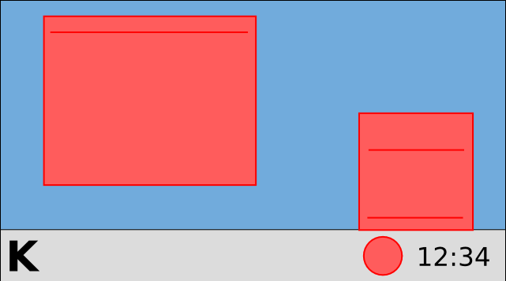
DbusMenu in the system tray
First there was XEmbed...
Handled by the application

Slide 3
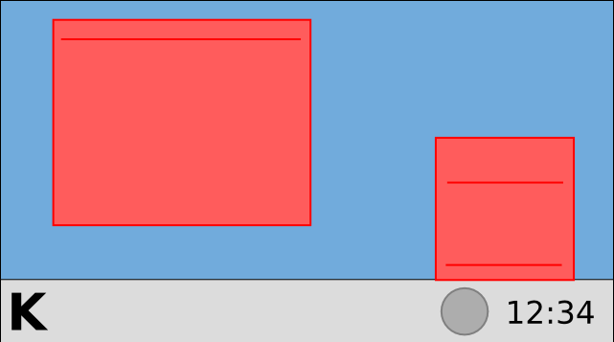
DbusMenu in the system tray
Then came KStatusNotifierItem...
Handled by the application
Handled by the system tray applet

Slide 4
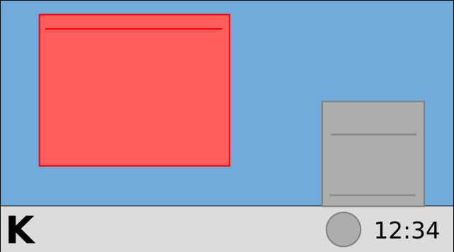
DbusMenu in the system tray
And finally DBusMenu
Handled by the system tray applet

Slide 5
DbusMenu in the menubar
Qt and GTK+ patches
Plasma menubar widget
GNOME menubar applet

