Slide 1

Team SQ(L)uad
“Providing sound database solutions since November 2016”
Team Members: Aggie Benichou, Frankie Klerer, Liam Mungovan, Nick Turney

Slide 2
Goals of Our Project
Assist the United Way of the Greater Lehigh Valley by building a single, unified database of all educational data of PA schools
Use the data to explore the performance of schools in PA, specifically in the Lehigh Valley
Create a user-friendly tool that allows the user to explore the data on their own
Provide a platform that is robust but expandable for the inclusion of future data

Slide 3
Tools and Approach
Tools used in the project: PSQL, Ruby on Rails, JQuery, CSS, JavaScript(D3), and Bootstrap
The first step was to draw out the design of our database
Next we implemented our design in PSQL and loaded our data
Third we queried the data and decided on visualizations to display on our website
Last, we used the available tools to create our web application and connect it to our database

Slide 4
The Data
The data we have is separated into two different sections: cohort graduation rates and graduation rates by school
Cohort graduation rates shows the data of different gender, racial/ethnic, and socioeconomic groups from 2011 to 2015
The cohort grad rates data is split into the number of years it took to graduate; either 4, 5, or 6 years
Grad rates by school show the academic performance of all high school or secondary schools in PA
Grad rates by school contains data from 2004 to 2015
Data comes from the PA Department of Education

Slide 5
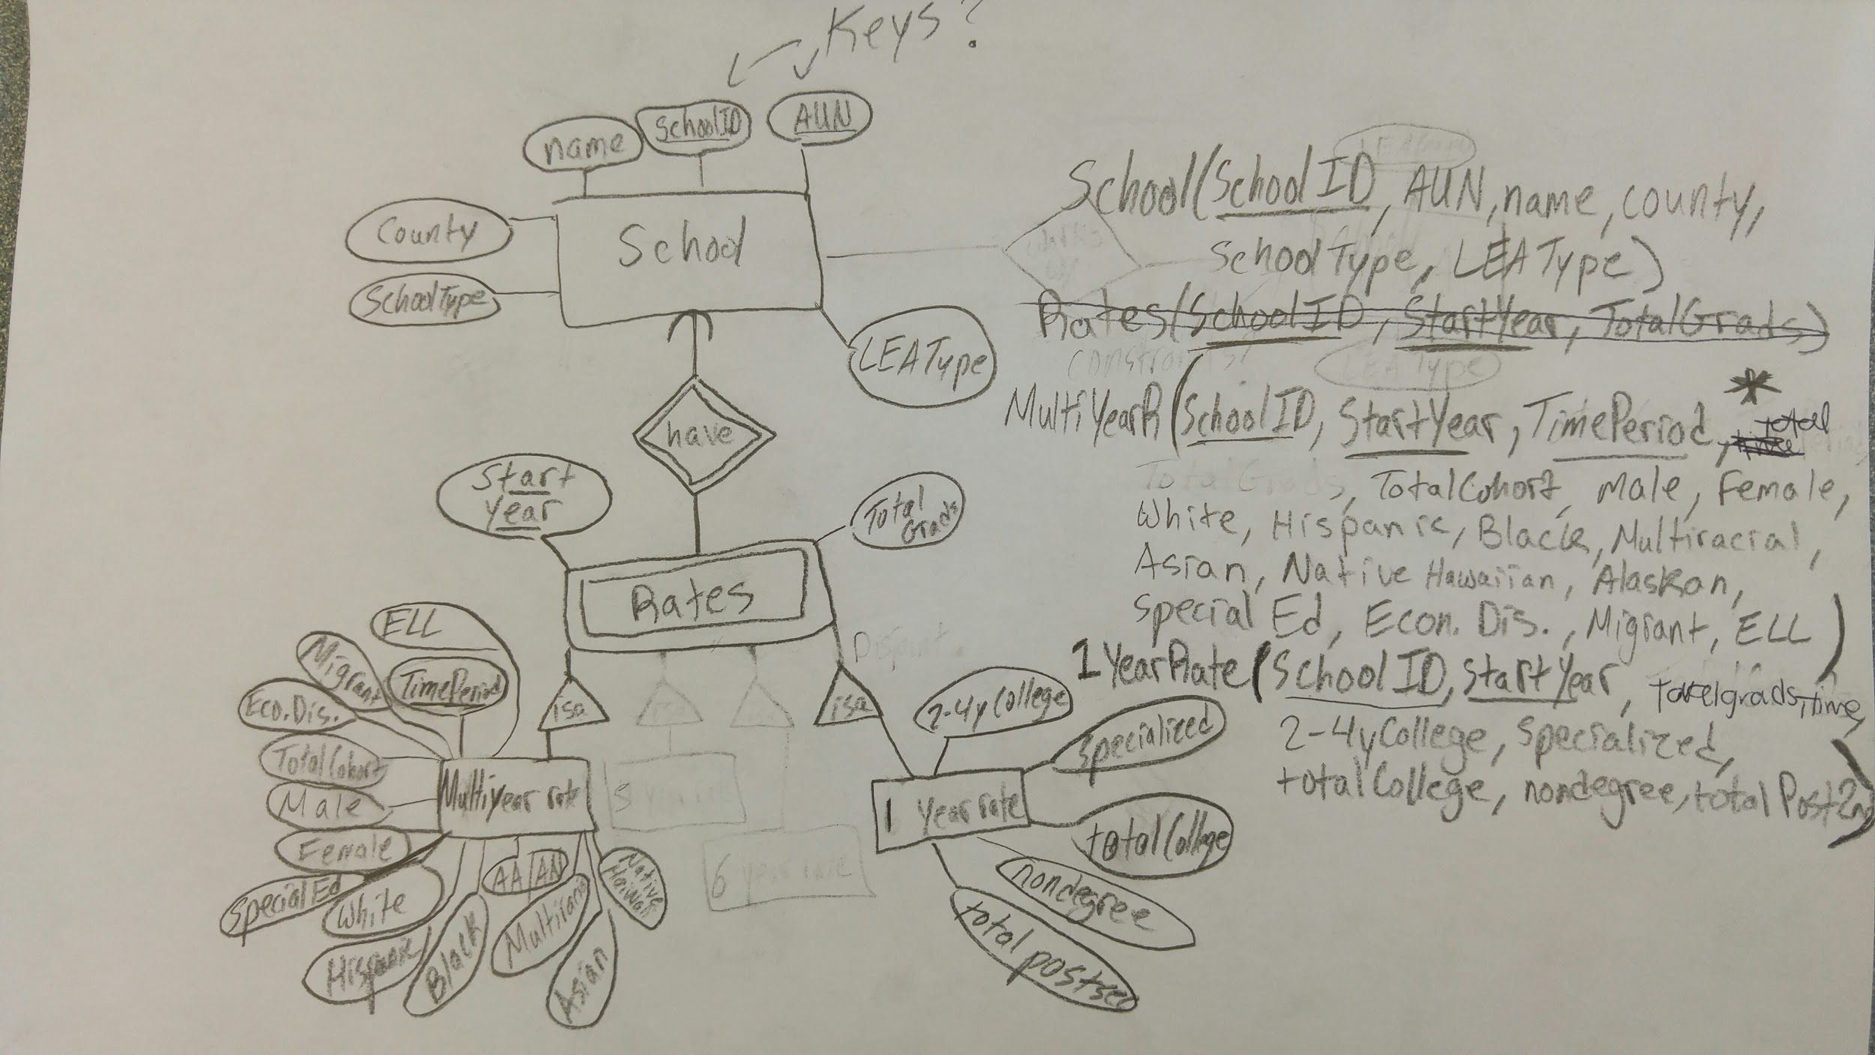

Slide 6
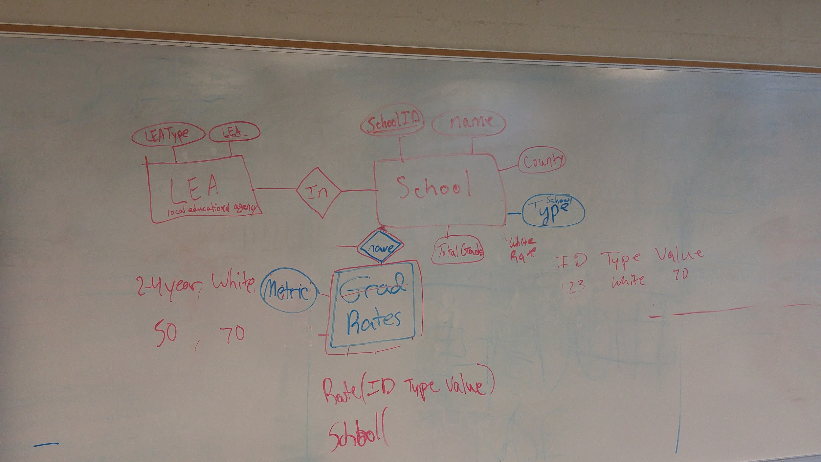

Slide 8
Database Design
We used three relations in our database: Schools, Yearly Rates, and Multi-Year Rates
The School relation lists information about each of the schools in PA where the data comes from
The Multi-Year Rates relation contains all information regarding the graduation rates of the various racial, ethnic, and socioeconomic groups categorized by the state of Pennsylvania
Yearly rates holds the data describing the education that students pursue after their high-school graduating

Slide 9
CREATE TABLE yearlyrates (
schoolid integer NOT NULL,
startyear integer NOT NULL,
totalgrads character varying(20),
twofouryearcollegepercent double precision,
specializeddegreepercent double precision,
totalcollegeboundpercent double precision,
totalndgpsspercent double precision,
totalpostsecondarypercent double precision,
endyear character varying(10),
);
CREATE TABLE multiyearrates (
schoolid integer NOT NULL,
startyear character varying(10) NOT NULL,
timeperiod integer NOT NULL,
totalcohort character varying(20),
totalgrads character varying(20),
male double precision,
female double precision,
white double precision,
hispanic double precision,
black double precision,
asian double precision,
multiracial double precision,
americanindianalaskan double precision,
specialed double precision,
econdisadv double precision,
migrant double precision,
ell double precision,
nativehawaiianpacificislander double precision,
endyear character varying(10),
);
CREATE TABLE school (
school_id integer NOT NULL,
aun integer,
school_name character varying(200),
county character varying(200),
type character varying(20),
lea character varying(75)
);

Slide 10
The Application
Our web application is has three pages: a “home” tab, an “About” tab, and a “Relations” tab
From the “Home” tab the user can select three schools to compare across any year and Cohort Grad Rate attribute
When the user makes their selections they are taken to a separate page where the graph is displayed
The “About” and “Relations” page give information describing the project and our database design

Slide 11

Future Improvements
We would like to include a few static graphs and charts showing interesting trends that we found
We would also like to include more dynamic visualizations that compare Yearly Rates, counties, or types of schools
Some sort of filter that removes the option to select schools without data

