Slide 1


SICSS: Regular expressions + Topic models

Slide 2
Welcome
How are you doing?

Slide 3

Welcome
Rens Wilderom - Core lecturer in the Computational Social Science
Completed PhD about development of dance music
How style impacts organization: modeling stylistic variations in the film art world
Leveraging large language models in cultural sociological research

Slide 4

Content for today
Regular expressions
Topic modeling: some “tricks of trade”
Run a topic model

Slide 5
Regex (Regular Expressions)
Regex, a language with which you can match and retrieve strings of text or numbers (we’ll explain this in a moment with examples)
It allows you to turn messy real world data (e.g. from websites, emails, or other forms of communication) into a neat data structure
This makes it a key (and often used) tool for computational (social) scientist

Slide 6
I will show 3 examples. Feel free to run these examples in your own Notebook

Slide 7

Example 1. Matching digits and using quantifiers
Imaging that you like to extract all 'years' from the string s below. This can be achieved with the Regex pattern \d{4} which will match on all four digit numbers. Whilst \d matches on all digits, {4} quantifies '4 instances of the foregoing character.'

Slide 8
use re.findall() when you want to retrieve multiple strings that match a pattern (in this case both 1997 and 1990).

Slide 9

Example 2. Matching word characters and whitespace
Word characters are matched with \w. Sometimes you also need to match whitespace, which can be done with the Regex character \s. In the example below, you only match two word characters that are followed by a whitespace, so only 'aa ' rather than 'bb'.

Slide 10
use re.search() when you want to retrieve only one string that matches the pattern

Slide 11

Example 3. Match anything in between two strings and divide matches into groups
You may be interested in any text or numbers in between two specific strings. In the following example, we like to retrieve anything that comes in between the letters 'b' and 'd.' We also specify that these characters should be surrounded by whitespace (so \sb\s and \sd\s), otherwise the pattern could also match on any 'b' or 'd,' including those that are part of larger words.
The pattern .*? matches on anything. It is placed between parentheses '()' to form a delimited group, i.e. a subset of your full match from which you can separately retrieve information, as will be explained in a moment.

Slide 12
At this point it is also useful to understand how to use groups
.group(0) always gives the full match associated with a Regex pattern. In the example above .group(0) would return:
b anything, including a c d
However, in this example, we are interested in .group(1), everything in between two strings, that is, the match between the parentheses:
anything, including a c

Slide 13
At a later point, you can take a moment to look at Exampes 4, 5, 6, and 7
For now: work on Challenge 1 + 2 from the Notebook
In your own time, you can work on Challenge 3-6
The solutions to the Challenges can be found here

Slide 14
Topic modeling

Slide 15
Topic models
Identifying themes in textual corpora (newspaper articles, letters, reviews, other kinds of documents)
“LDA takes a relational approach to meaning, in the sense that co-occurrences are important in the assignment of words to topics.” (DiMaggio et al., 2013). Words derive meaning from their context
Unsupervised machine learning technique: themes are “inductively” identified
Expected themes - and discovery of new themes

Slide 16
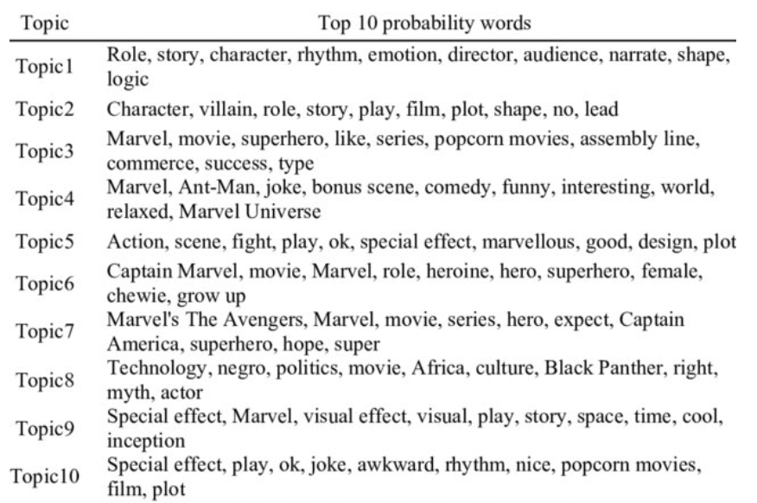
Topic models

Slide 17

Good reference for how topic models can be used in the social sciences

Slide 18

Application: comparing discourses on 1 project in 2 countries

Slide 19
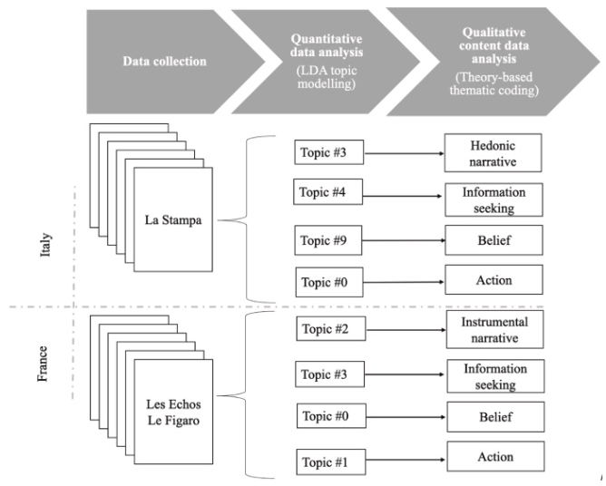

Slide 20

Some notes
Very much a qualitative research tool
Key parameter set by researcher: number of topics
Always controversy
If you encounter this, cite DiMaggio et al.: “One chooses the number [of topics] based on interpretability and analytic utility” (DiMaggio, Nag, Blei, 2013: 582).

Slide 21
“Think of the model as a lens for viewing a corpus of documents. Finding the right lens is different than evaluating a statistical model based on a population sample. The point is not to estimate population parameters correctly, but to identify the lens through which one can see the data most clearly. Just as different lenses may be more appropriate for long-distance or middle range vision, different models may be more appropriate depending on the analyst’s substantive focus. As the statistician George Box (1979, p. 202) wrote of models that cluster population data in order to make them tractable: ‘‘All are wrong; some are useful.’’” (DiMaggio, Nag, Blei, 2013: 582)

Slide 22
Notes on preprocessing
Preprocessing matters too (but not so much)
Preprocessing choices should not influence core results too much
Experiment with different preprocessing choices
Make a decision

Slide 23
Preprocessing steps in the Notebook
lowercase = True
strip_accents = 'unicode'
stop_words = 'english'
token_pattern = r'\b[a-zA-Z]{3,}\b', # keeps words of 3 or more characters
max_df = 0.5, # ignore words occurring in > 50 % of the corpus (i.e. corpus specific stop words)
min_df = 10) # ignore words in <10 documents of the corpus (goal is to ignore noise)

Slide 24
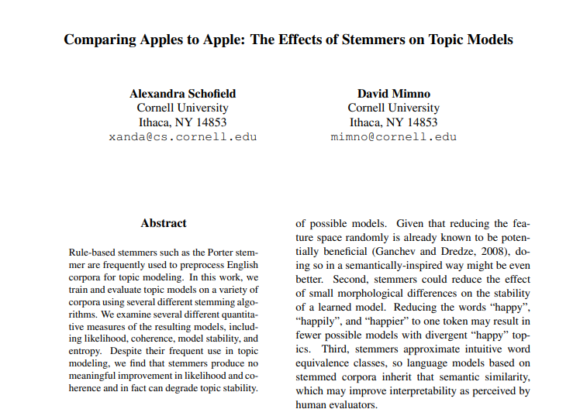
Preprocessing: no stemming (in contrast to what some people think)

Slide 25
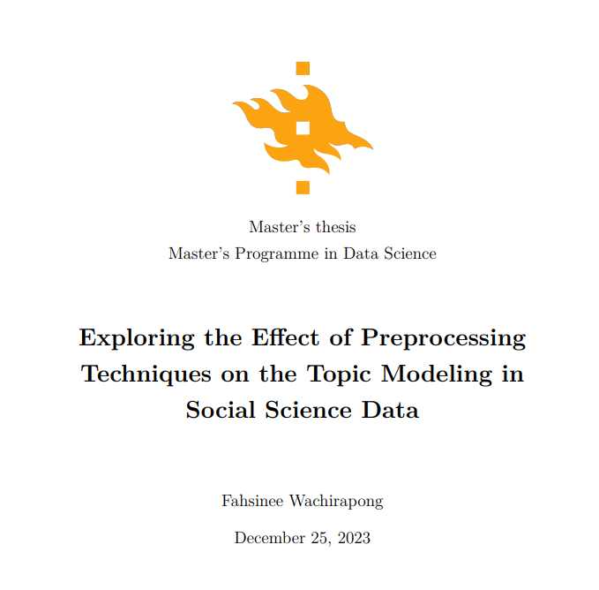

In general: appears to be a small literature on preprocessing

Slide 26
Run the topic model in the Notebook - then we discuss

Slide 27
Let’s discuss
Number of topics?
Preprocessing steps (e.g. max_df)?
Questions?

