Slide 1
Structured Knowledge Representations
Reshmi Pillai

Slide 2
PostDoc Researcher at the Department of Communication Science in the Vrije University Amsterdam
Consortium project ‘Towards Responsible AI for Local Journalism’, focusing on the adoption and implementation of artificial intelligence techniques, specifically natural language processing, in the context of local journalism.
Current research explores the construction of structured knowledge bases in the context of regional news media organizations in the Netherlands.
Previously (2019-2023) Lecturer at the Informatics Institute, University of Amsterdam, in the Master's program in Information Studies (Data Science track)
PhD (December 2021) from the University of Wolverhampton for her thesis on the expressions of psychological stress in tweets.

Slide 3

Session Plan
Knowledge Graph – Some Early Examples
Google Knowledge Graph
Applications
Knowledge Graphs – Components, Visualizations
Knowledge Graphs in the era of LLMs
Case Study – Creating a Knowledge Graph from a Wikipedia Page
Demo – Knowledge Graphs and LLMs : A Synergised Solution

Slide 4
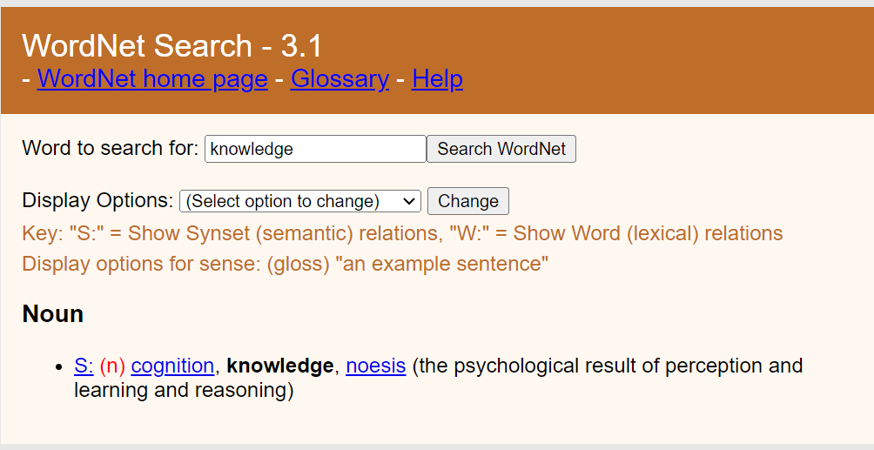
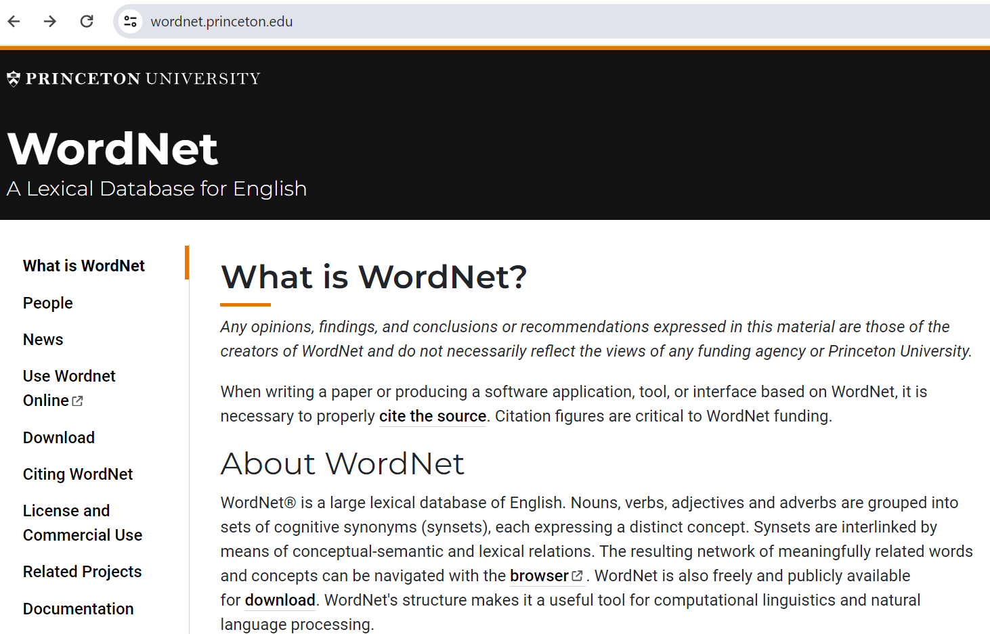
Some Early Steps
Graph Representation of nodes (entities) and edges (relations)
WordNet
Founded in 1985
Captures semantic relation between words and meanings

Slide 5
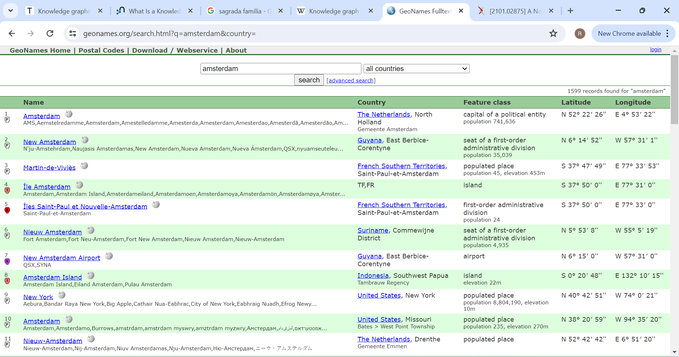
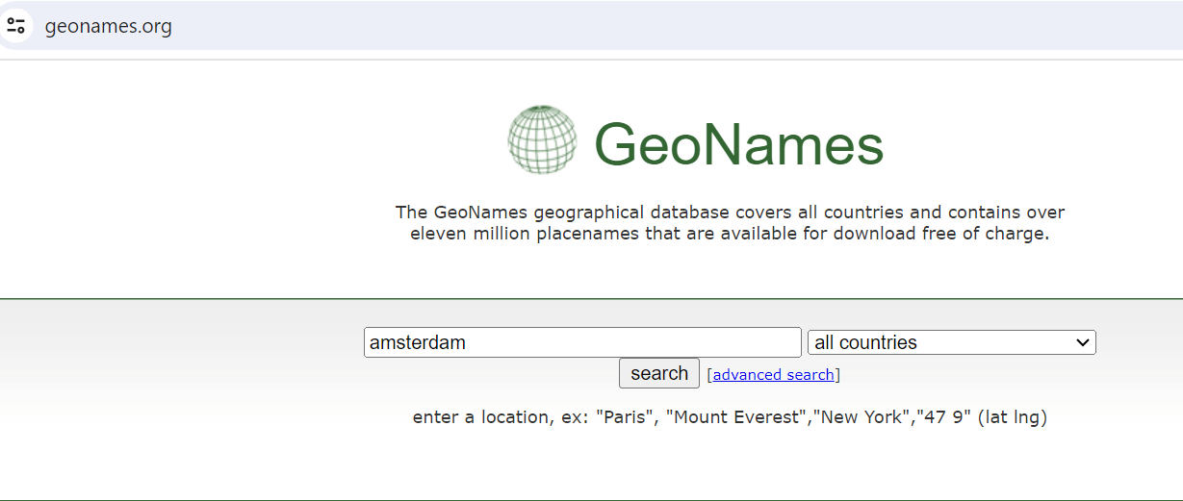
Some Early Steps
GeoNames 2005
Capture relationships between different geographic names and locales and associated entities.

Slide 6
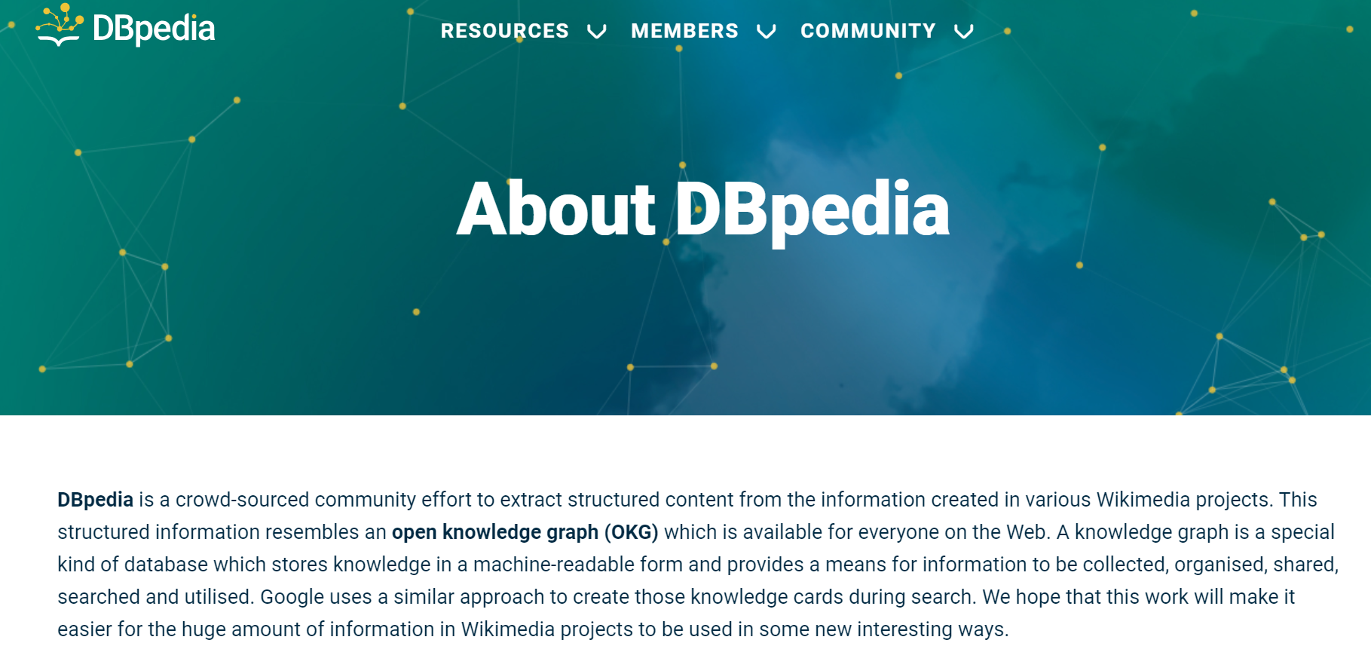
Some (other) Early Steps

Slide 7
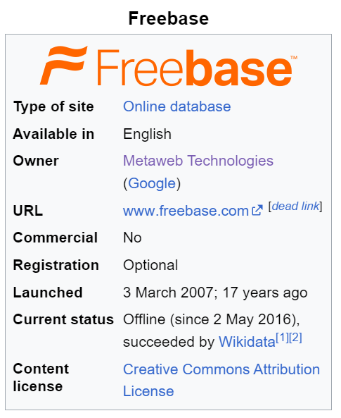
Some (other) Early Steps

Slide 8
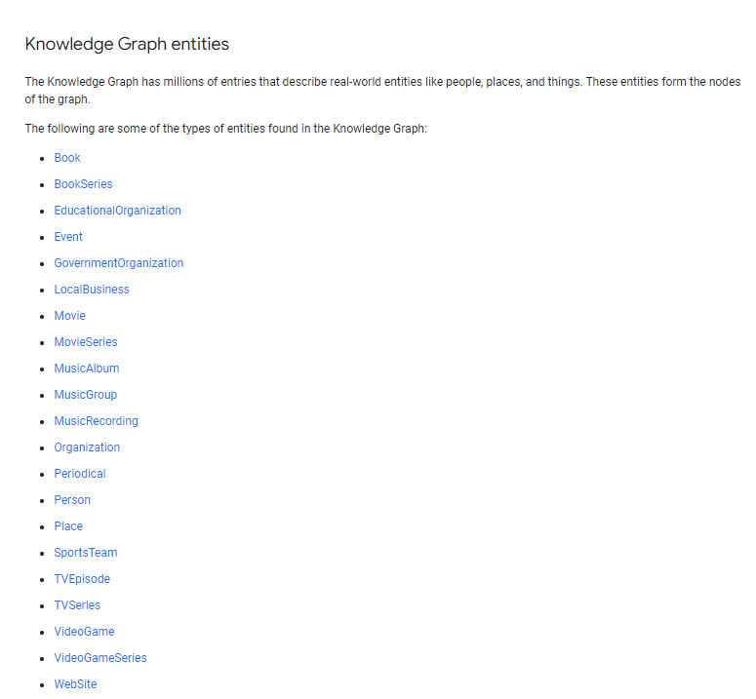
Google Knowledge Graph
How does Google answer questions like:
“How tall is the Eiffel Tower?”
“Where were the 2016 Summer Olympics held.”
Things, not Strings

Slide 9
Building Blocks of Knowledge Graphs
Entity
Relationship
Ontology
Semantics

Slide 10
Ontology
An ontology formally describes a (usually finite) domain of related concepts (classes of objects) and their relationships
For example, in a company setting, staff members, managers, company products, offices, and departments are concepts
Semantic search
Context-aware — It is based on the meaning of the concept or entity or the relation
Personalised — It is based on the user’s intent
Disambiguate — It can clearly differentiate between concepts

Slide 11
RDF and OWL
RDF (Resource Description Framework): A data model for representing information in the Web
RDF graphs: sets of subject-predicate-object triples. Used to express descriptions of resources.
RDF datasets: collections of RDF graphs, and comprise a default graph and zero or more named graphs.
OWL (Web Ontology Language): Constraints, cardinality of relations

Slide 12
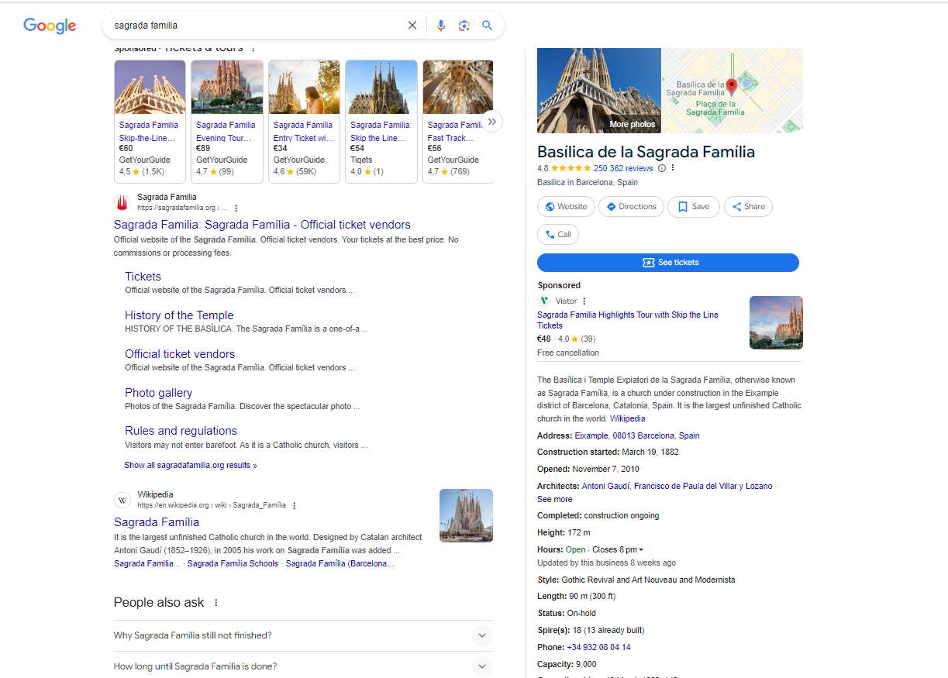
Google Knowledge Graph
Knowledge Panel

Slide 13
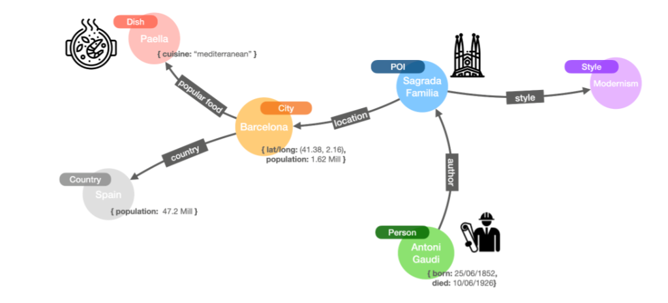
Sagrada Familia – What’s behind the Knowledge Panel?

Slide 14
Tell me all about Barcelona – Without Knowledge Graphs
Monument
Location
Cuisine
….

Slide 15
Tell me about Barcelona – With Knowledge Graphs

Slide 16
Knowledge graphs vs traditional databases?
Semantic search
Contextual understanding
Data inference
Scaling

Slide 17
Let’s go back to Sagrada Familia

Slide 18
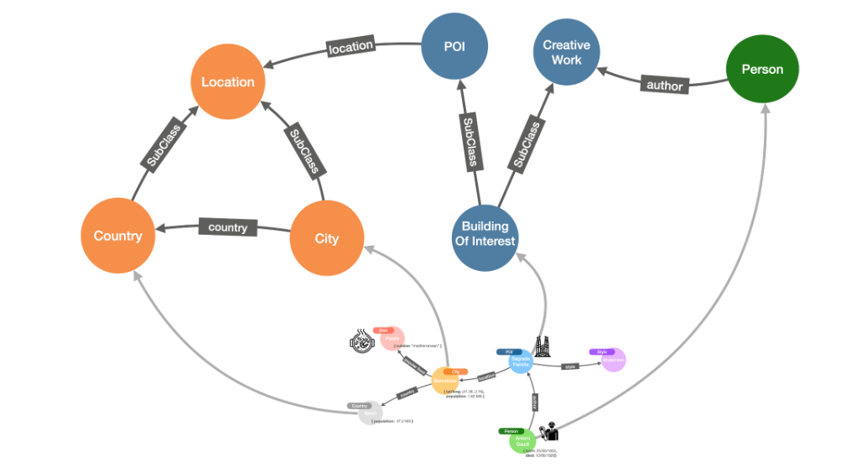

Slide 19
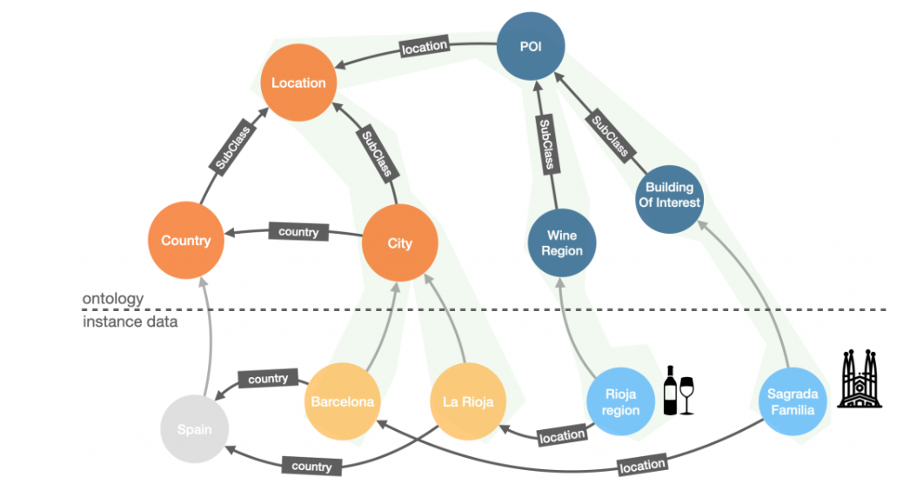
“Because you are interested in Sagrada Familia, maybe you are also interested in Rioja region”

Slide 20
“Because you are interested in Sagrada Familia, maybe you are also interested in Rioja region”
Inference comes from :
Evidence (instances in the lower layer)
And
Reasoning (ontology in the upper layer)

Slide 21
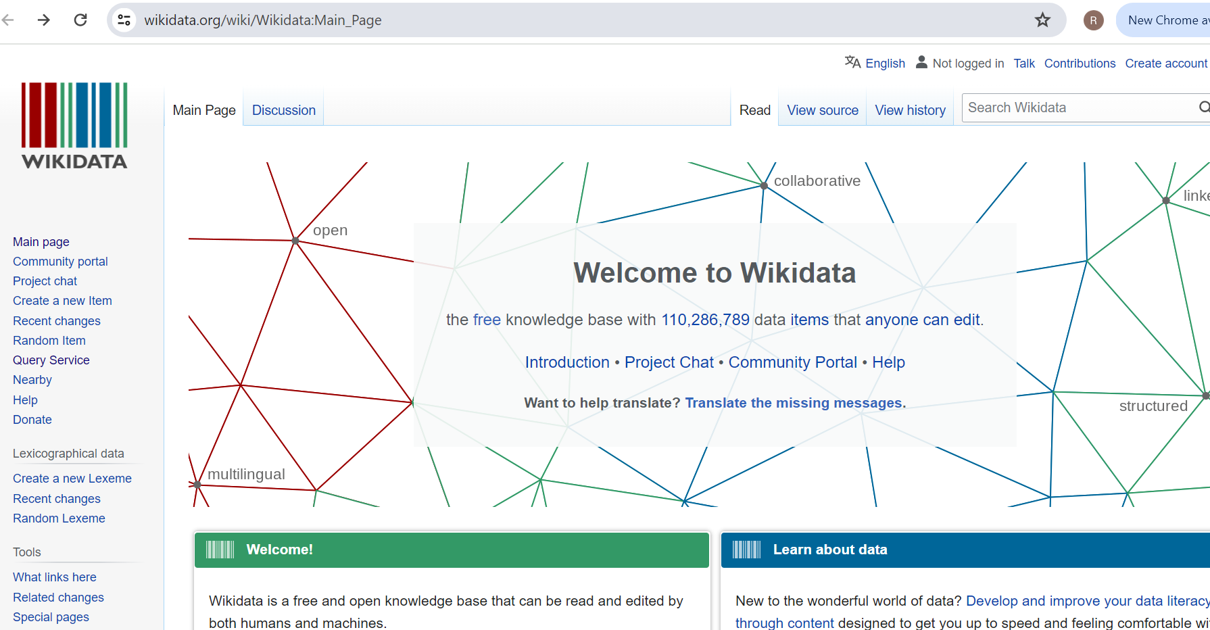

Let’s have a quick look at Google Knowledge Graph

Slide 22
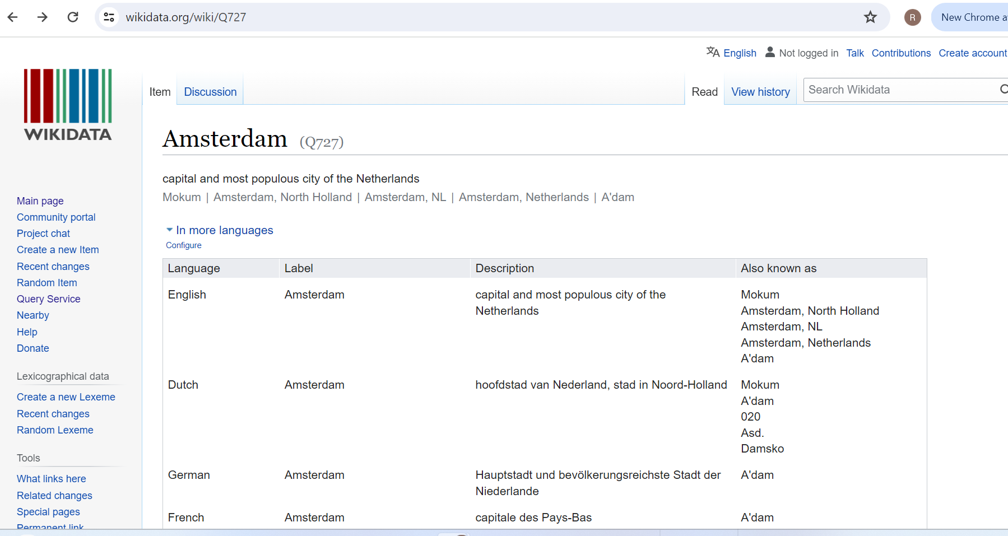



Slide 23
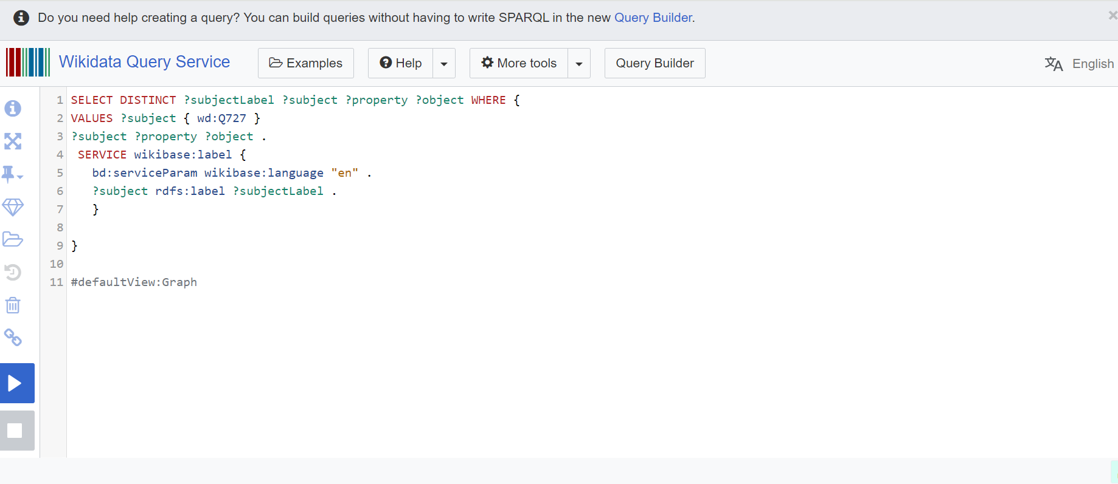

Slide 24
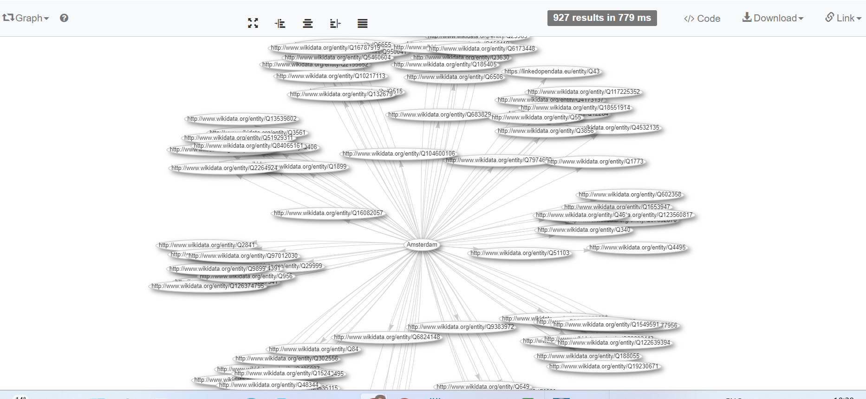

Slide 25
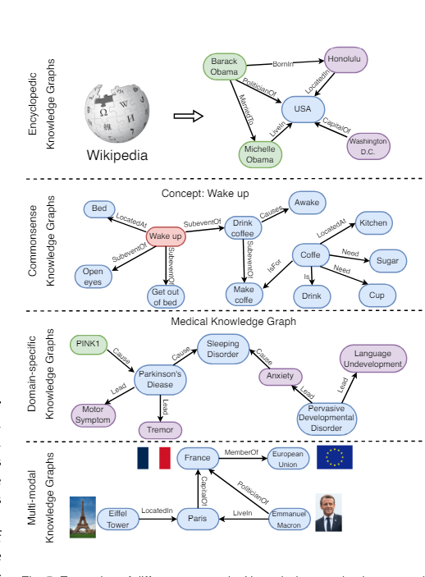
Different Types of Knowledge Graphs
Encyclopedic KG
Information from human experts, encyclopedias, and databases
DBPedia, FreeBase
Commonsense KG
knowledge about daily concepts, objects, and events
ConceptNet, ASER, ATOMIC
Domain-Specific KG
knowledge in a specific domain, e.g., medical, biology, and finance
UMLS
Multi-modal KG
Facts in multiple modalities such as images, sounds, and videos IMGpedia, MMKG, Richpedia

Slide 26
What is NOT a knowledge graph?
Not every RDF graph is a knowledge graph
For instance, a set of statistical data, e.g. the GDP data for countries, represented in RDF is not a KG
A graph representation of data is often useful, but it might be unnecessary to capture the semantic knowledge of the data.
It might be sufficient for an application to just have a string ‘Italy’ associated with the string ‘GDP’ and a number ‘1.95 trillion’ without needing to define what countries are or what the ‘Gross Domestic Product’ of a country is.
Not every knowledge base is a knowledge graph
A key feature of a KG is that entity descriptions should be interlinked to one another. The definition of one entity includes another entity. This linking is how the graph forms. (e.g. A is B. B is C. C has D. A has D)
Knowledge bases without formal structure and semantics, e.g. Q&A “knowledge base” about a software product, also do not represent a KG.

Slide 27
Building a Knowledge Graph
Data sources
Entity and relationship extraction
Maintaining
Why is it useful in social sciences?
Data connectivity
Deeper insights
Implicit relations extraction
Visualization of Knowledge Graphs Interactive User Interface
Supporting Various Data Formats
Clear Display of Data and Properties, relationships
Tools: Neo4j, KinGVisher
Challenges in Knowledge Graphs
Data quality and integrity
Privacy
scaling

Slide 28
Knowledge Graphs in Social Science Research - Examples
https://trifecta.dhlab.nl/
Tracing Contentious Entities and Concepts in Maritime History
Tracing Contentious Entities and Concepts in Food History
Journalistic Knowledge Graphs for news-making process
Berven, A., Christensen, O. A., Moldeklev, S., Opdahl, A. L., & Villanger, K. J. (2020). A knowledge-graph platform for newsrooms. Computers in Industry, 123, 103321.
Knowledge Graphs for regional newsrooms

Slide 29
Knowledge Graphs in the Era of Large Language Models

Slide 30
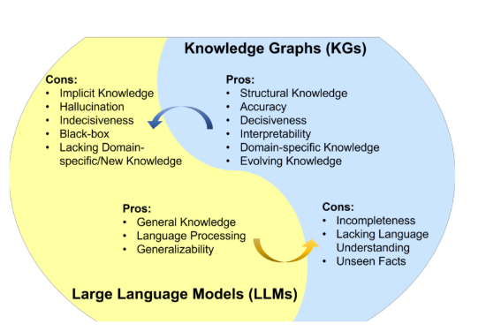
Knowledge graphs and LLMs comparison

Slide 31
Synergies
KG-enhanced LLMs incorporate KGs during the pre-training and inference phases of LLMs, or for the purpose of enhancing understanding of the knowledge learned by LLMs;
LLM-augmented KGs, that leverage LLMs for different KG tasks such as embedding, completion, construction, graph-to-text generation, and question answering; and
Synergized LLMs + KGs, in which LLMs and KGs play equal roles and work in a mutually beneficial way to enhance both LLMs and KGs for bidirectional reasoning,
Pan, S., Luo, L., Wang, Y., Chen, C., Wang, J., & Wu, X. (2024). Unifying large language models and knowledge graphs: A roadmap. IEEE Transactions on Knowledge and Data Engineering.

Slide 32

Questions?

Slide 33
Example – case study creating a knowledge graph from Wikipedia data (30 minutes)
1. Open a Wiki page of your choice
2. Create a knowledge graph representing 5-10 entities and their relationships
3. Run the colab notebook, with the wiki page of your choice
4. Do you see the entities you choose in the created knowledge graph?

Slide 34
Colab Steps
https://colab.research.google.com/
File-> Upload Notebook -> Browse in your file system and choose the .ipynb file

Slide 35
Demo – Graph RAG (15 minutes)
Neo4j
LangChain
(LlamaIndex)
OpenAI

Slide 36
Pan, S., Luo, L., Wang, Y., Chen, C., Wang, J., & Wu, X. (2024). Unifying large language models and knowledge graphs: A roadmap. IEEE Transactions on Knowledge and Data Engineering.
https://neo4j.com/blog/what-is-knowledge-graph/

