Slide 1
23andMe?
Ancestry Composition Classifier Alexander Gaujean

Slide 2
Ancestry Composition
With the current technological advancements in high throughput genome sequencing, an individual can have their all 6 billion base pairs sequenced for as little as $200.
This has led to the emergence of companies like 23andMe and Ancestry offering the public relatively cheap insights into their genome.
The human genome is full of mutations, which might seem alarming but most of these mutations are single base pairs and don’t necessarily have a phenotypic impact.
However, because of the rules of DNA inheritance these mutations can serve as markers that can identify intermingling populations.

Slide 3
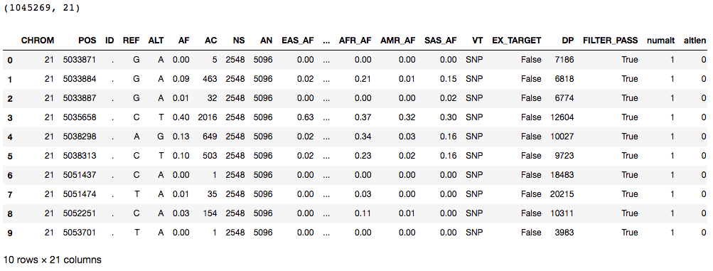
Data: International Genome Sample Resources (VCF)
Different Chromosomes have different amounts of population specific variants so I selected Chr21

Slide 4
Exploratory Analysis
Variant Density along Chromosome
Variant Read Depth
Transition (Ti) / Transversion (Tv) Ratio

Slide 5
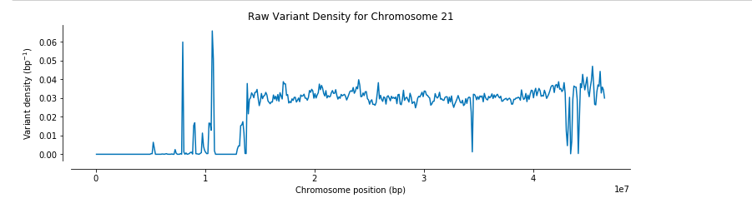
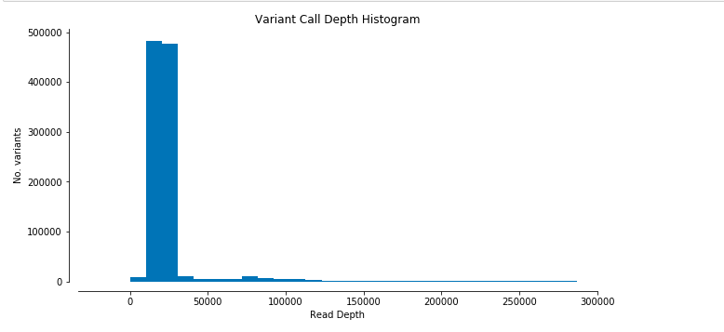
Fig 1 (Above). Shows the amount of variants along the length of our chromosome (binned)
Fig 2.(Left) Shows the number of times a variant was identified during the laboratory sequencing

Slide 6
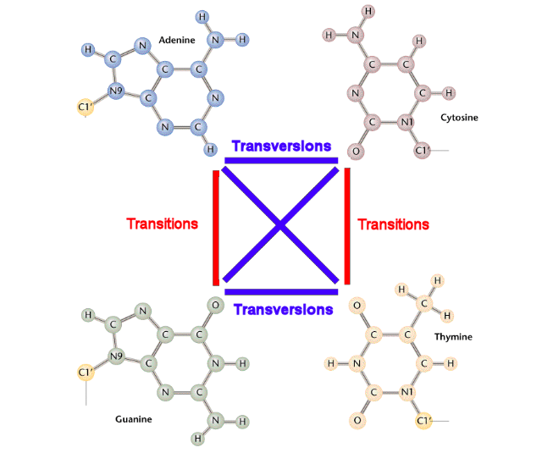
How Variants Arise
When looking at the type of mutations that occur in our genome there are important biochemical factors to consider.
In particular, the molecular structure of our four base pairs (Adenine, Thymine, Guanine and Cytosine ) result in two classes of nitrogenous bases.
Adenine (A) and Guanine (G) have a one ring structure and are known as purines. While Cytosine (C) and Thymine (T) are pyrimidines and assemble in two rings.

Slide 7
2.15
Even though there are twice as many possible transversion than transition permutations, because of the structural constraints of transversion the typical human genome has a Ti/Tv ratio of anywhere from 2.0 - 3.0

Slide 8
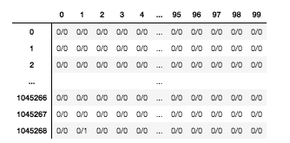
Identifying Sample Variants from a Subpopulation
Web scraping using Selenium
Dataset Contains 25 subpopulations
Each subpopulation contains individuals that displayed limited admixture
Approximately 100 individuals in each subpopulation
Finnish in Finland Population (n = 100)

Slide 9
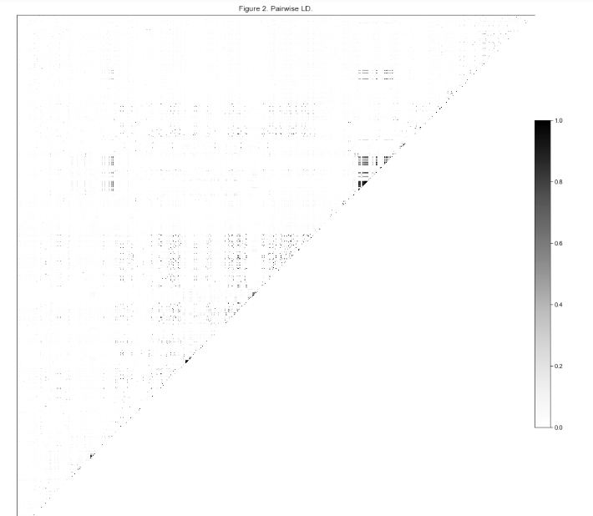

Pruning Linkage Disequilibrium
Reducing the amount of correlation between our SNPs or reducing correlated variables
Before
After

Slide 10
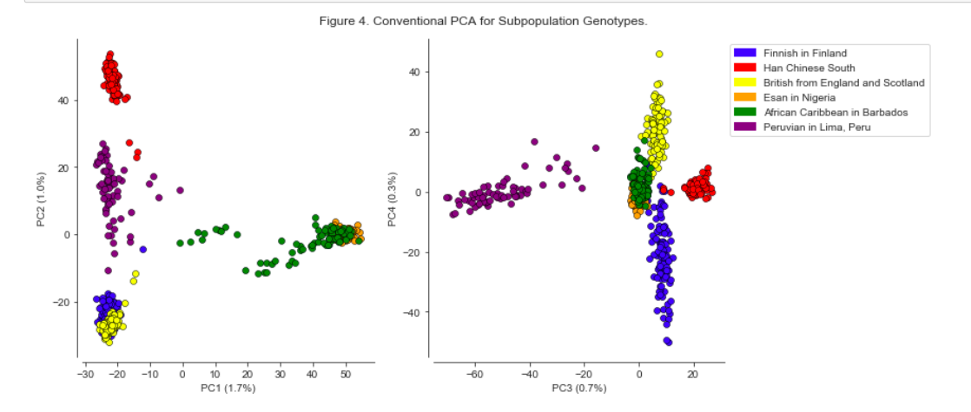
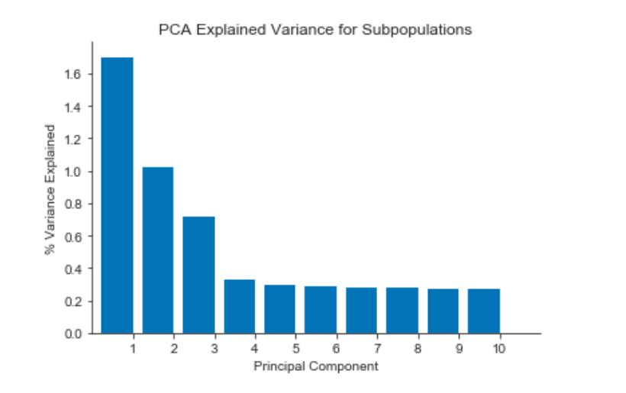
PCA via SVD

Slide 11
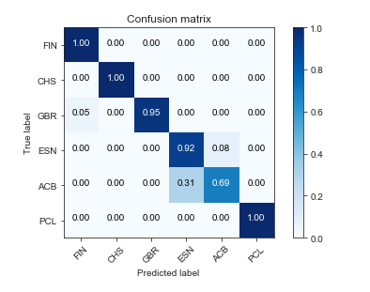
SVM Classifier
Using the ten Principal Components extracted from PCA I setup an SVM classifier with a linear kernel
Evaluation Metrics were encouraging however, without access to more samples it is hard to truly validate the model.

Slide 12
Next Steps
Want to examine each Chromosome individually and identify which Chromosomes contain the best markers for each subpopulation.
Of course need to go back and try and create a model for all 25 subpopulations as opposed to the 6 I looked at.
Construct a classifier that can identify a probability of an individual belonging to a sample and use this probability as a way to assess admixture composition, or what 23andMe calls Ancestry composition.

