Slide 1
Tests of Bootstrap & Dropout
Siqi Du
1 Credit

Slide 2
Workload
Saturday: 3 hrs (Test the code of dropout)
Sunday: 3 hrs(Test the code for bootstrap & dropout)

Slide 3
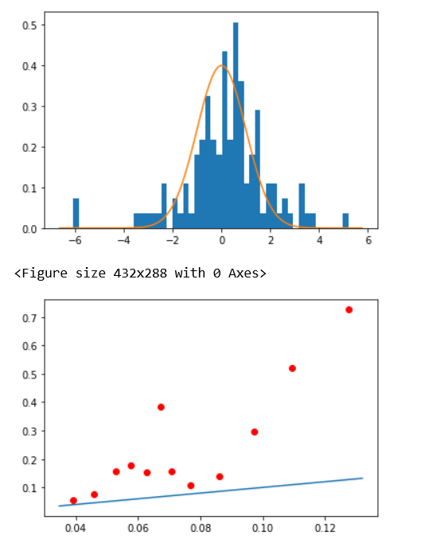
Dropout Results I
Input Layer: 24 units
First Hidden Layer: 16 units (Drop Rate = 0)
Second Hidden Layer: 16 units (Drop Rate = 0)
Output Layer: 1 units
Number of Models: 25
Epochs: 200
Mean of Abs. Residuals: 0.10
Mean of Standard Deviation: 0.08
First Graph:
X: Residual/Standard Deviation
Y: Frequency
Second Graph: X: Standard Deviation of Different Models
Y: Absolute Residual

Slide 4
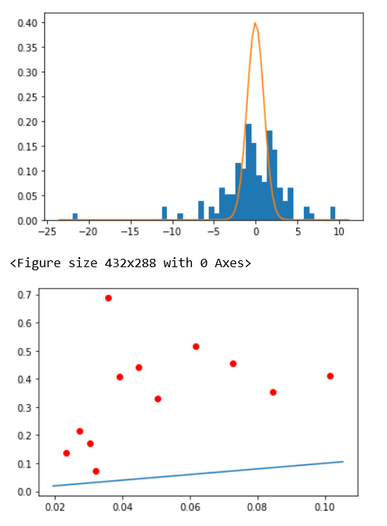
Dropout Results II
Input Layer: 24 units
First Hidden Layer: 16 units (Drop Rate = 0.2)
Second Hidden Layer: 16 units (Drop Rate = 0.2)
Output Layer: 1 units
Number of Models: 25
Epochs: 200
Mean of Abs. Residuals: 0.13
Mean of Standard Deviation: 0.05
First Graph:
X: Residual/Standard Deviation
Y: Frequency
Second Graph: X: Standard Deviation of Different Models
Y: Absolute Residual

Slide 5
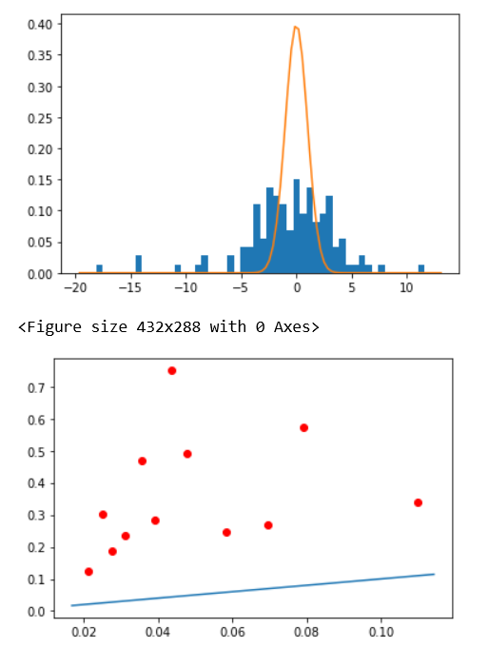
Dropout Results III
Input Layer: 24 units
First Hidden Layer: 16 units (Drop Rate = 0.3)
Second Hidden Layer: 16 units (Drop Rate = 0.3)
Output Layer: 1 units
Number of Models: 25
Epochs: 200
Mean of Abs. Residuals: 0.14
Mean of Standard Deviation: 0.04
First Graph:
X: Residual/Standard Deviation
Y: Frequency
Second Graph: X: Standard Deviation of Different Models
Y: Absolute Residual

Slide 6
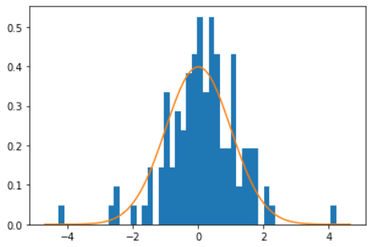
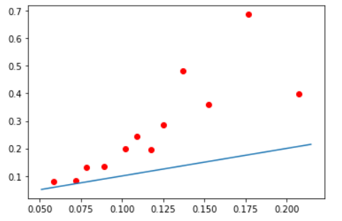
Bootstrap & Dropout Results I:
Input Layer: 24 units
First Hidden Layer: 16 units (Drop Rate = 0)
Second Hidden Layer: 16 units (Drop Rate = 0)
Output Layer: 1 units
Number of Models: 25
Epochs: 200
Mean of Abs. Residuals: 0.11
Mean of Standard Deviation: 0.12
First Graph:
X: Residual/Standard Deviation
Y: Frequency
Second Graph: X: Standard Deviation of Different Models
Y: Absolute Residual

Slide 7
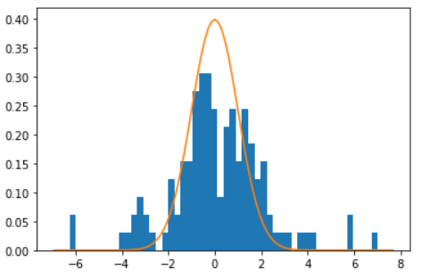
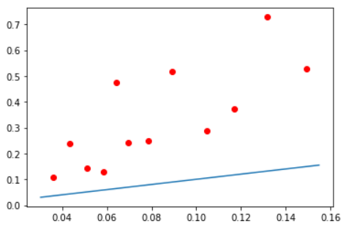
Bootstrap & Dropout Results II:
Input Layer: 24 units
First Hidden Layer: 16 units (Drop Rate = 0.2)
Second Hidden Layer: 16 units (Drop Rate = 0.2)
Output Layer: 1 units
Number of Models: 25
Epochs: 200
Mean of Abs. Residuals: 0.13
Mean of Standard Deviation: 0.09
First Graph:
X: Residual/Standard Deviation
Y: Frequency
Second Graph: X: Standard Deviation of Different Models
Y: Absolute Residual

Slide 8
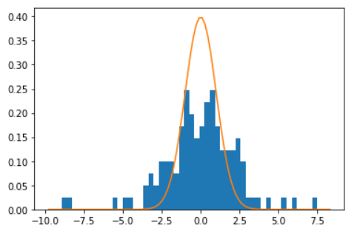
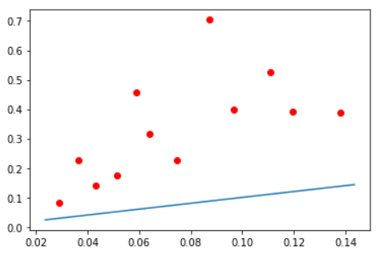
Bootstrap & Dropout Results III:
Input Layer: 24 units
First Hidden Layer: 16 units (Drop Rate = 0.3)
Second Hidden Layer: 16 units (Drop Rate = 0.3)
Output Layer: 1 units
Number of Models: 25
Epochs: 200
Mean of Abs. Residuals: 0.13
Mean of Standard Deviation: 0.08
First Graph:
X: Residual/Standard Deviation
Y: Frequency
Second Graph: X: Standard Deviation of Different Models
Y: Absolute Residual

