Slide 1



^{Light Scattering :}
Main concepts concerning Monte-Carlo Simulations

Slide 2
Layout
Application Fields
Physical Quantities relative to light scattering
Radiative Transfer Equation (RTE)
Discrete Ordinates Method (DOM)
  Explanation of the mathematical resolution
  Application for internal reflections at flat interfaces
    Why studying internal reflections ?
    How to compute internal reflections ?
    Validation of the DOM Implementation
    Study of hyper-parameters & their influence
    Results
Monte Carlo Simulations
  Main Concepts
  Practical Study (next lecture)

Slide 3

Monte Carlo Simulations
Main Concepts

Slide 4
Monte Carlo Simulations
Main Concepts : Introduction
broad class of computational algorithms that rely on repeated random sampling to obtain numerical results.
An early variant of the Monte Carlo method was devised to solve the Buffon's needle problem (18th century)

Slide 5
Monte Carlo Simulations
Main Concepts
Monte Carlo methods vary, but tend to follow a particular pattern:
Define a domain of possible inputs
Generate inputs randomly from a probability distribution over the domain
Perform a deterministic computation on the inputs
Aggregate the results

Slide 6
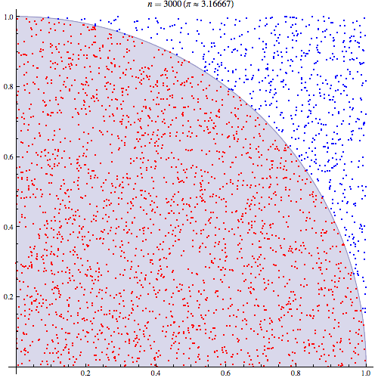
Monte Carlo Simulations
Main Concepts : Example
Draw a square, then inscribe a quadrant within it
Uniformly scatter a given number of points over the square
Count the number of points inside the quadrant, i.e. having a distance from the origin of less than 1
The ratio of the inside-count and the total-sample-count is an estimate of the ratio of the two areas, π/4. Multiply the result by 4 to estimate π.
Monte Carlo method applied to approximating the value of π.

Slide 7
Monte Carlo Simulations
Main Concepts : Remarks
If the points are not uniformly distributed, then the approximation will be poor.
The approximation improves as more points are placed.
Monte Carlo method applied to approximating the value of π.
Notes:
1. If the points are not uniformly distributed, then the approximation will be poor.
2. There are many points. The approximation is generally poor if only a few points are randomly placed in the whole square. On average

Slide 8

Monte Carlo Simulations
Main Concepts : Use in photon transport
Applied in different fields :
  Biomedical imaging,
  Radiation therapy,
  Photodynamic therapy,
  …
Still accurate in cases related to complex geometries
Enables to get access to multiple physical quantities at the same time.
Monte Carlo simulation of a pencil beam incident on a semi-infinite scattering medium. (Wikimedia)
Notes:
In the method, local rules of photon transport are expressed as probability distributions which describe the step size of photon movement between sites of photon-matter interaction and the angles of deflection in a photon's trajectory when a scattering event occurs
The Monte Carlo method is necessarily statistical and therefore requires significant computation time to achieve precision. In addition Monte Carlo simulations can keep track of multiple physical quantities simultaneously, with any desired spatial and temporal resolution. This flexibility makes Monte Carlo modeling a powerful tool. Thus, while computationally inefficient, Monte Carlo methods are often considered the standard for simulated measurements of photon transport for many biomedical applications.

Slide 9
Monte Carlo Simulations
Going further
  General Monte Carlo Simulations Concepts
    Dunn, W., & Shultis, J. K. (2011). Exploring Monte Carlo Methods. Elsevier Science
  Application to biomedical engineering
    ED Cashwell, CJ Everett, "A Practical Manual on the Monte Carlo Method for Random Walk Problems," Pergammon Press, New York, 1959.
    BC Wilson, G Adams, A Monte Carlo model for the absorption and flux distributions of light in tissue, Med. Phys. 10:824-830, 1983.
    L Wang, SL Jacques, L Zheng, MCML - Monte Carlo modeling of light transport in multi-layered tissues, Computer Methods and Programs in Biomedicine 47:131-146, 1995.
    L Wang, SL Jacques, "Monte Carlo Modeling of Light Transport in Multi-layered Tissues in Standard C," 1992-1998.
Notes:
In the method, local rules of photon transport are expressed as probability distributions which describe the step size of photon movement between sites of photon-matter interaction and the angles of deflection in a photon's trajectory when a scattering event occurs
The Monte Carlo method is necessarily statistical and therefore requires significant computation time to achieve precision. In addition Monte Carlo simulations can keep track of multiple physical quantities simultaneously, with any desired spatial and temporal resolution. This flexibility makes Monte Carlo modeling a powerful tool. Thus, while computationally inefficient, Monte Carlo methods are often considered the standard for simulated measurements of photon transport for many biomedical applications.

Slide 10
To take away
Determinist Methods
Stochastic Methods
Exact Methods of Resolution
Discrete Ordinates
Monte-Carlo
Spherical Harmonics
Approximate Methods of Resolution
Kubelka-Munk (2-fluxes)
4-fluxes
Diffusion Approximation
Validation of a code is 10 times longer than its implementation
Be aware of :
  hyper parameters
  Models assumptions
Validation of a code is 10 times
Be aware of :
  hyper parameters
  Models assumptions
arthur.gautheron@univ-st-etienne.fr

Slide 11
Thanks for your attention

