Slide 1
Click to continue…

Slide 2


Slide 3

Notes:
Аз съм
Какво е вагрант
Как да се организираме като екип
Пример за няколко виртуални машини
1ва презентация
Инструмент за виртуални машини

Slide 4
What is virtual machine
OS into OS (guest into host)
Virtual provider
Virtual disk
Virtual network
Notes:
!Покажи Virtual Box

Slide 5
What is box
Box is the image which creates the machine
Box = VM
Box is exported VM
Box is VM image into Atlas repo

Slide 6
Existing project
Its not working
HTTP Status 500
It works on my machine
type
Exception report
Wrong server version
Wrong operation system
Unknown error
Incompatible products
description
Notes:
Присъединяваме се към проект

Slide 7
My PC

Slide 8
Solution
Notes:
Изолация
Конфликти
Различни версии
Собствена мрежа
Собствена RAM и CPU

Slide 9
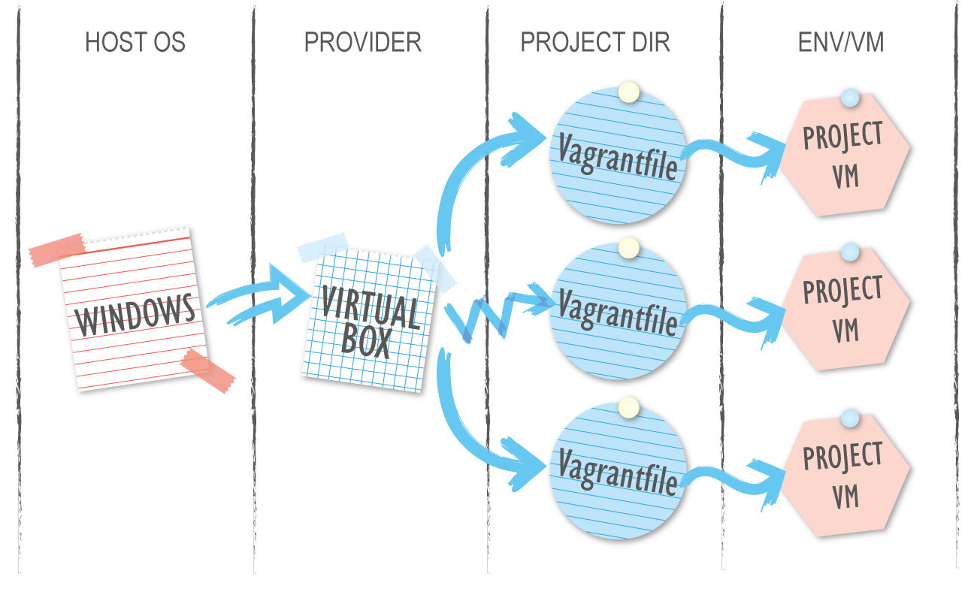
What is Vagrant?
Tool which create VM from file (Vagrantfile)
Easy reproducible
Same environment
Written on Ruby
Notes:
За програмисти и дизайнери
Нещо като docker image и docker file и docker container

Slide 10
Create & Connect
$ vagrant init {user}/{box}
$ vagrant up
$ vagrant ssh

Slide 11
Create & Connect
$ vagrant init agavazov/cent
$ vagrant up
$ vagrant ssh
Notes:
Example 1

Slide 12
What we need to start
Virtual Box →
Vagrant →
Enable bios virtualization (speak with IT support)
Open SSH (windows) →
RSync (windows) →
vagrant plugin install vagrant-vbguest →

Slide 13
Atlas repository
atlas.hashicorp.com
User
Box (Project)
Provider
Version

Slide 14
Vagrantbox.es
$ vagrant box add {title} {url}
$ vagrant init {title}
$ vagrant up

Slide 15
What is Vagrantfile?
Vagrant.configure(2) do |config|
config.vm.box = "agavazov/cent"
end
It's like automatic scenarios for:
Network setting
VM settings
Software installations
Project directories
....
Notes:
Това е ruby syntax

Slide 16
What is Vagrantfile?
Vagrant.configure(2) do |config|
config.vm.box = "agavazov/cent"
config.vm.synced_folder "C:\\project", "/project", type: "virtualbox"
end
Notes:
Example 2

Slide 17
Shared folders
Provider sharing
NFS (network file share)
RSync
Samba
config.vm.synced_folder ".", "/vagrant", type: "virtualbox"

Slide 18
Box VS Vagrantfile
Box is the image which creates the machine
Vagrantfile is the way how we create the machine

Slide 19
Team Configuration
JSON
YAML
Ruby, XML, etc…
require 'json'
configs = JSON.parse(File.read('users.json'))
OR
require 'yaml'
configs = YAML.load_file('users.yml')

Slide 20
Team organize
$ cd example-team
$ vagrant up
Notes:
Example team

Slide 21
Network basics
Public network – Team communication
Private network – Service communication
config.vm.network "private_network", ip: "10.255.255.10"
config.vm.network "public_network", ip: "192.168.1.10"
Notes:
Хубаво да сме с различно IP от 127.0.0.1:2200 защото може да имаме комуникация между различните машини
И хора от вън могат да се връзват към нашата машина

Slide 22
VM Customize
config.vm.provider "virtualbox" do |vb|
vb.name = "dev-box"
vb.memory = "2048"
vb.cpus = "2"
vb.gui = false
end

Slide 23
Provisioner
Puppet
Chef
Ansible
Shell

Slide 24
Shell provisioner
Inline
config.vm.provision "shell", inline: "echo hello world"
Path – external script
config.vm.provision "shell", path: "hello-world.sh"

Slide 25
Multi machine
One Vagrantfile
Shared private network
Different services
Different responsibilities
Think of it as a cloud

Slide 26
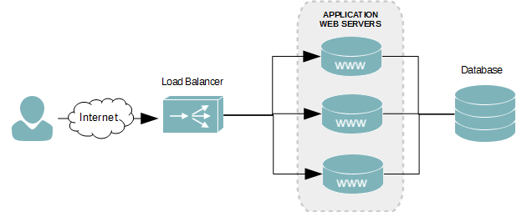
Multi machine

Slide 27
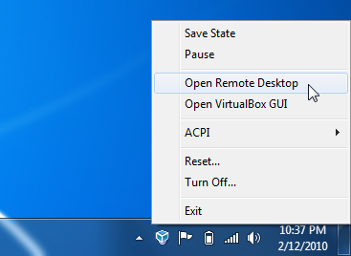
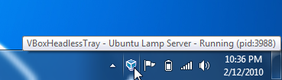
VBoxHeadlessTray
http://www.toptensoftware.com/VBoxHeadlessTray/
Notes:
Автоматичен старт
Интелигентно изключване

Slide 28
Create & deploy own box
Install Linux from scratch (or from repo)
sudo dd if=/dev/zero of=/EMPTY bs=1M; sudo rm -f /EMPTY; history –c
vagrant package --output name.box
Register into the repo and prepare version & provider
Upload the box

Slide 29
ANY
QUESTIONS?

Slide 30
https://github.com/ agavazov/vagrant-presentation

Slide 31
THANK YOU!

