Slide 1


Slide 2


Slide 3
Expectations
git clone user@host:space/project.git
package manager install
application start

Slide 4
Reallity
Its not working
HTTP Status 500
It works on my machine
type
Exception report
Wrong server version
Wrong operation system
Unknown error
Incompatible products
description

Slide 5
Expectations

Slide 6
Real environment
Няма изолация между услугите
Трудно пресъздаване и преинсталиране
Конфликти между версии или услуги
Липса на надеждност

Slide 7
Solution

Slide 8
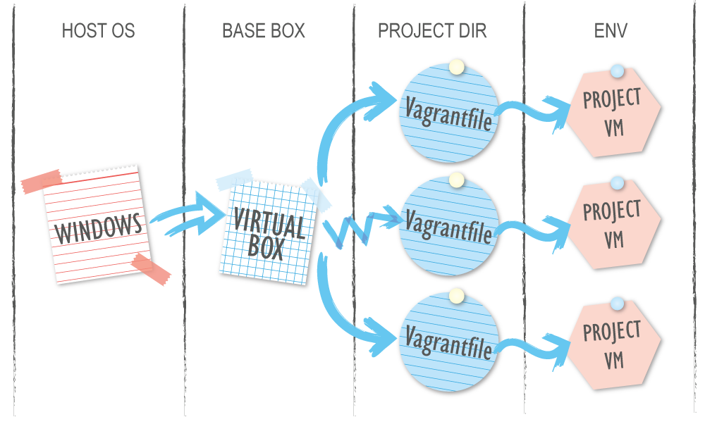
What is Vagrant
Инструмент който създава виртуални машини с една команда
Написан е на ruby
Създава еднаква среда за всички потребители сходна с тази в production
Всичко започва с Vagrantfile и командата vagrant up
Notes:
SSH команди и шернати директории
За програмисти и дизайнери
Box е пакетираният OS с инсталациите

Slide 9
What we need to start
Virtual Box
Vagrant
vagrant plugin install vagrant-vbguest
Enable bios virtualization (speak with IT support)
Open SSH
Rsync

Slide 10
What is Vagrantfile
require 'json'
Vagrant.configure(2) do |config|
config.vm.box = "agavazov/cent"
config.vm.synced_folder ".", "/vagrant", type: "virtualbox"
config.vm.provider "virtualbox" do |vb|
vb.memory = "2048"
vb.cpus = "2"
end
config.vm.provision "file", source: "C:\\id_rsa.pub", destination: ".ssh/authorized_keys"
config.vm.network "private_network", ip: "10.255.255.10"
config.vm.network "public_network", ip: "192.168.1.50"
config.vm.provision "shell", inline: <<-SHELL
eval 'yum install nginx -y'
eval 'systemctl enable nginx'
SHELL
end

Slide 11
HELLO WORDL
$ vagrant init debian/jessie64
# Add your public key into Vagrantfile
config.vm.provision "file",
source: "D:\\Workspace\\keys\\id_rsa.pub",
destination: ".ssh/authorized_keys"
$ vagrant up
Notes:
SSH problems & rsync problems

Slide 12
Team Configuration
Ruby
JSON
XML
YAML
require 'json'
configs = JSON.parse(File.read('users.json'))
user_config = configs['agavazov']
Vagrant.configure(2) do |config|
config.vm.hostname = user_config['hostname']
config.vm.network "private_network", ip: user_config["private_ip"]
config.vm.network "public_network", ip: user_config["public_ip"]
config.vm.provision "shell", inline: "echo '127.0.0.1 "
+ user_config['hostname'] + "' >> /etc/hosts"
end

Slide 13
Network basics
Public network – Service communication
Private network – Team communication
Host only adapters

Slide 14
VM Customize
config.vm.provider "virtualbox" do |vb|
vb.name = "dev-box"
vb.memory = "2048"
vb.cpus = "2"
vb.gui = false
vb.customize ["modifyvm", :id, "--cpuexecutioncap", "85"]
vb.customize ["modifyvm", :id, "--bioslogofadein", "off"]
vb.customize ["modifyvm", :id, "--bioslogofadeout", "off"]
vb.customize ["modifyvm", :id, "--bioslogodisplaytime", "0"]
vb.customize ["modifyvm", :id, "--biosbootmenu", "disabled"]
end

Slide 15
Symbolic Link
What Is a Symbolic Link?
How to enable it?
Customize VM with SharedFoldersEnableSymlinksCreate
config.vm.provider "virtualbox" do |vb|
vb.customize ["setextradata", :id, "VBoxInternal2/SharedFoldersEnableSymlinksCreate/__NAME__", 1]
end

Slide 16
Shared folders & mounts
User provider sharing
For big load use Virtio Disks
NFS (network file share)
RSync
Samba
config.vm.synced_folder ".", "/vagrant", type: "virtualbox“

Slide 17
Provisioner
Chef
Puppet
Ansible
Shell

Slide 18
Shell provisioner
config.vm.provision "shell", path: "script.sh"
config.vm.provision "shell", path: "https://example.com/provisioner.sh"
config.vm.provision "shell", inline: "echo hello world"
config.vm.provision "shell", inline: <<-SHELL
echo hello world
SHELL
config.vm.provision "shell" do |s|
s.inline = "echo $1"
s.args = "'hello, world!'"
end

Slide 19
Multi machine
One Vagrantfile
Shared private network
Different services
Different responsibilities
Think of it as a cloud

Slide 20
Box repositories
atlas.hashicorp.com
www.vagrantbox.es
http box
$ vagrant box add {title} {url}
$ vagrant init {title}
$ vagrant up

Slide 21
Create & deploy own box
Get the box from atlas (or start from scratch)
sudo dd if=/dev/zero of=/EMPTY bs=1M; sudo rm -f /EMPTY; history –c
vagrant package --output name.box
Register into the repo and prepare version & provider
Upload the box

Slide 22
The big example

Slide 23
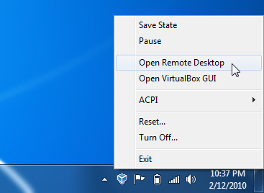
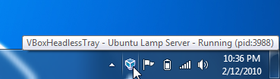
VBoxHeadlessTray
http://www.toptensoftware.com/VBoxHeadlessTray/
Notes:
Автоматичен старт
Интелигентно изключване

Slide 24
ANY
QUESTIONS?

Slide 25
https://github.com/ agavazov/vagrant-presentation

Slide 26
THANK YOU!

