Slide 1
Apache Solr - Full-Text Search Server
Andrea Gazzarini

Slide 2

About NobleProg

Slide 3






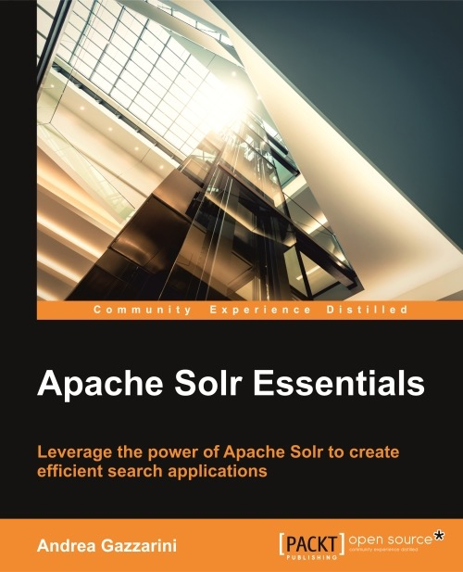



About Your Trainer
Name: Andrea Gazzarini
Founder & Director at SpazioCodice
Software Engineer, more than 15 years of experience
Java enthusiast
Apache Solr & Elasticsearch lover
Author of “Apache Solr Essentials” (Packt Publishing, 2015)
Apache committer (since 2009) for Qpid project

Slide 4
Course Details
Course Title: Apache Solr - Full-Text Search Server
The course is intended for IT specialist that want to implement a solution that allows for elastic and efficient searching of big data sources.
During
  Introduction
  Indexing
  Searching
  Advanced Topics
After
  Training Evaluation Form
    Will be sent to you by one of the training coordinators
  Course Attendance Certificate
    Will be sent to you by one of the training coordinators

Slide 5
Source code
Repository
https://github.com/agazzarini/as-full-text-search-server.git
The sample project contains both source code and sample configurations
Examples are written in Java, but it is very easy to understand, even if you don’t have a Java or a programming background
Each example is provided, wherever possible, in two forms: as a plain main class, and as a JUnit test
The sample project have been preloaded in Eclipse. We don’t need to code in this course, but using an IDE is useful for syntax highlighting or for executing test cases.
@Test
public void findAll() throws Exception {
IndexSearcher searcher = new IndexSearcher(DirectoryReader.open(directory));
Query query = new QueryParser("title", new StandardAnalyzer()).parse("title:Solr");
TopDocs matches = searcher.search(query, 10);
assertEquals(3, matches.totalHits);
Set<String> expected = new HashSet<String>();
expected.add("1");
expected.add("2");
expected.add("3");
Set<String> result = Arrays.stream(matches.scoreDocs)
.map(scoreDoc -> luceneDoc(scoreDoc.doc, searcher))
.map(doc -> doc.get("id"))
.collect(Collectors.toCollection(HashSet::new));
assertEquals(expected, result);
}
public static void main(String[] args) throws IOException, ParseException {
// 1. Creates a directory reference. This is where index datafiles will be created.
Directory directory = FSDirectory.open(new File("/tmp").toPath());
// 2. Creates an IndexWriter
try (IndexWriter writer = new IndexWriter(directory, new IndexWriterConfig())) {
// 3. Add some data
indexSomeData(writer);
// 4. Search
search(directory);
writer.deleteAll();
}
}

Slide 6

Search
The ultimate goal

Slide 7

Part 3: Search
Agenda
Context overview
Text analysis...again??
Query language
Query parsers
Request Handlers
Search Component
Response writers

Slide 8
Part 3: Search
Agenda
Context overview
Text analysis...again??
Query language
Query parsers
Request Handlers
Search Component
Response writers

Slide 9
Context Overview
Information Retrieval
Search, in this context, is about Information Retrieval
Although structured data is necessarily involved, the focus here is on unstructured or semi-structured content
The goal of the Information Retrieval is to provide efficient access to relevant information within a dataset, according with a given set of access patterns
The main difference with systems like RDBMS is that they are focused on structured data and they apply a rigorous “Boolean” model. The query language (e.g. SQL for RDBMS, SPARQL for RDF Stores) expresses a (even complex) boolean condition. Any record matching that condition is included in search results
Solr, but in general Lucene and its derived systems, go ahead, by combining the Boolean model with Vector Space Model
The adoption of such different paradigm has two main consequences:
  A powerful search that does “something” more than the exact clauses expressed in the query language: It gives to the requestor “relevant” documents
  The introduction of a given percentage of “noise” in results
Tuning, controlling and finding a compromise between those two aspects is the ordinary job of a search engineer
[1] https://cwiki.apache.org/confluence/display/solr/Taking+Solr+to+Production
[2] http://127.0.0.1:8983/solr

Slide 10
Context Overview
Information Retrieval
In order to measure the relevancy of a given result, Solr assigns it a “score”
The formula behind the score computation is behind the scope of this course, however important things that contribute to that formula are:
  Term Frequency (TF): how many times a given term occurs within a single document
  Document Frequency (DF): how many documents in the dataset contain a given term
  TF/IDF: the ratio between the term frequency and the inverse document frequency (1/DF)
  Field length: how many terms compose a field
  Matching clauses: the number of clauses, within a query, that found a match
  Boosting: functions or in general things that boost the score computed for a given match. Boosting can be applied at index time or a query time
Scores cannot be compared across queries, or even with the same query but with a different index.

Slide 11
Part 3: Search
Agenda
Context overview
Text Analysis...again???
Query language
Query parsers
Request Handlers
Search Component
Response writers

Slide 12
Text Analysis...again???
Yeah, but this happens at query time
At index time the text analysis is applied to fields values
At query time the same process happens but it is applied to the query string
Everything we already described about analyzers, char filters, tokenizers, token filters is also valid here in this context
Remember: if the schema defines query time analyzers, this is here where they enter in the game; otherwise the same analyzer defined at index time will be executed
TOKEN
+
query
Text analysis
produces
Offsets
Position increment
Payload
=
TERM
ANALYZER
0...*
1
1...*
CHAR FILTER
TOKENIZER
TOKEN FILTER

Slide 13
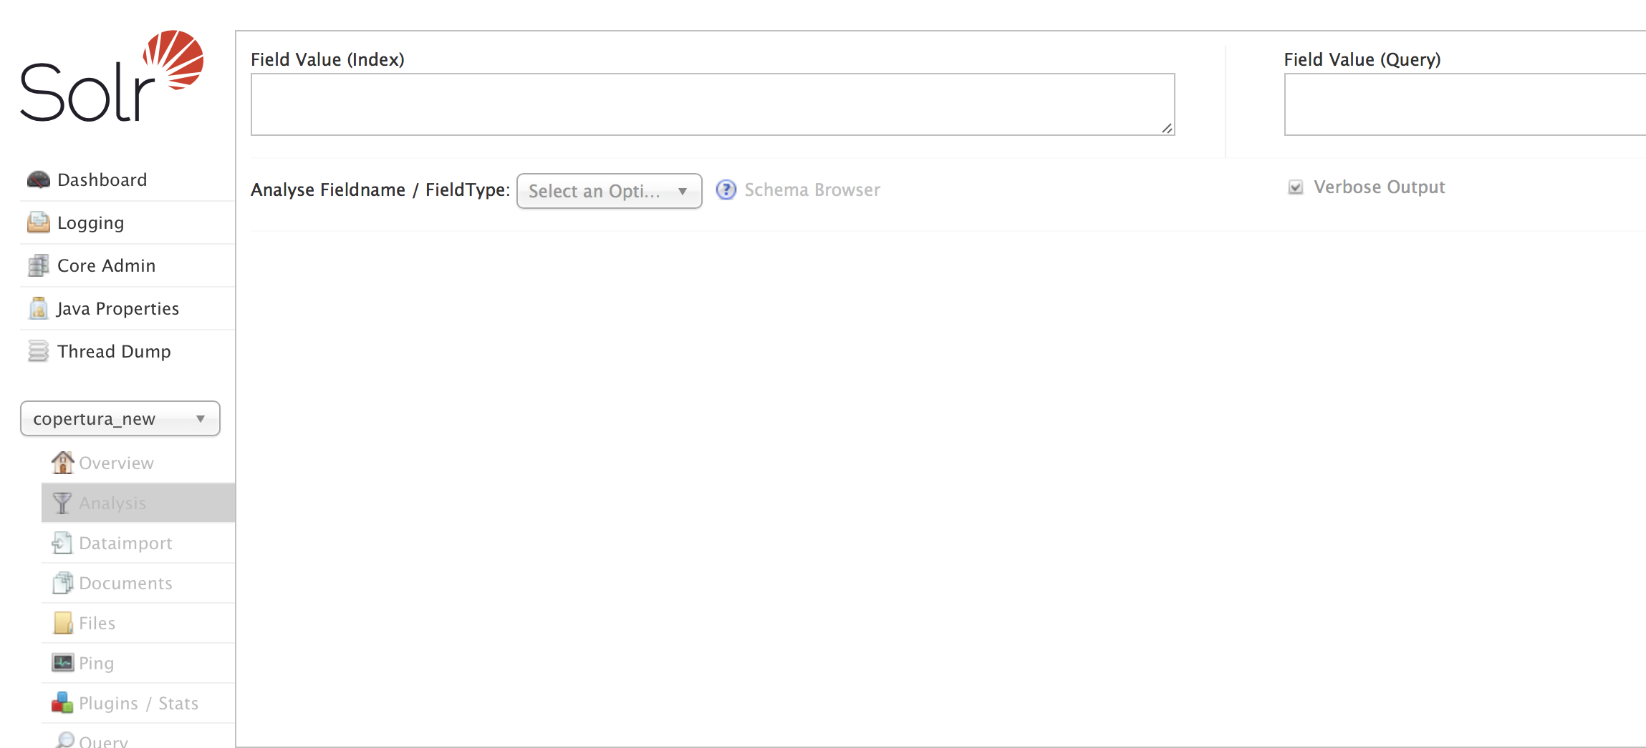
Text Analysis...again???
Field analysis in the administration console
Open the administration console
Select the core from the dropdown on the left
Select the “Analysis” menu item

Slide 14

Task: text analysis in the administration console

Slide 15
Part 3: Search
Agenda
Context overview
Text Analysis...again???
Query language
Query parsers
Request Handlers
Search Component
Response writers

Slide 16
Query language
Query protocol
Solr is like a tell-and-ask system: first we put data in (indexing) and then we can query it (search)
Solr is a system, not a human being, and therefore a protocol is need in order to define the interaction between it and its requestor
This protocol is called “query language“
Any tell-and-ask system has an its own query language (e.g. SQL for RDBMS, SPARQL for RDF Stores)
The query language is completely expressed through HTTP query parameters
The query, strictly speaking, corresponds to the value of the “q” parameter
The query (i.e. the q param) is interpreted by Solr in different ways, depending on the query parser associated with the request
There are several other possible parameters we can use for refining and modeling our search (e.g. filtering, faceting, limiting results, offset)

Slide 17
Query language
Some query parameters
Name | Description
q | Query string
start | Start offset within the search results
rows | Max number of results to return
sort | Sort criteria (e.g. title asc, author desc). It defaults to “score desc”
defType | Query parser (code) that will be used for parsing the q parameter
fl | List of stored fields that will be returned as part of each result
fq | Filter query, for refining / filtering out unwanted results
wt | Response type (e.g. xml, json)
debug | Enables the query explain, useful for debugging
facet and facet.* | Faceting
hl and hl.* | Highlithging
The list is not exhaustive and is not statically defined, because it depends on the query parser
Some parameter (i.e. filters) accepts more than one value:
http://localhost:8983/solr/ex1?fq=language:ita&fq=genre:jazz

Slide 18
Query language
Filter queries
Filter query is used to remove unwanted results from the query response
A request can have zero, one or more filter query. In case of multiple filter queries they will be interpreted in AND mode
A filter query is a query that doesn’t involve any score computation
A filter query is executed separately from the main query
A filter query is generally faster and reusable
Filter queries have a dedicated cache in Solr configuration
Filter queries use by default the Solr query parser for query syntax, but you can change it
Other than the functional goal, when using filter queries you must keep in mind these two aspects:
  Each filter query declare a mandatory clause
  Each filter query can be cached
fq=language:ita AND format:dvd ← THIS IS (USUALLY) WRONG!!!
fq=language:ita&fq=format:dvd ← THIS IS GOOD!

Slide 19
Task: let‘s run some query

Slide 20
Part 3: Search
Agenda
Context overview
Text Analysis...again???
Query language
Query parsers
Request Handlers
Search Component
Response writers

Slide 21

Query Parser
What is it?
A component which understand a specific query syntax
This is the first component involved in the query execution chain
If it is not specified, then a default parser is used (aka SolrQueryParser)
Solr comes with several available and ready-to-use query parsers
You can always write your own query parser (advanced)
The query parameter “defType” defines the query parser that will be used
If the request contains “debug=true” then you can see how the parser works (explain, execution)

Slide 22
Query parser
Some available query parsers
Name | Description
lucene | Very similar to Solr Query parser; it supports the Lucene query format
dismax / edismax | Disjunction Max / Extended Disjunction Max query parser
func | Function query parser
join | Join query parser (allows joins betweem documents / cores)
term | Term query parser (query on terms)
boost | Creates a boost query from the input string
raw | Creates term queries without any text analysis
geofilt | Geospatial queries
field | Creates field queries

Slide 23
Query parser
Solr Query Parser
It is the default parser
Usually referred as “Lucene Query Parser” because it derives directly from that implementation
Supports the full Lucene query syntax [1]
Behavior: it divides the query string in fields, values and operators
Fields must be declared in the schema
If a value follows a field then they are separated by : (e.g. title:history)
If a value is not associated with a field, then a default field is used
Wildcards can be used in values (*,?)
Values can be simple (single term) or compound (multiple terms)
Multiple terms can be grouped using parenthesis
If values are surrounded by double quotes then a proximity search is executed
Values can have modifiers associated (^ for boosting, ~ for fuzzy or proximity search)
There are 3 available operators which can be applied to field: MUST, SHOULD, NOT. They usually are (wrongly) associated with AND, OR and NOT boolean operators
[1] http://lucene.apache.org/core/6_6_0/queryparser/org/apache/lucene/queryparser/classic/package-summary.html#package.description

Slide 24
Query parser
Solr Query Parser: examples
Plain fielded search
http://localhost:8983/solr/sample/search?q=title:solr
Field search with default field
http://localhost:8983/solr/sample/search?q=apache solr full text server&df=title
Operators
http://localhost:8983/solr/sample/search?q=+title:apache author:pippo -title:solr
Boosting
http://localhost:8983/solr/sample/search?q=title:apache^1.5 author:pippo
Wildcards
http://localhost:8983/solr/sample/search?q=title:apach? author:alexand*
Fuzzy search
http://localhost:8983/solr/sample/search?q=author:charlie~

Slide 25
Query parser
Solr Query Parser: examples
Proximity search
http://localhost:8983/solr/sample/search?q=title:”apache solr”
Proximity search with phrase slop
http://localhost:8983/solr/sample/search?q=title:”apache solr”~2
Range query with bounds included
http://localhost:8983/solr/sample/search?q=year:[1987 TO 2017]
Range query with bounds excluded
http://localhost:8983/solr/sample/search?q=year:{1987 TO 2017}
Range query with wildcards
http://localhost:8983/solr/sample/search?q=year:[1987 TO *]
Match all query
http://localhost:8983/solr/sample/search?q=*:*

Slide 26
Task: let‘s run some query using the Solr Query Parser

Slide 27
Query parser
Disjunction Max Query Parser
First dismax has been introduced, then (in Solr 4) it has been “extended”
Right now, the “dismax” is deprecated in favour of “edismax”
Here we are describing the DisMax for focusing on its peculiarities
There’s no query syntax(!). Better, the query string is supposed to contain only search terms (e.g. q=this is the user entered query)
As you imagine, this roughly maps the user “view” of the query
How does Solr execute the query using those terms? It’s up to you
The DisMax query parser provides several configuration parameters [1] that allows you to define and tune a given search logic
The main difference between the default parser and dismax is that the search logic is moved outside the q parameter. When we will see the request handler this difference will play an important role
[1] https://cwiki.apache.org/confluence/display/solr/The+DisMax+Query+Parser

Slide 28
Query parser
DisMax Query Parser: most important parameters
Name | Description | Example
qf | List of fields where the search will be executed, with optional boost | qf=title^1.8 author^0.5 publisher
pf | Once the search has been executed, a phrase query on top of this fields list is executed as well, in order to raise the score of those matches that have contiguous terms | pf=title^1.2 abstract
bq | An additional boost query (lucene query syntax) used for raise the score of some results. This is a multivalued parameter. | bq=title:Jazzilandia&bq=author:Pastorius
bf | A boost function. The goal is always the same: rasing the score of documents | bf=log(popularity)
qs, ps | Query and phrase slop: specifies the number of positions two terms can be apart in order to match the specified phrase | ps=2&qs=3
mm | Specifies the minimum number of clauses that must match in a query. Can be a number, a percentage or an expression | mm=1 (OR) mm=100% mm=3<75% 6<-1
tie | The parser executes several queries and then it takes, for computing the final score, only the sub query that produced the max score. Through this parameter, which is a float between 0 and 1, we can take in account also the other matching sub queries. | tie=0.2

Slide 29
Query parser
DisMax Query Parser: examples
Search on title (most important) and abstract
http://localhost:8983/solr/sample/search?q=apache solr&qf=title^1.5,abstract
Same search but boost a bit with a proximity search
http://localhost:8983/solr/sample/search?q=apache solr&qf=title^1.5,abstract&pf=abstract
All clauses are mandatory (AND behavior)
http://localhost:8983/solr/sample/search?q=apache solr&qf=title,abstract&mm=100%
Boost up books of a given author
http://localhost:8983/solr/sample/search?q=apache solr&qf=title,abstract&bq=author:Bhremer
Pure Disjunction Max Query
http://localhost:8983/solr/sample/search?q=apache solr&qf=title,abstract&tie=0
Disjunction Sum Query
http://localhost:8983/solr/sample/search?q=apache solr&qf=title,abstract&tie=1

Slide 30
Task: let‘s run some query using the DisMax Parser

Slide 31
Query parser
Extended Disjunction Max Query Parser
Dismax has been introduced first, then (in Solr 4) it has been “extended”
Right now, the “dismax” is deprecated in favor of “edismax”
Query syntax: dismax (only search terms) + Solr Query Parser (fielded search)
Additional configuration parameters [1], mainly used for boosting
Combines the advantages of the two parsers
Any parameters already seen is also working with the eDisMax
This is the obvious choice for implementing and tuning a search logic
[1] https://cwiki.apache.org/confluence/display/solr/The+Extended+DisMax+Query+Parser

Slide 32
Query parser
eDisMax Query Parser: most important parameters
Name | Description | Example
pf2 | Once the search has been executed, a bigram phrase query on top of this fields list is executed as well, in order to raise the score of those matches that have contiguous terms | pf2=title^1.2 abstract
pf3 | Once the search has been executed, a trigram phrase query on top of this fields list is executed as well, in order to raise the score of those matches that have contiguous terms | pf3=title^1.2 abstract
boost | A multiplicative boost function. This is a multivalued parameter. | boost=log(popularity)&boost=sqrt(likes)
ps2,ps3 | Phrase slop (same as ps) but for bigrams (pf2) and trigrams (pf3) matches | ps2=2&ps3=3

Slide 33
Query parser
eDisMax Query Parser: examples
Mixed search (fielded and only terms)
http://localhost:8983/solr/sample/search?q=apache solr AND author:Ross&qf=title,author
Mixed search (fielded and only terms)
http://localhost:8983/solr/sample/search?q=apache solr OR author:R?ss*&qf=title,author
Mixed search (fielded and only terms)
http://localhost:8983/solr/sample/search?q=apache solr +author:R?ss* -Kim&qf=title,author
Dismax search with multiplicative boost
http://localhost:8983/solr/sample/search?q=apache solr&boost=log(popularity)

Slide 34
Task: let‘s run some query using the eDisMax Parser

Slide 35
Query parser
Some available query parsers
Name | Description
lucene | Very similar to Solr Query parser; it supports the Lucene query format
dismax / edismax | Disjunction Max / Extended Disjunction Max query parser
func | Function query parser
join | Join query parser (allows joins betweem documents / cores)
term | Term query parser (query on terms)
boost | Creates a boost query from the input string
raw | Creates term queries without any text analysis
geofilt | Geospatial queries
field | Creates field queries

Slide 36

Part 3: Search
Questions & Answers

Slide 37
Part 3: Search
Agenda
Context overview
Text Analysis...again???
Query language
Query parsers
Request Handlers
Search Component
Client API

Slide 38
Request Handlers
What is a RequestHandler?
We already met a request handler when we indexed data (/update)
A request handler is a pluggable component that handles incoming request
The UpdateRequestHandler handles index manipulation requests (e.g. add/delete)
The SearchHandler handles search request
There are several other request handlers implicitly defined in solrconfig.xml (e.g. /admin, /update)
The administration API are served by a request handler (/admin). The graphical administration console is based on those API
In this section we will talk about “search” request handlers
A search handler must be configured in solrconfig.xml
It has a name, which defines the endpoint URI (e.g. “/search”, /something”)
It has a classname, which usually defaults to “solr.SearchHandler”
It can be marked as default (i.e. if the incoming request doesn’t indicate a request handler then it will play as default)
It has a configuration where we can implement / build / tune the corresponding search logic
It is usual to define many search endpoints (/search, /autocomplete)

Slide 39
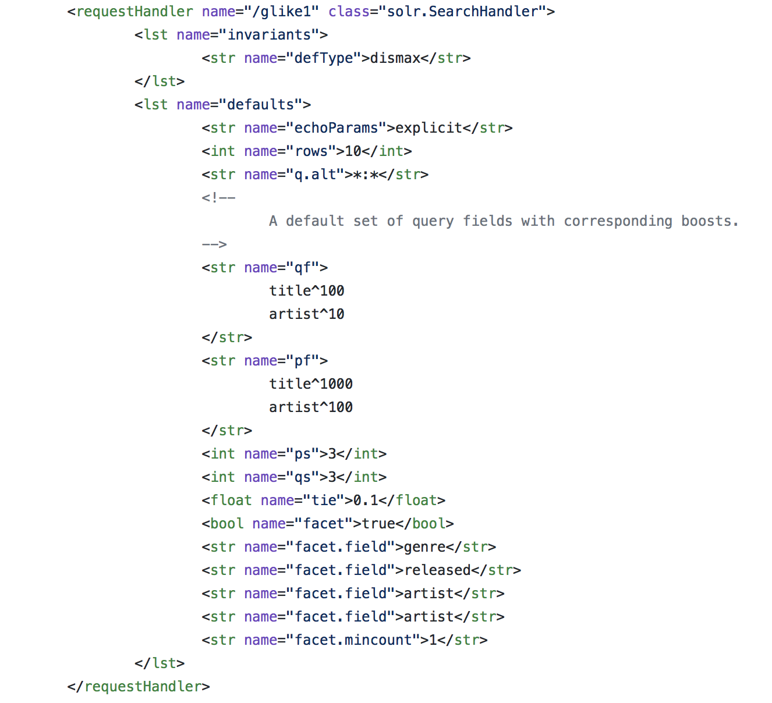
Request Handlers
SearchHandler: how it looks like in sorlconfig.xml

Slide 40
Search Components
Suggester
The component [1] provides users with automatic suggestions for query terms. You can use this to implement a powerful auto-suggest feature in your search application.
Term dictionary pluggability (DocumentDictionary, the most common and simple to use uses a lucene index to provide suggestions)
Lookup implementation pluggability
Distributed support: it works only in SolrCloud mode
Document dictionary requires a separate index to be built. This happens
    Explicitly: by issuing a specific request to this component
    Implicitly: in the configuration you have several “automatic” options (after startup, aftert commit or after optimize)
IMPORTANT: matches are not entire documents! The focus is on the field, with an optional payload
At index time you can configure a weight field, for controlling the suggestions order
A couple of lookup implementations (AnalyzingInfixLookup and BlendedInfixLookup) supports also context filters. That is: you can filter out suggestions using arbitrary (lucene) queries
[1] https://cwiki.apache.org/confluence/display/solr/Suggester

Slide 41
Request Handlers
SearchHandler: structure
Parameters
0...1
invariants
0...1
defaults
0...1
appends
SEARCH HANDLER
solrconfig
1...n
name
class
components
0...1
first-components
0...1
components
0...1
last-components

Slide 42
Request Handlers
SearchHandler configuration
Configuration parameters can be set within three different sections called “invariants”, “defaults” and “appends”
“defaults” parameters only if they are absent in the incoming request
“appends” parameters are always appended
“invariants” parameters will be always applied. They cannot be overridden. In case the request contains those parameters, they will be ignored
Any parameter we described in the previous section (query parser, query language) can be configured within the request handler. This allows us to move the search logic within Solr: the client would specifiy only the necessary parameters (e.g. q, fq)
As you can see from the picture, there’s another configuration section which is about search components. We will see in the next section what they are. Here, the important thing is: you can declare those components and you can specify “when” they will play within the request lifecycle (at the beginning, in the middle or at the end)
http://localhost:8983/solr/mycore/search?q=history
<requestHandler name=”/search” ….>
<lst name=”defaults”>
<str name=”rows”>20</str>
</lst>
</requestHandler>

Slide 43
Part 3: Search
Agenda
Context overview
Text Analysis...again???
Query language
Query parsers
Request Handlers
Search Component
Client API

Slide 44
Search Components
What is a search component?
At this point you don’t know, but you already met search components
A search component is, as the name suggests, a component that plays a role within the execution of a search request
The most important search component is the “query” component, which is implicitly defined in search handlers and it’s responsible for the query execution
There are others search components implicitly defined in a search handler, but they are disabled
A search component can be explicitly declared and configured within the solrconfig.xml
A search component has a name, which is used to position the component in the search handler (first-components, components, last-components)
It’s quite easy to write your own search component, only Java and a minimal Solr knowdlege are needed
<searchComponent name="prices" class="a.b.c.MyComponent">
<str name="datasource">jdbc/myds</str>
<str name="another-param">xyz123</str>
</searchComponent>

Slide 45
Search Components
Available search components
Name | Description
query | It is responsible for parsing and executing the query. Most part of the configuration parameters we previously described are managed by this component
facet | Enables the so-called faceted search
highlighting | Contributes to search results by adding a trailing section in response which contains a set of snippets with the field values and the matching terms highlighted (i.e. within some HTML markup like <b>...</b>
mlt | More Like This. It allows us to find documents that have some similarity with one or more search results
elevation | The query elevation provides a way to bring up on the top of the search list a set of documents matching a given criteria (i.e. a given query). Often used in e-commerce shops
stats | Adds in the response fields statistics (e.g. min, max, average)
spellcheck | Enables the “did you mean?” feature
suggester | Provides users with automatic suggestions for query terms
terms | Provides access to the internal Lucene term dictionary
term vector | For each document in search results, this component appends the corresponding TermVector
debug | Provides debug information (e.g. explain, query parsing debug)

Slide 46
Search Components
Facet
This is one of the most used and cool Solr features
Facets are runtime aggregations among search results
The facet component can be activated with the param “facet” (facet=true), usually within the search handler configuration
In Solr we have 5 kinds of facets:
  Facet fields: aggregations on a given field
  Facet queries: aggregations (i.e count) on arbitrary queries
  Facet ranges / interval: aggregations on numeric / date fields by ranges
  Pivot facets: nested fields aggregations
  JSON Facets: provides a more complex query, JSON-based language for dealing with aggregations and activating things like metrics and buckets
The facet component has common parameters [1] shared among the different faceting types and parameter that are specific to a given type
[1] https://lucene.apache.org/solr/guide/6_6/faceting.html#faceting

Slide 47
Search Components
Highlighting
Contributes to search results with “snippets”
A new section with HTML highlighted snippets is appended at the end of the response
Useful feature for giving to the end users information about matching terms
Useful for example when you’re dealing with PDF or large documents
Three available highlighter implementation. Each of them require some specific configuration on the field that you want to highlight:
  Standard Highlighter: requires term vectors (better) or stored fields
  Fast Vector Highlighter: requires term vectors, offsets and positions
  Posting Highlighter: requires field offsets and positions
The highlighting is an “heavy” feature: cool but at the same time it needs to be carefully tuned, because it could require a lot of memory and / or disk space (i.e. index size)
[1] https://cwiki.apache.org/confluence/display/solr/Highlighting

Slide 48
Search Components
MoreLikeThis
Allows to find documents that have some similarity with one or more search results
There are three available ways for using this functionality
  MoreLikeThisRequestHandler: a request handler which gets a query that identifies a document and then finds similar documents, according to the configured criteria
  MoreLikeThisComponent: a search component running after the query component and, for each results, find similar documents
  MoreLikeThisQueryParser: a query parser which provides the more like this function through the query language
It requires term vectors or stored flag set to true on all fields used for similarity computation
The first way (MoreLikeThisRequestHandler) is definitely the most used
[1] https://cwiki.apache.org/confluence/display/solr/MoreLikeThis

Slide 49
Search Components
Suggester
The component [1] provides users with automatic suggestions for query terms. You can use this to implement a powerful auto-suggest feature in your search application.
Term dictionary pluggability (DocumentDictionary, the most common and simple to use uses a lucene index to provide suggestions)
Lookup implementation pluggability
Distributed support: it works only in SolrCloud mode
Document dictionary requires a separate index to be built. This happens
    Explicitly: by issuing a specific request to this component
    Implicitly: in the configuration you have several “automatic” options (after startup, aftert commit or after optimize)
IMPORTANT: matches are not entire documents! The focus is on the field, with an optional payload
At index time you can configure a weight field, for controlling the suggestions order
A couple of lookup implementations (AnalyzingInfixLookup and BlendedInfixLookup) supports also context filters. That is: you can filter out suggestions using arbitrary (lucene) queries
[1] https://cwiki.apache.org/confluence/display/solr/Suggester

Slide 50
Part 3: Search
Agenda
Context overview
Text Analysis...again???
Query language
Query parsers
Request Handlers
Search Component
Client API

Slide 51
Client API
Several choices available...it’s up to you
Solr exposes all its services through HTTP, so it’s very easy to write a client program that indexes and queries data
However, there are a lot of ready-to-use libraries
Client libraries, especially if open-source, are reccomended because
  Someone already developed them
  They offer functional (e.g. index, search) and non functional features (e.g. load balancing, retrying, protocol and transport management)
SolrJ is the official Java client API. It is a Solr subproject and it is part of the Solr download bundle (you can also download separately through Maven, Gradle or other similar tool)
SolrJ, being the reference client API, supports all features exposed by Solr
If you’re using another language you should check which features are supported. For example, if you’re using Solr in distributed mode (aka SolrCloud) you should check if the chosen library supports it (the interaction is a little bit different because it involves another system called Zookeeper)
[1] https://lucene.apache.org/solr/guide/6_6/faceting.html#faceting

Slide 52
Client API
Other bindings
Name | Language
sunburnt | Python | https://github.com/tow/sunburnt
pysolr | Python | https://github.com/django-haystack/pysolr
solrcloudpy | Python | https://github.com/solrcloudpy/solrcloudpy
solr-ruby | Ruby | https://github.com/rsolr/rsolr
Blacklight | Ruby | http://projectblacklight.org
Solarium | PHP | http://www.solarium-project.org
Solr-PHP-Client | PHP | https://github.com/PTCInc/solr-php-client
Flux | Clojure | https://github.com/mwmitchell/flux
Solr-scala-client | Scala | https://github.com/takezoe/solr-scala-client
scalikesolr | Scala | https://github.com/seratch/scalikesolr
SolrNET | .NET | https://github.com/SolrNet/SolrNet

Slide 53
Part 3: Search
Questions & Answers

Slide 54
Advanced Topics
Deployment scenarios, ext modules

Slide 55
Part 4: Advanced topics
Agenda
Deployment scenarios
Contrib modules
Q&A

Slide 56
Part 4: Advanced topics
Agenda
Deployment scenarios
Contrib modules
Q&A
Client API

Slide 57
Deployment scenarios
Search infrastructure is strictly tied to your needs
The training instance we used in this course is a standalone Solr instance
Contrary to what you could think, a search infrastructure with one single standalone instance is very popular (especially when Solr is integrated with CMS like Drupal, Magento)
The standalone instance is not so good from a non-functional perspective
But remember: the right configuration depends on your needs. There are a lot of projects which are doing thei business with a single Solr standalone instance
Other than the standalone instance, we can have other scenarios
At the other extreme there’s Solr in distributed mode, also known as SolrCloud
If you move towards SolrCloud your search infrastructure
  gains in terms of non functional capabilities
  grows in terms of complexity
  needs more hardware resources
Standalone and SolrCloud are not the only possible choices. In this section we will describe all of them
[1] https://lucene.apache.org/solr/guide/6_6/faceting.html#faceting

Slide 58

Deployment scenarios
Scenario #1: standalone instance
Data
Read
C1
I
C2
Index
Search
S
earcher
Cn
= Core n

Slide 59
Deployment scenarios
Scenario #2: manual sharding
I
ndexer
Index
Index
NODE #1
NODE #2
NODE #3
C1/S1
C1/S2
C1/S3
Search
Search
C2/S1
C2/S2
C2/S3
Search
Search
S
earcher
Cn/Sm
= Shard “m” belonging to Core “n”

Slide 60
Deployment scenarios
Scenario #3: master / slave
Data
MASTER
Read
INDEX 1
I
Index
Synchronize
Synchronize
SLAVE #1
SLAVE #2
SLAVE #3
INDEX 1
INDEX 1
INDEX 1
Search
Search
Round-robin
S

Slide 61
Deployment scenarios
Scenario #4: SolrCloud
CLUSTER
ZOOKEEPER
ENSEMBLE
NODE #1
NODE #2
NODE #3
ZK #1
SHARD1
SHARD1
SHARD1
L
R
R
ZK #2
SHARD2
SHARD2
SHARD2
R
L
R
SHARD3
SHARD3
SHARD3
ZK #n
R
R
L
I
S
Discover search & index endpoints

Slide 62
Deployment scenarios
Scenario #1: standalone instance
Data
Read
C1
I
C2
Index
Search
S
earcher
Cn
= Core n

Slide 63
Deployment scenarios
Questions & Answers

Slide 64
Part 4: Advanced topics
Agenda
Deployment scenarios
Contrib modules
Q&A
Client API

Slide 65
Contrib modules
Outside the Solr core but definitely useful
Contrib modules are external projects that enable additional features
Although they are not part of the Solr core, you can find them in the download bundle
There’s no automatic way to install them
Since they are written in Java, installing them is usually a matter of:
    Copying some library in the lib folder of your core (or using the “lib” directive)
    Adding some configuration in solrconfig.xml
If you are in distributed mode, the libraries above must be available on every node in the cluster
Adding or removing a new module requires a core reload or (better) a restart of the whole instance
Each module covers different needs so there’s no a general configuration

Slide 66
Contrib modules
DataImportHandler
It is a RequestHandler mainly used for gathering data from RDBMS, but it is able to index data from other many datasources (e.g. XML files, rich documents, emails, URLs)
The RDBMS support, being the most popular, has a lot of options
It has support for full and delta indexing
A lot of data manipulation can be done before sending documents to Solr
Once configured, a dedicated section appears in the administration console
As any request handler it can be controlled through HTTP requests
Not so efficient, especially if the database schema is complex (it scans data sequentially)
The DataImportHandler configuration happens in two places:
    solrconfig.xml: you need to configure the service endpoint as a plain request handler
    dih-config.xml: where you define the (SQL) queries and the data manipulation
In my experience: when you have a “simple” database schema the DIH is very good, you don’t need to write code and, after a short configuration, everything is working. Instead, when that schema and / or the gathering logic is complex it’s usually better to
write a custom client.

Slide 67
Contrib modules
Solr Content Extract Library (SolrCell)
It is a RequestHandler used for indexing the textual content of rich documents (e.g. MS Office, Libre / Open office, PDF)
It uses Apache Tika [1] behind the scenes
It extracts the text and the metadata from submitted files
As any request handler it can be controlled through HTTP requests
Not so efficient, each request allows a maximum of one file
SolrCell configuration happens in two places:
    solrconfig.xml: you need to configure the service endpoint as a plain request handler
    tika.config (optional): if you need to tune some aspect of Tika
In my experience: in a production environment I never used this module. Extracting a text from a PDF is a very CPU-intensive job, so unless you have few files, it’s always better to create a custom client process which is able to do that job using Tika, batch the requests and send the text data to Solr

Slide 68
Contrib modules
Other modules
LangId
An update request processor which is inserted in the indexing chain in order to determine the language of a given field.
UIMA
An update request processor which enables Named Entity Recognition (NER) on one or more fields. The module is just a bridge to UIMA, which is itself a pluggable system and where the concrete NER engine must be configured (note that some engine, like Alchemy, provides a trial period but they are commercial products)
MapReduce
An implementation of a MapReduce Hadoop Job for working with HDFS
Solaritas
A request handler and a query response writer which uses Apache Velocity for building a GUI directly from the Solr response. Good for rapid prototyping.

Slide 69

Thank you!
Contact
NobleProg
Mr Antolin Hernandez
Training Coordinator
Tel: +1 647 977 5839
Skype:NobleProg MX
Email: antolin.hernandez@nobleprog.eu
www.nobleprog.ca
To edit footnote click on Insert / Header & Footer

