Slide 1
Apache Solr - Full-Text Search Server
Andrea Gazzarini

Slide 2
Before We Start
About NobleProg
About your Trainer
Housekeeping
Course Details
Source code

Slide 3

About NobleProg

Slide 4


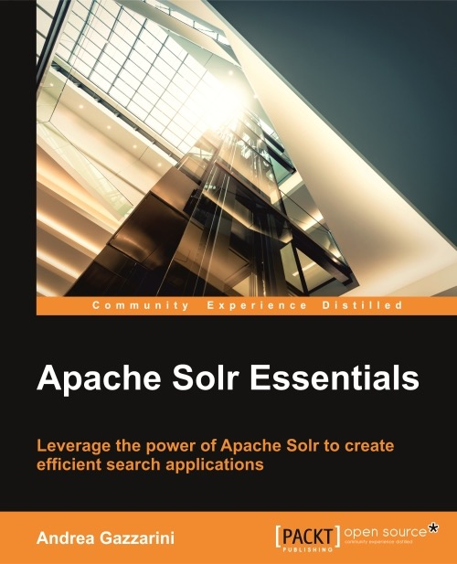






About Your Trainer
Name: Andrea Gazzarini
Founder & Director at SpazioCodice
Software Engineer, more than 15 years of experience
Java enthusiast
Apache Solr & Elasticsearch lover
Author of “Apache Solr Essentials” (Packt Publishing, 2015)
Apache committer (since 2009) for Qpid project
http://home.apache.org/committer-index.html#agazzarini
http://qpid.apache.org
https://www.linkedin.com/in/andreagazzarini
https://twitter.com/agazzarini
http://www.spaziocodice.com

Slide 5
About You
Your Name
Your Background
Your Objectives
  Have you completed a Pre-Course Questionnaitre?
What is your current experience
How will you be using the knowedge you gain on this course
Are you currently working on a relevant project/application
  Version
  Vendor
  OS
  …. etc

Slide 6
Housekeeping
  Schedule
    Start 09:30
    Finish 16:30
    Lunch
      30-45 mins
    Break
      10-15 mins AM
      10-15 mins PM
    Register (are we all here)
    Mobiles silent/off

Slide 7
Course Details
Course Title: Apache Solr - Full-Text Search Server
The course is intended for IT specialist that want to implement a solution that allows for elastic and efficient searching of big data sources.
During
  Introduction
  Indexing
  Searching
  Advanced Topics
After
  Training Evaluation Form
    Will be sent to you by one of the training coordinators
  Course Attendance Certificate
    Will be sent to you by one of the training coordinators

Slide 8
Source code
Repository
https://github.com/agazzarini/as-full-text-search-server.git
The sample project contains both source code and sample configurations
Examples are written in Java, but it is very easy to understand, even if you don’t have a Java or a programming background
Each example is provided, wherever possible, in two forms: as a plain main class, and as a JUnit test
The sample project have been preloaded in Eclipse. We shouldn’t need to code in this course, but using an IDE is useful for syntax highlighting or for executing test cases.
@Test
public void findAll() throws Exception {
IndexSearcher searcher = new IndexSearcher(DirectoryReader.open(directory));
Query query = new QueryParser("title", new StandardAnalyzer()).parse("title:Solr");
TopDocs matches = searcher.search(query, 10);
assertEquals(3, matches.totalHits);
Set<String> expected = new HashSet<String>();
expected.add("1");
expected.add("2");
expected.add("3");
Set<String> result = Arrays.stream(matches.scoreDocs)
.map(scoreDoc -> luceneDoc(scoreDoc.doc, searcher))
.map(doc -> doc.get("id"))
.collect(Collectors.toCollection(HashSet::new));
assertEquals(expected, result);
}
public static void main(String[] args) throws IOException, ParseException {
// 1. Creates a directory reference. This is where index datafiles will be created.
Directory directory = FSDirectory.open(new File("/tmp").toPath());
// 2. Creates an IndexWriter
try (IndexWriter writer = new IndexWriter(directory, new IndexWriterConfig())) {
// 3. Add some data
indexSomeData(writer);
// 4. Search
search(directory);
writer.deleteAll();
}
}

Slide 9

Introduction
Overview + Get Solr up and running

Slide 10

Part 1: Introduction
Agenda
Context overview
What is Apache Lucene?
What is Apache Solr?
Installation
Q&A

Slide 11
Part 1: Introduction
Agenda
Context overview
What is Apache Lucene?
What is Apache Solr?
Installation
Q&A

Slide 12
Context overview
Why you should know more about Lucene and Solr
Search is everywhere: do you know a project where search is not needed?
When entering in big data scenarios, you need those tools that hide, as much as possible, non functional complexity
Solr nicely fits any kind of scenario: from local applications to enterprise projects
It is a nice and soft introduction into the big data word
Lucene and Solr hide very good all the complexity of Information Retrieval: you don’t have to be an Information Retrieval expert.
The low learning curve has some nice effects: you can immediately focus on your problem, and in the meantime you can go deeper on those topics you’re interested
All most popular Content Management Systems (CMS) like Drupal, Magento, Prestashop, Wordpress can be integrated with Solr
A nice side effect is that when dealing with Solr, you’re dealing with Lucene as well. That means a walk though Solr prepares your mind towards Lucene and also all products (like Solr) that are built on top of that (i.e. Elasticsearch)

Slide 13
Part 1: Introduction
Agenda
Context overview
What is Apache Lucene?
What is Apache Solr?
Installation
Q&A

Slide 14

What is Apache Lucene?
In few words…
http://lucene.apache.org
High-performance, scalable information retrieval software *library*
Enables searching capabilities to your applications
Cohesive and simple interface, which hides a really complex world
Available in many other languages (e.g. C#, Ruby, Python)
Open source: Apache Top Level Project

Slide 15
What is Apache Lucene?
Brief history
Doug Cutting releases the first version on SourceForge
1999
Lucene becomes an Apache Project
2001
Lucene becomes an Apache Top Level Project
2005
Lucene 6.6.0
2017

Slide 16
What is Apache Lucene?
Basic flow
Data ingestion, aka “indexing” (i.e. creates the “index”)
Search
Data is acquired, the index is created
Indexing
Query the data stored in the index
Search
IMPORTANT: the index is an immutable structure: each time something changes (even a single attribute of a given “record”), we need to rebuild the index

Slide 17
What is Apache Lucene?
Example
Index
public void indexSomeData(IndexWriter writer) throws IOException {
writer.addDocument(newBook("1", "Apache Solr Essentials", "Andrea Gazzarini"));
writer.addDocument(newBook("2", "Apache Solr FullText Search Server", "John White"));
writer.addDocument(newBook("3", "Enterprise Search with Apache Solr", "Martin Green"));
writer.commit();
}
Search
public void search(Directory directory) throws IOException, ParseException {
IndexSearcher searcher = new IndexSearcher(DirectoryReader.open(directory));
Query query = new QueryParser("title", new StandardAnalyzer()).parse("title:Solr");
TopDocs matches = searcher.search(query, 10);
System.out.println("Search returned " + matches.totalHits + " matches.");
Arrays.stream(matches.scoreDocs)
.map(scoreDoc -> luceneDoc(scoreDoc.doc, searcher))
.forEach(doc -> {
System.out.println("-------------------------------------");
System.out.println("ID:\t" + doc.get("id"));
System.out.println("TITLE:\t" + doc.get("title"));
System.out.println("AUTHOR:\t" + doc.get("author"));
});
}

Slide 18

Task: let‘s have a look at the sample code in the Eclipse workspace

Slide 19
Part 1: Introduction
Agenda
Context overview
What is Apache Lucene?
What is Apache Solr?
Installation
Q&A

Slide 20
What is Apache Solr?
In few words…
http://lucene.apache.org/solr/downloads.html
Highly reliable, scalable and fault tolerant search *service*
A Lucene “serverization” with a lot of additional features
All services are exposed through a HTTP (REST Like interface)
Written in Java
Rich ecosystem for building enterprise-level applications (e.g. contrib modules, CRM integrations)
Open source: Apache Top Level Project
Very low learning curve

Slide 21

What is Apache Solr?
Brief history
Yonik Seeley creates the first version (not public)
2004
-
CNET Networks donates the Solr code to the Apache Software Foundation
2005
Solr becomes an Apache Top Level Project
2007
Version 1.3
2008
Version 1.4: Lucidworks is publicly launched
2009
Solr and Lucene development is “merged”
2010
Solr and Lucene adopt a unified “versioning” number
2011
Version 6.6.0 (Solr 7 is quite ready!)
2017

Slide 22
Part 1: Introduction
Agenda
Context overview
What is Apache Lucene?
What is Apache Solr?
Installation
Q&A

Slide 23
Installation
Different ways to do the same thing
Solr is written in Java and available as a ready-to-use download bundle
As consequence of that Java (8) is required.
For a quick taste or for study purposes, just extract the downloaded archive somewhere
For development purposes the procedure is a little bit complicated, but we don’t need that right now
For a production use, there’s an installation procedure (only available for linux based systems) [1]
Once installed, Solr is running as a web service
It provides, through HTTP, several services endpoints
It comes with a bundled web-based administraton console [2]
[1] https://cwiki.apache.org/confluence/display/solr/Taking+Solr+to+Production
[2] http://127.0.0.1:8983/solr

Slide 24
Installation
After the installation
Navigate under the bin folder, there you can find start / stop commands
Once Solr has been started, open a browser and go to http://127.0.0.1:8983/solr
gxserver:bin agazzarini$ ./solr start -f
Starting Solr on port 8983 from /Users/agazzarini/Products/solr-6.2.1/server
...
319 INFO (main) [ ] o.e.j.w.StandardDescriptorProcessor NO JSP Support for /solr, did not find org.apache.jasper.servlet.JspServlet
...
643 INFO (main) [ ] o.e.j.s.h.ContextHandler Started o.e.j.w.WebAppContext@71423665{/solr,file:///Users/agazzarini/Products/solr-6.2.1/server/solr-webapp/webapp/,AVAILABLE}{/Users/agazzarini/Products/solr-6.2.1/server/solr-webapp/webapp}
652 INFO (main) [ ] o.e.j.s.ServerConnector Started ServerConnector@44c03695 {HTTP/1.1,[http/1.1]}{0.0.0.0:8983}
## Starts Solr in foreground mode on the default port (8983)
> ./solr start -f
## Starts Solr in background mode on the 8985 port
> ./solr start -p 8985
## Stops Solr
> ./solr stop

Slide 25
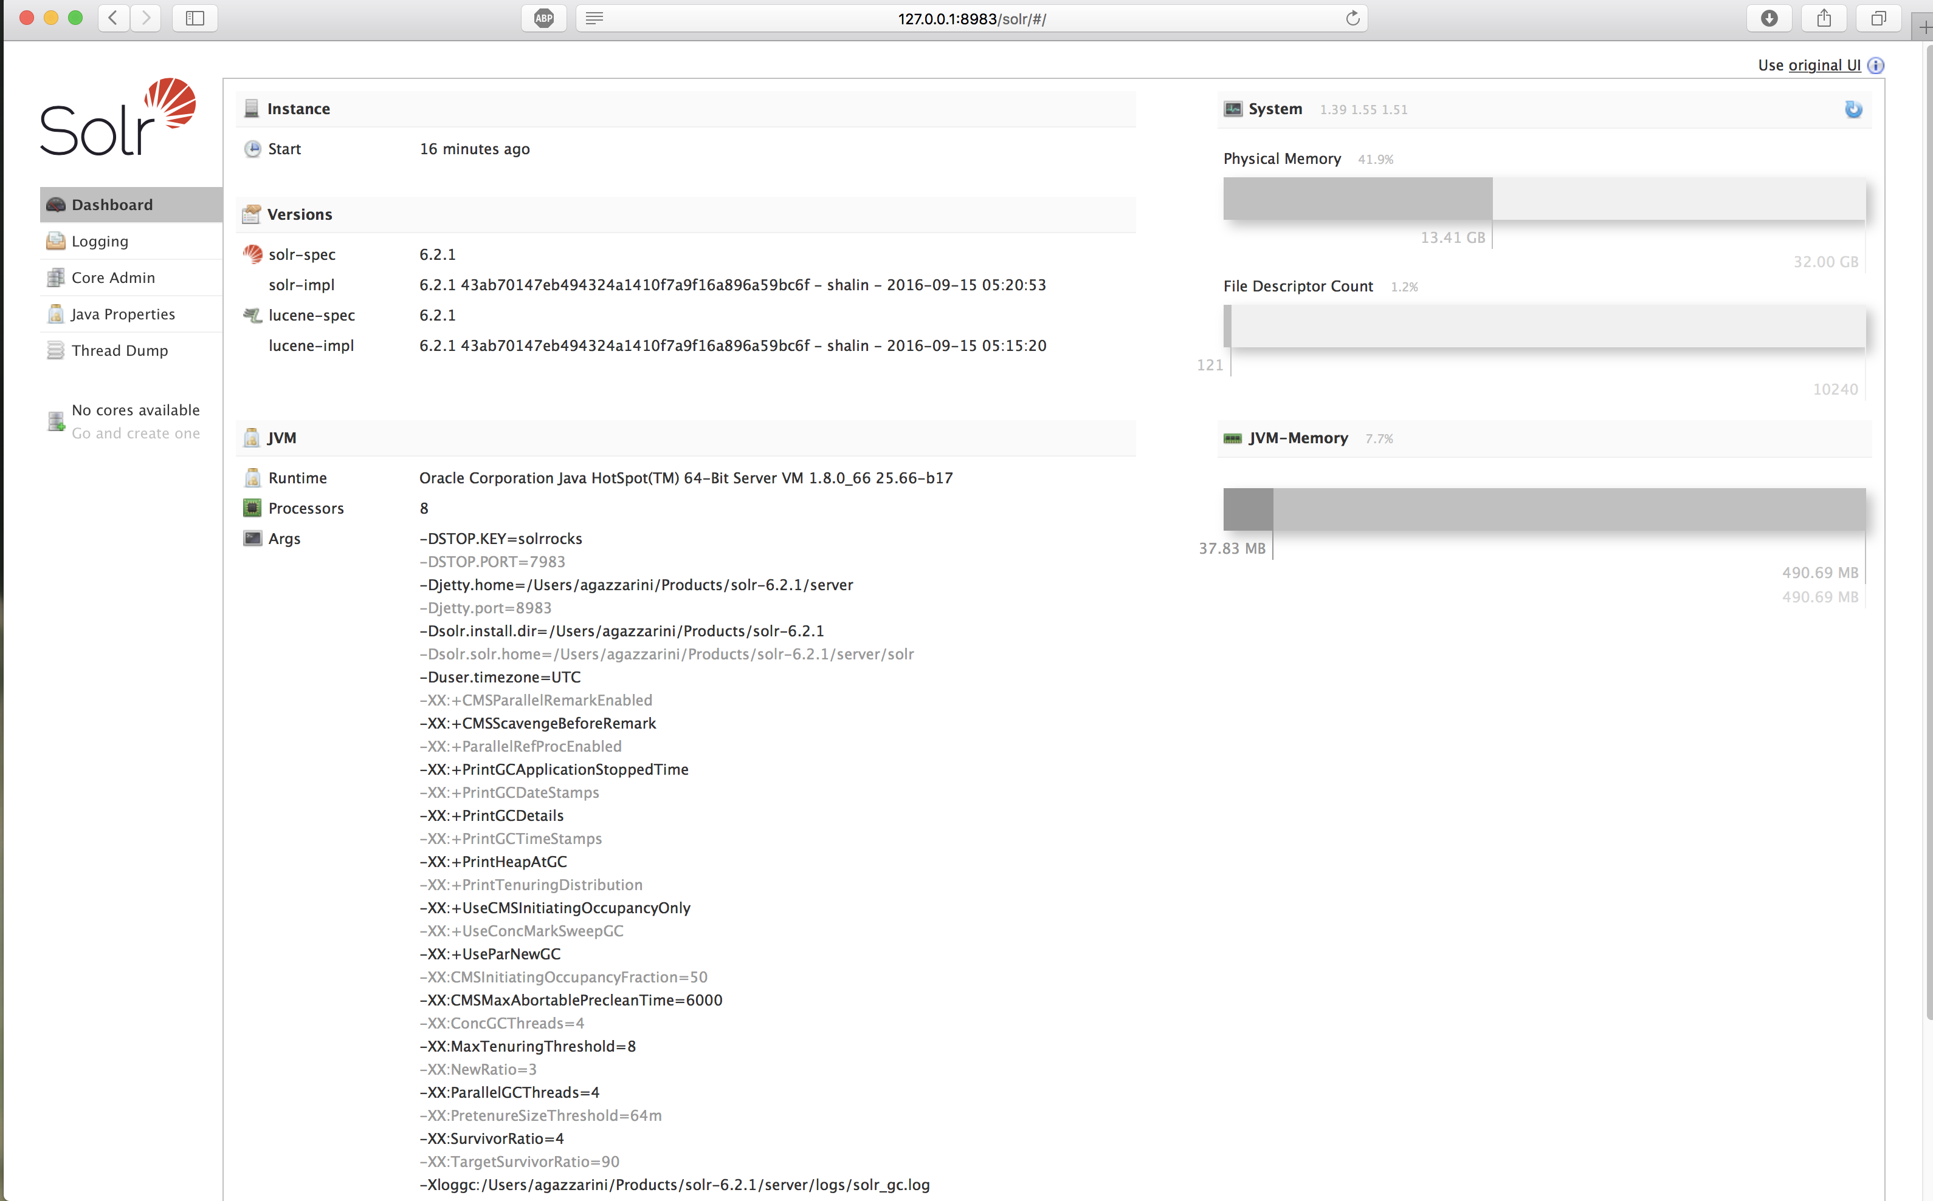
Installation
Congrats! Solr is running

Slide 26
Task: install Solr on your training machine

Slide 27

Part 1: Introduction
Questions & Answers

Slide 28
Indexing
The necessary evil

Slide 29
Part 2: Indexing
Agenda
Data model & key concepts
Text Analysis
Index configuration
C(R)UD
Q&A

Slide 30
Part 2: Indexing
Agenda
Data model & key concepts
Text Analysis
Index configuration
C(R)UD
Q&A

Slide 31
Data model & key concepts
Inverted Index
Systems like Solr, belonging to the Information Retrieval systems family, don’t operate directly on the source data.
Before enabling the search capabilities on a given dataset, the input data needs to be acquired through a preliminary phase called “indexing”. The goal of this phase is to create an immutable structure called “inverted index”.
An inverted index is, as the name suggests:
an index: an ordered terms list (terms coming from the input data)
inverted: instead of associating the source data identifiers with terms, it does the opposite. Each term in the index is associated with the documents it belongs (like the book you can find at the end of a book)
Inverted
Index

Slide 32
Data model & key concepts
Inverted Index
{
{ "id": 1, "title":"The Birthday Concert" },
{ "id": 2, "title":"Live in Italy" },
{ "id": 3, "title":"Live in Paderborn" },
}
Document identifiers
Terms
e | 1 | 2 | 3
Birthday | X
Concert | X
Italy |  | X
In |  | X | X
Paderborn |  |  | X
The | X
Live |  | X | X

Slide 33
Data model & key concepts
Document
A Document is the main I/O unit of work. It is a logical grouping of several attributes (usually) belonging to the same entity of our Domain model.
Compared with other storage systems, a document can be seen as:
a record within an RDBMS table
a row within a NoSql (e.g. Apache HBase)
a row of an excel file
But there are some important differences to keep in mind…

Slide 34
Data model & key concepts
Document / Row / Record
e | Column Store | RDBMS | Solr
Primary Key | Mandatory | Optional | Optional*
Composite Primary Key | Yes | Yes | No
Attributes names | Dynamic | Static | Dynamic
Attributes multivalued | No | No | Yes
Data types | Dynamic | Static | Dynamic
Data types configurability | Depends | None | High

Slide 35
Data model & key concepts
Document: example
{
{
"id":27302038,
"title":"A book about something",
"author": ["Ashler, Frank","York, Lye"],
"subject": ["Generalities", "Social Sciences"],
"language": "English"
},
{
"id":2830002,
"title": "Another book about something",
"author": "Ypsy, Lea",
"subject: "Geography & History",
"publisher": "Rome: Edikin, 2010"
}
}
Document
Attribute values (multivalued)
Attribute name
Attribute value (single value)

Slide 36
Data model & key concepts
Core
A core is the logical service view of a given index. It is a service unit which manages a single index, in terms of schema definition, configuration and exposed services
A Solr instance can have zero, one or more cores
Each core has therefore an its own configuration, completely independent from the other cores configured on the same instance
At startup Solr creates, configures and enables all available cores according with their corresponding configuration.
Previously (Solr < 4.x) each core had to be explicitly declared within a configuration file called solr.xml. Without that configuration the core wasn’t enabled.
Starting from Solr 4 a new auto-discovery feature has been added and now Solr is able to auto-detect valid cores within a given folder
Physically, a core is composed by a configuration and a data folder

Slide 37
Data model & key concepts
Core
A core has a name. It is used as a logical identifier of the core itself and therefore must be unique
Each core has a set of dedicated HTTP endpoints
Each core has a dedicated configuration. At least it must contain two files (schema.xml and solrconfig.xml). Other files are needed depending on the configuration itself
Each core can have a dedicated set of third-party libraries
Each core has a data folder where its index resides.
Each core is completely decoupled from the other cores on the same instance: it has an its own lifecycle
When Solr is running in a distributed mode (aka SolrCloud), a Core is logically spread among several machines and it is called “Collection”

Slide 38
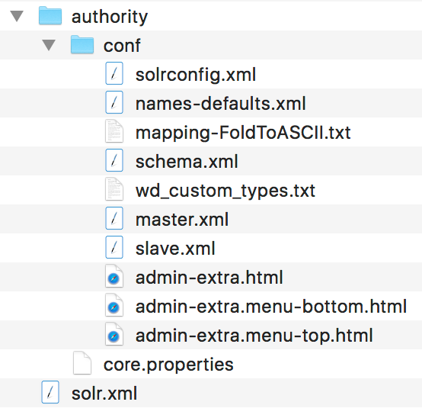
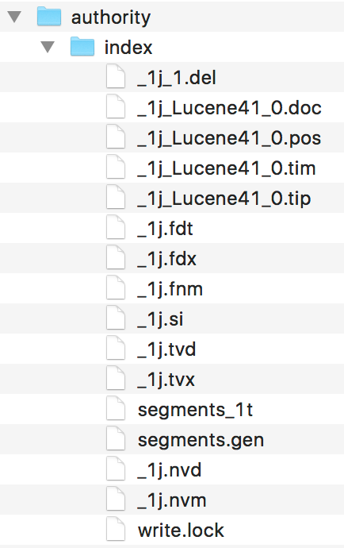
Data model & key concepts
Core
Configuration folder
Data folder
Lucene Index
The folder contains the two main configuration files (schema.xml and solrconfig.xml)
and other files, depending on the configuration itself.

Slide 39
Task: load the sample cores provided with the source code in your Solr instance

Slide 40
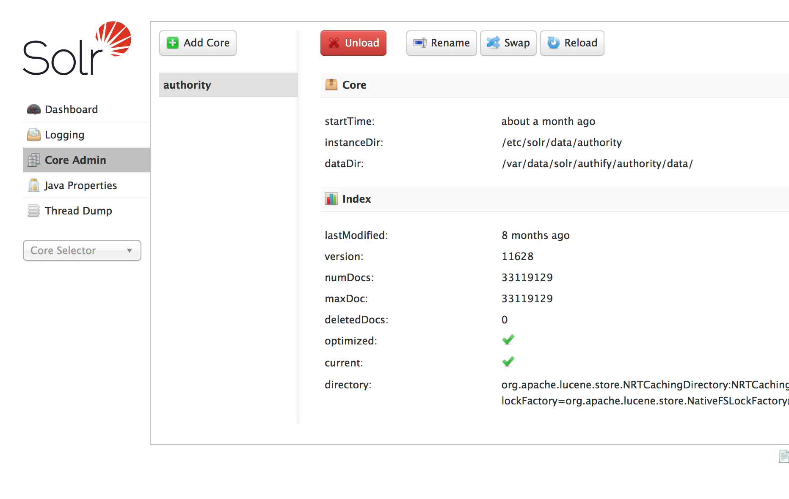
Data model & key concepts
Core: a first look at the administration console

Slide 41
Data model & key concepts
Schema
The schema defines the “shape” of the index associated with the core, in terms of attributes, fields and types.
it is defined within an XML configuration file called “schema.xml”
it contains types and fields definitions
Solr can work also without schema, in the so called “schemaless” mode, good for rapid prototyping but not recommended for a production system
1…*
SCHEMA
FIELD
TYPE
1…*
1

Slide 42
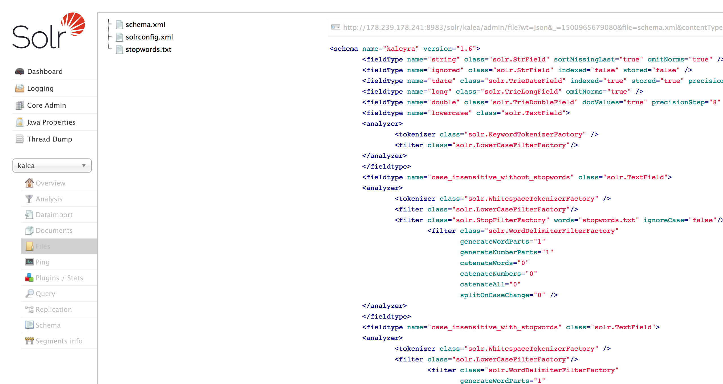
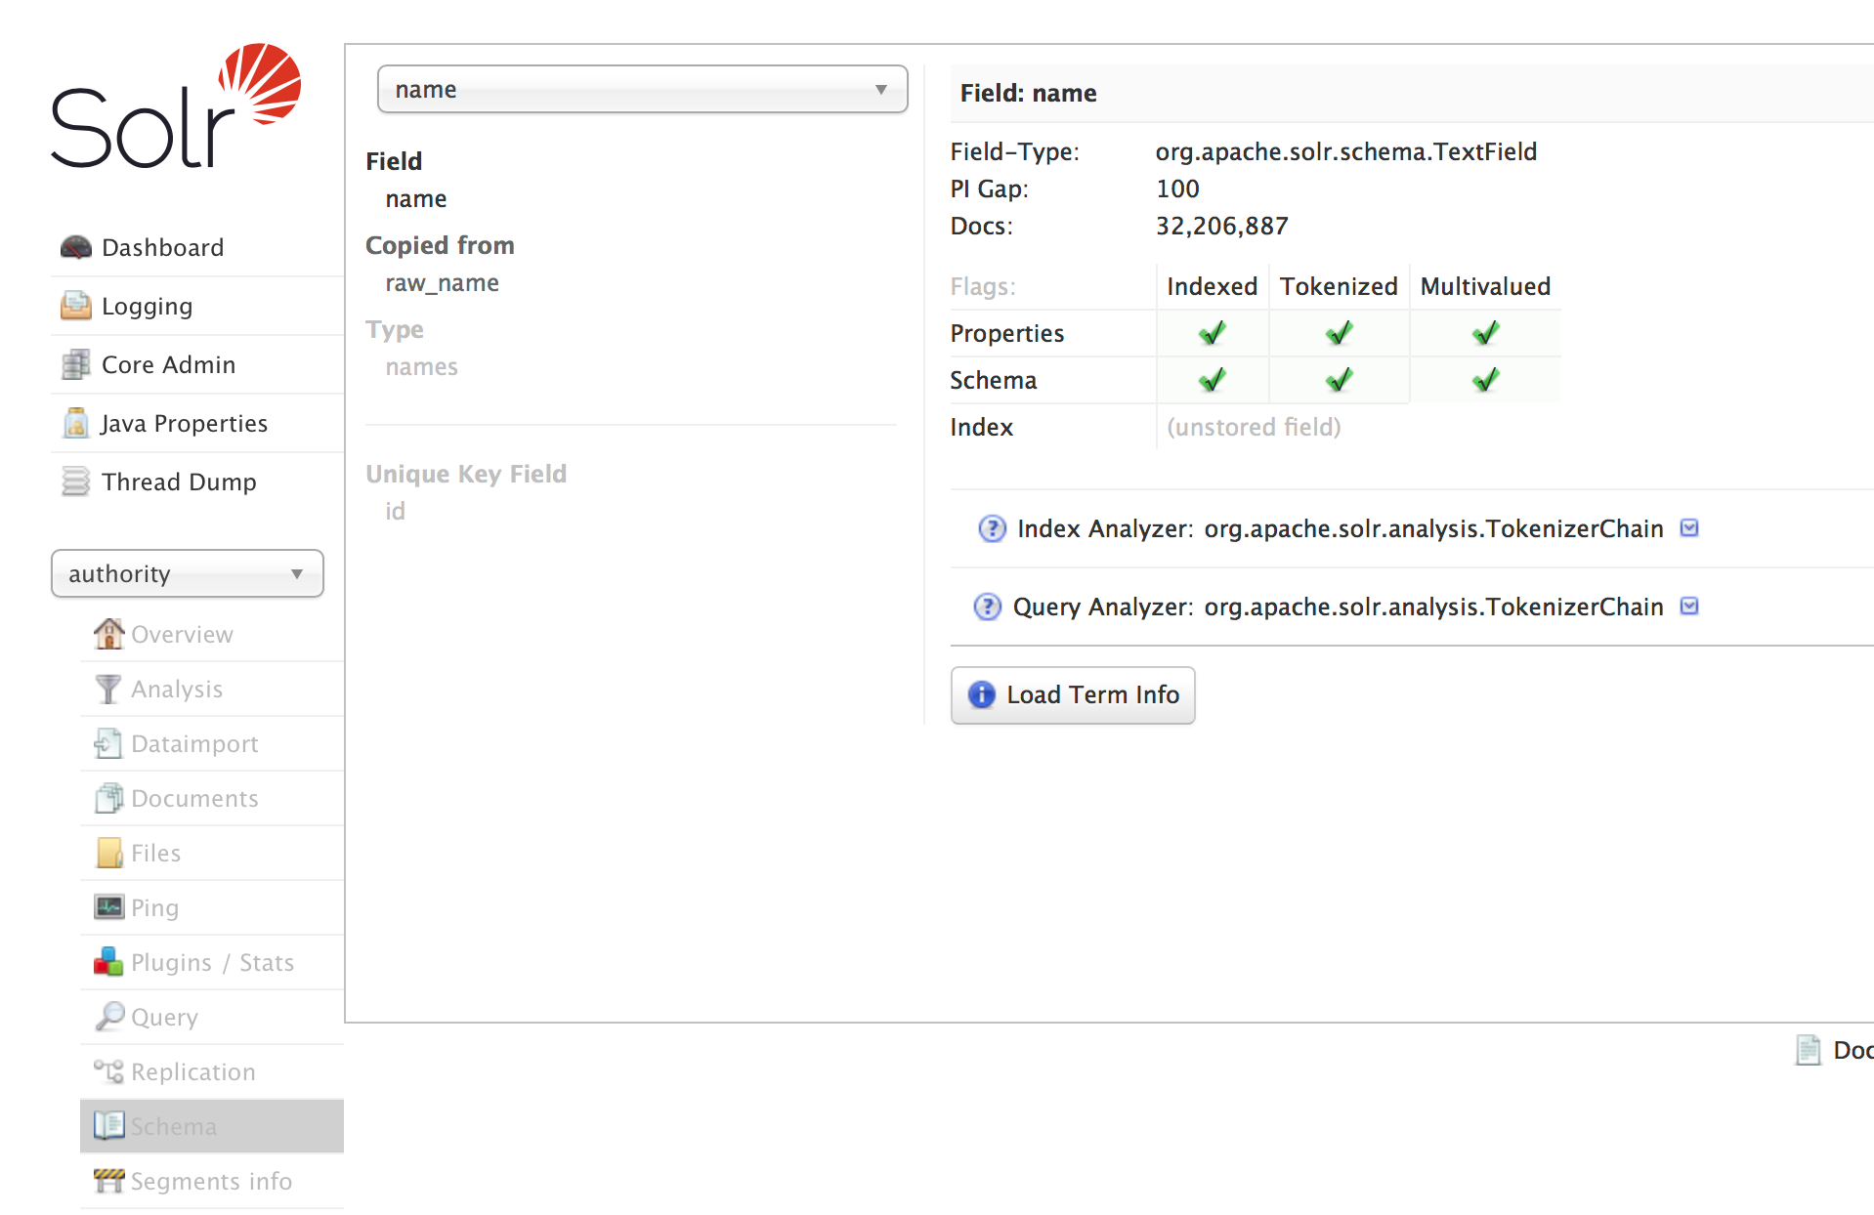
Data model & key concepts
Schema: the administration console

Slide 43
Data model & key concepts
Schema: types, some examples
Type | Description
String | Text with no analysis (i.e. no analyzers)
Text | Text with an analysis chain (1-2 analyzers)
Numeric | Numeric values with configurable precision level
Boolean | True,False
Date | Date and time
Currency | Support for currencies and exchange rates
Binary | Base64 encoded binary content
Geospatial | Different fields types for geospatial searches
Random | Pseudo-random values

Slide 44
Data model & key concepts
Schema: types, some attributes
Type | Description
name | Attribute name
type | Attribute type
indexed | Marks the type as “searchable”
stored | Marks the type as “retrievable”
sortMissingFirst sortMissingLast | Sort criteria to be adopted in case of missing value
multiValued | Marks the type as multivalued
omit* | Don’t compute field metadata during the indexing
…
Most of those attributes can be overridden at field level. As consequence of that,
their declaration at type level acts as a default rule.

Slide 45
Task: open the administration console and have a look at all sections where you can see or manage schema fields

Slide 46
Part 2: Indexing
Questions & Answers

Slide 47
Part 2: Indexing
Agenda
Data model & key concepts
Text Analysis
Index configuration
C(R)UD
Q&A

Slide 48
Text Analysis
What is it?
Text analysis is a crucial part of the indexing phase. It converts the incoming values (i.e. the attributes values of the input documents) into a set of terms according with a given configuration. Terms are the building blocks of the inverted index. At the end of the text analysis, each resulting term is posted to the index with the following metadata:
Position increment: the term position relative to the previous token
Offsets: start and end offset within the input stream
Type: term type, some filters put and use this information
Payload: optiona byte payload used for custom usages
In Solr, the analysis process happens in two different moments:
Index time: values analysed are the fields values of the incoming documents
Query time: analysis is applied to the user-entered query term(s)

Slide 49
Text Analysis
Schema revisited: fields, types and analyzers
1...*
SCHEMA
FIELD
is associated with
TYPE
1...*
Attributes
1
index
query
0...1
0...1
ANALYZER
0...*
1
1...*
CHAR FILTER
TOKENIZER
TOKEN FILTER

Slide 50
Text Analysis
Analyzers
The analyzer defines an analysis chain; that is: it defines the members of the text analysis chain that will be applied to a given field at a given time (index and / or query time)
*
TOKEN
+
index
produces
Text Analysis
Offsets
Position increment
Payload
=
TERM
query
0...1
0...1
ANALYZER
0...*
1
1...*
CHAR FILTER
TOKENIZER
TOKEN FILTER

Slide 51
Text Analysis
Field Type/Analyzer: few simple things to remember
Here are four simple points to remember about analyzers:
Only text fields types (e.g. solr.TextField or subclasses) can have a text analysis chain associated
A text field type can define a text analysis chain (i.e. analyzer) which will be applied only at index time
A text field type can define a text analysis chain (i.e. analyzer) which will be applied only at query time
A text field type can define one single text analysis chain (i.e. analyzer) that will be applied both at index and query time.
An analyzer can define
  One or more CharFilter
  One and only one Tokenizer
  One or more TokenFilter

Slide 52
Text Analysis
CharFilter
A Char Filter is an optional component that pre-processes input characters.
An analyzer can have zero, one or more char filters as first members of the text analysis chain.
They can manipulate the incoming character stream by adding, removing or replacing characters while preserving the original character position
A typical usage of CharFilter is when you want to normalize diacritics, as in the following example:
<charFilter class="solr.MappingCharFilterFactory" mapping="mapping-FoldToASCII.txt"/>
Using the component above,
- the incoming value “Karl Millöcker”
- will be normalized in “Karl Millocker” (see the o without the dieresis)
https://cwiki.apache.org/confluence/display/solr/CharFilterFactories

Slide 53
Text Analysis
Tokenizer
A Tokenizer breaks an incoming character stream into one or more tokens, depending on specific criteria.
An analyzer must have one and only one tokenizer
The resulting set of tokens is usually referred to as “token stream”
There are a lot of available tokenizers [1] but in general is very easy to create a new tokenizer
Suppose we have “I’m writing here” as input value. The following table shows how different tokenizers work:
Tokenizer | Description | Output
WhiteSpaceTokenizer | Splits by whitespaces | “I’m”, “writing”, “here”
KeywordTokenizer | Doesn’t split at all | “I’m writing here”
RegexTokenizer | Split by regex | “I”,”m”,”writing”,”here”
[1] https://cwiki.apache.org/confluence/display/solr/Tokenizers

Slide 54
Text Analysis
TokenFilter
A TokenFilter is a processor for a token stream. Better, it processes each token in the incoming stream and applies some kind of transformation to it. Analyzing token after token, a filter can add, remove or change tokens therefore producing a new token stream.
An analyzer chain can have one or more token filters
Token filters can be chained in order to produce complex analysis processes
The order in which those components are declared matters, the chain is not commutative: a different order could result in a different output token stream
There are a lot of available filters [1]; writing a new filter requires a knowledge of Java and Lucene internals
Usage examples includes stopwords removal, stemming, synonyms, lowercasing
[1] https://cwiki.apache.org/confluence/display/solr/Filter+Descriptions

Slide 55
Text Analysis
Types: putting all together
In the following example, we have a field type which declares a text analysis chain that will be applued at index time:
In this chain:
The CharFilter normalizes all diacritics
The Tokenizer produces a token stream, splitting by whitespaces
For each resulting token:
  If the token value matches a stopword (i.e. a word within the stopwords.txt file) it will be removed from the stream
  The token is replaced with the lowercase version
<fieldType name="my-text-type" class="solr.TextField" positionIncrementGap="100">
<analyzer type="index">
<charFilter class="solr.MappingCharFilterFactory" mapping="mapping-FoldToASCII.txt"/>
<tokenizer class="solr.WhitespaceTokenizerFactory"/>
<filter class="solr.StopFilterFactory" words="stopwords.txt"/>
<filter class="solr.LowerCaseFilterFactory"/>
</analyzer>
</fieldType>

Slide 56
Text Analysis
Fields
A field defines the structure and the composition of a given attribute of your domain model. Briefly, fields are the attributes of the things you’re going to manage in Solr.
Here are some important thing to remember about fields
Fields are declared in the schema, together with field types
A field is associated with one field type
A field has a name, a type (i.e. a field type) and other attributes that depend on the specific field kind.
A field can override some configuration attributes coming from the field type definition
A field cannot have NULL as value (like in RDBMS): in that case (i.e. in case an incoming record doesn’t have a value for that field) it simply doesn’t exist
Once a schema has been defined and some data has been indexed, a change in schema requires a reindex of the whole dataset
Fields can be classified in static, dynamic and derived fields

Slide 57
Text Analysis
Static (named) fields
A field which is statically declared in the schema. Note that “static” refers to the field name: it has nothing to do with the value (which obviously is not static).
As you can see, the field declaration in the example above is complete and known in advance. You will understand better the term “static” in the next slide.
<field name="title" type="string" indexed="false" stored="true" required="true" multiValued="false"/>
<field name="author" type="text-with-stemming" multiValued="true"/>
<field name="id" type="int" indexed="true" stored=”true”/>

Slide 58
Text Analysis
Dynamic (named) fields
A field with a dynamic, runtime-computed, name. These fields are useful when you don’t know their exact name in advance; you know that all of them must respect a given naming convention (e.g. prefix or suffix) but their actual names depend on the incoming documents.
See the following example, this is a dynamic field in action, beloging to a “book” entity:
What is the difference with the static fields seen previously? Here we have a wildcard as part of the field name, so at runtime (i.e. at index time) if an incoming document contains three fields abstract_en, abstract_ru, abstract_it, Solr will automatically create three different fields with that configuration.
<dynamicField name="abstract_*" type="text-with-stemming" multiValued="true"/>

Slide 59
Text Analysis
Derived fields
A field that is filled with values coming from other fields. A derived field is not natively present in the incoming document, but it is declared in the Solr schema. The goal is to populate it with values of other fields.
See the following example, this is a dynamic field in action, beloging to a “book” entity:
As you can see, a derived field is first declared as a regular field and then, by means of the copyField directive, the magic happens.
Why do we need derived fields? There are a lot of reason: the most popular usage is to have different fields with different text analysis defined (i.e. different types). Instead of having the indexing client sending multiple attributes with the same value, Solr takes care about that, by filling the derived fileds with a given source value.
<field name=”title” type=”string”/>
<field name=”title_without_stopwords” type=”text-without_stopwords”/>
<copyField source="title" dest="title_without_stopwords"/>
* That’s the reason why you a might want to protect the /update path

Slide 60
Text Analysis
Bonus: UpdateRequestProcessor
There’s another place where we can “interfere” with the indexing process.
While analyzers are good for controlling the final shape of the inverted index, sometimes
You need to do something at document level
You need to manipulate the data sent by the client, before the indexing happens
You need to discard or enrich input documents (with a new field that is completely unknown to the indexing client)
In all these cases, Solr provides an interesting extension point where we can plug in our “interceptor” logic. It is called the UpdateRequestProcessor chain. This is the chain of all components that are responsible to index a single document.
By default, it is composed only by two components: one that print logs messages and another which executes the indexing
You can plug in your custom processor or one of the available processors [1]
[1] https://cwiki.apache.org/confluence/display/solr/Update+Request+Processors

Slide 61
Task: let‘s do some practice with text analysis at index time

Slide 62
Part 2: Indexing
Questions & Answers

Slide 63
Part 2: Indexing
Agenda
Data model & key concepts
Text Analysis
Index configuration
C(R)UD
Q&A

Slide 64
C(R)UD
Solr configuration
Solr can be configured at different levels.
OS: RAM, paths, user
Global settings: the solr.xml file
Core: the solrconfig.xml within the conf folder of each core, contains things valid only for that specific core
The solrconfig.xml contains index and search settings for a given core
Index settings include:
  paths
  background tasks
  Index endpoints
  Indexing interceptor
Search settings include
  Search services (requestHandlers)
  Search components
  Response writers
  Query parsers
* That’s the reason why you a might want to protect the /update path

Slide 65
C(R)UD
Solrconfig.xml
The more commonly used elements in solrconfig.xml are
Data directory location: where Solr creates the index
Cache parameters: size, warming and cache configuration
Index processor chain: customize the default indexing chain
Listeners: for executing specific task at a given time
Request handlers: each request handler is a service endpoint with a dedicated configuration
Search components: implicit or explicit components that contributes to search results
Response writers: if you want to use a different output format
* That’s the reason why you a might want to protect the /update path

Slide 66
C(R)UD
Solrconfig.xml: property expansion
Within the solrconfig.xml you can use system properties or properties you define in core.properties; the syntax is the following:
System properties that start with “solr.” are reserved. Some properties are implicitly defined. The Solr reference [1] guide lists some of them, but in order to make sure they are defined, open the console and see the JVM properties.
solr.solr.home
solr.core.name
solr.core.config
solr.core.schema
solr.core.dataDir
solr.core.transient
Solr.core.loadOnStartup
solr.install.dir
* That’s the reason why you a might want to protect the /update path
${system property:default value}
${solr.data.dir:/tmp}
${my.custom.priperty:its.default.value}
[1] https://cwiki.apache.org/confluence/display/solr/Configuring+solrconfig.xml

Slide 67
Task: let‘s open the solrconfig.xml

Slide 68
Part 2: Indexing
Questions & Answers

Slide 69
Part 2: Indexing
Agenda
Data model & key concepts
2. Text Analysis
3. Index configuration
4. C(R)UD
5. Q&A

Slide 70
C(R)UD
REST-Like interface
Solr exposes the indexing service through HTTP, by means of a REST-like interface. Each service endpoint is defined (implicitly or explicitly) within the solrconfig.xml configuration file.
The endpoint which provides the indexing service is called “/update”
Starting from Solr 5, this endpoint is implicit and thefore there’s no need to declare it in the configuration.
The update endpoint uses the Content-type HTTP header for managing different input formats
Out of the box Solr support several formats: XML, JSON, CSV, Binary (Java)
The service endpoints, that’s the reason why we said “REST-Like”, responds on both GET and POST requests. It can be invoked programmatically, using a browser, using the administration console, or using the command line (e.g. CURL)*
* that’s the reason why you should always protect this path, and / or the administration console
* That’s the reason why you a might want to protect the /update path
> curl “http://127.0.0.1:8983/solr/update” -H “Content-type: text/xml” -d @inputfile.xml
> curl “http://127.0.0.1:8983/solr/update?stream.body=<delete>...</delete>

Slide 71
C(R)UD
Input data format
Solr accepts incoming data using a well-defined data format. That means regardless the content type of the incoming data (e.g. xml, json) a Solr input request does have a precise structure:
As you can see, we have a parent tag which indicates the requested operation (add, index in this case) and then one or more documents. Each document is a key-value pair where key is the field name and value is / are field value / values.
<add commitWithin="10000" overwrite="true">
<doc boost="1.9">
<field name="id">12020</field>
<field name="title" boost="2.2">
Round around midnight
</field>
<field name="subject">Music</field>
<field name="subject">Jazz</field>
</doc>
…
</add>
{
"add": {
"commitWithin": 10000,
"overwrite": true,
"doc": {
"boost": 1.9,
"id": 12020,
"title": {
"value": "Round around midnight",
"boost": 2.2
},
"subject": ["Music", "Jazz"]
}
}
}

Slide 72
C(R)UD
Add / Replace
Since the document is the unit of work, it’s not possible to change a single field of a given document: we need to reindex the whole document. So practically there’s no update in Solr, only insert: an existing document will be replaced with the new version.
# curl http://127.0.0.1:8983/solr/update \
-H "Content-type: text/xml" \
--data-binary @datafile.xml
# curl http://127.0.0.1:8983/solr/update -H "Content-type: text/xml" \
--data-binary
'<add commitWithin="10000" overwrite="true">
<doc boost="1.9">
<field name="id">12020</field>
…
<field name="subject">Jazz</field>
</doc>
…
</add>'

Slide 73
C(R)UD
Delete
A deletion request doesn’t physically delete data in the index. Instead, the affected documents are marked as “deleted” and then asynchronously (or explicitly after issuing a commit command) they will be deleted.
The delete request can be executed following two criteria: by a list of identifiers or by an arbitrary query (be careful with this!)
# curl http://127.0.0.1:8983/solr/update -H "Content-type: text/xml"
--data-binary
'<delete>
<id>77616</id>
</delete>'
# curl http://127.0.0.1:8983/solr/update -H "Content-type: text/xml"
--data-binary
'<delete>
<query>author:Gazzarini</query>
</delete>'

Slide 74
C(R)UD
Commit, optimize and rollback
Changes resulting from add or delete requests are not immediately visible. They must be committed first by issuing a commit or optimize command. Or, you can discard those changes by issuing a rollback command:
Solr provides three different commit commands:
- soft: it works entirely in memory, fast but not persistent. That means in case of crash, committed data is lost
- hard: flushes the data to disk. Slower than the previous but committed data survives to crashes
- optimize: hard commit with index optimization (not recommended)
# curl http://127.0.0.1:8983/solr/update?commit=true
# curl http://127.0.0.1:8983/solr/update?optimize=true
# curl http://127.0.0.1:8983/solr/update?rollback=true

Slide 75
Task: index some data

Slide 76
Part 2: Indexing
Questions & Answers

Slide 77

And now it’s time to search
Contact
NobleProg
Mr Antolin Hernandez
Training Coordinator
Tel: +1 647 977 5839
Skype:NobleProg MX
Email: antolin.hernandez@nobleprog.eu
www.nobleprog.ca
To edit footnote click on Insert / Header & Footer

