Slide 1
GPU facilities on COSMA
Overview of availability
ICC Theory Lunch
4th April 2022
Alastair Basden

Slide 2
Who?
Anyone (ICC or collaborators) can make use of the COSMA GPUs
  No need to be part of an active DiRAC project
  These are an ICC-owned facility.

Slide 3
What?
We have:
  10x NVIDIA V100 GPUs
  3x NVIDIA A100 GPUs (40GB)
  1x AMD MI100 GPU
  6x AMD MI50 GPUs

Slide 4
Where?
From a COSMA login node, you can:
  ssh to gn001: 10x NVIDIA V100 GPUs
  ssh to ga003: 6x AMD MI50 GPUs
  ssh to ga004: 1x AMD MI100 GPU
  Use login8b: 1-3 NVIDIA A100 GPUs
    (ask if you have a specific requirement)
  Submit to the cosma8-shm queue
    mad04 and mad05 - 1-3 NVIDIA A100 GPUs each

Slide 5
When?
Can be used any time
  Just check they aren’t fully in use before doing so
  nvidma-smi or rocm-smi tool is good for this

Slide 6
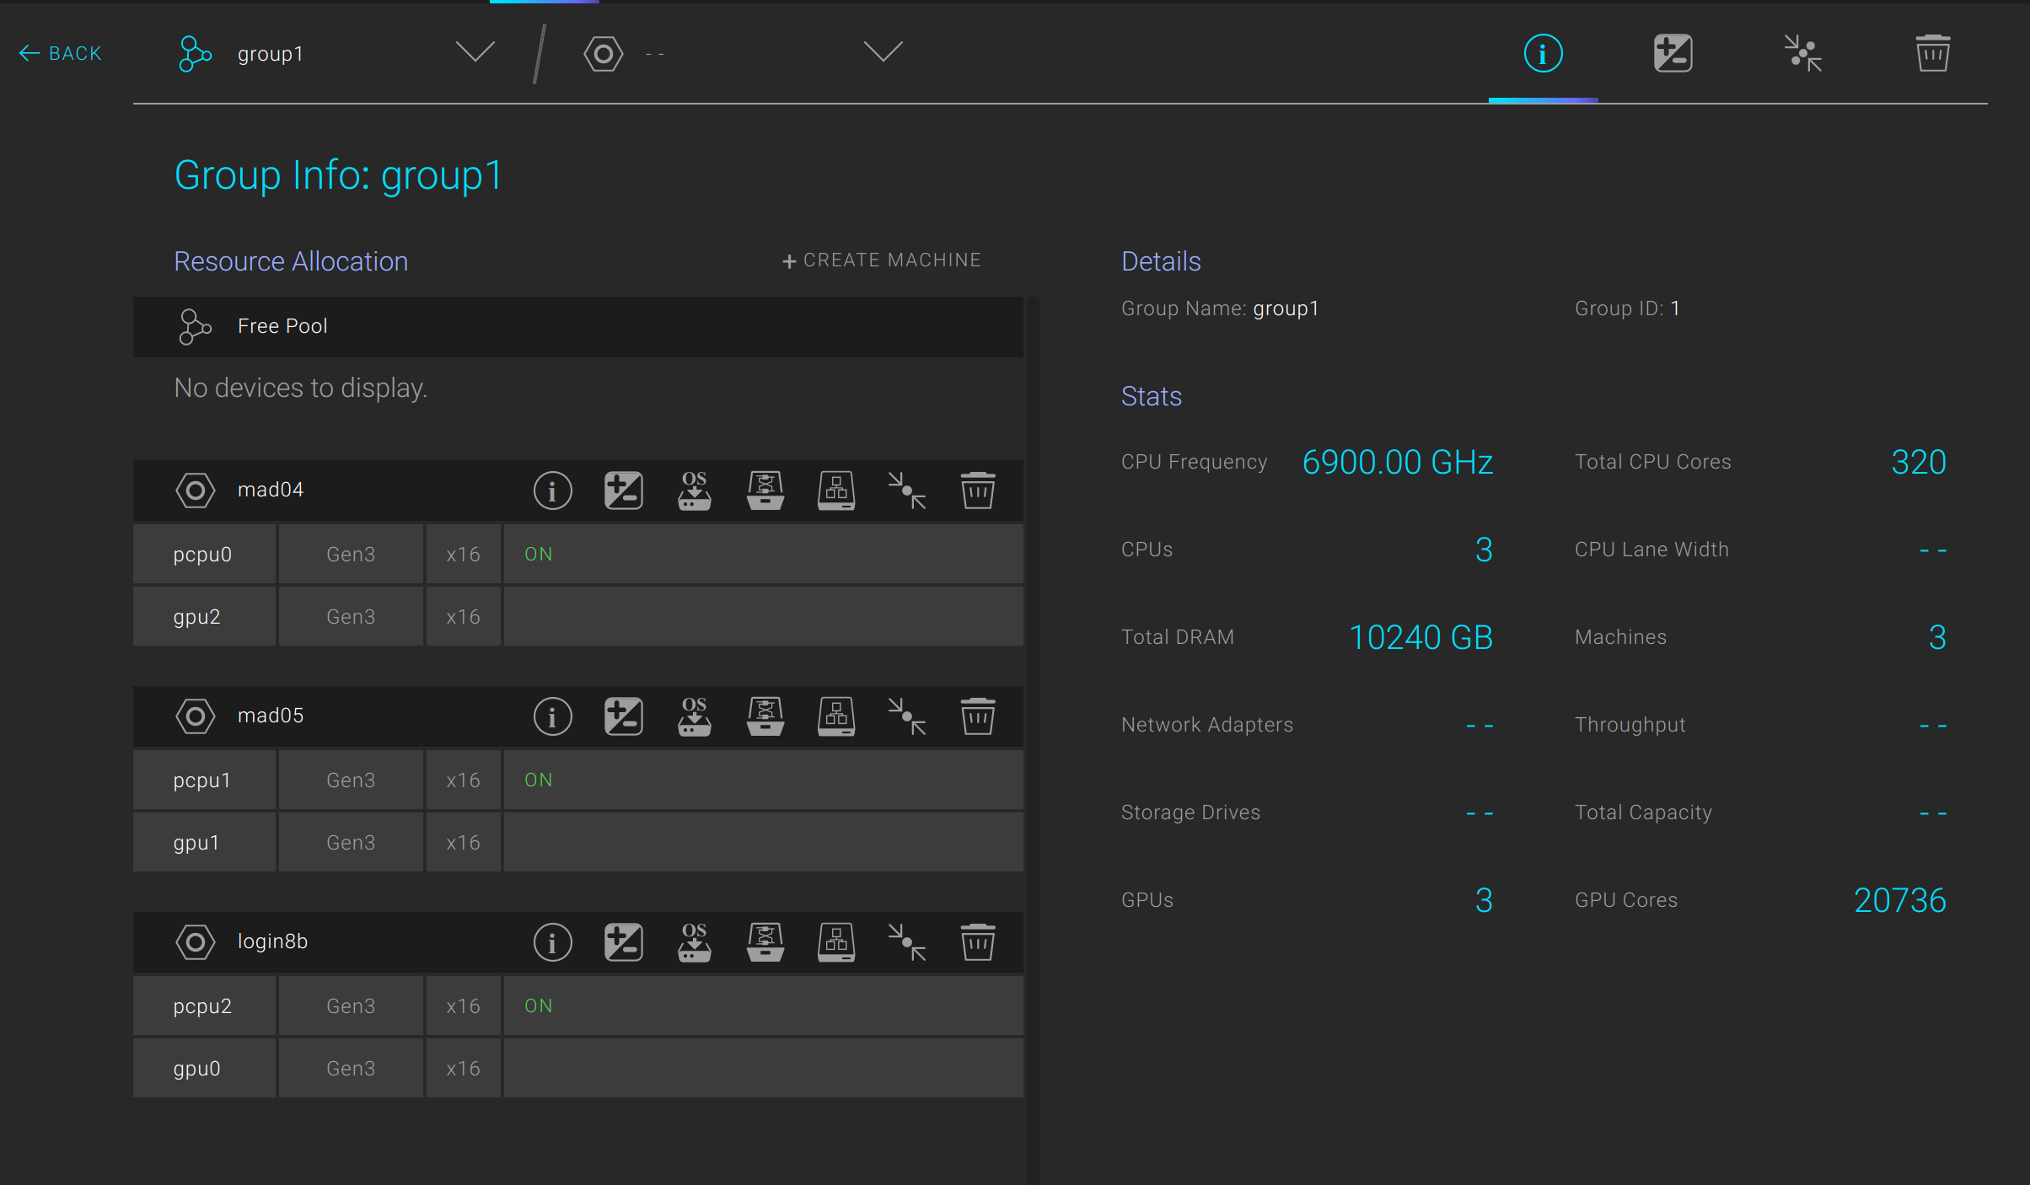
How?
Mostly accessed directly - no queue system except for cosma8-shm.
  Log on to the relevant node and run your code…
A100 slightly different
  Composible Liqid fabric
  We can move GPUs at
  the press of a button

Slide 7
Why?
AI work
Test and development
If you need more GPUs:
  Try a seedcorn application for the DiRAC Extreme Scaling or Data Intensive systems

