Slide 1
Exxon vs. Twitter R Analysis
Adam Baca

Slide 2
Yahoo Finance
This is the default website in the Tseries package, why not?
The code used here shows the trends for a 7 day period (5 open market days).
The intent here was to go deep into the weeds until I remembered that this is NOT a statistics course so this is more of a project that is aimed at showing the capabilities of using R (or any other program) for mining data for a specific purpose and cross-referencing a different source of information for an glimpse into the future and how social media is, and can be used.

Slide 3
TwitteR (yes the R is capitalized)
Twitter (no capital R) is a popular social media platform that allows developers to extract surprising amounts of data from their user base.
There are so many ways to use the data but will only be using the text data to identify keywords (if any) that are correlated with the market price of XOM (ExxonMobil)
This is where I had to scale back on the technical disaster that this could become and focus on the scope of this project.

Slide 4
What is the Point?
Think about insider trading, yes that is a bad word, but what if we could establish links between the market and keywords that people are tweeting?
The short market is not the most ethically sound way to go, after attending a conference with the former CFO of Enron Andy Fastow it seems like a something we should be careful about. (That is my disclaimer, this way of thinking is not for human consumption).
Consider what type of social media communication is more likely: A) Positive – great business deals and events? B) Negative-Everything went wrong and the employee is emotional?
People are more likely to complain about things than to praise them, especially when it takes the extra effort to do it on the internet.

Slide 5
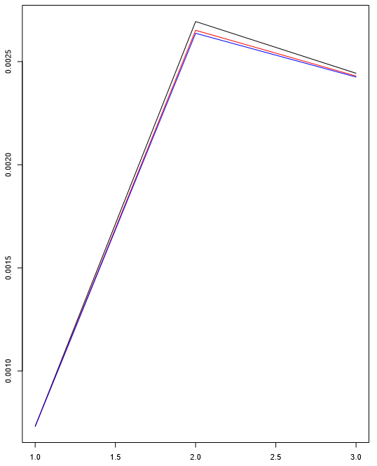
The Data
Something happened after market close on March 31 and before the market opened on April 3rd (over the weekend).
Lots of Russia news, former XOM CEO Rex Tillerson announces sanctions will remain for Russia until actions on Ukraine are reversed.
Guyana discovery on Friday. Keyword: Guyana
The data was captured and stored in: mongo or mysql!!
The occurrence of Guyana escalated after then but were there indicators?

