Slide 1


GUI-BASED PATIENT MANAGEMENT SYSTEM
LAGOS UNIVERSITY TEACHING HOSPITAL (LUTH)
MSc Biomedical Engineering 2025/2026 | Group 1 | College of Medicine, University of Lagos
By:
AGBAI, Sunny Okonkwo; AJASA, James;
NNAEKWE, Onyinyechukwu
Health Informatics & Management Information System (BME 806) module: Develop a GUI-based application to manage patient records, appointments, and prescriptions
Python 3.x
ipywidgets
Jupyter/Colab
0
Language
GUI Framework
Platform
Database
Required
February 2026

Slide 2
Presentation Agenda
01
Introduction & Background
06
Tab 2: Patient Records
02
Project Assignment & Objectives
07
Tab 3: Appointments
03
System Architecture & Technologies
08
Tab 4: Prescriptions
04
Flow Diagram — System Logic
09
Code Analysis & Key Functions
05
Tab 1: Register New Patient
10
Testing, Conclusions & Recommendations
2

Slide 3
Introduction & Background
Why does a hospital need a Patient Management System?
The Hospital Problem
Simple Analogy (For Everyone!)
Hospitals like LUTH handle thousands of patients monthly. Paper-based records are slow, error-prone, difficult to search, and can be lost. Digital systems save time, improve accuracy, and enhance patient safety.
Imagine you have 1,000 toys in a big pile and need to find your red ball. Without organisation, you check every toy! But with labelled boxes, sorted by colour and type, you find it instantly. That is what our system does for patient data!
What Our System Manages:
Patient
Registration
Patient
Records
Appointments
Prescriptions
New patients get a unique ID (LUTH-2025-XXX)
Search and view any patient profile instantly
Book doctor visits with date, time, department
Issue and track medications with doctor sign-off
3

Slide 4
Project Assignment & Objectives
MSc Biomedical Engineering — Health Informatics & Management Information System (BME 806) module
ASSIGNMENT BRIEF:
Group 1 — Develop a GUI-based application to manage patient records, appointments, and prescriptions.
Project Objectives:
1. Design a user-friendly GUI running inside Jupyter Notebook / Google Colab
2. Implement patient registration with automatic sequential ID generation
3. Build a searchable patient records module (search by name or ID)
4. Create an appointment booking system with department selection
5. Develop a prescription issuance module with auto date-stamping
6. Use in-memory Python data structures; no database server required
4

Slide 5
System Architecture & Technologies
Three-tier logical architecture — no database or server required
PRESENTATION LAYER
ipywidgets GUI — Buttons, text boxes, dropdowns, tabs rendered as HTML in Jupyter/Colab browser interface
communicates
APPLICATION LOGIC LAYER
Python functions — Input validation, ID generation, data manipulation, output formatting, error handling
communicates
DATA STORAGE LAYER
In-memory Python Lists — patients[ ], appointments[ ], prescriptions[ ] — pre-loaded with 3 sample LUTH patients
Technologies Used:
5

Slide 6
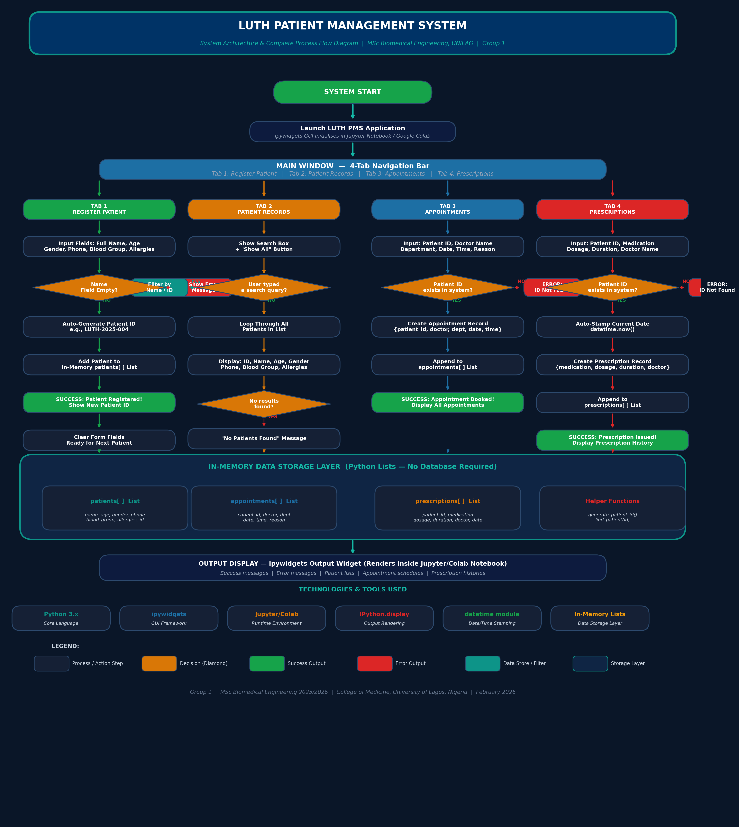
System Flow Diagram
Complete process logic from application launch to output display
Decision diamonds (amber) represent validation checkpoints that protect data integrity across all four modules.
6

Slide 7
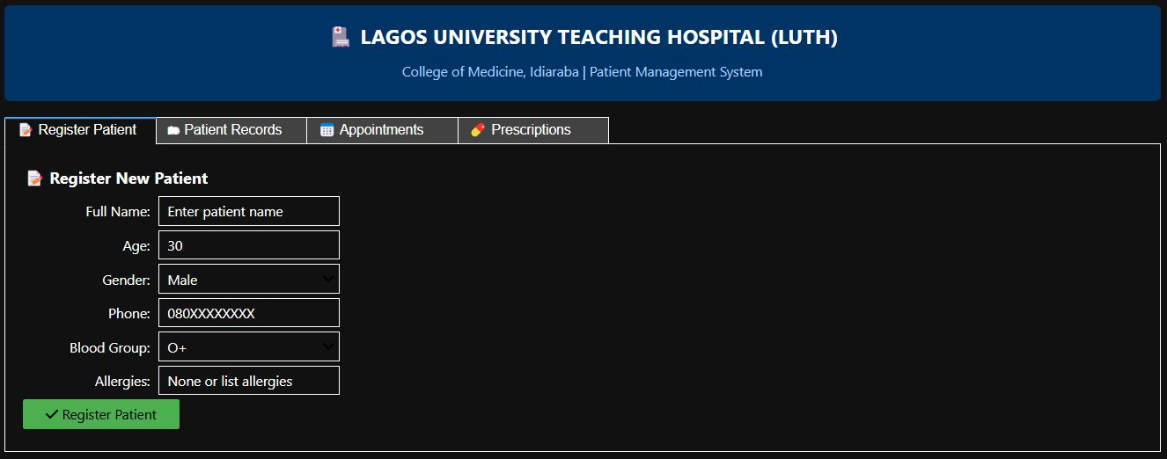
Tab 1: Register New Patient
Entry point for all new hospital visitors — auto-generates unique patient ID
FEATURES
6 input fields:
Name, Age, Gender, Phone, Blood, Allergies
Dropdown menus for Gender & Blood Group (8 types)
Input validation: name cannot be empty
Auto-generates ID:
LUTH-2025-XXX (sequential)
Form auto-clears after successful registration
Like filling in a child's school enrollment form; the hospital records who you are, your age, and important health information. The computer automatically gives you your own hospital number!
7

Slide 8
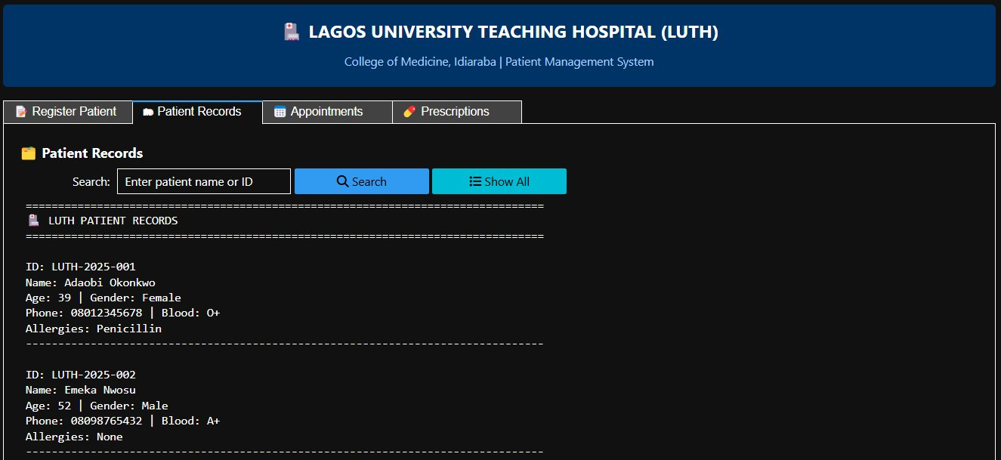
Tab 2: Patient Records
Searchable view of all registered patients — search by name or patient ID
FEATURES
Auto-displays all patients on tab open
Real-time search by name OR patient ID
Case-insensitive: 'adaobi' = 'ADAOBI'
Shows: ID, Name, Age, Gender, Phone, Blood Group, Allergies
Clear 'not found' error for failed searches
Like looking up a name in a class register. The teacher can find any student's details in seconds — no flipping through pages!
8

Slide 9
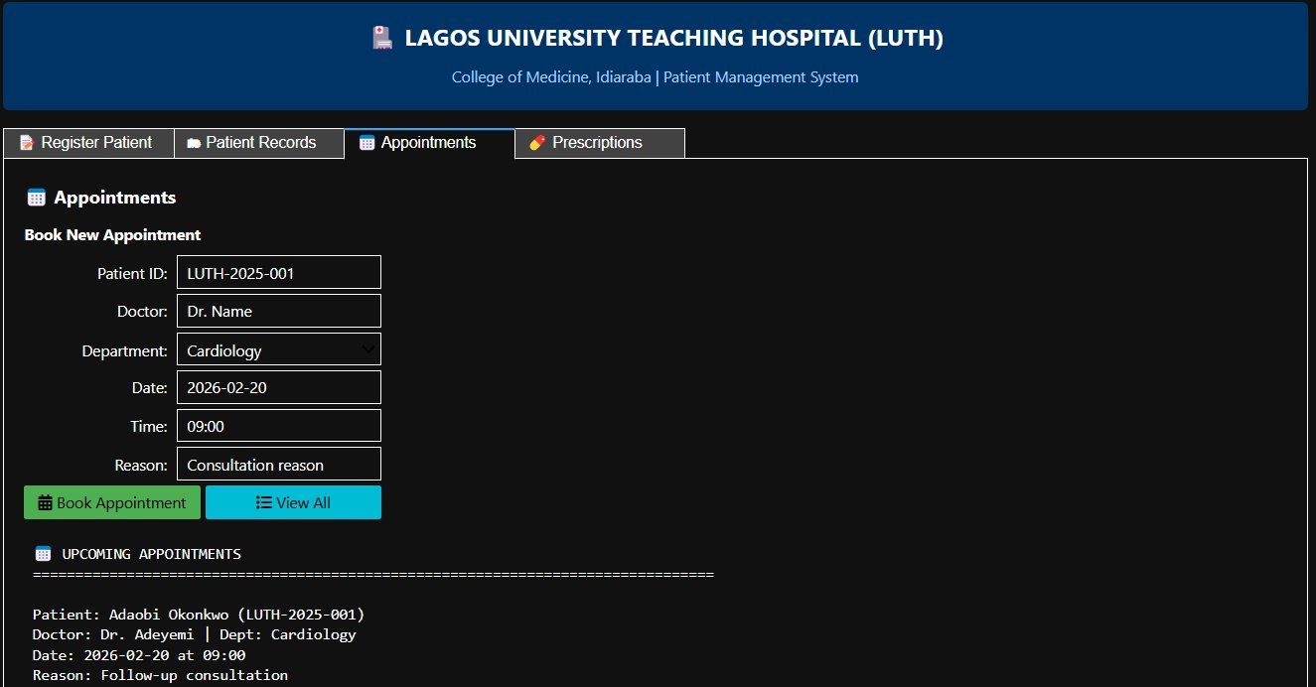
Tab 3: Appointments
Book and view doctor appointments across 7 hospital departments
FEATURES
Validates Patient ID exists before booking
7 departments: Cardiology, Endocrinology, Paediatrics, Surgery, Radiology, Lab, Pharmacy
Date + Time input fields
Consultation reason field
Error if unknown Patient ID entered
Shows full appointment list after booking
Like booking a playdate with the doctor! You say when you want to come, which department, and why. The system remembers everything and shows all upcoming appointments.
9

Slide 10
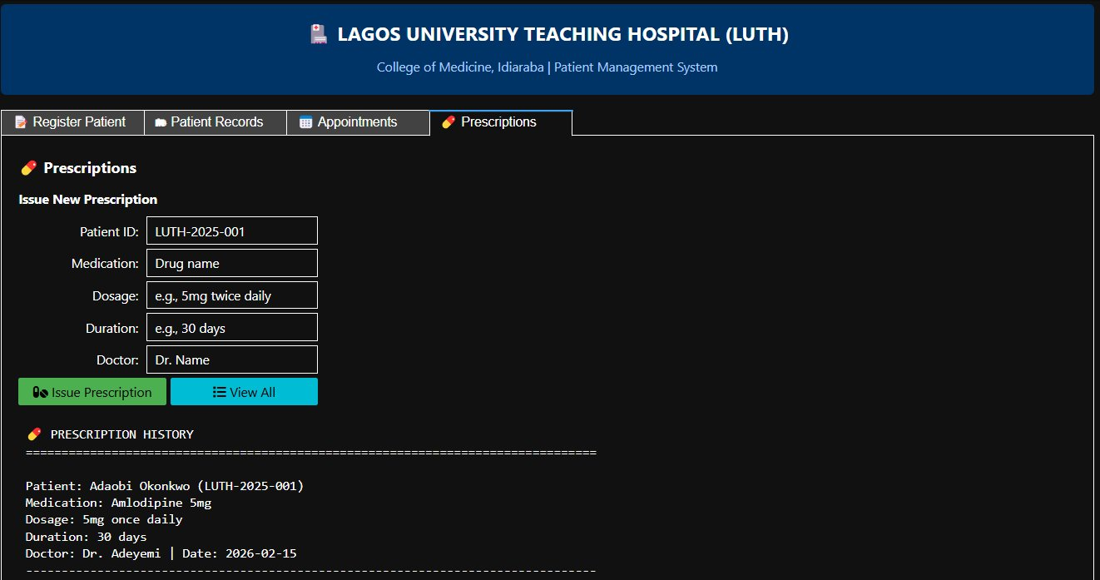
Tab 4: Prescriptions
Issue and track medication prescriptions with automatic date-stamping
FEATURES
Patient ID validation before issuing
Medication name, dosage, duration fields
Issuing doctor name recorded
Auto date-stamp: datetime.now()
Prescription history always visible below
Error message if Patient ID not found
The doctor's written note about your medicine — now stored safely in the computer! Like a receipt from the pharmacy, but the computer keeps it forever so no one forgets.
10

Slide 11
Code Analysis: Key Functions & Data Structures
Python 3 — ~350 lines, modular architecture, no external dependencies beyond ipywidgets
generate_patient_id()
create_appointments_tab()
Returns LUTH-2025-XXX format using len(patients)+1 with zero-pad
Builds Tab 3: 6 inputs + 2 buttons. Calls find_patient() before booking
find_patient(id)
create_prescriptions_tab()
Iterates patients list; returns dict if id matches, else None
Builds Tab 4: 5 inputs. Auto-stamps date via datetime.now()
create_register_tab()
create_app()
Builds Tab 1: 6 input widgets + Button + Output. Binds register_patient callback
Master assembler: HTML header + Tab widget + 4 children + VBox wrapper
create_records_tab()
Builds Tab 2: search box, 2 buttons, Output. Case-insensitive name/ID filter
11

Slide 12
Testing, Validation & Results
10 test cases — all PASSED
Register with valid data
PASS
Book appointment — valid Patient ID
PASS
Patient added, new ID shown
Appointment saved, list updated
Register with empty name
PASS
Book appointment — invalid Patient ID
PASS
Error message shown, no data written
Error: ID not found
Search by name (case-insensitive)
PASS
Issue prescription — valid Patient ID
PASS
Correct patient record returned
Prescription saved, date auto-stamped
Search by Patient ID
PASS
Issue prescription — invalid Patient ID
PASS
Correct patient record returned
Error: ID not found
Search for non-existent patient
PASS
View all patients (Show All)
PASS
'Not found' message shown
All records displayed
12

Slide 13
Future Recommendations & Enhancements
This prototype can evolve into a full production healthcare system
Database Integration
SMS/Email Notifications
01
Replace in-memory lists with SQLite/PostgreSQL for persistent, crash-safe data storage
04
Auto-send appointment reminders via Twilio SMS or SendGrid email API
User Authentication
Web Application
02
Role-based access: receptionists register patients; only doctors issue prescriptions
05
Port to Flask/Django for multi-user browser access without Jupyter requirement
Electronic Medical Records
HL7 FHIR Compliance
03
Add diagnosis notes, lab results, and clinical history per patient visit
06
Implement international healthcare data standards for Nigeria's NHIA integration
13

Slide 14
PROJECT SUMMARY
GUI-Based Patient Management System — LUTH | Group 1
4
3
10/10
0
GUI Tabs
Sample Patients
Tests Passed
DB Required
CONCLUSION
This project delivered a fully functional, validated GUI Patient Management System for LUTH using Python and ipywidgets. All four modules, Registration, Records, Appointments, and Prescriptions; are working, tested, and documented. The application demonstrates that lightweight, accessible healthcare software tools can be built rapidly using open-source Python, with zero infrastructure cost, making such solutions viable for resource-constrained healthcare settings across Nigeria and beyond.
MSc Biomedical Engineering 2025/2026 | Group 1 | College of Medicine, University of Lagos, Nigeria
14

Slide 15
Thank You
Questions & Discussion
GUI-Based Patient Management System — LUTH | Group 1
MSc Biomedical Engineering 2025/2026 | Group 1 | College of Medicine, University of Lagos, Nigeria
Tab 1: Register New Patient
Tab 2: Patient Records
Tab 3: Appointments
Tab 4: Prescriptions
15

Slide 16
PREDICTIVE MODELLING FOR COVID-19 IN PUBLIC HEALTH
HealthGuard Analytics | Data Science Capstone Project | February 2026
Random Forest
99.30%
Deaths
18M
Best Model
Accuracy
Top Feature
Aug Forecast

