Slide 1




JCI NORTHERN CONFERENCE · GBEDEGU '26 · SKILLS DEVELOPMENT SESSION
AI-Powered Personal Brand
& Digital Presence
Godwin Agbane
CEO, Innoedge Technologies
Hawthorn Suites, Abuja · Friday 21 August 2026 · 10:00 AM
Notes:
Welcome. Frame the session: this is a working session, not a lecture — by the end they'll have a prompt playbook, a toolbox mapped to their business, and a plan to ship a personal website this week. Everything shown has a free tier. Ask: 'How many of you used an AI tool this week?' to gauge the room.

Slide 2




INTRODUCTION
Your guide today
Senior engineer — 7+ years
Distributed systems and fintech; national-scale identity infrastructure.
TODAY'S PROMISE
A prompt playbook you can use tomorrow
An AI toolbox mapped to branding, sales, leads and operations
A personal website you can ship this week — for free
A 30-day plan to put it all to work
Group CEO, Innoedge Technologies
GoDoctor, Financiar, ExamPadi and a portfolio of Nigerian tech ventures.
AI-native operator
Runs engineering and business operations daily with AI agents and automation.
Builder, not vendor
Nothing today is sponsored — tools I actually use, free options first.
Slides + every link: scan the QR at the end.
Godwin Agbane · AI-Powered Personal Brand & Digital Presence · GBEDEGU '26
Notes:
30 seconds on credibility, then move: 7+ years engineering national-scale systems, running multiple ventures with AI daily. The point: I'm a practitioner — every tool in this deck is one I use or have tested. Then set the promise for the session (right card).

Slide 3
ROADMAP
Where we're going in the next hour
01
02
03
The evolution
The big four assistants
Prompt engineering
How work, communication — and now intelligence — keep shifting.
Claude, ChatGPT, Gemini, Grok — what they cost and which to pick.
Roles, right vs wrong prompts, and the ladder to agents & workflows.
04
05
06
The business toolbox
Build & ship
Scale & act
Branding, content, sales, research, lead gen and automation tools.
A personal website built with AI and hosted free — this week.
Scaling with AI, free vs paid, and your 30-day action plan.
Godwin Agbane · AI-Powered Personal Brand & Digital Presence · GBEDEGU '26
Notes:
Walk the six stops quickly. Tell them where questions fit: quick ones anytime, deep ones in the 30-minute Q&A. Sections 4 and 5 are the hands-on heart of the talk.

Slide 4

01
From letters to LLMs
The evolution of work and communication — and why this moment is different.
Notes:
Transition: before the tools, the pattern. Every generation had a communication revolution; the people who moved early won disproportionately. Set up that AI is this generation's shift.

Slide 5





EVOLUTION OF WORK & COMMUNICATION
Every era collapsed distance — and time
1800s
1900s
1990s
2000s
2010s
2020s
Letters & telegraph
Telephone & fax
Email & the web
Mobile & social
Cloud & remote work
AI & agents
Weeks to reach a customer
Same-day business
Global reach begins
Everyone is reachable
Work from anywhere
Work delegated to software
The gap that keeps shrinking: idea → audience → income.
Godwin Agbane · AI-Powered Personal Brand & Digital Presence · GBEDEGU '26
Notes:
Walk the line left to right, fast and fun. Anchor locally: from NIPOST letters, to GSM in 2001 changing Nigerian business overnight, to WhatsApp commerce, to now. Each jump shrank the time between 'I have something to sell' and 'someone heard about it'. AI shrinks the time between idea and finished work.

Slide 6
THE PATTERN
Every shift minted new winners
1990s — first businesses online
58%
Owned search results while rivals printed flyers.
of U.S. small businesses used generative AI in 2025 — up from 40% in 2024.
2000s — first brands on social
Owned the feed and built audiences for free.
U.S. Chamber of Commerce, 2025
Today — first AI-powered operators
Own speed: more output, more presence, same 24 hours.
83%
The winners weren't the most talented. They adopted earliest and stayed consistent.
of growing small businesses are already experimenting with AI.
Salesforce SMB Trends Report
Godwin Agbane · AI-Powered Personal Brand & Digital Presence · GBEDEGU '26
Notes:
Sources: U.S. Chamber of Commerce Impact of Technology report (Aug 2025) — 58% of US small businesses using generative AI in 2025, up from 40% in 2024. Salesforce SMB Trends — 83% of growing SMBs experimenting with AI. Message: the adoption curve is steep, but most people are still shallow users — showing up early AND deep is the edge. Nigeria is not behind on access anymore: the tools price in naira now.

Slide 7





EVOLUTION OF AI
AI's journey: from rules to coworkers
1950s–80s
1990s–2000s
2012
2017
2022
2025–26
Rules & expert systems
Machine learning
Deep learning
Transformers
The ChatGPT moment
Agentic AI
Hand-written logic
Learning from data
AI sees and hears
The 'T' in GPT
AI goes mainstream
AI that does the work
70 years to get here. The last 4 changed everything.
Godwin Agbane · AI-Powered Personal Brand & Digital Presence · GBEDEGU '26
Notes:
Fast history: hand-written rules → machines learning from data → deep learning seeing and hearing (2012) → transformers (2017, the T in GPT) → ChatGPT making it mainstream (Nov 2022) → 2025-26: agentic AI that plans and executes multi-step work. The key frame: each stage answered better; this stage WORKS. That's why it matters for business, not just tech people.

Slide 8


WHERE WE ARE NOW
2026: AI doesn't just answer — it works
Chatbot → Agent
Answers → Deliverables
Isolated → Connected
It no longer just chats. Give it a goal and tools, and it plans, browses, and executes multi-step work.
Spreadsheets, decks, documents, websites — real files you can send, not text you copy-paste.
AI now plugs into Gmail, WhatsApp, Slack, Notion, your CRM — it works inside your business.
RIGHT HERE IN NIGERIA
Google AI Plus now prices in naira: ₦7,450/month — Gemini Pro, Veo video, Flow, NotebookLM and 200 GB storage.
Nigerian students: 12 months free (announced August 2026). Access is solved — the edge now is knowing how to use it.
Godwin Agbane · AI-Powered Personal Brand & Digital Presence · GBEDEGU '26
Notes:
Three shifts that matter to a business owner. Then the Nigeria strip: Google AI Plus launched at N7,450/month locally (includes Gemini Pro, Veo video, Flow, NotebookLM, 200GB) and in Aug 2026 Google announced 12 months free for Nigerian students. Access is no longer the excuse; skill is the differentiator. Sources: technext24, techcabal Aug 2026.

Slide 9
02
Your AI workforce: the big four
Claude · ChatGPT · Gemini · Grok — what they do, what they cost, which to pick.
Notes:
Positioning: think of these as staff you can hire from $0. You don't need all four — you need one, used deeply.

Slide 10


THE ASSISTANTS · AUGUST 2026
The big four at a glance
Claude
ChatGPT
Gemini
Grok
Anthropic · Fable 5
OpenAI · GPT-5.6
Google · 3.1 Pro
xAI · Grok 4.5
Turns work into real files: Excel, PowerPoint, Word
Agents: Claude Code & Cowork do multi-step work
Projects + memory learn your brand voice
Agent Mode browses, clicks and acts for you
Custom GPTs — package & share your know-how
Deep Research writes cited reports
Lives inside Gmail, Docs, Drive, Meet
Bundles NotebookLM + Veo video + Flow
Cheapest paid tier — ₦7,450/mo in Nigeria
Real-time pulse of X — trends as they happen
DeepSearch for live web research
Grok Imagine for images & video
Free · Pro $20 · Max $100+
Free · Go ~$8 · Plus $20
Free · Plus $4.99 · Pro $19.99
Free · X Premium $8 · SuperGrok $30
Godwin Agbane · AI-Powered Personal Brand & Digital Presence · GBEDEGU '26
Notes:
Prices are consumer tiers, USD/month, verified Aug 2026. Claude: Fable 5, Pro $20, Max from $100 — strongest at agents + producing real files (Excel/PowerPoint/Word), Claude Code & Cowork. ChatGPT: GPT-5.6, Go ~$8, Plus $20, Pro from $100 — Agent Mode, custom GPTs, biggest ecosystem. Gemini: 3.1 Pro; AI Plus $4.99 = N7,450 in Nigeria; Pro $19.99 — lives inside Gmail/Docs/Drive, includes NotebookLM + Veo/Flow. Grok 4.5: $8 via X Premium, SuperGrok $30 — real-time X data, DeepSearch. Don't read the slide — tell them the one-line personality of each.

Slide 11

CHOOSING
Which one should you pick?
You live in Gmail, Docs & Drive
Start with Gemini — it's already inside your tools, and it's ₦7,450/month here.
You want deliverables & agents
Choose Claude — decks, spreadsheets, documents and multi-step agent work.
You want the biggest ecosystem
Choose ChatGPT — Agent Mode plus thousands of custom GPTs and apps.
Your brand lives on X / real-time
Choose Grok — it reads the timeline as it happens.
Strategy: master ONE paid assistant. Keep the rest on free tiers. Depth beats breadth — its memory learns your business.
Godwin Agbane · AI-Powered Personal Brand & Digital Presence · GBEDEGU '26
Notes:
Simple router. Most people in this room live in Gmail/WhatsApp — Gemini's N7,450 tier is the lowest-friction start. If they want AI producing documents and doing agent work, Claude. Biggest app ecosystem, ChatGPT. Building in public on X, Grok. Then the strategy line: one paid assistant mastered beats five tabs of free ones — depth compounds because memory/projects learn you.

Slide 12



CAPABILITIES
Beyond the chat box: features that do real work
Projects & memory
Real file creation
Deep research
Upload your brand docs once — every chat starts already knowing your business.
Ask for the spreadsheet, the deck, the contract draft — get the actual file.
Cited market and competitor reports in minutes, not days.
Agent & computer use
Voice
Connectors (MCP)
It browses, clicks, fills forms and completes tasks while you watch.
Talk instead of type — meetings, dictation, live translation.
Plug into Gmail, Slack, Notion, your CRM — AI inside your workflow.
Godwin Agbane · AI-Powered Personal Brand & Digital Presence · GBEDEGU '26
Notes:
Most people use 10% of what they pay for. Walk each: Projects/memory = it remembers your brand voice and documents across chats. File creation = ask for the .xlsx or .pptx, not a wall of text. Deep research = cited market reports in minutes. Agent/computer use = it browses and fills forms. Voice = meetings, dictation, even translation. Connectors (MCP) = it reads your Gmail/Slack/CRM. Demo idea: show a Project with your brand guide uploaded.

Slide 13
03
Prompt engineering
Talking to AI so it delivers — prompts, roles, and the ladder up to agents and workflows.
Notes:
The highest-ROI skill in this talk. Same tool, same 30 seconds — the prompt is the difference between generic and excellent.

Slide 14
THE FORMULA
Anatomy of a great prompt
R
Role
C
Context
T
Task
“You are a brand strategist for African SMEs.”
“My audience is young professionals in Abuja; goal is enquiries.”
“Write my Instagram bio and a pinned-post caption.”
C
Constraints
E
Examples
I
Iterate
“150 words, warm but expert tone, no hashtags, no jargon.”
“Here are two bios I love — match this energy.”
“Make option 2 bolder. Now shorten it. Now punchier.”
Godwin Agbane · AI-Powered Personal Brand & Digital Presence · GBEDEGU '26
Notes:
Six elements — spell them as a habit, not a form to fill: Role (who should it be), Context (who's the audience, what's the goal), Task (the verb), Constraints (length, tone, format, what to avoid), Examples (show 1-3 samples of what good looks like), Iterate (treat the first answer as draft one). Have the room write one live for their own business.

Slide 15


RIGHT VS WRONG
Same tool. Same 30 seconds. Different business.
The prompt most people write
The prompt that works
“Write a LinkedIn post about my business.”
“You are a LinkedIn ghostwriter for a Nigerian fintech founder. [ROLE] My audience: young professionals in Abuja. [CONTEXT] Write a 150-word launch post for our payments app — warm, confident, no hashtags, end with a question. [TASK + CONSTRAINTS] Here's a post whose tone I like: …” [EXAMPLE]
Generic — could be anyone's business
No audience, no goal, no voice
You'll rewrite it anyway
Sounds like you. Ready to post — first try.
Godwin Agbane · AI-Powered Personal Brand & Digital Presence · GBEDEGU '26
Notes:
Read the weak prompt flatly, then the strong one with energy. Point out each element as you hit it: role, context, task+constraints, example. If demoing live, run both in front of them — the contrast sells the whole section.

Slide 16


LEVEL UP
Four power moves for better answers
1 · Show examples (few-shot)
2 · Make it plan first
Paste 2–3 samples of what ‘good’ looks like. Quality jumps instantly — it copies your taste.
“Before writing, show me your outline.” Approve the plan, then let it write. Fewer rewrites.
3 · Force the format
4 · Run a critique loop
“Give me a table / checklist / 3 options ranked.” Structure you can act on, not an essay.
“Now critique this draft against my goals — then rewrite it.” Your free in-house editor.
Godwin Agbane · AI-Powered Personal Brand & Digital Presence · GBEDEGU '26
Notes:
Quick hits: (1) Few-shot: show 2-3 examples of what good looks like — the fastest quality upgrade. (2) Plan first: ask it to outline its approach before writing. (3) Force the format: table, checklist, JSON — you get structure you can use. (4) Critique loop: 'critique your own draft against my goals, then rewrite' — a built-in editor. These four turn a casual user into a power user.

Slide 17

THE LEVERAGE LADDER
From prompts to systems
More leverage →
Each rung: less of your time
per unit of output.
Graph
A team of agents
Loop
Draft → critique → improve
Agent
Goal + tools — works alone
Workflow
Chained steps, repeatable
Prompt
One ask, one answer
Godwin Agbane · AI-Powered Personal Brand & Digital Presence · GBEDEGU '26
Notes:
This is the mental model of the whole talk. Prompt: one ask, one answer. Workflow: chained steps you repeat. Agent: a goal plus tools — it works alone. Loop: draft-critique-improve until it passes your bar. Graph: a team of specialized agents handing work to each other, like an org chart. Every business in this room can climb one rung this month.

Slide 18


AGENTS, PLAINLY
An agent = a goal + tools + permission to work
A goal
“Find 20 corporate event venues in Abuja and compare them.”
WHAT THAT LOOKS LIKE
You (5 min): write the brief above
Agent (30 min): searches, calls up rates, builds the comparison sheet
Agent: drafts a personalized outreach email per venue
You (10 min): review, tweak two lines, hit send
Tools
Web browsing, spreadsheets, email drafts, your files.
Permission
Clear boundaries: research freely — but I approve anything sent.
You brief it like a junior staffer.
It reports back like one, too.
A day of admin → 15 minutes of judgment.
Godwin Agbane · AI-Powered Personal Brand & Digital Presence · GBEDEGU '26
Notes:
Demystify. An agent isn't sci-fi: it's an AI you brief like a junior staffer. Walk the example — this is a real task type: research venues, compile comparison, draft outreach. Your role changes from doing to reviewing. Emphasize: you still approve everything that goes out or spends money.

Slide 19

QUALITY & SCALE
Loops and graphs: your invisible team
The loop — quality control
The graph — division of labour
Draft — the writer AI produces version 1
Critique — a critic AI scores it against YOUR checklist
Rewrite — fixes what failed
Repeat — until it passes, then it reaches you
Researcher
Writer
Fact-checker
Designer
Each agent owns one step and hands off to the next — an org chart made of AI workers, with you as the final approver.
A free quality-control department.
One person, operating like a firm.
Godwin Agbane · AI-Powered Personal Brand & Digital Presence · GBEDEGU '26
Notes:
Loop = automated quality control: one AI drafts, a critic checks against your checklist, it redrafts until it passes. Graph = division of labor: specialized agents each own a step and hand off, like an org chart. You sit at the end as approver. These two patterns are how one person starts operating like a small firm.

Slide 20


CONNECT
Plugins, skills & MCP: AI inside your tools
MCP — the “USB-C of AI”. One open standard that plugs any AI assistant into your business tools. Created by Anthropic, now adopted across the industry.
Gmail
Google Drive
Slack
Notion
GitHub
Stripe
HubSpot
Shopify
Claude Skills & plugins
ChatGPT GPTs & apps
Teach it your repeatable jobs — branded decks, weekly reports, invoice formats — once. It does them your way, forever.
Package your instructions and knowledge into a mini-app. Use it, share it with your team — or sell your expertise.
Godwin Agbane · AI-Powered Personal Brand & Digital Presence · GBEDEGU '26
Notes:
MCP = Model Context Protocol, an open standard started by Anthropic in 2024, now adopted industry-wide (OpenAI, Google; governed under the Linux Foundation). Plain English: one universal port — 'USB-C for AI' — so your assistant can read your inbox, update your CRM, post to Slack. Skills/plugins (Claude) and GPTs/apps (ChatGPT) let you package your repeatable jobs — your invoice format, your brand deck style — and reuse or share them.

Slide 21
04
The business toolbox
Branding · content · sales & research · lead generation · workflow automation.
Notes:
The shopping section. Every tool here has a free tier or free trial. Encourage note-taking or remind them the QR at the end has every link.

Slide 22


BRANDING
Look professional from day one
Pomelli — by Google Labs
FREE (BETA)
Canva Magic Studio
FREE · PRO $18
Reads your website → builds your “Business DNA” → generates on-brand social campaigns.
Magic Write, Magic Design, background removal — the everything design studio.
Looka
FROM $20 ONCE
Adobe Express + Firefly
FREE · $9.99
AI logo and complete brand kit — colours, fonts, cards — in minutes.
Pro-grade templates plus generative images, safe for commercial use.
Godwin Agbane · AI-Powered Personal Brand & Digital Presence · GBEDEGU '26
Notes:
Pomelli (Google Labs): paste your website URL → it builds your 'Business DNA' (colors, fonts, tone) → generates on-brand social campaigns. Free during beta; rolled out to 170+ countries in 2026. Canva Magic Studio: the everyday design studio; free plan is generous, Pro $18/mo. Looka: logo + brand kit from $20 one-time. Adobe Express + Firefly: pro templates + generative images, free tier, premium $9.99. Prices Aug 2026.

Slide 23

SPOTLIGHT
Pomelli: your brand team in three steps
1 · Paste your website
2 · It learns your DNA
3 · Generate campaigns
Give Pomelli your site or social page URL — that's the whole setup.
Colours, fonts, tone of voice, imagery — extracted into a “Business DNA” profile.
Editable, on-brand posts for Instagram, Facebook, LinkedIn and X — download and publish.
Free while in beta · rolled out to 170+ countries in 2026 · labs.google/pomelli
Honest caveat: it creates the assets — you still download and post them yourself.
Godwin Agbane · AI-Powered Personal Brand & Digital Presence · GBEDEGU '26
Notes:
labs.google/pomelli. Launched Oct 2025, expanded to 170+ countries through 2026, 100% free while in beta. One honest caveat: it doesn't post for you — you download the assets and post manually. If it's not yet available on someone's account here, a VPN or waiting usually solves it — check before relying on it. Demo this live if wifi allows: paste a real business URL from the audience.

Slide 24




CONTENT & PRESENCE
One idea → content everywhere
Gamma
Free 400 credits · Plus $9/mo
Decks, docs and one-page sites from a prompt.
Opus Clip
Free 60 min/mo · from $15
One long video → a week of short clips, auto-captioned.
HeyGen
3 free videos/mo · from $29
Your AI avatar presents any script, on camera, in minutes.
ElevenLabs
Free tier · from $6/mo
Studio voiceovers — including a clone of your own voice.
Buffer
Free plan · ~$6/channel
Schedule everywhere, with an AI assistant for captions.
Godwin Agbane · AI-Powered Personal Brand & Digital Presence · GBEDEGU '26
Notes:
Gamma: decks/docs/one-page sites from a prompt (free 400 credits, Plus $9). Opus Clip: turns one long video into many short clips with captions (free 60 min/mo, $15). HeyGen: an AI avatar of you presents scripts to camera (3 free videos/mo, $29). ElevenLabs: voiceovers, even a clone of your voice (free tier, from $6). Buffer: schedules everywhere with an AI assistant (real free plan, ~$6/channel). Workflow: record one 10-min video weekly → clips, captions, voiceover, schedule — all AI.

Slide 25
SPOTLIGHT
Google Flow: a film studio in your browser
What it does
THE NIGERIA MATH
Text or photos → cinematic video, powered by Veo 3.1
Scene-builder timeline: string clips into a real ad
Camera moves, styles, and consistent characters
Runs on credits included in Google AI plans
₦7,450 / month
Flow + Veo 3 Fast video credits
Gemini Pro + NotebookLM upgrades
200 GB storage
Students: 12 months FREE (Aug 2026)
Product ads · event recaps · brand stories — without a camera crew.
Less than one billboard day — for a video department.
Godwin Agbane · AI-Powered Personal Brand & Digital Presence · GBEDEGU '26
Notes:
Flow is Google's AI filmmaking workspace powered by Veo 3.1: describe a scene (or give photos) → cinematic video clips up to ~30s with a scene-builder timeline and camera controls. Works on credits from Google AI plans — and this is the punchline for this room: the ₦7,450/month Nigerian AI Plus plan includes Flow, plus students get 12 months free (Aug 2026). Use cases: product ads, event recaps, brand story videos — no camera crew.

Slide 26


SALES & RESEARCH
Know your market. Find your buyers.
Perplexity
Free · Pro $20/mo
Research with citations — market scans and competitor checks you can trust.
NotebookLM
Free (in ₦7,450 plan)
Feed it your documents; ask anything — it even makes a podcast of them.
Apollo.io
Free tier · from $49
275M+ B2B contacts, filters, and automated outreach sequences.
Clay
Free credits · from $185
Enriches and personalizes lead lists at scale — growth-team grade.
HubSpot + Breeze
Free CRM · AI add-ons
A genuinely free CRM with an AI copilot built in.
Godwin Agbane · AI-Powered Personal Brand & Digital Presence · GBEDEGU '26
Notes:
Perplexity: search that answers with citations — market scans, competitor checks (free; Pro $20). NotebookLM: upload YOUR documents — reports, transcripts, plans — and query them; audio overviews turn them into a podcast (free, included in AI Plus). Apollo: 275M+ B2B contact database plus outreach sequences (free tier; from $49). Clay: enrichment and personalization at scale — the growth-team power tool (from $185, free 100 credits). HubSpot: real free CRM with the Breeze AI copilot included.

Slide 27

LEAD GENERATION
An AI-assisted pipeline, end to end
Attract
Capture
Qualify
Outreach
Nurture
AI content, SEO posts, short video
AI website + chat + forms
Enrich & score your leads
Personalized drafts at scale
Automated follow-up sequences
Pomelli · Canva · Opus
Wix · Durable · HubSpot
Clay · Apollo
Apollo · ChatGPT/Claude
HubSpot · Zapier · Buffer
You don't need a marketing team. You need a system — and a human eye before anything sends.
Godwin Agbane · AI-Powered Personal Brand & Digital Presence · GBEDEGU '26
Notes:
Walk the funnel: Attract (AI content + SEO posts + video), Capture (your AI-built site with chat + forms), Qualify (enrich and score with Clay/Apollo), Outreach (personalized drafts at scale — but reviewed by you), Nurture (automated follow-up sequences via HubSpot/Buffer/Zapier). Point: none of these stages needs a marketing team anymore — they need a system. Next section shows the automation glue.

Slide 28

WORKFLOW AUTOMATION
“When X happens, AI does Y” — while you sleep
Zapier
Make
n8n
8,000+ apps. Describe the workflow in plain English — it builds it. Agents included.
Visual drag-and-drop scenarios — see your whole workflow as a map.
Open source. Self-host it free, AI-native nodes, no per-task fees.
Free plan · from $20/mo
Free tier · from $9/mo
Self-host ₦0 · cloud $20
The formula: Trigger (new lead, new DM, new order) → AI step (draft, summarize, decide) → Action (reply, log, notify you).
Godwin Agbane · AI-Powered Personal Brand & Digital Presence · GBEDEGU '26
Notes:
Automation platforms are the glue: a trigger (new form entry, new DM, new invoice) fires a workflow with AI steps in the middle. Zapier: 8,000+ app integrations, natural-language builder and agents (free plan, from $20). Make: visual drag-and-drop scenarios, cheapest entry ($9). n8n: open source — self-host it for the cost of a small server, AI-native, no per-task fees (cloud from $20). For technical folks in the room, n8n self-hosted is the cost-conscious power move.

Slide 29

REAL EXAMPLE
A lead machine you could build this weekend
New enquiry
AI drafts reply
Lead logged
Day-3 follow-up
Monday 8 AM
IG DM · WhatsApp · web form
In your voice, from your FAQ
Sheet or free CRM, auto-tagged
Polite nudge if no response
Summary of every lead, to you
Runs 24/7. Costs ₦0–$20/month. Your job shrinks to one thing: review and approve. AI drafts — you decide.
Godwin Agbane · AI-Powered Personal Brand & Digital Presence · GBEDEGU '26
Notes:
Make it concrete with a flow every SME recognizes: enquiry lands in IG DM / WhatsApp / website form → AI drafts a reply in your voice (from your FAQ + price list) → lead logged to a sheet or free CRM → no reply in 3 days triggers a polite follow-up draft → Monday 8am you get a summary of every lead and where it stands. Total cost: N0 to ~$20/month depending on tools. Emphasize: AI drafts, human approves — especially anything public or money-related.

Slide 30
05
Build it tonight
Your personal website — designed by AI, hosted free, live before the weekend ends.
Notes:
The hands-on payoff. Everyone in this room can leave with a plan to be online by Sunday.

Slide 31
WEBSITE BUILDERS
Two roads to a website — both start with a sentence
No-code lane — easiest
Vibe-code lane — free-est
Durable — full business site in ~30 seconds (publish from ~$12/mo)
Wix AI — chat your site into existence (free with Wix branding)
Framer — designer-grade polish (free on a framer subdomain)
Lovable — full apps with payments & login, zero code (free · $25)
Claude / ChatGPT — describe it, get a complete one-file website, free
v0 by Vercel — prompt-to-app for the technical (free tier)
Bolt.new — full-stack apps in the browser (free tier)
Your edge — total control, ₦0, and you learn as you go
Best if you never want to see code.
Best if you want it free and fully yours.
Godwin Agbane · AI-Powered Personal Brand & Digital Presence · GBEDEGU '26
Notes:
No-code lane: Durable generates a full business site in ~30 seconds (from ~$12/mo to publish); Wix AI builds conversationally (free with ads); Framer is designer-grade (free on their subdomain); Lovable builds full apps with payments/auth, no code (free tier, $25). Vibe-code lane (free-est): describe your site to Claude or ChatGPT, get a complete one-file website; v0 and Bolt for those who want real apps. Next slide: how to host the vibe-coded one for exactly N0.

Slide 32
SHIP IT
Live on the internet in four steps — for ₦0
1 · Prompt it
2 · Iterate
“One-page personal brand site: my name, services, testimonials, WhatsApp contact. Navy & teal, mobile-first, single HTML file.”
“Bolder hero.” “Add my photo.” “Make the buttons teal.” Plain English until it feels like you.
3 · Host free
4 · Domain (optional)
Vercel · Netlify · Cloudflare Pages · GitHub Pages — free tiers cover a personal site with ease.
$5–12/year for .me or .com.ng. Until then, the free subdomain works fine.
Total cost: ₦0 — plus a domain only if you want one.
Godwin Agbane · AI-Powered Personal Brand & Digital Presence · GBEDEGU '26
Notes:
Step 1: the prompt — 'Build me a one-page personal brand site: my name, what I do, three services, two testimonials, a contact section with WhatsApp button. Navy and teal, modern, mobile-first. Single HTML file.' Step 2: iterate in plain English. Step 3: host free — Vercel, Netlify, Cloudflare Pages or GitHub Pages all have free tiers that easily cover a personal site. Step 4 (optional): a custom domain, $5-12/year (.me, .com.ng). This page (the QR one) runs exactly this way. Total: N0 plus optional domain.

Slide 33

PUTTING IT TOGETHER
Your AI personal-brand stack
A home base you own
A LinkedIn that sells you
Your own website + link hub — AI-built, free-hosted. No algorithm can take it away.
Headline, About, Featured — AI-drafted, you-edited. It's where clients check first.
A content engine
One visual identity
One substantial piece a week → AI turns it into posts, clips, captions, a newsletter.
Same palette, fonts and tone everywhere — your brand kit makes it automatic.
Godwin Agbane · AI-Powered Personal Brand & Digital Presence · GBEDEGU '26
Notes:
Tie the tools back to the talk title. Home base: your own site — the one asset no algorithm can take away. LinkedIn: AI-drafted, you-edited headline/about/featured — recruiters and clients check it first. Content engine: one substantial piece a week, AI multiplies it into every format. Visual identity: one palette and typeface everywhere — Pomelli/Canva brand kit makes consistency automatic. Consistency for 90 days beats brilliance for one week.

Slide 34

SCALING WITH AI
One person + AI = a small firm
Delegate the repetitive
Multiply your content
Automations answer, log, remind and report — 24/7, no salary.
One idea becomes a post, a clip, a carousel, a newsletter — same day.
Hire agents as junior staff
Systemize your best work
Research, first drafts, data entry, QA — briefed like interns, reviewed like interns.
Your winning prompts become SOPs — skills your whole team (and AI) reuses.
The guardrail: humans stay on money, legal, and anything public. AI drafts — you approve.
Godwin Agbane · AI-Powered Personal Brand & Digital Presence · GBEDEGU '26
Notes:
Scaling used to mean hiring. Now: delegate the repetitive to automations (24/7, no salary), multiply every piece of content into every format, brief agents like junior staff for research/drafts/QA, and systemize — your best prompts become SOPs (skills) anyone, human or AI, can run. Then the guardrail, said seriously: keep a human on money, legal, and anything public-facing. AI drafts; you approve. Reputation is the one thing you can't regenerate.

Slide 35

FREE VS PAID
Start free. Pay only when it pays you.
The ₦0 stack (yes, really)
Pay when you pass a test
Claude / ChatGPT / Gemini / Grok — free tiers
Pomelli (beta) + Canva + Wix free plans
NotebookLM + Perplexity for research
HubSpot free CRM + Buffer free plan
n8n self-hosted + free hosting (Vercel, GitHub)
Test 1: you hit the free limit every week
Test 2: it saves you 2+ hours a month
Test 3: it directly touches revenue
First upgrades: one assistant (₦7,450–$20) → Canva Pro → your domain
Tools don't build brands — consistency does. Buy the tool the day it removes a bottleneck, not before.
Godwin Agbane · AI-Powered Personal Brand & Digital Presence · GBEDEGU '26
Notes:
Left: the N0 stack is real — free assistant tiers, Pomelli beta, Canva/Wix free, NotebookLM, HubSpot CRM, Buffer free, n8n self-hosted, free hosting. Right: three tests before paying — do you hit the free limit weekly? does it save 2+ hours/month? does it touch revenue? First upgrades in order for most people: one assistant (from N7,450 or $8-20), then Canva Pro, then a domain. Close with the line at the bottom — tools don't build brands, consistency does.

Slide 36

ACTION PLAN
Your next 30 days
Week 1 · Foundations
Week 2 · Presence
Week 3 · Ship
Week 4 · Systems
Pick ONE assistant
Save 5 role prompts for your business
Run your brand through Pomelli / Canva
LinkedIn overhaul — AI drafts, you edit
Same name, bio & handle everywhere
First AI-assisted post goes out
Build your site with AI
Host it free — go live
QR code on your card & flyers
Automate one workflow
Start the weekly content engine
Review: what saved time? Double down
Godwin Agbane · AI-Powered Personal Brand & Digital Presence · GBEDEGU '26
Notes:
Make it feel doable — each week is a few evenings. Week 1: pick ONE assistant, write and save 5 role prompts for your business, run Pomelli/Canva on your brand. Week 2: LinkedIn overhaul — AI-drafted, you-edited; make bio/handles consistent everywhere. Week 3: build and ship the website; put the QR on your card and flyers. Week 4: automate one workflow and start the weekly content engine. Then the challenge: 'It's Friday. Your website can be live by Sunday night. Send it to me when it is.'

Slide 37
CLOSING
If you remember five things
Every era rewards early adapters — with AI, you are still early.
1
Prompt like a manager: role, context, constraints, examples, iterate.
2
One paid assistant, mastered, beats ten tabs of tools.
3
Agents and automations are staff — brief them well, review their work.
4
Ship something this week: a site, a post, a workflow. Momentum beats perfection.
5
Godwin Agbane · AI-Powered Personal Brand & Digital Presence · GBEDEGU '26
Notes:
Deliver slowly, one at a time. 1: Every era rewards early adapters — you're still early to AI. 2: Prompt like a manager — role, context, constraints, examples, iterate. 3: One paid assistant, mastered, beats ten tabs of tools. 4: Agents and automations are staff — brief them properly, review their work. 5: Ship something this week — a site, a post, a workflow. Then bridge to the contact slide and Q&A.

Slide 38
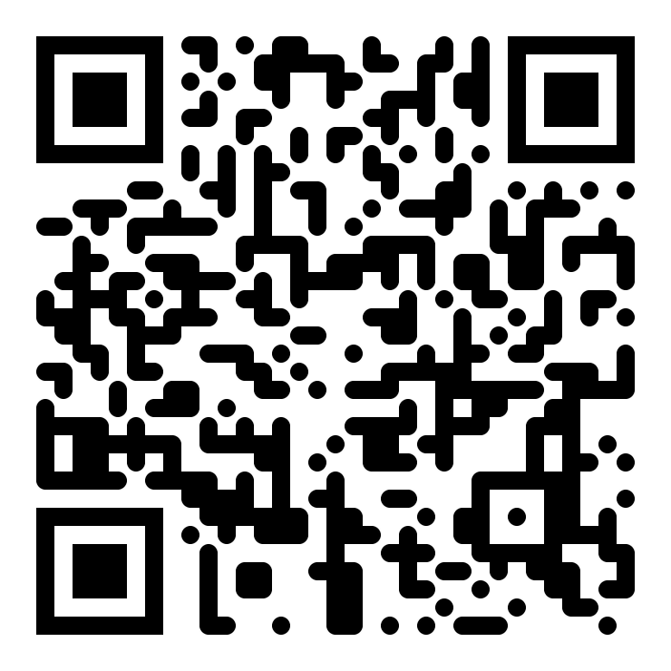
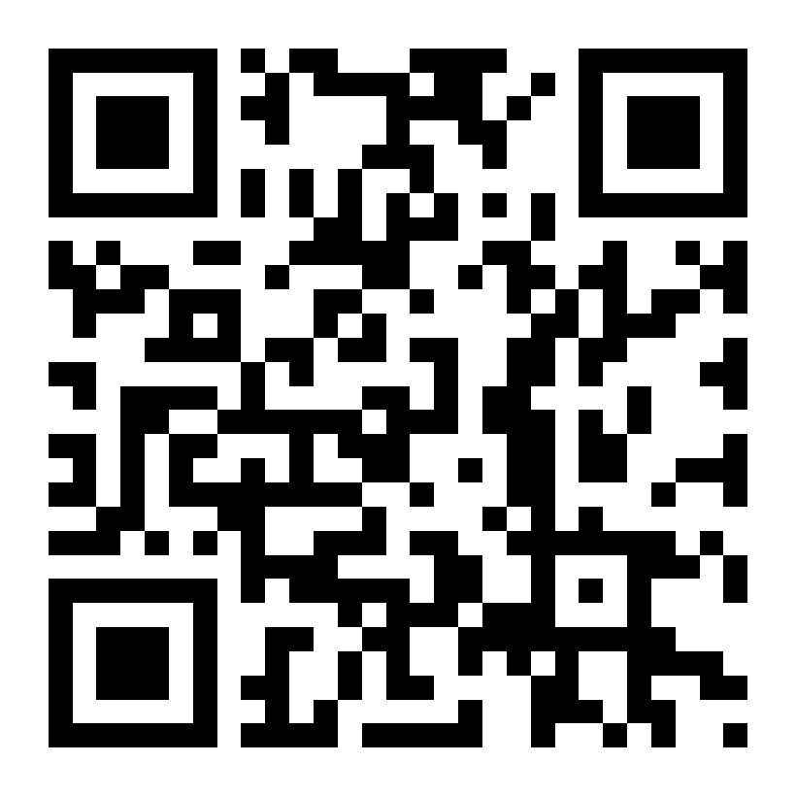
THANK YOU · LET'S CONNECT
Godwin Agbane
CEO, Innoedge Technologies · Engineer · Builder
godwin.innoedgetech.com
SCAN TO CONNECT
SCAN FOR RESOURCES
innoedgetech.com
my page + socials
handbook + tool links
agbane6@gmail.com,
Godwin Agbane on LinkedIn
Slides, every tool link, the prompt handbook and open-source picks — one scan.
Notes:
Leave this up through Q&A. Left QR: personal page and socials. Right QR: the resource hub — these slides, the prompt handbook, the AI coworker workflow guide, every tool link with free-tier notes, and the open-source picks. Invite them to scan now, then open Q&A (30 minutes).

