Slide 1
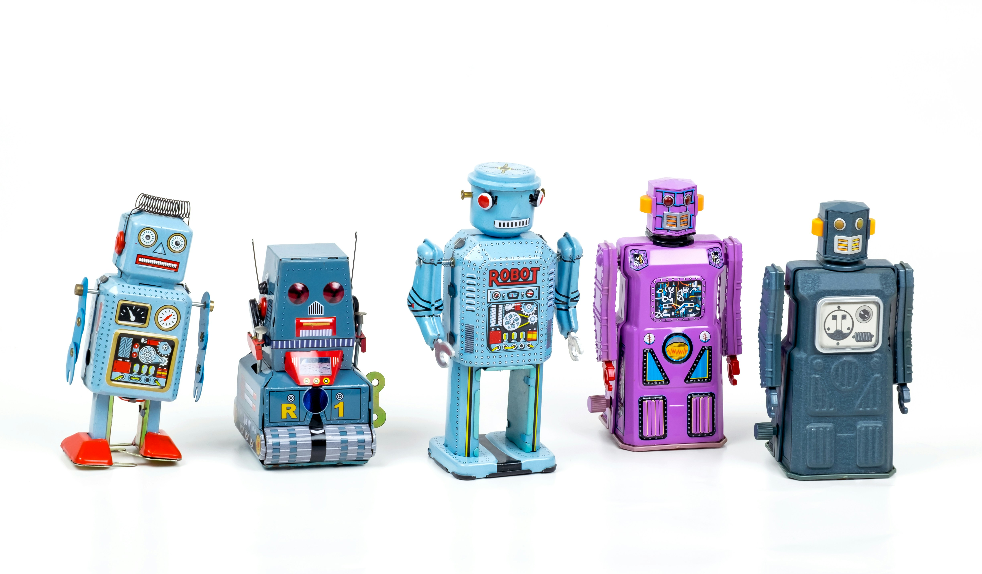
WMFM! (What’s My Fitted Model) - if AI can do this what should we do?
Adrian Barnett, QUT, 15 July 2026
Photo by Eric Krull on Unsplash

Slide 2
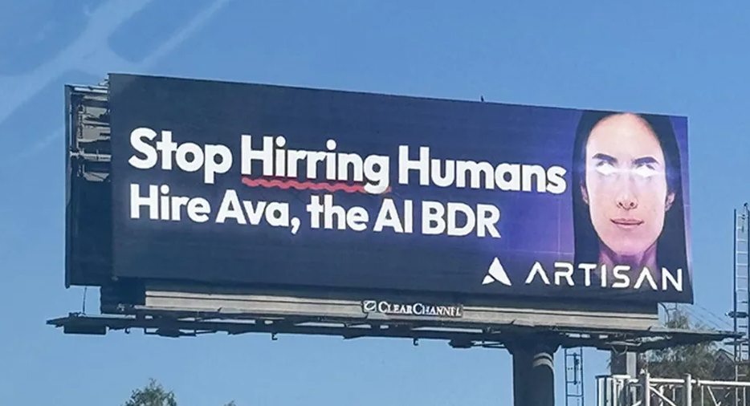

Slide 3
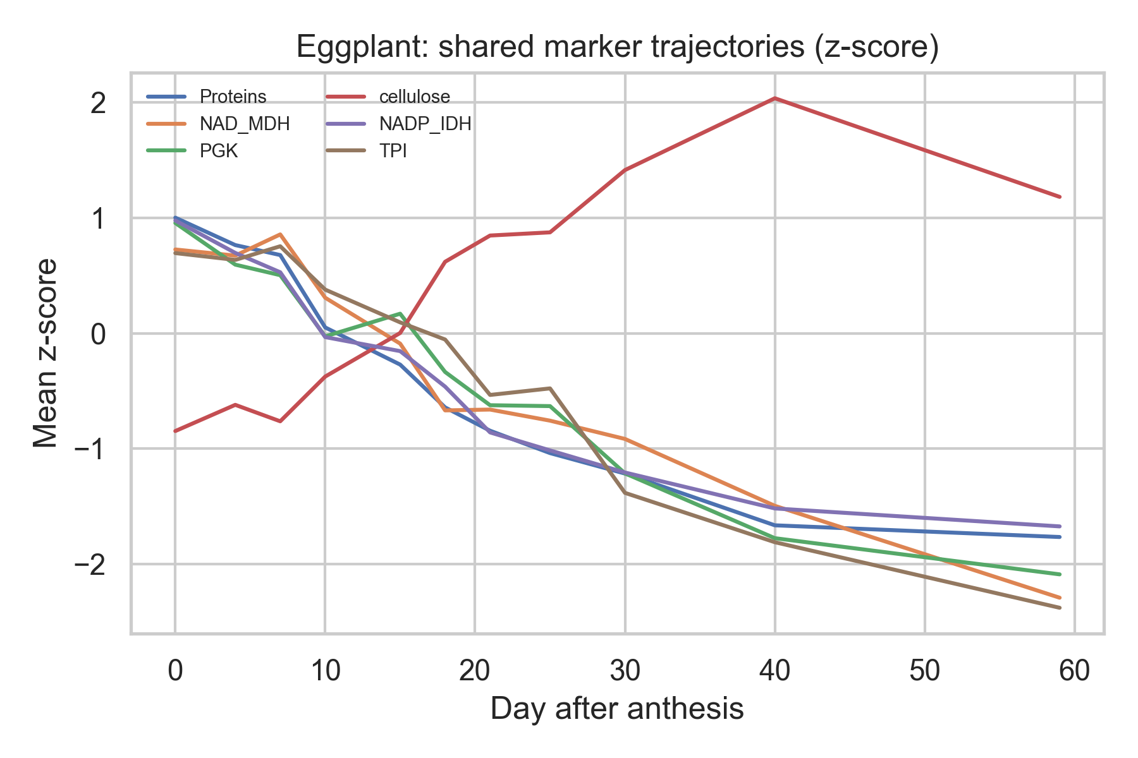
30 minute paper
With Matt Spick. Using Prism https://www.octopus.ac/publications/za6p-4457/versions/latest

Slide 4
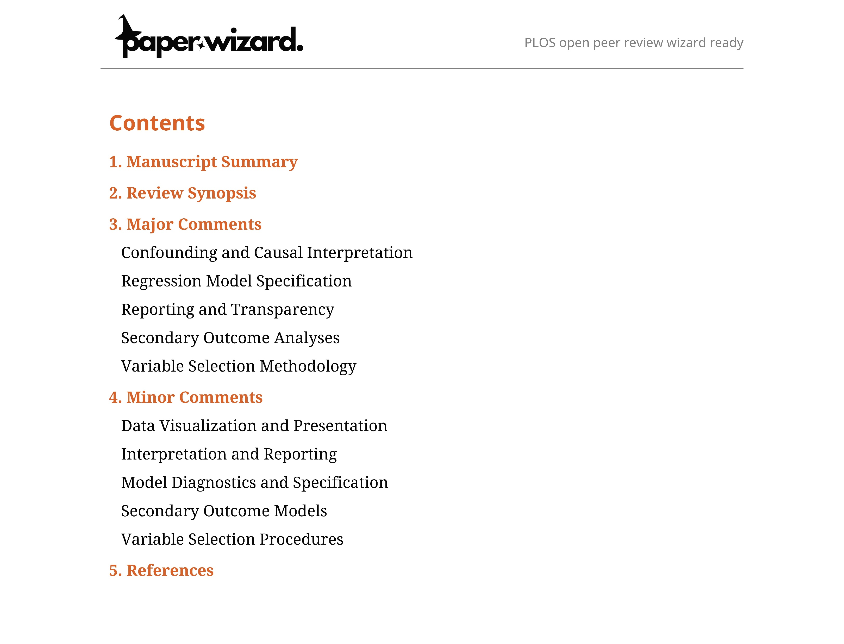
AI reviewer

Slide 5

AI hacks and cherry picks
Study of classification models
  occasionally fabricated or synthesized new datasets
  misrepresents statistics or substitutes them with alternatives
  post-hoc selection bias
Study of p-values
  ChatGPT, Gemini, and Claude fall prey to dichotomania at the 0.05 and 0.10 thresholds commonly used to declare ‘statistical significance’
Photo by Tim Witzdam on Unsplash
DOIs: 10.1017/jdm.2025.7 and 10.48550/arXiv.2509.08713

Slide 6
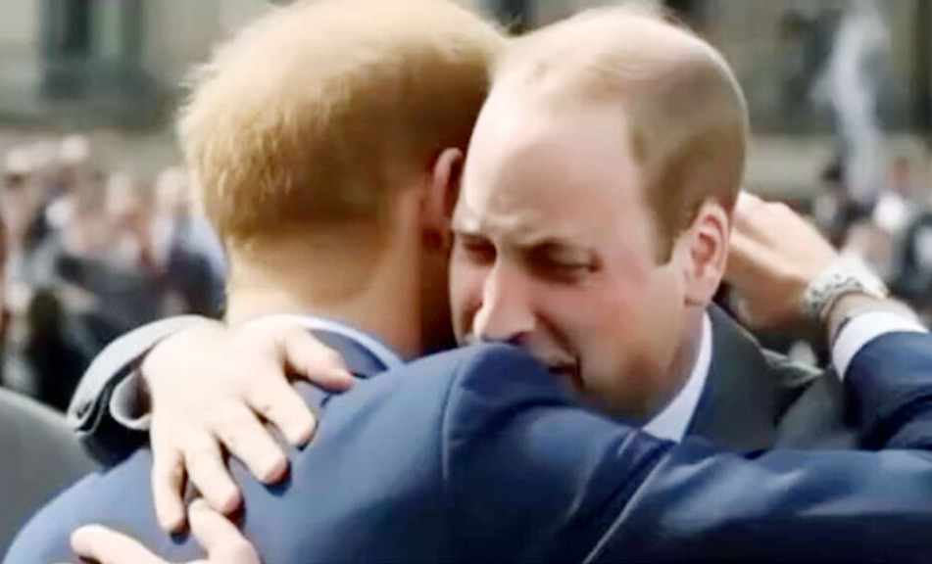
News click-bait
William and Harry hugging at the King’s coronation
Earns millions of clicks
The truth follows days later and does not reach everyone
Notes:
https://news.sky.com/story/fake-ai-images-keep-going-viral-here-are-eight-that-have-caught-people-out-13028547

Slide 7
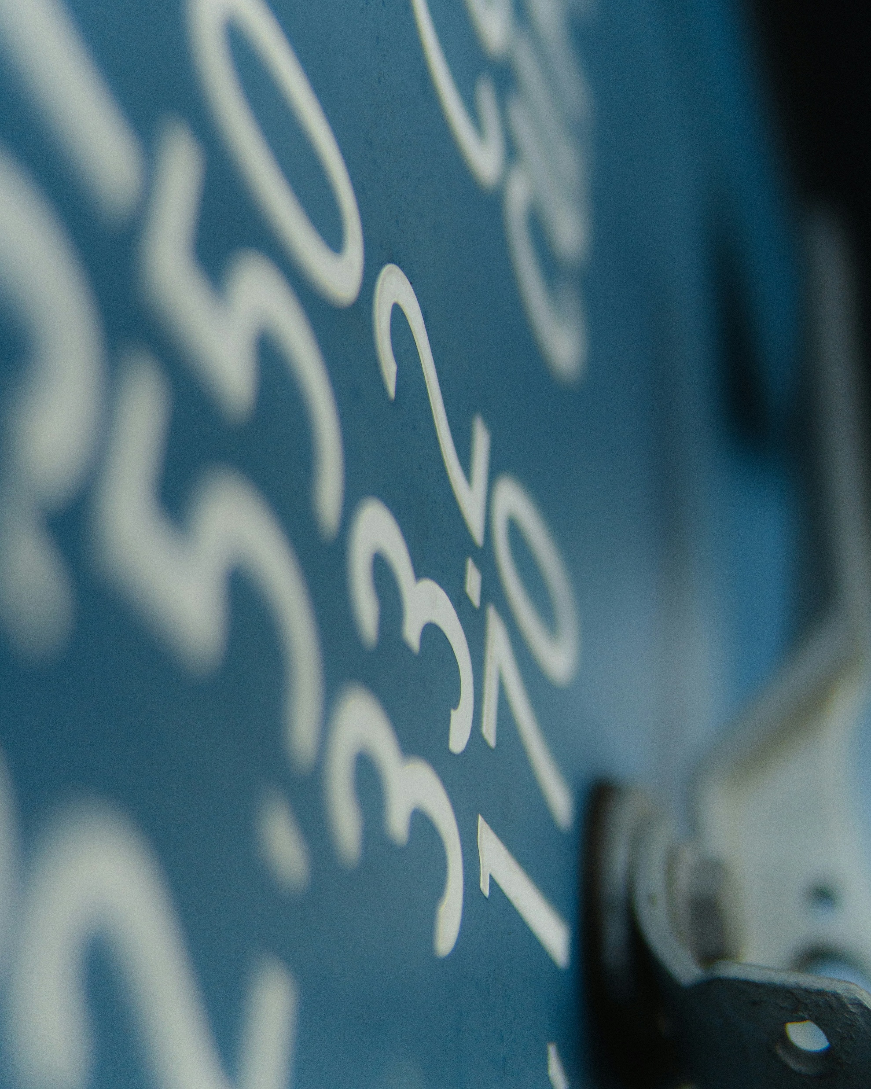
Academic click-bait
Fast and formulaic paper created
Published in Q1 journal
Is the analysis competent?
Are the results accurate?
Photo by Florian Paulus on Unsplash

Slide 8
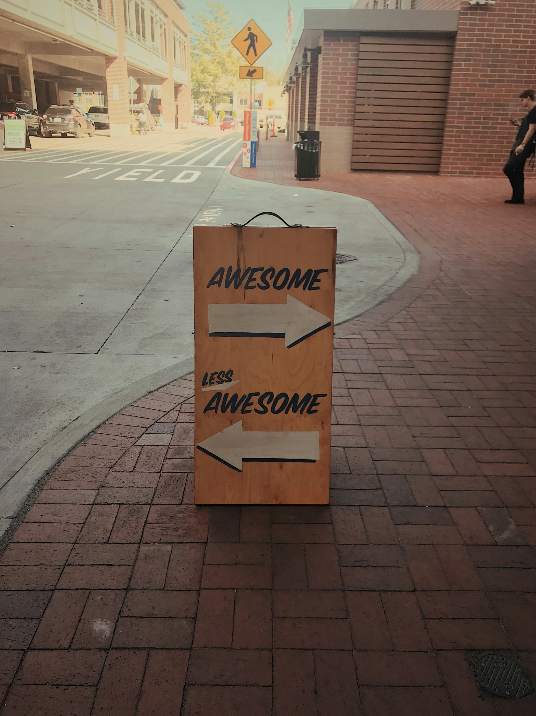
We need to create feedback loops
Fight for quality over quantity
Reject mediocre papers
Insist on protocols and open code & data
Photo by Jon Tyson on Unsplash

