Slide 1
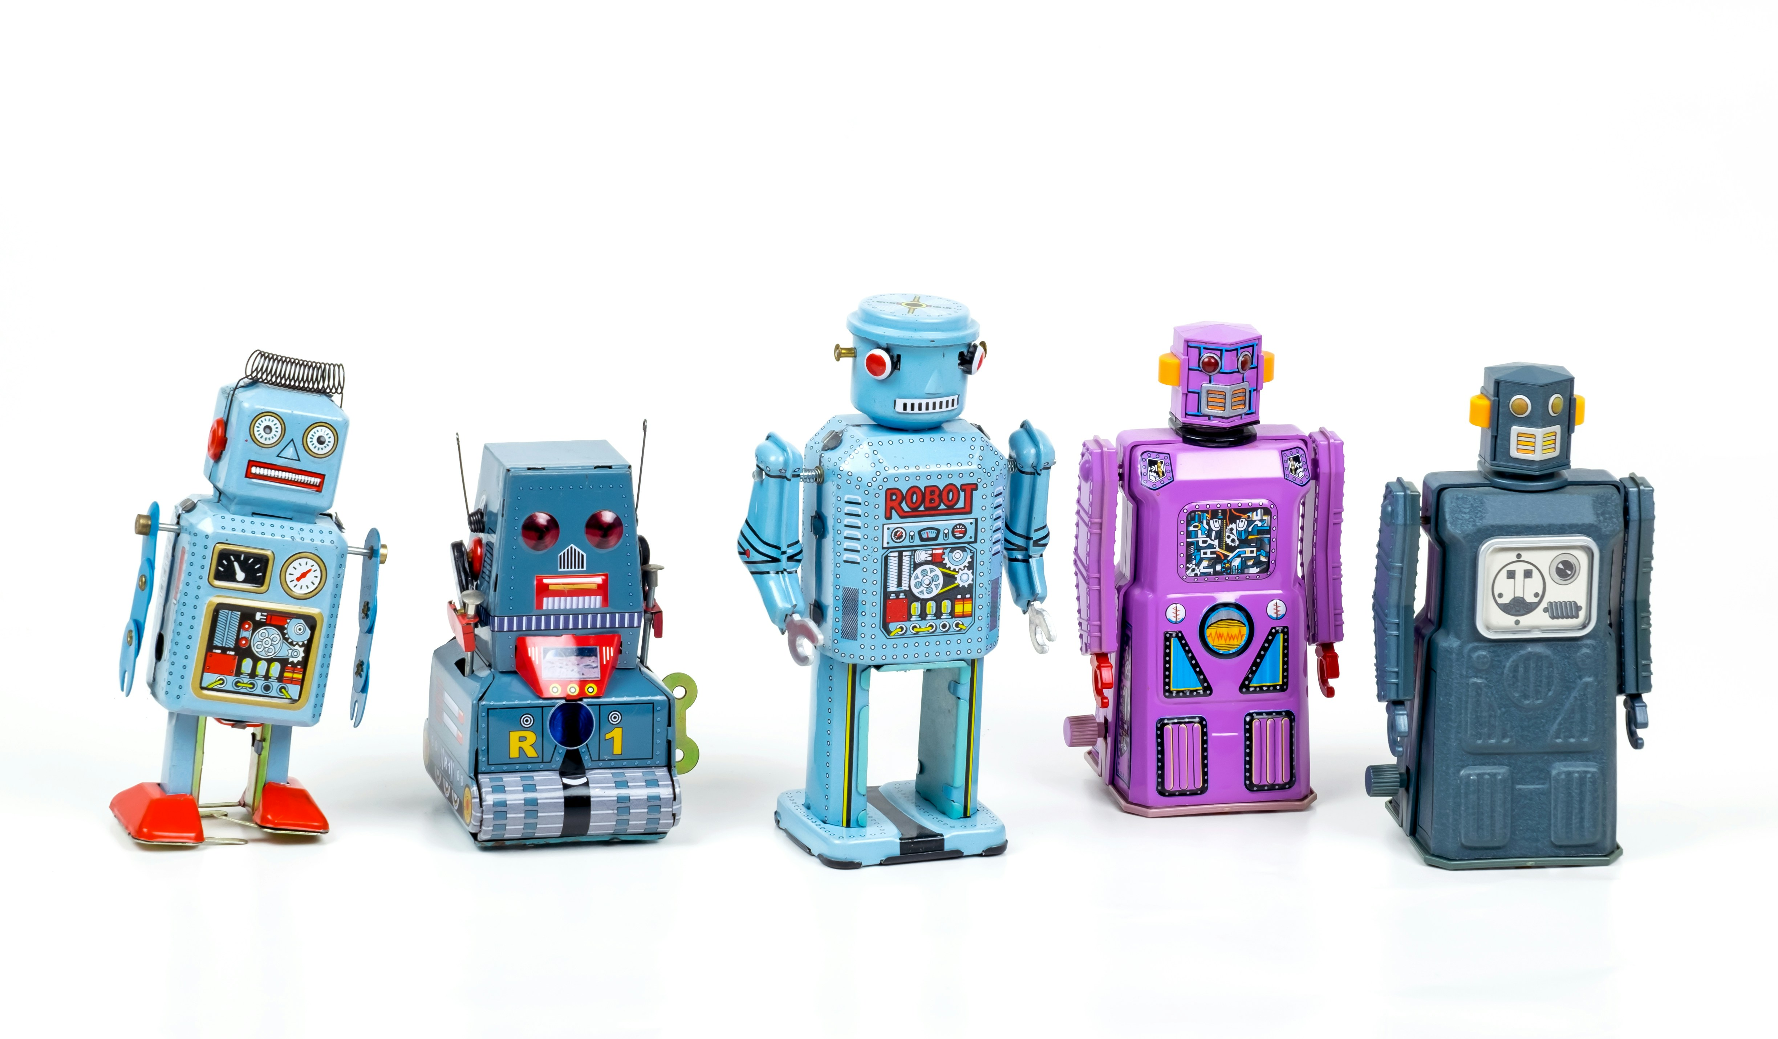
Will AI take my job?
Adrian Barnett, QUT, 19 July 2026
Photo by Eric Krull on Unsplash

Slide 2
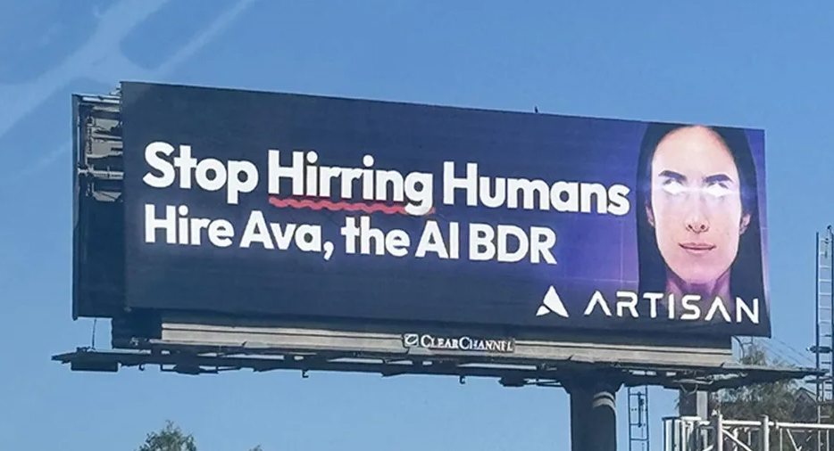

Slide 3
Should AI take your job?
Sarah O’Connor, “We Are Not Machines: The Fight for the Future of Work”
“The limits of the applicability of computers are ultimately statable only in terms of oughts.” Joseph Weizenbaum, ~1970
“The space between what the machines can and can’t do […] will only be filled in by a series of human decisions, arguments, markets, battles, compromises and preferences.”
“Take action, individually and collectively, to seize opportunities, or pivot away from risks […] to actively shape the technology itself and the way it is implemented.”
https://www.afr.com/technology/should-ai-steal-your-job-people-are-fighting-back-20260602-p60374
Notes:
https://www.afr.com/technology/should-ai-steal-your-job-people-are-fighting-back-20260602-p60374

Slide 4
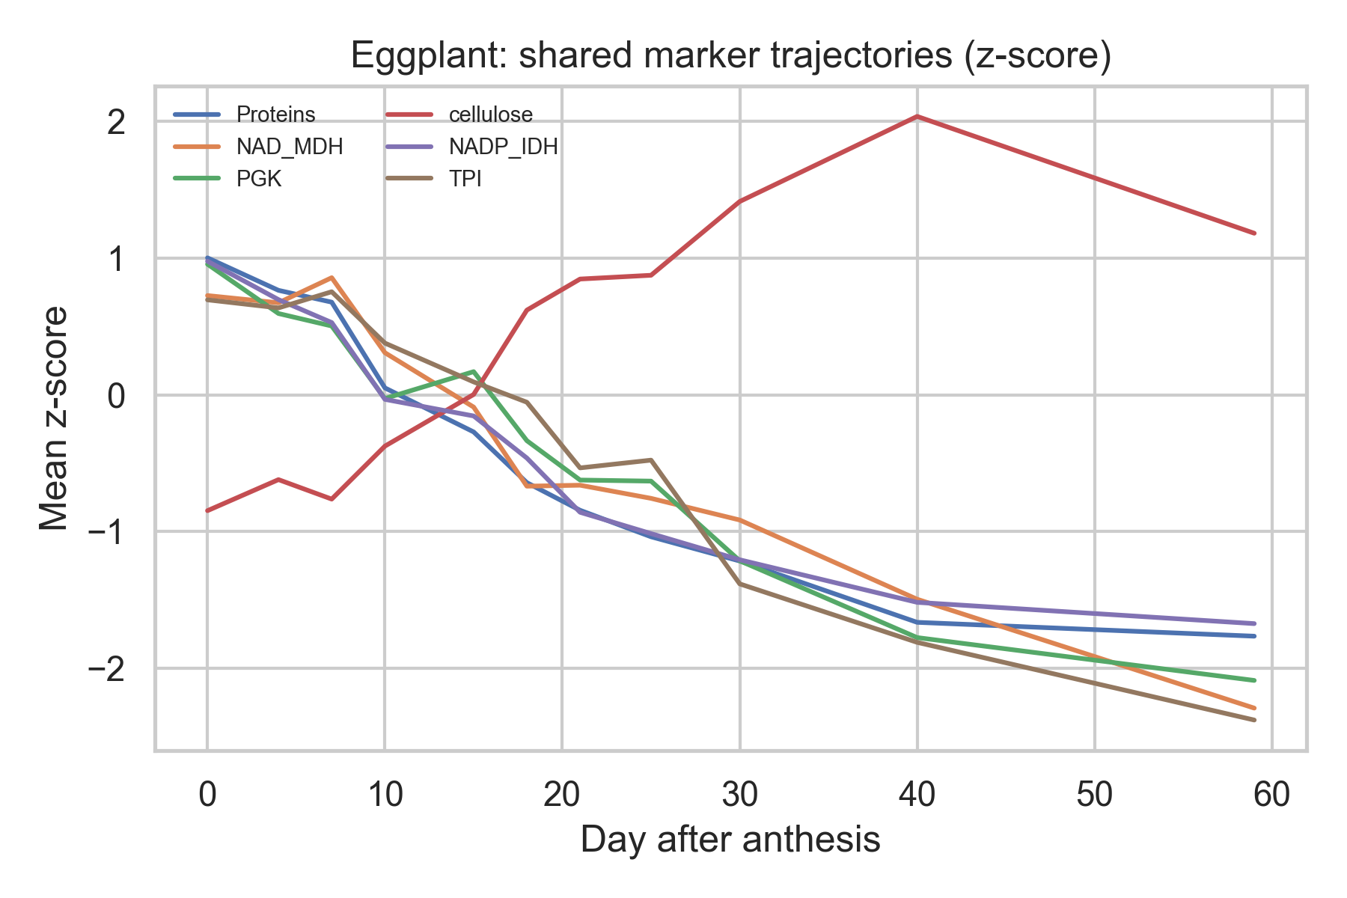
30 minute paper
With Matt Spick. Using Prism https://www.octopus.ac/publications/za6p-4457/versions/latest

Slide 5
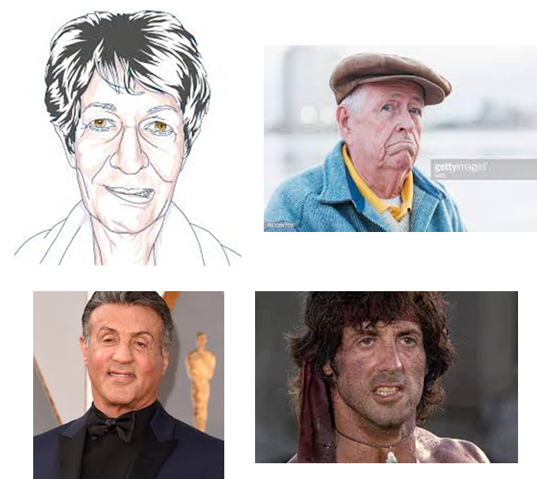
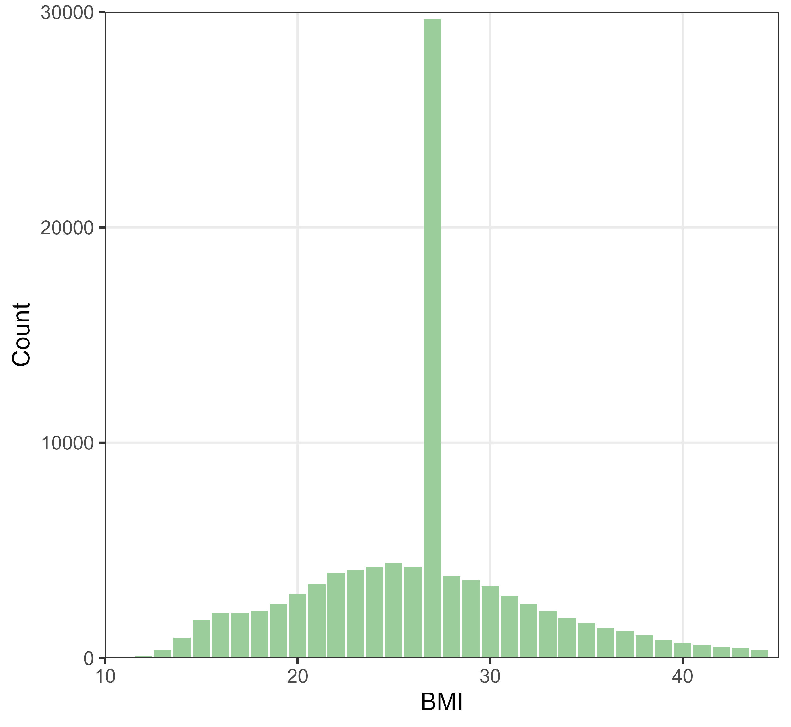
AI cowboys
“A smart camera located in patient rooms has been used to collect images”
“An authoritative dataset was used as the research object”
DOIs: 10.1038/s41598-025-28513-5 & 10.1038/d41586-026-00697-4

Slide 6
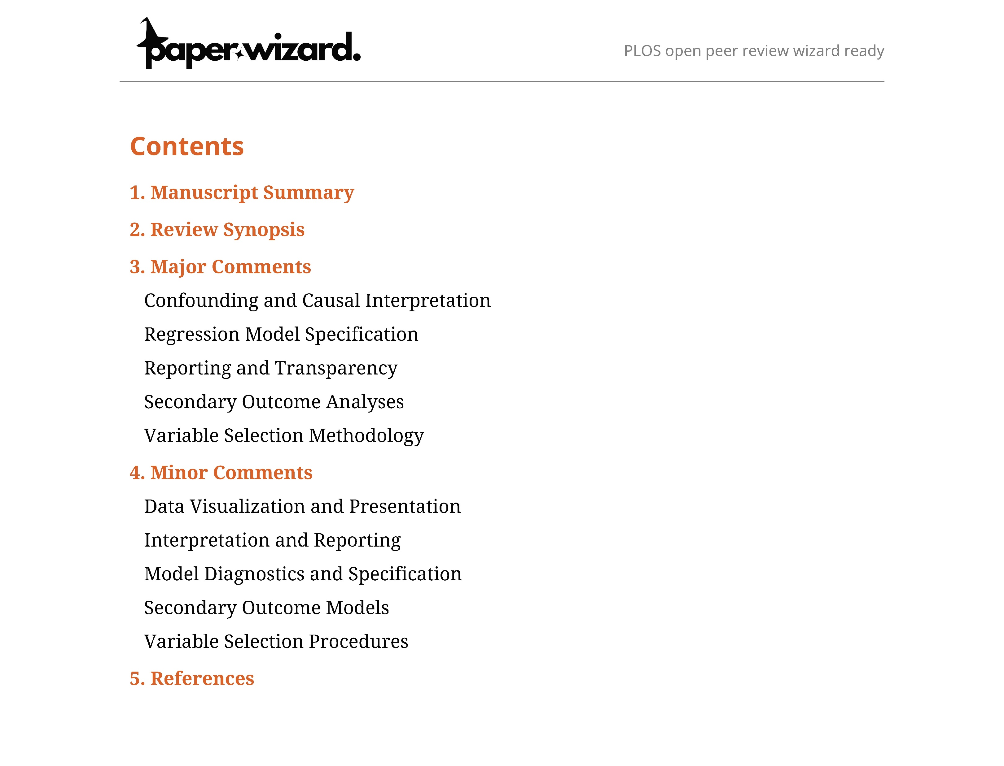
AI reviewer

Slide 7

AI hacks and cherry picks
Study of classification models
  occasionally fabricated or synthesized new datasets
  misrepresents statistics or substitutes them with alternatives
  post-hoc selection bias
Study of p-values
  ChatGPT, Gemini, and Claude fall prey to dichotomania at the 0.05 and 0.10 thresholds commonly used to declare ‘statistical significance’
Photo by Tim Witzdam on Unsplash
DOIs: 10.1017/jdm.2025.7 and 10.48550/arXiv.2509.08713

Slide 8
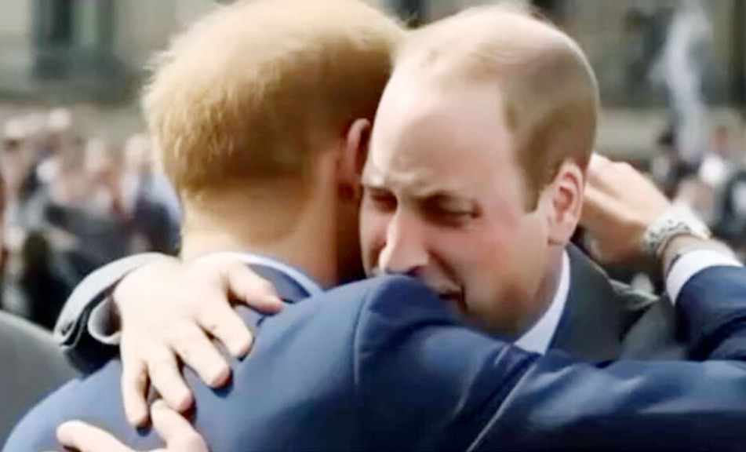
News click-bait
William and Harry hugging at the King’s coronation
Earns millions of clicks
The truth follows days later and does not reach everyone
Notes:
https://news.sky.com/story/fake-ai-images-keep-going-viral-here-are-eight-that-have-caught-people-out-13028547

Slide 9

Academic click-bait
Fast and formulaic prediction model created
Published in Q1 journal
Is the model competent?
Is the model accurate?
Photo by Florian Paulus on Unsplash

Slide 10

We need to create feedback loops
Fight for quality over quantity
Reject mediocre papers
Insist on protocols and open code & data
Photo by Jon Tyson on Unsplash

Slide 11

Photo by Kelly Sikkema on Unsplash

