Slide 2
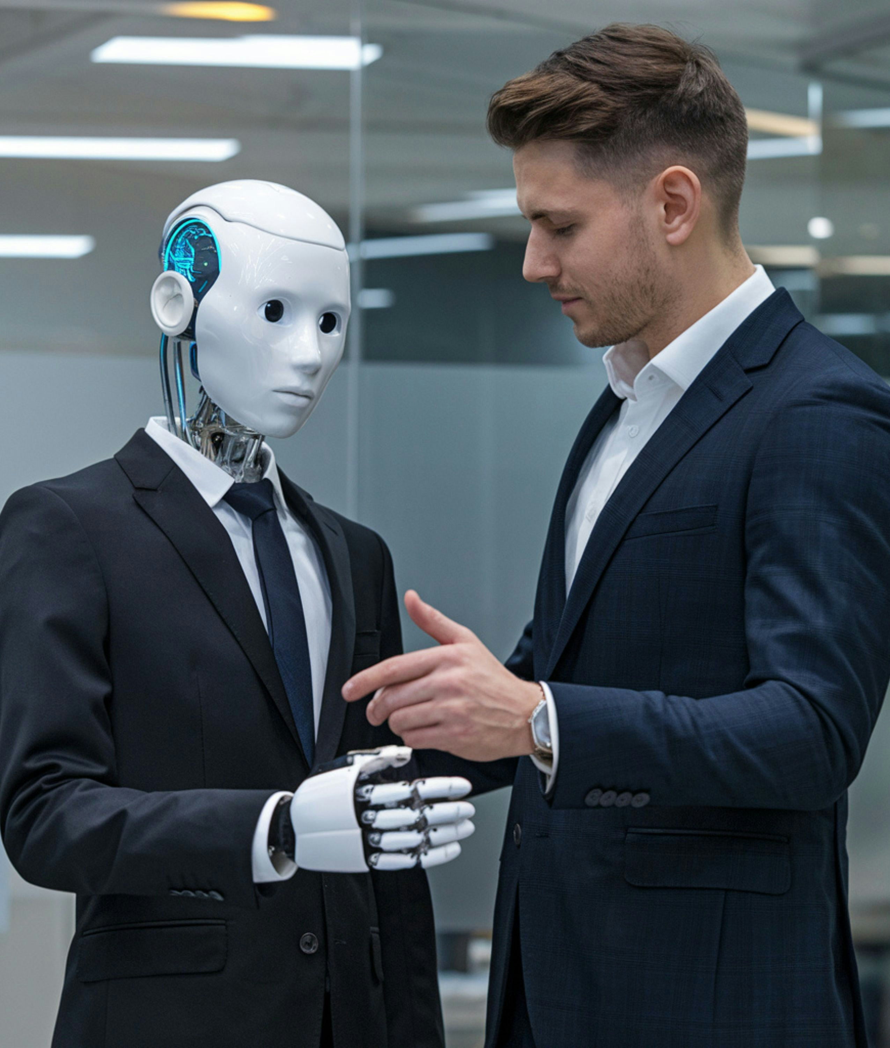
Modern journalism
AI generated or enhanced headlines, content and images
Journalists checking AI created content (paid less for more stories)
AI free publications
Photo by Brey on Unsplash

Slide 3
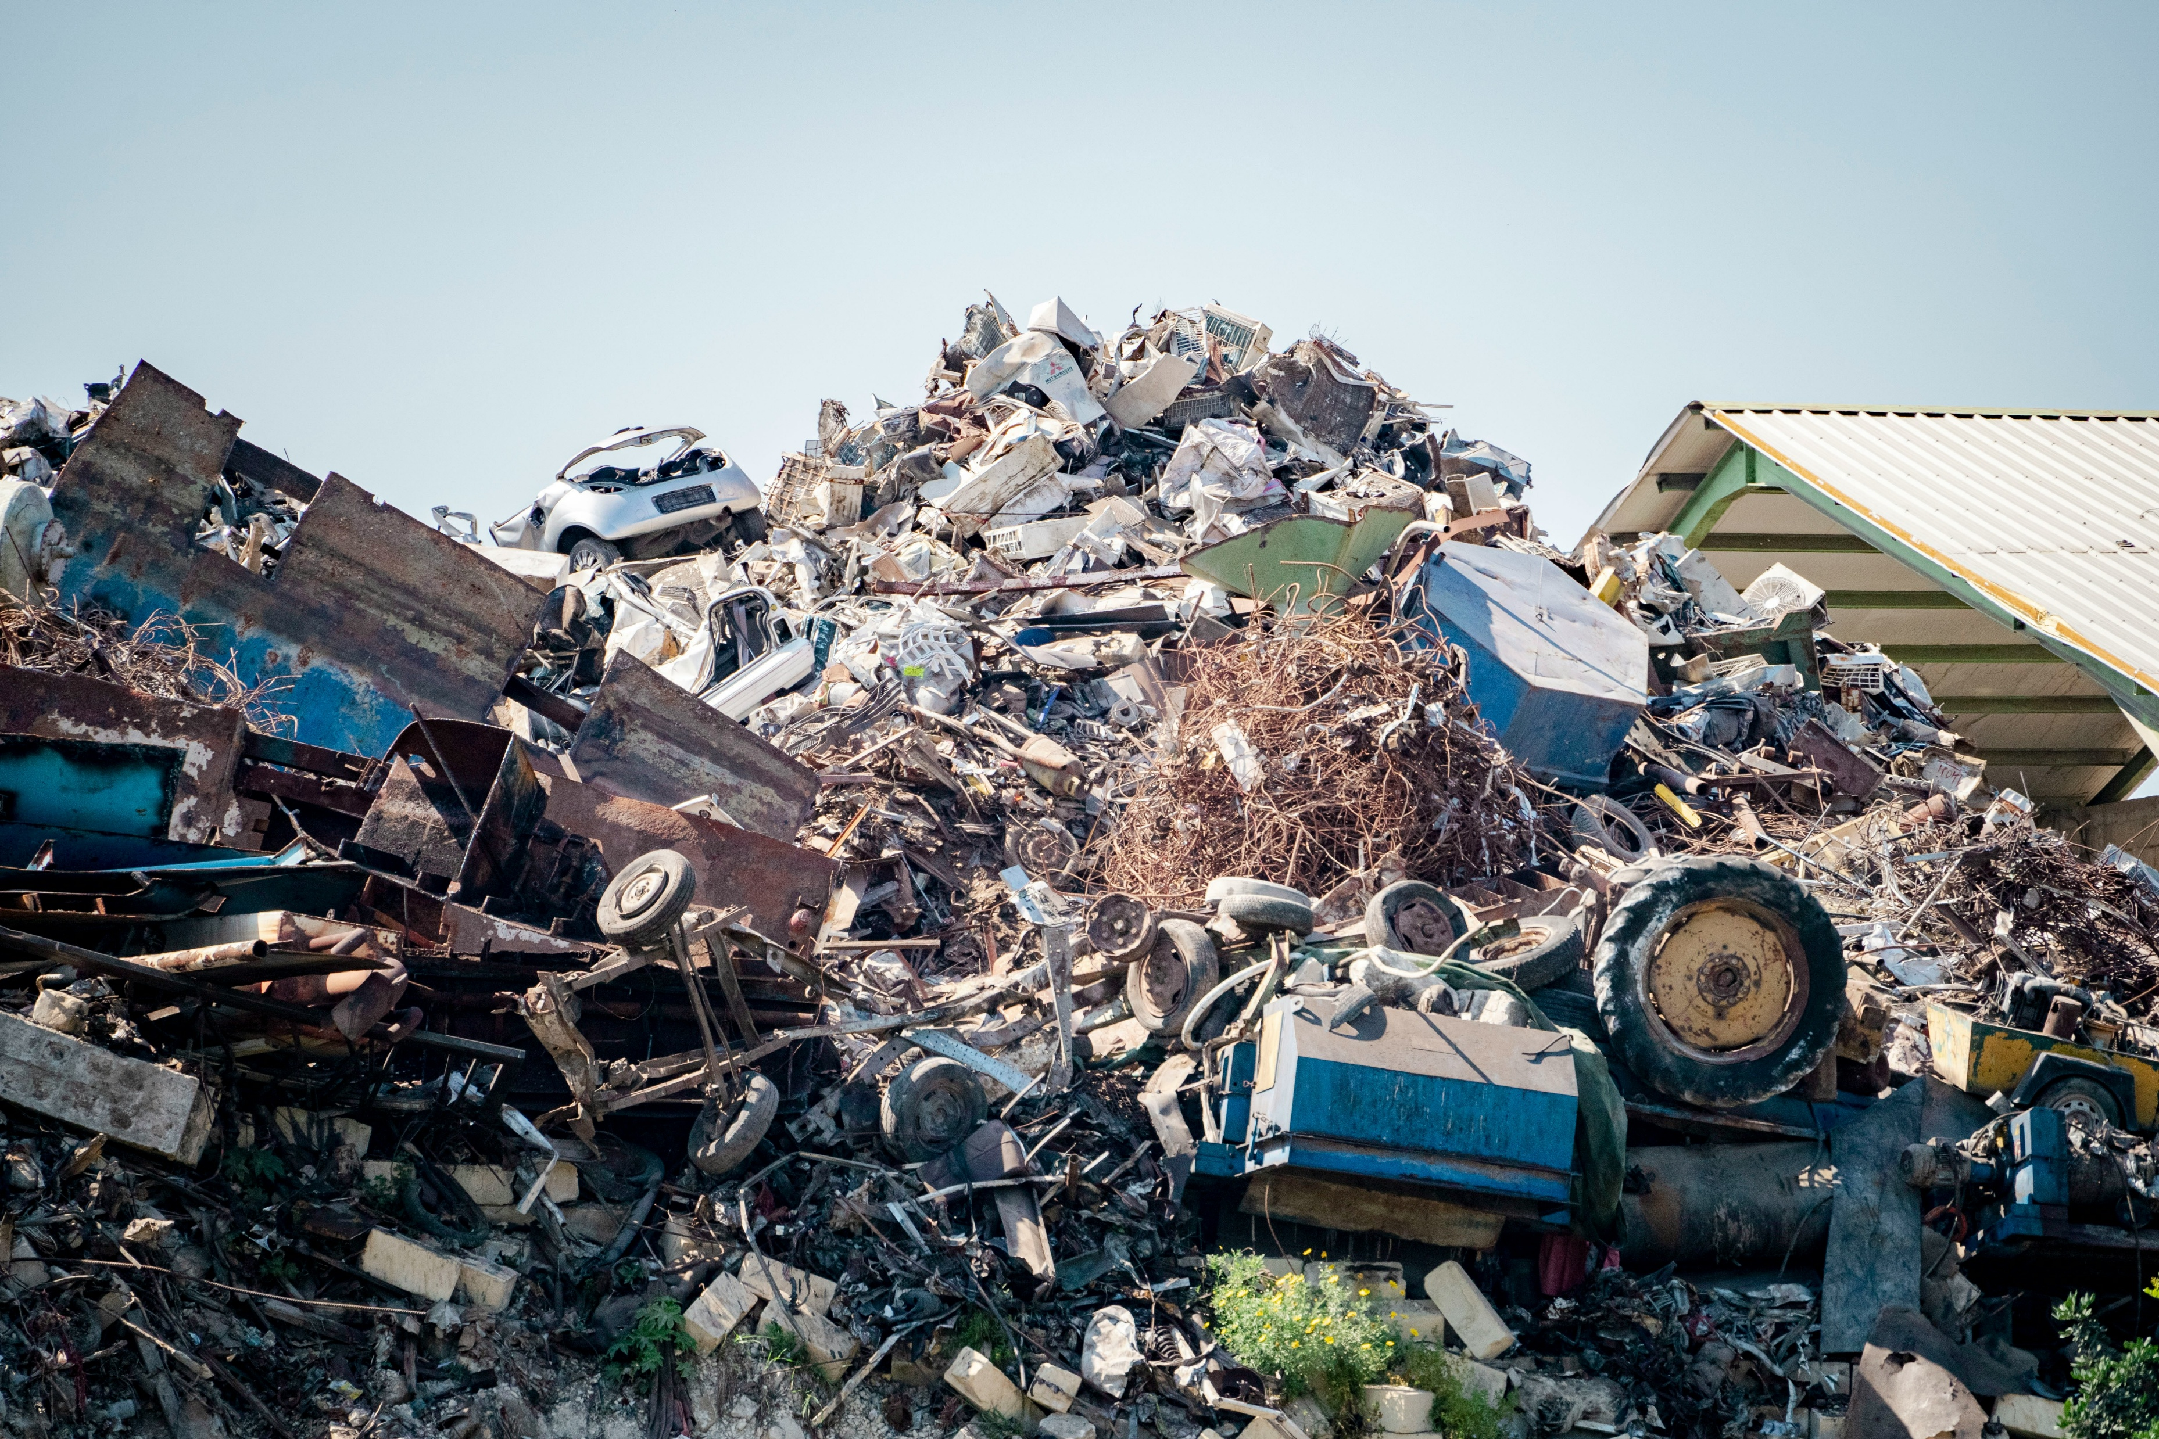
Photo by Evan Demicoli on Unsplash

Slide 4
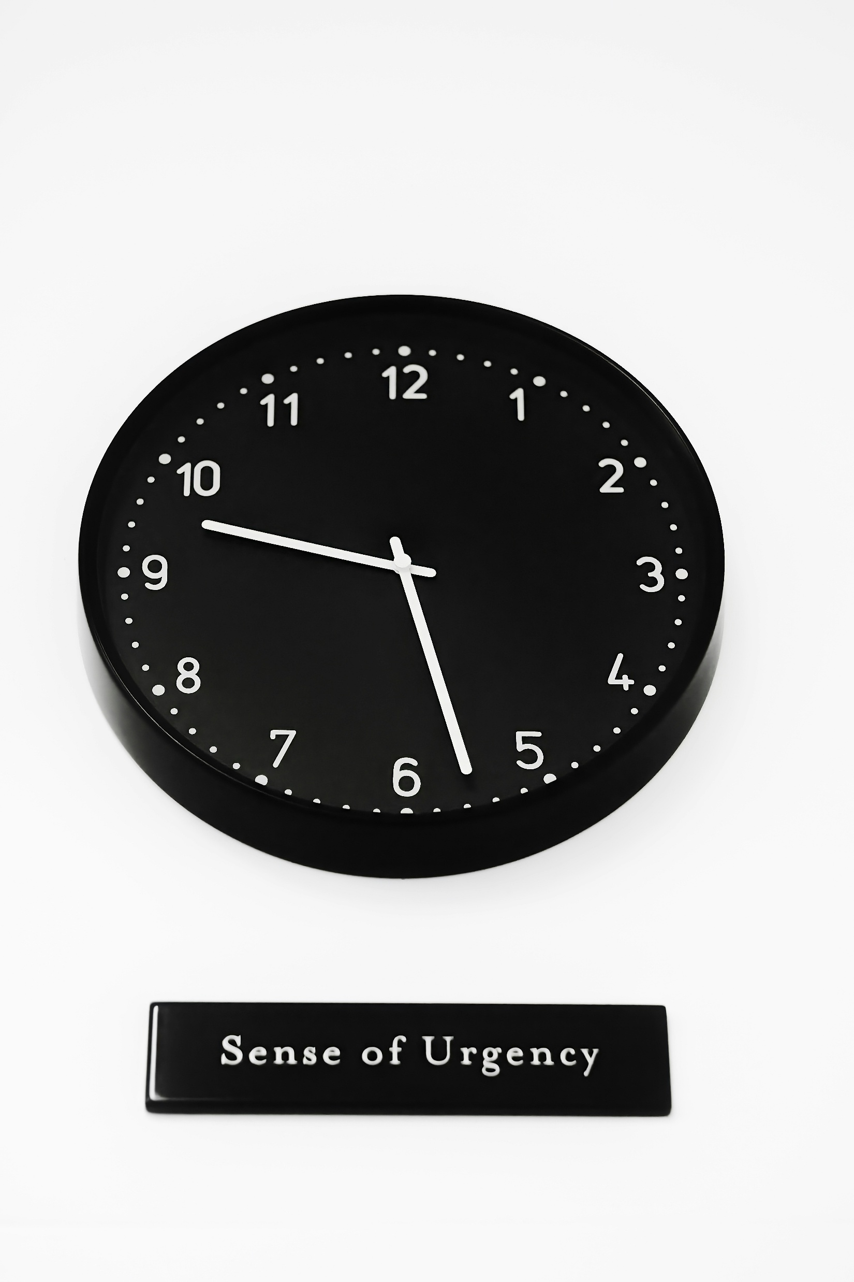
Saved time
Most academics will just do more
  Even more papers to review
  Even more literature to summarise
Fight for quality over quantity
Reject mediocre papers
Insist on protocols and open code/data
Photo by Philip Shoots on Unsplash

