Slide 1
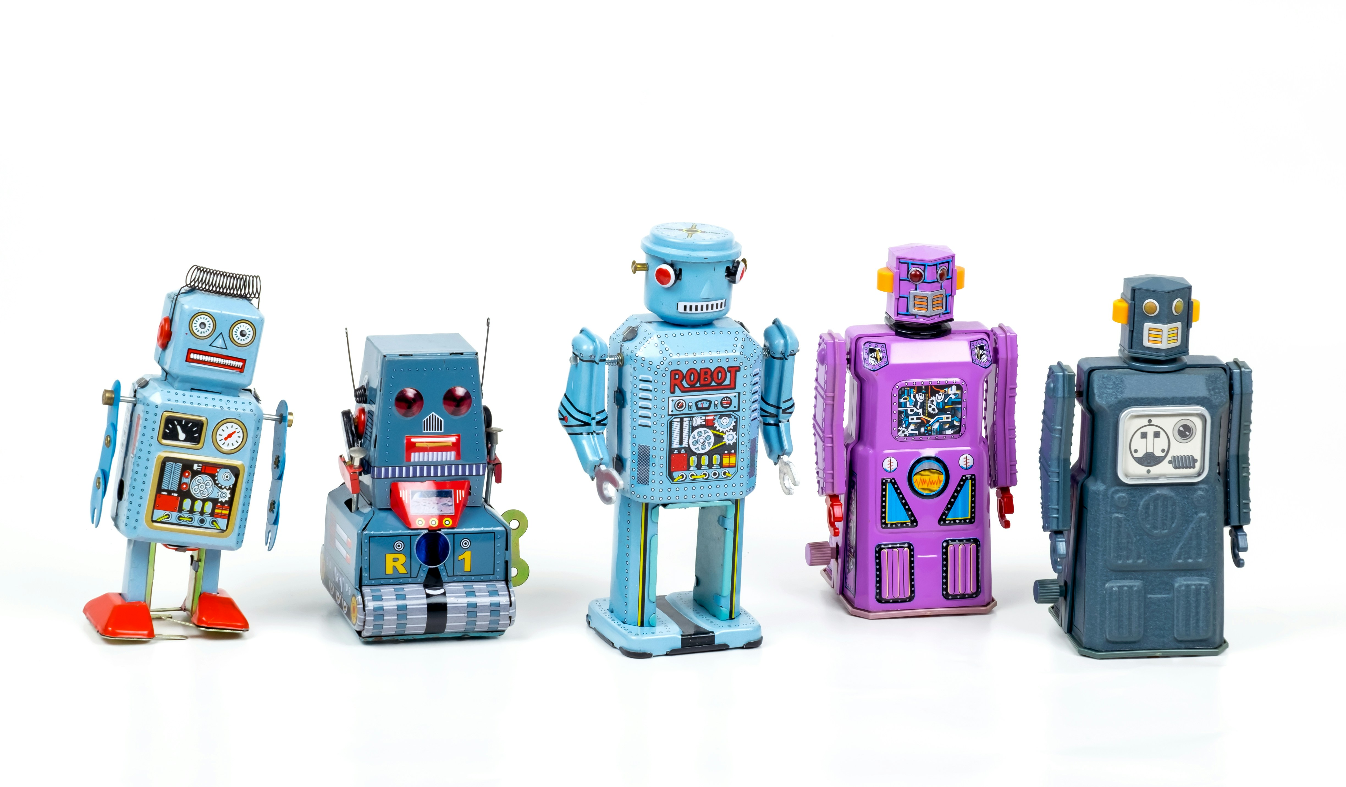
Responsible use of AI and reproducible research
Australian and New Zealand Stroke Organisation Conference 2026
Adrian Barnett, QUT
Photo by Eric Krull on Unsplash

Slide 2
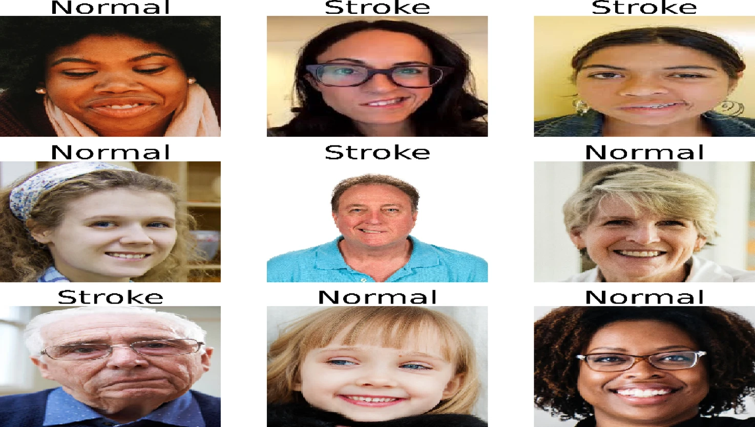
Stroke or normal?
From “Real-time monitoring system for early stroke detection based on fog computing and enhanced deep learning techniques” Scientific Reports

Slide 3
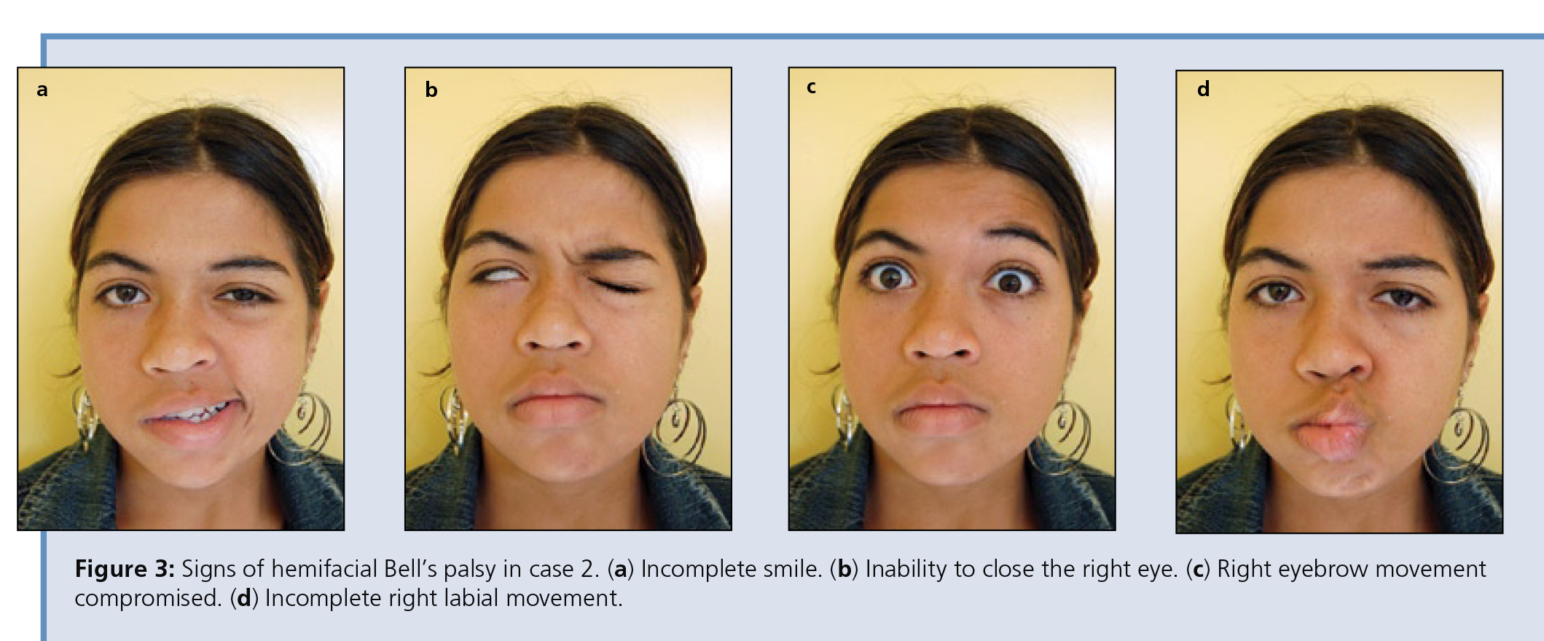
From: “Management of Bell’s Palsy: A Report of 2 Cases” Journal of the Canadian Dental Association (reproduced with permission and thanks to Dr de Araujo and the anonymous patient)

Slide 4
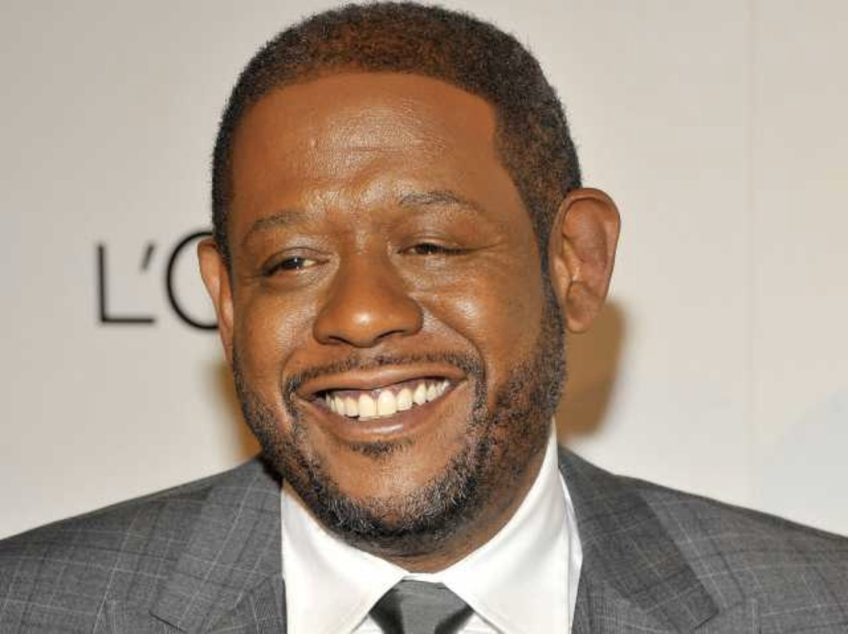
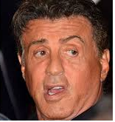
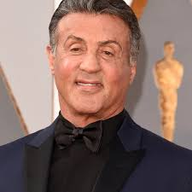
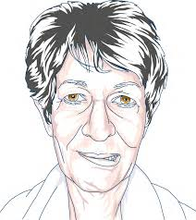
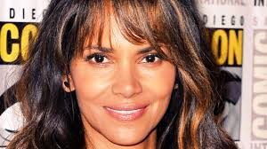
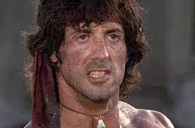
Comically bad data
“A smart camera located in patient rooms has been used to collect images”
Notes:
Halle Berry, Forest Whitaker

Slide 5
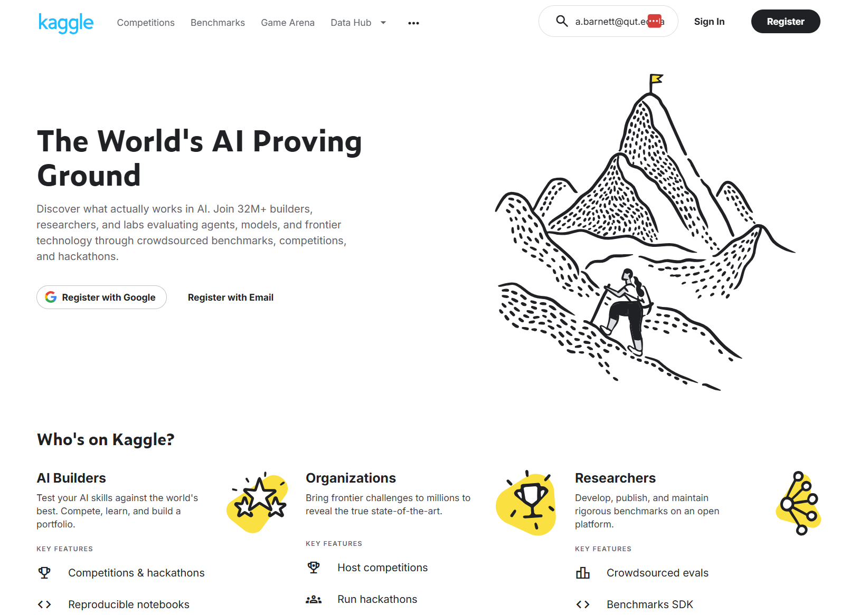

Slide 6
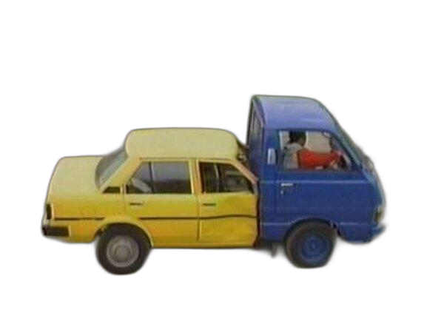
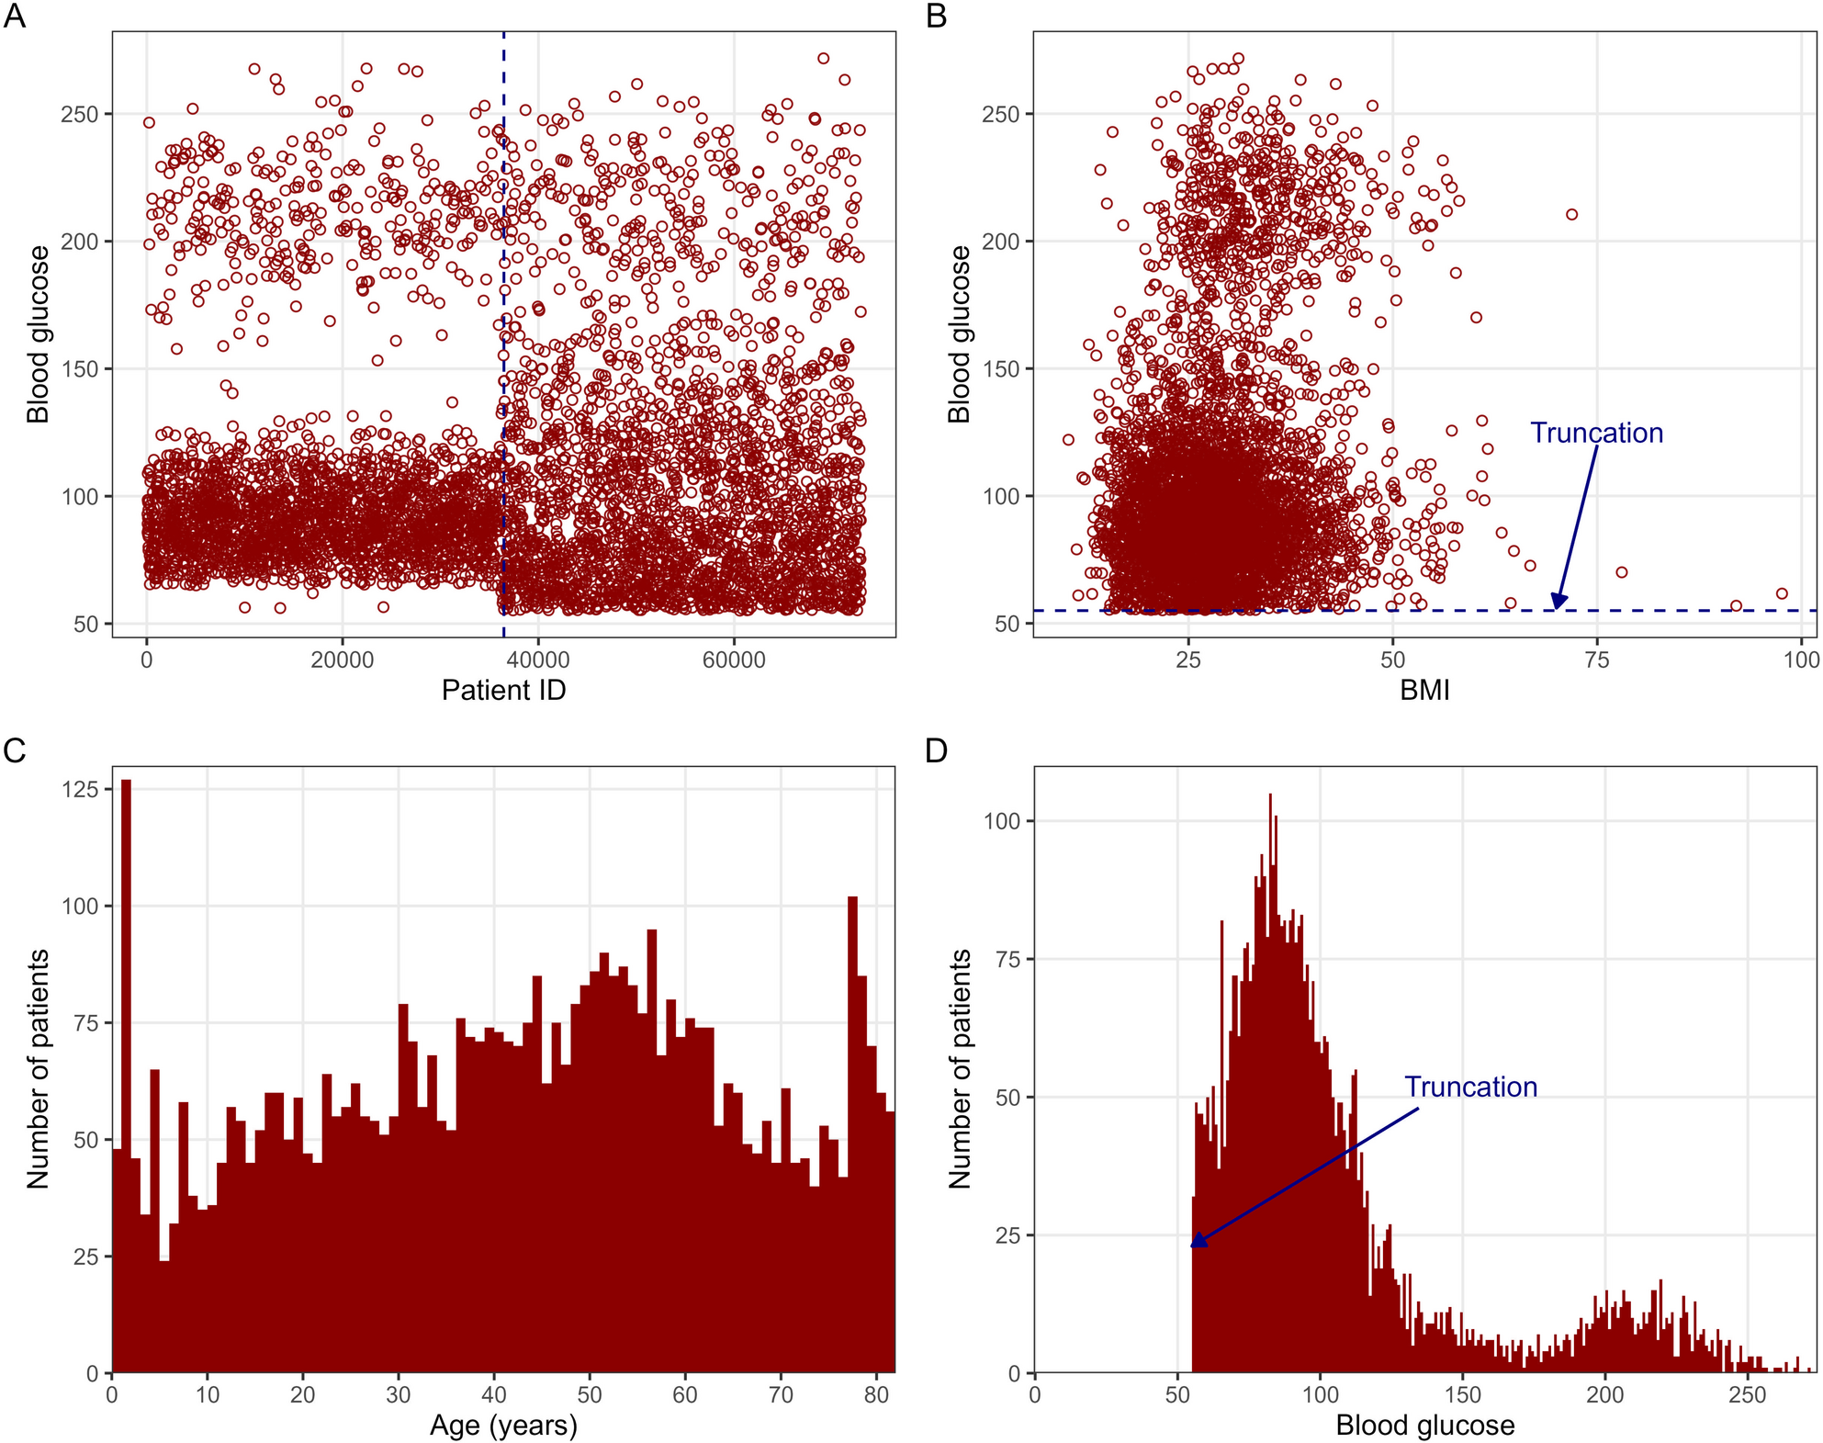
More stroke data from Kaggle
PMID: 42243840

Slide 7
Many journals do not care about the data
103+ papers published using the numerical stroke data
  The data are still available on Kaggle
  7 papers retracted
12+ papers published using the stroke image data
  The data were pulled from Kaggle for copyright infringement
  1 paper retracted
“The core contribution of this paper is […] a methodological advance that stands on its own merits regardless of the EHRs dataset's authenticity.”
“This paper was published in Algorithms, a journal focused on computational methodology rather than clinical practice guidelines.”

Slide 8
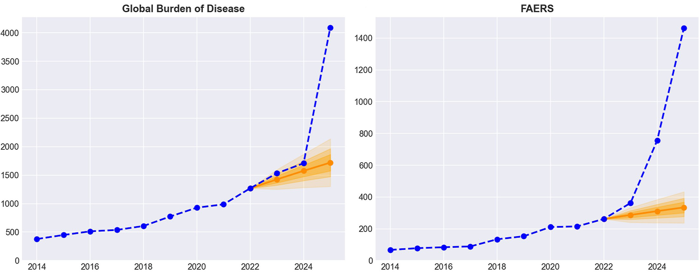
Fast churn research
PMID: 41740900

Slide 9

Data too open?
With Matt Spick (Uni of Surrey), we created a paper using Prism (OpenAI) in 30 minutes with no human input
Paper Orchestra (Google), produces a submission-ready manuscript with figures and verified citations in about 40 minutes
Photo by Muhammad Zaqy Al Fattah on Unsplash

Slide 10
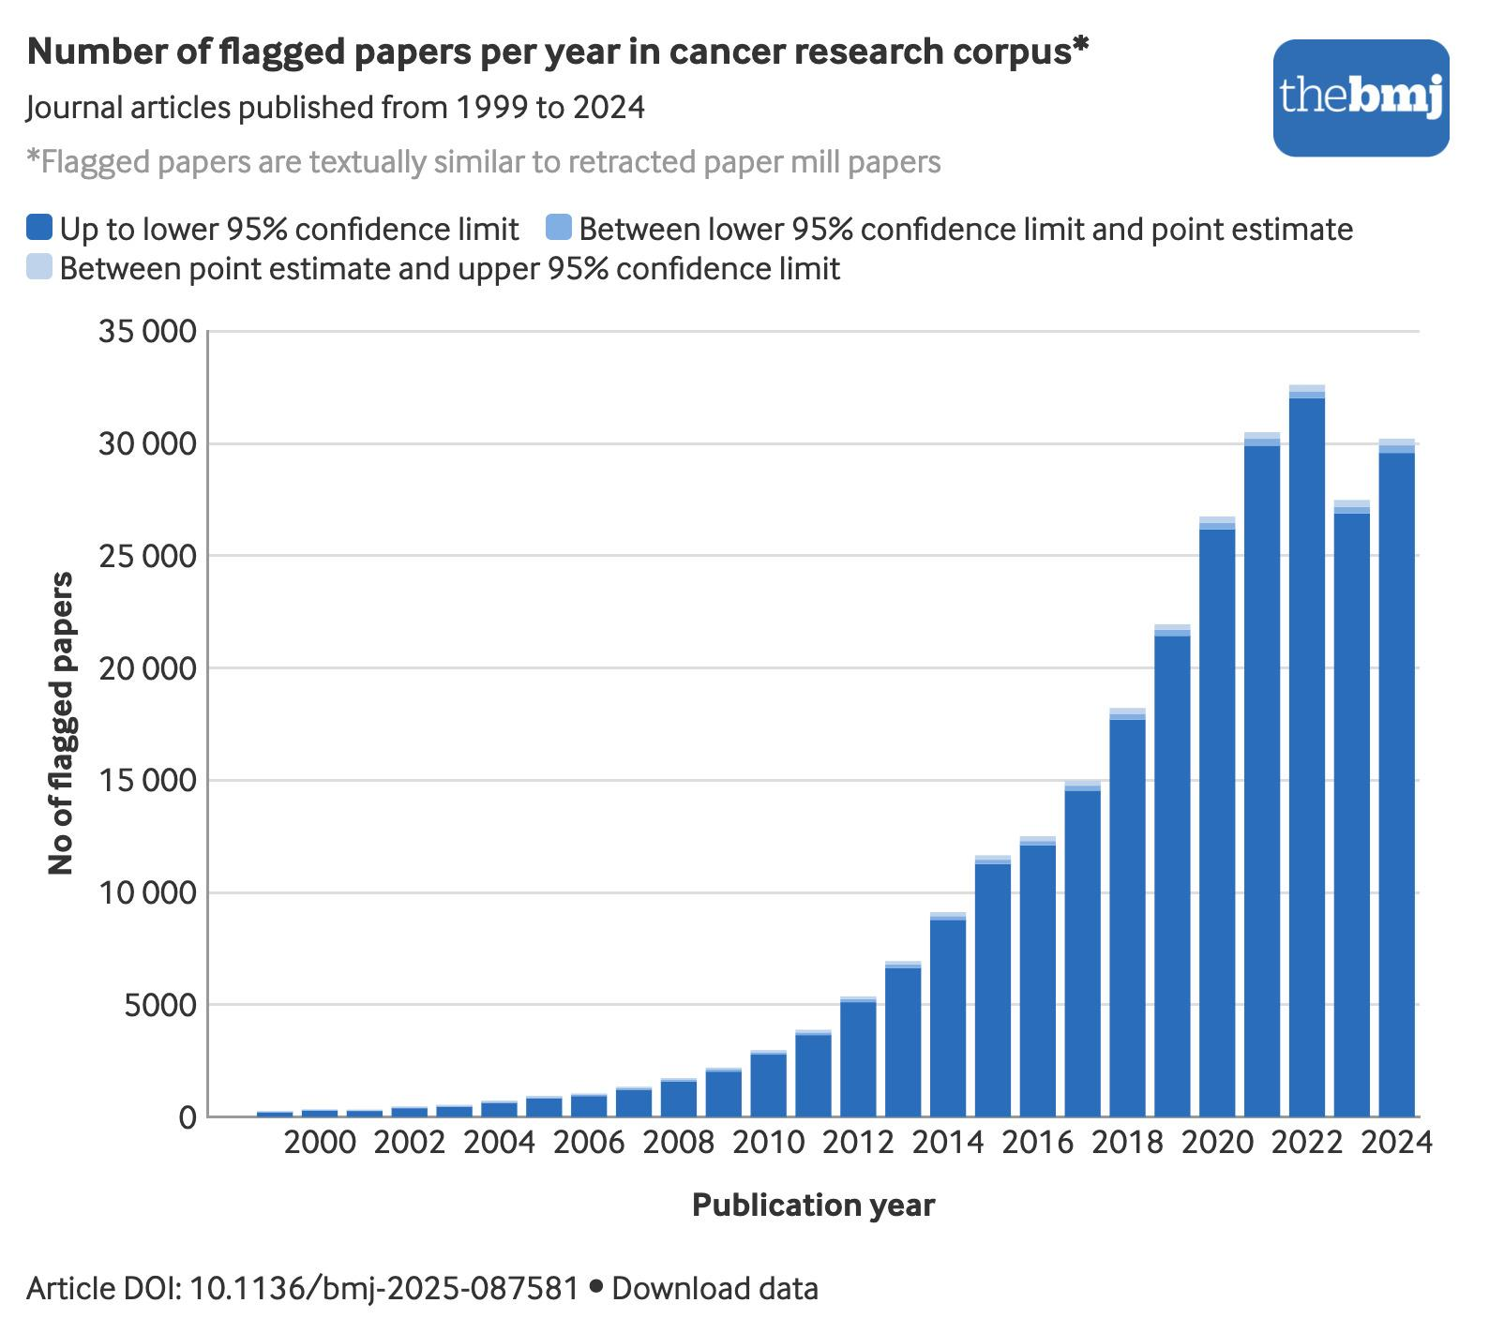
Paper mills in cancer

Slide 11
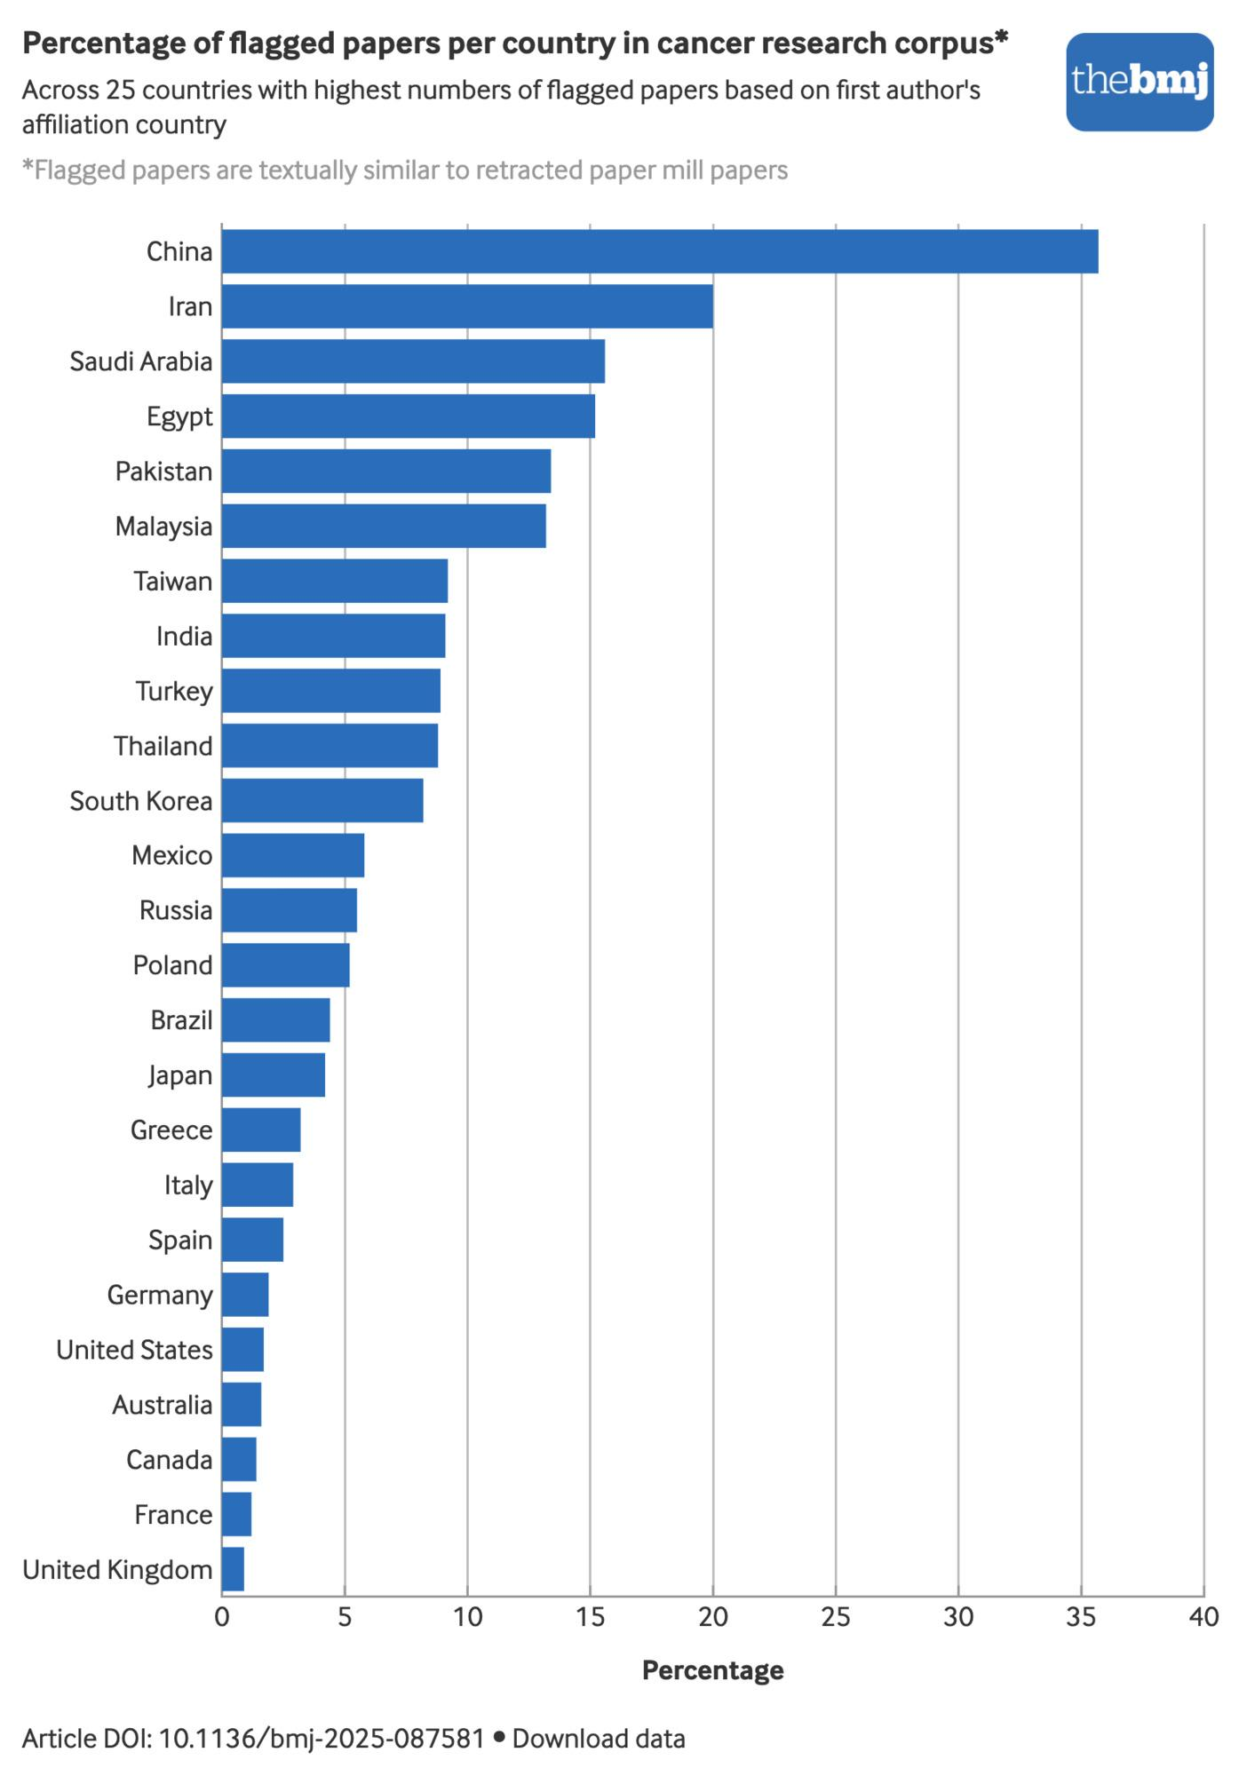
Country incentives matter

Slide 12
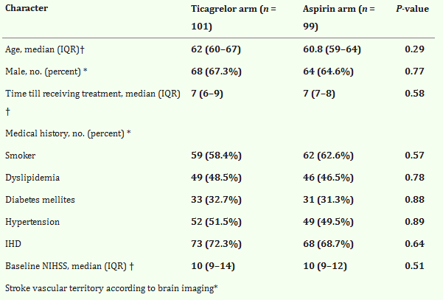
Problematic evidence in stroke guidelines
0.98 probability that the trial is under-dispersed
A randomized pilot study of the efficacy and safety of loading ticagrelor in acute ischemic stroke. Neurol Sci (2023).

Slide 13

“AI slop is an oil spill in our digital oceans” Katelyn Chedraoui
Photo by Alex Albert on Unsplash

Slide 14

Participate in our research
Early-career perspectives on questionable research practices in clinical research

