Slide 1

G2M Case Study
Virtual Internship
09-Dec-2022

Slide 2
Executive Summary
Data Properties
The dataset contains information about Yellow Cab and Pink Cab’s cab users from 2016 to 2018.
Additional features/categories were added for the analysis
Weather and Holiday data were used for the analysis
Steps in recreating the dataset
Joining datasets
Features creation
How was analysis performed? What type of analysis was used and why?
Visualization is done via various graphs to highlight key metrics for the analysis
What were the results?
The analysis shows that key insights that were used for the recommendation
Similarly, features that do not contribute to key metrics such as profitability, market share, etc. were disregarded to simplify the presentation for the audience
What is the recommendation?
Option A: Fully invest in Yellow Cab given its profitability, market share, and margins
Option B: Partially invest in Yellow Cab for a niche market that is performing above par (high market share with above average profitability percentage) which is California. From there, XYZ can slowly adapt to changes in the market and reevaluate its investment strategy.

Slide 3
Business Problem and Objective
Business Problem: XYZ it is planning for an investment in Cab industry and as per their Go-to-Market(G2M) strategy they want to understand the market before taking final decision (i.e. what is the better investment opportunity for XYZ)
Objective : Provide key insights to recommend the optimal option for XYZ’s G2M strategy

Slide 4
Data Overview and Assumptions
Profile (rows, columns) of each csv file
Dateset Cab_Data: (359392, 7)
Dateset city: (20, 3)
Dateset customer_id: (49171, 4)
Dateset transaction_d: (440098, 3)
Dateset holidays: (57, 2) weather: (864, 5)
Dateset weather: (864, 5)
df (Master Date): (359392, 31)
Overview of field names and data types
See pandas_profiling result for the summary
Data Relationships
Merged cab and transaction_id on ‘Transaction _ID’
Merged df and city on ‘City’
Merged df and customer_id on ‘Customer ID
Merged df and holidays on ‘Date of Travel’
Merged df and weather on ‘Month_Year_State’
Cab_data.csv
df = Consolidated Data
Customer_ID.csv
Transaction_ID.csv
City.csv
US holiday.csv
weather.csv

Slide 5
Data Overview and Assumptions
Feature Transformation and Additional Features
Added features for financials (Income, Price per KM etc.)
Added features for dates (Day of Week, Month, Year)
Converted Population and Users to numeric
Included categorization for age, income_salary, Market Penetration, city size
Weather data based on public dataset and considers the most frequent weather condition for the period
Method of creating the Master Data
Merged data based on common columns
Data is aligned with the number of rows for cab data
Removal of Duplicates
drop_duplicates() done
Data Imputation and Outlier Detection
Nan weather data replaced with ‘UNKN’ due to lack of information
Additional Data
Holiday Data
Weather Data
Cab_data.csv
df = Consolidated Data
Customer_ID.csv
Transaction_ID.csv
City.csv
US holiday.csv
weather.csv

Slide 6
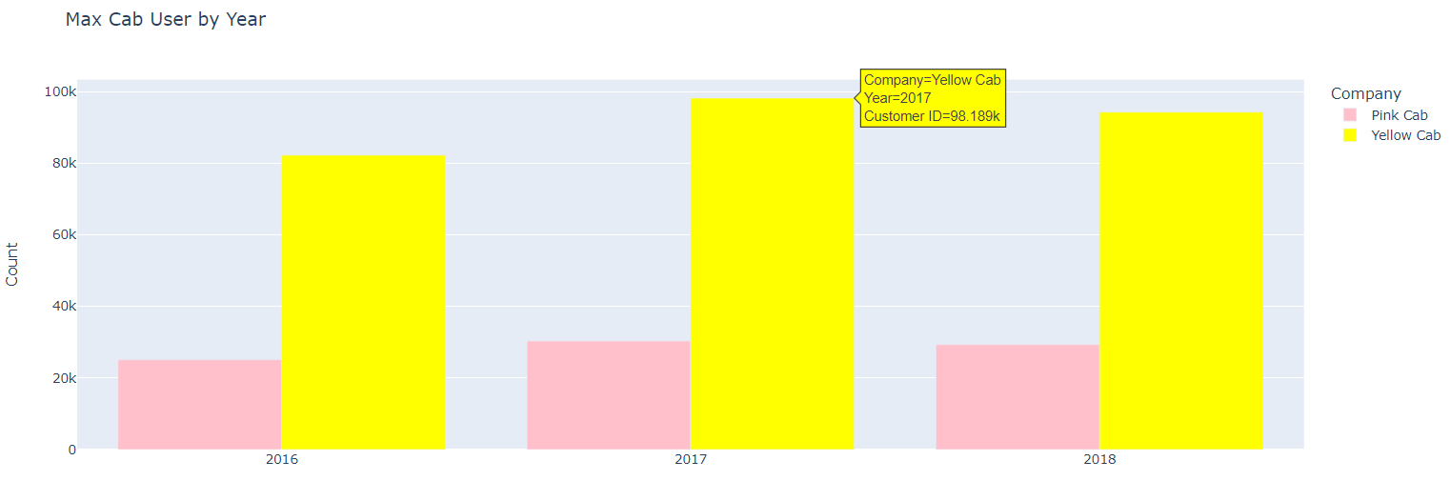
Key Insights Which company has the maximum cab users at a particular period?
Based on year, Yellow Cab significantly surpasses Pink Cab since 2016.

Slide 7
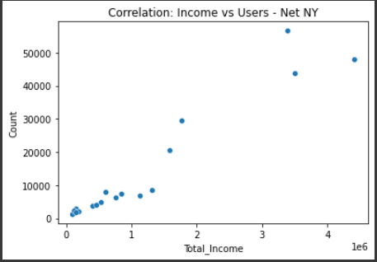
Key Insights Does margin proportionality increase with the number of customers?
Net of New York (outlier), we can see that Total Income is positively correlated with the number of Users.

Slide 8
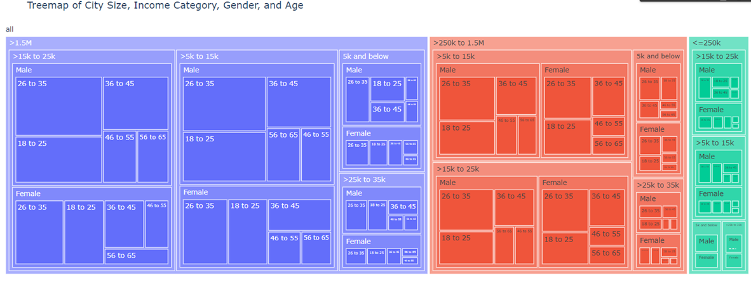
Key Insights What are the attributes of these customer segments?
A city’s population size dictates the number of cab users (i.e. the larger the city, the larger the number of cab users.
Most users have an income of >5K to 25K and generally dominated by Male users.

Slide 9
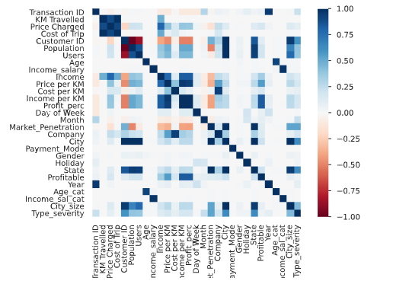
Key Insights What features are correlated?
Income from cab rides from large cities are positively correlated.
Population and Market Penetration are somewhat negatively correlated.
Income per KM and Income_salary is positively correlated

Slide 10
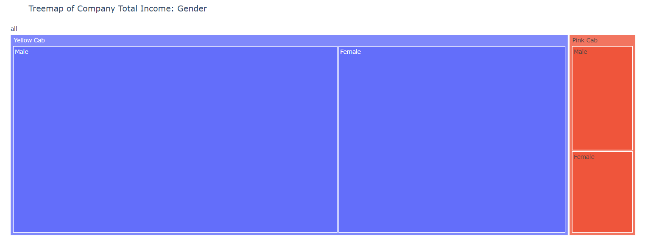
Hypotheses
Male users drive Total Income for both companies: True

Slide 11
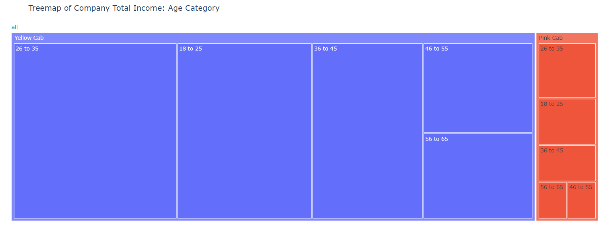
Hypotheses
The age of users is the same for both companies in terms of Total Income contribution: True

Slide 12
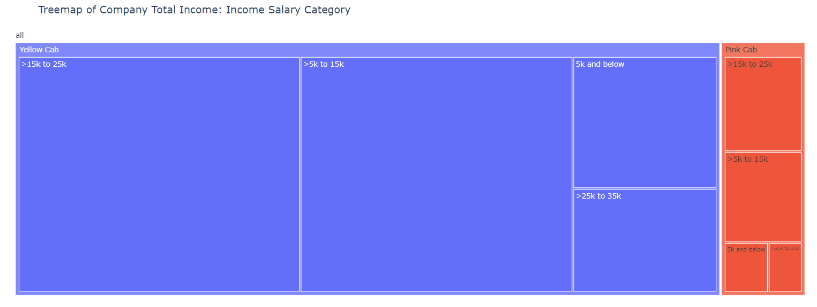
Hypotheses
Those in the lower income bracket (>5k to 25k) contribute the bulk of Total Income: True

Slide 13
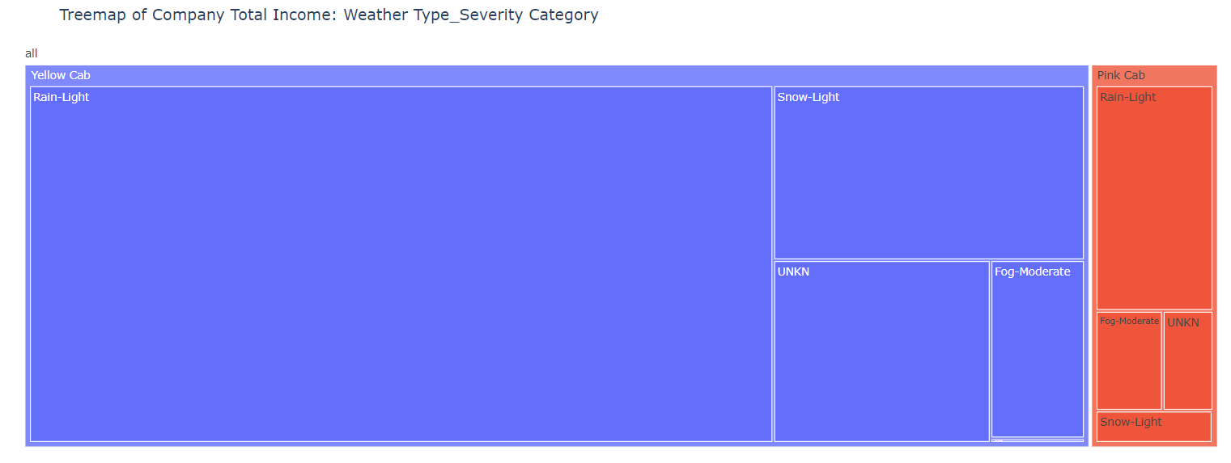
Hypotheses
Users tend to use cabs when there is rain and is profitable: True as users ride cabs during light rains and such rides are profitable.

Slide 14
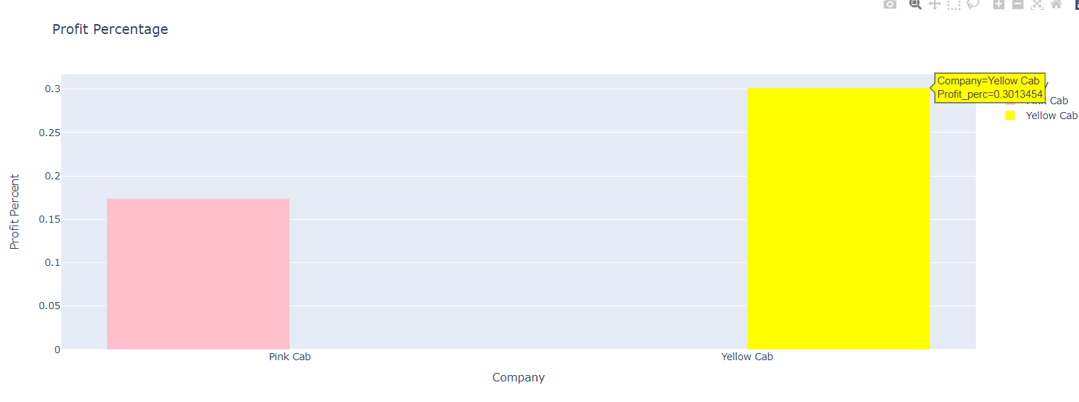
Hypotheses
Profit percentage is different for both companies: False as Yellow Cab’s profit percentage is at 30%

Slide 15
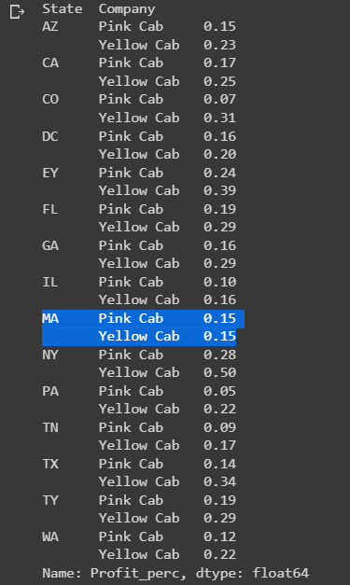
Hypotheses
There are cities where Pink Cab is at par with Yellow Cab in terms of profit percentage: True as both companies yield the same profit percentage in the state of Massachusetts.

Slide 16
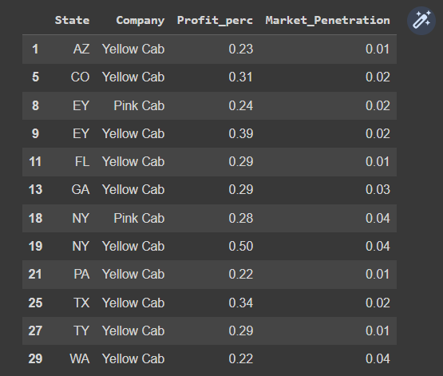
Hypotheses
There are still opportunity areas (cities) for Yellow Cab that can be improved given the low market penetration and above-average profitability percentage: True as the states of AZ, CO, EY, etc. have below average market penetration but above average profit percentage.

Slide 17

Hypotheses
There is an area (city) where Yellow Cab performs better in terms of Market Penetration and profitability percentage: True the state of California is a sweet spot for Yellow Cab.

Slide 18
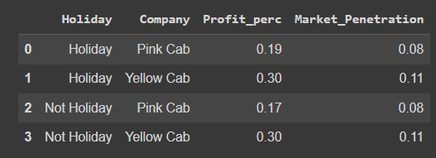
Hypotheses
The profit percentage for holidays is the same for non holidays: False as the profit margins are negligible for users riding on holidays versus non holidays.

Slide 19
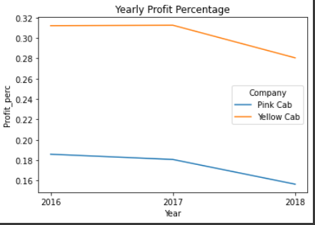
Hypotheses
The decrease in profit percentage is systemic and affects both companies: True

Slide 20
Recommendation
We recommend the following for XYZ:
Option A: Fully invest in Yellow Cab given its profitability, market share, and margins
Option B: Partially invest in Yellow Cab for a niche market that is performing above par (high market share with above average profitability percentage) which is California. From there, XYZ can slowly adapt to changes in the market and reevaluate its investment strategy for future expansion.

Slide 21
Thank You

