Slide 1
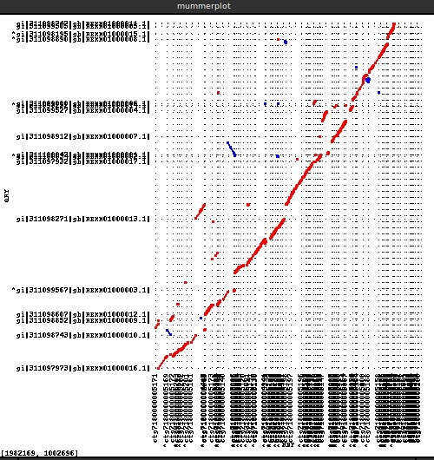
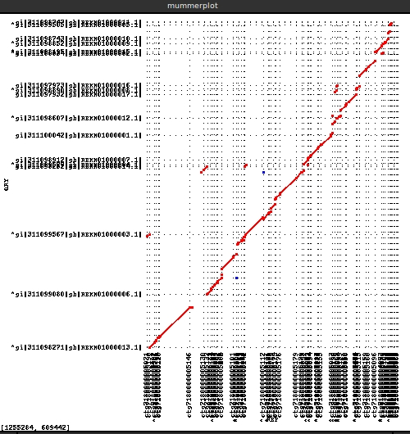
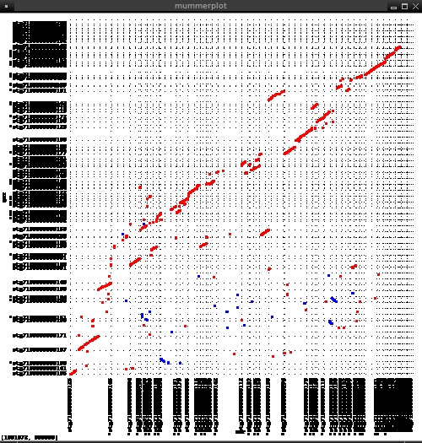
Unmapped vs Downei Reference contigs
Mapped to Downei vs Downei Reference contigs
MUMer plots
Mapped to Downei vs unmapped contigs

Slide 2
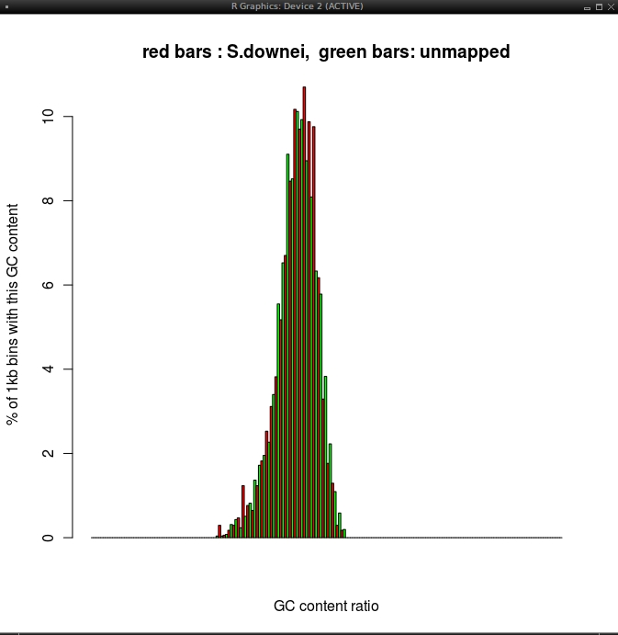
GC content calculated on
1000bp sliding window

Slide 3
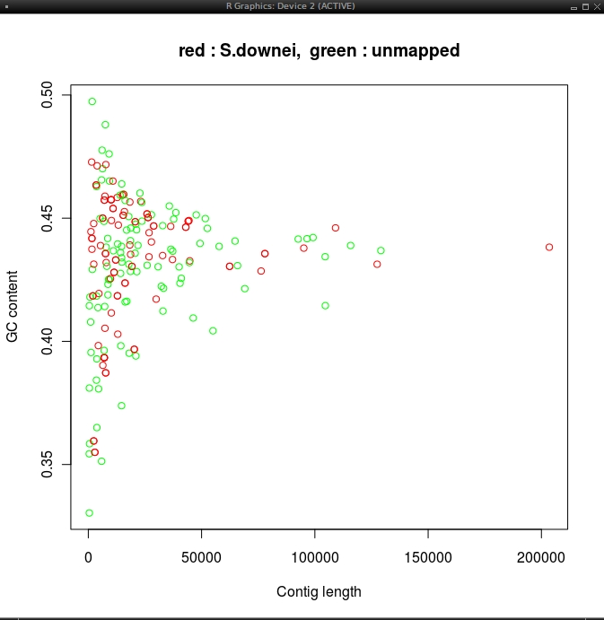
GC content VS contig length
GC content is calculated along the length of the entire contig

