Slide 1


Path planning algorithm for cluttered environments using computational geometry approaches
Mid Term Review
Submitted by : Shreyash Patidar
[ME18B074]
Guided By : Prof. M. Ramanathan

Slide 2
Problem Statement
The project work aims at creating a new algorithm in Path Planning using Computational Geometry approaches
This work involves designing a new data structure to represent nodes and obstacles, and building graphs to handle obstacles in the cluttered environment more efficiently.
The aim is to exploit the concepts of Computational Geometry to handle the geometry of obstacles more effectively, and at the same time use elliptical approximations to address the problem of higher Complexity of Geometry based algorithms.

Slide 3
Dynamic
3D
Convex Hull/ Voronoi Diagram
Environment
Robotics
Computational Geometry
Cluttered
Map Building
Path Planning
Global
Local

Slide 4
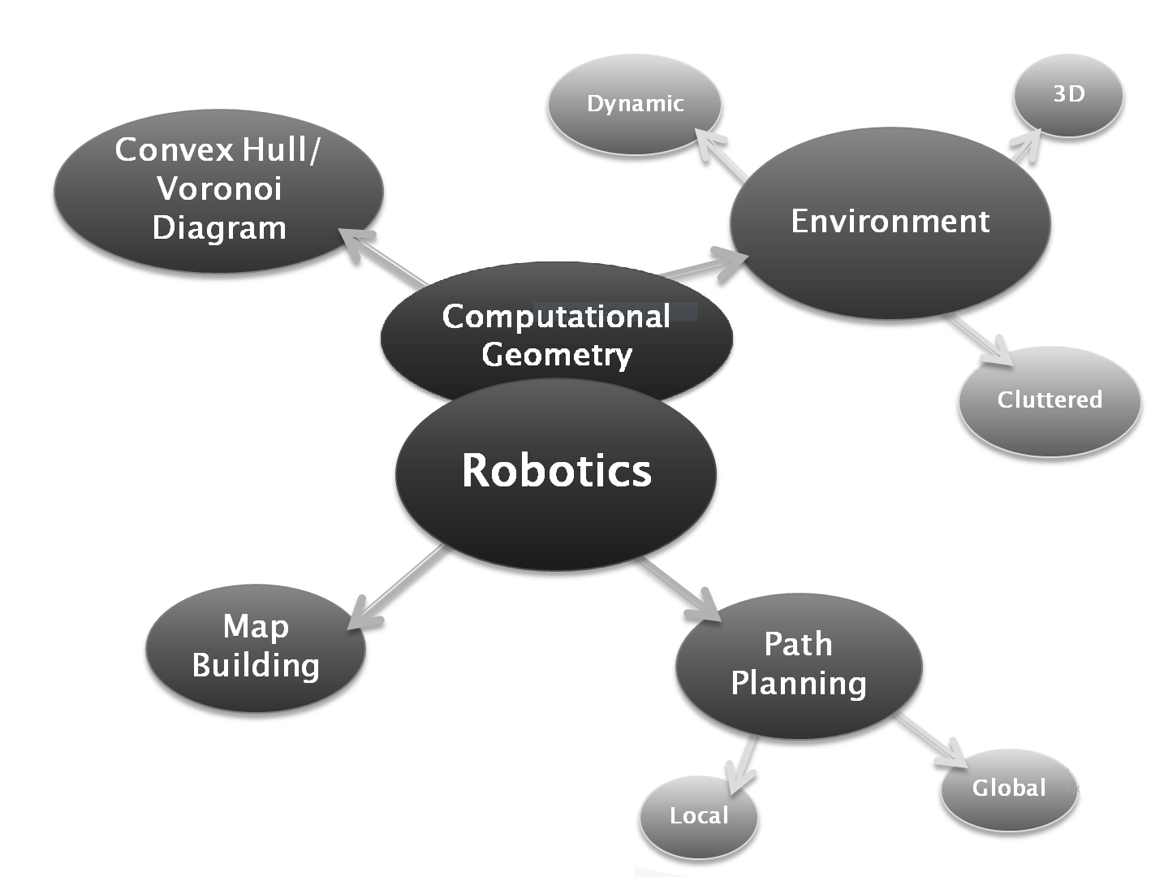


Slide 5
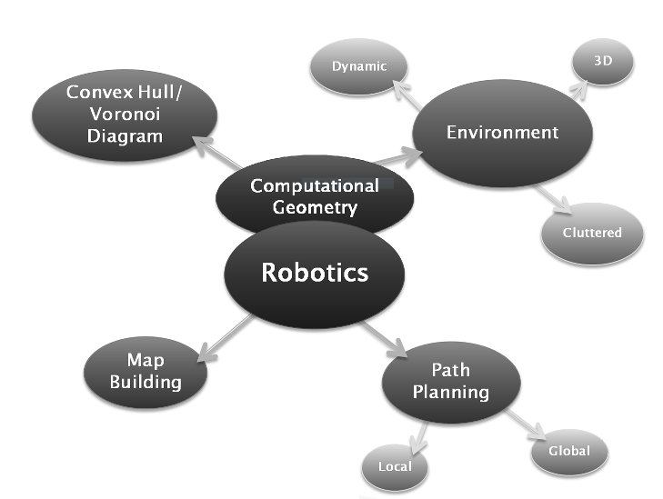
Progress so far…
Obstacle pairs as quad representation
Current Algorithm
Local Voronoi Diagrams
Tangent based test to identify nearest neighbours

Slide 6
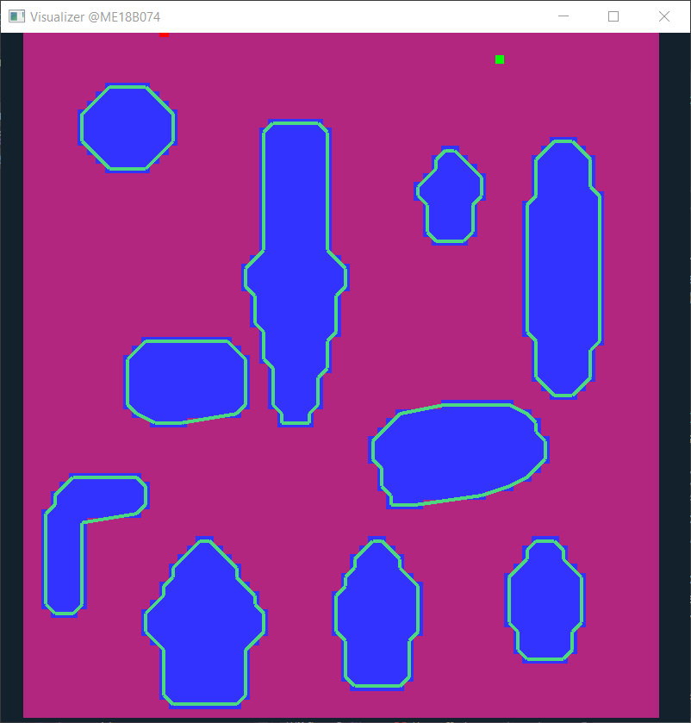
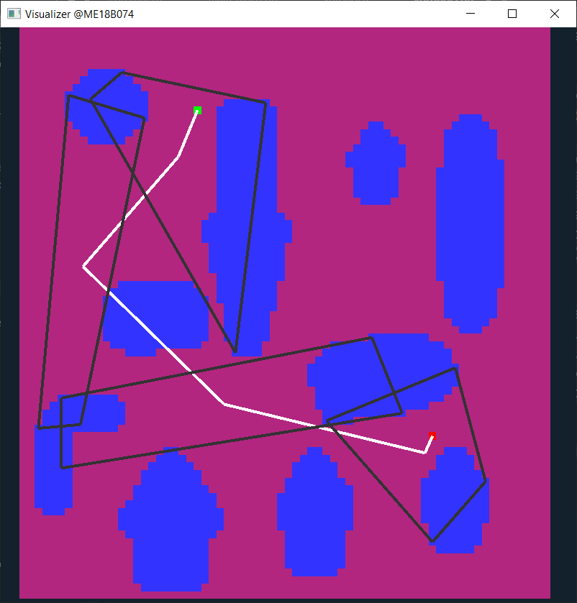
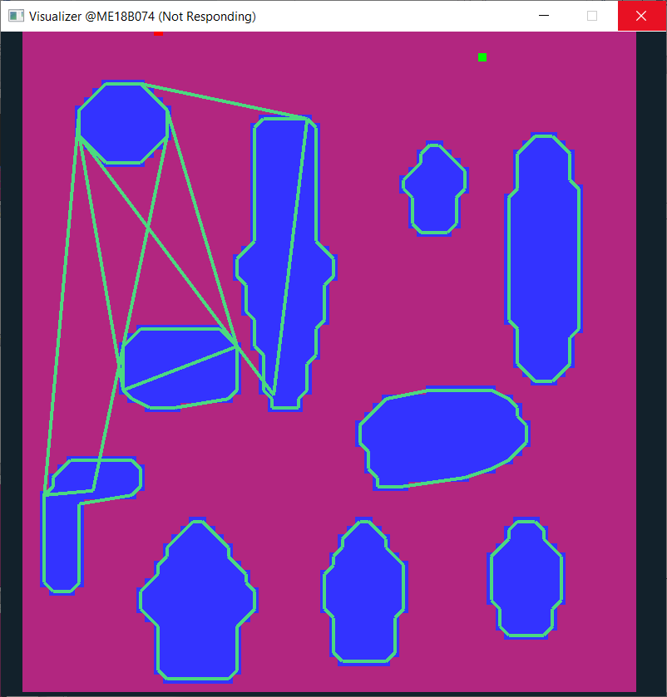
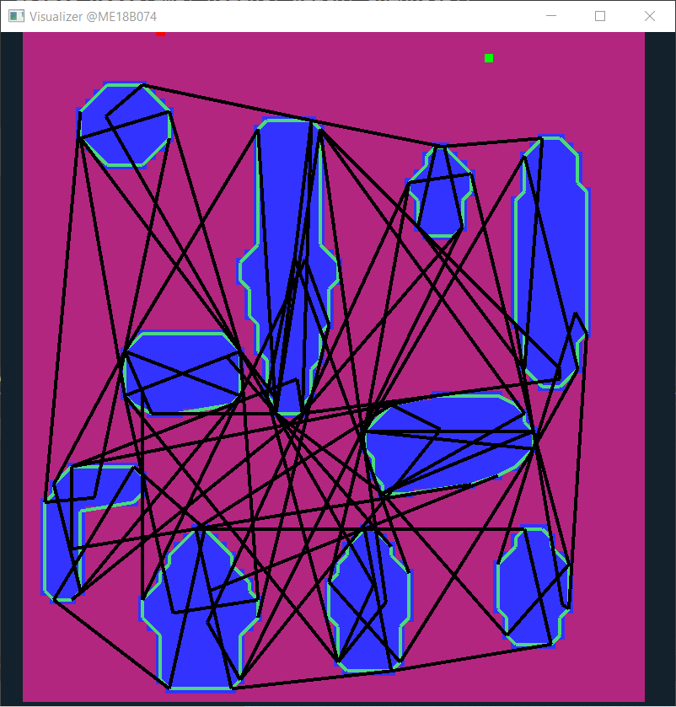
Algorithm
Locating obstacles and storing as polygons / ellipses
Finding neighbour pairs
Path search in this quad map
Graph building with quads as nodes

Slide 7
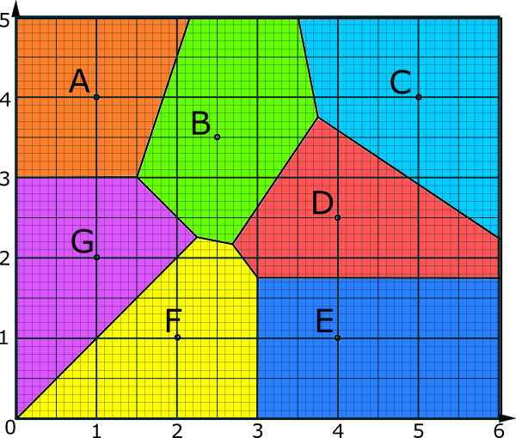
Nearest Neighbours
Do two given polygons share a voronoi edge?
Which polygons in a given map shares voronoi edge?
1
2
5
7
If a robotic agent is moving around obstacle 1; its path around that location will be influenced only and only by obstacles 2, 5 and 7
https://www.transum.org/Maths/Activity/Graph/VoronoiDiagram.asp

Slide 8
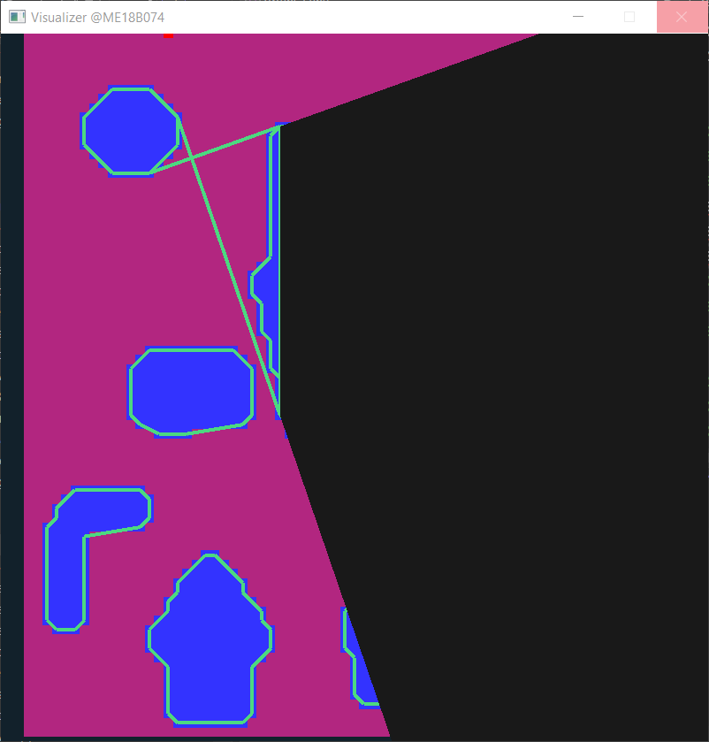
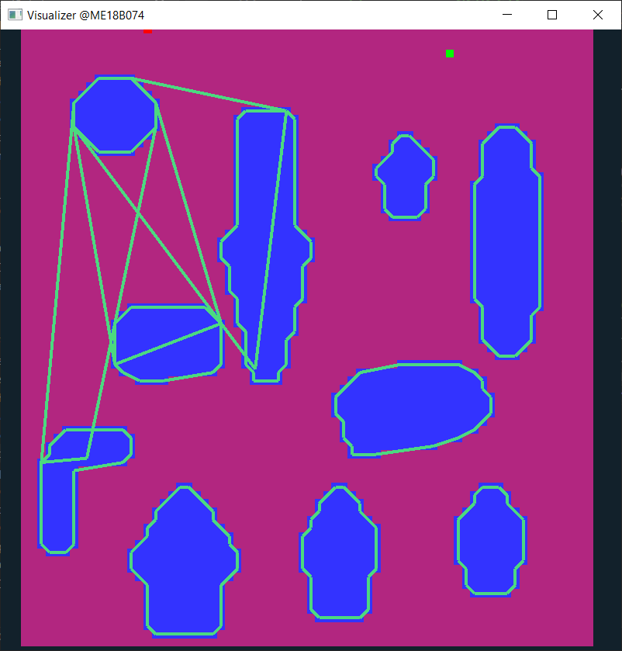
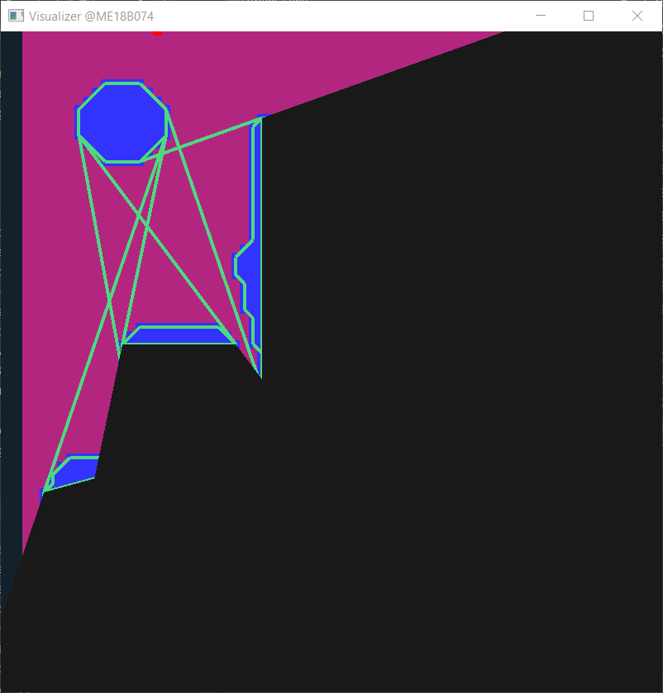
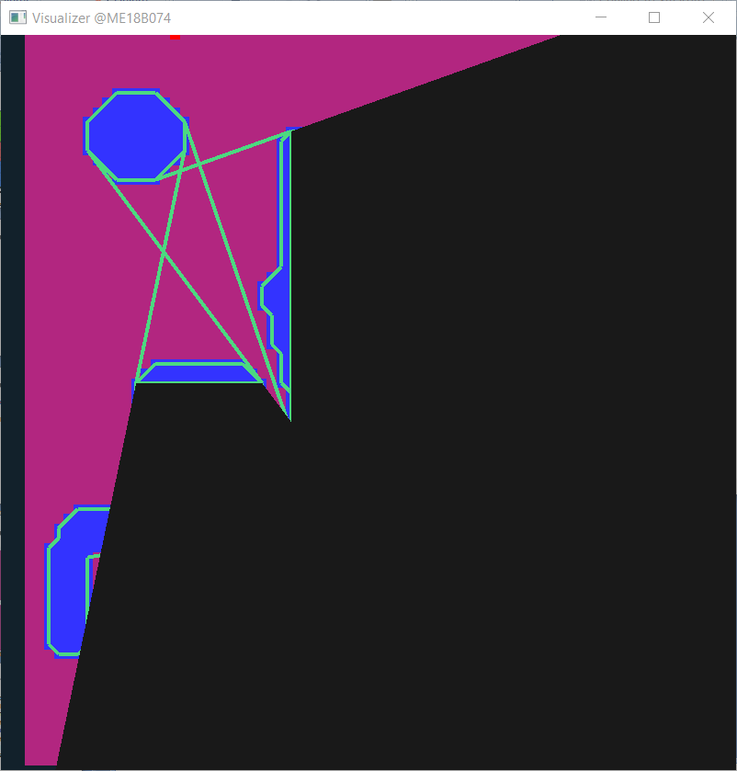
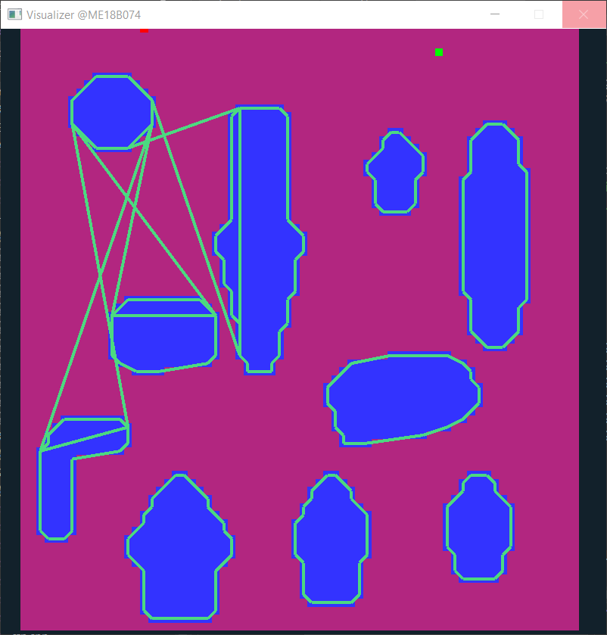

Checks to Identify Nearest Neighbours

Slide 9
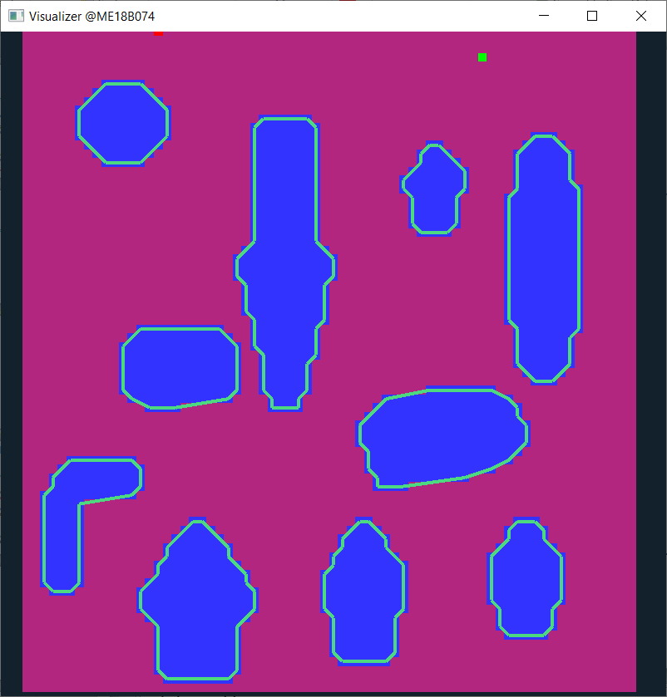
Checks to Identify Nearest Neighbours
Check-list
1
3
2
1
5
3
4
5
2
6
6
7
4
8
9
9
7
8

Slide 10

Quad Data Structure

Slide 11
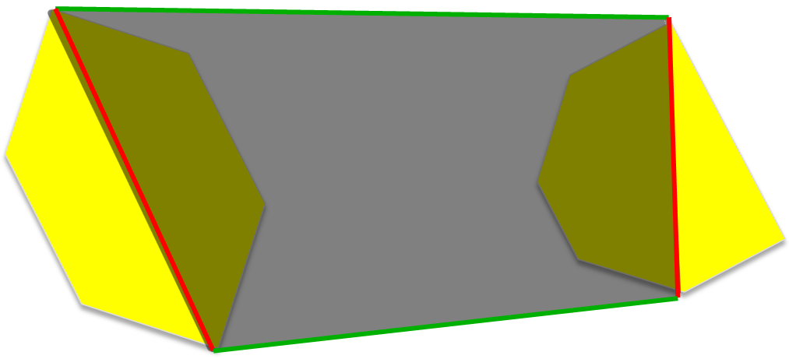
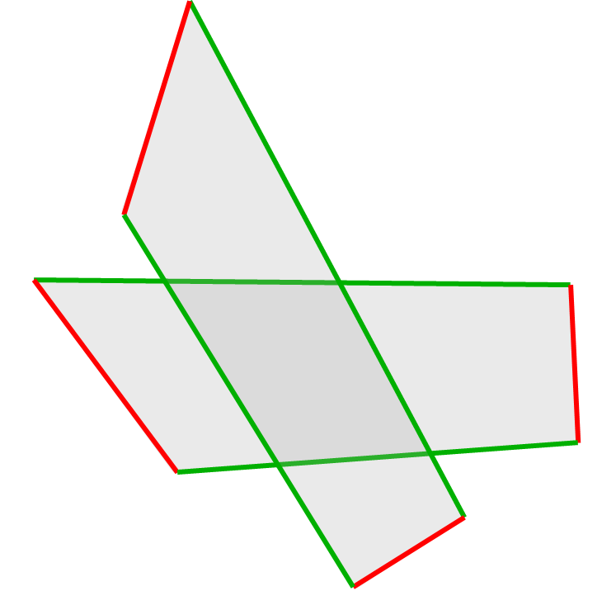
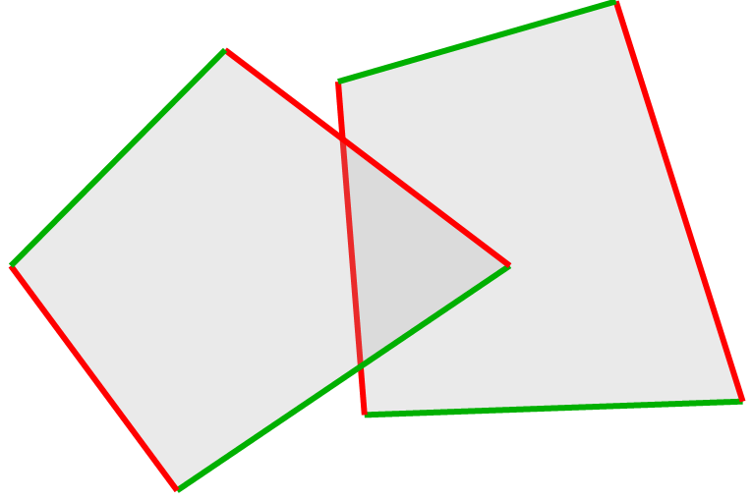
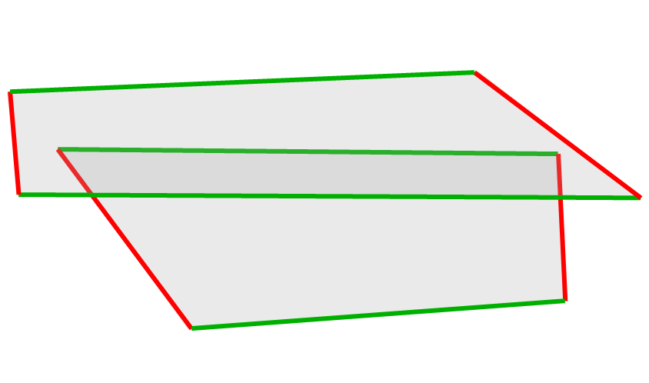
Quad Data Structure
Intersection Rules
Rules:
Robot can enter/exit this quad from any point on green line.
It can never cross /enter/exit from red line
Local path inside this quad is determined by the geometry of these 2 polygons
Can pass through quads
Can pass through quads
Cannot pass through quads
Fig : Representing obstacle maps as a collection of quads

Slide 12
Path Search
The obstacle map is then represented as a collection of these constrained quads.
Path is first searched with these quads as nodes.
Later local paths inside these quads can be computed keeping geometry of corresponding obstacle pair in consideration.

Slide 13
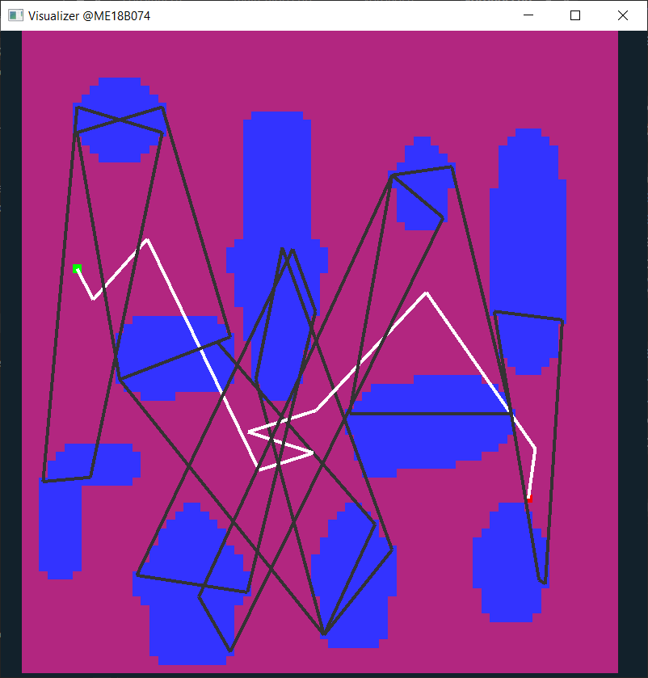
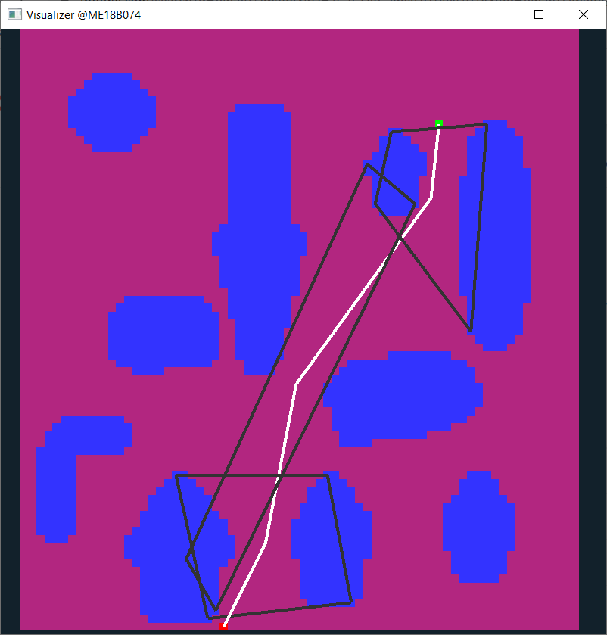
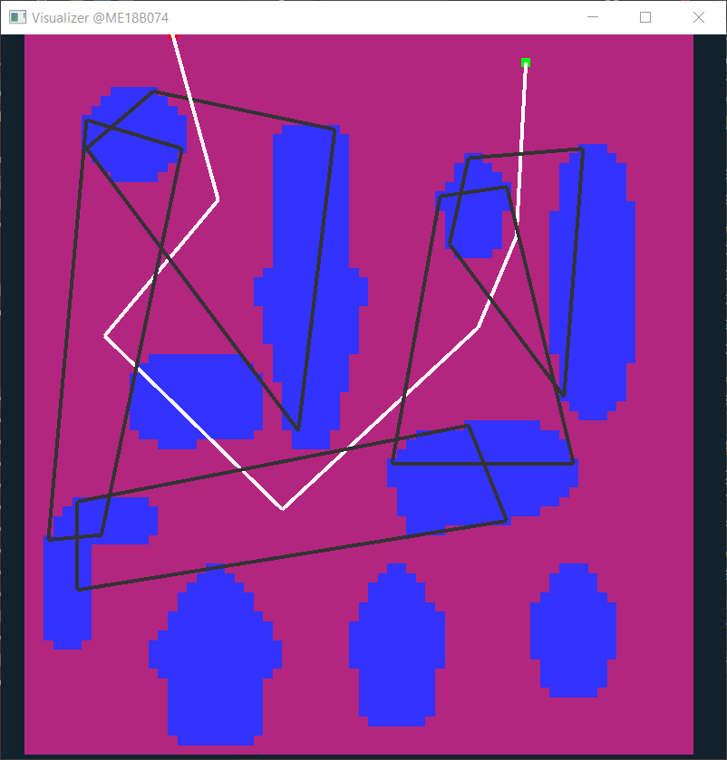
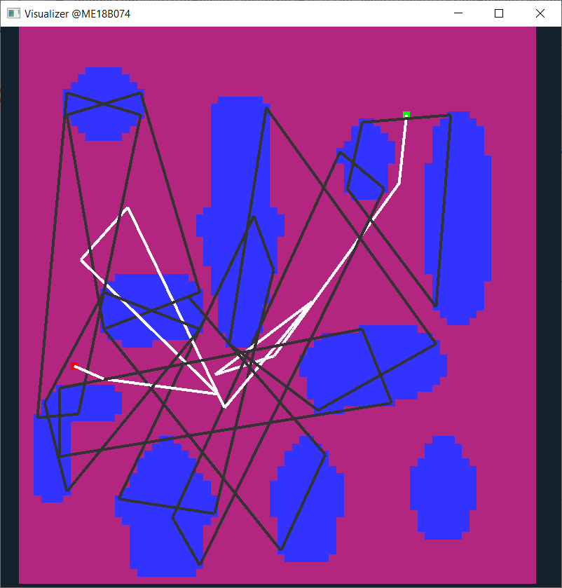
Results

Slide 14
Results
A bare minimum and functional algorithm is ready which considers obstacles as polygons (no approximations) and not ellipses.
The current version of the coded algorithm is not optimized to its full potential, and thus it doesn’t guarantee significant accuracy.
But it acts as a proof of concept and validates the proper functioning of nearest-neighbours and quad data-structure part of the algorithm.
The quad-ranking strategy needs to be thought of to eliminate unnecessary back-and-forth turns in the planned paths.
There are certain quads, which get covered up by 2-3 other quads as a group. This redundancy needs to be resolved to further speed up traversals.

Slide 15
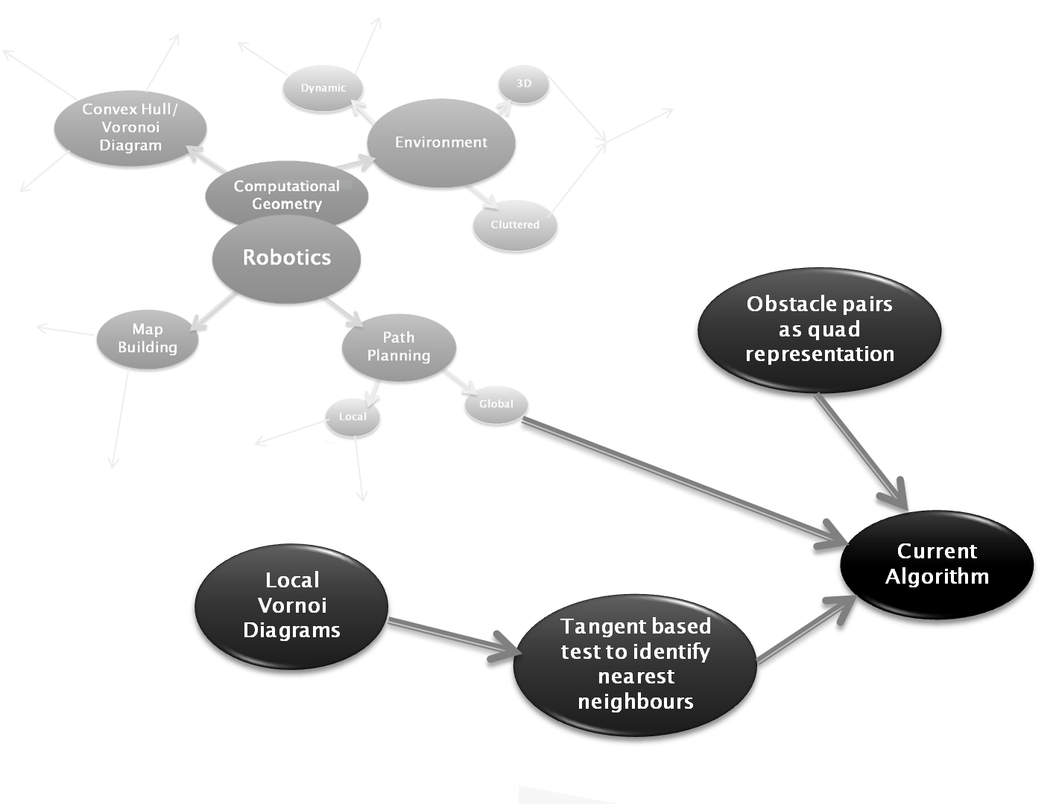

Slide 16
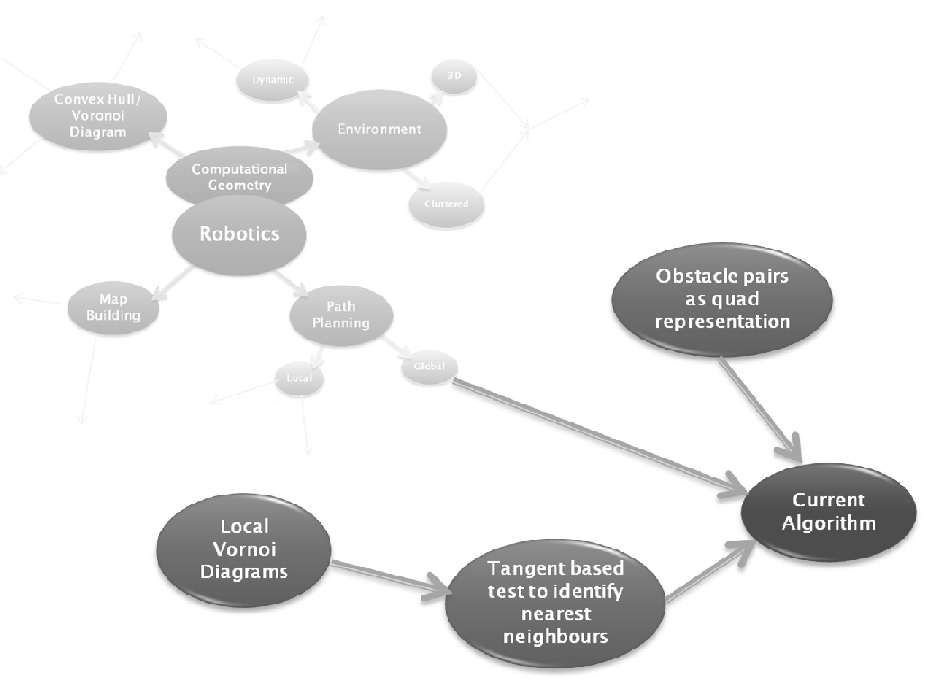
To be done…
Approximating obstacles as ellipses
Current Algorithm
Quad ranking and heuristics
Extending to 3D environment

Slide 17
Timeline
Jan 2023 – Finish till Elliptical approximation
Feb 2023 – Fine tune 2D algorithm and optimize it to full potential.
March 2023 – Extending it to 3D environments
April 2023 – Further fine-tuning and converting to ready-to-use format/package

Slide 18
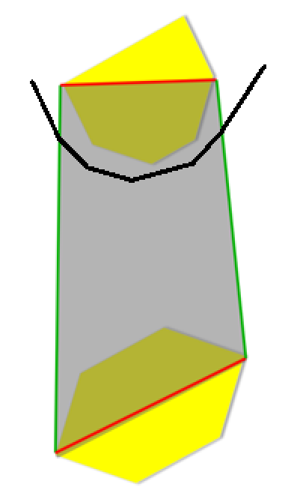
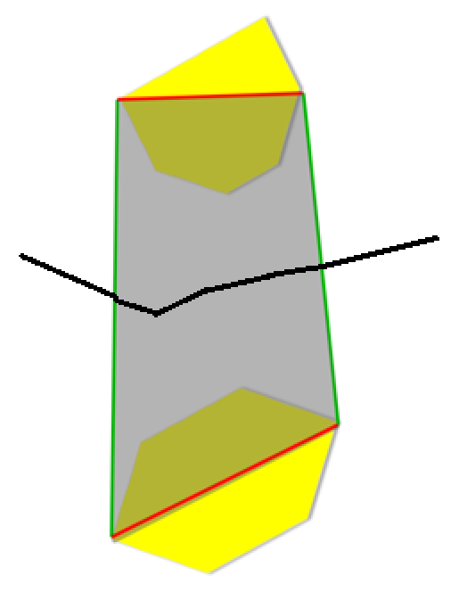
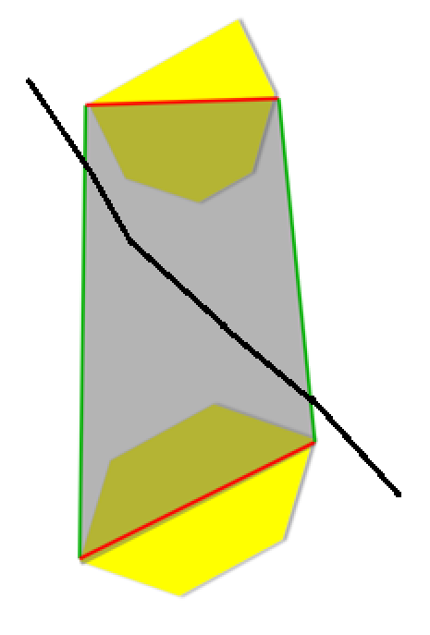
Wall Follower
Distance maximization
Longest uninterrupted path

Slide 19
THANK YOU!

