Slide 1

Path Planning Algorithm for Cluttered Environments using Computational Geometry Approaches
Final Review Presentation
Shreyash Patidar [ME18B074]
Department of Mechanical Engineering
(IDDD Robotics)
Guided by: Dr. Ramanathan M
IIT MADRAS
May 17, 2023
IIT Madras
Final Review
1
Notes:
// Title Page

Slide 2
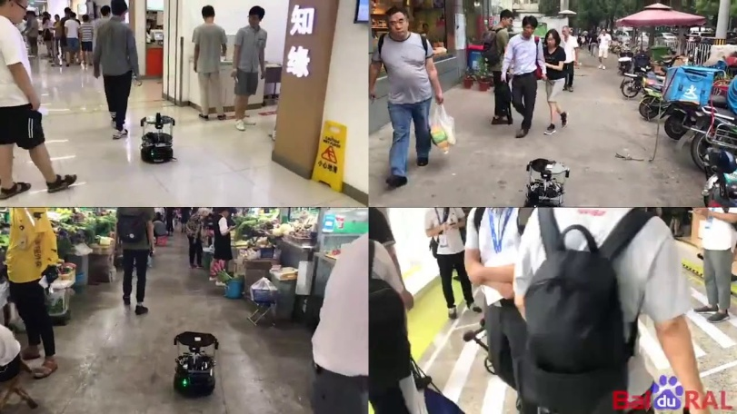
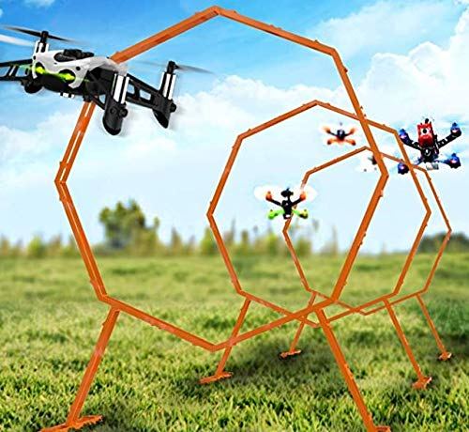
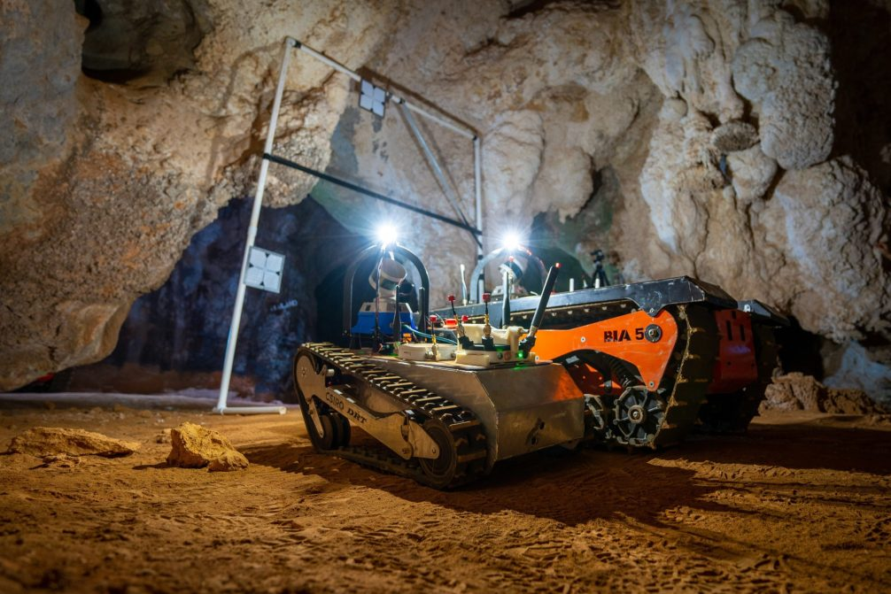
Problem Statement
The project work aimed at exploring the possibilities of creating new light-weight Path Planning algorithms using Computational Geometry approaches.
Main focus area was to optimize the algorithm for cluttered environments or tight spaces where obstacle geometry plays a significant role.
Computational Geometry is used as a tool to handle geometries well and elliptical approximations(constraining the order of accuracy) are made to improve computational time and performance of algorithm.
IIT Madras
Final Review
2

Slide 3
Problem Statement
Key problems worked out :
Approximation of obstacles as ellipses within accuracy limits.
Geometry-based checks to filter out "nearest-neighbours" obstacle pairs.
Creating a new “quad” data structure -> data handling, introducing movement constraints, intersection rules, heuristics and importance functions for graph search
Graph search and post-processing of planned path.
Extending the algorithm to make it compatible with 3D environments.
IIT Madras
Final Review
3

Slide 4
Literature Review (Existing Algorithms)
Category | Description | Algorithms | Pros and Cons
Bug algorithm | Go towards goal direction, if any obstacle is encountered: follow its boundary till robot comes back to initial goal line. | Bug 0 | Can get stuck in loops
 |  | Bug 1 | If goal is reachable; guarantees the path. Otherwise reports failure in finite time.
 |  | Bug 2
Uninformed Search Algorithms | Graph based search only on the basis of cost functions of explored nodes and paths | Depth First | Returns optimal path. It can take more time to return first feasible path.
 |  | Breadth First
 |  | Dijkstras | More memory requirement. Needs to store costs to each node.
Informed Search Algorithms | Heuristic based searchs, keeps a rough sense of direction and greedily explores towards goal node. | A* and its variants | Can return the feasible paths quickly. First path found need not be the best one.
IIT Madras
Final Review
4

Slide 5
Literature Review (Existing Algorithms)
Category | Description | Algorithms | Pros and Cons
Geometry Based Algorithms | Considering polygonal robot and obstacle geometries. Using edge and vertices data to analyze free space and plan paths | Vornoi algorithm Visibility Graphs Triangulation based algortihms | May become more computationally heavy. Returns exact solutions
Sampling based Algorithms | Samples points in free space. Tries to connect them and iteratively sample along newly connected edges. | RRTs, RDTs and variants | Work well for higher dimensional spaces. Neither optimal nor complete.
Characteristics of a good algorithm :
Must return optimal path in quickest possible time.
Must be memory efficient.
Must ensure a guaranteed path for a reachable goal
IIT Madras
Final Review
5

Slide 6
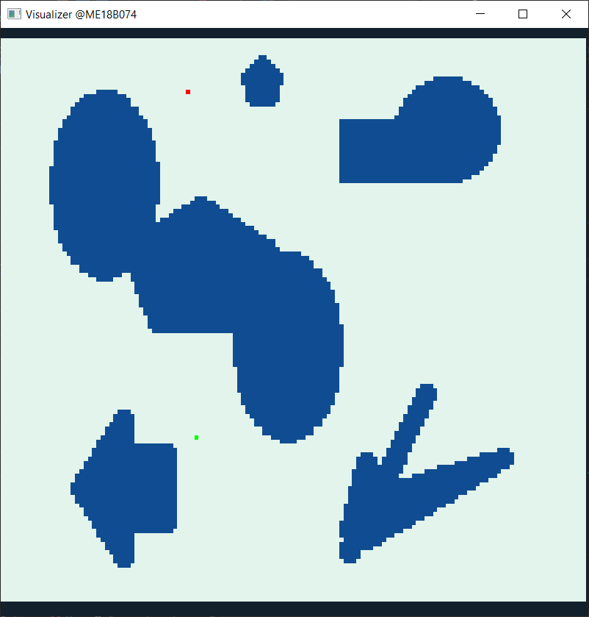
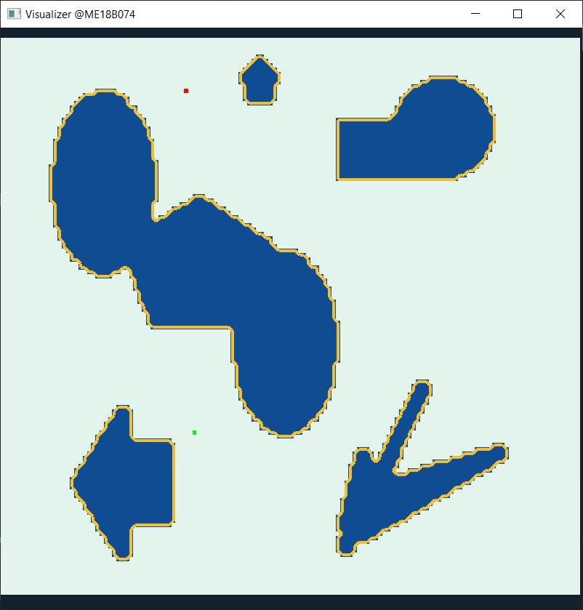
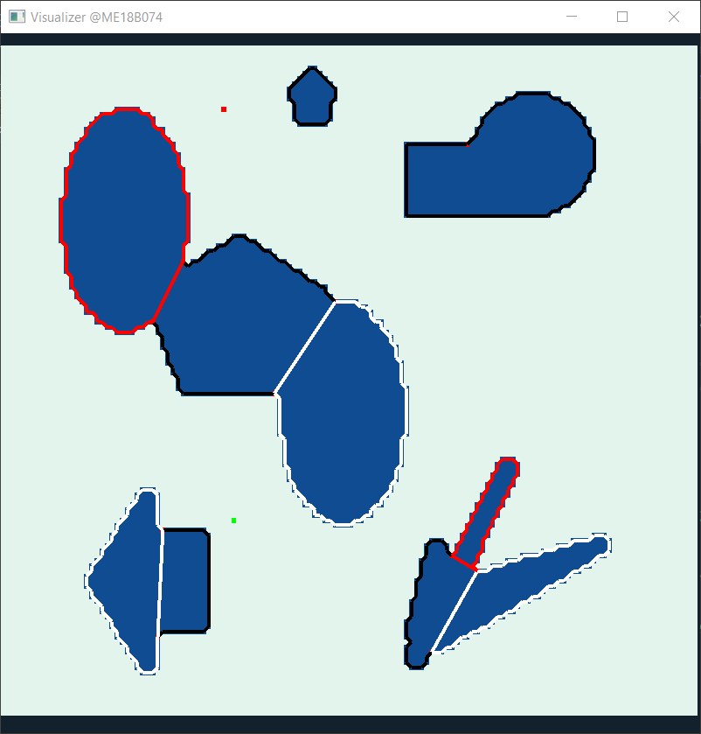
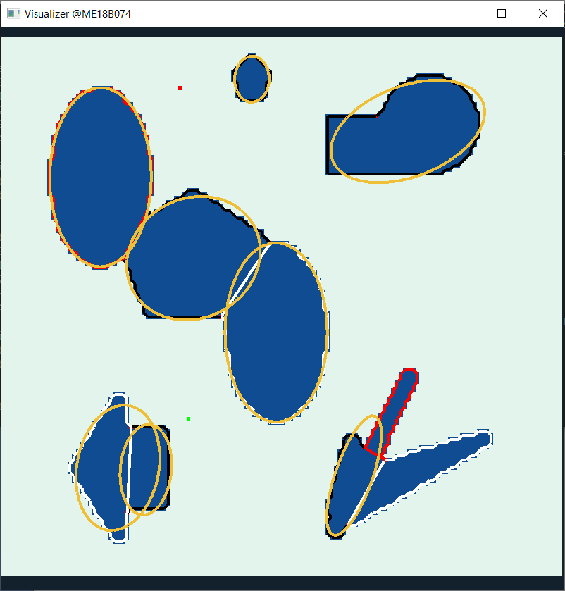

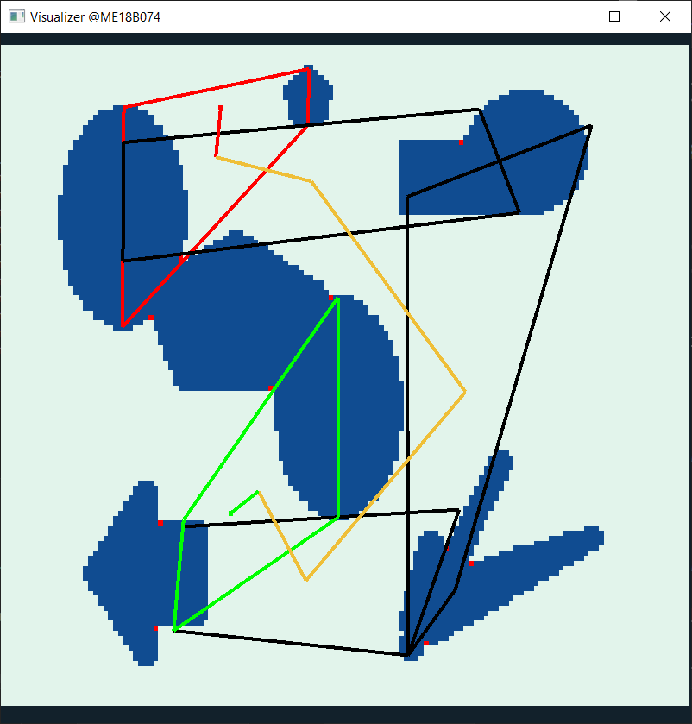

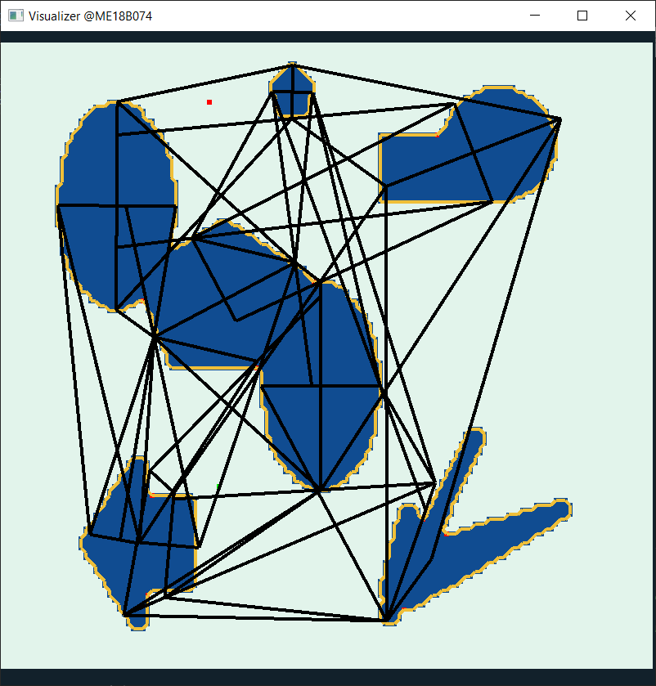
A peek into Algorithm
Input
Boundary Detection
Convex Clustering
Ellipse Approximation
Local Path Planning
Path Cleanup
Graph Search
Graph Building
IIT Madras
Final Review
6

Slide 7
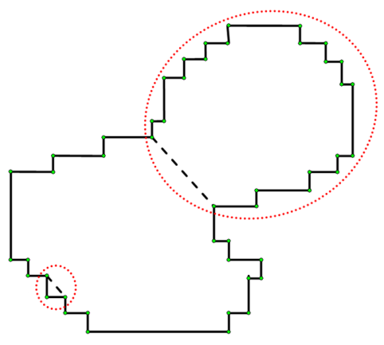
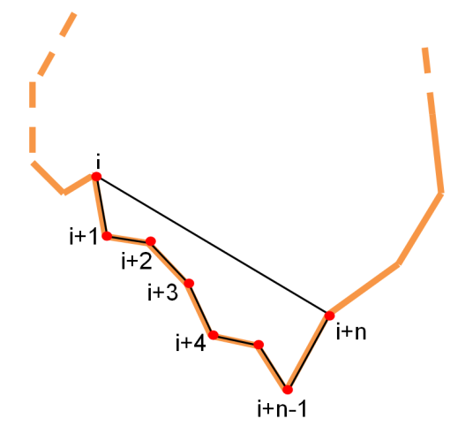
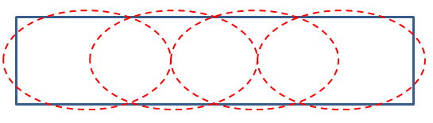
Elliptical Approximation
Convex Clustering
Dividing polygonal obstacle into multiple convex polygons, as ellipse fitting is more easier
Ear algorithm
Consecutive n-vertices of polygons are sampled. Area and (area/length of chord) ratios are used to divide polygons into convex polygons.
In first pass, ears of size 7-9 are chosen to eliminate pixel noise. In further passes, ears of size 3-5 are used to pin-point separation points.
Ellipse fitting on non-convex shapes after convex clustering
Convex clustering
i^{th} ear of size n+1
Ellipse fitting on convex shapes
IIT Madras
Final Review
7

Slide 8
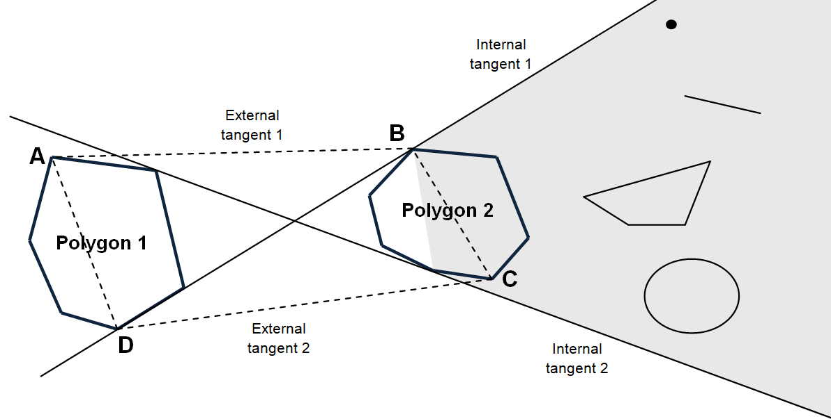

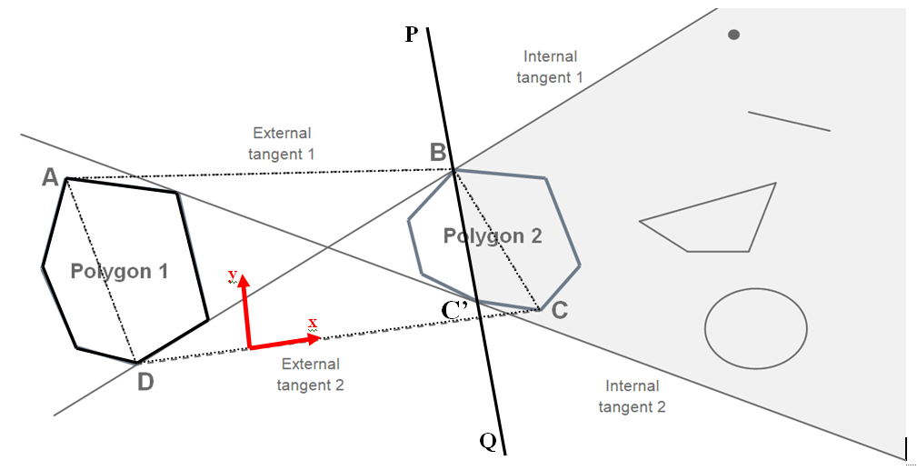
Nearest Neighbours
For a chosen polygon (polygon 1), any other polygon (polygon 2) shields all the features in the highlighted area such that any portion of its voronoi edge (in the voronoi diagram constructed for all the polygons as a whole) with polygon 1 will not lie inside the quadrilateral ABCD.
Nearest Neighbour test
IIT Madras
Final Review
8

Slide 9
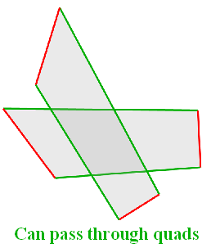
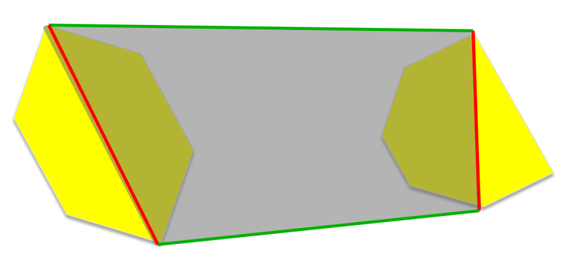
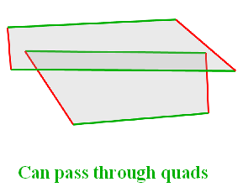
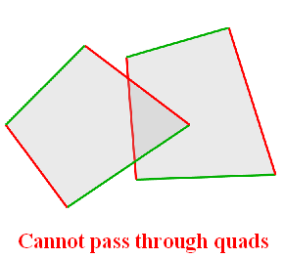
Quad Data-Structure
Free space between two nearest neighbours can be represented as a quadrilateral formed by the two common external tangent and corresponding chords in the polygons.
Constraints:
Robot can enter/exit this quad from any point on green line.
It can never cross /enter/exit from red line
Local path inside this quad is determined by the geometry of these 2 polygons
Intersection Rules :
Quad Representation
IIT Madras
Final Review
9

Slide 10
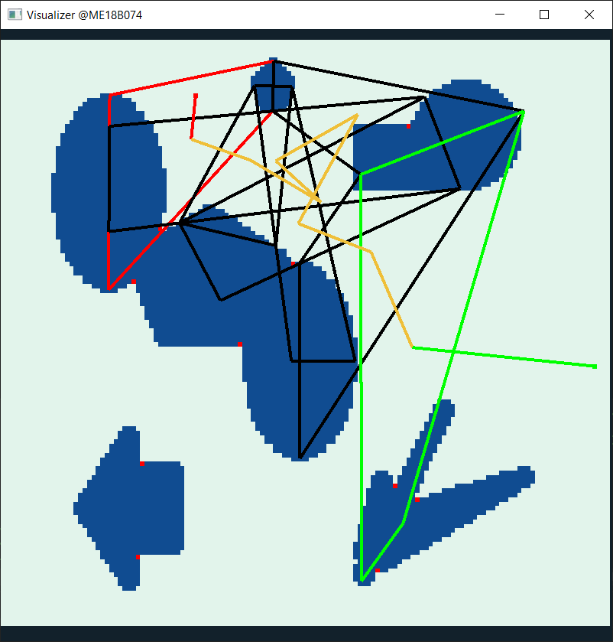
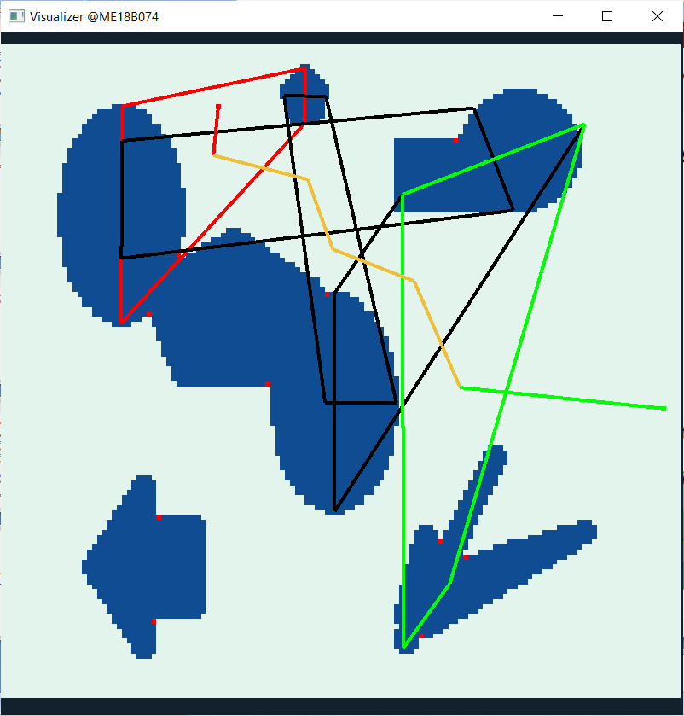

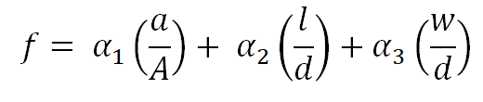
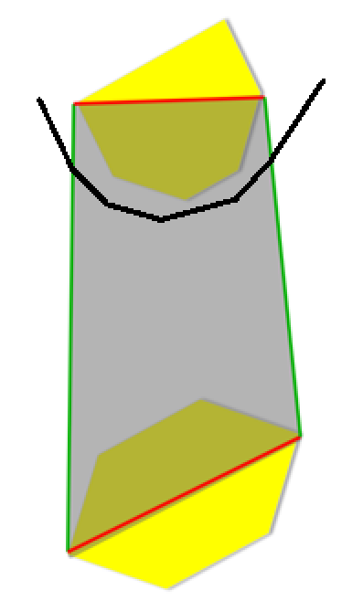
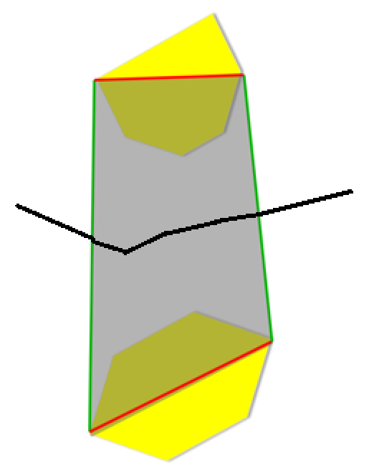
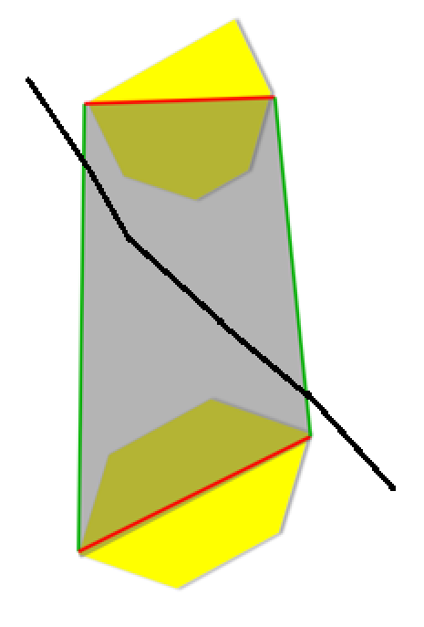
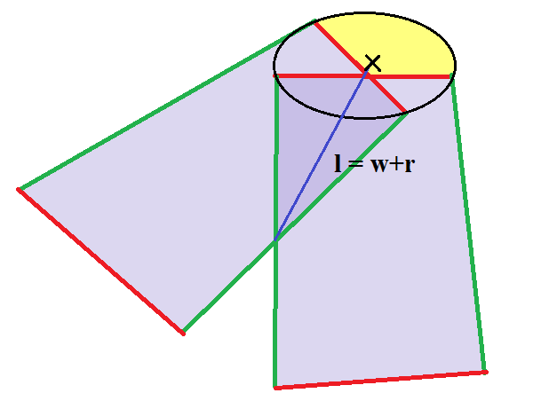

Graph Search and Path Post Processing
Importance function for a quad is given by
where,
a : estimated free area of quad
l : mean quad length; distance between corresponding obstacle centers
w : mean quad width
A : area of image frame
d : diagonal length of image frame
Cost function for crossing from one quad to
another
where,
s : size of robot(width)
w₀ = (l-r) : width of exchange zone
Path Post Processing
Wall Follower
Distance maximization
Longest uninterrupted path
Local Path Planning
IIT Madras
Final Review
10

Slide 11
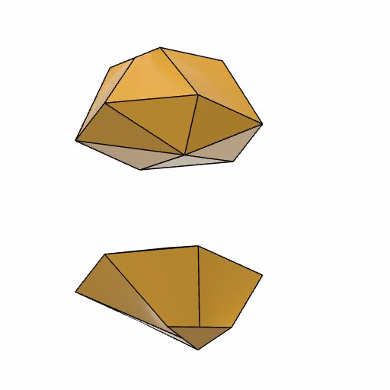
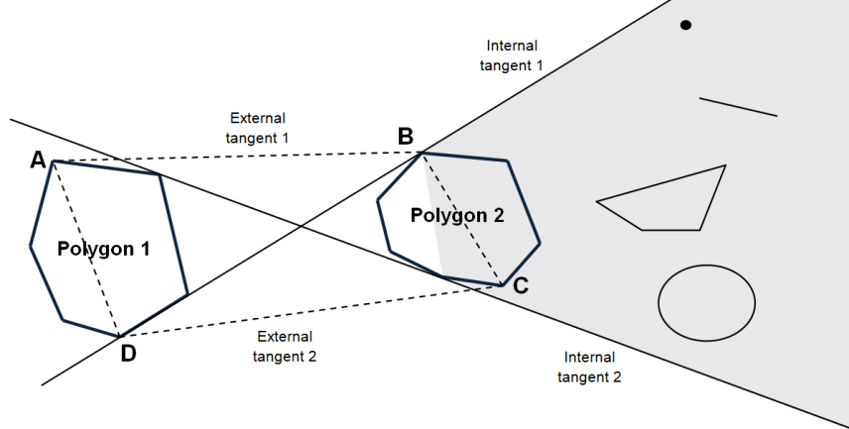
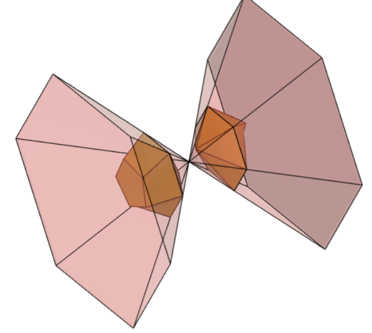
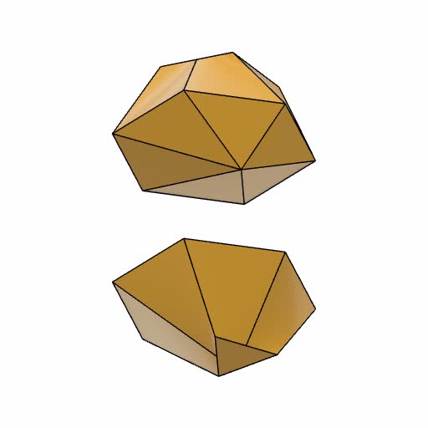
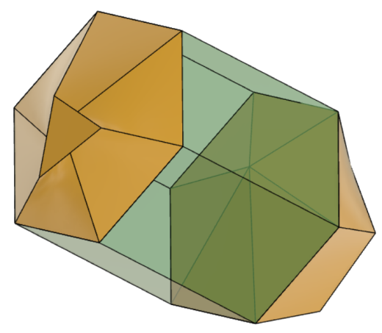
Translating idea to 3D
Nearest neighbour test
Quad Representation
IIT Madras
Final Review
11

Slide 12
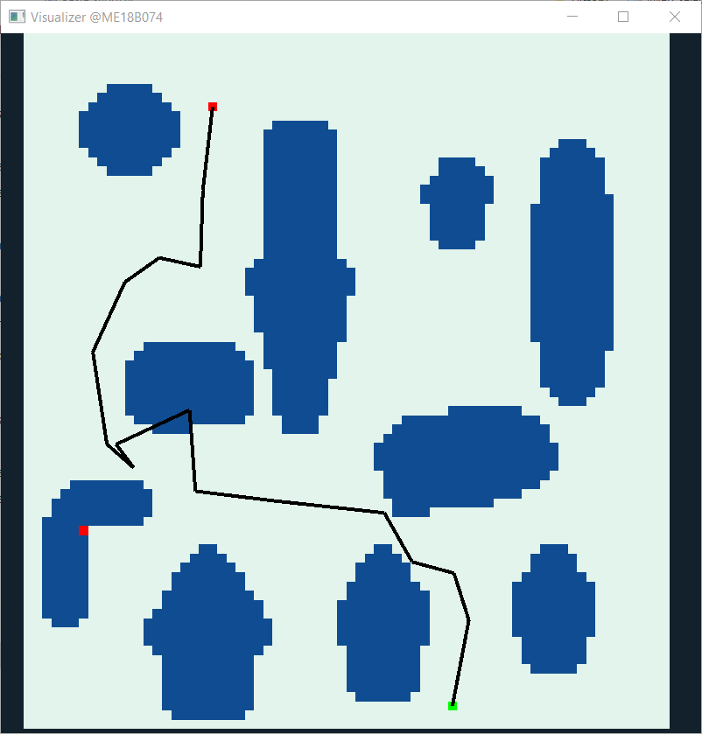
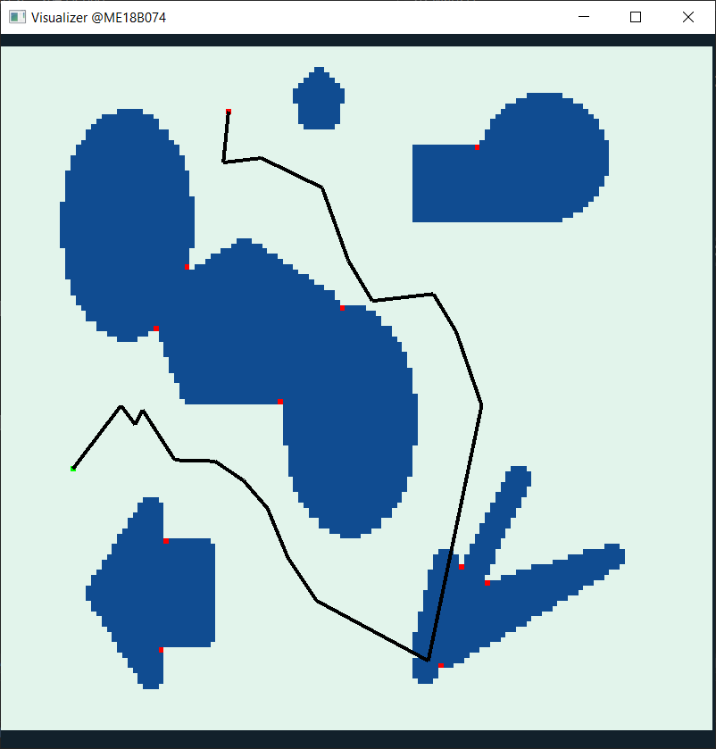
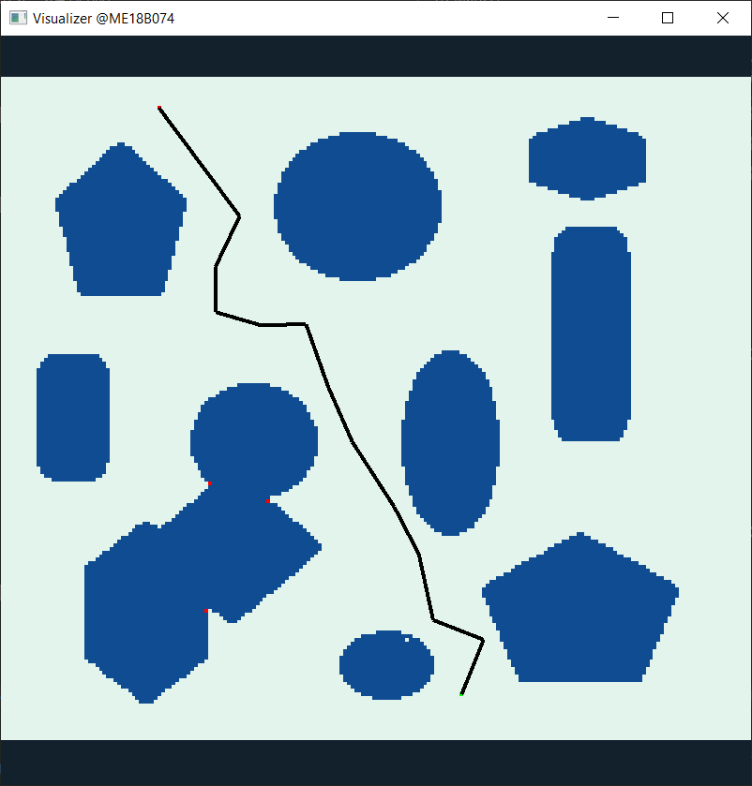
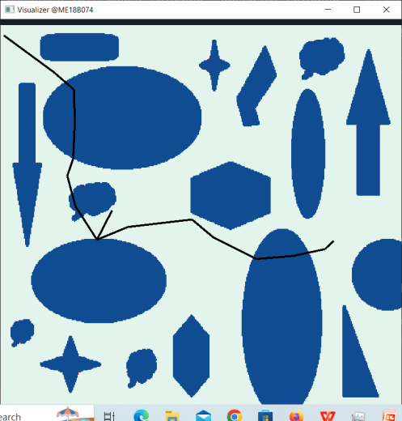
Results
Frame Size | Number of obstacles | Iterations | Configuration time (ms) | Average time per path search (µs) | Effective frame rate
 |  |  |  |  | Input @30fps | Input @60fps | Input @120fps | Input @240fps
70x76 | 10 | 255 | 26.6 | 6121 | 25.3 | 43.9 | 69.2 | 97.2
138x132 | 7 | 220 | 34.5 | 5847 | 25.5 | 44.4 | 70.5 | 99.8
207x182 | 11 | 232 | 66.5 | 6060 | 25.4 | 44.0 | 69.5 | 97.8
448x433 | 18 | 274 | 1234.1 | 14240 | 21.0 | 32.4 | 44.3 | 54.3
IIT Madras
Final Review
12

Slide 13
Conclusions
A quick-enough real-time path-planning algorithm is ready and functional, which returns a feasible path.
The elliptical approximation is a bottleneck in this algorithm, and the correctness of the planned path is highly dependent on the ellipse fitting operations.
"Exact tangent computation of ellipses is possible in near-constant time operations" was a claim made earlier during the project. But contrary to expectations, the computation is bit heavy. Hence, approximated tangents are computed to achieve similar performances.
Introduction of a new data representation – Quad structure was found feasible, and it makes the solution highly modular for subsequent kinodynamic planning and environment specific optimization.
Graph search and path post-processing operations are to be optimized for the shortest / quickest paths.
IIT Madras
Final Review
13

Slide 14
THANK YOU!
IIT Madras
Final Review
14

