Slide 1

Monthly Business Review
Dec. 11, 2025
LLC
Responsive Reliable Supportive

Slide 2
Agenda
Financial Overview - Glenn
KPI chart and tracking
Financial Forecast - Dave
Customer Service/Marketing - Matt
Action Items & Calendar Review - Laurie
CAR Update - Laurie
Risk/Opportunity - Dave
Add’l Discussion Points & Conclusion
Owner Meeting

Slide 3
Financial Review
Glenn Jones
LLC
Responsive Reliable Supportive

Slide 4
# Products Shipped
Oct / Nov | 2025
Shipped stocks in Nov |  | 253
Shipped stocks in Oct |  | 338
Shipped stocks in Sep |  | 238
4-Week Moving Average | Nov | 63
 | Oct | 85
AS products delivered | Nov | 0
 | Oct | 0

Slide 5
Credit Card Sales
Credit card sales for Nov 2025 | 71,694
Credit card sales for Oct 2025 | 64,391
Credit card sales for Nov 2024 | 219,366
Credit card sales for Oct 2024 | 149,189
Credit card sales for Dec 2024 | 122,023
YTD Comparison 1,917,913.66 (2024) v 1,483,604.54 (2025) | 77%

Slide 6
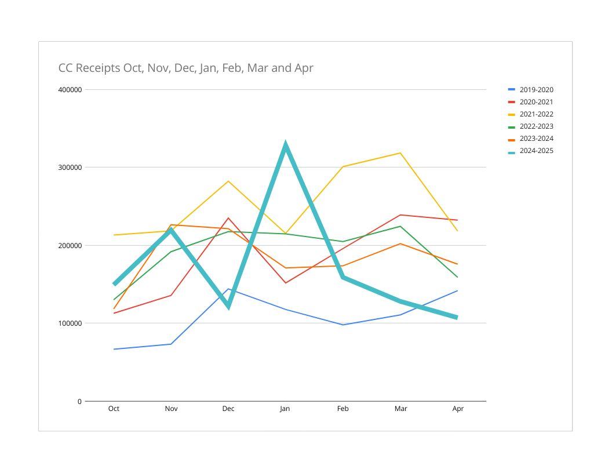

Slide 7
Combined Financial Highlights
Combined | Nov 2025 | Oct 2025 | YTD
Revenue | 143,964.3 | 200,480.85 | 2,244,966.88
Gross Margin | 33.63% | 53.69% | 38.21%
Net Income | -5,937.37 | 18,427.93 | -79,631.45
Net Margin | -3.84% | 9.43% | -3.55%
Non-recurring expenses included
See additional sheet for cash flow forecast |  | 263,622 end of Nov | 300,000 end of Dec

Slide 8
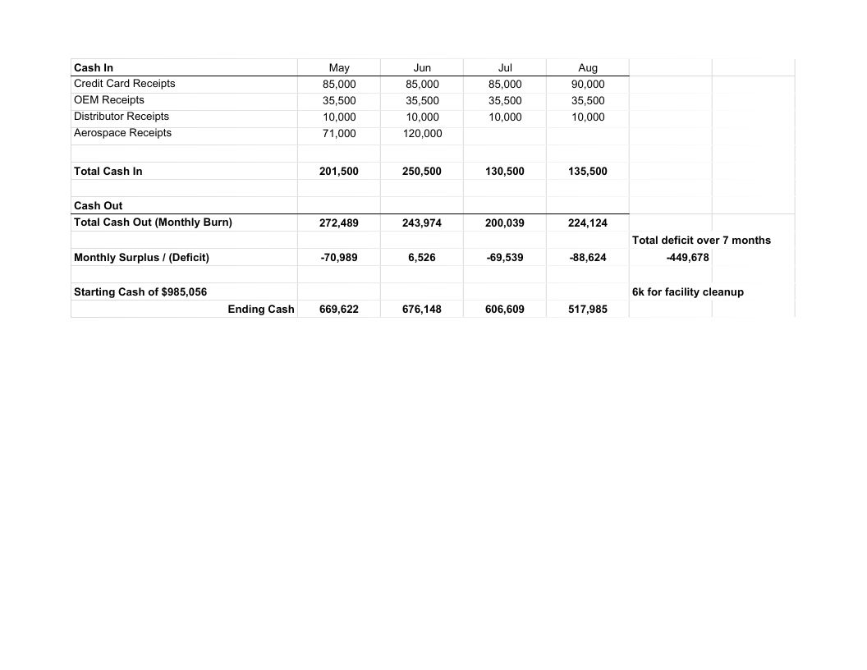
Cash Flow Projection May - Aug

Slide 9
AS Financial Highlights
AS | Sep 2025 | YTD
Revenue | 52,600.00 | 375,292.72
Gross Margin | 36.04% | 49.44%
Net Income | 16,439.27 | 157,125.44
Net Margin | 31.25% | 41.87%
Non-recurring expenses included
DDTC | 3,000.00

Slide 10
Quality Objectives PL1
Process | KPI | GOAL | 7/3/25 | 8/7/25 | 9/4/25 | 10/2/25 | 11/6/25 | 12/4/25
Sales | Year over year revenue growth | 5% | -62.08% | -70.13% | -65.61% | -65.32%
Sales | 12 month credit card sales growth | 5% | -16.55% | -11.31% | -12.18% | -9.4% | -15% | -22%
Inventory | Supplier’s Avg. Score | 90% | 90.65% | 92.9% | 95.07% | 95.19% | 95.8% | 96.08%
Production | Scrap rate | 1% | 8% | 0 | .89% | 0
Production | OTD | 90% | 0 | 0 | 11% | 27%
Production | Customer returns | 3% | 0 | 1 | 0 | 0 | 0 | 1

Slide 11
Quality Objectives PL2
Process | KPI | GOAL | 8/7/25 | 9/4/25 | 10/2/25 | 11/6/25 | 12/4/25
Sales | Year over year revenue growth | 5% | 100% | 100% | 100% | 44% | 44%
Inventory | Supplier’s Avg. Score | 90% | 93.97% | 94.13% | 93.53% | 93.71% | 93.76%
Production | Scrap rate | 1% | 0 | N/A | 2.5% | 0 | 13.7%
Production | OTD | 90% | 100% | N/A | 60% | 0 | 0
Production | Customer returns | 3% | 0 | N/A | 2.5% | 0 | 0
Production | First Article Approval | 80% | N/A | N/A | N/A | N/A | 100%

Slide 12
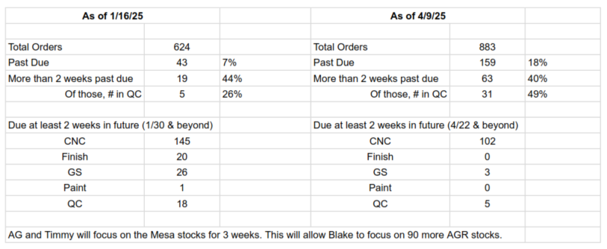
Better Focus on When Stocks are Due

Slide 13
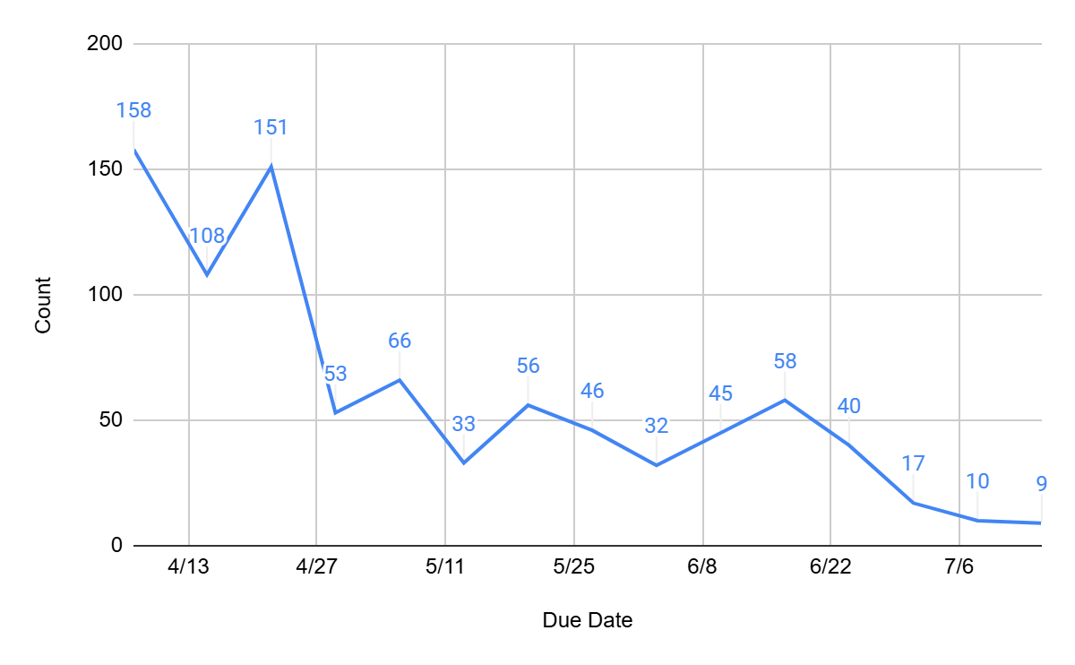
Number of Stocks Due by Week

Slide 14
Financial Forecast & Strategy
Dave Tandy
LLC
Responsive Reliable Supportive

Slide 15
Financial Forecast
Customer payables update/forecast
$1M LOC from South State Bank update - no change
Decision Points: no change
Grading & slab work - positive results from Yuma, verbal agreement from StrataG for Bandit Orders
New CNC - 1000+ units of 12” tube
Building Upgrades - discussion triggered at 500+ units of 12” tube
R&D Discussion
Methods
Equipment

Slide 16
Customer Service, Marketing & Sales
Matt Tandy
LLC
Responsive Reliable Supportive

Slide 17
Sales & Marketing Update
Customer Surveys Conducted - Oct & Nov
Customer Survey Average Score - __/50
Sales pipeline
PL1
Snowy Mountain Rifles
Montana Rifle Company
PL2
Vendor portals/approvals

Slide 18
Action Items & Calendar Review
Laurie Tandy
LLC
Responsive Reliable Supportive

Slide 19
Action Items Status Update
Item | Source | Responsible Parties | Due Date | Status
Epoch | Matt & Glenn | Glenn | ongoing | Phase 2
Bank Transition Plan | Matt & Dave | Dave | ongoing | Phase 1 will be LOC application
ACMA Customer List | Business Review | Steve | Until complete
Performance metrics for Epoch | Dave - business review | Glenn, Tasha | TBD

Slide 20
Action Items Status Update
Item | Source | Responsible Parties | Due Date | Status
Update company voicemail | Angie - business review | Glenn | 9/11/2025
Acquire backup hard drives; schedule auto backups | Business review | Glenn | 11/13/2025
Reach out to Alamo re: bent pillars. Determine need for new subs. | Business review | Glenn | 12/11/2025

Slide 21
Action Items Status Update
Item | Source | Responsible Parties | Due Date | Status
Business continuity meeting & “rehearsals” | Business review | Matt | 11/13/2025
Research financial counseling and training | Business review | Angie & HR | ongoing
ITAR Training created & conducted | ITAR/AS | Matt & HR | 11/13/2025
Create list of all local defense contractors | Business Review | Laurie | 10/21/2025 | complete

Slide 22
Action Items Status Update
Item | Source | Responsible Parties | Due Date | Status
Identify actions to be returned | Business review | Matt & Timmy | 12/31/2025
Gate repair | Operations | Glenn | ASAP | complete
Finalize details for Christmas party | Business Review | Angie | 12/11/2025

Slide 23
Calendar Review
a. Short Term Events (30 days):
i. Dec 11 - Business Review
ii. Dec 17 - Christmas Party
iii. TBD - Annual EAB Meeting
iv.
b. Mid-Term Events (31-90 days):
i. Jan 8 - Business Review
ii. Feb 2-6 - Maintenance Week
iii. Feb 12 - Business Review
iv. Mar 16-20 - Calibration Week
c. Long-Term Events (91+ days):
i. Apr 9 - Business Review

Slide 24
Corrective Actions Update
Laurie Tandy
LLC
Responsive Reliable Supportive

Slide 25
Corrective Actions Update
Open CARs | Status
N/A

Slide 26
Risks and Opportunities
Dave Tandy
LLC
Responsive Reliable Supportive

Slide 27
Update & Identify Risks & Opportunities
SEE:
QMS Dashboard "Org Risks"

Slide 28
Conclusion

Slide 29
Owner Discussion Points
Christmas Bonus
Follow up on Steve’s email

