Slide 1
Project 5:Custom OCR System
Using YOLOv3 + Tesseract for Lab Report Processing
Built on Google Colab with Python
Gurpreet kaur
Submission Date: 10 NOV 2025

Slide 2
Problem Statement
🔬Lab reports contain structured data in specific regions
📄 Need to extract text from specific areas automatically
✏️ Convert scanned reports into editable digital format
⚡ Process multiple reports efficiently

Slide 3
💡 Our Solution
YOLOv3
  Detects specific regions in lab reports (headers, tables, results)
Tesseract OCR
  Extracts text from detected regions with high accuracy
Preprocessing
  Enhances image quality for better text recognition
CSV Export
  Structured output with coordinates and extracted text

Slide 4
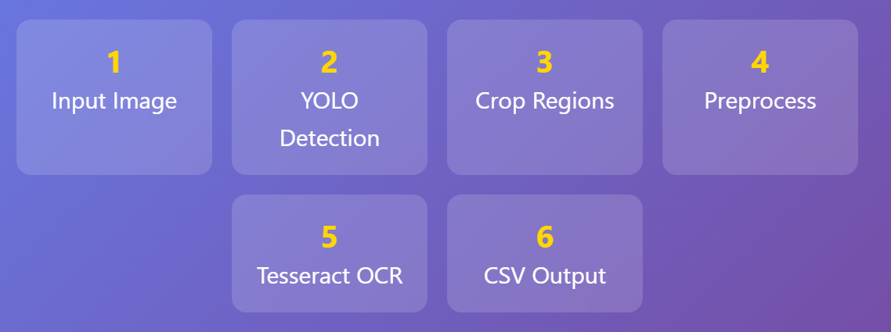
🏗️ System Architecture

Slide 5
🎯 YOLOv3 Object Detection
📦 You Only Look Once - Real-time detection
🎨 Identifies specific regions in lab reports
📍 Returns bounding box coordinates (x, y, width, height)
✅ Confidence threshold > 50% for accuracy
🔄 Non-Maximum Suppression to remove duplicates

Slide 6
🔧 Image Preprocessing
🔍 Resize 3x - Enhance small text visibility
⚫ Grayscale - Convert to single channel
🌫️ Gaussian Blur - Reduce noise (5x5 kernel)
◼️ Otsu Thresholding - Binary image conversion
🔄 Bitwise NOT - Black text on white background

Slide 7
📖 Tesseract OCR Engine
🤖 Open-source OCR engine by Google
🔤 Supports 100+ languages
⚙️ PSM 6 mode - Uniform block of text
📊 Extracts text with layout preservation
✨ Works best with preprocessed images

Slide 8
🛠️ Technology Stack
🐍 Python
Core programming language
📓 Google Colab
Free GPU runtime environment
📁 Google Drive
Dataset and model storage
📚 Libraries
OpenCV, PyTesseract, NumPy, Pandas

Slide 9
⭐ Key Features
🚀 No Classes - Simple, straightforward code
📦 Batch Processing - Handle multiple images
💾 Auto Save - Results to CSV automatically
🖼️ Visualization - Images with bounding boxes
📊 Summary Report - Processing statistics

Slide 10
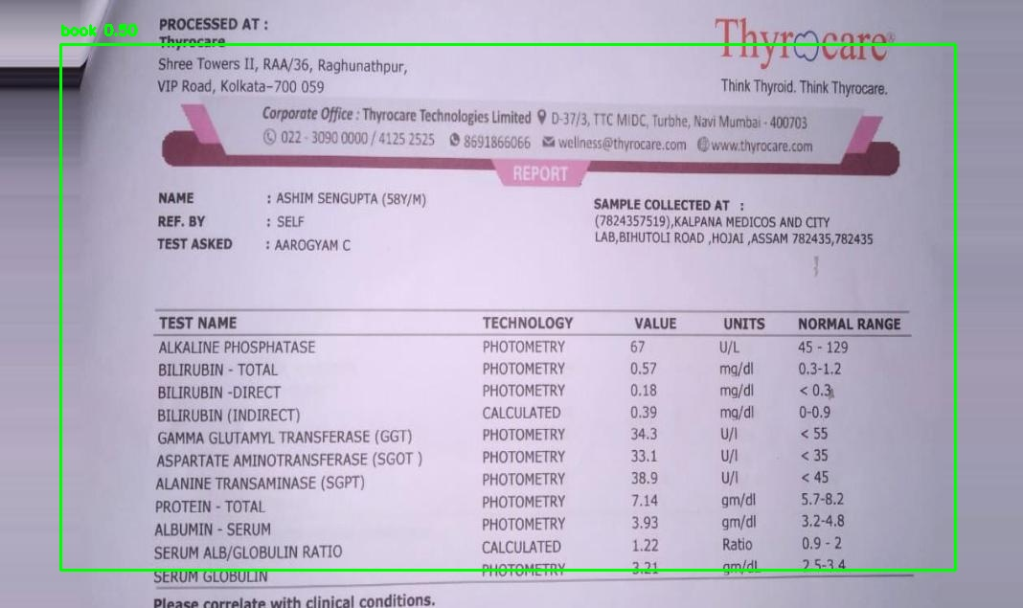

Slide 11
✨ Results & Benefits
⚡ Fast Processing - Seconds per image
🎯 High Accuracy - With proper preprocessing
💰 Cost Effective - Free tools and cloud resources
🔄 Scalable - Process hundreds of reports
📊 Structured Data - Easy to analyze and integrate

Slide 12
Thanks

