Slide 1
Project 7:Disaster Tweet Classification using NLP
Machine Learning • NLP • Flask Deployment
Gurpreet kaur
Submission Date: 30 July 2025

Slide 2
Problem Statement
Automatically detecting disaster-related tweets can greatly improve response times and help public safety organizations allocate resources efficiently. This project leverages NLP and machine learning to classify tweets as either disaster-related or not.

Slide 3
Project Workflow
Data Cleaning & Preprocessing
Feature Engineering
Model Training & Evaluation
Web Deployment using Flask

Slide 4
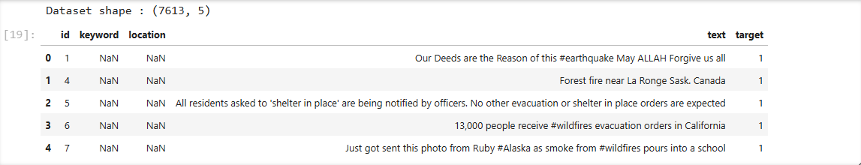
EDA Summary
• Analyzed class distribution: Disaster vs Non-Disaster
• Common keywords: earthquake, flood, fire, etc.
• Text lengths and sentiment scores extracted
• Visualized frequency and correlation of key terms

Slide 5
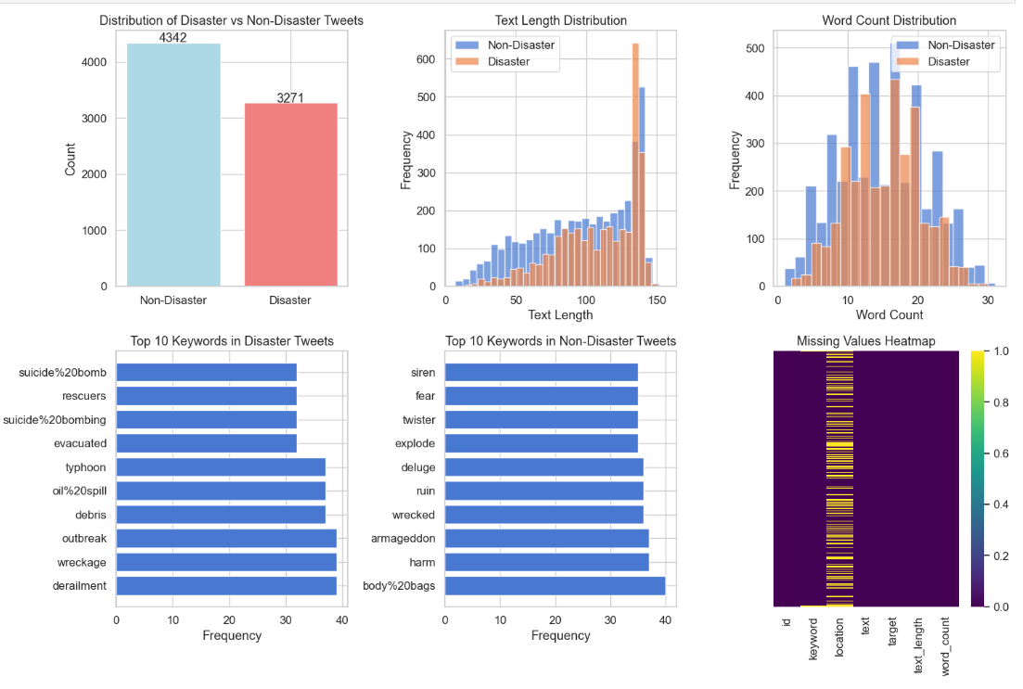

Slide 6
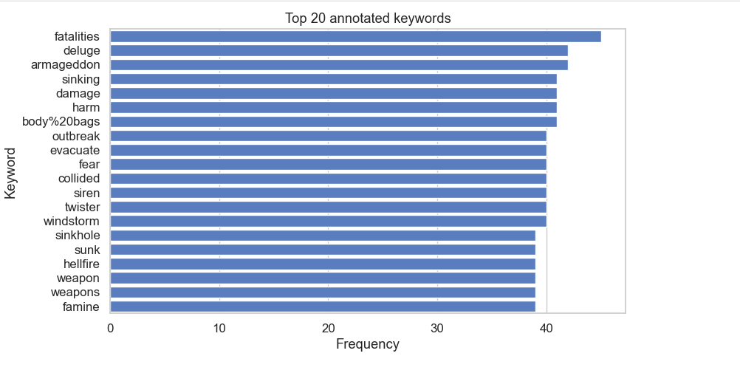

Slide 7
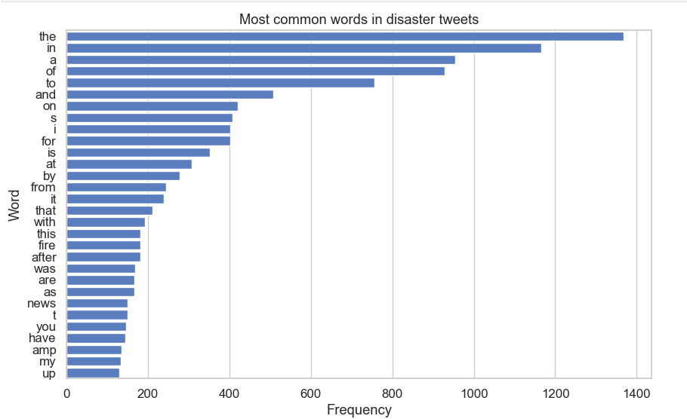

Slide 8
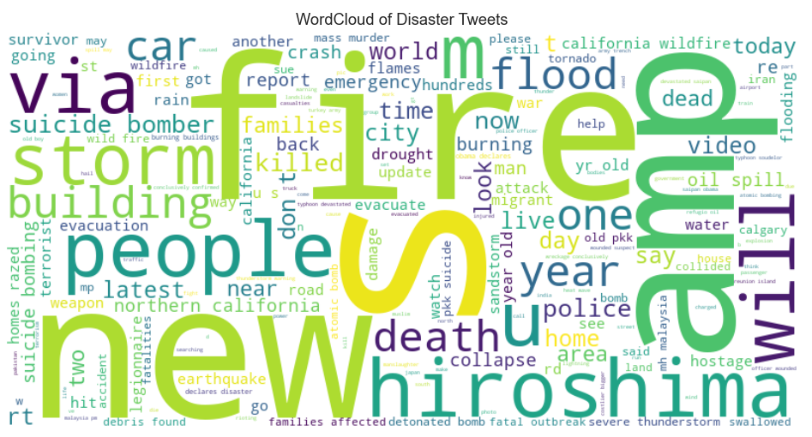

Slide 9
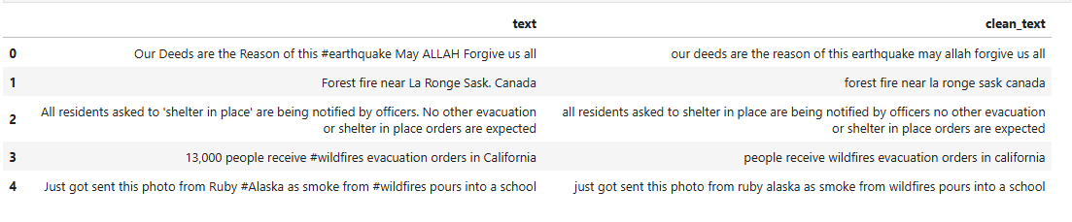
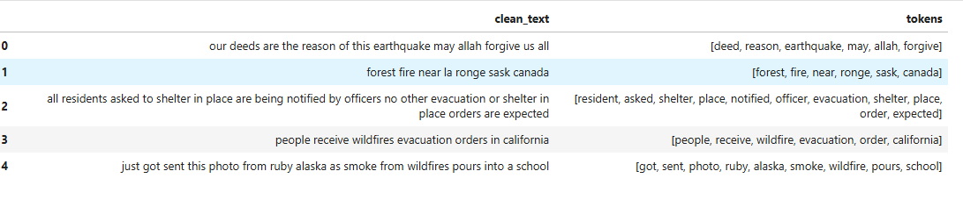

Slide 10
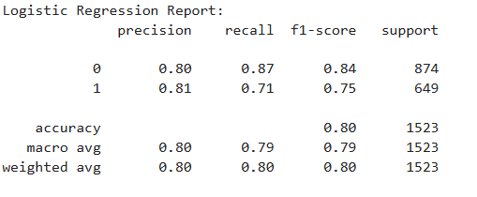
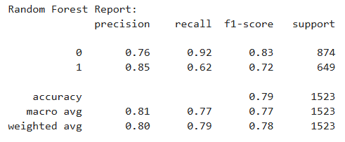
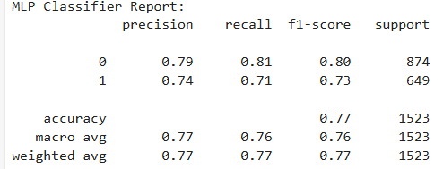
Model Training
• Vectorizer: TF-IDF (unigrams + bigrams)
• Features: Char/word count, hashtag/mention count, sentiment (neg/pos/neu/compound)
• Model: Random Forest (also tested Logistic Regression and MLP Classifier)
• Performance: Accuracy, F1-score, ROC-AUC

Slide 11
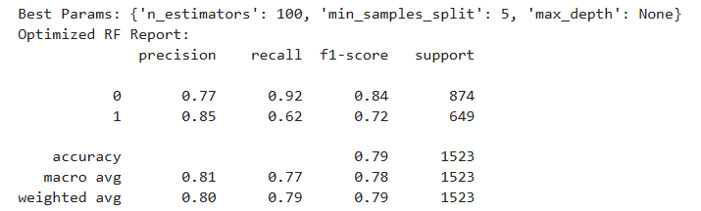
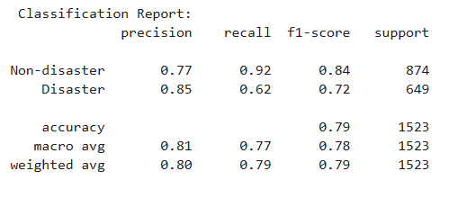

Slide 12
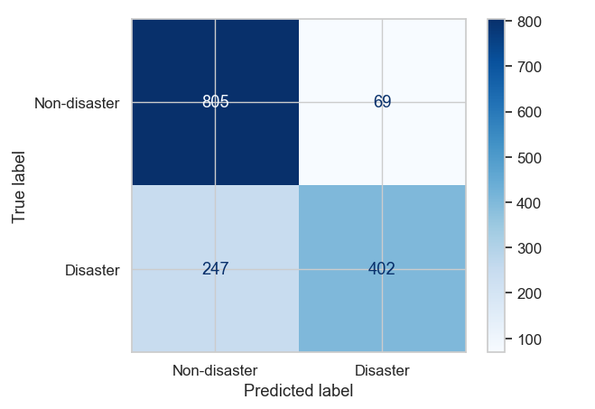

Slide 13
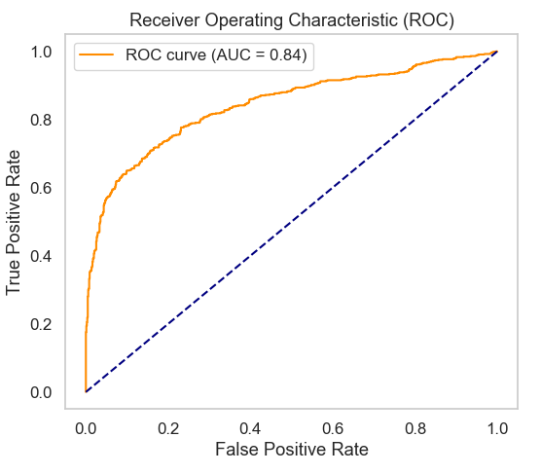

Slide 14
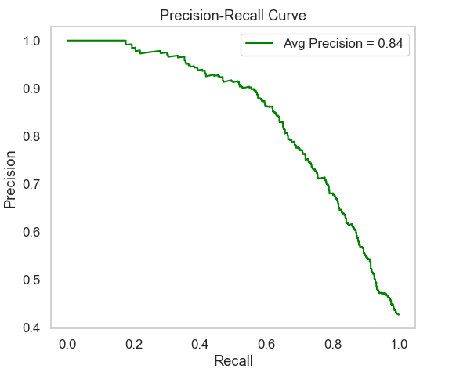


Slide 15
Web App Deployment
• Developed using Flask
• Users can paste tweet content and classify instantly
• Real-time results with confidence and recent history
• Designed responsive UI with gradient background and styled result box

Slide 16
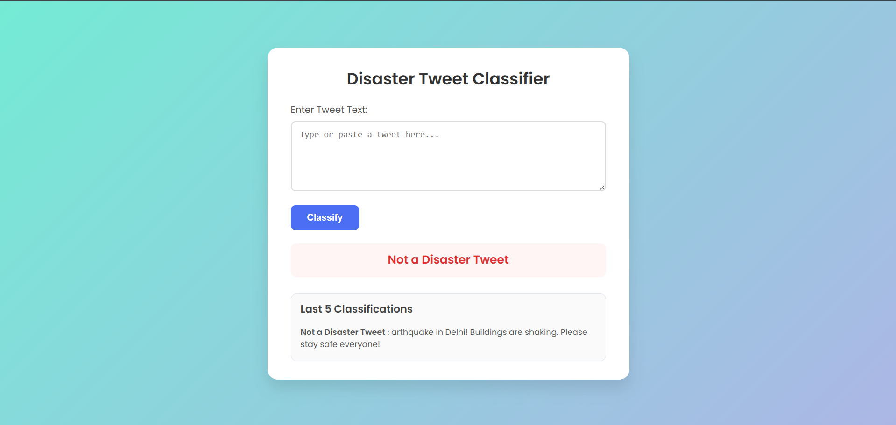
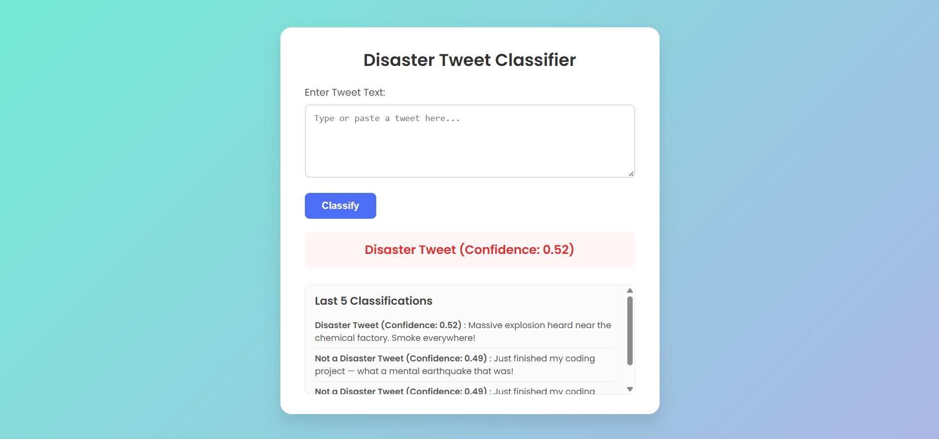

Slide 17
Learning Outcomes
• Applied full NLP pipeline from cleaning to deployment
• Used TF-IDF and metadata features for text classification
• Built a Flask web interface with a modern UI
• Learned version compatibility handling and model serialization

Slide 18
Future Work
• Integrate live Twitter API for real-time monitoring
• Replace classical ML with deep learning models (BERT, LSTM)
• Deploy to cloud (Render, Heroku, AWS)
• Add multilingual support and location extraction

Slide 19
Thank You

