Slide 1
Social Network Analysis
Introduction to Social Network Analysis
Prof. Keeheon Lee
TA. Jaekeun Lee
010-5599-9411
agdal1125@gmail.com

Slide 2
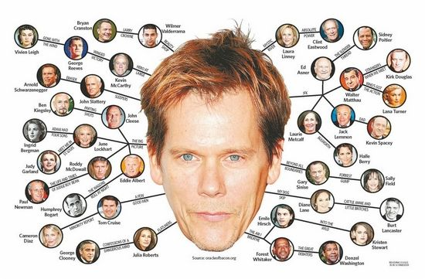

Six Degrees of Separation
Everyone is linked to everybody else through a few highly connected intermediaries
1
2
3
4
5
6
You
Random
Person
Six Degrees of Separation
Kevin Bacon Game
source: Mooseville

Slide 3
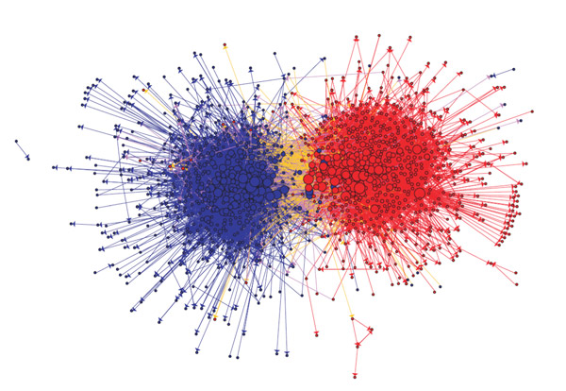
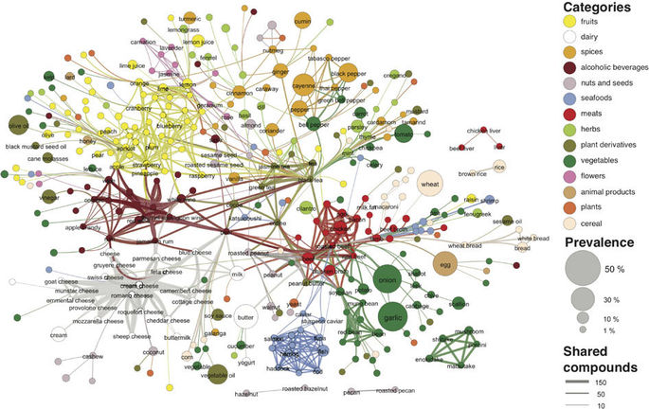
Social Network Analysis
Network Analysis became an institutionalized, transdisciplinary perspective whose basic concepts are widely familiar and used by researchers across diverse field of studies: economics, anthropology, information science, biology, sociology, etc

Slide 4
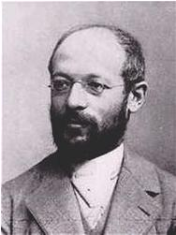
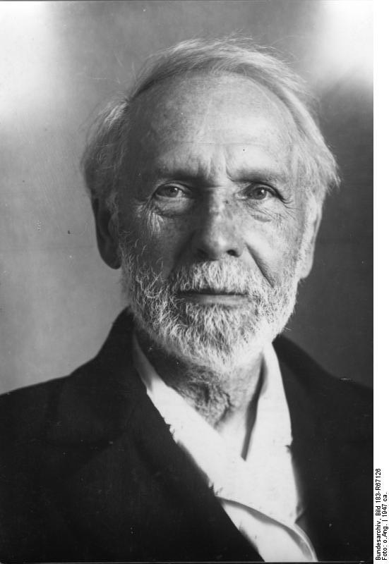
Development of Social Network Analysis
It was in the 1930s that specifically network thinking emerged as a distinct approach to social structure. (John Scott & Freeman)
German social theorist influenced by Georg Simmel adopted his emphasis on formal properties of social interaction to construct “formal sociology”, that investigated social relations produced through the interweaving of social encounters
Alfred Vierkandt and Leopold von Wiese explicitly used the terminology of points, lines and connections to describe social relations
Georg Simmel – Founder of formal sociology
Alfred Vierkandt

Slide 5
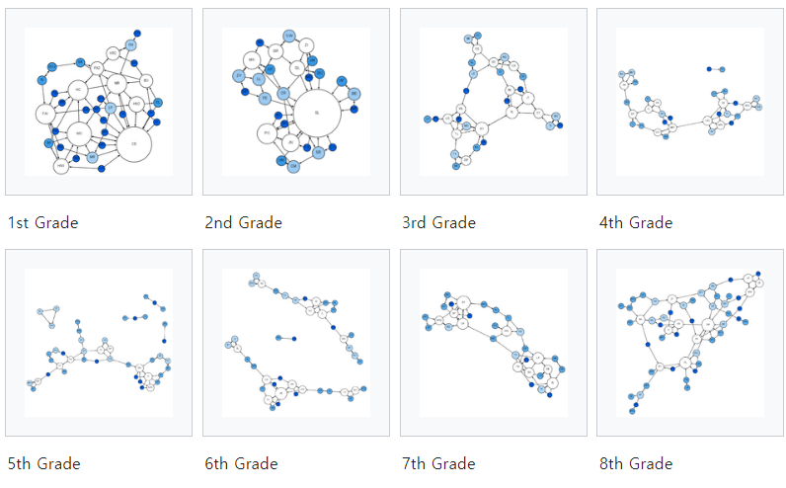
Development of Social Network Analysis
Moreno and Lewin contributed to investigating “field” or “space” of social relations and its network characteristics. Moreno gave his approach a name; “sociometry”, a method of depicting social structures as network diagrams (sociograms)
Sociometry became a major field of investigation in education and social psychology where it gave rise to the approach called “group dynamics” and Harary and Norman strongly developed this “group dynamics”
Lundberg and Steele introduced these idea to American sociology.
Lloyd Warner, Elton Mayo devised network diagrams to represent structure of group relations for investigation of community structures in American cities and town.
Moreno’s Sociograms

Slide 6
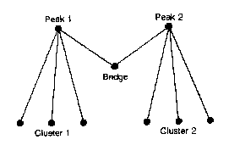
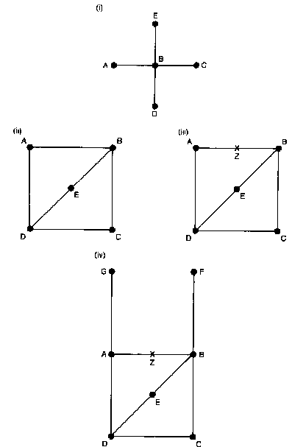
Development of Social Network Analysis
Lloyd Warner developed technologies for depicting large scale community relations in matrix form as representation of “clique structure” of the city, in 1930~1935 and published this in 1941.
George Homans developed these matrix methods in 1950s
Barnes (1954) proposed taking the idea of a network of relations and Elizabeth Bott’s kinship network reinforced this.
Harrison White used algebra to represent kinship structures (1963)
Warner’s matrix of cliques
Hawtorn

Slide 7
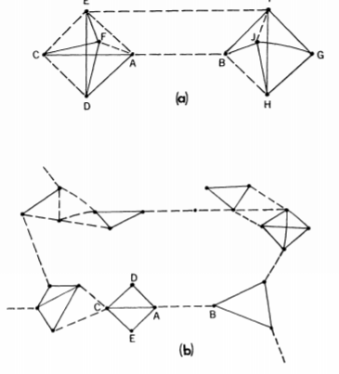
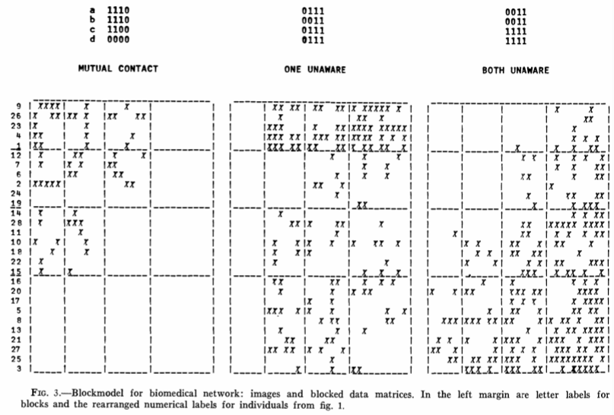
Development of Social Network Analysis
Edward Laumann employed multidimensional scaling methods as an extension of Lewin’s approach
Levine (1972) explored multidimensional scaling methods of corporate power
Lee(1969) and Granovetter (1973) used extended sociometrical methods to investigate abortion and employment respectively.
White and his colleagues developed methods of matrix analysis for studying social positions (1976)
Late 1970s work on the methodology of social network analysis has increased massively.
Figure used in
The Strength of Weak Ties – Mark S Granovetter 1973
Figure of Matrix Analysis
(Social Structure from Multiple Networks – Boorman and H.White 1976)

Slide 8
Central ideas and applications of SNA
Predominant approach in SNA has been the graph theory (originated by Euler) until recently.
In SNA, individuals and groups are represented as nodes. Social relationships are represented by lines. The lines are assigned a direction to represent the flow of influence and values to represent strength of relation.
The network can be directed, undirected and valued data to construct measures of overall density and relative centrality. Centrality measurements are used as proxies of power and influence and have allowed the investigation of brokerage relations. Investigation of cliques and clusters are major area of work within this approach.

Slide 9
Central ideas and applications of SNA
Matrix form of network data has great advantage when handling a large scale data sets.
There were matrix-based approach originated from Harrison White and Doug White that focuses not on the properties of individuals and groups but on the characteristics of social position, roles and categories.
This kind of positional approach or Block Model are matrix clustering that organize networks into hierarchical positions. “structural equivalence”, “substitutability” of individuals (nodes) within social positions have been developed, advancing this aspect of SNA

Slide 10
Central ideas and applications of SNA
Software Context
UCINET is one of the most widespread software for SNA. PAJEK is also visualization software for network structure. It is now included as a sub-program within UCINET
Principal area of application
The investigation of corporate power and interlocking directorships. Drawing network diagrams of board-level connections with ad hoc techniques adopting the language of webs and networks. Use of social network as a way of exploring the power and influence of banks in the American corporate world.
Another is investigation of community structure originating from investigation by Lloyd Warner. Fisher (1977) and Wellman(1979) generated the work that moved this field on in a systematic direction. Wellman elaborated on electronic means of communication as basis of interpersonal networks and this idea converged with social capital that developed out of Putnam’s work.
There are numerous other applications: terrorism, criminality, religious networks, social movements, policy networks.

Slide 11
Enter the physicists
Growth of interest among physicist in applying network ideas to social phenomena has contributed to development of SNA.
Suggestions and prior work on random networks by theorists such as Barabasi(2002) and Watts(1999,2003) have ignored or have been unaware of the vast amount of prior works of social networks, as they proposed investigations into networks of directorships as if none has so far been undertaken
According to the review of published studies by Freeman(2004) the work by physicist has rarely cited work by social network analyst and social network analyst have been reluctant to engage with the work of physicist. The citation pattern of a network analysis shows almost a complete separation of the two groups.
Physicist’s has been working on network dynamics and change or overtime. This has been developed weakly, but suggests a new way to network transformation and process –wise studies

Slide 12
Areas of advance
There are 4 major areas advance that can be identified:
1. Use of statistical significance tests
2. Development of models of longitudinal change
3. Exploration of new methods of visualization
4. Explorations into the cultural context of social network models.

Slide 13
Areas of advance – Statistical Significance Tests
Standard statistical procedures such as significance tests, regression, and ANOVA all assume independence of observations, but typical network data does not accord with this.
Stanley Wasserman and his colleagues generalized Markov graphs to a larger family of models. Their exponential random graph models (p* models) define a probability distribution on the set of points using specific parameter vectors.

Slide 14
Areas of advance – ABM Modeling
Use of models that depict the ways where the behavior of individual agents results in global transformations of network structure, also known as ABM (agent-based-modeling).
Prediction on patterns of changes in network by time became possible. (See Tom Snijder 1997, Monge and Contractor 2003)
SIENA program by Snijder offers easy use of the technique

Slide 15
Areas of advance – Visualization
Visualization of social networks became difficult for large network that hardly capture simple visual effect. Multidimensional scaling emerged as the attempt to overcome the jumble of criss crossing lines and display points according to their relative distance.
Ann Mische has developed some interesting arguments that build on work of Mustafa Emirbayer who contributed important work on “relational sociology”

Slide 16
Areas of advance – Explorations into the cultural context of social network models
Ann Mische has developed some interesting arguments that build on work of Mustafa Emirbayer who contributed important work on “relational sociology”

Slide 17
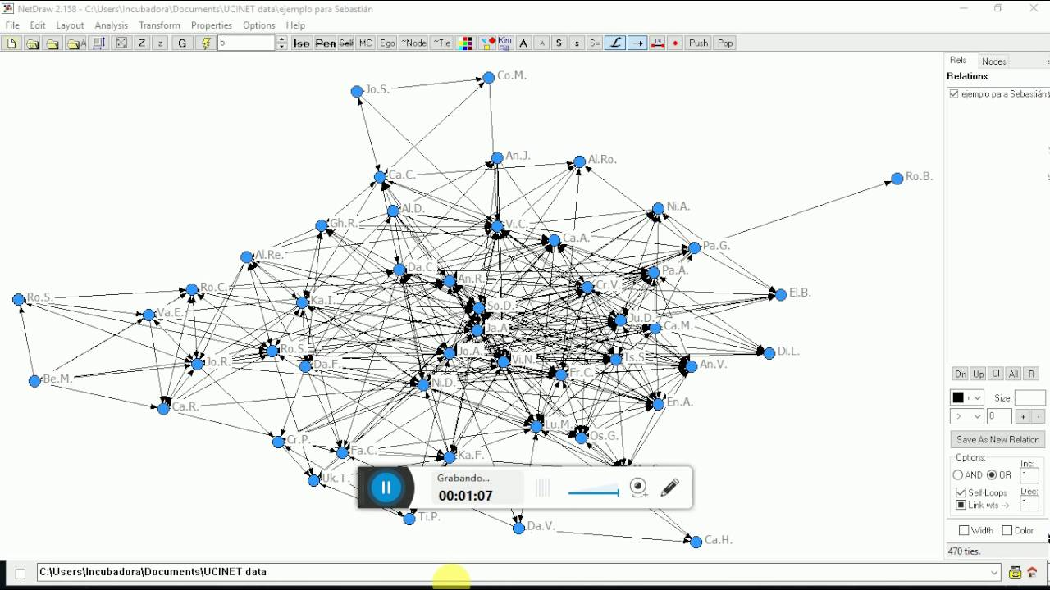
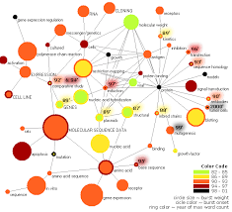
Software used for SNA
UCINET, Pajek, NetMiner, STRUCTURE, MultiNet, StOCNET, Gephi – became widely available for routines network data analysis. These software enables visualization of complex network graph and calculation of statistical measurements.
In this course, we will mainly use Gephi
UCINET
Pajek

