Slide 1
Social Network Analysis
Network Fundamentals
Prof. Keeheon Lee
TA. Jaekeun Lee
010-5599-9411
agdal1125@gmail.com

Slide 2
Contents
Underlying Assumptions
Actors and Relations
Networks
Research Design Elements

Slide 3
1. Underlying Assumptions behind Social Network Analysis
Network perspective emphasizes structural relations as a key principle. Social structure consists of “regularities in the patterns of relations among concrete entities; it is not a harmony among abstract norms and values or a classification of concrete entities by their attributes” (White, Boorman * Breiger, 1976, pp. 733-734)
Importance of social network analysis rests on three underlying assumptions about patterned relations and their effects.

Slide 4
Assumption 1
Structural relations are often more important for understanding observed behaviors than are such attributes as age, gender, values and ideology.
Unlike many attributes that remain unaltered across the numerous social contexts that entities participate, particular social relations exists only at specific time and place locales and either disappear or are suspended.
ex) teacher-student relation do not exist outside a school setting
person’s gender, race, education status do not change regardless of the location
In conjecturing that patterned relations influence social entities apart from their attributes, network analysis claims to offer more comprehensive theoretical and empirical explanations of the sources of social action.
ex) Elite families in the 15th century Florence supported the rival Medici or political factions depended more on the ruling elite’s
economic, patronage, and marital relations than on their class and status attributes (Padgett & Ansell 1993)

Slide 5
Assumption 2
Social networks affect perceptions, beliefs and actions through a variety of structural mechanisms that are socially constructed by relations among entities.
Direct contacts, and more intensive interactions dispose entities to better information, greater awareness and higher susceptibility to influencing or being influenced by others.
Indirect relations through intermediaries (broker connections) bring exposure to relatively new ideas and potential access to useful resources.
Network helps create interests, shared identities, and to promote shared norms and values by channeling information and resources to particular structural locations
Network analysis help uncovering the set of theoretical mechanisms where social relations affect social entities and to identify the contingent conditions under which specific mechanisms operate in particular empirical contexts
ex) Individual physical and mental health depend substantially on social support networks (Cohen et al., 1998)
Spread of sexually transmitted infections in American cities (Jolly, Muth, Wylie & Potterat, 2001)
Operation of “Dark networks” for drug trafficking, immigrant smuggling, and terrorist campaigns (Raab & Milward, 2003)

Slide 6
Assumption 3
Structural relations should be viewed as dynamic processes.
Networks are not static structures but continuously change through interactions among their constituent people, groups or organizations.
Network analysis encompasses both structures and entities, thus it provides conceptual and methodological tools for linking changes in micro-level choices to macro level structural alterations.
The cross-level dynamic processes are still in development and notable things is that longitudinal network datasets are continuing to proliferate as well as its methods for conceptualization and investigation of changes in network
Ex. ) COMPARING NETWORKS ACROSS SPACE AND TIME, SIZE AND SPECIES, Faust, Skvoretz, 2002
Statistical Analysis of Longitudinal Network Data with Changing Composition. Snijders, Huisman, 2007

Slide 7
2. Actors and Relations
Any networks, including social networks consist of at least two indispensable elements: actors and relations
Actors
Individual natural persons, or collectivities such as informal groups, or formal organizations. Actors are the subjects that consist the network
ex) Charities, political parties, children, residents of nursing home, high school students attending a prom, etc
Relations
Specific kind of contact, connection or tie between a pair of actors (dyad). Relations may be either directed, where the sender and receiver can be clarified or nondirected, where mutuality occurs.
ex) Friendship, sue, collaboration, exchange, trust, backstab,
Directed
Actor
Relationship
Actor
dyad

Slide 8
Actors and Relations - Continued
Social researches tend to rely heavily on measuring and analyzing the attributes of actors as the units of analysis, whether through survey or experimental data collection. (Remember assumption 1)
Attributes and relations are conceptually distinct approaches to investigating social behavior, but they should not be seen as mutually exclusive options. Many actor attributes can be reconceptualized as relations among dyads.
Number of friends in child → analysis of all dyadic friendship choices can uncover important cliques and clusters
Baseball team’s aggregate won & lost record → ratios of victory to defeat for each pair of teams may reveal the subtleties in a league’s power structure
Nation’s annual volumes of exports and imports → Amount of exchanges between each national dyad represents the structure of trading networks
Relations reflect emergent dimensions of complex social systems that cannot be captured by simple statistics of actor attributes.
When performing network analysis, exclusive focus on actor attributes loses many important explanatory insights provided by network perspectives on social behavior.

Slide 9
3. Networks
Social Network is a structure composed of a set of actors, some of whose members are connected by a set of one or more relations. The first researcher credited with using the term was Joh A. Barnes (1954). Barnes viewed social interactions as “set of points some of which are joined by lines” to form “total network” or relations, whereas informal set of personal relations was viewed as “partial network” within this totality.
Social Structures can be represented as networks; as sets of nodes (or social system members) and sets of ties depicting their interconnections (Wellman & Berkowitz, 1988, p. 4)
A configuration of empirical relations among concrete entities identifies a specific network structure, a pattern or form of that network. Structures can vary from isolated(no connections) to saturated (full connections) structures.
Social Network Analysis is not merely a representation and visualization. It proposes that network analysis can explain variation in structural relations and their consequences. It is analysis of social structures and describing underlying patterns and impact of such patterns on behavior and attitudes.

Slide 10
4. Research Design Elements
Network research design has three principal elements:
1. Sampling units, 2. relational form and content, 3. level of data analysis
Sampling Units
Choosing the most relevant social setting and decide which entities in that setting comprise the network actors.
Relational Form and Content
Deciding specific relations to collect data. Relation among pairs of actors have both form and content, a dichotomy that Georg Simmel proposed in his paper (1908)
Contents – interests, purposes, drives, motives of individuals in an interaction
Forms – modes of interaction through which specific contents attain social reality.
Relational Form – property of actor relations that exists independently of any specific contents. Two fundamental relational forms are 1. strength, intensity, frequency and 2. direction of relations, asymmetric, mutual or null choices.
Relational Content – analytic construct created by a researcher to capture the meaning of a relation from the actors’ subjective viewpoints

Slide 11
4. Research Design Elements - Continued
Relational Form and Content- continued
Type of tie – choice of a relational content
Multiplex networks - network with two or more types of ties
Examples of Types of relational content
Transaction relations – Actors exchange control over physical or symbolic media, for example, in gift giving or economic sales and purchases
Communication relations – Linkages between actors are channels through which message may be transmitted
Boundary penetration relations – Ties consist of membership in two or more social formations, for example, corporation boards of directors
with overlapping members
Instrumental relations – Actors contact one another in efforts to secure valuable goods, services, or information such as jobs, abortion, advice
Sentiment relations – Actors expressing their feelings of affecting, deference, loathing, hostility towards one another
Authority/power relations – Rights and obligations of actors to issue and obey commands. Frequent appearance in hierarchical organizations
Kinship and descent relations – blonds of blood and marriage reflect relations among family roles

Slide 12
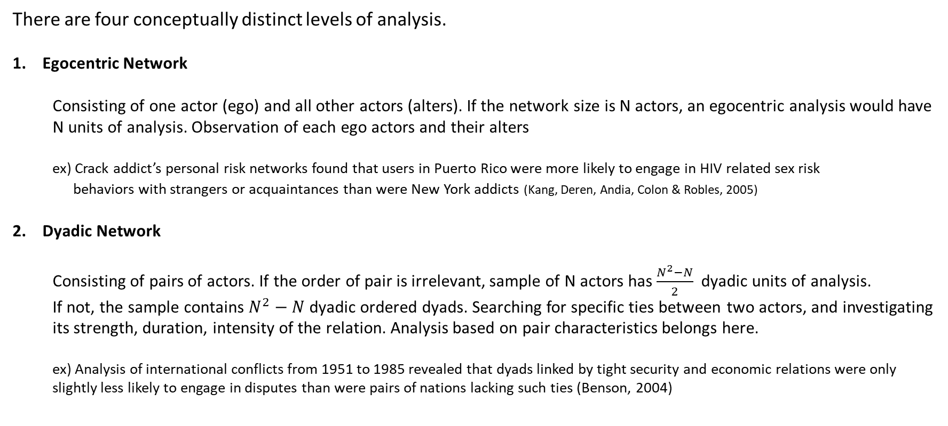
4. Research Design Elements - Continued
Levels of Analysis
There are four conceptually distinct levels of analysis.
Egocentric Network
  Consisting of one actor (ego) and all other actors (alters). If the network size is N actors, an egocentric analysis would have N units of analysis. Observation of each ego actors and their alters
  ex) Crack addict’s personal risk networks found that users in Puerto Rico were more likely to engage in HIV related sex risk
  behaviors with strangers or acquaintances than were New York addicts (Kang, Deren, Andia, Colon & Robles, 2005)
Dyadic Network
  Consisting of pairs of actors. If the order of pair is irrelevant, sample of N actors has $\frac{N^{2}−N}{2}$ dyadic units of analysis.
  If not, the sample contains $N^{2}−N$ dyadic ordered dyads. Searching for specific ties between two actors, and investigating its strength, duration, intensity of the relation. Analysis based on pair characteristics belongs here.
  ex) Analysis of international conflicts from 1951 to 1985 revealed that dyads linked by tight security and economic relations were only slightly less likely to engage in disputes than were pairs of nations lacking such ties (Benson, 2004)

Slide 13
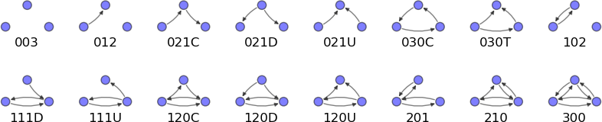
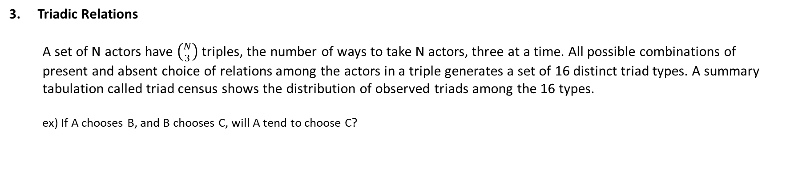
4. Research Design Elements - Continued
Levels of Analysis - Continued
3. Triadic Relations
  A set of N actors have $\left({N \atop 3}\right)$ triples, the number of ways to take N actors, three at a time. All possible combinations of present and absent choice of relations among the actors in a triple generates a set of 16 distinct triad types. A summary tabulation called triad census shows the distribution of observed triads among the 16 types.
  ex) If A chooses B, and B chooses C, will A tend to choose C?
Triadic types

Slide 14
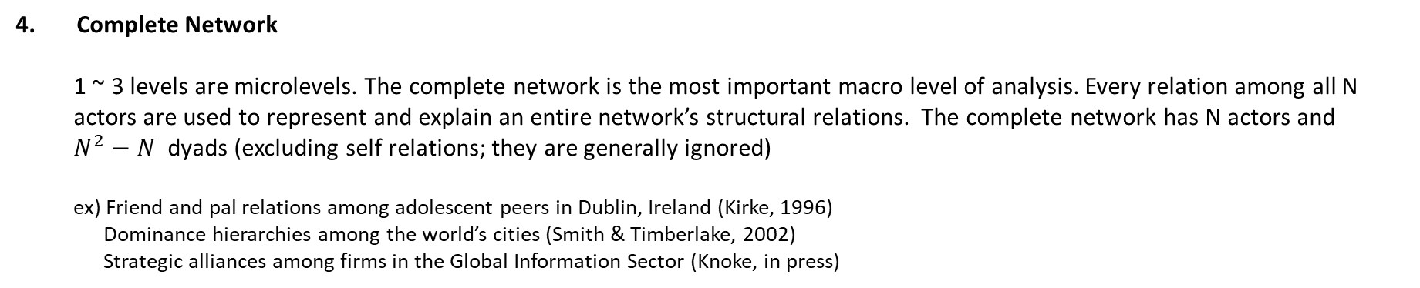
4. Research Design Elements - Continued
Levels of Analysis - Continued
4. Complete Network
  1 ~ 3 levels are microlevels. The complete network is the most important macro level of analysis. Every relation among all N actors are used to represent and explain an entire network’s structural relations. The complete network has N actors and
  $N^{2}−N$ dyads (excluding self relations; they are generally ignored)
  ex) Friend and pal relations among adolescent peers in Dublin, Ireland (Kirke, 1996)
  Dominance hierarchies among the world’s cities (Smith & Timberlake, 2002)
  Strategic alliances among firms in the Global Information Sector (Knoke, in press)
The four levels of analysis imply that emergent phenomena at one level cannot be simply deduced from
the knowledge of the relations at other levels. Hence, it is important to find appropriate level of analysis to design
your research.
  ex) Transitivity of choice relations is a substantively important variable for theories of friendship formation ( “a friend of my friend, is my friend”).
  This can easily be observed in triadic level but not at egocentric, dyadic level.

