Slide 1
Social Network Analysis
Data Collection
Prof. Keeheon Lee
TA. Jaekeun Lee
010-5599-9411
agdal1125@gmail.com

Slide 2
Contents
Boundary Specification
Data Collection Procedures
Cognitive Social Structure
Information Bias
Reliability
Missing Data

Slide 3
1. Boundary Specification
Before Data Collection
In any empirical network research, investigators must initially attend to three important issues before beginning to collect data:
Boundary specification, network sampling, and measurement of relations.
Boundary Specification?
Where does a researcher set the limits when collecting data on social relations that may have no obvious limits?
Realist vs. Nominalist Strategies
Realist strategy defines boundary as the limits that are consciously experienced by all or most actors in the entity. Actors and their relations are included or excluded depending on the relevance judged by other actors (subjective perception). Nominalist strategy closes its network by imposing an a priori conceptual framework that serves an analytic or theoretical purpose for a particular project (analytic imposition).
  ex) Realist strategy
  Knoke and Laumann applied this principle to select the core organizations of the U.S. energy and health national policy domains:
  they excluded any organizations that domain informants did not perceive as influential in national energy and health policy making
  Nominalist strategy:
  Marxist researchers identify boundaries of the working class with following definition: all employees having a common relation to a mode of
  production

Slide 4
1. Boundary Specification - Continued
Boundary Specification?
Laumann, Marsden, and Prensky organized their initial answer around the two contrasting realist and nominalist strategies and replaced this with three generic approaches to identifying network boundaries: Positional, Relational, Event-based
Positional strategy
This approach uses the attributes of actors, their membership or affiliation in a formal organization or their occupancy of a well-defined position for inclusion in a network.
Event based strategy
This method draws network boundaries by including actors who participate in a defined set of activities occurring at a specific times and places. In this sense, categorizing the event and such actions are crucial. This method is vulnerable to missing data by overlooking significant key players of activities.

Slide 5
1. Boundary Specification - Continued
Boundary Specification?
Laumann, Marsden, and Prensky organized their initial answer around the two contrasting realist and nominalist strategies and replaced this with three generic approaches to identifying network boundaries: Positional, Relational, Event-based
Relational strategy
This approach relies on knowledgeable informants or the network actors themselves to nominate additional actors for inclusion. Relational approaches embrace several procedures, including the reputational method, snowball sampling, fixed list selection, expanding selection and k-core method.
Reputational method | Asking the most knowledgeable informants or experts to nominate a set of actors for the study (There is a possibility of sampling bias)
Snowball sampling (Chain referral method) | Begin with a small set of network actors, then ask for nomination of others with specific kind of relation, than repeat this process.
Fixed list selection | Reporting ties involving a set of actors identified a priori by the researchers and their informants
Expanding selection | Identify as many actors as they wish without referring to a list of names
K-core method | If every actors has ties with at least k other actors in the subgroup, the subgroup is k-core.

Slide 6
2. Data Collection Procedures
Single and Multiple Name Generators
Name generators are mostly used in studies of egocentric networks where survey questionnaires collect information from each ego respondent about relationships among a set of alters with whom ego has direct contact. Egocentric network researchers rely on two survey instruments: name generators and name interpreters.
Name generator identifies a respondent’s alters. It is a survey item used to collect information of actors. Name interpreters obtain information on each alter and the relations among them and with ego.
Single Name Generator: Relies on one questionnaire item to elicit the alters’ names. It can produce a core set of alters, but only fraction of the contacts identified by using multiple name generators.
Multiple Name Generator: Includes multiple questionnaire items

Slide 7
2. Data Collection Procedures
Single and Multiple Name Generators
4 types of constraints used to build name generators (Campbell & Lee 1991)
Role/content constraint: Guide respondents to focus on only one or few types of relations in nominating their contacts
Geographical constraint: Restrict nomination to people residing within specific area
Temporal constraint: Require respondent to name their contacts within a certain retrospective period
Numerical constraint: Limits respondent to name only N number of people to fit the criteria

Slide 8
2. Data Collection Procedures
Positional Generators and Resource Generators
These generators are used to identify ego’s network of social resources, which is defined as access to resources
that is embedded in hierarchical formation of wealth, power, and status
Positional Generators: Ask respondents whether they have contacts in certain social positions. (Occupation, etc) It produces egocentric networks measuring personal connections to several occupations in hierarchical ladders.
Resource Generators: This generator is more resource-focused. It asks respondents whether people know anybody useful for special purpose or resources. The question typically starts with, “Do you know anybody who can … “
The two generators may product similar result, but access to information (positional) and access to instrumental support (resource) sometimes correlates only weakly. Thus, it can be said that the two generators comprise distinct dimensions of social capital.
(Van der Gaag & Snijders, 2004 / Lin and Dumin’s positional generator, 1986)

Slide 9
2. Data Collection Procedures
Measuring total personal network
Total personal network is defined as all the alters known to ego. There are two types of method used to measure the total personal network: checklist method and reverse small world method (RSW). In the checklist method, researchers randomly select several names and then interviewers read those names to randomly selected respondents
Checklist method
Researchers first select several names and interviewers read those names to randomly selected respondents. If they do recognize, name interpreter is used to elicit information about that alter. This approach underrepresented blacks, Hispanics, and Asians, but it is superior to other approaches in capturing a much more representative sample. It can produce the largest network.
Reverse Small World Method (RSW)
Researchers create fictitious targets, persons with invented names and randomly assigned traits. Then, task informants to identify all alters whom they believe could either directly deliver message or be a link in a chain to the target. The RSW method can only capture a portion of individual’s total network. (Freeman and Thompson 1989)

Slide 10
2. Data Collection Procedures
Archival Documents
Originally, the data was not collected for network studies, but it can provide useful information for social network analysis.
It is relatively inexpensive compared to surveys, it poses no burden on informant time and efforts and may contain high-quality longitudinal information when data are maintained over time. Examples could be journal publications, patents, citation informations.

Slide 11
3. Cognitive Social Structure
“Who knows, who knows whom?”
In a network with N actors, a complete Cognitive Social Structure (CSS) dataset for one type of relationship consists of N cognitive maps.
The cognitive maps show the presence and absence of ties from every participant-informant’s point of view
CSS data collection
Each informant must make $N^{2}−N$ judgements about the specified dyadic relations. (directed)
CSS data usage
Determine the amount of consensus on network structures as perceived by the actors
Assess biases in perceived network structures in comparison to some criterion.
Consensus & Bias
Consensus: extent of agreement between two or more informants’ judgements or assessments of social relations
Bias: accuracy of an informant’s perceptions of network relations when compared to a specified criterion. ( aggregation of all participant’s perceived networks or relational data obtained from direct behaviors of participants)

Slide 12
3. Cognitive Social Structure
Perceptual Errors
Cognitive Social Structure (CSS) also helps researchers identify perceptual errors in respondent interview or process of data collection. Both close and distant ties can be subject to high informant bias.
Respondent’s self-reports often includes systematic perceptual errors. Individuals tend to see themselves as closer to the center of their own network representations than to the global network center; they view themselves as surrounded by friends who also had numerous friendships among themselves. (Kumbasar et al. 1994)
Individuals are more prone to provide distorted, biased information about their friends’ relations. Information about more distant contacts are less susceptible to these distortions. Cognitive correction occurs when individuals see unbalanced relations, because people experience psychological or emotional stress (Balance Schema). (Heider, 1958; Newcomb, 1961)
Cognitive miser model (Taylor and Fiske’s, 1978) informants typically have less knowledge about the distant relations with whom they are not directly linked. Balance schema activates and informants report biased information while filling in knowledge gaps about close and distant relations, regardless of their motivations

Slide 13
4. Informant Bias
Information Bias
Discrepancy between self-reported and actual behaviors. It is the cause of gap between verbal and behavioral data.
The Cause
Disability to cognitively handle the large amount of data required to report their behaviors accurately (Bernard, Killworth, Sailer & Kronenfeld, 1984)
Informant’s false impose of categorical form on noncategorical affiliation patterns
(Freeman, 1992)
Informant’s correction of perceptions to maintain a balanced network among their close friends. (Krackhardt & Kilduff, 1999)
Group level representation of a network may be more accurate than the individual level reports (Kumbasar et al., 1994)

Slide 14
4. Informant Bias
The Cause (continued)
“People do not know, with any acceptable accuracy to whom they talk over any given period of time...... We are now convinced that cognitive data about communication cannot be used as proxy for the equivalent behavioral data” (Bernard et al. 1981, pg.17)
Biased informants perceive themselves as close to the center, forget less-prominent players, falsely recall major actors in a network
Cognitively correct their perceptions to force a balanced network between themselves and their close or distant friends.
Inaccurate recall of (1) whom they have interacted, (2) falsely recalling interactions that never occurred
Despite some systematic distortion in cognitive data, facilitative factors could reduce informant biases, such as greater informant familiarity with cultural subjects or informants providing recall aid to informants

Slide 15
4. Informant Bias
The Lesson
High levels of agreement between informants often indicate low levels of bias and greater informant validity. Consensus answers are almost equivalent to valid answers
(Romney et al. 1986)
Highly knowledgeable informants produce unbiased data about long-term repeated patterns and produce consensus answers to questions that promises great validity.
Because individual’s perceptions are biased toward portraying themselves as more central in a network than systematic aggregation of all network actor’s perceptions, systematic perceptions should be better indicator of people’s locations in a network.
Egos tend to be biased about their close friends and distant contacts by activating the “balanced schema”, in making reports.
Thus, researchers using egocentric approach to collecting network data should adopt corrective measure to prevent information bias when analyzing close ties and distant relations.

Slide 16
5. Reliability
Reliability
Measures the extent to which a particular instrument when applied repeatedly to the same subjects, yields an identical result every time.
Reliability measures
Interobserver reliability
Test-retest reliability
Internal consistency-reliability
Test-retest reliability
Often used to evaluate informant reliability. Retest is the repeated version of test conducted at a later time. By comparing the test and retest result, informant’s reliability can be decided.
Interval between test and retest is a critical issue. (It should be short)

Slide 17
5. Reliability
Jaccard Coefficient
One of the simple and frequently used test-retest reliability measure
Measures proportion of agreements after excluding joint negative pairs
Ranges from 0 to 1 (0.00 = no reliability, 1.00 = complete reliability)
Second Interview
First Interview | Names Checked | Not Checked
Names Checked | A = 12 | B = 5
Not Checked | C = 3 | D = 15
First interview, informant checked 17 names, not checked 18 names
Second interview, informant checked 15 names, not checked 20 names
In both interviews, 15 names were not checked
Jaccard Coefficient = A/(A+B+C) = 12/(12+5+3) = 0.60

Slide 18
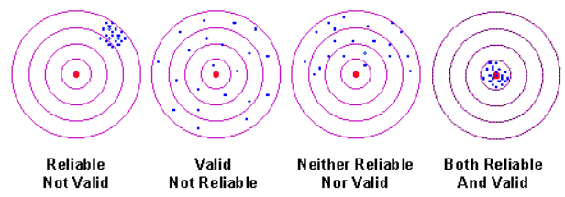
5. Reliability
Reliability Studies
Informant reliability is often correlated with validity…informants should be weighted by their reliability. (Romney & Weller, 1984)
High valid network responses typically have high reliability, if an informant can always enumerate all friends in response to a specific name generator.

Slide 19
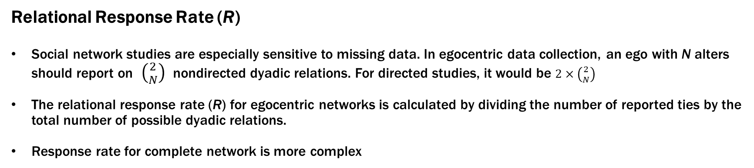
6. Missing Data
Relational Response Rate (R)
Social network studies are especially sensitive to missing data. In egocentric data collection, an ego with N alters should report on $\left({2 \atop N}\right)$ nondirected dyadic relations. For directed studies, it would be $2×\left({2 \atop N}\right)$
The relational response rate (R) for egocentric networks is calculated by dividing the number of reported ties by the total number of possible dyadic relations.
Response rate for complete network is more complex
ex) if ego has 5 alters:
alter
Ego has to report relationship of all 5 alters: $\left({2 \atop 5}\right)= \frac{N!}{2!×\left(5−2\right)!} =10$
alter
alter
ego
If ego give information of 8 relations, the R = 8/10 = 0.80 or 80%
alter
alter

Slide 20
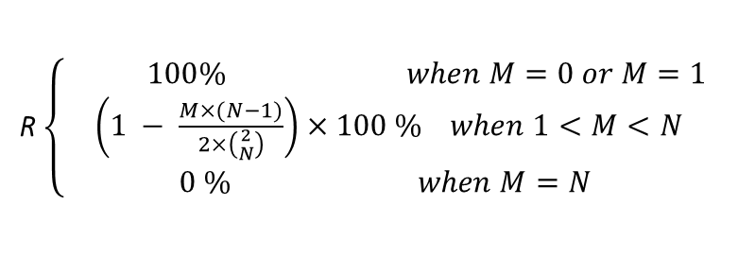
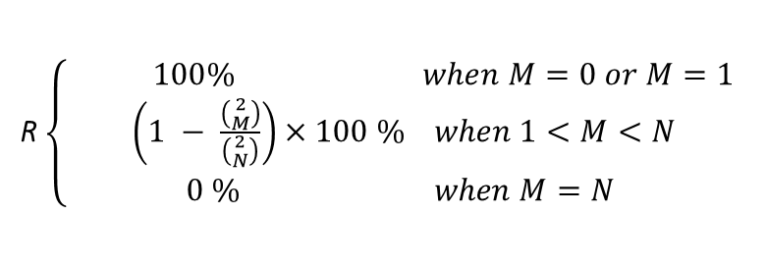
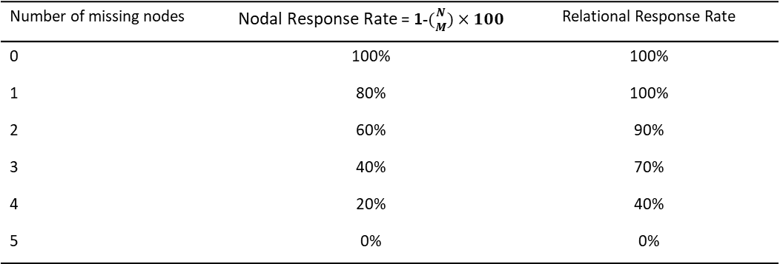
6. Missing Data
Relational Response Rate (R)
A complete nondirected network of N actors with no alter reports from M actors, the response rate for a particular relation is calculated as:
Number of missing nodes | Nodal Response Rate = 1-$({N \atop M})×100$ | Relational Response Rate
0 | 100% | 100%
1 | 80% | 100%
2 | 60% | 90%
3 | 40% | 70%
4 | 20% | 40%
5 | 0% | 0%
R $\left\{\begin{aligned} 100\% when M=0 or M=1 \\ \left(1 − \frac{\left({2 \atop M}\right)}{\left({2 \atop N}\right)}\right)×100 \% when 1<M<N \\ 0 \% when M=N\end{aligned}\right.$
*Includes assumption that a report by one member of a dyad can be treated as a reliable measure
Response rates for a network of five actors
In a directed network, relational response rate = nodal response rate
A complete directed network of N actors with no alter reports from M actors, the response rate for a particular relation is calculated as:
R $\left\{\begin{aligned} 100\% when M=0 or M=1 \\ \left(1 − \frac{M×(N−1)}{2×\left({2 \atop N}\right)}\right)×100 \% when 1<M<N \\ 0 \% when M=N\end{aligned}\right.$

Slide 21
6. Missing Data
Prevention
Missing data does not have a complete solution. The only way is convincing respondents of the importance of participation in the research and utilizing different persuasion techniques, and extraordinary research design and putting efforts

